Slide 2
Informed consent for genetic testing: Genetics 210
Rosalind Chuang, M.D.
Department of Neurology
Stanford University

Slide 3

Benefits (1)
Relief
Fewer check ups
Knowledge: Integrating genetic information into healthcare enables proactive and informed decision-making
  Preventive treatment

Slide 4
Benefits (2)
Make important life planning decisions
  Even if cure not yet available
Intervention
Enroll in research trials
Provide information for family

Slide 5
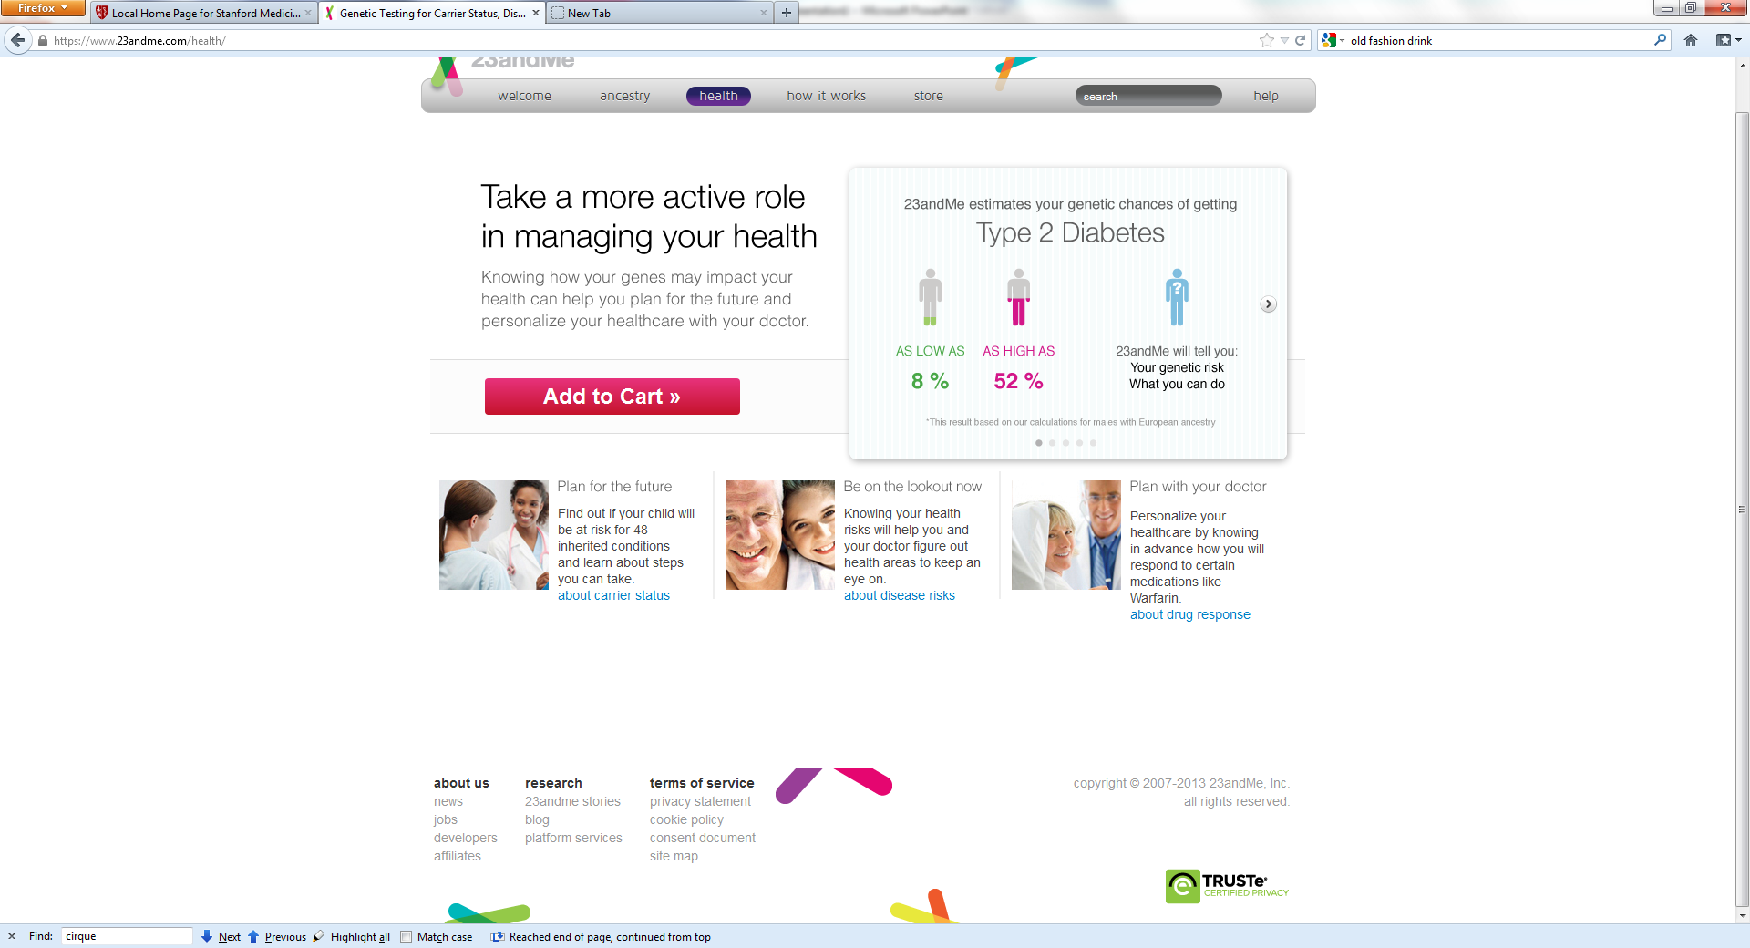

Slide 6
Limitations of genetic testing
Having positive genetic testing developing disease.
Risk for developing disease may not be accurate based on current research
  Most risks from GWAS data have low odds ratios for developing disease
Does not predict when a person may show symptoms of a disease
Does not predict severity of symptoms

Slide 7
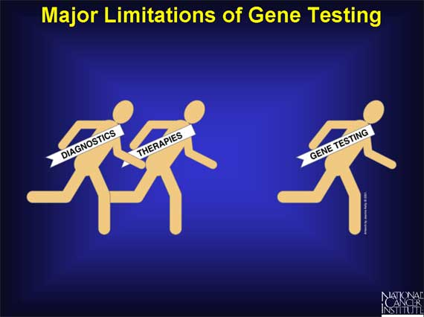

Slide 8
Risks
Personal implications
  Risk for a disease
    Neurological disease without known treatment or cure: Alzheimer’s disease or Parkinson’s disease
    Psychiatric diseases: schizophrenia
    Cancer genes- BrCA1 and 2
Confidentiality issues
    Others may find out test results

Slide 9
Psychological outcome from genetic information
Anxiety/Stress
Confusion
Impact on family:
  In some cases, genetic testing creates tension within a family because the results can reveal information about other family members in addition to the person who is tested.

Slide 10
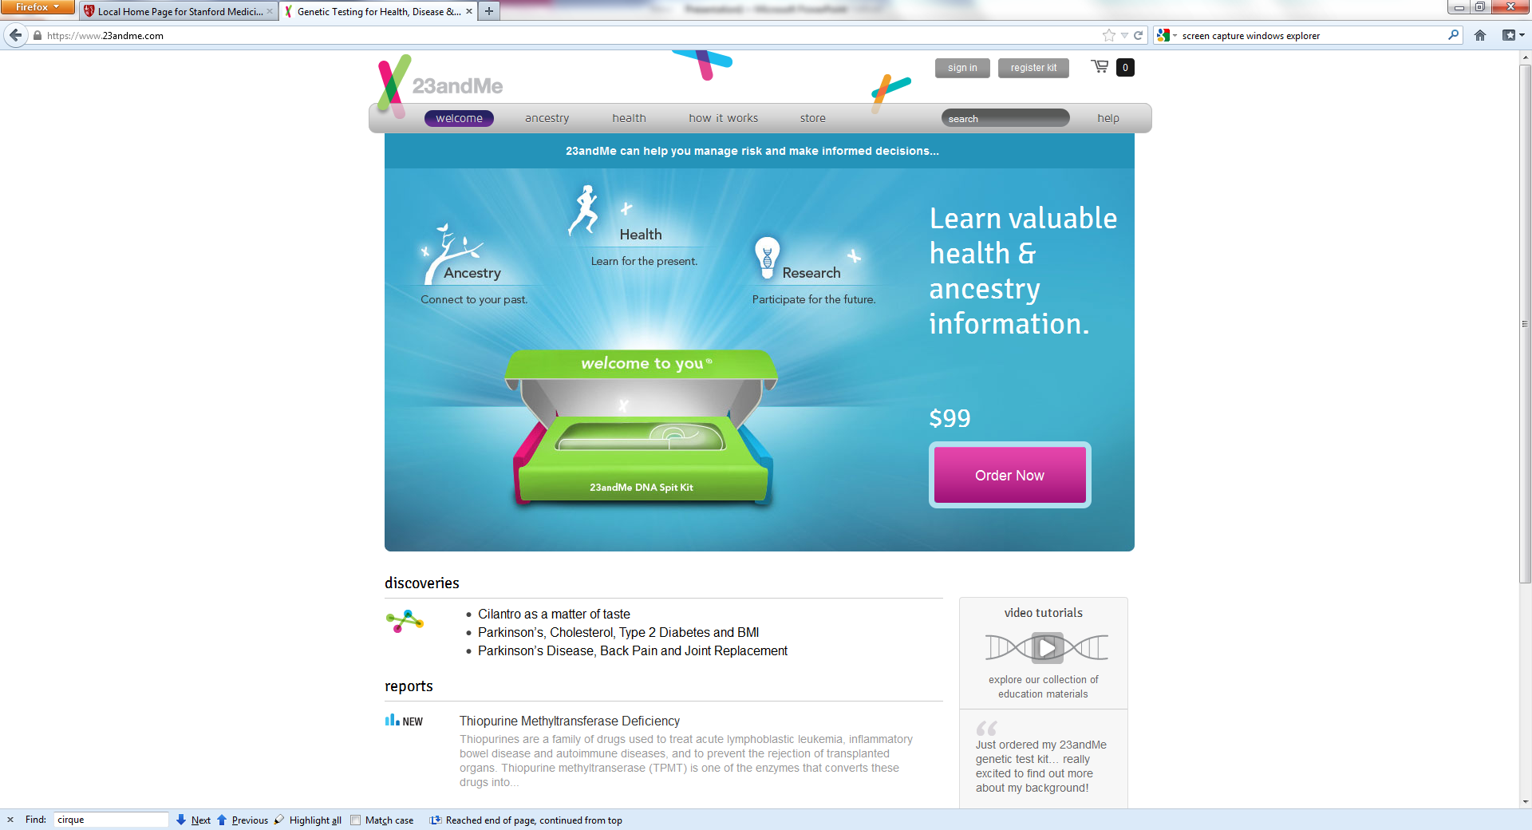

Slide 11
Ancestry
Find information about your immediate family background that may not have been disclosed
  Jewish?
  African-American?
Adoption history not disclosed
Raises question of paternity
Notes:
Example of a faculty member who found out her family was Jewish and hid their identity during WWII.

Slide 12
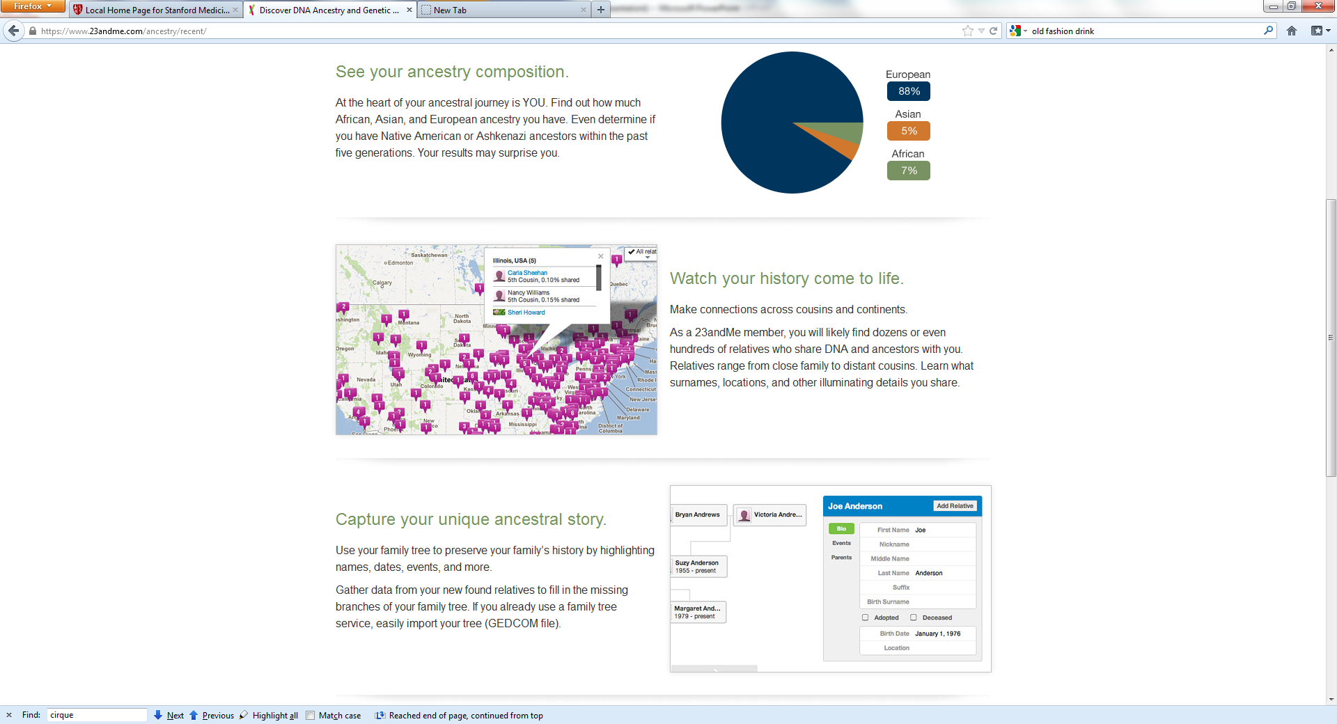
Notes:
Your “relatives” may not be linked to you, or find closely related relatives that you were not previously aware of.

Slide 13
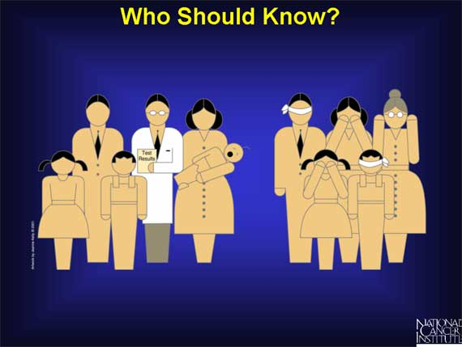
Do others want to know?

Slide 14
Other “risks” for genetic testing
False positives
  Anxiety/Stress
  Harm from undergoing unnecessary tests or procedures
False negatives:
  Ignoring a disease when genetic testing is negative
    Diseases can occur sporadically

Slide 15
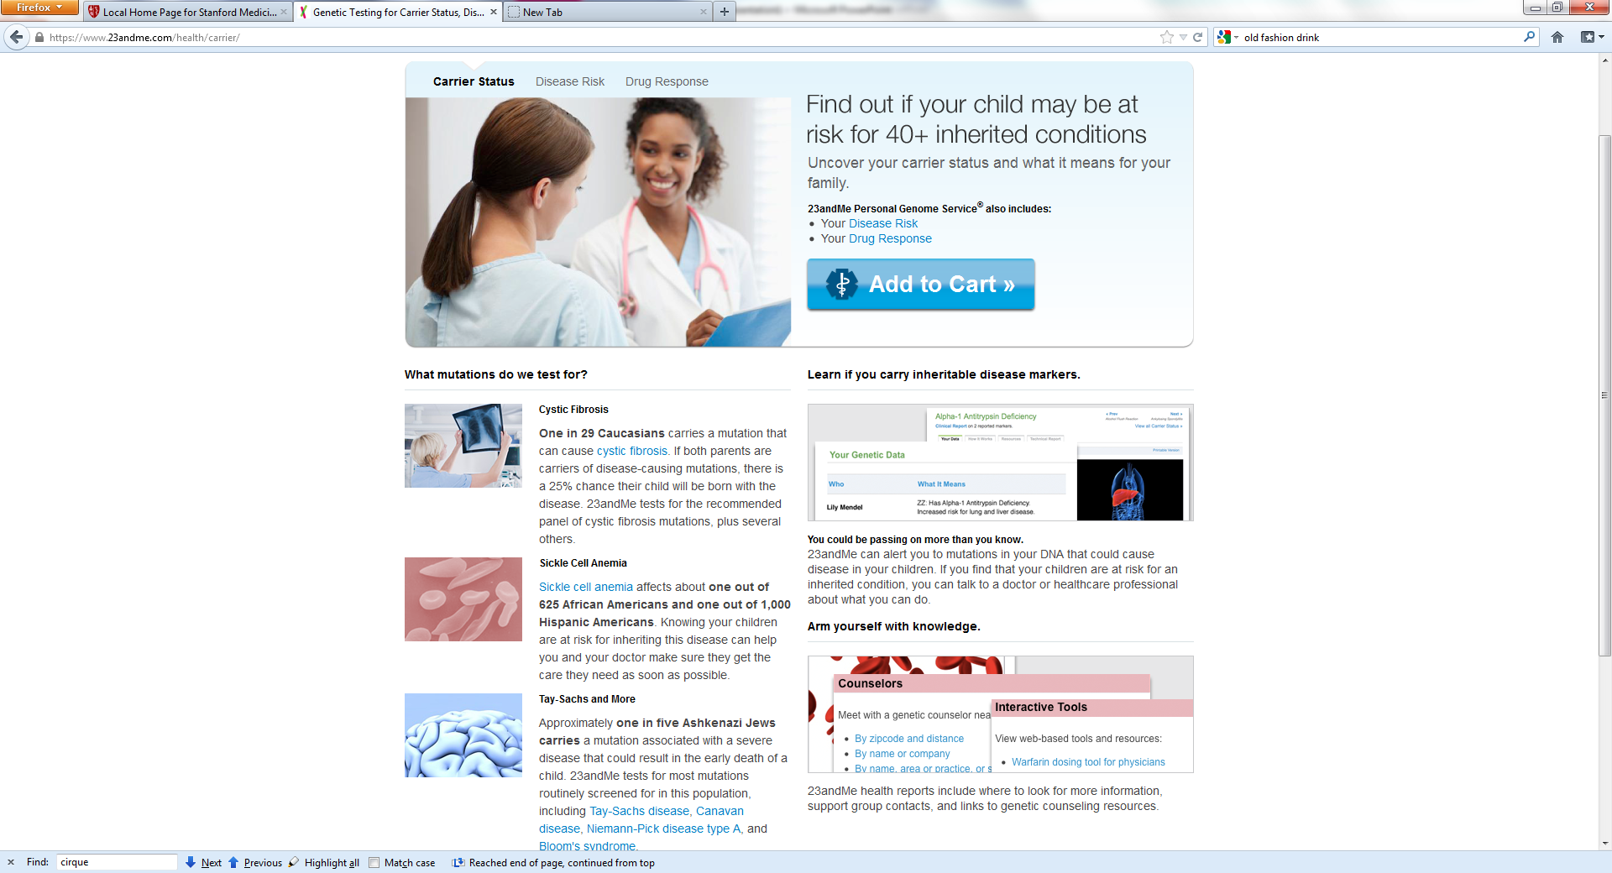

Slide 16
Family planning implications
Cystic Fibrosis or Tay Sachs
  High carrier rate in Caucasians (CF) or Ashkenazi Jews (TS)
  Would that influence your choice in partners?
  What if you and your spouse are both carriers? How does that influence family planning?

Slide 17
Informed Consent for Research

Slide 18
23andme Informed Consent
Read the consent form: https://www.23andme.com/legal/privacy/
Decide whether you wish to:
  Participate in research
    Your de-identified genetic information may be used without your knowledge for future research
  Bank your DNA at 23andme
  Provide voluntarily personal information (beyond information necessary for registration)
  Store genetic information on the database after completing the class
  Allow sharing
    23andMe gives you the ability to connect with other individuals who have 23andMe accounts through our community forums, relative finding features, and other sharing features. For some features, opt-out is required to avoid notifications

Slide 19

Example of test results

Slide 20

Sensitive test results
Alzheimer’s disease
Parkinson’s disease
Huntington’s disease is NOT tested
Pandora’s Box
Artist: J. Waterhouse

Slide 21
Risk of Genetic discrimination
Genetic discrimination occurs when employers or insurance company because they have a gene mutation that causes or increases the risk of an inherited disorder.
People who undergo genetic testing may be at risk for genetic discrimination.
Traditional genetic test results are usually included in medical records.
  Medical records are accessible to health insurance companies
  Pre-existing medical or psychiatric conditions make preclude insurance eligibility
  Failure to disclose pre-existing conditions prior to new insurance may have consequences

Slide 22
Genetic Information Non-discrimination Act (GINA)
Went into effect November 2009
http://www.dol.gov/ebsa/faqs/faq-GINA.html

Slide 23
What does GINA do?
Prevents health insurance plan from collecting genetic information including family medical history prior to, or in connection, with enrollment for purposes of underwriting.
What is “underwriting?”
  Rules for or determination of eligibility (including enrollment and continued eligibility) for benefits under the plan or coverage (including changes in deductibles or other cost-sharing mechanisms in return for activities such as completing a health risk assessment (HRA) or participating in a wellness program);
  Computation of premium or contribution amounts under the plan (including discounts, rebates, payments in kind, or other premium differential mechanisms in return for activities such as completing an HRA or participating in a wellness program);
  The application of any preexisting condition exclusion under the plan; and
  Other activities related to the creation, renewal, or replacement of a contract of health insurance or health benefits.
Prevents employers from requesting genetic information prior to employment

Slide 24
What GINA does not do
No protection against life insurance, disability insurance, or long term care insurance
Apply to diagnosed conditions
Apply to employers with fewer than 15 employees
Certain groups:
  Members of the US Military
  Veterans receiving care through the VA
  Federal employees enrolled in the FEHB
  Individuals using the Indian Health Service
Doesn’t require insurer to pay for additional screening or treatment based on genetic information.
  E.g. BrCA1 carriers: Insurers may ask for genetic information to determine coverage

Slide 25
Summary
Decision to undergo genetic testing is personal
  Consider underlying motivation
  Consider discussing with close family members
Genetic testing is not required for successful completion of this class

Slide 26
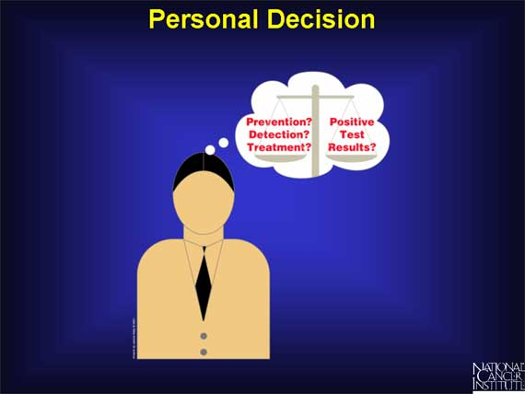

Slide 27
If you have questions or concerns before or after testing:
Genetic counseling
Psychological counseling
R. Chuang: rschuang@stanford.edu

