Slide 1
Final
Thursday May 22, 2014
Take home
No help
10% extra credit
Due Monday May 26, 2013 at midnight
Submit to gene210.stanford@gmail.com

Slide 2
Discovery of new Mendelian disorders by Next Gen sequencing

Slide 3
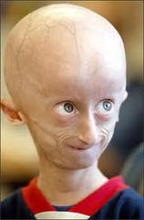
Strategy
Syndrome
Full Genome Sequence
Look for coding mutations

Slide 4
Mutational load in a normal person
Rare non-synonymous/splice site/insertions ~500
Rare, strong loss of function ~25
Genes with compound heterozygous mutations 1-3
stop
stop
stop
Glu -> Pro
homozygous
Compound heterozygous

Slide 5
Find multiple people with the same syndrome
Each person has ~25 mutations
Look for mutations that affect the same gene

Slide 6
Syndromes caused by mutations with a recessive phenotype
X
X
X
X
X
X
Affected
1
Affected
2
Affected
3

Slide 7
Dopa (3,4-dihydroxyphenylalanine)–responsive dystonia (DRD).
Dystonia - involuntary muscle contractions that cause slow repetitive movements or abnormal postures.
hereditary dystonia that gets worse late in the day.
begins in childhood.
associated with mutations in genes encoding guanosine 5′-triphosphate (GTP), cyclohydrolase (GCH1), tyrosine hydroxylase (TH), and sepiapterin reductase (SPR).
Bainbridge, M.N. et al. Whole-genome sequencing for optimized patient
management. Sci. Transl. Med. 3, 87re3 (2011).

Slide 8
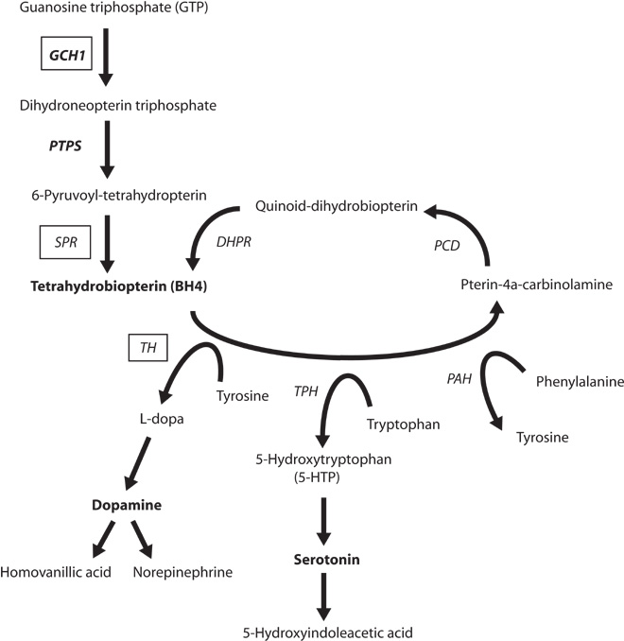

Fig. 1 Metabolic pathways of neurotransmitter production.
Bainbridge M N et al. Sci Transl Med 2011;3:87re3-87re3
Published by AAAS
Notes:
Metabolic pathways of neurotransmitter production. DRD has been associated with mutations in the genes encoding GTP cyclohydrolase (GCH1), tyrosine hydroxylase (TH), and sepiapterin reductase (SPR) (boxed), which are enzymes associated with production of the neurotransmitters dopamine and serotonin. The catalytic action of GCH1 is the rate-limiting step in production of tetrahydrobiopterin (BH4), a cofactor for the tyrosine and tryptophan hydroxylases. Disruption of the GCH1 gene can cause autosomal dominant DRD. Autosomal recessive DRD is caused by mutations in TH and SPR. Both 5-hydroxytryptophan (5-HTP) and dopamine production are disrupted by mutations in SPR, whereas only dopamine production is disrupted by mutations in TH.

Slide 9
Clinical history
fraternal twin pair.
diagnosed with DRD at age 5.
L-dopa was found to alleviate the clinical symptoms of dystonia in one twin.
no identified deleterious variants in the TH or GCH1 genes.
Sequencing of the SPR gene was not available.
high-throughput sequencing used to interrogate the whole genomes of the male and female twins.

Slide 10
Mother
Father
X
X
X
X
X
X
Affected
Affected

Slide 11
Results
Three genes found with rare compound heterozygous mutations.
  ZNF544 encodes a computationally predicted zinc finger protein with no known function or targets
  C2orf16.
  SPR encoding sepiapterin reductase.
  SPR mutations seen in two previous families with DRD.

Slide 12
Fig. 1 Metabolic pathways of neurotransmitter production.
Bainbridge M N et al. Sci Transl Med 2011;3:87re3-87re3
Published by AAAS
Notes:
Metabolic pathways of neurotransmitter production. DRD has been associated with mutations in the genes encoding GTP cyclohydrolase (GCH1), tyrosine hydroxylase (TH), and sepiapterin reductase (SPR) (boxed), which are enzymes associated with production of the neurotransmitters dopamine and serotonin. The catalytic action of GCH1 is the rate-limiting step in production of tetrahydrobiopterin (BH4), a cofactor for the tyrosine and tryptophan hydroxylases. Disruption of the GCH1 gene can cause autosomal dominant DRD. Autosomal recessive DRD is caused by mutations in TH and SPR. Both 5-hydroxytryptophan (5-HTP) and dopamine production are disrupted by mutations in SPR, whereas only dopamine production is disrupted by mutations in TH.

Slide 13
Results
  Gave serotonin precursor 5-hydroxytryptophan (5-HTP) to the twins.
  The male DRD patient reported improved focus in school, as well as improved coordination in athletics. Further, the male showed reduced drooling and hand tremor.
  The female twin reported reduced frequency of laryngeal spasms, improved sleep and focus, and improved tolerance for exercise and was able to resume participation in sports after a 14-month absence.

Slide 14
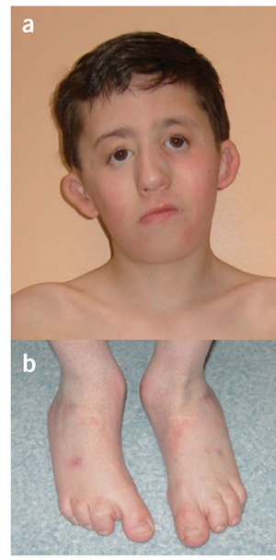
Miller Syndrome
Cupped ears
coloboma of the lower eyelids,
prominent nose,
micrognathia
absence of the fifth digits of the feet
Ng, S.B. et al. Exome sequencing identifies the cause of a Mendelian disorder.
Nat. Genet. 42, 30–35 (2010).
Notes:
(a,b) A 9-year-old boy with Miller syndrome caused by mutations in DHODH. Facial anomalies (a) include cupped ears, coloboma of the lower eyelids, prominent nose, micrognathia and absence of the fifth digits of the feet (b). (c,d) A 26-year-old man with methotrexate embryopathy. Note the cupped ears, hypertelorism, sparse eyebrows and prominent nose (c) accompanied by absence of the fourth and fifth digits of the feet (d).

Slide 15
Mother
Father
X
X
X
X
Affected

Slide 16
Family 1
Family 2
Family 3
X
X
X
X
X
X
X
X
X
X
X
X
X
X
Affected
1A
Affected
1B
Affected
2
Affected
3

Slide 17
Non-synonymous and Rare (~450/person)
Two variants in the same gene (30/person)
Same gene in 1A and 1B = 9 genes
Same gene in 1A, 1B, 2 and 3 = DHODH
dihydroorotate dehydrogenase
Validate by sequencing the gene in 3 more cases.

Slide 18
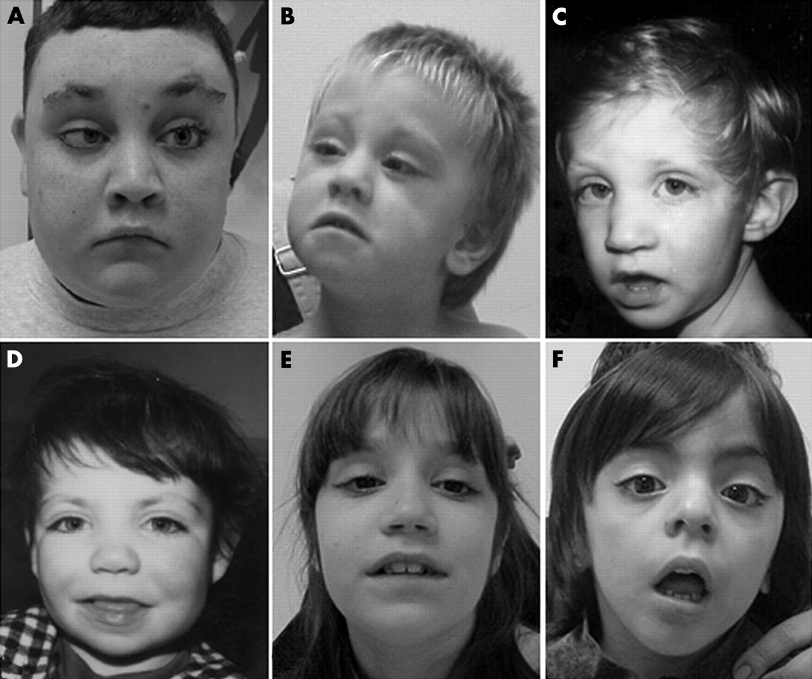
Kabuki Syndrome
Ng, S.B. et al. Exome sequencing identifies MLL2 mutations as a cause of
Kabuki syndrome. Nat. Genet. 42, 790–793 (2010).
Notes:
Kabuki syndrome is a rare, multiple malformation disorder characterized by a distinctive facial appearance (Supplementary Fig. 1), cardiac anomalies, skeletal abnormalities, immunological defects and mild to moderate mental retardation

Slide 19
Kabuki syndrome
distinctive facial appearance, cardiac anomalies, skeletal abnormalities, immunological defects and mild to moderate mental retardation.
Six cases of parent-child transmission.
Autosomal dominant disorder.

Slide 20
Parent 1
Parent 2
X
X
Affected

Slide 21
Strategy
Look for rare, loss-of-function protein coding changes in strongest patient
Look for mutations in same gene in the second strongest patient, then third, then fourth, etc.
After 4 patients, only one gene is common. MLL2
Retrospectively, see that MLL2 has suggestive mutations in 5 more patients. Ultimately, 9/10 patients had mutations in MLL2.
For validation, found 26/43 patients had mutations in MLL2. 0/190 controls had mutations.

Slide 22
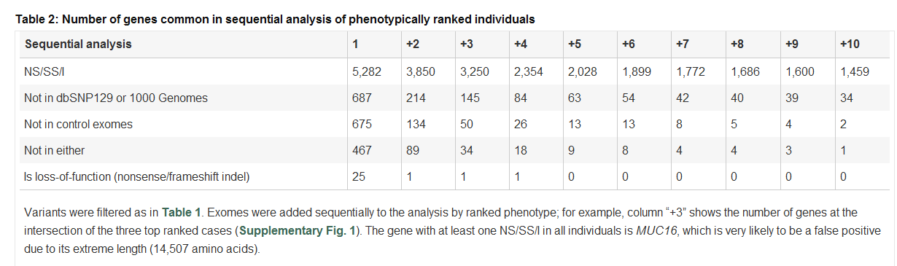

Slide 23
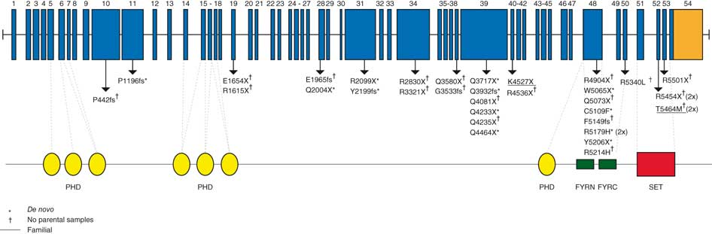
Genomic structure and allelic spectrum of MLL2 mutations that cause Kabuki syndrome
The SET domain of MLL2 confers strong histone 3 lysine 4 methyltransferase activity and is important in the epigenetic control of active chromatin states.

Slide 24
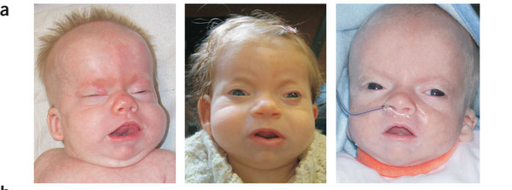
Schinzel-Giedon syndrome
Severe mental retardation, distinctive facial features, multiple congenital malformations (including skeletal abnormalities, genitourinary and renal malformations, and cardiac defects) and a higher-than-normal prevalence of tumors, notably neuroepithelial neoplasia.
Hoischen, A. et al. De novo mutations of SETBP1 cause Schinzel-Giedion
syndrome. Nat. Genet. 42, 483–485 (2010).

Slide 25
Mother
Father
X
Affected

Slide 26
Strategy
Look for rare, loss-of-function protein coding changes
Only 1 gene shared in four patients – SETB1.
In all cases, mutations occurred de novo in patients and were absent from parents.
Validated in 8/9 additional patients.
Gain-of-function effect or dominant-negative effect

Slide 27
recap
Dopa responsive disorder – Knew the pathway and could guess which mutations were right
Miller’s syndrome – recessive mutations in DHODH
Kabuki syndrome – autosomal dominant
Shinzel Giedon syndrome – spontaneous mutations

Slide 28
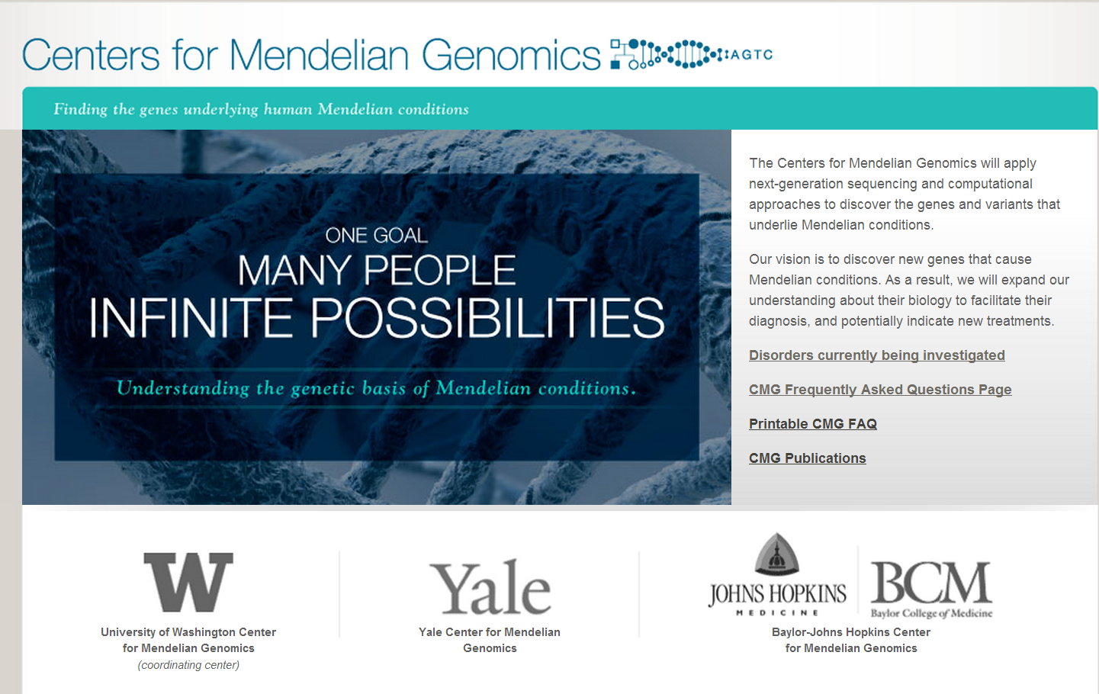
www.mendelian.org

Slide 29
www.mendelian.org
Large scale public effort to identify Mendelian mutations
UW/Yale/Hopkins/Baylor
Doctors send in samples
Centers sequence families, find mutations
Joint publication

Slide 30
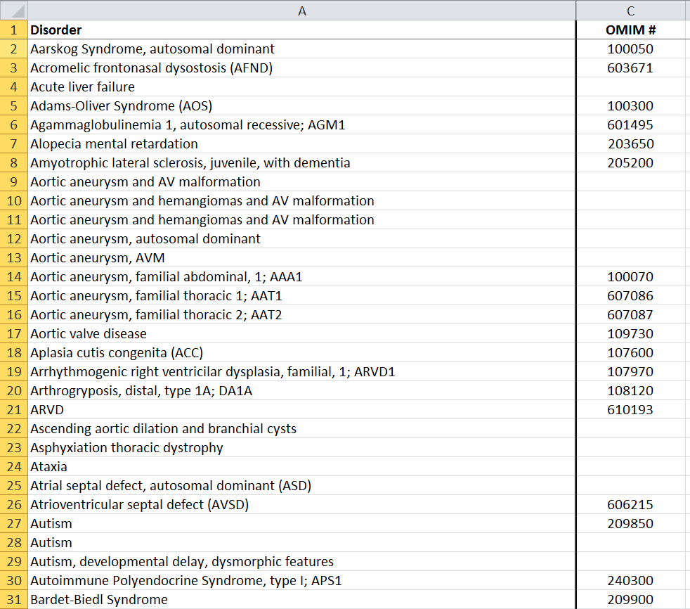
www.mendelian.org
Sequencing 500 Mendelian families
Either exome or wgs

Slide 31
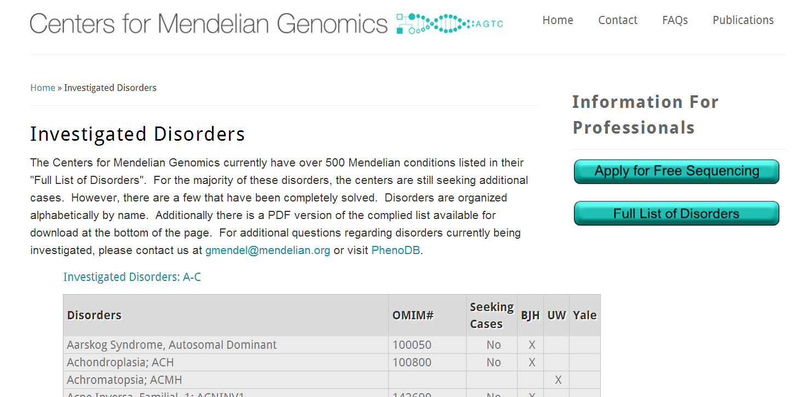

Slide 32
Overview of Next Gen Sequencing results for disease
Rare Syndromes: DRD, Miller’s etc.
Not common diseases: Type 2 diabetes, cardiovascular disease
Constrained to protein coding mutations. Mutations that disrupt expression not currently recognized.
Much of Heritability is still missing.

