Slide 1
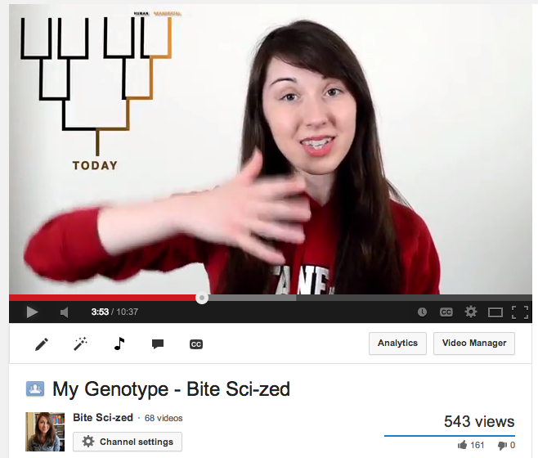
My Genotype - Bite Sci-zed
Email from high school student:
“...still trying to figure out what it is I want to do with my life. I'm thinking I want to study genomics… I'm extremely interested in having my genome sequenced. I've been looking into 23andMe's service, which includes ancestry, and health surveys, and also provides the raw data, all for $99. It seems too good to be true considering whole genome sequencing takes quite a bit of time at this point, and the sequencing machines are generally very expensive.”
http://youtu.be/4bGZuAqxxxw

Slide 2
A Conversation on Personal Genetics
When: 2-4:15 PM, Thursday June 5th
Where: Munzer Auditorium, Beckman Center
Speakers:
  Kelly Ormond – Stanford Genetics, Genetic Counselor
  Jacob Sherkow – Stanford Law School, Fellow, Center for Law and the Biosciences
  Dr. Jill Hagenkord – 23andMe, Chief Medical Officer
Reception with refreshments afterwards – 4:15 PM

Slide 3
Final
Future Genetics
Course evaluation
Class discussion/feedback

Slide 4
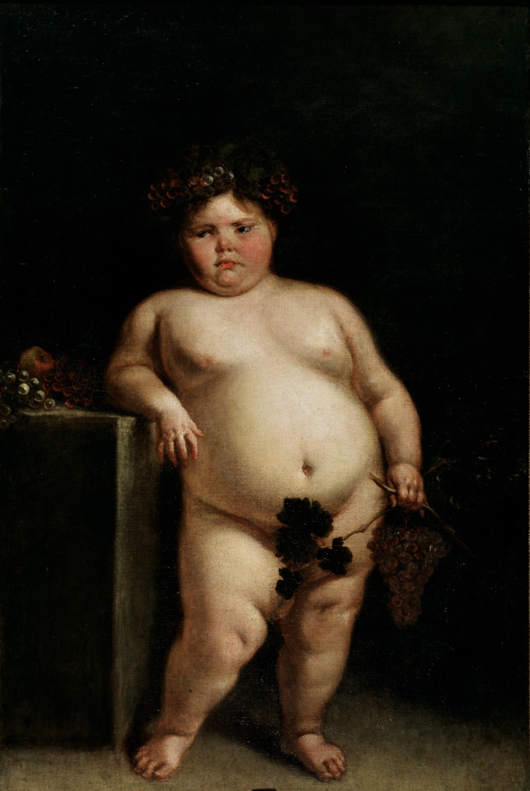
Obesity
Prader Willi Syndrome
Genotation/class exercises/snyderome

Slide 5

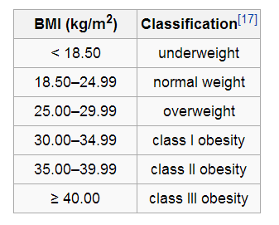
Body Mass Index
  m and h are the subject's weight in kilograms and height in meters respectively.
BMI calculator
http://stanfordhospital.org/clinicsmedServices/COE/surgicalServices/generalSurgery/bariatricsurgery/resources/bmi_calculator.html?gclid=CjgKEAjwwPabBRCXo46OtM_RhGMSJACgCeqABB_Q-2yY-0Hkk4wRzE0K6tzrYzAsvKekxjOA1w1dmvD_BwE

Slide 6
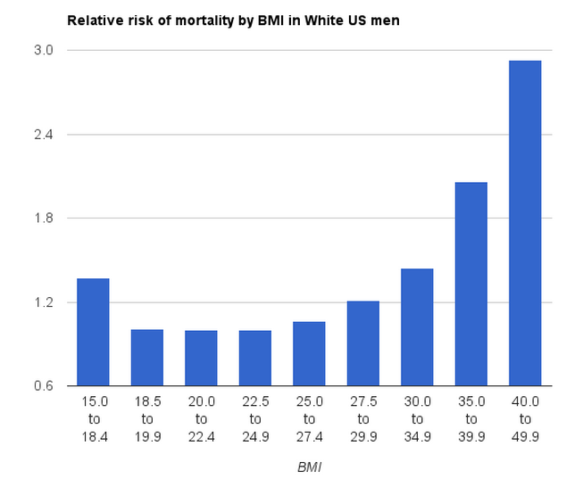
5’ 8”, 263 lbs
5’ 8”, 121 lbs

Slide 7
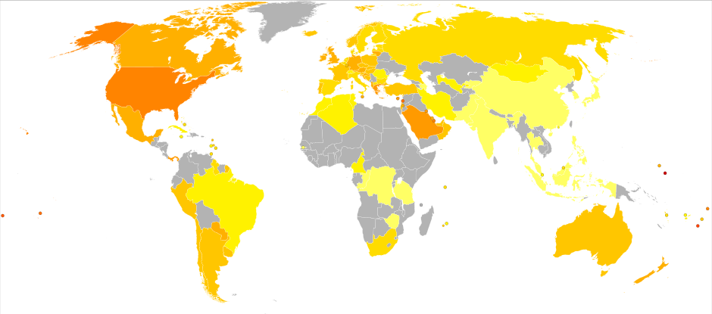

World Prevalence of Obesity

Slide 8
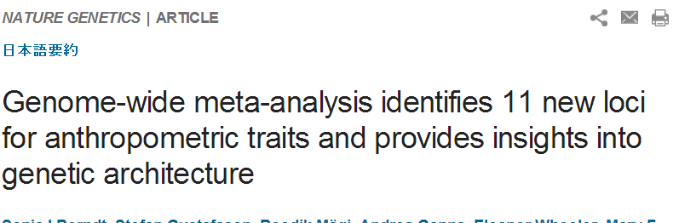
genome-wide search
upper versus the lower 5th percentiles
  body mass index,
  height and waist-to-hip ratio,
  clinical classes of obesity,
263,407 individuals of European ancestry
Found 11 loci
Notes:
Nat Genet. 2013 May;45(5):501-12. doi: 10.1038/ng.2606. Epub 2013 Apr 7.

Slide 9
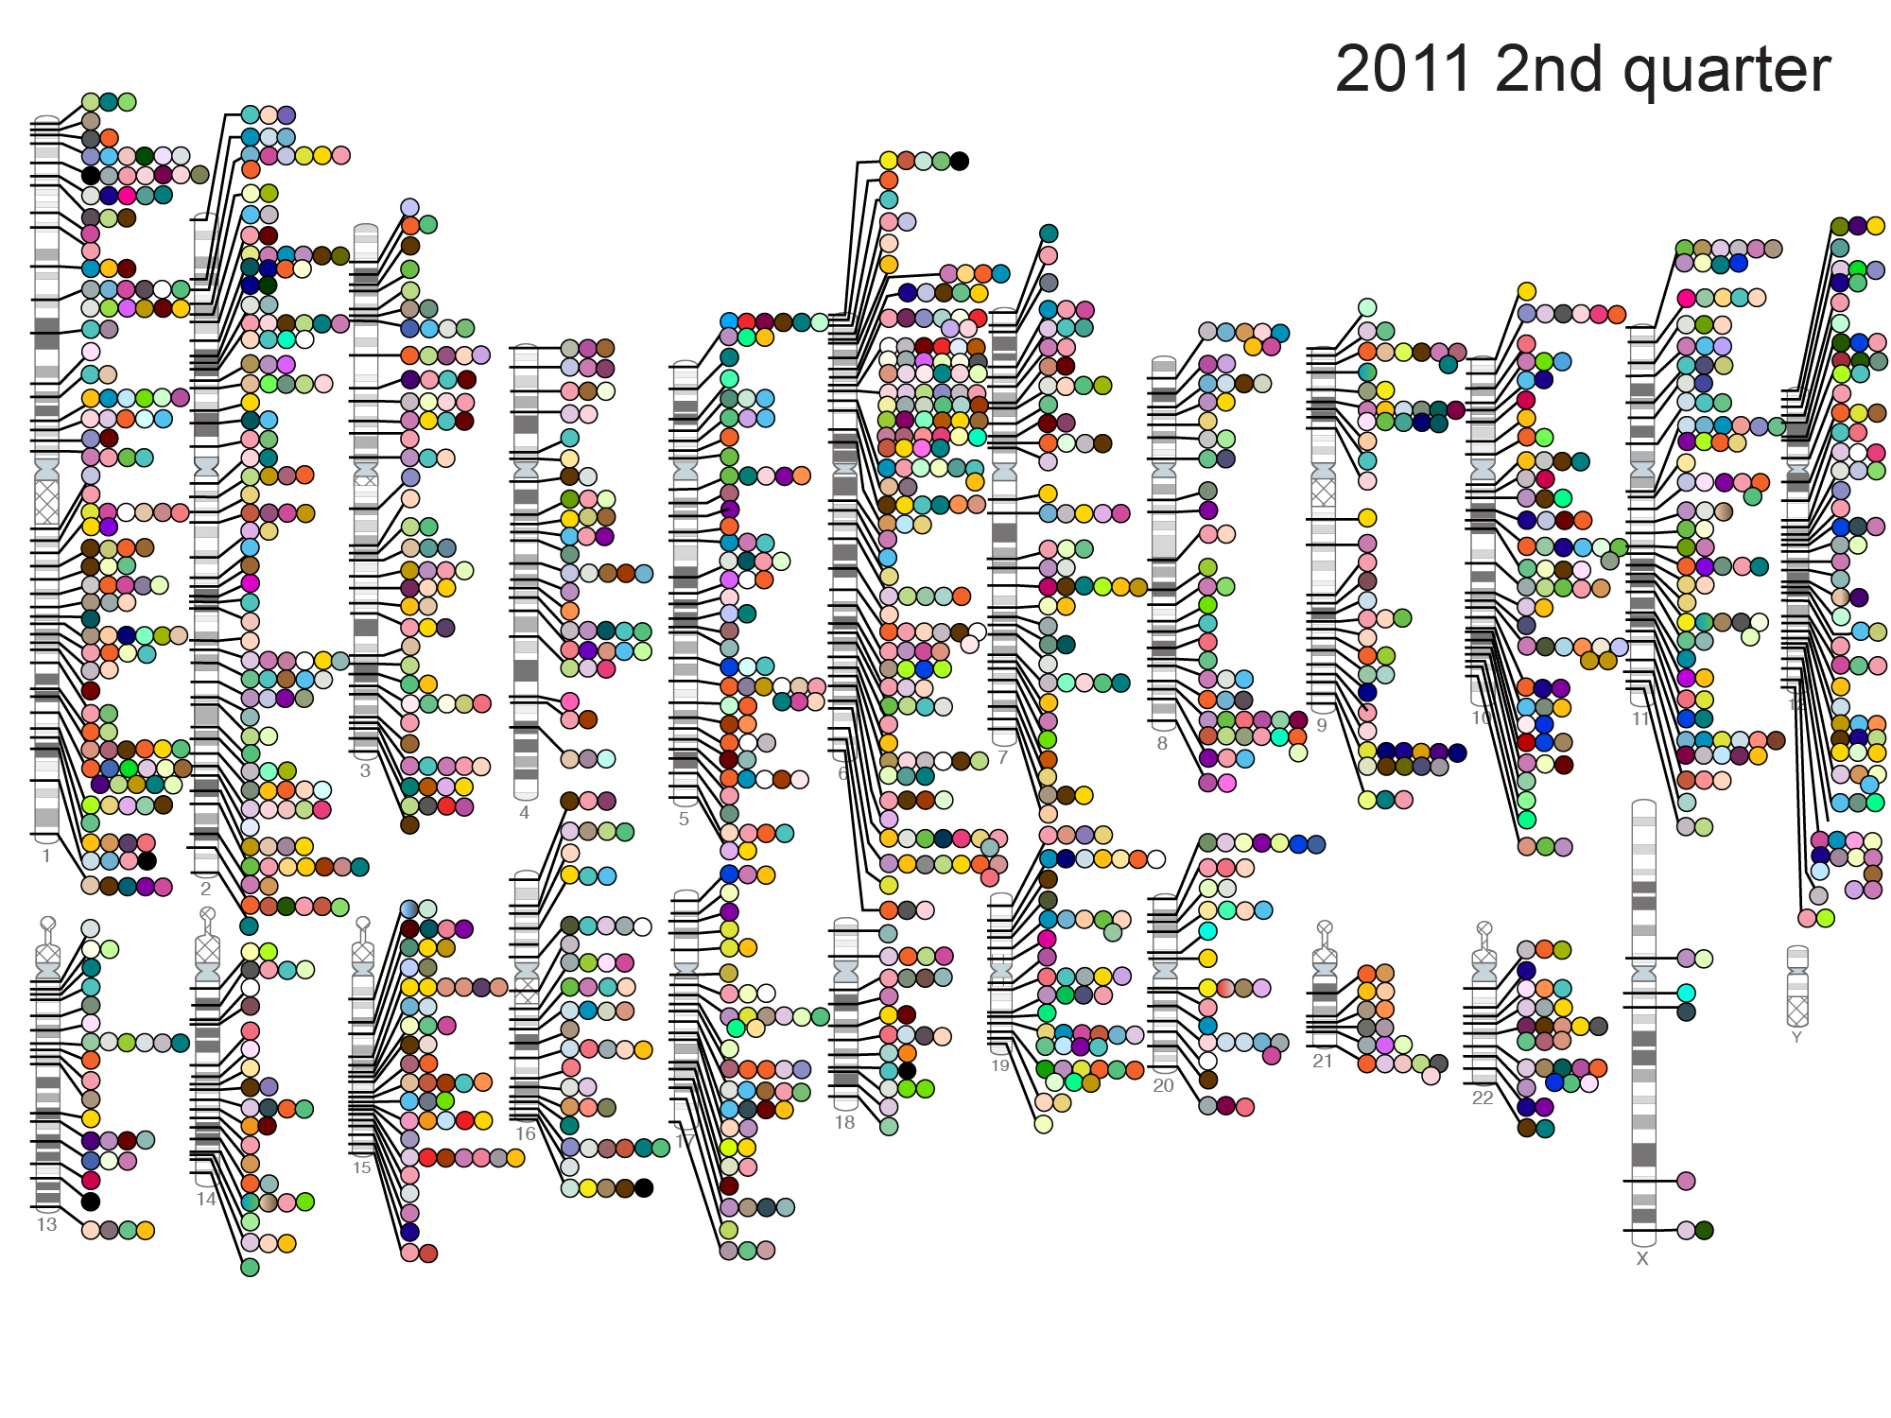
Published Genome-Wide Associations through 06/2011,
1,449 published GWA at p≤5x10⁻⁸ for 237 traits
NHGRI GWA Catalog
www.genome.gov/GWAStudies

Slide 10
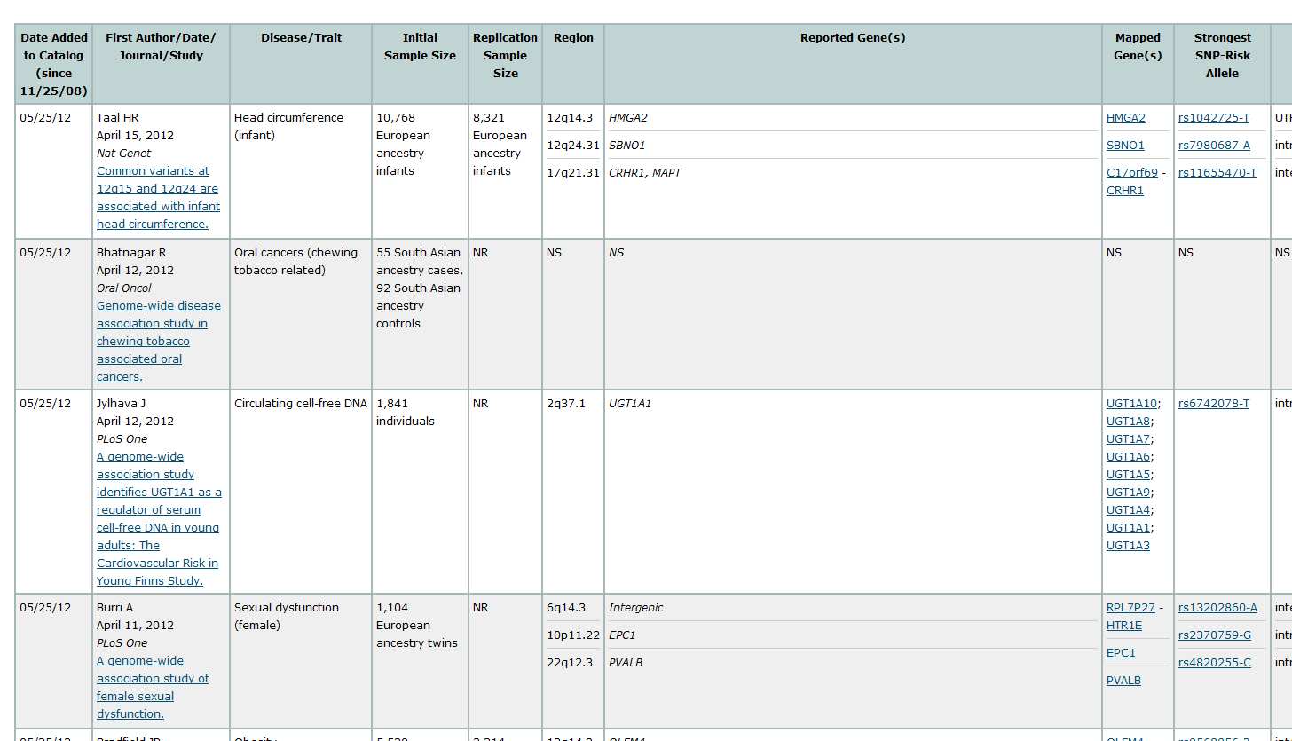
GWAS examples

Slide 11
Frontiers in Personalized Medicine
PW-GW-AS: phenotype wide – genotype wide – association study
Reverse human genetics

Slide 12
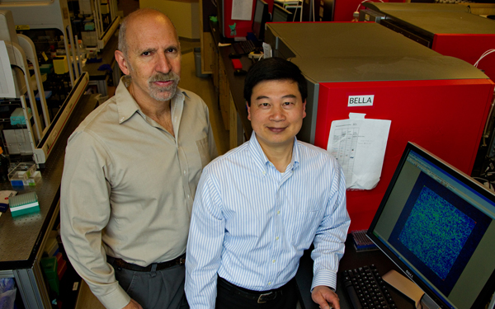
UCSF Kaiser-Permanente
N. Risch and P. Y. Kwok

Slide 13
UCSF Kaiser-Permanente
100,000 patients
Genotype and telomere lengths
many health traits

Slide 14
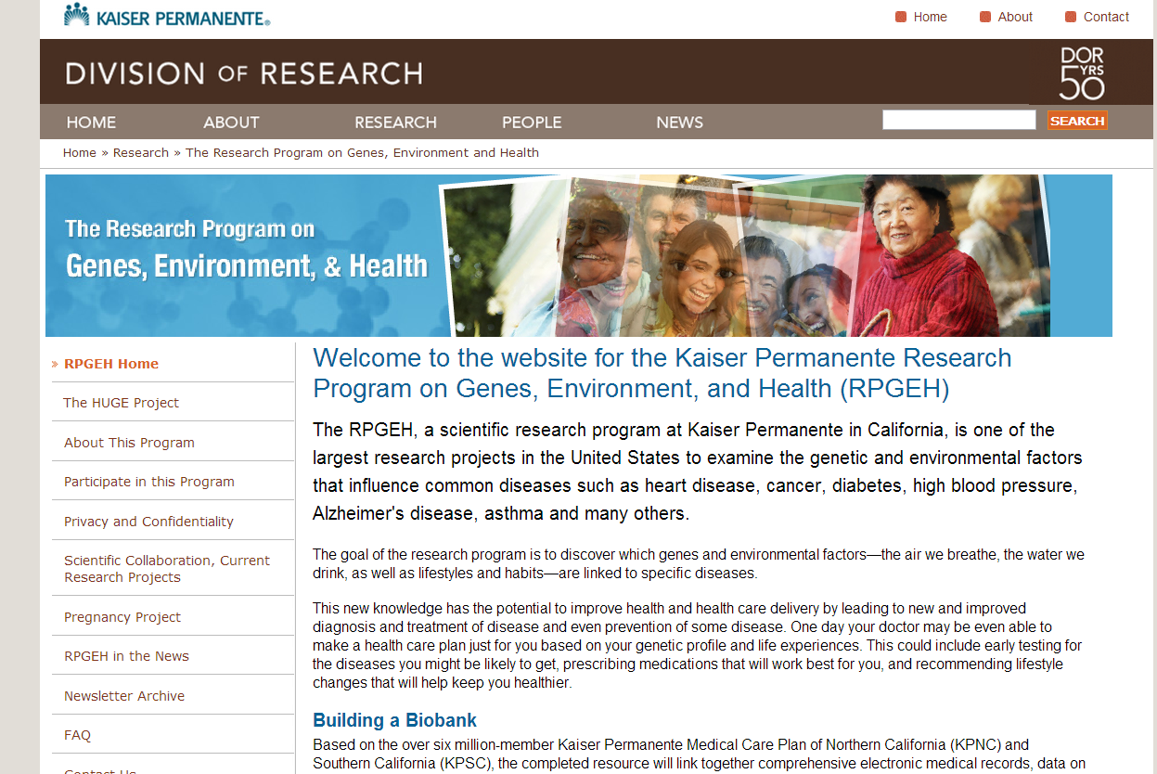

Slide 15
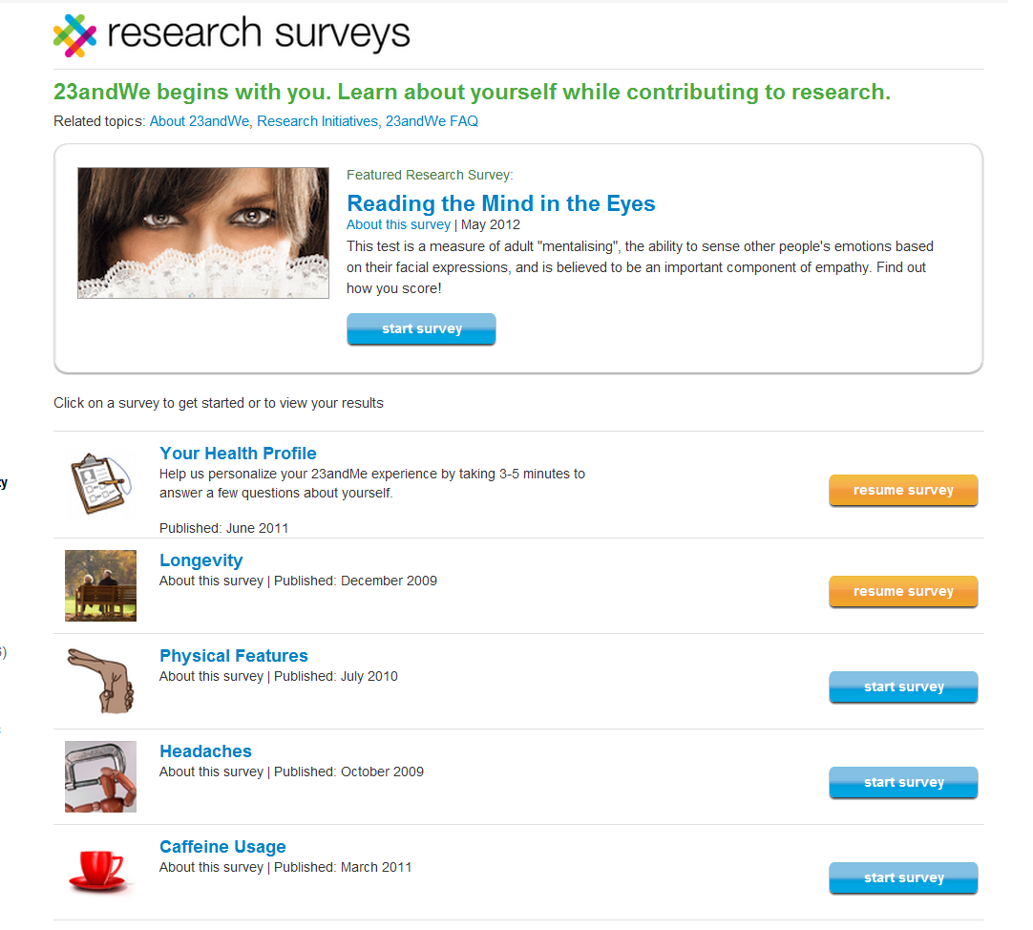
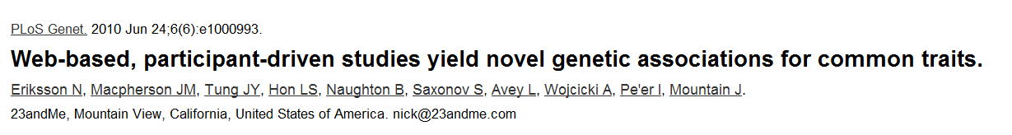
23andme

Slide 16
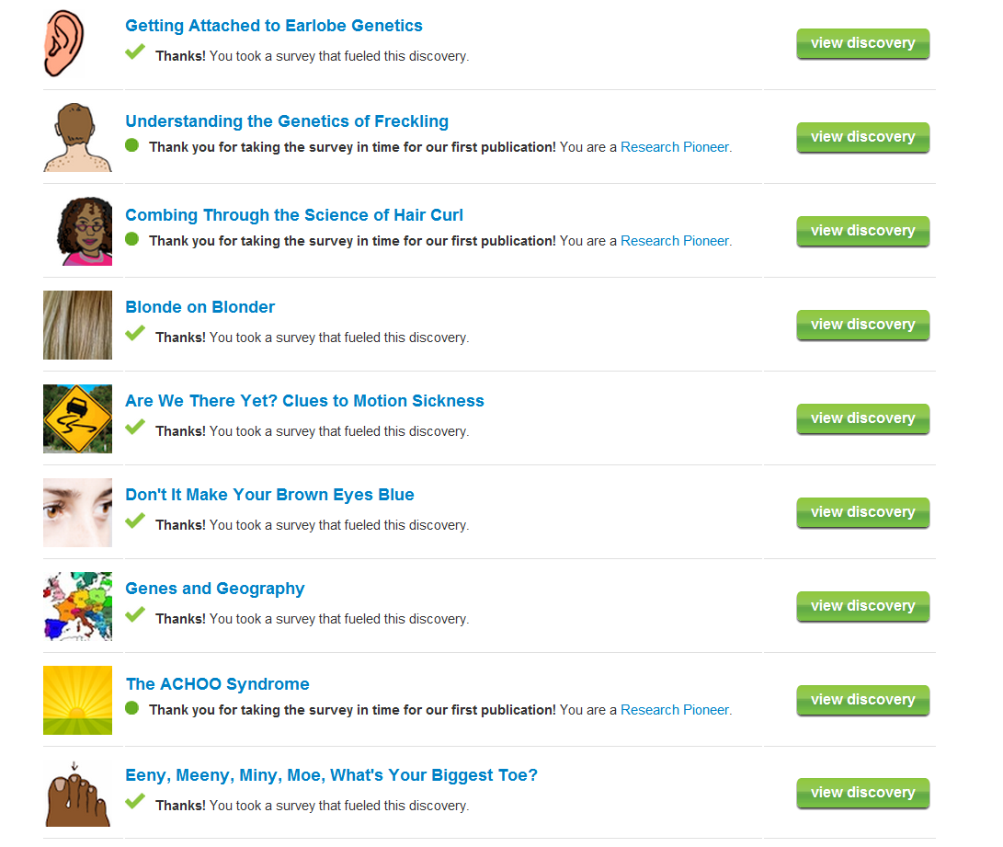
Research Discoveries at 23andme

Slide 18
Hair Curl
Asparagus smell
Photic sneeze
freckling
Notes:
(A) hair curl, (B) asparagus anosmia, (C) photic sneeze reflex, and (D) freckling

Slide 19
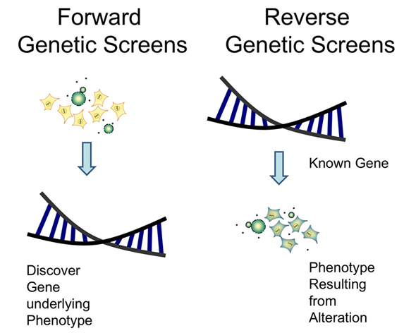

Slide 20
DRD sequencing: Results
Three genes found with rare compound heterozygous mutations.
  ZNF544 encodes a computationally predicted zinc finger protein with no known function or targets
  C2orf16.
  SPR encoding sepiapterin reductase.

Slide 21
Human knockout for NFATC2
Pro860Leu
NFATC2
His426Arg
Stuart Kim’s genome

Slide 22
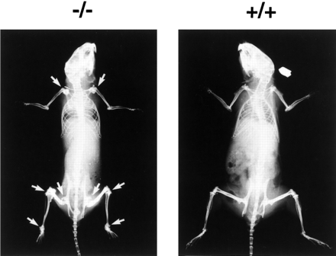
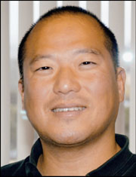
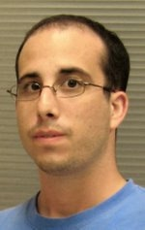
A human model for NFATC2
187 publications on NFATC2 in mice

Slide 23
Reverse Human Genetics
Sequence 1,000,000 people
  Each person is compound heterozygous ~2 gene.
  DRD patients (2), Snyder (1), Kim (2)
Entire population has ~2M knockouts
  For each gene, there are about 100 people lacking that gene (compound heterozygous)
Find an interesting gene
  Mutant phenotype is known in model organisms
  Expression or biochemical activity is interesting
  Etc.
Recruit ~100 people that are compound heterozygous for your gene.
  Guess phenotype based on known function in model organisms
  Have people come into clinic, take questionaire, etc.
  This could tell you function of gene in people
Examples
  Neurotransmitter receptors/brain function
  foxP2/speech function
  Telomerase or insulin signaling receptor/longevity

