Slide 1
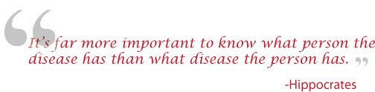
Genetics 210: Personalized Medicine and Genomics
For: MDs, PhDs and curious students
Spring term. Tue 2:15 – 4:05
Thur. 2:15-4:05
LKSC 102
Genotyping : free
Gene210.stanford.edu: info and FAQs

Slide 2
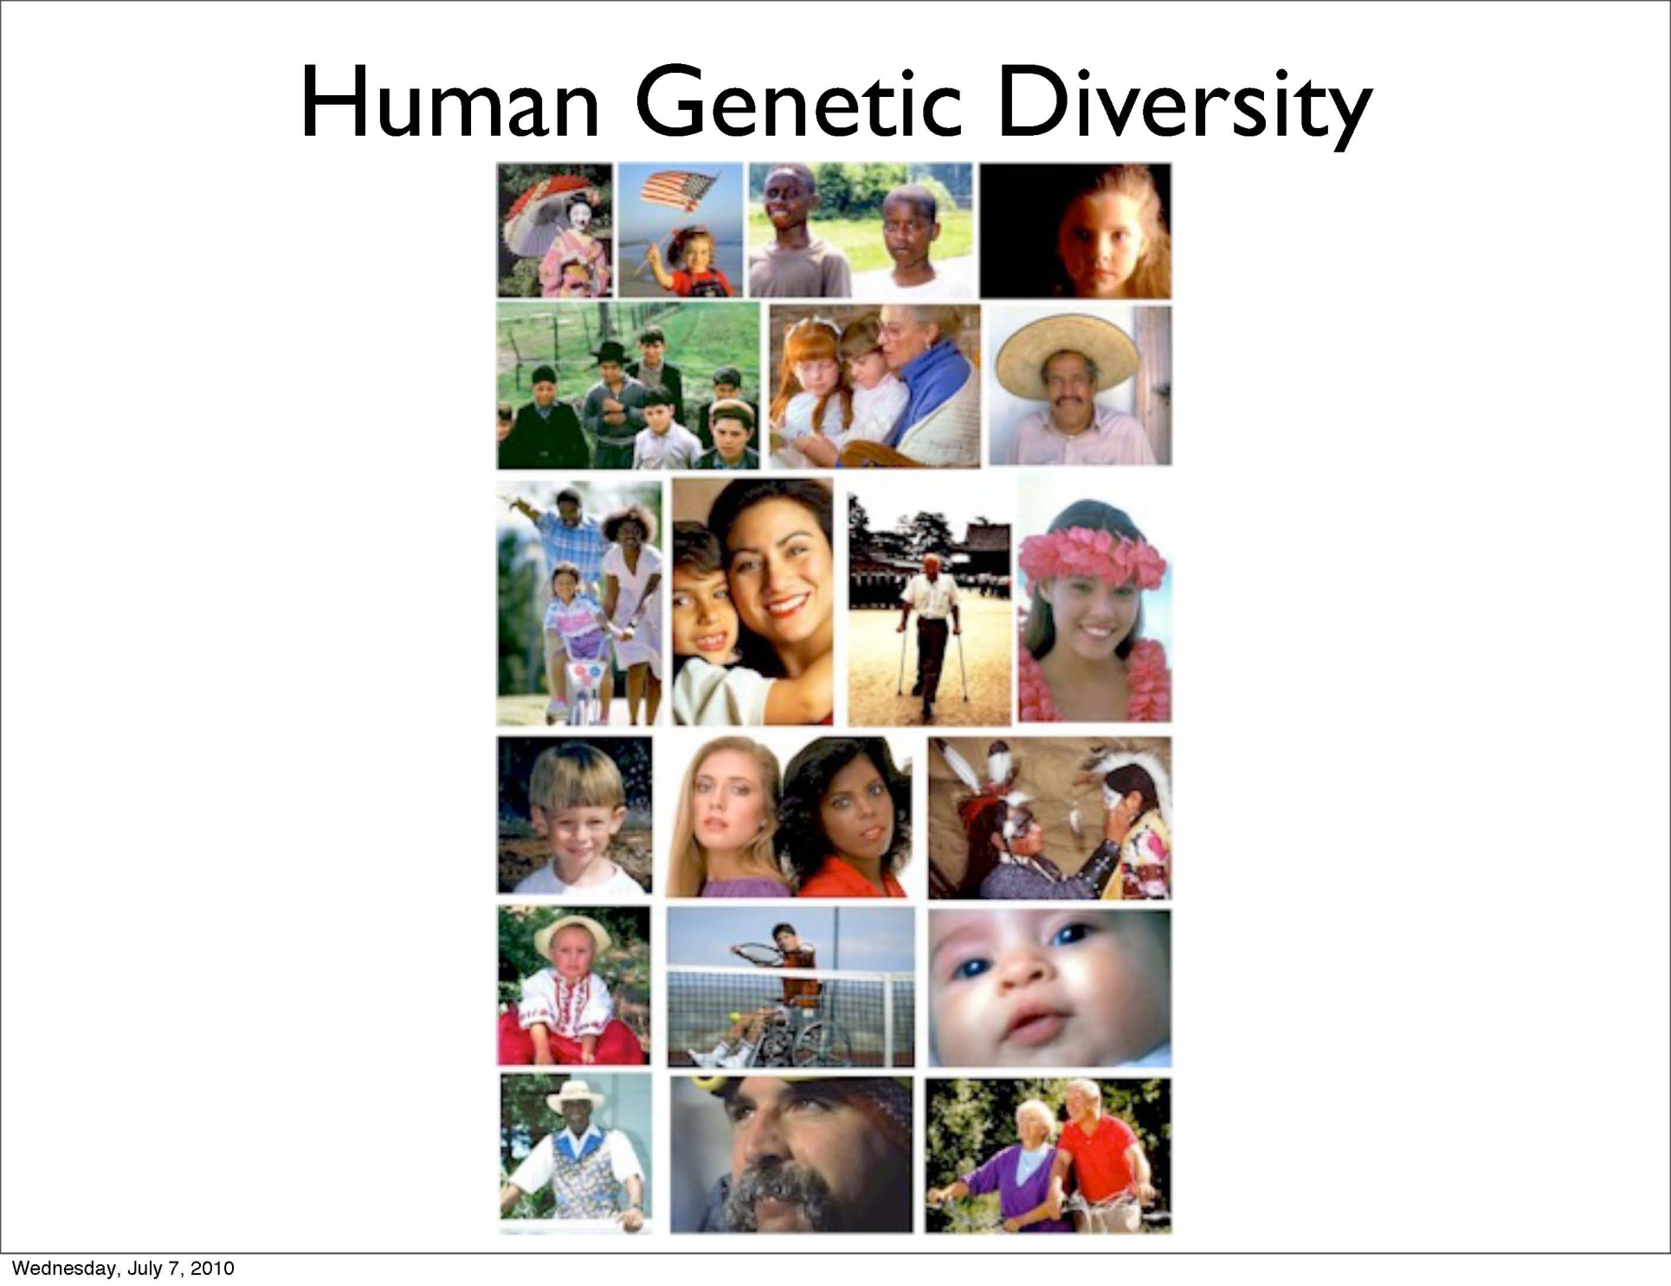

Slide 3
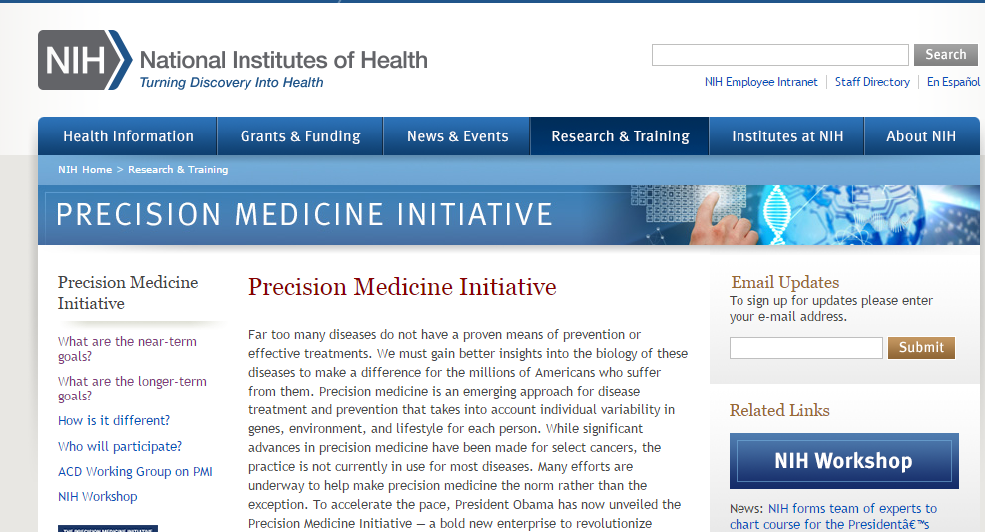

Slide 4
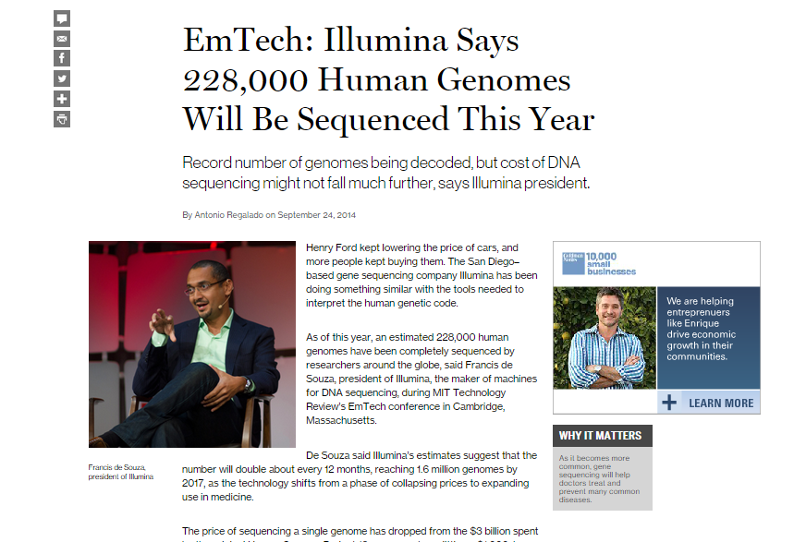

Slide 5
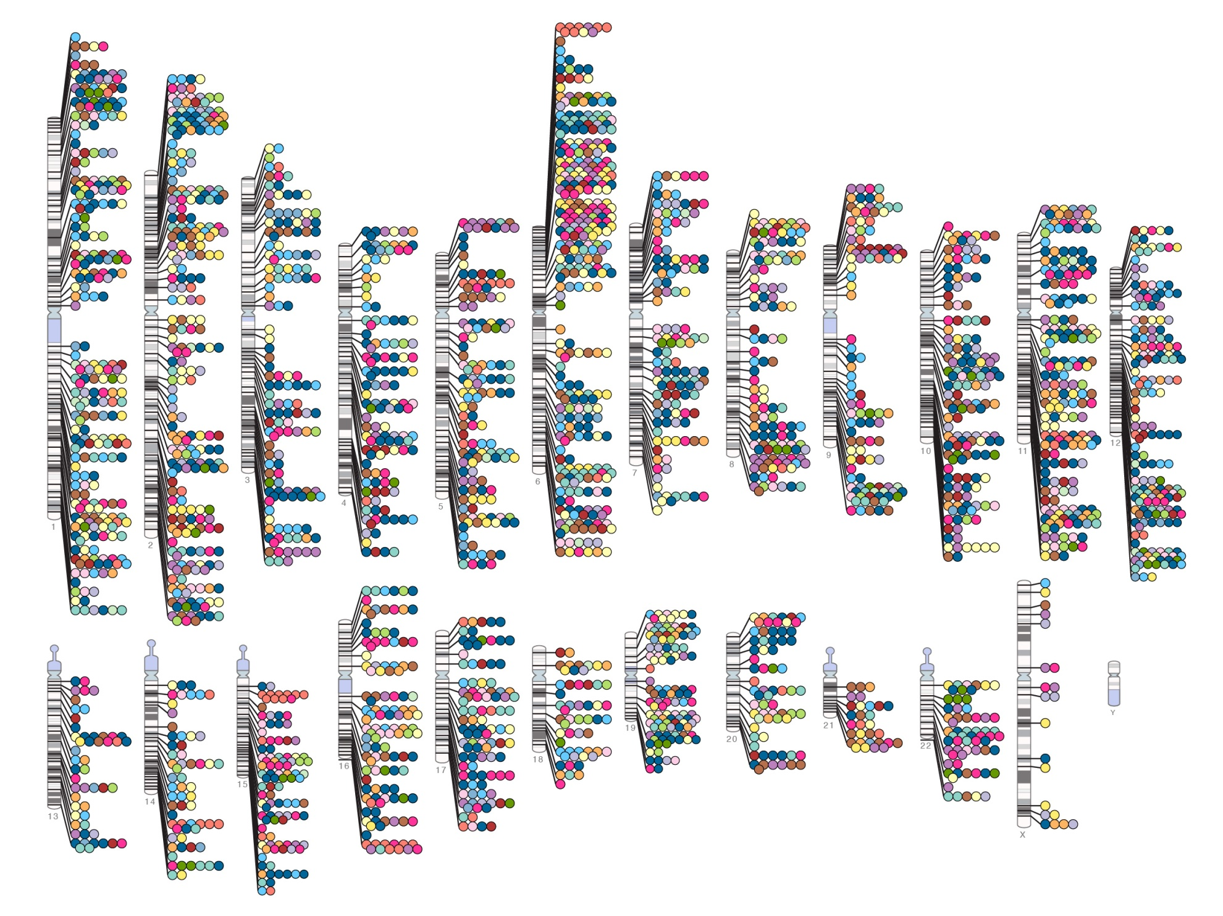
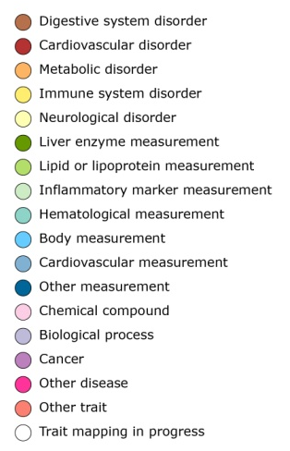

Published Genome-Wide Associations through 07/2012
Published GWA at p≤5X10⁻⁸ for 18 trait categories
NHGRI GWA Catalog
www.genome.gov/GWAStudies
www.ebi.ac.uk/fgpt/gwas/

Slide 6
Course Staff
http://stanford.edu/class/gene210/web/html/contact.html
Course Organizers:
  Stuart Kim (Dev. Bio., Genetics)
  Aaron Gitler (Genetics)
TAs
  Andrew Roos (Epidemiology)
  Rachel Goldfeder (BMI)

Slide 7
Participants
MD students
Biomedical PhD
BioInformatics
Other Science PhD
Other programs (Law, Psych)?
Undergrad
DCI/MD
Notes:
Engage in current and future possibilities about precision medicine
Broad, diverse for everyone to learn
Not for high-end human genetics, end-game diagnostics.
New way to teach. Workshops and projects, not lectures and term papers.

Slide 8
Course syllabus
http://stanford.edu/class/gene210/web/html/schedule.html
Activities
  In class GWAS exercise
  cardiovascular, diabetes, cancer, crohn’s etc.
  Neandertal
  Human positive selection
  Who done it?
Presentations
  Josh Knowles (cardiovascular)
  Russ Altman (pharmacogenetics)
  Yair Blumenfeld (prenatal sequencing)
  Steve Montgomery (eQTLs)
  Mike Snyder (next gen sequencing)

Slide 9
Course Requirements http://stanford.edu/class/gene210/web/html/course_requirements.html
1. Problem Sets (20%)
  Problem set 1. Out April 2. Due April 16.
  Problem set 2. Out April 16. Due April 28.
  OK to work in team, but need to work independently.

Slide 10
Course Requirements http://stanford.edu/class/gene210/web/html/course_requirements.html
2. Projects (40%) Choose one of the following projects.
  a. Genotation Write-up
    Create a page on a new topic for genotation. It should include introductory text and a look-up table for other students to use. Consult Stuart with your idea for a new genotation topic.
  b. Write-up
    One page write up of association of how a SNP is linked with a particular trait. The format is the same as used at SNPedia.com.
  c. Special Project
    In the past, some students have found a specific interest in some aspect of Personalized Medicine. This may come from your interest in some aspect of your own genetics, the ethics of genetic testing, or entrepreneurial possibilities in Personalized Medicine. You may come up with an individualized project for class credit by discussing your idea with one of the course directors.

Slide 11
Course Requirements http://stanford.edu/class/gene210/web/html/course_requirements.html
Final Exam (40% credit) take home.
  Scenario is that you are an MD diagnosing a patient.
  You will be given the genotypes of a hypothetical family. The final will have various scenarios.
  Extra credit. (10%)
    a. You will be given the genotypes of 7 people (SK, KK, RT, NT, NZ, MPS, GC).
    b. You will be told ancestry and specific traits for these 7 people.
    c. You need to match the genotype with the person.

Slide 12
Course Requirements http://stanford.edu/class/gene210/web/html/course_requirements.html
Super-projects
  In the past, some students have taken this introductory class even though they are highly advanced in human genetics and bioinformatics. These students can do a more advanced project by consulting one of the course instructors. Students that undertake a super-project do not need to take the final exam. Possible super-projects topics include:
    a. Annotate genotypes of entire family. Determine recombination breakpoints in all children.
    b. Write a grant for Kaiser-Permanente GWAS (n=110,000 patients)
    c. Write a program to calculate best genetic mate between one student and all other students of the opposite sex.

Slide 13
History
Joint Genotyping Task Force
Charles Prober Dean Hank Greely Law School
Russ Altman Genetics Clarence Braddock Med School
Pat Brown Biochem. Gil Chu Biochem
Mike Grecius Neur. Sean David Med. School
Carlos Bustamente Gen. Harry Greenberg Dean
Ralph Horwitz Psych Louanne Hudgins Epidemiology
Anne James Legal Counsel Jesse Karmazin Med. School
Stuart Kim Dev. Bio. Mark Krasnow Biochem
Phil Lavori HRP David Magnus Cen. BME
Kelly Ormond Genetics Alan Schatzberg Psych.
Mike Snyder Genetics Atul Butte BMI
Keyan Salari Med. School Mildred Cho Pediatrics

Slide 14
Course proposed in 2008
Joint Genotyping Task Force
Charles Prober Dean Hank Greely Law School
Russ Altman Genetics Clarence Braddock Med School
Pat Brown Biochem. Gil Chu Biochem
Mike Grecius Neur. Sean David Med. School
Carlos Bustamente Gen. Harry Greenberg Dean
Ralph Horwitz Psych Louanne Hudgins Epidemiology
Anne James Legal Counsel Jesse Karmazin Med. School
Stuart Kim Dev. Bio. Mark Krasnow Biochem
Phil Lavori HRP David Magnus Cen. BME
Kelly Ormond Genetics Alan Schatzberg Psych.
Mike Snyder Genetics Atul Butte BMI
Keyan Salari Med. School Mildred Cho Pediatrics

Slide 15
Concern over student stress
Joint Genotyping Task Force
Charles Prober Dean Hank Greely Law School
Russ Altman Genetics Clarence Braddock Med School
Pat Brown Biochem. Gil Chu Biochem
Mike Grecius Neur. Sean David Med. School
Carlos Bustamente Gen. Harry Greenberg Dean
Ralph Horwitz Psych Louanne Hudgins Epidemiology
Anne James Legal Counsel Jesse Karmazin Med. School
Stuart Kim Dev. Bio. Mark Krasnow Biochem
Phil Lavori HRP David Magnus Cen. BME
Kelly Ormond Genetics Alan Schatzberg Psych.
Mike Snyder Genetics Atul Butte BMI
Keyan Salari Med. School Mildred Cho Pediatrics

Slide 16
Support for counseling
Joint Genotyping Task Force
Charles Prober Dean Hank Greely Law School
Russ Altman Genetics Clarence Braddock Med School
Pat Brown Biochem. Gil Chu Biochem
Mike Grecius Neur. Sean David Med. School
Carlos Bustamente Gen. Harry Greenberg Dean
Ralph Horwitz Psych Louanne Hudgins Epidemiology
Anne James Legal Counsel Jesse Karmazin Med. School
Stuart Kim Dev. Bio. Mark Krasnow Biochem
Phil Lavori HRP David Magnus Cen. BME
Kelly Ormond Genetics Alan Schatzberg Psych.
Mike Snyder Genetics Atul Butte BMI
Keyan Salari Med. School Mildred Cho Pediatrics

Slide 17
No Coercion
Joint Genotyping Task Force
Charles Prober Dean Hank Greely Law School
Russ Altman Genetics Clarence Braddock Med School
Pat Brown Biochem. Gil Chu Biochem
Mike Grecius Neur. Sean David Med. School
Carlos Bustamente Gen. Harry Greenberg Dean
Ralph Horwitz Psych Louanne Hudgins Epidemiology
Anne James Legal Counsel Jesse Karmazin Med. School
Stuart Kim Dev. Bio. Mark Krasnow Biochem
Phil Lavori HRP David Magnus Cen. BME
Kelly Ormond Genetics Alan Schatzberg Psych.
Mike Snyder Genetics Atul Butte BMI
Keyan Salari Med. School Mildred Cho Pediatrics

Slide 18
No financial ties to 23andme
Joint Genotyping Task Force
Charles Prober Dean Hank Greely Law School
Russ Altman Genetics Clarence Braddock Med School
Pat Brown Biochem. Gil Chu Biochem
Mike Grecius Neur. Sean David Med. School
Carlos Bustamente Gen. Harry Greenberg Dean
Ralph Horwitz Psych Louanne Hudgins Epidemiology
Anne James Legal Counsel Jesse Karmazin Med. School
Stuart Kim Dev. Bio. Mark Krasnow Biochem
Phil Lavori HRP David Magnus Cen. BME
Kelly Ormond Genetics Alan Schatzberg Psych.
Mike Snyder Genetics Atul Butte BMI
Keyan Salari Med. School Mildred Cho Pediatrics

Slide 19
Informed consent
Joint Genotyping Task Force
Charles Prober Dean Hank Greely Law School
Russ Altman Genetics Clarence Braddock Med School
Pat Brown Biochem. Gil Chu Biochem
Mike Grecius Neur. Sean David Med. School
Carlos Bustamente Gen. Harry Greenberg Dean
Ralph Horwitz Psych Louanne Hudgins Epidemiology
Anne James Legal Counsel Jesse Karmazin Med. School
Stuart Kim Dev. Bio. Mark Krasnow Biochem
Phil Lavori HRP David Magnus Cen. BME
Kelly Ormond Genetics Alan Schatzberg Psych.
Mike Snyder Genetics Atul Butte BMI
Keyan Salari Med. School Mildred Cho Pediatrics

Slide 20
Personal Genotyping
Voluntary. You can use a public genome file instead of your own.
Confidential – instructors will not ask who opted to be genotyped.
Private – Your own DNA information will not be revealed.
Counseling - genetic counseling via 23andMe and medical/psychological counseling via Dr. Alan Schatzberg (Psychology, Stanford).

Slide 21
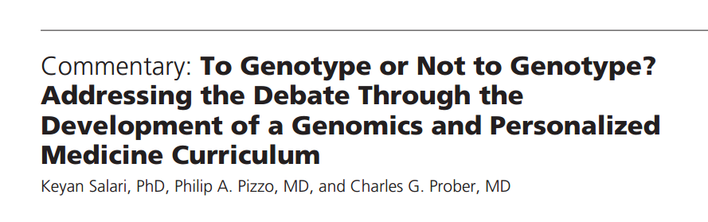
Summary of the Joint Genotyping Task Force Committee
Acad Med. 2011;86:925–927.

Slide 22
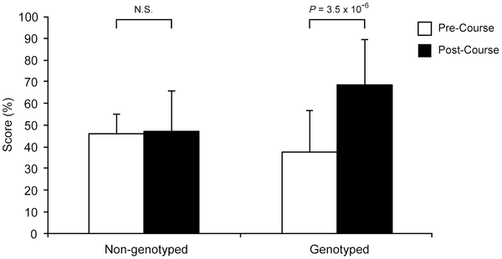

Figure 1. Student scores assessing knowledge of genomics.
Salari K, Karczewski KJ, Hudgins L, Ormond KE (2013) Evidence That Personal Genome Testing Enhances Student Learning in a Course on Genomics and Personalized Medicine. PLoS ONE 8(7): e68853. doi:10.1371/journal.pone.0068853
http://www.plosone.org/article/info:doi/10.1371/journal.pone.0068853

Slide 23
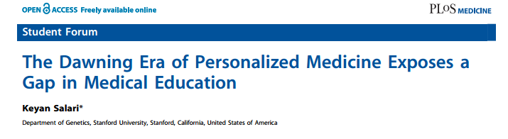
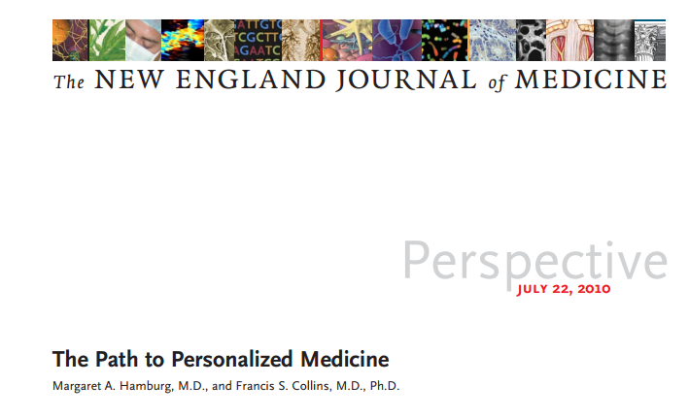
Readings today 4/1

Slide 24
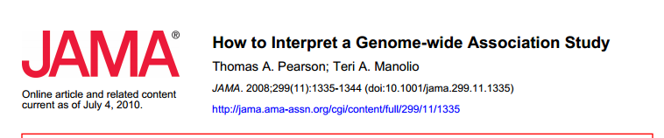
Reading #1: Thursday 4/3

Slide 25
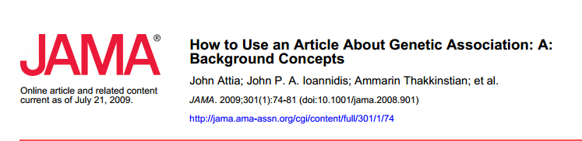
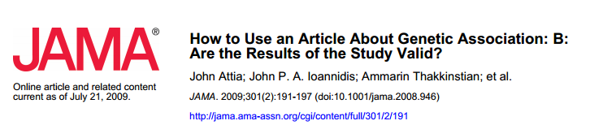
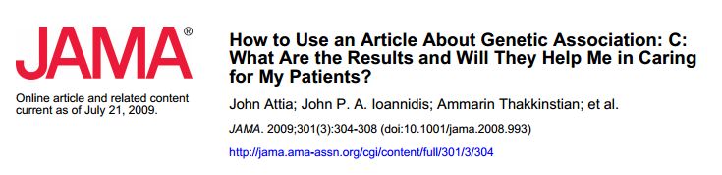
Reading #2: Thursday 4/3

Slide 26
Personalized Medicine
Alzheimer’s disease – ApoE (2,3,4)
Huntington’s disease (HTT)
Cystic fibrosis (CFTR)
Breast Cancer (BRCA1, BRCA2)
Warfarin sensitivity (VKORC)

Slide 27
Low Bone Mineral Density
Osteoporosis
Stress fracture
17 GWA studies
33,000 people total
56 loci identified
Developed a genetic signature based on combined score from all 56 loci.

Slide 28
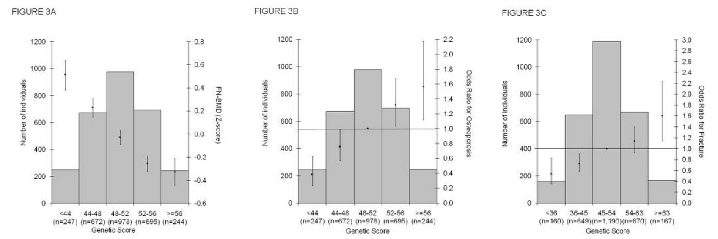
BMD/osteoporosis/fracture

Slide 29
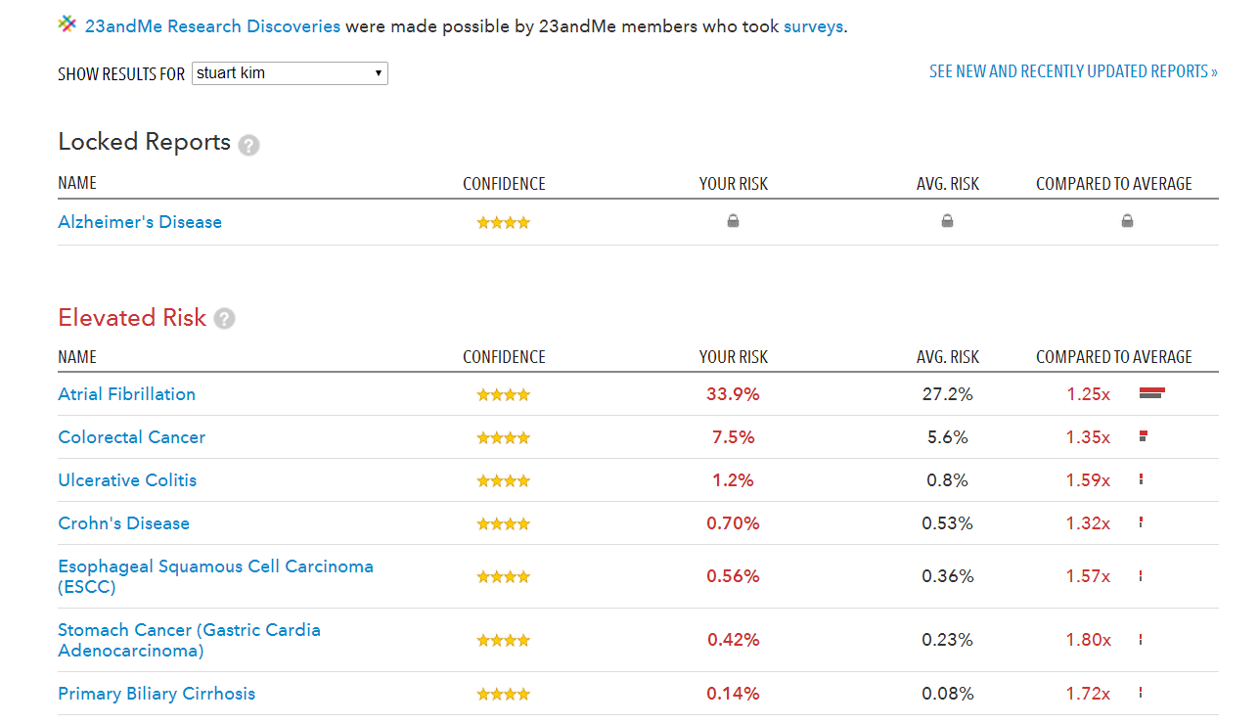

Slide 30
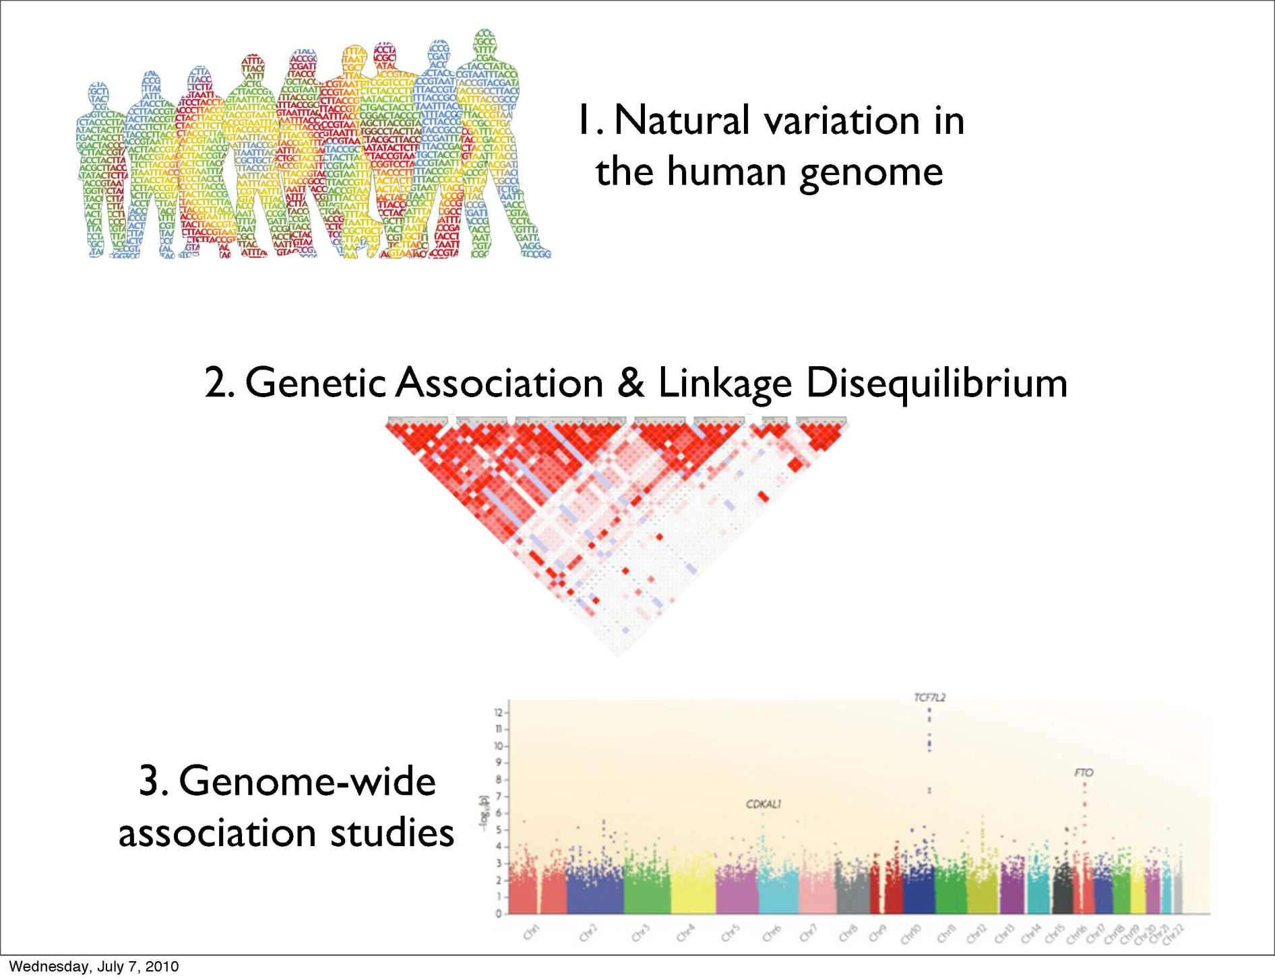

Slide 31
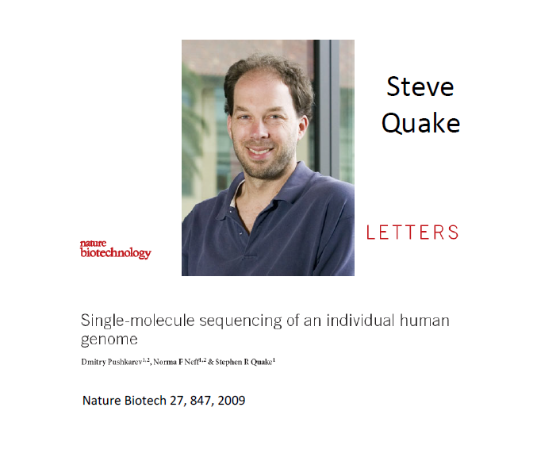

Slide 32
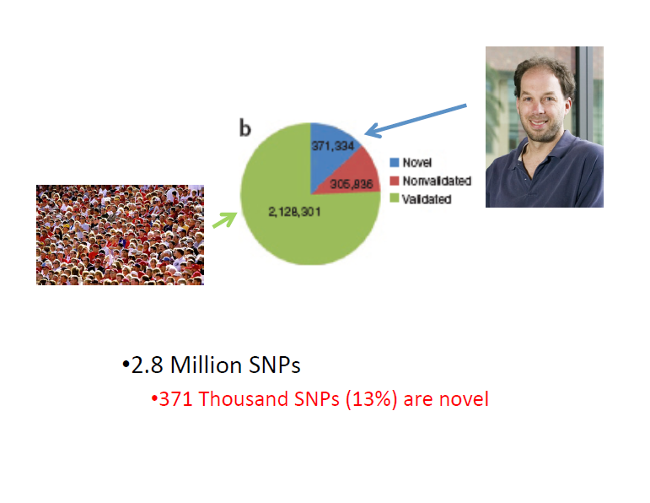

Slide 33
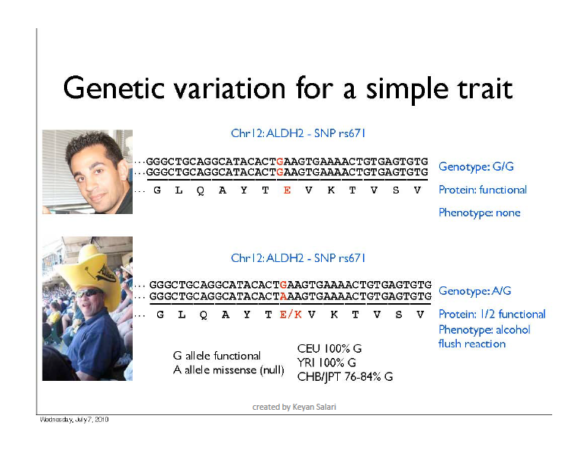

Slide 34
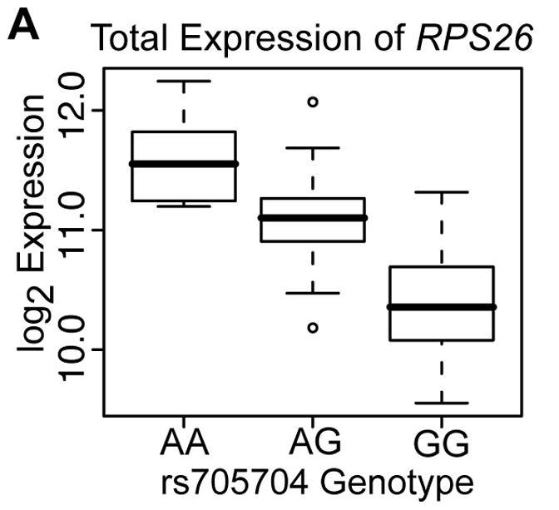
Some DNA variants affect expression

Slide 35
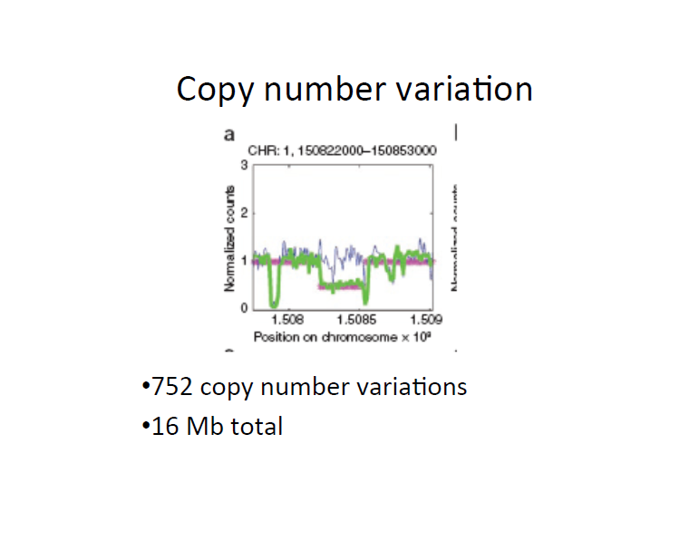
Notes:
Blue is similated
Green is real
Red is modelled

Slide 36
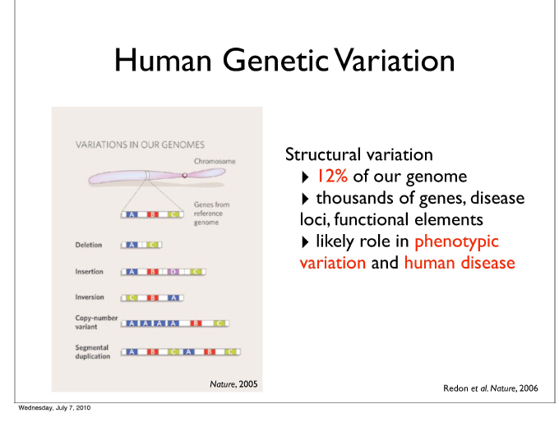

Slide 37
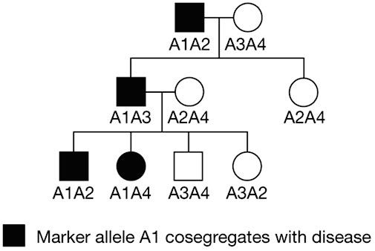

Slide 38
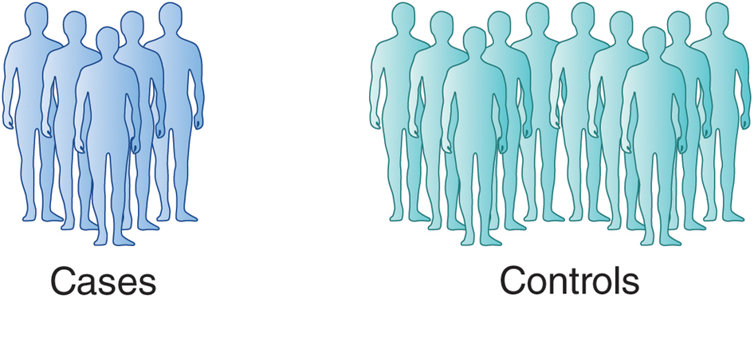
Genome Wide Association Studies
Genotype of SNPxxx
GGGGGGGGGGGGGGGGGGGGGGGGGGGGGGGGGGGGGGGGGGGGGGGGGGGGGGAAAAAAAAAAAAAAAAAAAA
Genotype of SNPxxx
GGGGGGGGGGGGGGGGGGAAAAAAAAAAAAAAAAAAAA
AAAAAAAAAAAAAAAAAAAA
AAAAAAAAAAAAAAAAAAAA
G is risk, A is protective

Slide 39
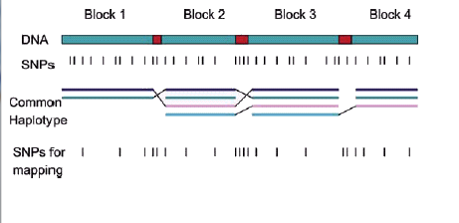

Slide 40
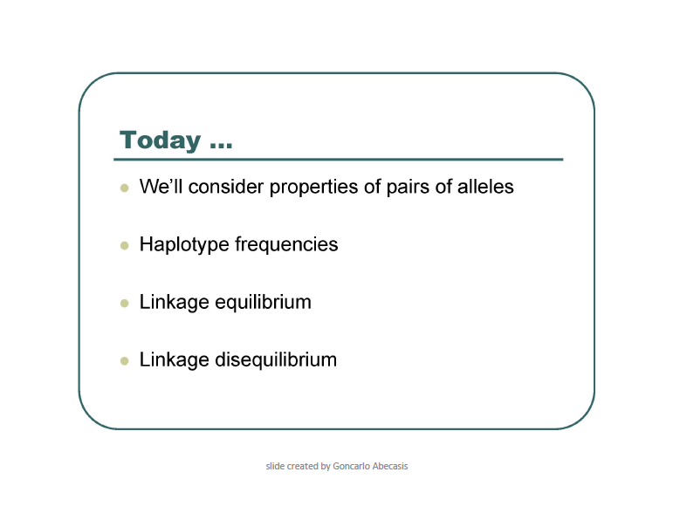

Slide 41
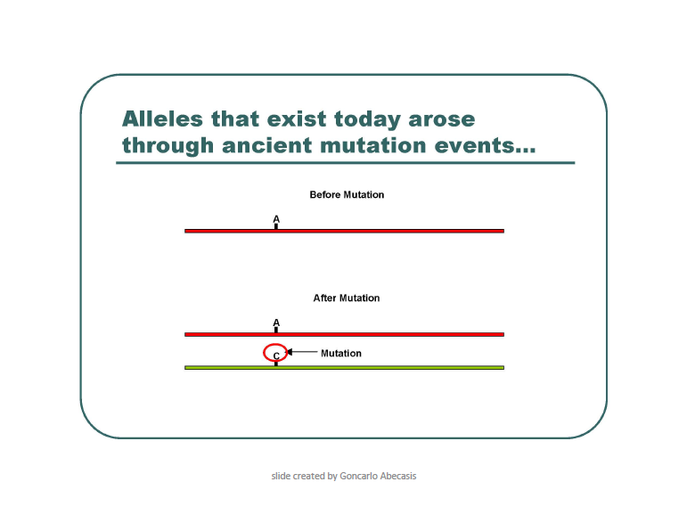

Slide 42
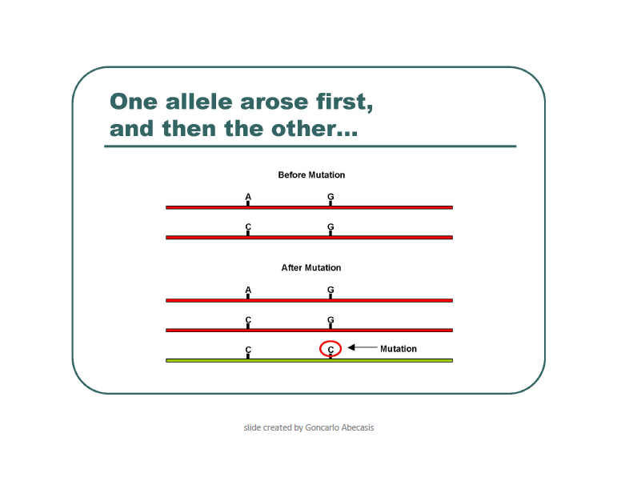

Slide 43
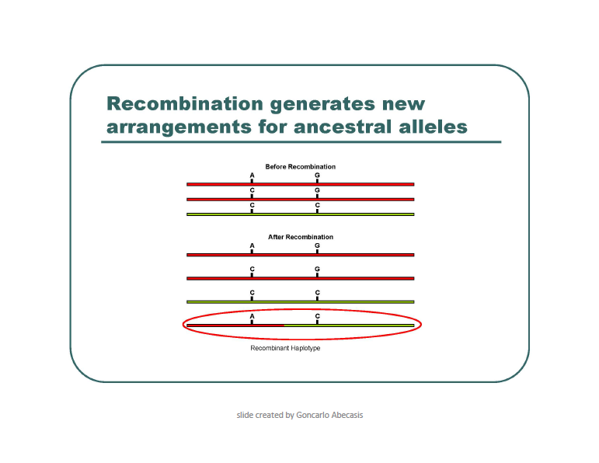

Slide 44
Genetic Linkage

Slide 45
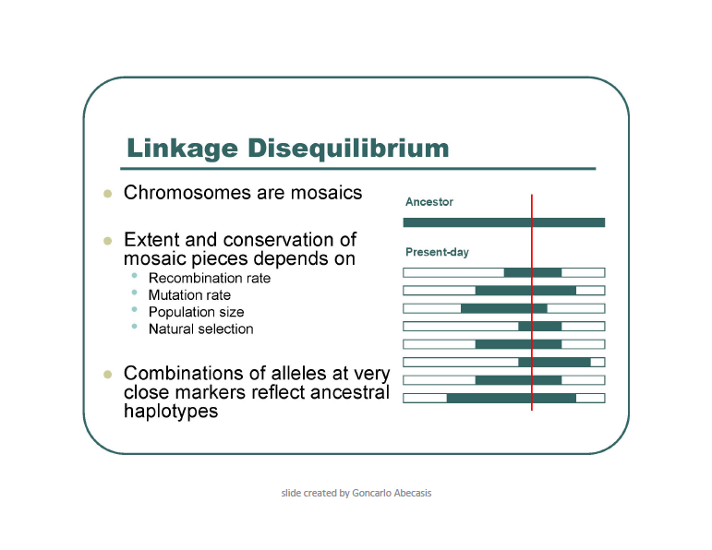

Slide 46
Terminology
Genotype frequency: The frequency of a particular genotype in the popolation; e.g. A/a B/b. If the SNPs segregate randomly, you can calculate this by multiplying each of the allele frequencies.
Linkage disequilibrium: If the SNPs segregate randomly, they are said to be in equilibrium. If they do not segregate randomly, they are in linkage disequilibrium.
Haplotype: a set of markers that co-segregate with each other.
abc or abc or ABC
abc ABC ABC
Phase: refers to whether the alleles are in cis or in trans.
ab or aB
AB Ab

Slide 47
Linkage
The correlation between two markers (R) is a way to measure their linkage.
R=1 indicates that the two markers are completely linked.
R=0 indicates that the two markers segregate randomly.
R² measures the loss of information when marker A is replaced by marker B.

Slide 48
Scenario 1

Slide 49
Scenario 2
A
G
Chrom 1
Chrom 2
C
G
First polymorphism
Second polymorphism
A
G
Chrom 1
Chrom 2
C
C

Slide 50
Scenario 1
SNP1 SNP2
A C Ancestral
C C derived SNP1
C G derived SNP2
A G recombinant (not observed)
Scenario 2
SNP1 SNP2
A C Ancestral
C G derived SNP1 and SNP2
C C haplotype 1
A G haplotype 2

Slide 51
Linkage
Go to http://genotation.stanford.edu/
Load your genome, race
Under “presentations”, run “genetic linkage, part 1”
Click “look up exercise”
Click “submit my information”
Using the allele frequencies from class, calculate the chance of someone having your genotype.
Compare the predicted genotype frequency to the observed genotype frequency in the class.
Discuss.
Repeat for parts 2 and 3. Discuss.

Slide 52
Data 1
rs6447271 3 AA 5 AG 20 GG
rs12426597 1 CC 9 CT 18 TT
How many rs6447271 (AA) ; rs12426597 (CT) would you expect if these loci are not linked?
rs6447271 (AA) = 3/28 total = .107
rs12426597 (CT) = 9/28 total = .321
rs6447271 (AA) ; rs12426597 (CT) = .107 x .321 = .034

Slide 53
What can we say about rs6447271 and rs12426597?
rs6447271, rs12426597
haplotype expected observed
AA CC ___ 0
AA CT ___ .04
AA TT ___ .07
AG CC ___ 0
AG CT ___ .04
AG TT ___ .14
GG CC ___ .04
GG CT ___ .25
GG TT ___ .43

