Slide 1
Linkage

Slide 2
Announcements
Problem set 1 is available for download. Due April 14.
class videos are available from a link on the schedule web page, and at https://med.stanford.edu/mediadropbox/courseListing.html?identifier=dbio220&cyyt=1156
Open up today’s lecture on powerpoint, there are tables to fill out.
Stuart Office Hours Monday 4-6 pm.

Slide 3
Class GWAS
Go to genotation.stanford.edu
Go to “traits”, then “GWAS”
Look up your SNPs
Fill out the table
Submit information

Slide 4
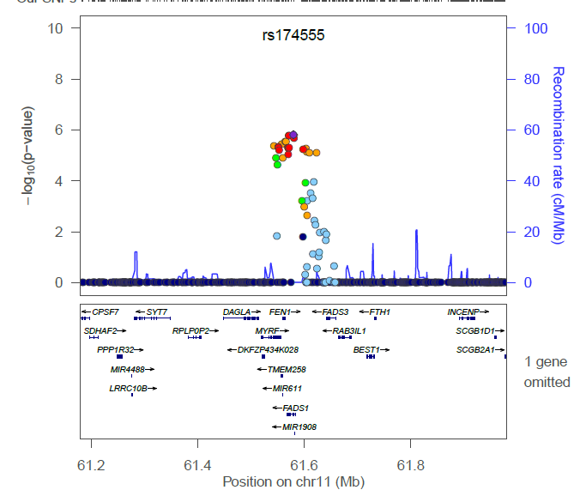

Slide 5
Terminology
Genotype frequency: The frequency of a particular genotype in the population; e.g. A/a B/b. If the SNPs segregate randomly, you can calculate this by multiplying each of the allele frequencies.
Linkage disequilibrium: If the SNPs segregate randomly, they are said to be in equilibrium. If they do not segregate randomly, they are in linkage disequilibrium.
Haplotype: a set of markers that co-segregate with each other.
abc or abc or ABC
abc ABC ABC
Phase: refers to whether the alleles are in cis or in trans.
ab or aB
AB Ab

Slide 6
Scenario 1
T
G
Chrom 1
Chrom 2
C
A
Scenario 2
T
G
C
A

Slide 7
Data 1 http://web.stanford.edu/class/gene210/web/html/schedule.html click on “LD Blocks exercise”
rs6447271 0 AA 15 AG 20 GG
rs12426597 0 CC 12 CT 23 TT
| rs12426597/rs6447271 | | | count | | | frequency
+---------------------- | --+ | ------ | -+ | ----------
| TT / GG | | | 13 | | | 0.37
| TT / AG | | | 10 | | | 0.29
| TT / AA | | | 0 | | | 0
| CT / GG | | | 7 | | | 0.2
| CT / AG | | | 5 | | | 0.14
| CT / AA | | | 0 | | | 0
| CC / GG | | | 0 | | | 0
| CC / AG | | | 0 | | | 0
| CC / AA | | | 0 | | | 0

Slide 8
Scenario 1 or 2?
Plan A:
Plan B:

Slide 9
Data 1 http://web.stanford.edu/class/gene210/web/html/schedule.html click on “LD Blocks exercise”
rs6447271 0 AA 15 AG 20 GG
rs12426597 0 CC 12 CT 23 TT
rs6447271 15A 55 G
rs12426597 12C 58 T
rs6447271 .21A .79 G
rs12426597 .17C .73 T

Slide 10
rs6447271 .21A .79 G
rs12426597 .17C .73 T
| rs12426597/rs6447271 | observed | expected | expected
| TT / GG | .37 | (2 * T) * (2*G)
| TT / AG | .28 | (2*T) * 2*(A*G)
| TT / AA | 0
| CT / GG | .20
| CT / AG | .14
| CT / AA | 0
| CC / GG | 0
| CC / AG | 0
| CC / AA | 0

Slide 11
Genetic Linkage 1
rs6447271
Chr. 4
rs12426597
Chr. 12

Slide 12
Data 2
rs1333049 8 GG 14 CG 6 CC
rs10757274 8 AA 12 AG 8 GG
| rs1333049/rs10757274 | count | frequency
| GG / AA | 7 | 0.25
| GG / AG | 1 | 0.04
| GG / GG | 0 | 0
| CG / AA | 1 | 0.04
| CG / AG | 11 | 0.39
| CG / GG | 2 | 0.07
| CC / AA | 0 | 0
| CC / AG | 0 | 0
| CC / GG | 6 | 0.21

Slide 13
rs1333049 .54G .46 C
rs10757274 .50A .50 G
| rs1333049/rs10757274 | frequency | expected | expected
| GG / AA | 0.25 | (G*G) * (A*A)
| GG / AG | 0.04 | (G*G) * 2 * (A*G)
| GG / GG | 0
| CG / AA | 0.04
| CG / AG | 0.39
| CG / GG | 0.07
| CC / AA | 0
| CC / AG | 0
| CC / GG | 0.21

Slide 14
Genetic Linkage 2
rs10757274
rs1333049
Chr. 9
29 kb
R² = .901

Slide 15
Data 3 rs17822931 .56C .44T rs4988235 .34A .66G
rs17822931/rs4988235 | frequency | expected
| TT / AA | 0.06
| TT / AG | 0
| TT / GG | 0.26
| CT / AA | 0.06
| CT / AG | 0.03
| CT / GG | 0.13
| CC / AA | 0.06
| CC / AG | 0.26
| CC / GG | 0.13

Slide 16
Genetic Linkage 3
Lactase, GG -> lactose intolerance
rs4988235
Chr. 2
Ear wax, TT-> dry earwax
rs17822931
Chr. 26

Slide 18
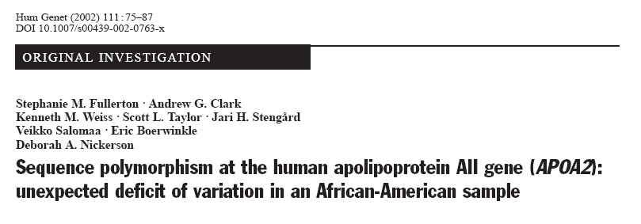
Sequence APOA2 in 72 people
Look at patterns of polymorphisms

Slide 19
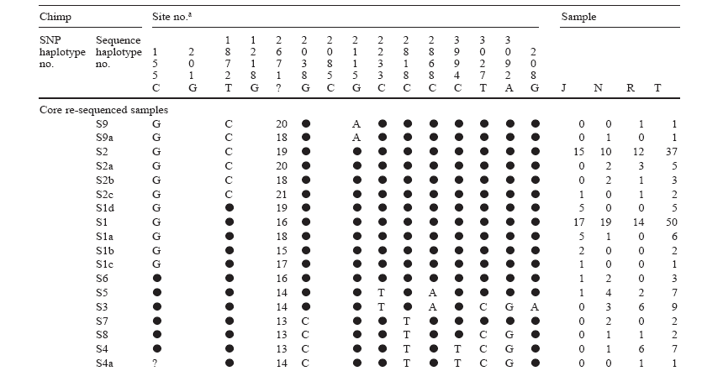
Find polymorphisms at these positions.
Reference sequence is listed.

Slide 20
Sequence of the first chromosome.
Circle is same as reference.

Slide 23
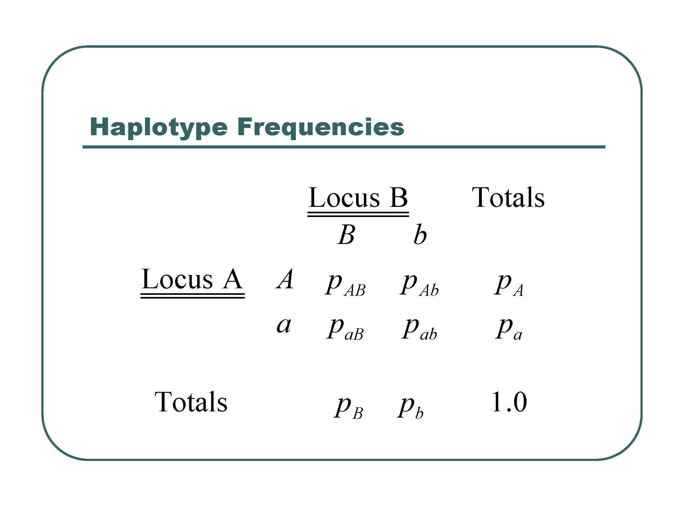

Slide 24
 | 2818 C | 2818 T
3027 T |  |  | .87 T alleles
3027 C |  |  | .13 C alleles
 | .92 C Allele | .08 T allele

Slide 25
Expected haplotype frequencies if unlinked
 | 2818 C | 2818 T
3027 T | .87 x .92 = .80 | .87 x .08 = .07 | .87 T alleles
3027 C | .13 x .92 = .12 | .13 x .08 = .02 | .13 C alleles
 | .92 C Allele | .08 T allele

Slide 26
Expected if unlinked
Observed
 | 2818 C | 2818 T
3027 T | .80 .86 | .07 .01 | .87 T alleles
3027 C | .12 .06 | .02 .07 | .13 C alleles
 | .92 C Allele | .08 T allele

Slide 27
R – correlation coefficient
P_{AB} – P_{A}P_{B}
R =
SQR(P_{A} x P_{a} x P_{B} x P_{b})

Slide 28
Calculate R
R = .86 – (.87)(.92) / SQR (.87 * .13 * .92 * .08)
= .06 / SQR (7.2 x 10⁻³)
= .06 / .085
= .706

Slide 29
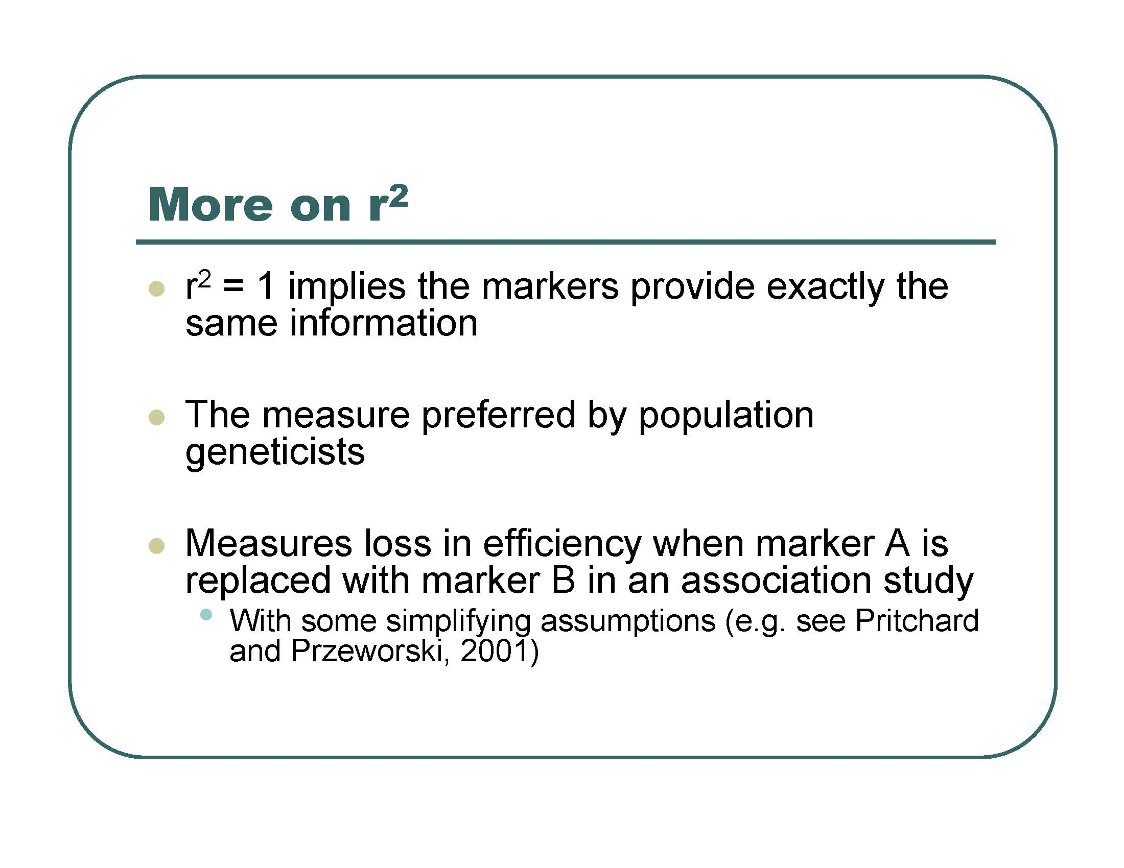

Slide 30
R² = 0.706²
= .497

Slide 31
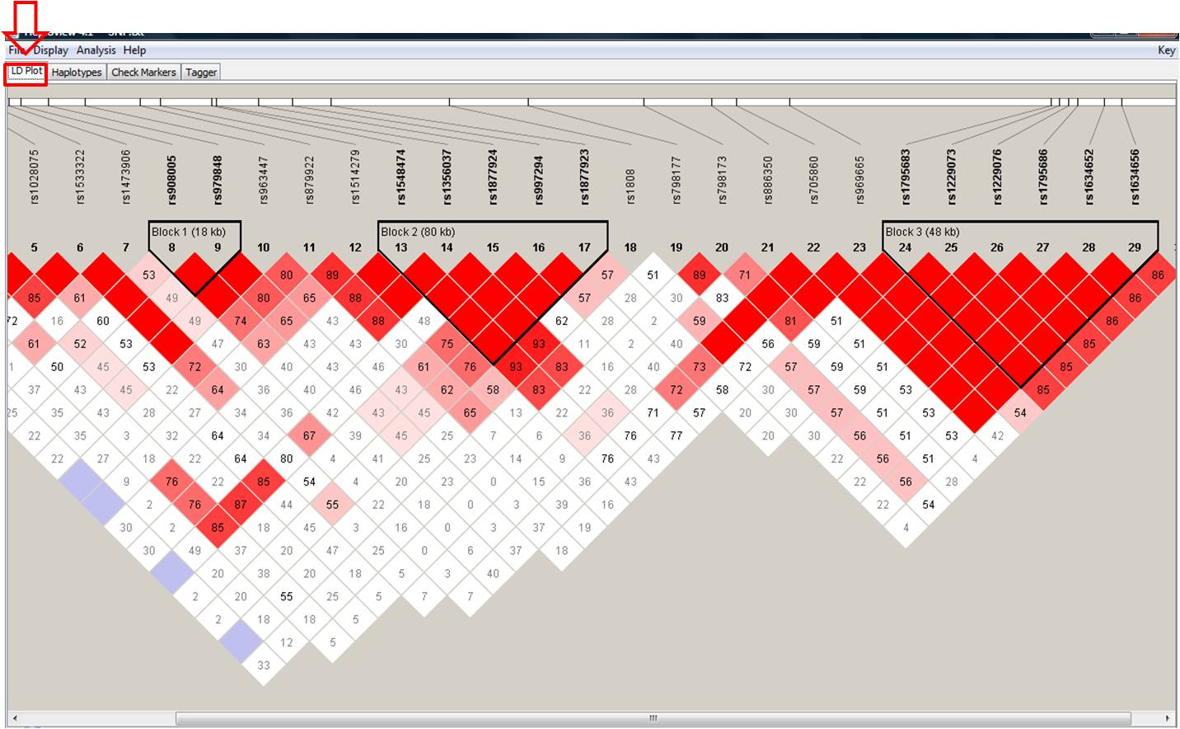
Haplotype blocks

Slide 32
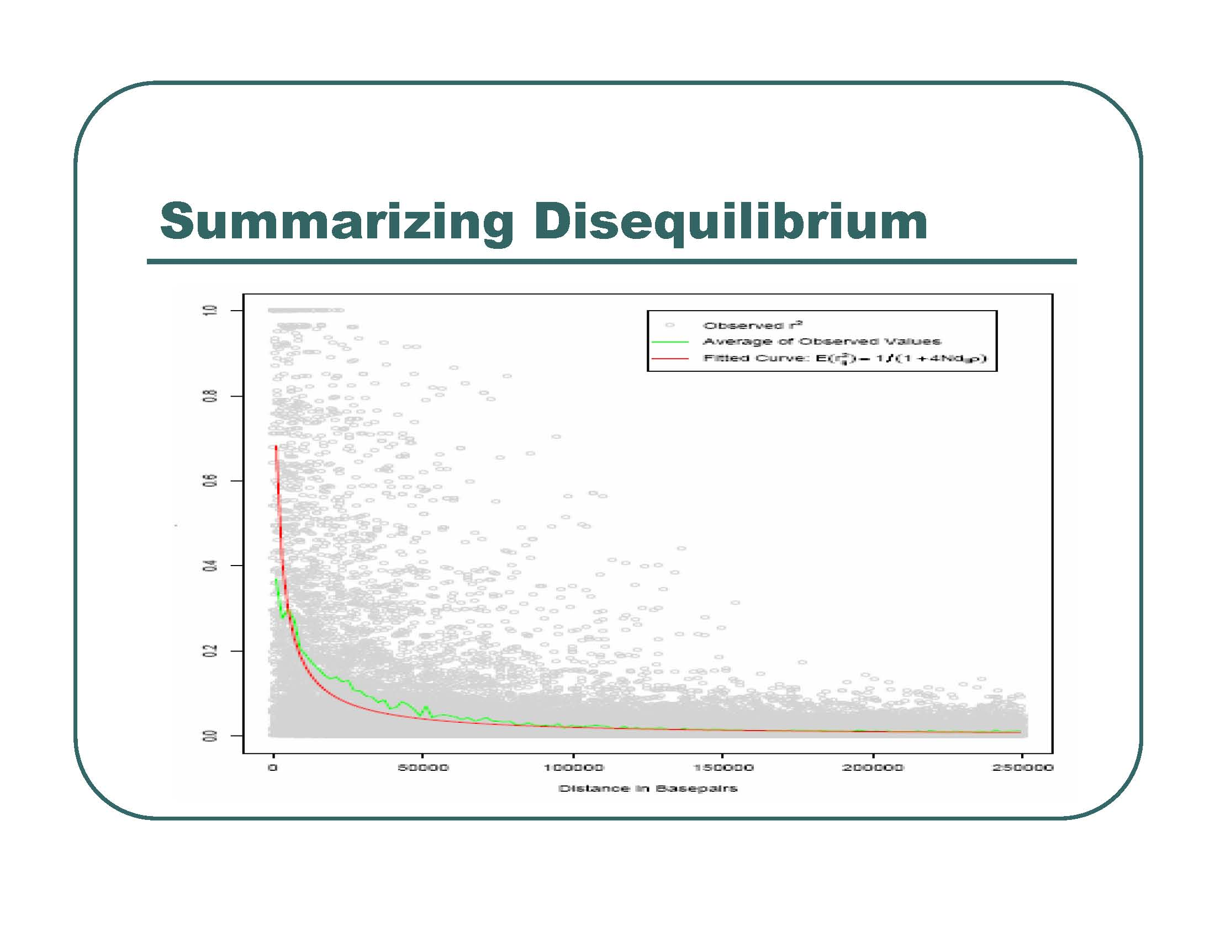

Slide 33
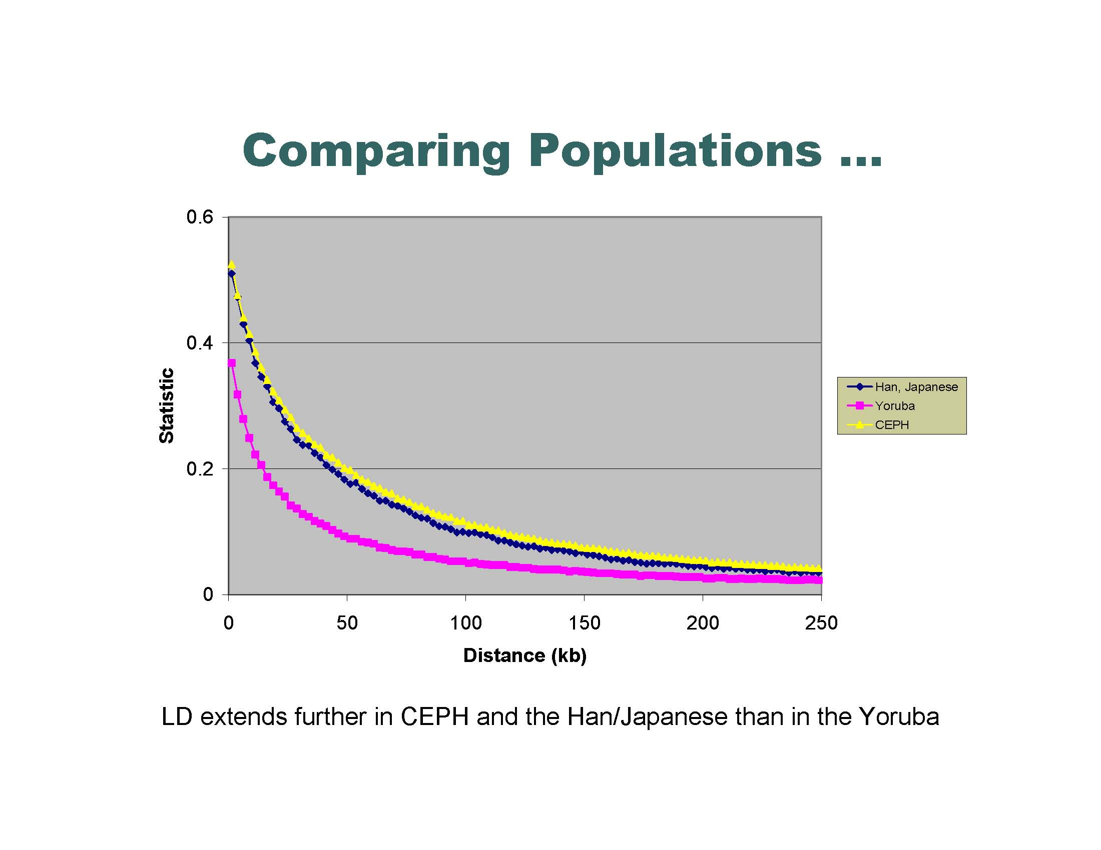

Slide 34
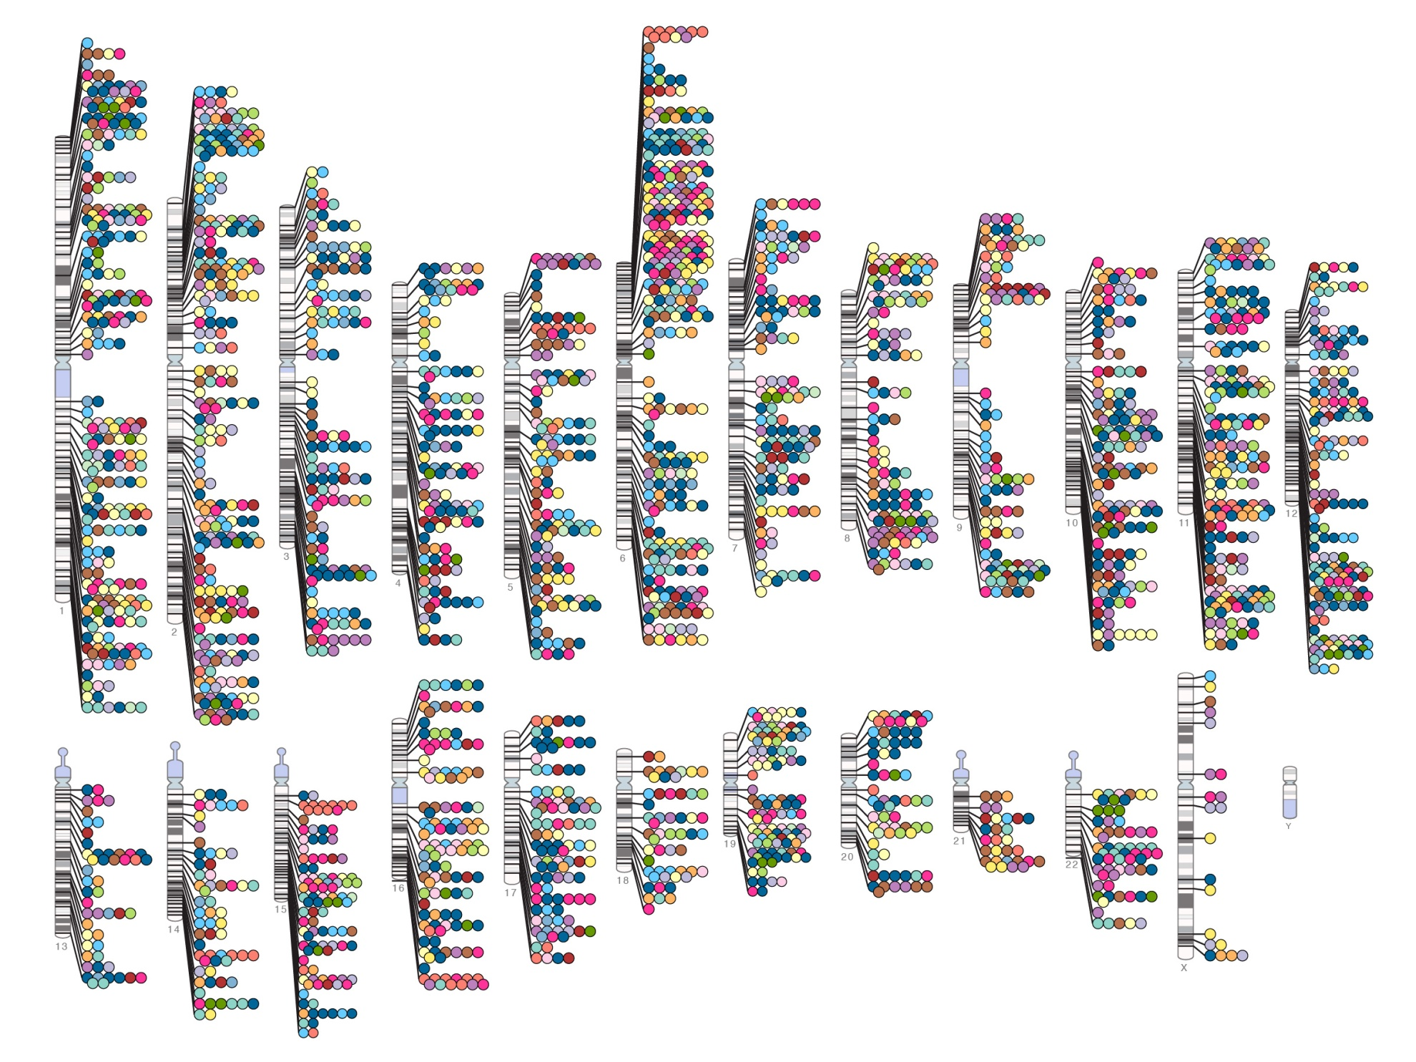
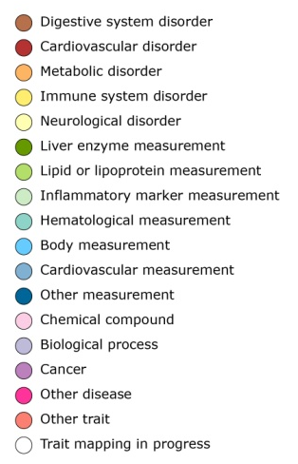

Published Genome-Wide Associations through 07/2012
Published GWA at p≤5X10⁻⁸ for 18 trait categories
NHGRI GWA Catalog
www.genome.gov/GWAStudies
www.ebi.ac.uk/fgpt/gwas/

Slide 35
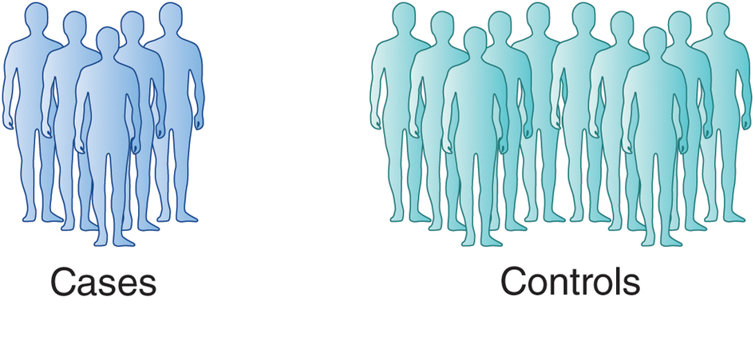
Genome Wide Association Studies
Genotype of SNPxxx
GGGGGGGGGGGGGGGGGGGGGGGGGGGGGGGGGGGGGGGGGGGGGGGGGGGGGGAAAAAAAAAAAAAAAAAAAA
Genotype of SNPxxx
GGGGGGGGGGGGGGGGGGAAAAAAAAAAAAAAAAAAAA
AAAAAAAAAAAAAAAAAAAA
AAAAAAAAAAAAAAAAAAAA
G is risk, A is protective

Slide 36
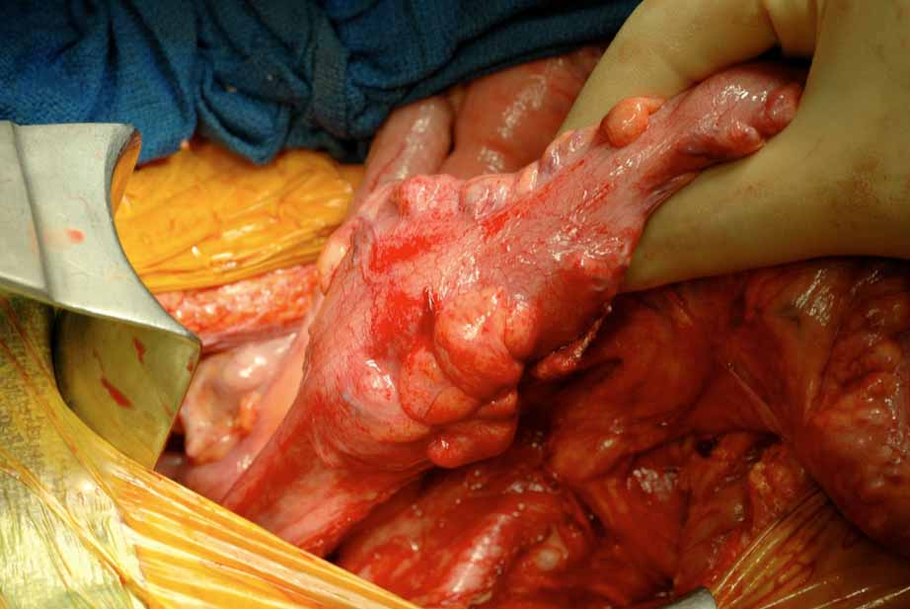
Colorectal cancer
1057 cases
960 controls
550K SNPs

Slide 37
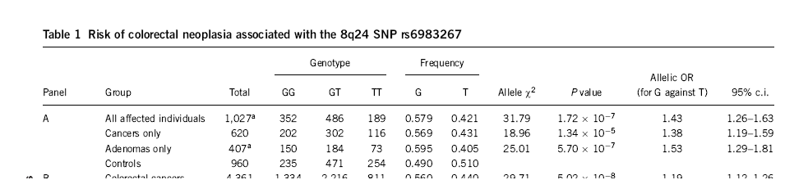
Colorectal cancer
data from rs6983267
Cancer: 0.57G 0.43T
controls: 0.49G 0.51T
1027 Colorectal cancer
960 controls

Slide 38
Cancer: 0.57G 0.43T
Are these different?
controls: 0.49G 0.51T
Chi squared

Slide 39
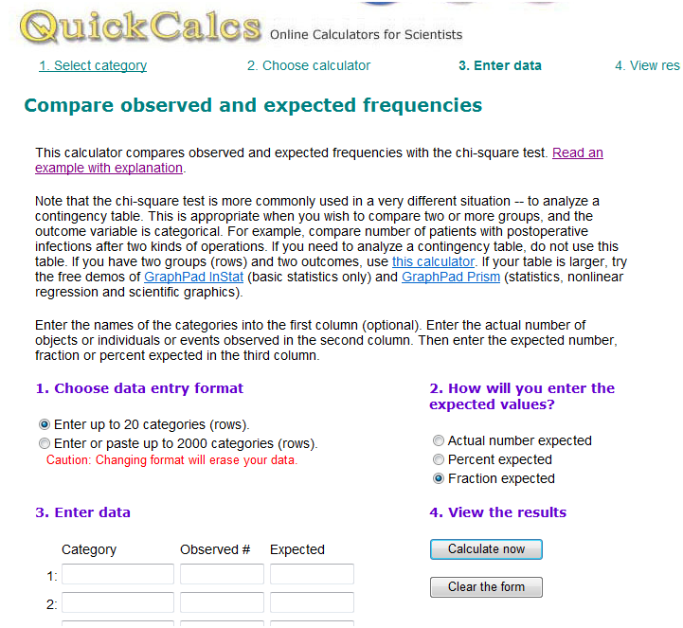
Chi squared http://www.graphpad.com/quickcalcs/chisquared1.cfm

Slide 40
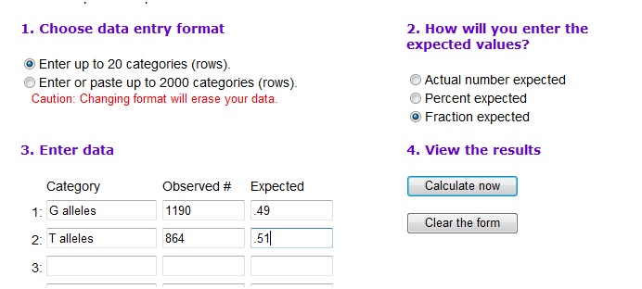
Chi squared
http://www.graphpad.com/quickcalcs/chisquared1.cfm
Chi squared = 31
P values = 10⁻⁷

Slide 41
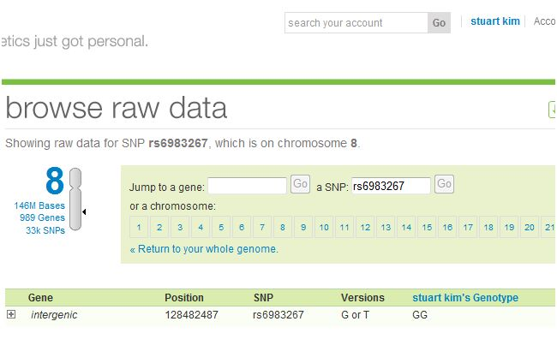
Stuart’s genotype
Homozygous bad allele ☹

Slide 42
Other models
Dominant: Assume G is dominant.
GG or GT vs TT
 | GG or GT | TT
Cases | 838 | 189
Controls | 706 | 254

Slide 43
Other models
Recessive: Assume G is recessive.
GG vs GT or TT
 | GG | GT or TT
Cases | 352 | 675
Controls | 235 | 725

Slide 44
Other models
additive: GG > GT > TT
Do linear regression 3 genotype x 2 groups

Slide 45
% cancer
TT
GT
GG
%cancer = β (genotype) + ε

Slide 46
Allelic odds ratio: ratio of the allele ratios in the cases divided by the allele ratios in the controls
How different is this SNP in the cases versus the controls?
Cancer .57 G/.43 T = 1.32
Control .49 G/ .51T = 0.96
Allelic Odds Ratio = 1.32/0.96 = 1.37

Slide 47
Allelic odds ratio*: ratio of the allele ratios in the cases divided by the allele ratio in the entire population
(need allele ratio from entire population to do this)
How different is this SNP in the cases versus everyone?

Slide 48
Likelihood ratio: What is the likelihood of seeing a genotype given the disease compared to the likelihood of seeing the genotype given no disease?
Increased Risk: What is the likelihood of seeing a trait given a genotype compared to overall likelihood of seeing the trait in the population?
Notes:
For GG genotype: 352/

Slide 49
Multiple hypothesis testing
“Of the 547,647 polymorphic tag SNPs, 27,673 showed an association with disease at P < .05.”
P = .05 means that there is a 5% chance for this to occur randomly.
If you try 100 times, you will get about 5 hits.
If you try 547,647 times, you should expect 547,647 x .05 = 27,382 hits.
So 27,673 (observed) is about the same as one would randomly expect.

Slide 50
Multiple hypothesis testing
“Of the 547,647 polymorphic tag SNPs, 27,673 showed an association with disease at P < .05.”
Here, have 547,647 SNPs = # hypotheses
False discover rate = q = p x # hypotheses. This is called the Bonferroni correction.
Want q = .05. This means a positive SNP has a .05 likelihood of rising by chance.
At q = .05, p = .05 / 547,647 = .91 x 10⁻⁷
This is the p value cutoff used in the paper.

Slide 51
Multiple hypothesis testing
“Of the 547,647 polymorphic tag SNPs, 27,673 showed an association with disease at P < .05.”
The Bonferroni correction is too conservative. It assumes that all of the tests are independent.
But the SNPs are linked in haplotype blocks, so there really are less independent hypotheses than SNPs.
Another way to correct is to permute the data many times, and see how many times a SNP comes up in the permuted data at a particular threshold.

Slide 52
Summary
Are the SNPs linked?
  Calculate Correlation
Is the SNP associated with a disease?
  Chi-squared
Is the SNP genome-wide significant?
  Correct for multiple hypothesis testing
How big is the effect of the SNP?
  Odds ratio, increased likelihood

