Slide 1
http://web.stanford.edu/class/gene210/files/lectures/2015/3%20GWASancestry.pptx

Slide 2
Height
Do “height” exercise in Genotation/traits/height
Fill out form.
Submit SNPs

Slide 3
SNPedia
The SNPedia website
  http://www.snpedia.com/index.php/SNPedia
A thank you from SNPedia
  http://snpedia.blogspot.com/2012/12/o-come-all-ye-faithful.html
Class website for SNPedia
  http://stanford.edu/class/gene210/web/html/projects.html
List of last years write-ups
  http://stanford.edu/class/gene210/archive/2012/projects_2014.html
How to write up a SNPedia entry
  http://stanford.edu/class/gene210/web/html/snpedia.html

Slide 4
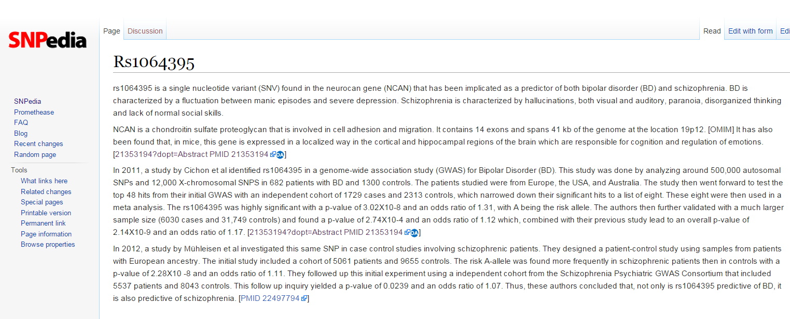

Slide 5
What should be in your SNPedia write-up?
Summarize the trait
Summarize the study
  How large was the cohort?
  How strong was the p-value?
  What was the OR, likelihood ratio or increased risk?
Which population?
What is known about the SNP?
  Associated genes?
  Protein coding?
  Allele frequency?
Does knowledge of the SNP affect diagnosis or treatment?

Slide 6
Summarize the trait
“BD is characterized by a fluctuation between manic episodes and severe depression. Schizophrenia is characterized by hallucinations, both visual and auditory, paranoia, disorganized thinking and lack of normal social skills.”

Slide 7
Summarize the study
How large was the cohort?
How strong was the p-value?
What was the OR, likelihood ratio or increased risk?
“This study was done by analyzing around 500,000 autosomal SNPs and 12,000 X-chromosomal SNPS in 682 patients with BD and 1300 controls.” “The rs1064395 was highly significant with a p-value of 3.02X10-8 and an odds ratio of 1.31, with A being the risk allele. ”

Slide 8
What is known about the SNP?
Associated genes?
What was the OR, likelihood ratio or increased risk?
“rs1064395 is a single nucleotide variant (SNV) found in the neurocan gene (NCAN) that has been implicated as a predictor of both bipolar disorder (BD) and schizophrenia. ”

Slide 9
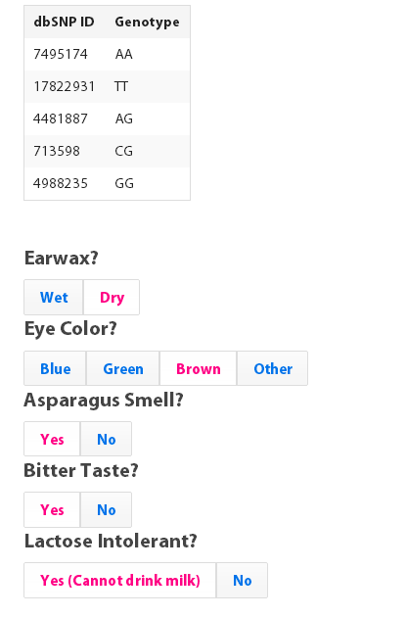
Class GWAS

Slide 10
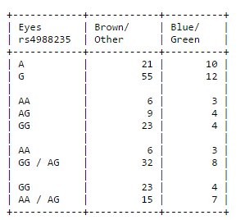
Class GWAS http://web.stanford.edu/class/gene210/web/html/exercises.html eye color data for rs4988235

Slide 11
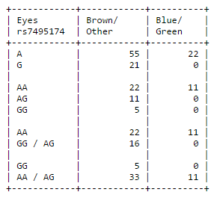
Class GWAS http://web.stanford.edu/class/gene210/web/html/exercises.html eye color data for rs7495174

Slide 12
eye color data for rs7495174
How do we calculate whether rs7495174 is associated with eye color?
What is the threshold for significance?
Later: odds ratio, increased likelihood

Slide 13
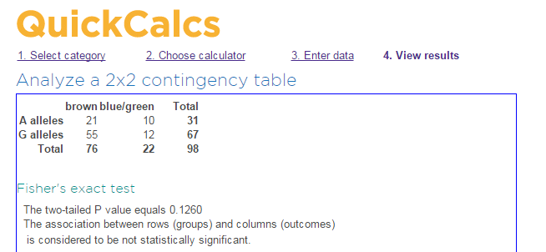
Is rs7495174 is associated with eye color??

Slide 14
Class GWAS
Calculate chi-squared for allelic differences in all five SNPs for one of these traits:
Earwax
Lactose intolerance
Eye color
Bitter taste
Asparagus smell

Slide 15
Class GWAS (n=98)
Allele p-values
 | rs4988235 | rs7495174 | rs713598 | rs17822931 | rs4481887
Earwax | .09 | .0001 | .27 | .001 | .62
Eyes | .12 | 0.003 | 0.015 | 0.144 | 0.42
Asparagus | .36 | .01 | .67 | .28 | .14
Bitter | .79 | .76 | .011 | .80 | .09
Lactose | .09 | 1.0 | 0.65 | 1.0 | 0.62

Slide 16
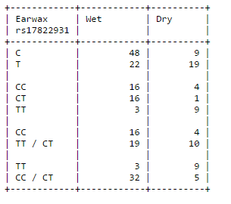
Class GWAS
3. genotype counts
T is a null allele in ABC11
T/T has dry wax. T/C and C/C have wet earwax usually.

Slide 17
Recessive model is best for earwax
rs17822931
Allelic p value = .0014
Genotype p value, T is dominant = 0.34
Genotype p value, T is recessive = .0001

Slide 18
3 genetic models
 | allelic | Dominant | Recessive
Earwax rs17822931 | P = .0014 | (T) P= .34 | (T) P = .0001
Eyes | .003 | (G) .0093 | (G) .57
Asparagus | .14 | (G) .48 | (A) .084
Bitter | .011 | (G) 0.000498 | 0.0565
Lactose | .09 | (G) 0.41 | 0.20

Slide 19
Class GWAS results
Lactose intolerance: rs4988235, GG associated with lactose intolerance
Eye color: rs7495174, AA associated with blue/green eyes
Bitter taste: rs713598, CC associated with inability to taste bitterness
Earwax: rs17822931, TT associated with dry earwax
Asparagus smell: rs4481887, A more likely to be able to smell asparagus than G

Slide 20
Allelic odds ratio: ratio of the allele ratios in the cases divided by the allele ratios in the controls
How different is this SNP in the cases versus the controls?
Wet wax C/T = 48/22 = 2.18
Dry wax C/T = 9/19 = .47
Allelic odds ratio = 2.18/.47
= 4.6
In 2014, OR was 10.9

Slide 21
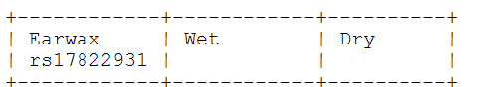
Increased Risk: What is the likelihood of seeing a trait given a genotype compared to overall likelihood of seeing the trait in the population?
Prior chance to have dry earwax
14 Dry/49 total students = .286
For TT genotype, chance is
9 Dry/12 students = .75
Increased risk for dry earwax for TT compared to prior:
.75/.286 = 2.6
Notes:
For GG genotype: 352/

Slide 22
Class GWAS
Odds Ratio, Increased Risk
 |  | P-value | OR | IR
Lactose Intolerance | rs4988235 | .09 | 2.7 | 1.2
Eye Color | rs7495174 | .0093 | 0 | inf
Asparagus | rs4481887 | .084 | 2.35 | 1.18
Bitter Taste | rs713598 | .000498 | 0.22 | 0.519
Earwax | rs17822931 | .004 | 4.6 | 2.6

