Slide 1
Height
Do “height” exercise in Genotation/traits/height
Fill out form.
Submit SNPs

Slide 2
SNPedia
The SNPedia website
  http://www.snpedia.com/index.php/SNPedia
A thank you from SNPedia
  http://snpedia.blogspot.com/2012/12/o-come-all-ye-faithful.html
Class website for SNPedia
  http://stanford.edu/class/gene210/web/html/projects.html
List of last years write-ups
  http://stanford.edu/class/gene210/archive/2012/projects_2014.html
How to write up a SNPedia entry
  http://stanford.edu/class/gene210/web/html/snpedia.html

Slide 3
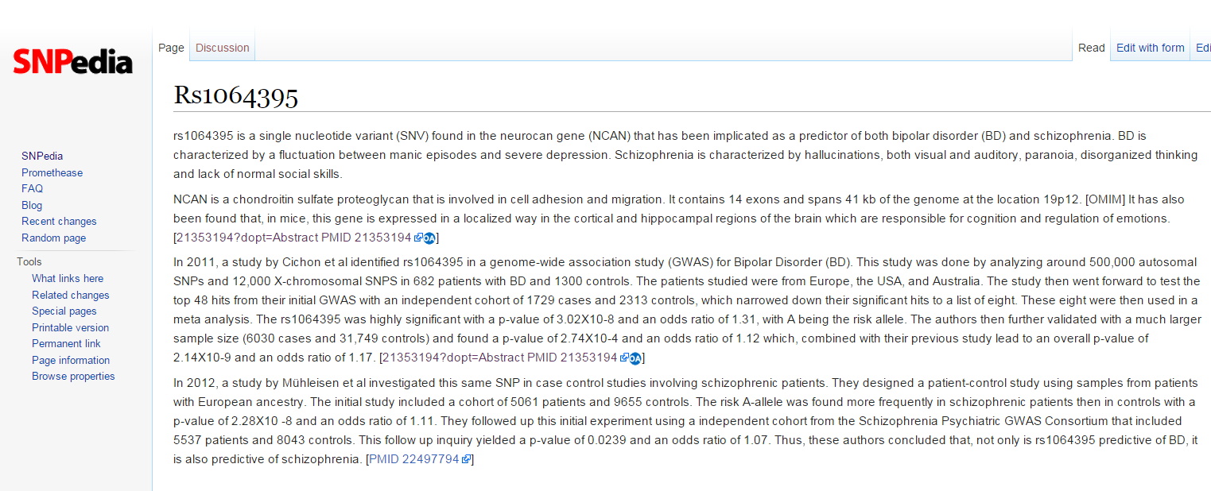

Slide 4
What should be in your SNPedia write-up?
Summarize the trait
Summarize the study
  How large was the cohort?
  How strong was the p-value?
  What was the OR, likelihood ratio or increased risk?
Which population?
What is known about the SNP?
  Associated genes?
  Protein coding?
  Allele frequency?
Does knowledge of the SNP affect diagnosis or treatment?

Slide 5
Summarize the trait
“BD is characterized by a fluctuation between manic episodes and severe depression. Schizophrenia is characterized by hallucinations, both visual and auditory, paranoia, disorganized thinking and lack of normal social skills.”

Slide 6
Summarize the study
How large was the cohort?
How strong was the p-value?
What was the OR, likelihood ratio or increased risk?
“This study was done by analyzing around 500,000 autosomal SNPs and 12,000 X-chromosomal SNPS in 682 patients with BD and 1300 controls.” “The rs1064395 was highly significant with a p-value of 3.02X10-8 and an odds ratio of 1.31, with A being the risk allele. ”

Slide 7
What is known about the SNP?
Associated genes?
What was the OR, likelihood ratio or increased risk?
“rs1064395 is a single nucleotide variant (SNV) found in the neurocan gene (NCAN) that has been implicated as a predictor of both bipolar disorder (BD) and schizophrenia. ”

Slide 8
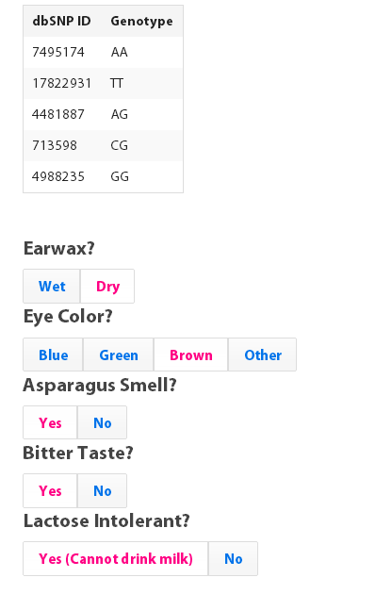
Class GWAS

Slide 9
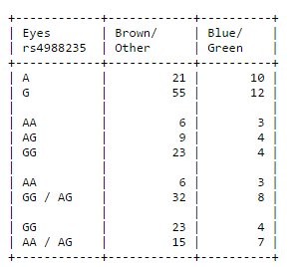
Class GWAS http://web.stanford.edu/class/gene210/web/html/exercises.html eye color data for rs4988235

Slide 10
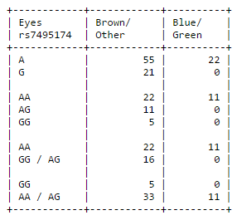
Class GWAS http://web.stanford.edu/class/gene210/web/html/exercises.html eye color data for rs7495174

Slide 11
eye color data for rs7495174
How do we calculate whether rs7495174 is associated with eye color?
What is the threshold for significance?
Later: odds ratio, increased likelihood

Slide 12
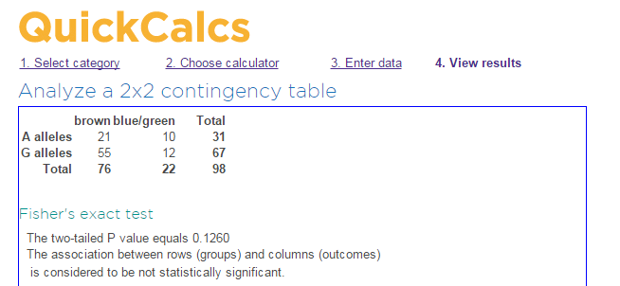
Is rs7495174 is associated with eye color??

Slide 13
Class GWAS
Calculate chi-squared for allelic differences in all five SNPs for one of these traits:
Earwax
Lactose intolerance
Eye color
Bitter taste
Asparagus smell

Slide 14
Class GWAS (n=98)
Allele p-values
 | rs4988235 | rs7495174 | rs713598 | rs17822931 | rs4481887
Earwax
Eyes | .12
Asparagus
Bitter
Lactose

Slide 15
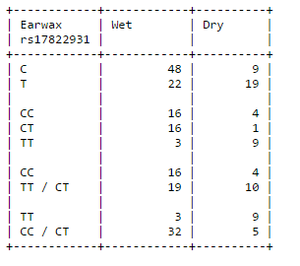
Class GWAS
3. genotype counts
T is a null allele in ABC11
T/T has dry wax. T/C and C/C have wet earwax usually.

Slide 16
Recessive model is best for earwax
rs17822931
Allelic p value = .0014
Genotype p value, T is dominant = 0.34
Genotype p value, T is recessive = .0001

Slide 17
3 genetic models
 | allelic | Dominant | Recessive
Earwax rs17822931 | P = .0014 | (T) P= .34 | (T) P = .0001
Eyes
Asparagus
Bitter
Lactose

Slide 18
Class GWAS results
Lactose intolerance: rs4988235, GG associated with lactose intolerance
Eye color: rs7495174, AA associated with blue/green eyes
Bitter taste: rs713598, CC associated with inability to taste bitterness
Earwax: rs17822931, TT associated with dry earwax
Asparagus smell: rs4481887, A more likely to be able to smell asparagus than G

Slide 19
Allelic odds ratio: ratio of the allele ratios in the cases divided by the allele ratios in the controls
How different is this SNP in the cases versus the controls?
Wet wax C/T = 48/22 = 2.18
Dry wax C/T = 9/19 = .47
Allelic odds ratio = 2.18/.47
= 4.6
In 2014, OR was 10.9

Slide 20
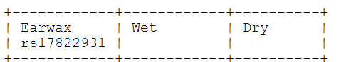
Increased Risk: What is the likelihood of seeing a trait given a genotype compared to overall likelihood of seeing the trait in the population?
Prior chance to have dry earwax
14 Dry/49 total students = .286
For TT genotype, chance is
9 Dry/12 students = .75
Increased risk for dry earwax for TT compared to prior:
.75/.286 = 2.6
Notes:
For GG genotype: 352/

Slide 21
Class GWAS
Odds Ratio, Increased Risk
 |  | P-value | OR | IR
Lactose Intolerance | rs4988235
Eye Color | rs7495174
Asparagus | rs4481887
Bitter Taste | rs713598
Earwax | rs17822931 |  | 4.6 | 2.6

Slide 22
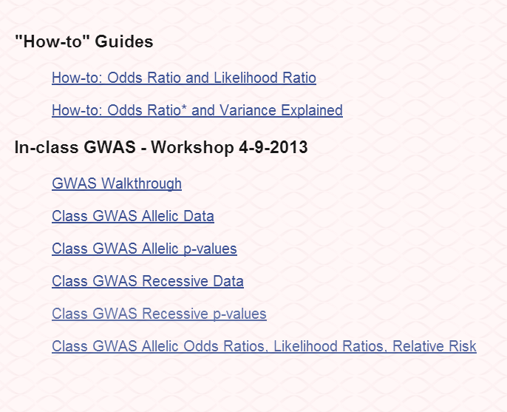
GWAS guides on genotation
http://www.stanford.edu/class/gene210/web/html/exercises.html

Slide 23
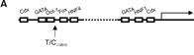
Lactose Intolerance
Rs4988235
Lactase Gene
A/G
A – lactase expressed in adulthood
G – lactase expression turns off in adulthood

Slide 24
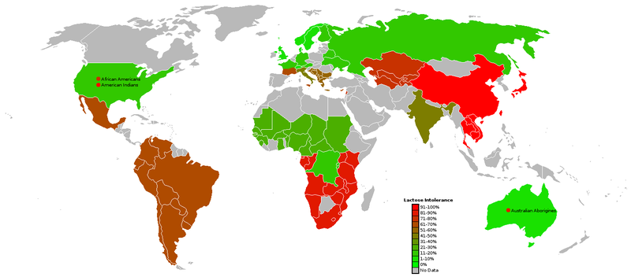
Lactose Intolerance

Slide 25
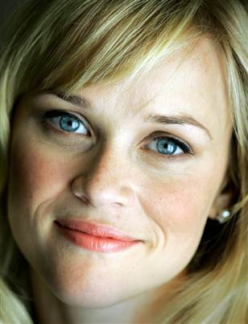
Eye Color
Rs7495174
In OCA2, the oculocutaneous albinism gene (also known as the human P protein gene).
Involved in making pigment for eyes, skin, hair.
accounts for 74% of variation in human eye color.
Rs7495174 leads to reduced expression in eye specifically.
Null alleles cause albinism

Slide 26
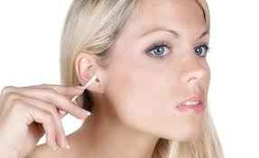
Ear Wax
Rs17822931
In ABCC11 gene that transports various molecules across extra- and intra-cellular membranes.
The T allele is loss of function of the protein.
Phenotypic implications of wet earwax: Insect trapping, self-cleaning and prevention of dryness of the external auditory canal.
Wet earwax: linked to axillary odor and apocrine colostrum.

Slide 27
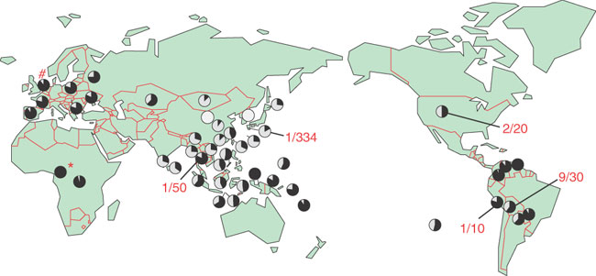
Ear Wax
Rs17822931
“the allele T arose in northeast Asia and thereafter spread through the world.”

Slide 28

Asparagus
Certain compounds in asparagus are metabolized to yield ammonia and various sulfur-containing degradation products, including various thiols and thioesters, which give urine a characteristic smell.
Methanethiol (pungent)
dimethyl sulfide (pungent)
dimethyl disulfide
bis(methylthio)methane
dimethyl sulfoxide (sweet aroma)
dimethyl sulfone (sweet aroma)
rs4481887 is in a region containing 39 olfactory receptors

Slide 29
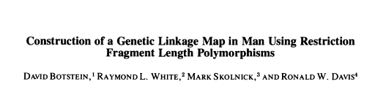
Genetic principles are universal
Am J Hum Genet. 1980 May;32(3):314-31.

Slide 30
Different genetics for different traits
Simple: Lactose tolerance, asparagus smell, photic sneeze
Complex: T2D, CVD
Same allele: CFTR,
Different alleles: BRCA1, hypertrophic cardiomyopathy

Slide 31
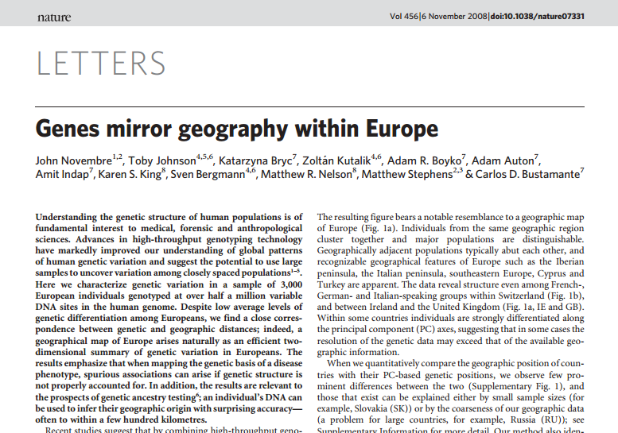

Slide 32
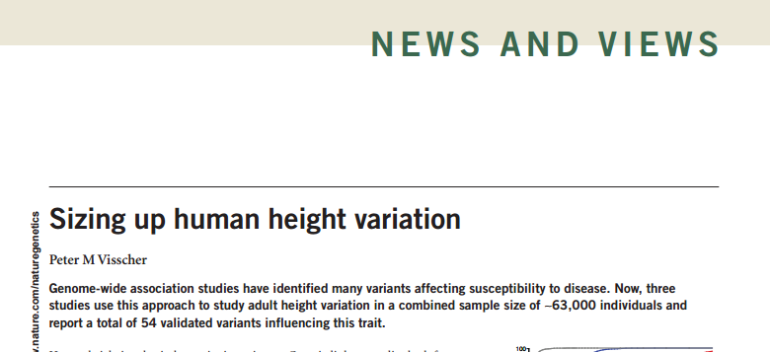

Slide 33
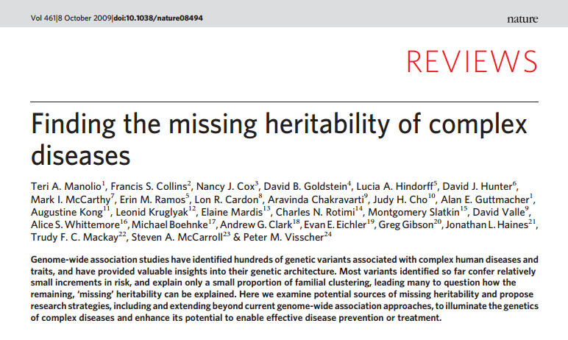

Slide 34
Ancestry
Go to Genotation, Ancestry, PCA (principle components analysis)
Load in genome.
Start with HGDP world
Resolution 10,000
PC1 and PC2
Then go to Ancestry, painting

Slide 35
Ancestry Analysis
people
10,000
1
1
AA
CC
etc
GG
TT
etc
AG
CT
etc
SNPs
We want to simplify this
10,000 people x 1M SNP matrix using a method called
Principle Component Analysis.
1M

Slide 36
PCA example
students
30
1
Eye color
Lactose intolerant
Asparagus
Ear Wax
Bitter taste
Sex
Height
Weight
Hair color
Shirt Color
Favorite Color
Etc.
simplify
Kinds of students
Body
types
100

Slide 37
Informative traits
Skin color eye color height weight sex hair length etc.
Uninformative traits
shirt color
Pants color
favorite toothpaste
favorite color
etc.
~SNPs informative for ancestry
~SNPs not informative for ancestry

Slide 38
PCA example
Skin Color
Eye color
Lactose intolerant
Asparagus
Ear Wax
Bitter taste
Sex
Height
Weight
Pant size
Shirt size
Hair color
Shirt Color
Favorite Color
Etc.
Skin color
Eye color
Hair color
Lactose intolerant
Ear Wax
Bitter taste
Sex
Height
Weight
Pant size
Shirt size
Asparagus
Shirt Color
Favorite Color
Etc.
RACE
Bitter taste
SIZE
Asparagus
Shirt Color
Favorite Color
Etc.
100
100
100

Slide 39
PCA example
Skin color
Eye color
Hair color
Lactose intolerant
Ear Wax
Bitter taste
Sex
Height
Weight
Pant size
Shirt size
Asparagus
Shirt Color
Favorite Color
Etc.
RACE
Bitter taste
SIZE
Asparagus
Shirt Color
Favorite Color
Etc.
Size = Sex + Height + Weight +
Pant size + Shirt size …
100
100

Slide 40
Ancestry Analysis
 | 1 | 2 | 3 | 4 | 5 | 6 | 7
Snp1 | A | A | A | A | A | A | T
Snp2 | G | G | G | G | G | G | G
Snp3 | A | A | A | A | A | A | T
Snp4 | C | C | C | T | T | T | T
Snp5 | A | A | A | A | A | A | G
Snp6 | G | G | G | A | A | A | A
Snp7 | C | C | C | C | C | C | A
Snp8 | T | T | T | G | G | G | G
Snp9 | G | G | G | G | G | G | T
Snp10 | A | G | C | T | A | G | C
Snp11 | T | T | T | T | T | T | C
Snp12 | G | C | T | A | A | G | C

Slide 41
Reorder the SNPs
 | 1 | 2 | 3 | 4 | 5 | 6 | 7
Snp1 | A | A | A | A | A | A | T
Snp3 | A | A | A | A | A | A | T
Snp5 | A | A | A | A | A | A | G
Snp7 | C | C | C | C | C | C | A
Snp9 | G | G | G | G | G | G | T
Snp11 | T | T | T | T | T | T | C
Snp2 | G | G | G | G | G | G | G
Snp4 | C | C | C | T | T | T | T
Snp6 | G | G | G | A | A | A | A
Snp8 | T | T | T | G | G | G | G
Snp10 | A | G | C | T | A | G | C
Snp12 | G | C | T | A | A | G | C

Slide 42
Ancestry Analysis
 | 1 | 2 | 3 | 4 | 5 | 6 | 7
Snp1 | A | A | A | A | A | A | T
Snp3 | A | A | A | A | A | A | T
Snp5 | A | A | A | A | A | A | G
Snp7 | C | C | C | C | C | C | A
Snp9 | G | G | G | G | G | G | T
Snp11 | T | T | T | T | T | T | C
Snp4 | C | C | C | T | T | T | T
Snp6 | G | G | G | A | A | A | A
Snp8 | T | T | T | G | G | G | G
Snp2 | G | G | G | G | G | G | G
Snp10 | A | G | C | T | A | G | C
Snp12 | G | C | T | A | A | G | C

Slide 43
Ancestry Analysis
 | 1 | 2 | 3 | 4 | 5 | 6 | 7
Snp1 | A | A | A | A | A | A | T
Snp3 | A | A | A | A | A | A | T
Snp5 | A | A | A | A | A | A | G
Snp7 | C | C | C | C | C | C | A
Snp9 | G | G | G | G | G | G | T
Snp11 | T | T | T | T | T | T | C
 | 1-6 | 7
Snp1 | A | T
Snp3 | A | T
Snp5 | A | G
Snp7 | C | A
Snp9 | G | T
Snp11 | T | C
 | 1
Snp1 | A
Snp3 | A
Snp5 | A
Snp7 | C
Snp9 | G
Snp11 | T
 | 7
Snp1 | T
Snp3 | T
Snp5 | G
Snp7 | A
Snp9 | T
Snp11 | C
=X
=x

Slide 44
Ancestry Analysis
 | 1 | 2 | 3 | 4 | 5 | 6 | 7
Snp1 | A | A | A | A | A | A | T
Snp3 | A | A | A | A | A | A | T
Snp5 | A | A | A | A | A | A | G
Snp7 | C | C | C | C | C | C | A
Snp9 | G | G | G | G | G | G | T
Snp11 | T | T | T | T | T | T | C
 | M | N
PC1 | X | x

Slide 45
Ancestry Analysis
 | 1 | 2 | 3 | 4 | 5 | 6 | 7
Snp4 | C | C | C | T | T | T | T
Snp6 | G | G | G | A | A | A | A
Snp8 | T | T | T | G | G | G | G
 | 1-3 | 4-7
Snp4 | C | T
Snp6 | G | A
Snp8 | T | G
 | 1-3
Snp4 | C
Snp6 | G
Snp8 | T
 | 4-7
Snp4 | T
Snp6 | A
Snp8 | G
=Y
=y
 | 1-3 | 4-7
PC2 | Y | y

Slide 46
Ancestry Analysis
 | 1 | 2 | 3 | 4 | 5 | 6 | 7
PC1 | X | X | X | X | X | X | x
PC2 | Y | Y | Y | y | y | y | y
Snp2 | G | G | G | G | G | G | G
Snp10 | A | G | C | T | A | G | C
Snp12 | G | C | T | A | A | G | C
 | 1-3 | 4-6 | 7
PC1 | X | X | x
PC2 | Y | y | y
Snp2
Snp10
Snp12

Slide 47
PC1 and PC2 inform about ancestry
 | 1-3 | 4-6 | 7
PC1 | X | X | x
PC2 | Y | y | y
Snp2 | G | G | G
Snp10 | A | T | C
Snp12 | G | A | C

Slide 48
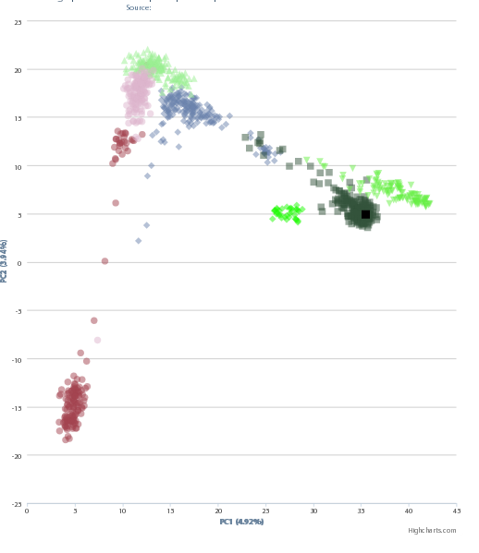
Ancestry PCA

Slide 49
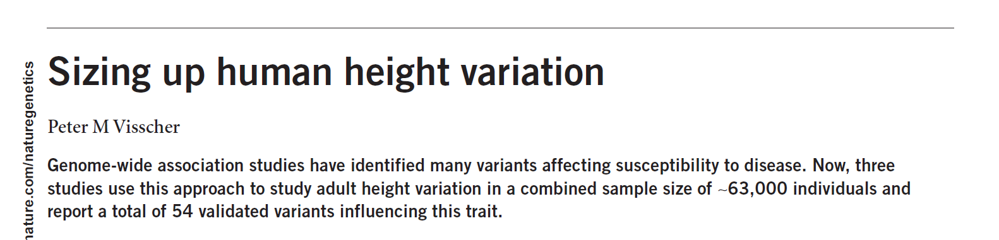
Complex traits: height heritability is 80%
NATURE GENETICS | VOLUME 40 | NUMBER 5 | MAY 2008

Slide 50
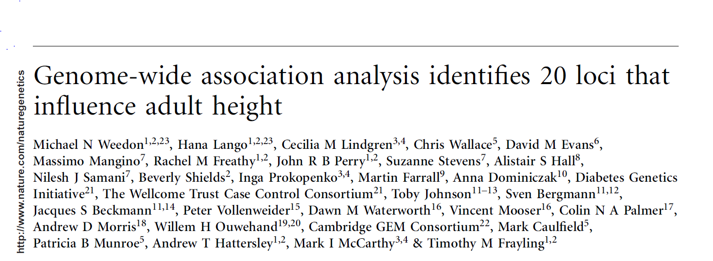
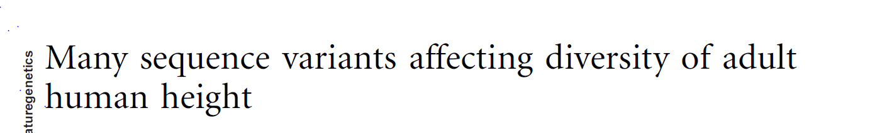
63K people
54 loci
~5% variance explained.
NATURE GENETICS VOLUME 40 [ NUMBER 5 [ MAY 2008
Nature Genetics VOLUME 42 | NUMBER 11 | NOVEMBER 2010

Slide 51
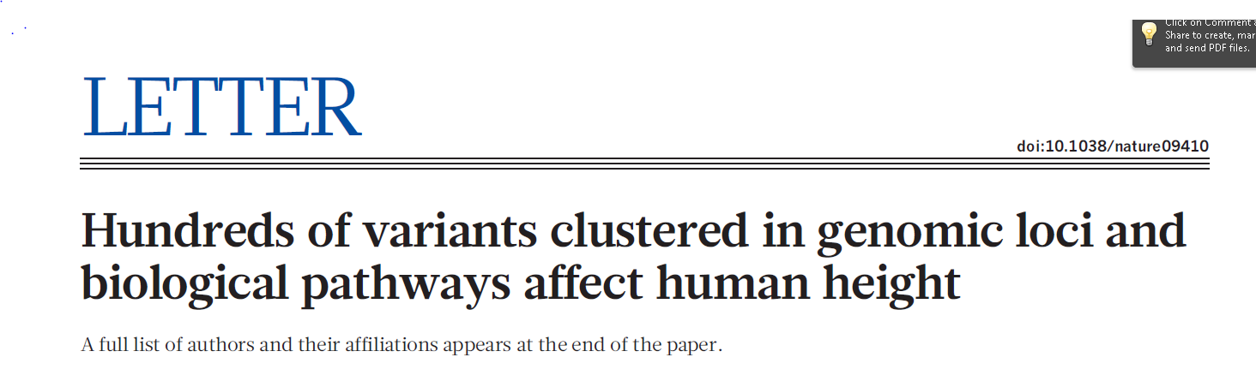
832 | NATURE | VOL 467 | 14 OCTOBER 2010
183K people
180 loci
~10% variance explained

Slide 52
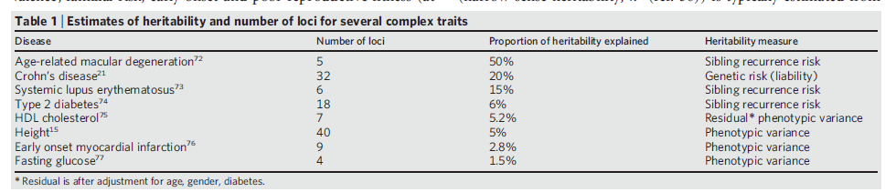
Missing Heritability

Slide 53
Where is the missing heritability?
Lots of minor loci
Rare alleles in a small number of loci
Gene-gene interactions
Gene-environment interactions

Slide 54
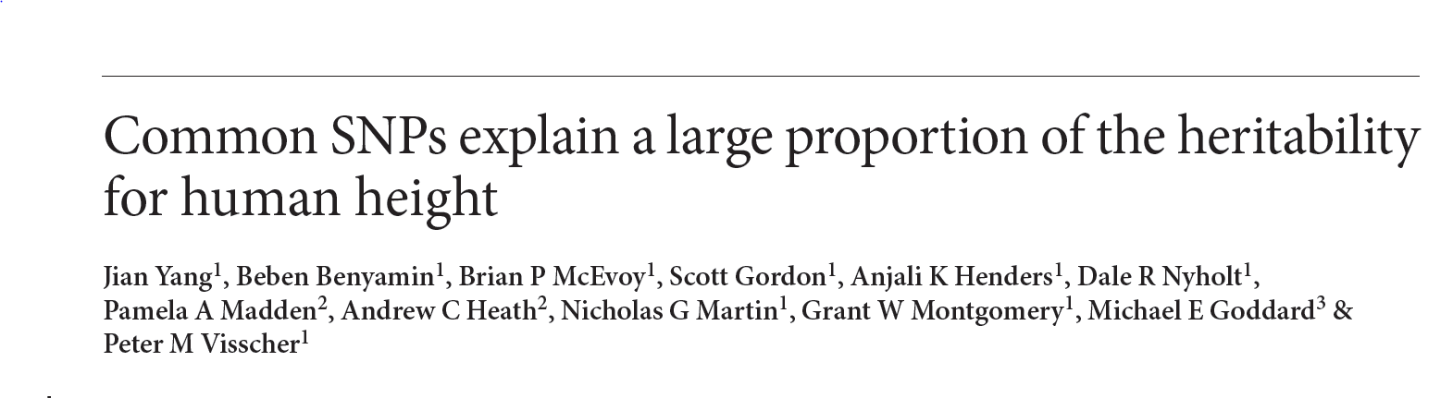
Nature Genetics VOLUME 42 | NUMBER 7 | JULY 2010

Slide 55
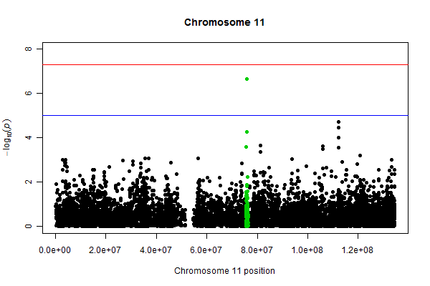

Slide 56
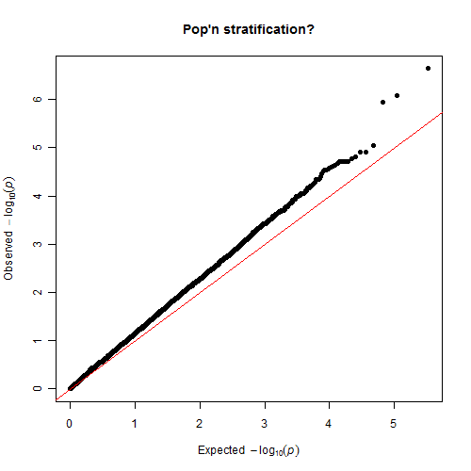
Q-Q plot for human height
This approach explains 45% variance in height.

Slide 57
Rare alleles
Cases
Controls
You wont see the rare alleles unless you sequence
Each allele appears once, so need to aggregate alleles in the same gene in order to do statistics.

Slide 58
Gene-Gene
A
B
C
diabetes
D
E
F
A⁻ not affected
D⁻ not affected
A⁻ D⁻ affected
A⁻ E⁻ affected
A⁻ F⁻ affected
A⁻ B⁻ not affected
D⁻ E⁻ not affected

Slide 59
Gene-environment
Height gene that requires eating meat
Lactase gene that requires drinking milk
These are SNPs that have effects only under certain environmental conditions

