Slide 1
Tue 4/14 and Thur 4/16
Bone mineral density/osteoporosis
Chronic kidney disease
Longevity
Type 2 diabetes
Who done it?

Slide 2
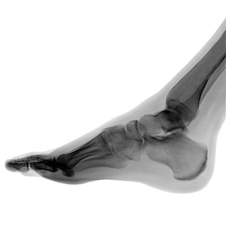
Stress Fracture
A stress fracture is one type of incomplete fracture in bones. It is caused by "unusual or repeated stress" and also heavy continuous weight on the ankle or leg. This is in contrast to other types of fractures, which are usually characterized by a solitary, severe impact.
It could be described as a very small sliver or crack in the bone; this is why it is sometimes dubbed "hairline fracture".

Slide 3

Stress fracture is a common sports injury, and most cases are associated with athletics.

Slide 4
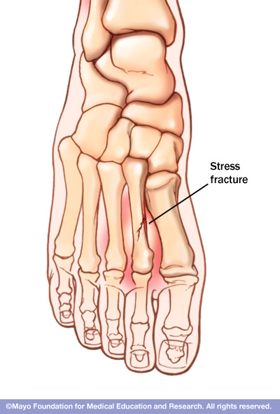
The most common sites of stress fractures are the second and third metatarsals of the foot. Stress fractures are also common in the heel (calcaneus), the outer bone of the lower leg (fibula), and the navicular, a bone on the top of the midfoot.

Slide 5
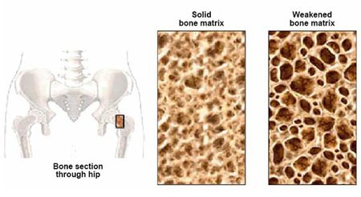
We all lose some bone mass as we age. Bones naturally become thinner (called osteopenia) as you grow older, because existing bone is broken down faster than new bone is made. As this occurs, our bones lose calcium and other minerals and become lighter, less dense, and more porous. This makes the bones weaker and increases the chance that they might break (fracture).

Slide 6
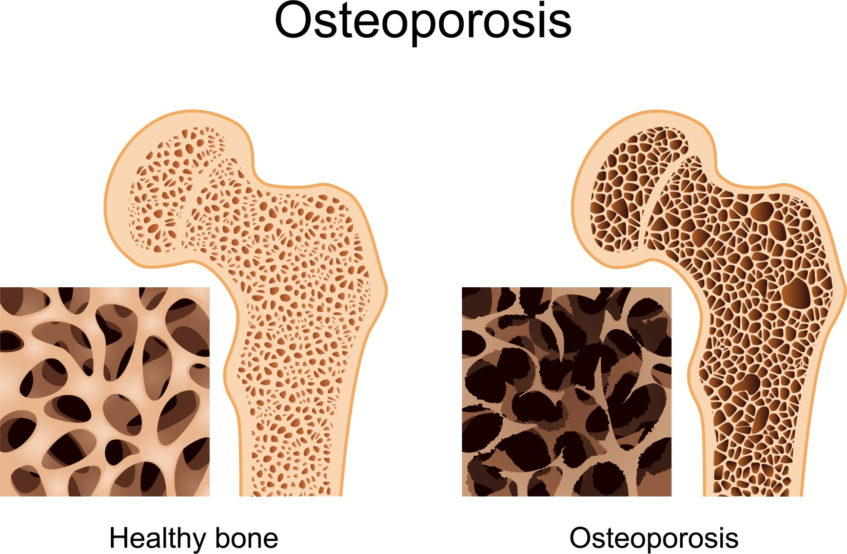
Bone is living tissue, which is constantly being absorbed and replaced. Osteoporosis occurs when the creation of new bone doesn't keep up with the removal of old bone.
White and Asian women — especially those who are past menopause — are at highest risk.

Slide 7
Osteoporosis symptoms
Back pain, caused by a fractured or collapsed vertebra
Loss of height over time
A stooped posture
A bone fracture that occurs much more easily than expected

Slide 8
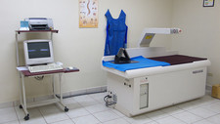
Dxa scan
Dual-energy X-ray absorptiometry (DXA) is a technique used to measure bone mineral density. Two X-ray beams of different energy levels are aimed at a patient’s bones to determine BMD.

Slide 9
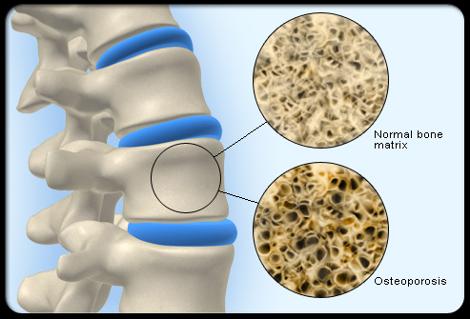
Low bone mass (medically termed osteopenia): A BMD defines osteopenia as a T-score between -1 and -2.5. This signifies an increased fracture risk but does not meet the criteria for osteoporosis.
Osteoporosis: A BMD greater than 2.5 standard deviations from the normal (T score less than or equal to -2.5) defines osteoporosis.

Slide 10
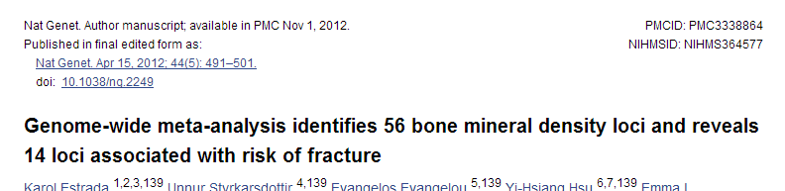
Meta-analysis of 17 GWA studies
Phenotypes
  Femoral neck bone mineral density (cases n=32,961; controls ~100K)
  Lumbar spine bone mineral density (cases n=31,800 ; controls ~100K)
2.5 million SNPs
56 SNPs are genome-wide significant (p < 5 x 10⁻⁸)

Slide 11
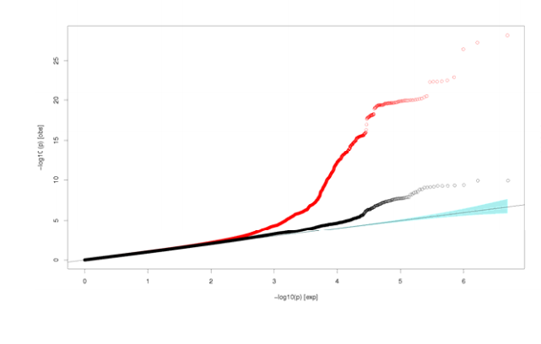
Femoral neck Quantile‐quantile (Q‐Q) plots.
(All analyzed HapMap CEU imputed SNPs passing quality control criteria in the studies (red dots) and after adjustment for 82 SNPs selected for replication(black dots).

Slide 12
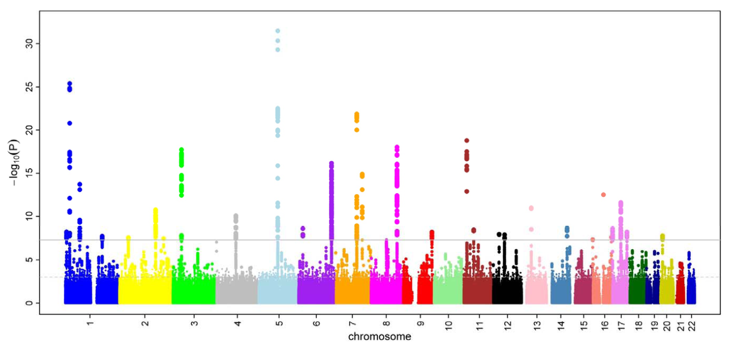
Femoral neck BMD Manhattan plot

Slide 13
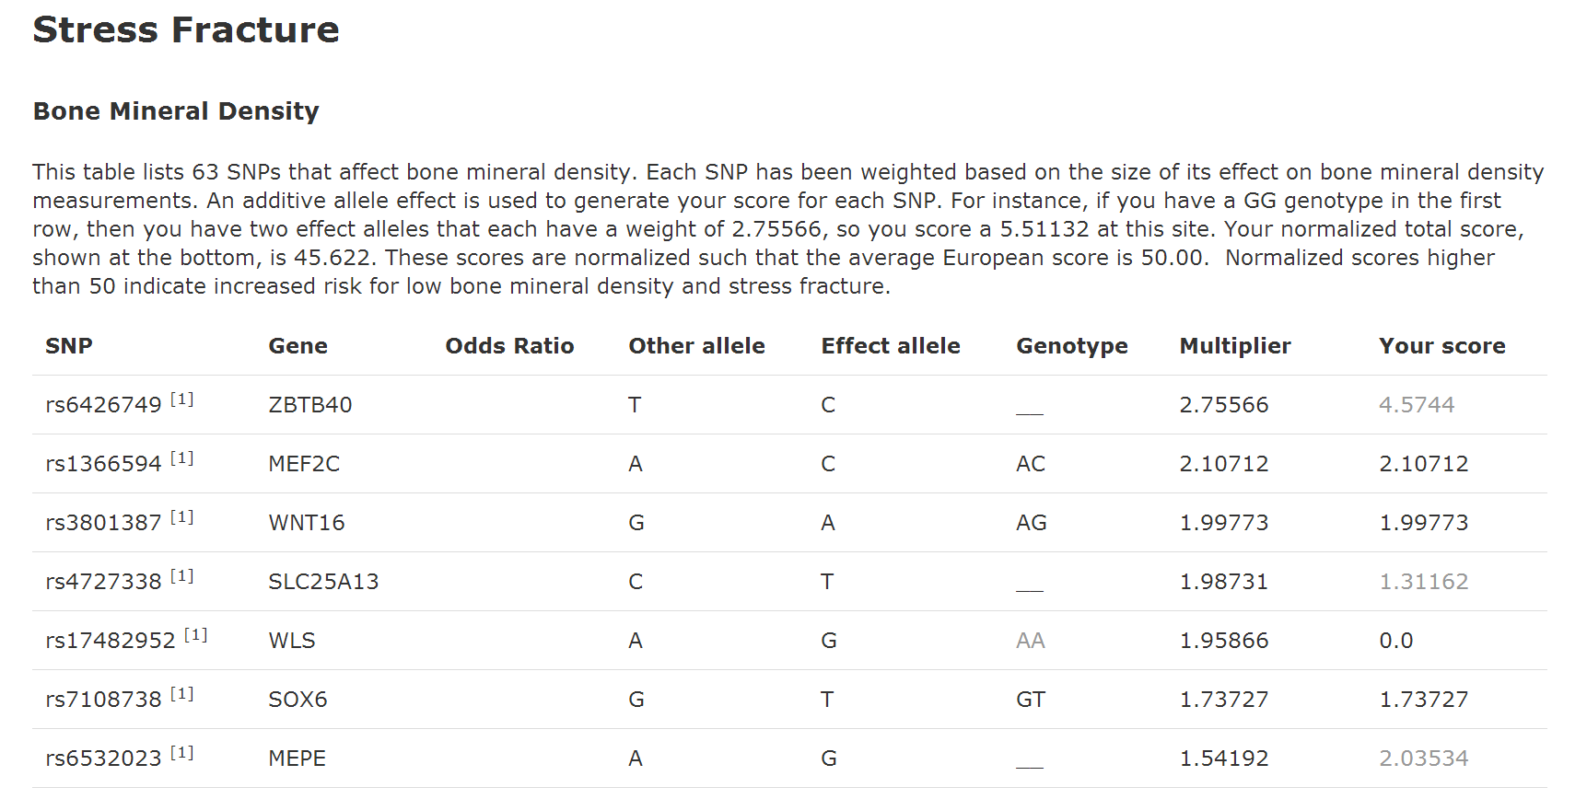

Slide 14
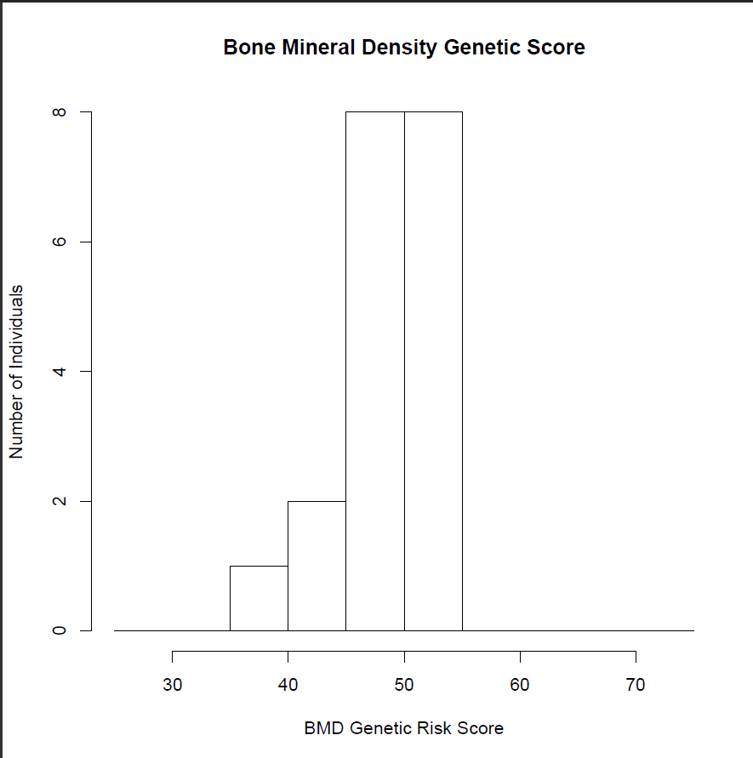
Gene 210 2014

Slide 15
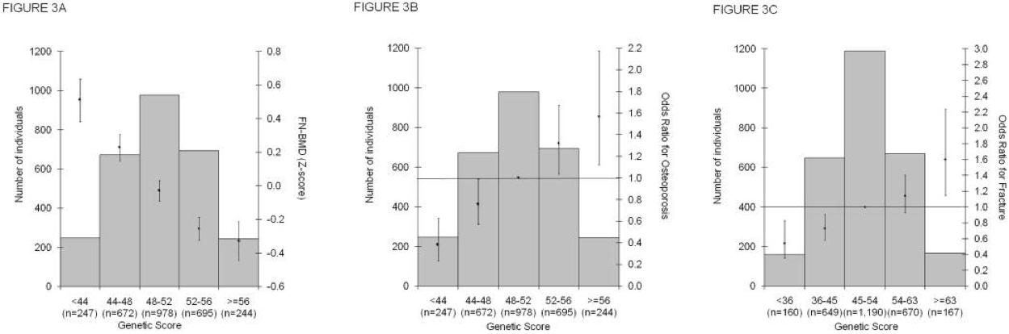

Slide 16
Low BMD/Osteoporosis prevention
Adequate amounts of calcium
Adequate amounts of vitamin D
Regular exercise

Slide 17
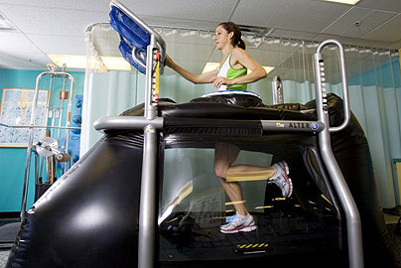
Alter G – reduce stress fracture risk

Slide 18
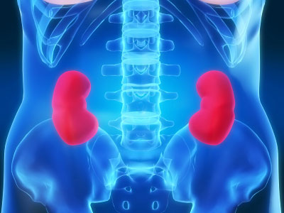
Chronic Kidney Disease
Chronic Kidney Disease is a slow loss of renal function over time. This leads to a decreased ability to remove waste products from the body and perform homeostatic functions.

Slide 19
Epidemiology
CKD affects about 26 million people in the US
Approximately 19 million adults are in the early stages of the disease
  On the rise do to increasing prevalence of diabetes and hypertension
Total cost of ESRD in US was approximately $40 billion in 2008

Slide 20
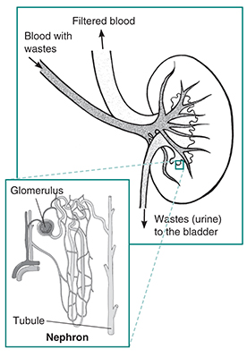

Slide 21
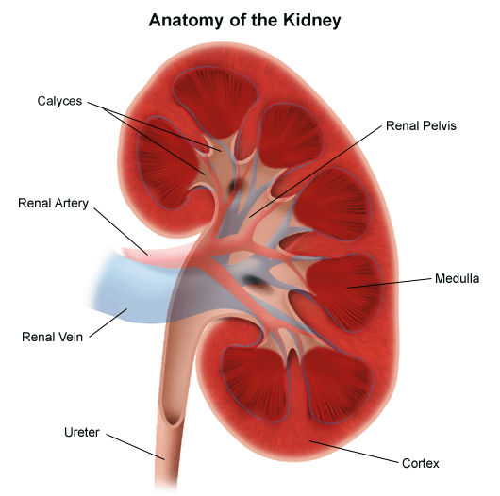
Clinical Definition
Glomerular Filtration Rate of less than 60 ml/minute per 1.73m² per body surface area (normal is 125ml/min) .
Presence of kidney damage, regardless of the cause, for three or more months
Notes:
Things that cause kidney disease:
-Glomerulonephritis, a group of diseases that cause inflammation and damage to the kidney's filtering units. These disorders are the third most common type of kidney disease.
-Inherited diseases, such as polycystic kidney disease, which causes large cysts to form in the kidneys and damage the surrounding tissue.
-Malformations that occur as a baby develops in its mother's womb. For example, a narrowing may occur that prevents normal outflow of urine and causes urine to flow back up to the kidney. This causes infections and may damage the kidneys.
-Lupus and other diseases that affect the body's immune system.
-Obstructions caused by problems like kidney stones, tumors or an enlarged prostate gland in men.
-Repeated urinary infections.

Slide 22
Measuring kidney function eGFR: MDRD calculation
eGFR = 175 x SerumCr^{-1.154} * age^{-0.203} * 1.212 (if patient is black) * 0.742 (if female)
Creatinine is a muscle waste product that is cleared by kidney filtration.
Low kidney function leads to high levels of creatinine.
Amount of muscle influences amount of creatinine made. High levels of muscle gives higher creatinine baseline, independent of kidney function.
Older people produce less creatinine from their muscles.
African Americans produce more creatinine.
Women produce less creatinine
10% error from true GFR

Slide 23

CKD Symptoms
Hematuria
Flank pain
Edema
Hypertension
Signs of uremia
Lethargy and fatigue
Loss of appetite
If asymptomatic may have elevated serum creatinine concentration or an abnormal urinalysis

Slide 24
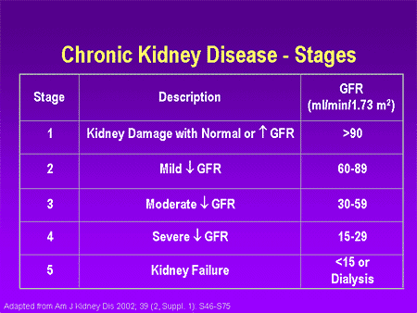

Slide 25
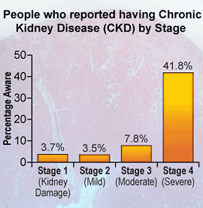
In the early stages of CKD, people do not notice any symptoms. The disease often develops so slowly that many people don't realize they're sick until the disease is advanced. In 2006, CKD was responsible for the death of nearly 45,000 people, ranking as the ninth leading cause of death in the United States.
However, the risk for kidney disease can be reduced by preventing – when possible – diabetes and high blood pressure and managing these conditions when present.

Slide 26
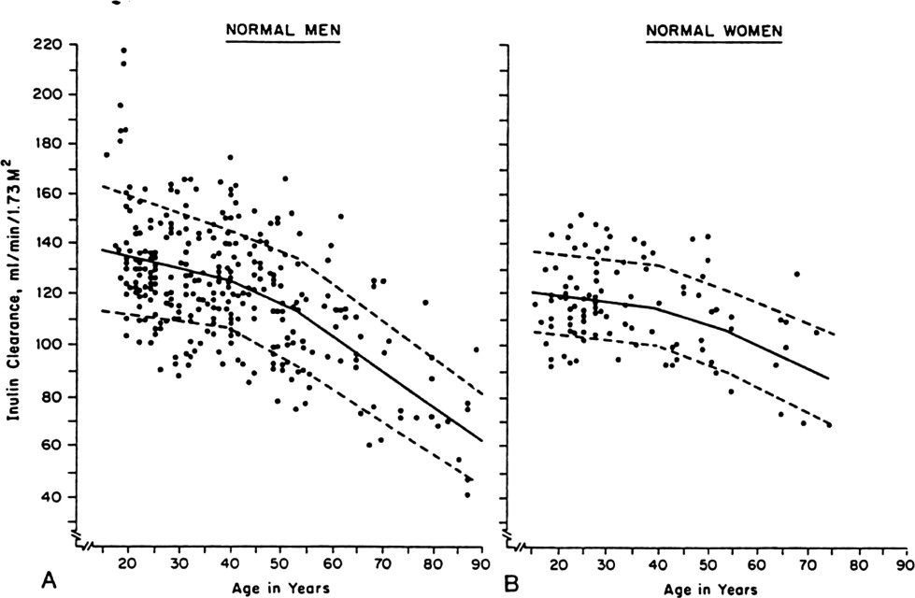
Kidney function declines with age in humans
Glomerular
Filtration
Rate
Poor kidney function is a risk factor for death from major age-related diseases:
-Chronic kidney disease
-Cardiovascular disease
-Stroke
-Type 2 Diabetes
Levey et al. 2009; Fan et al. 2011
Notes:
I work specifically on kidney aging so I’d like to highlight two important reasons why kidneys are a particularly important organ for aging. The first reason is that kidneys show a quantifiable decline in a key biomarker of function with age as shown on these scatter-plots showing that glomerular filtration rate (a biomarker of how well kidneys filter the blood) declines steadily with age.
The second important point is that poor kidney function is a major risk factor for leading causes of age-related death in humans- most notably chronic kidney disease as well as cardiovascular disease, stroke and type 2 diabetes which are collectively among the leading causes of death in the U.S.

Slide 27
Risk Factors
Age of more than 60 years
Hypertension and Diabetes
  Responsible for 2/3 of cases
Cardiovascular disease
Family history of the disease.
Race and ethnicity
    Highest incidence is for African Americans
    Hispanics have higher incidence rates of ESRD than non-Hispanics.
Notes:
_followed by American Indians and Alaska Natives, then Asian Americans and native Hawaiians and other Pacific Islanders, and finally Caucasians.

Slide 28
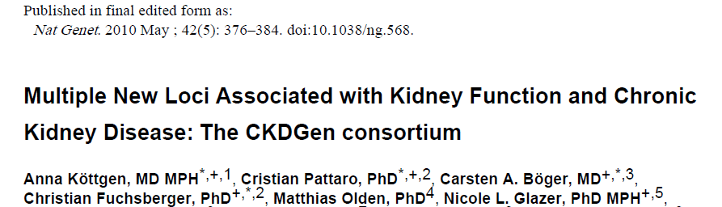
Meta-analysis of genome-wide association data from 20 Studies
67,093 Caucasian individuals
Serum creatinine (eGFRcrea), cystatin C (eGFRcys), and CKD (eGFRcrea <60 ml/min/1.73m²; n = 5,807 CKD cases).
20 new loci

Slide 29
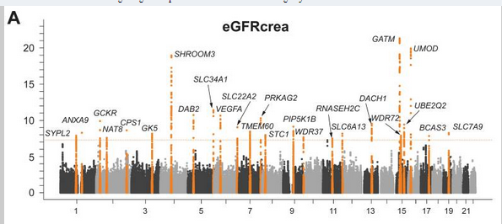

Slide 30
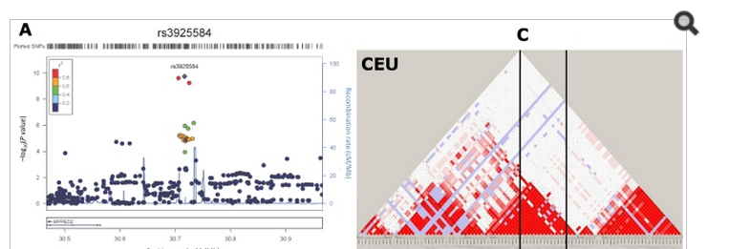

Slide 31
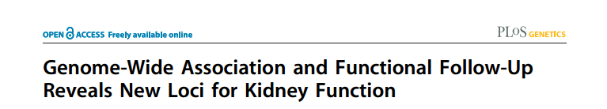
Meta-analysis of genome-wide association data from 20 Studies
130K Caucasian individuals
Serum creatinine (eGFRcrea)
6 new loci for CEU
4/6 validate in African Americans

Slide 32
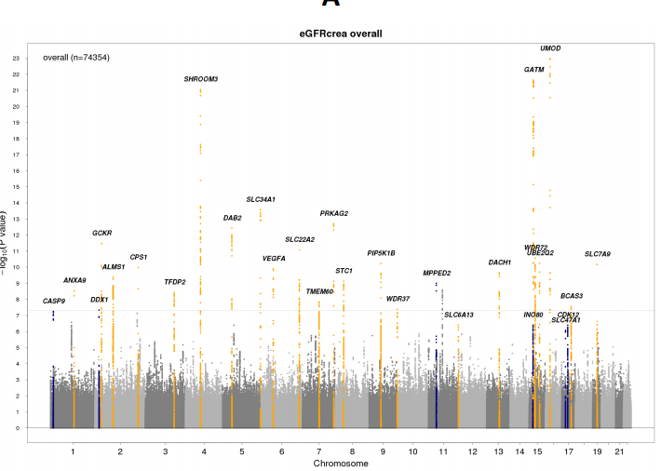

Slide 33
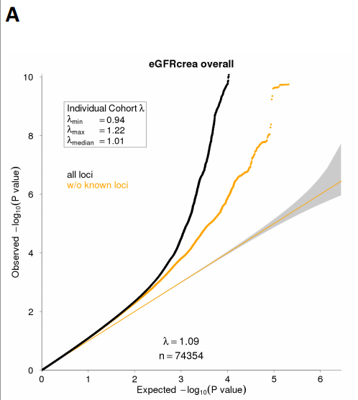

Slide 34
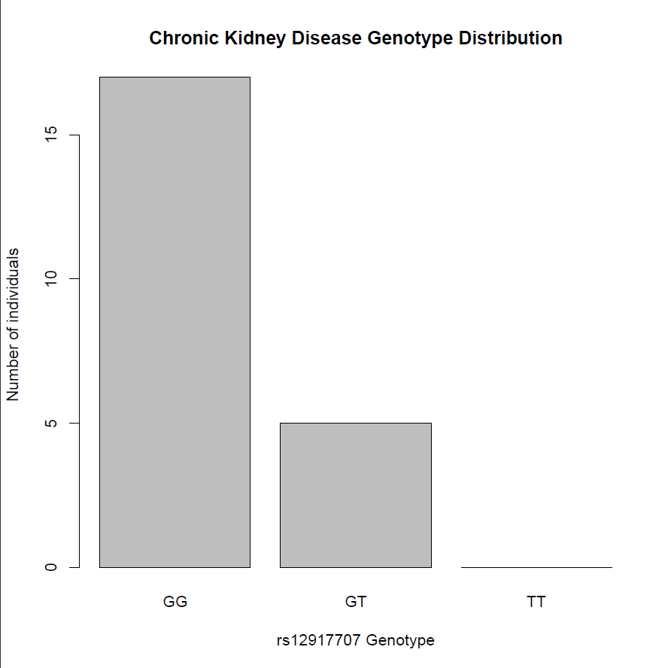
CKD: rs12917707

Slide 35
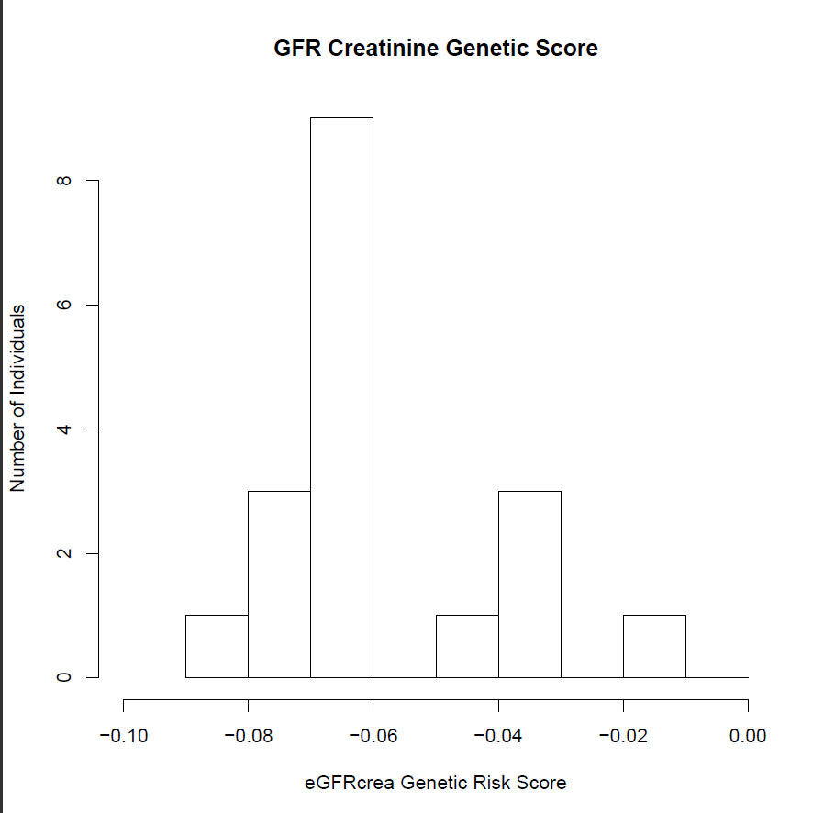
Estimated GFR creatinine

Slide 36
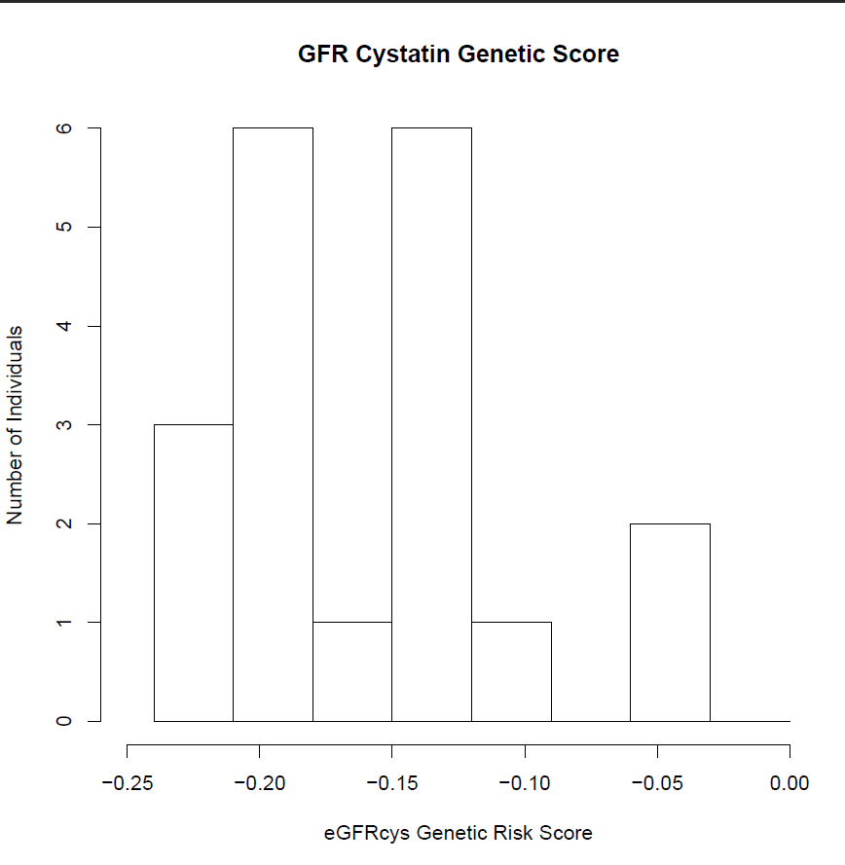
Estimated GFR cystatin C

Slide 37
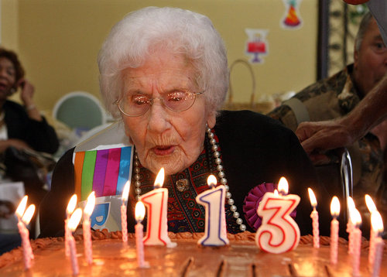
Genetics of extreme human longevity

Slide 38
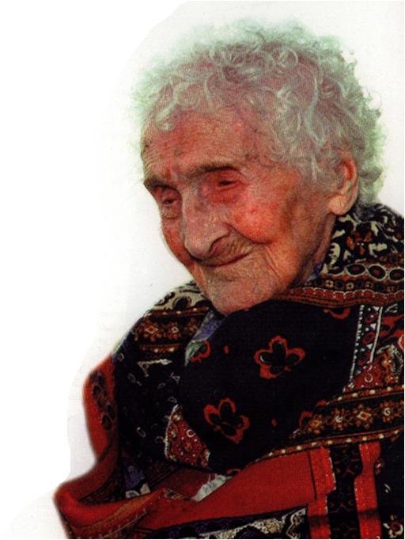
World’s Oldest Human
Jeanne Calment
of Arles, France
1875-1997
122 yrs
Notes:
Took up fencing at 85 bicycling at age 100
Her brother lived to the age of 97, her father 94, and her mother lived to the age of 86.
In 1965, with no living heirs, Jeanne Calment signed a deal, common in France, to sell her condominium apartment en viager to lawyer François Raffray, then 47.
Raffray agreed to pay a monthly sum until she passed away, an agreement sometimes called a "reverse mortgage". She was then 90, and the value of the apartment was equal to ten years of payments. Unfortunately for Raffray, not only did she survive more than thirty years, but he died first, in December, 1995, of cancer, at the age of 77. His widow had to continue the payments.

Slide 39
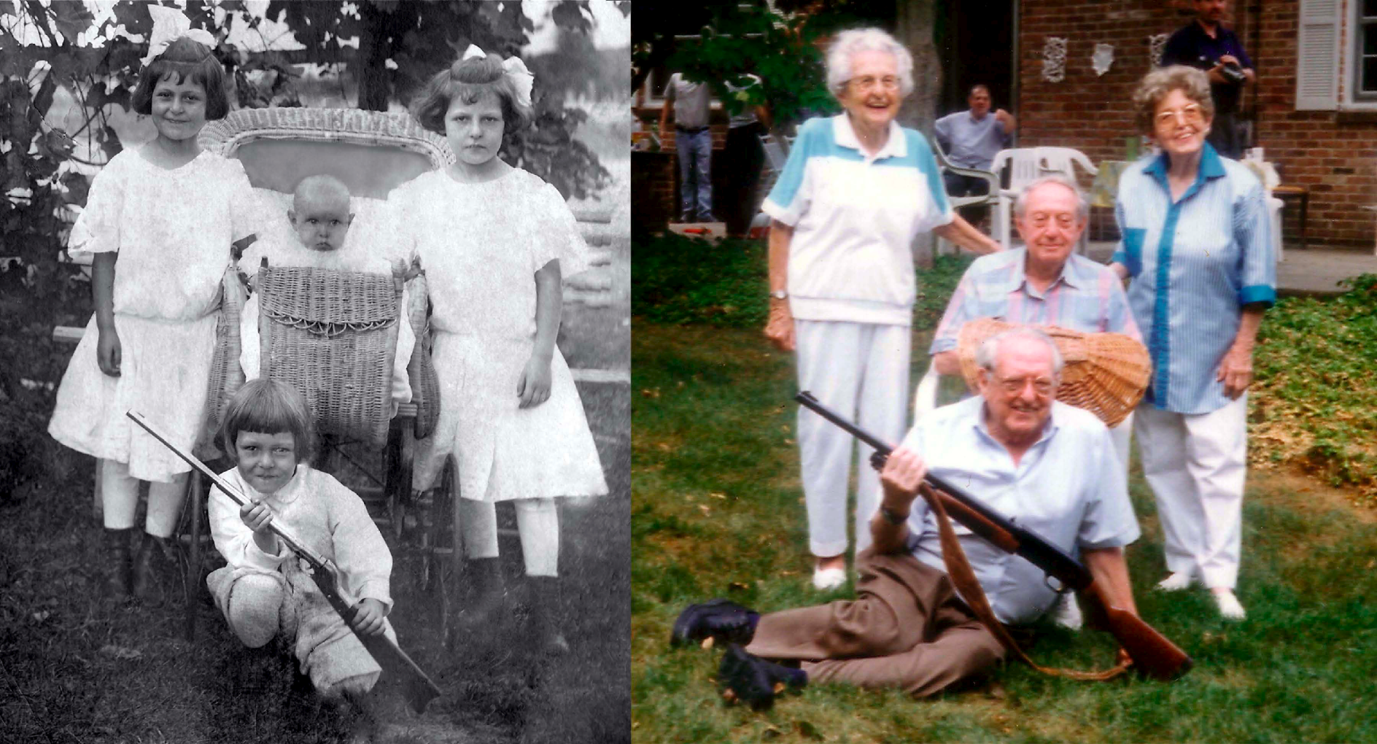
Longevity is Heritable
From Gross L., 2006
Helen Reichert and siblings, as children and centenarians
Notes:
Helen Reichert is depicted (standing, left) at age nine, with her sister and brother. She is currently 104 years old, and all her siblings achieved exceptional longevity, accompanied by relatively good physical and mental health. Because neither Helen nor her siblings chose particularly healthful lifestyles (Helen has been smoking since age 18), their survival may be attributed to special longevity-assurance genes, according to research reported in this issue of PLoS Biology. See Atzmon et al.

Slide 40
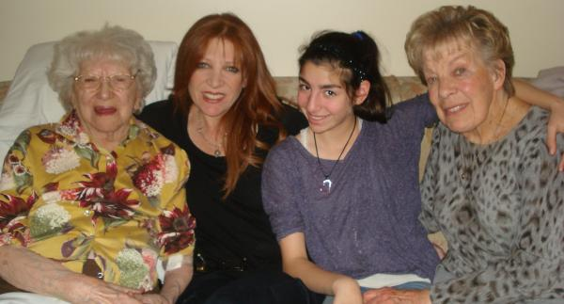
Longevity is Heritable
Mollye Marcus, 111 years old, and family

Slide 41
Centenarian offspring have reduced onset of disease and live 8-14 yrs longer
Terry et al. 2004; Adams et al., 2008; Perls et al. 2007

Slide 42
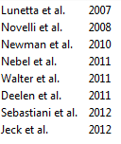
PLAN A: GWAS studies find only APOE
Important caveat: cohort sizes are small.
No Significant SNP
APOE
No Significant SNP
APOE
No Significant SNP
APOE
APOE
Notes:
APOE e4 is killer gene: brca & parkinson are not common enough to show up (on chips or gwas): MAF parkinson SNP LRRK2 is 0.1% (1 allele in 1000G)
MAF brca1/2 SNPs is <1% (in canada 0.3 & 0.7% resp. : http://jnci.oxfordjournals.org/content/98/23/1694.full)
e3/e4 is 19% in cau (e4/e4 2%) Coon et al.

Slide 43
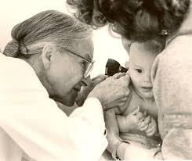
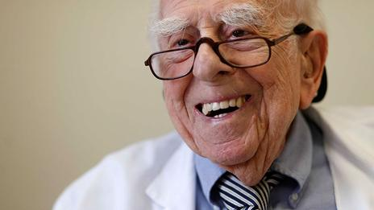
Supercentenarian are healthy agers
Dr. Leila Denmark practiced medicine
until age 103
Dr. Ephraim Engleman, 103, still works as a doctor
in San Francisco

Slide 44

Supercentenarian are healthy agers
Irving Kahn, Wall Street’s oldest professional investor, continued working till
a few months before his death at age 109.
Co-founder of Kahn Brothers Group, which manages $1 billion.
Sibling to Helen Reichert.

Slide 45
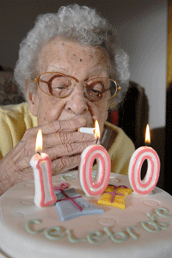
Lifestyle does not fully explain supercentenarian longevity
Supercentenarians showed no difference with general population in:
  smoking
  diet
  physical activity
  alcohol
Rajpathak et al., 2011

Slide 46
There are only 17 Supercentenarians alive in the US today.
Source: Gerontology Research Grouphttp://www.grg.org/Adams/E.HTM

Slide 47

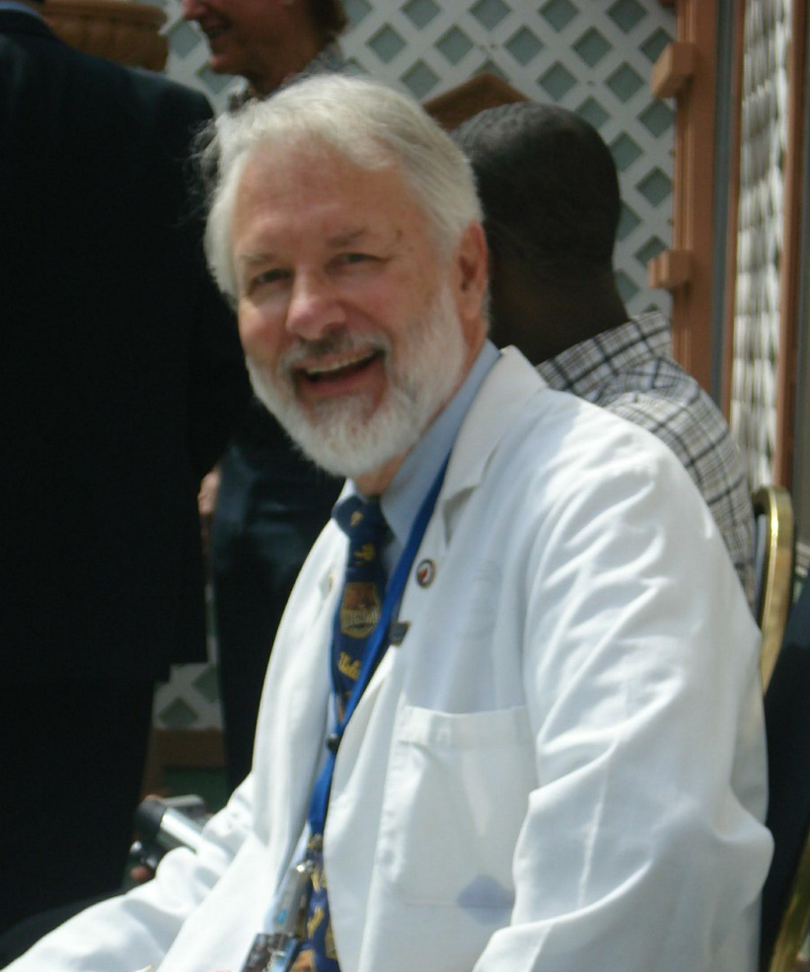

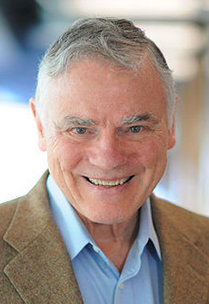

PLAN B: Whole Genome Sequencing of the World’s Oldest People
Gerontology Research Group
Dr. Hinco Gierman
Dr. Kristen Fortney
Dr. L. Stephen Coles
Dr. Lee Hood

Slide 48

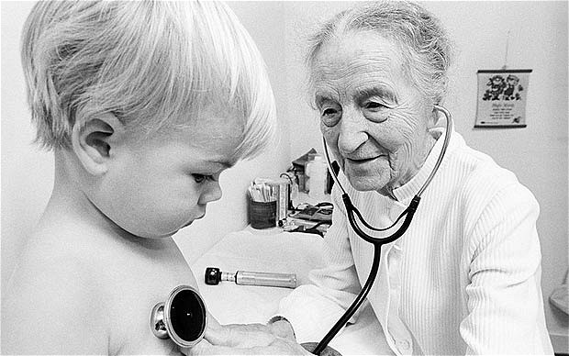
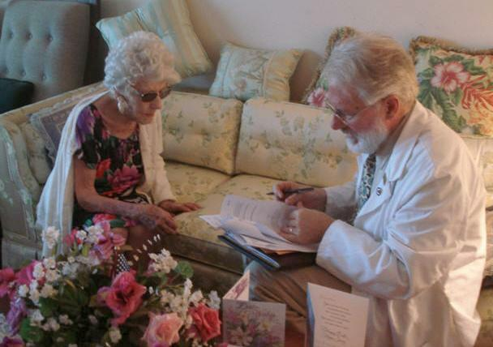
Recruitment of 17 SC
Highly functional into old age.
Average age of death: 113
World’s oldest woman (8th)
Only 2/17 had major age-related disease (cancer, CVD, AD, T2D)

Slide 49
Collapse variants into genes
X
Dominant
X
Recessive
X

Slide 50

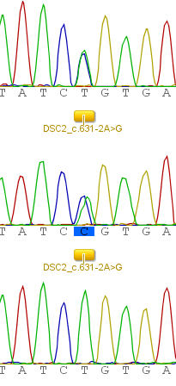
One supercentenarian has a hypertrophic cardiomyopathy mutation
Forward read SC carrier
T
C
Reverse read SC carrier
T
C
Forward read control
T
T
Notes:
One supercentenarian male has a known pathogenic variant (c631-2A>G) associated with arrhythomegenic right ventricular cardiomyopathy.

Slide 51
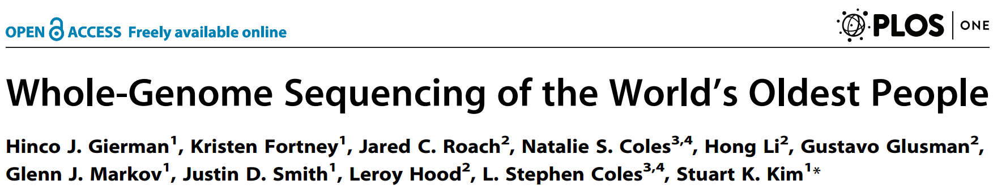

We made the 17 supercentenarian genomes publicly available
supercentenarians.stanford.edu
70 Google users + x Stanford users

Slide 52
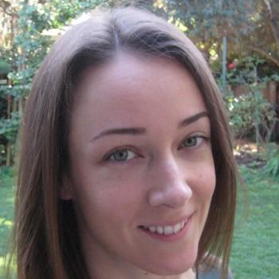


PLAN C: iGWAS finds loci for extreme longevity
We propose to take advantage of prior knowledge from disease.
Our assumption is that variants that protect from disease should also predispose to longevity.
Kristen Fortney
Dr. Art Owen
Edgar Dobriban

Slide 53
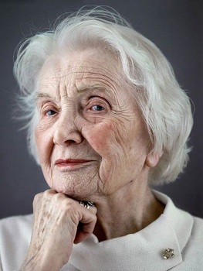
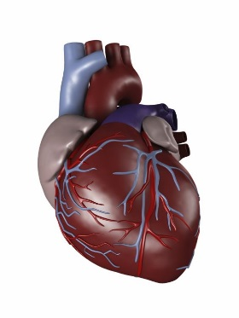
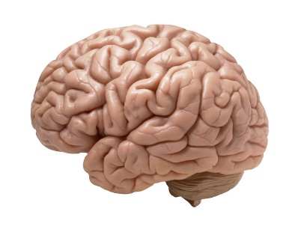
Testing whether disease SNPs are linked to longevity
Longevity GWAS: 801 cases
[Sebastiani et al. PLoS One 2012]
Coronary Artery Disease GWAS: 22,233 cases
[Schunkert et al. Nat Genet 2013]
Late-onset Alzheimer disease GWAS: 8,309 cases
[Naj et al. Nat Genet 2011]
We ranked SNPs by their P values for heart disease, and then looked at their P values for longevity.

Slide 54
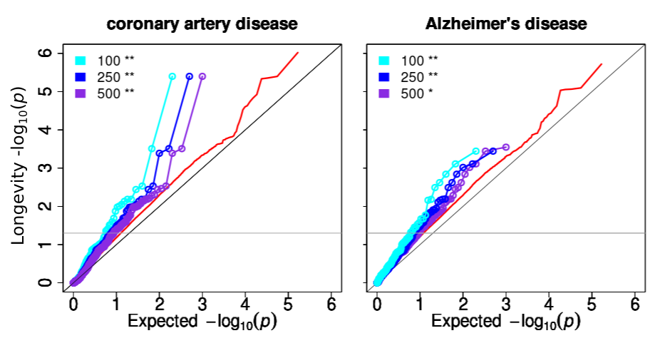
We find that disease GWAS are a rich source of prior knowledge on longevity

Slide 55
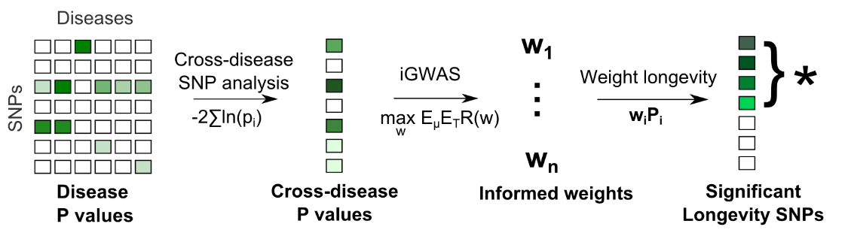
Informed GWAS
We applied our method to two GWAS of longevity:
NECS, with 801 centenarians (Sebastiani et al. 2012)
90PLUS, with 5406 over age 90 (Deelen et al. 2014)

Slide 56
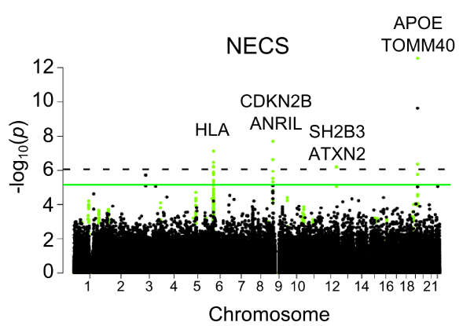
We found 8 significant loci for longevity at FDR < 10%

Slide 57
Four loci replicate, and two others show some evidence of replication
HLA locus (rs3763305/rs12194148) implicated in both discovery studies
KCNT2 locus (rs10737670) nominally significant in one replication study

Slide 58
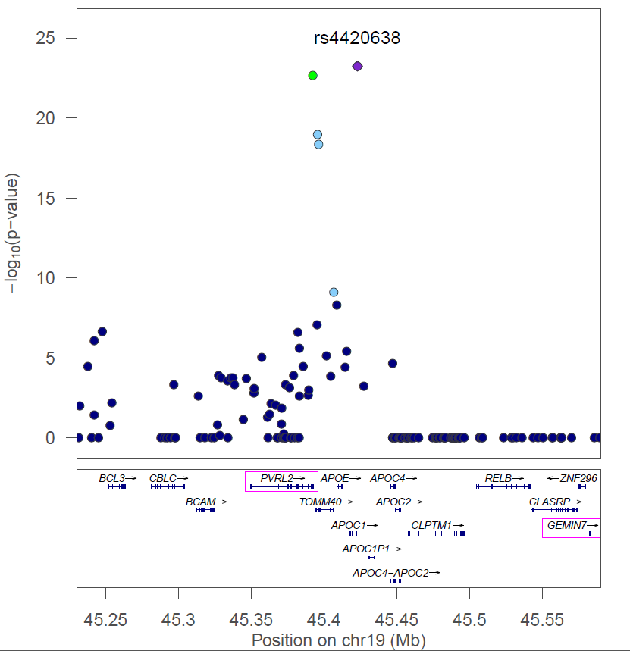

APOE is implicated in longevity and many diseases
Centenarian allele protective for Alzheimer’s, cholesterol levels, and pancreatic cancer
Genetic signal may depend on APO E4 haplotype

Slide 59



SH2B3/ATXN2 can affect lifespan and neurological disease
Centenarian allele protective for lung and pancreatic cancer, heart disease, rheumatoid arthritis, diastolic blood pressure, bone mineral density
LOF mutations in Drosophila ortholog of SH2B3 extend lifespan [Slack et al. 2010]. ATXN2 involved in neurological disorders ALS, SCA2.

Slide 60


CDKN2B/ANRIL is implicated in cellular senescence
Centenarian allele protective for heart disease and diabetes
CDKN2A encodes p16/INK4a, an inhibitor of the cell cycle and regulator of cell senescence.

Slide 61


Lead SNP in ABO locus tags the
O blood group
Lead SNP linked to SNP that defines the common allele (O1) for O blood group
People with blood type O protected from coronary heart disease, cancer, and have lower cholesterol levels

Slide 62


The HLA locus
Centenarian allele protective for rheumatoid arthritis and cholesterol levels.
HLA-DR and HLA-DQ genes are highly polymorphic and have been associated with over 40 diseases.

Slide 63


KCNT2/CFH locus
Centenarian allele protective for macular degeneration
Locus contains KCNT2 (encodes a potassium channel) and six genes in the CFH family (complement factor H).

Slide 64
Summary
One of the genetic mechanisms for extreme longevity involves the avoidance of certain risk alleles for common diseases
Using a new method, we identified lead SNPs for exceptional longevity in eight loci. Four loci were replicate and two partially replicate.
Several SNPs found by iGWAS show an association for many diseases which seem to have distinct etiologies.
Beyond the study of human longevity, iGWAS could be applied to other GWA studies, such as diseases or traits that show some co-morbidity or correlation

