Slide 1
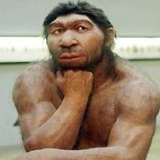
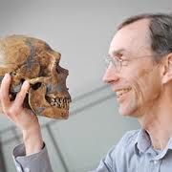
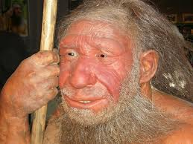
Neandertals
Svante Paabo

Slide 2
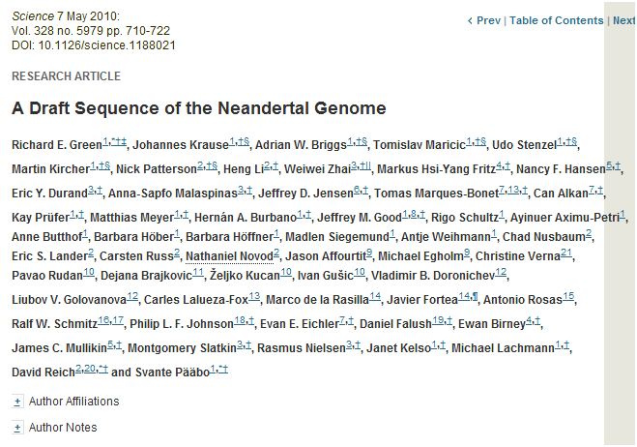

Slide 3
First appear in the European fossil record about 400,000 years ago
Lived in Europe and Western Asia as far east as Southern Siberia and as far south as the Middle East came into contact with modern humans from at least 80,000 years ago
Neandertals

Slide 4
Neanderthal cranial capacity is thought to have been as large as babies or larger as adults than Homo sapiens
Neandertals were heavily built with robust bone structure.
They were much stronger than Homo sapiens, having particularly strong arms and hands
Neandertals

Slide 5
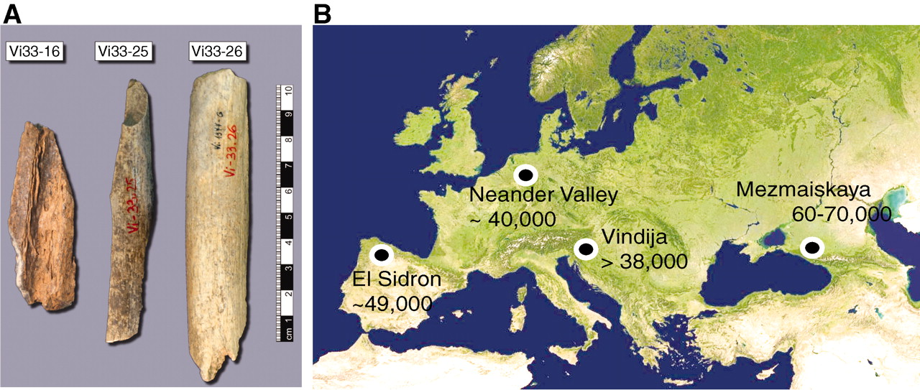

Samples and sites from which DNA was retrieved.
R E Green et al. Science 2010;328:710-722
Published by AAAS
Notes:
Samples and sites from which DNA was retrieved. (A) The three bones from Vindija from which Neandertal DNA was sequenced. (B) Map showing the four archaeological sites from which bones were used and their approximate dates (years B.P.).
First bone carbon dated to 38,310 T 2,130 years bP
Third bone is 44,450 years B.P.
5.3 Gb total sequence.
About 1% contamination.

Slide 6
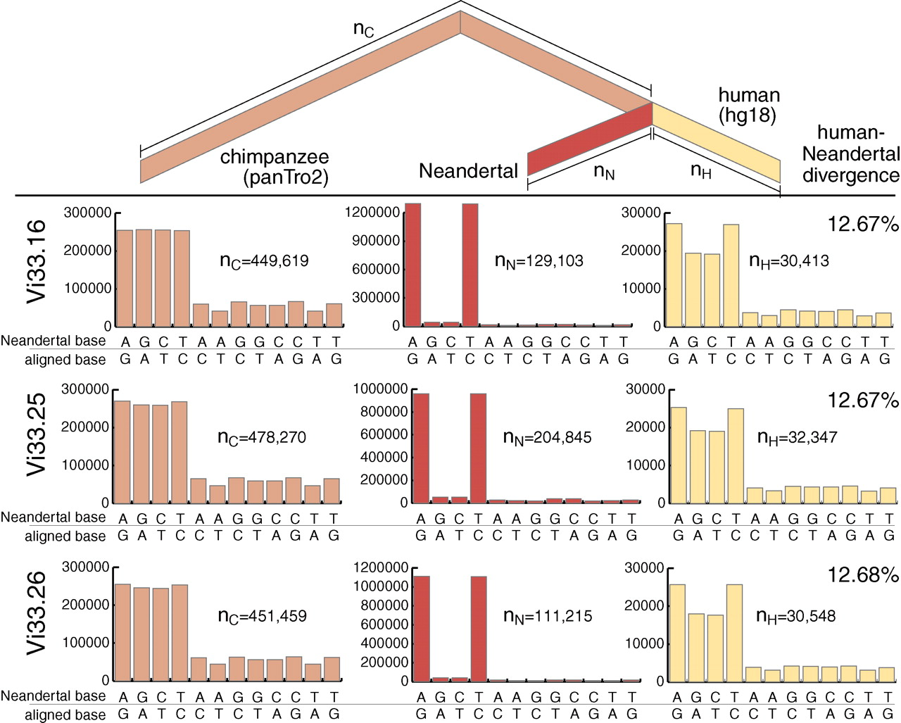
100%
12-14%
8-10%
78 aa substitutions
R E Green et al. Science 2010;328:710-722
Published by AAAS
Notes:
Nucleotide substitutions inferred to have occurred on the evolutionary lineages leading to the Neandertals, the human, and the chimpanzee genomes. In red are substitutions on the Neandertal lineage, in yellow the human lineage, and in pink the combined lineage from the common ancestor of these to the chimpanzee. For each lineage and each bone from Vindija, the distributions and numbers of substitutions are shown. The excess of C to T and G to A substitutions are due to deamination of cytosine
Neandertals from across a great part of their range in western Eurasia are equally related to present-day humans. residues in the Neandertal DNA.
Neandertals and present-day human populations separated between 270,000 and 440,000 years ago

Slide 7
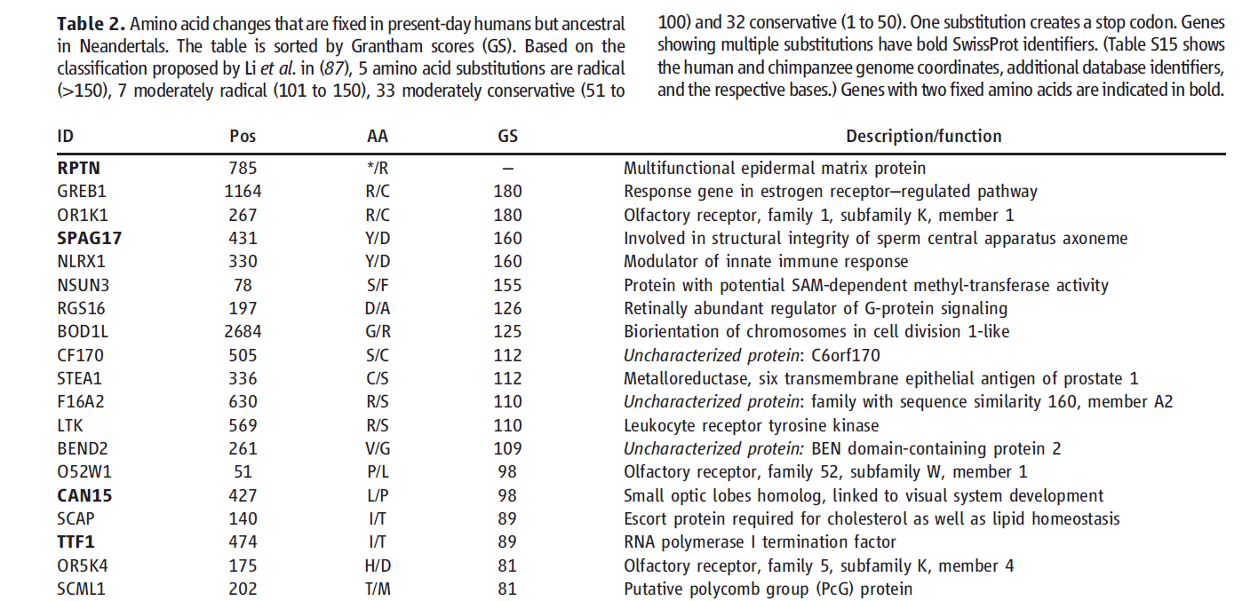
Notes:
These are 78 AA changes specific to the human cell lineage. They are fixed in human, but absent in Neandertal. They may be especially interesting as they may point to changes that make us human.
It is intriguing that skin-expressed genes comprise three out of six genes that either carry multiple fixed substitutions changing amino acids or in which a start or stop codon has been lost or gained. This suggests that
selection on skin morphology and physiology may have changed on the hominin lineage.
changes in the HARs tend to predate the split between Neandertals and modern humans. However, we also identified 51 positions in 45 HARs where Neandertals carry the ancestral version whereas all known present-day humans carry the derived version.

Slide 8
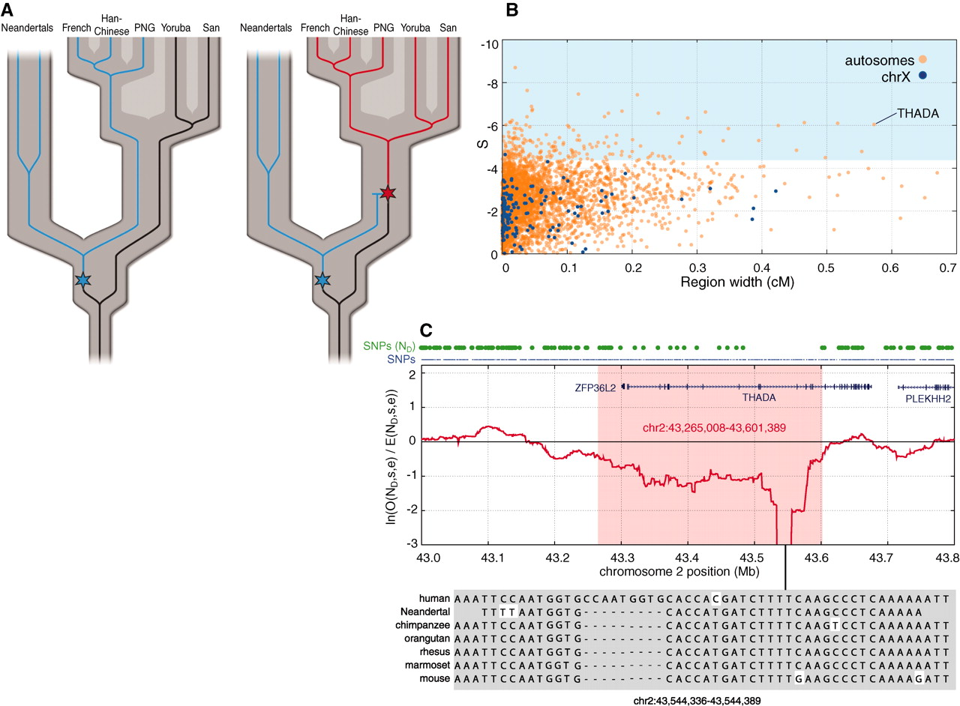
Fig. 4 Selective sweep screen.
R E Green et al. Science 2010;328:710-722
Published by AAAS
Notes:
Selective sweep screen. (A) Schematic illustration of the rationale for the selective sweep screen. For many regions of the genome, the variation within current humans is old enough to include Neandertals (left). Thus, for SNPs in present-day humans, Neandertals often carry the derived allele (blue). However, in genomic regions where an advantageous mutation arises (right, red star) and sweeps to high frequency or fixation in present-day humans, Neandertals will be devoid of derived alleles. (B) Candidate regions of selective sweeps. All 4235 regions of at least 25 kb where S (see SOM Text 13) falls below two standard deviations of the mean are plotted by their S and genetic width. Regions on the autosomes are shown in orange and those on the X chromosome in blue. The top 5% by S are shadowed in light blue. (C) The top candidate region from the selective sweep screen contains two genes, ZFP36L2 and THADA. The red line shows the log-ratio of the number of observed Neandertal-derived alleles versus the number of expected Neandertal-derived alleles, within a 100 kilobase window. The blue dots above the panel indicate all SNP positions, and the green dots indicate SNPs where the Neandertal carries the derived allele.
We identified a total of 212 regions containing putative selective sweeps

Slide 9
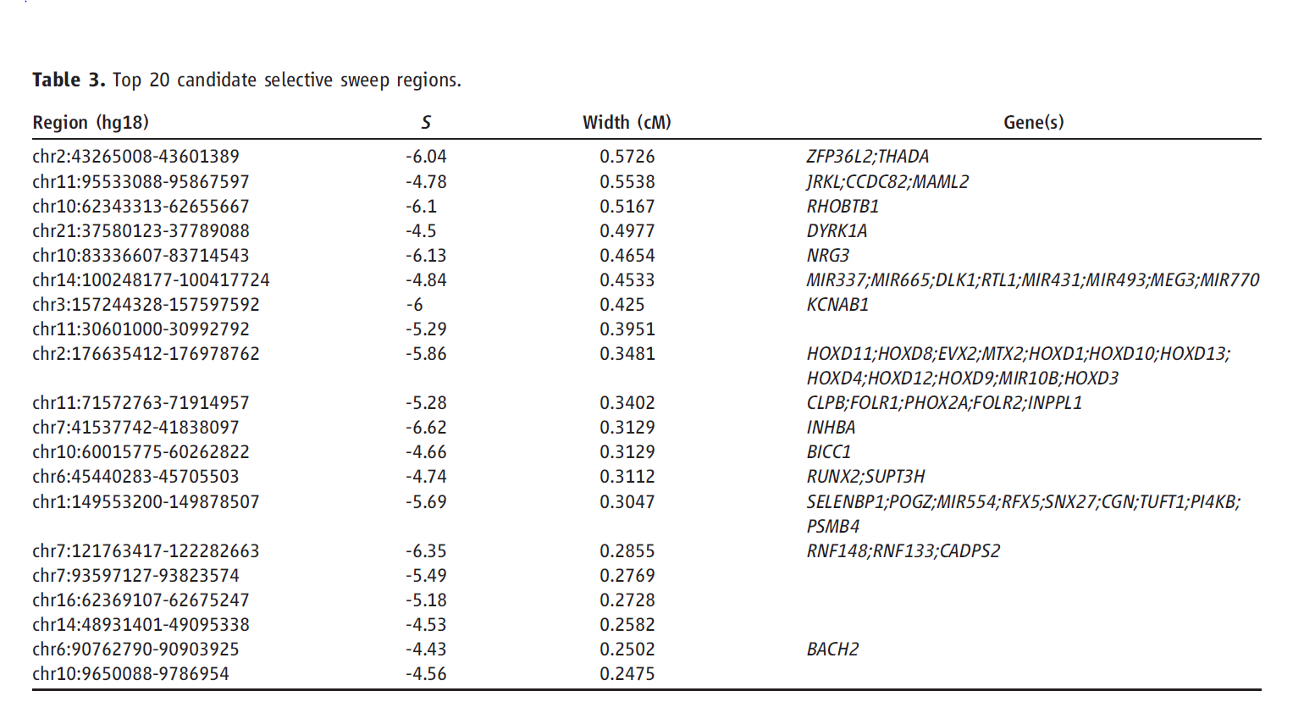
Changes in THADA (T2D gene) may have affected aspects of energy metabolism in early modern humans.

Slide 10
DYRK1A is thought to underlie some of the cognitive impairment associated with having three copies of chromsome 21

Slide 11
NRG3 is associated with schizophrenia

Slide 12
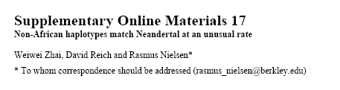
Page 150 out of ~200.

Slide 13
Scenario for Neandertal gene flow into OOA genomes.
The Neandertals are equally close to Europeans and East Asians. However,
the Neandertals are significantly closer to
non-Africans than to Africans
R E Green et al. Science 2010;328:710-722
Published by AAAS
Notes:
Selective sweep screen. (A) Schematic illustration of the rationale for the selective sweep screen. For many regions of the genome, the variation within current humans is old enough to include Neandertals (left). Thus, for SNPs in present-day humans, Neandertals often carry the derived allele (blue). However, in genomic regions where an advantageous mutation arises (right, red star) and sweeps to high frequency or fixation in present-day humans, Neandertals will be devoid of derived alleles. (B) Candidate regions of selective sweeps. All 4235 regions of at least 25 kb where S (see SOM Text 13) falls below two standard deviations of the mean are plotted by their S and genetic width. Regions on the autosomes are shown in orange and those on the X chromosome in blue. The top 5% by S are shadowed in light blue. (C) The top candidate region from the selective sweep screen contains two genes, ZFP36L2 and THADA. The red line shows the log-ratio of the number of observed Neandertal-derived alleles versus the number of expected Neandertal-derived alleles, within a 100 kilobase window. The blue dots above the panel indicate all SNP positions, and the green dots indicate SNPs where the Neandertal carries the derived allele.

Slide 14
Neandertal
Out of Africa
Africa
Step 1: candidate region
In a 50 kb region, search for regions in which OOA is very different from Africa
Step 2: compare to Neandertal
Look for cases in which there is high match to the Neandertal sequence across many SNPs. The OOA/Neandertal allele should be derived, not ancestral

Slide 15
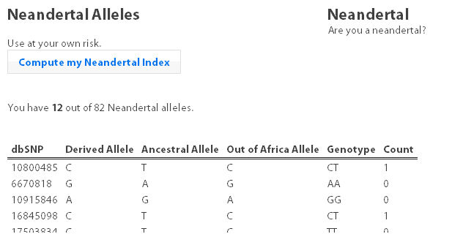
Running total
Same as Neandertal allele
Same as Chimp
Your genotype
# Neandertal

Slide 16
Class neandertal histogram

Slide 17
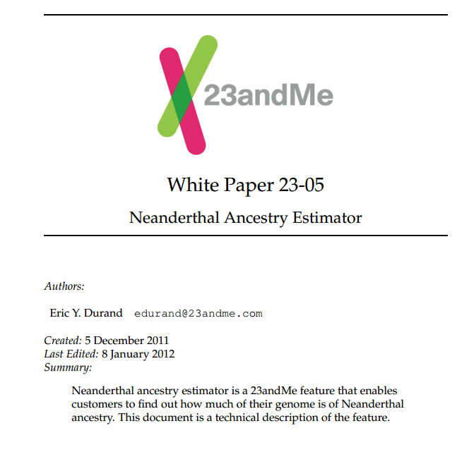

Slide 18
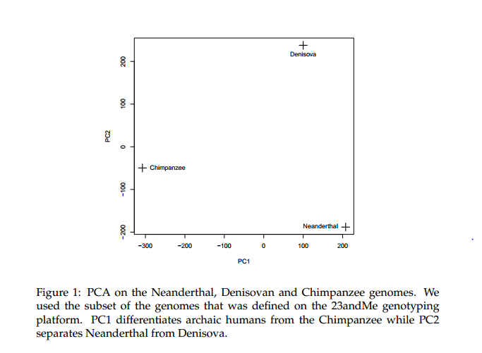

Slide 19
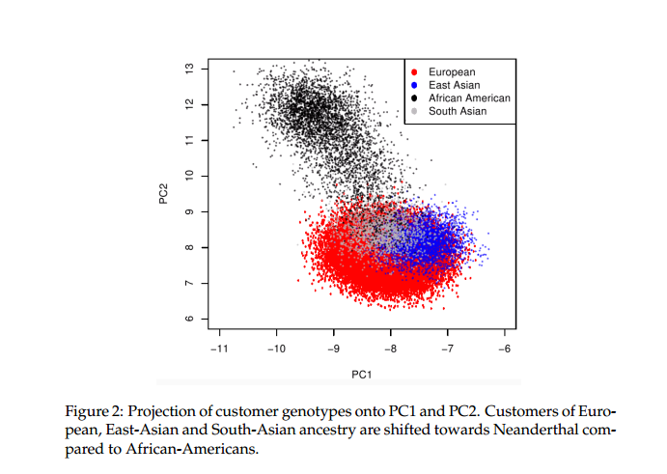

Slide 20
Class gene210 v 23andme neandertal results

Slide 21
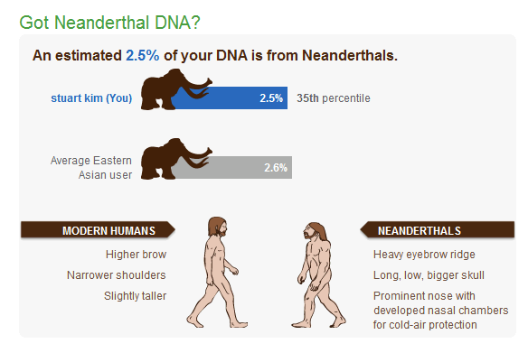

Slide 22
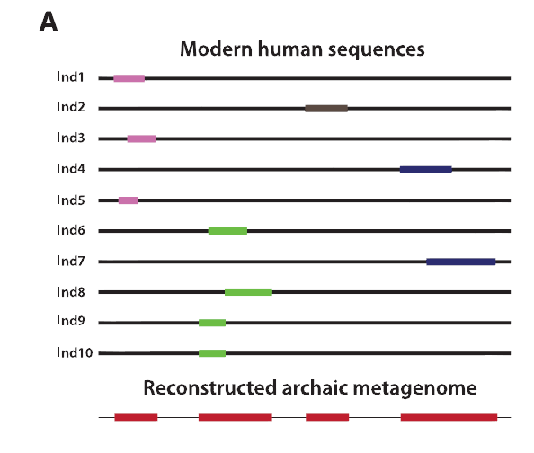
Finding Neandertal sequences in human genomes
Notes:
Science 343, 1017 (2014);
Benjamin Vernot and Joshua M. Akey
Resurrecting Surviving Neandertal Lineages from Modern Human Genomes

Slide 23
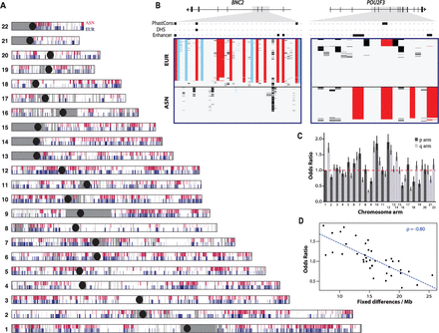
Regions derived from Neandertal
Notes:
Neandertal NE = 1500
Asian NE = 8,800
Caucasian NE = 9475
Up to 5000 ya
With 200 people of Eur and Asn – total is ~70% of Neandertal genome.

Slide 24
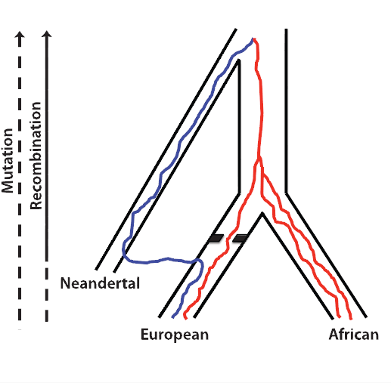
Neandertal sequences introgressed multiple times into the human genome

Slide 25
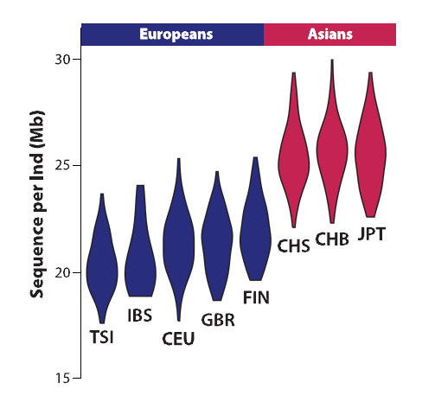
Asians have more Neandertal DNA than Europeans

Slide 26
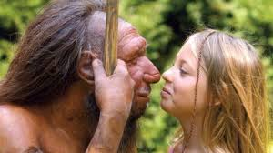
BNC2
Haplotype is at 67% frequency in Europeans, absent in Africans and Asians

Slide 27
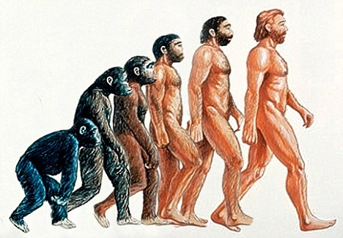
Human Positive Selection

Slide 28
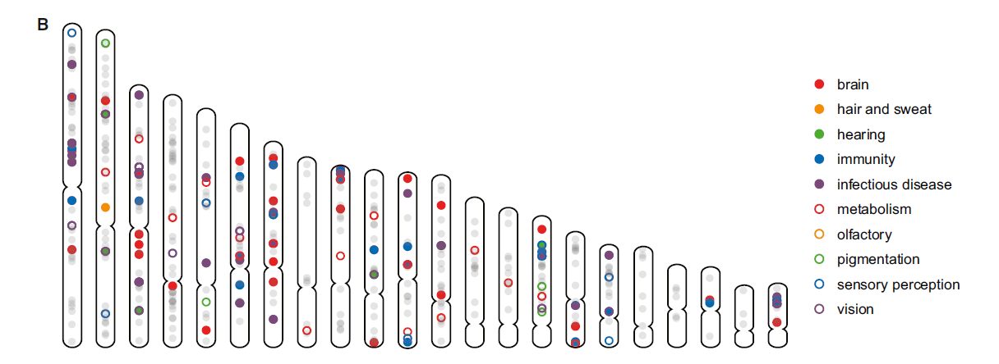
Human Positive Selection Loci

Slide 29
Positive selection regions
Mostly changes in expression. Only 35 affect protein coding
Examples:
  SCL24A5 lighter skin
  MATP lighter skin
  LCT milk drinking
  EDAR hair thickness
  ARHGEF3 bone mineral density
  BTLA rheumatoid arthritis
  ITPR3 Type 1 diabetes
  TLR5 interferon gamma secretion

Slide 30
Genotation
Run selection exercise.

Slide 31
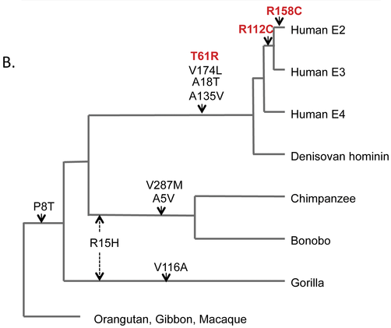

Positive selection at the ApoE locus
McIntosh AM, Bennett C, Dickson D, Anestis SF, et al. (2012) The Apolipoprotein E (APOE) Gene Appears Functionally Monomorphic in Chimpanzees (Pan troglodytes). PLoS ONE 7(10): e47760. doi:10.1371/journal.pone.0047760
http://www.plosone.org/article/info:doi/10.1371/journal.pone.0047760

Slide 32
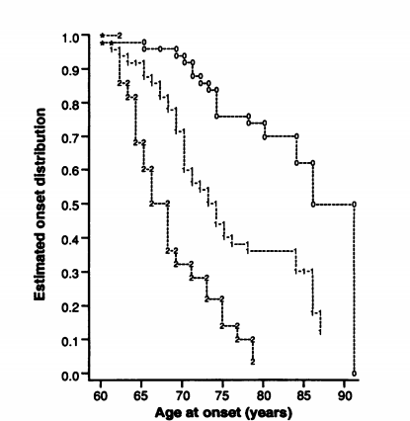
ApoE4 and Alzheimer’s
E3/E3
E3/E4
E4/E4
Caucasian and Japanese carriers of 2 E4 alleles have between 10 and 30 times the risk of developing AD by 75 years of age, as compared to those not carrying any E4 alleles.
Notes:
Science 13 August 1993:
Vol. 261 no. 5123 pp. 921-923
DOI: 10.1126/science.8346443
REPORTS
Gene dose of apolipoprotein E type 4 allele and the risk of Alzheimer's disease in late onset families
EH Corder,
AM Saunders,
WJ Strittmatter,
DE Schmechel,
PC Gaskell,
GW Small,
AD Roses,
JL Haines,
MA Pericak-Vance

Slide 33
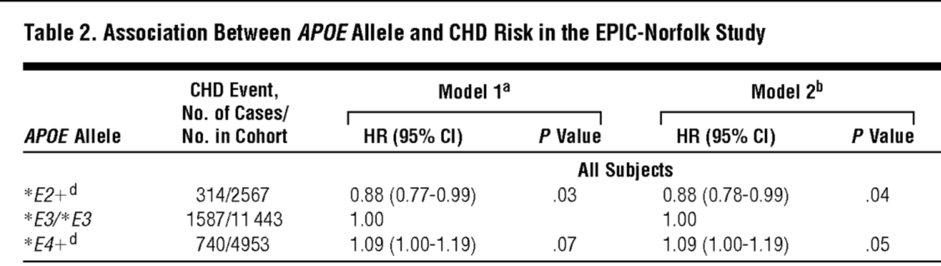
ApoE and coronary heart disease
From: APOE Genotype, Lipids, and Coronary Heart Disease Risk: A Prospective Population Study
Arch Intern Med. 2009;169(15):1424-1429. doi:10.1001/archinternmed.2009.234

Slide 34
ApoE (2,3,4)
E4 is found in approximately 14 percent of the population.
E4 has been implicated in:
  Atherosclerosis
  Alzheimer's disease
  impaired cognitive function
  Reduced hippocampal volume
  HIV
  faster disease progression in multiple sclerosis
  unfavorable outcome after traumatic brain injury
  ischemic cerebrovascular disease
  sleep apnea
  accelerated telomere shortening ]
  Reduced neurite outgrowth

Slide 35
McIntosh AM, Bennett C, Dickson D, Anestis SF, et al. (2012) The Apolipoprotein E (APOE) Gene Appears Functionally Monomorphic in Chimpanzees (Pan troglodytes). PLoS ONE 7(10): e47760. doi:10.1371/journal.pone.0047760
http://www.plosone.org/article/info:doi/10.1371/journal.pone.0047760

Slide 36
Ways to detect genes under positive selection
1. Proportion of functional changes
- Positive selection may favor many alleles, not just one
- This can be detected by a large number of coding changes relative to neutral changes in the gene.
Notes:
Evidence from divergence
data (7) and site frequency spectrum data (90)
suggests that approximately10%of the genome
is under positive selection. This

Slide 37
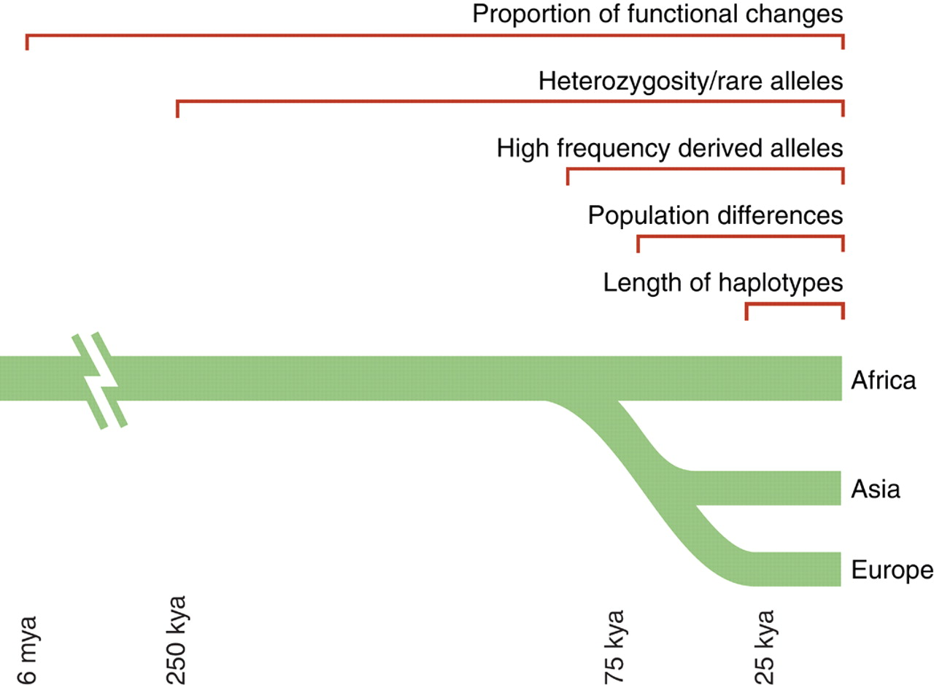
Fig. 1. Time scales for the signatures of selection.
P C Sabeti et al. Science 2006;312:1614-1620
Published by AAAS
Notes:
Time scales for the signatures of selection. The five signatures of selection persist over varying time scales. A rough estimate is shown of how long each is useful for detecting selection in humans. (See fig. S1 for details on how the approximate time scales were estimated).

Slide 38
FOXP2: a transcription factor involved in human speech
Adaptively evolving along human lineage.
Highly conserved, but has recent human-specific changes
Mutations of FOXP2 cause a severe speech and language disorder

Slide 39
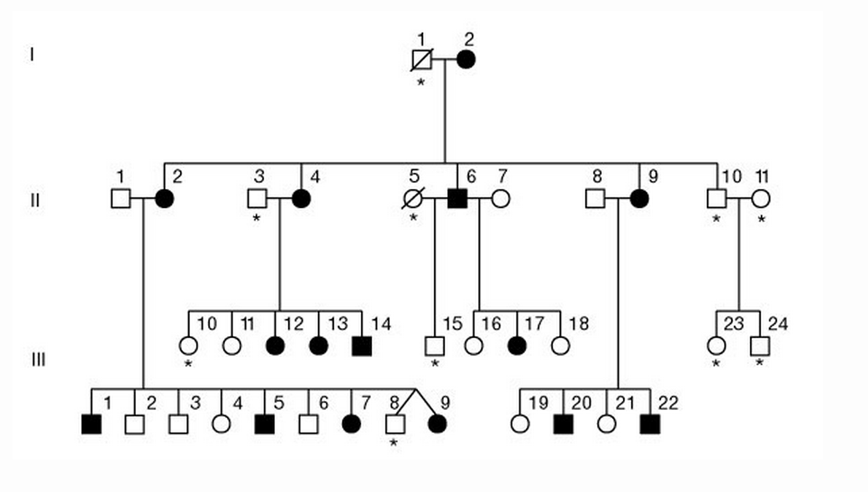
FOXP2 mutations affect speech and language
Affected members have deficits in language processing (such as the ability to break up words into their constituent phonemes) and grammatical skills (including production and comprehension of word inflections and syntactical structure).

Slide 40
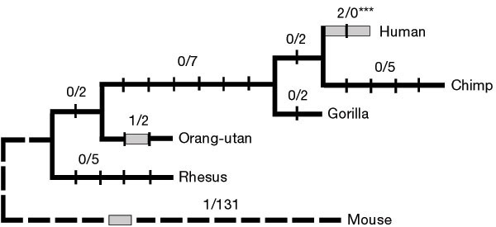
Foxp2 gene
Has high functional differences.
Bars represent nucleotide changes. Grey bars indicate amino-acid changes

Slide 41
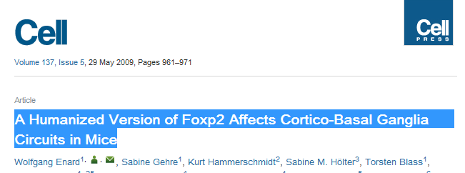
Replaced mouse FOXP2 with human FOXP2
Found gain-of-function changes in brain and behavior

Slide 42
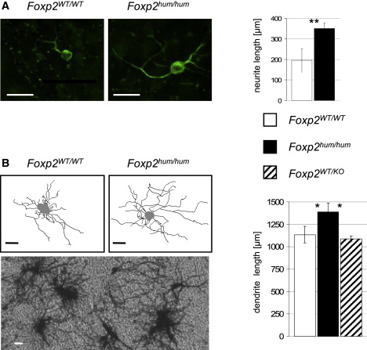
Foxp2^{hum} Increases the Length of Dendritic Trees
Notes:
Figure 4. Foxp2^{hum} Increases the Length of Dendritic Trees(A) Foxp2^{hum/hum} and Foxp2^{wt/wt} striatal neurons stained for the neuronal marker beta–III-tubulin (green) after 7 days of differentiation. Plotted are averages (±SEM) of three individuals for each of which the total neurite length of five neurons was measured. Asterisks indicate a significant difference (Mann-Whitney U, p < 0.01) between the 15 neurons of each genotype.(B) Golgi-Cox staining and representative drawings of medium spiny neurons in vivo. Plotted are averages (±SEM) of six (nine for Foxp2^{wt/wt}) individuals for each genotype of which the total dendritic tree of three neurons has been measured. Asterisks indicate a significant difference (Mann-Whitney U, p < 0.05) between the neurons of each genotype. Scale bars represent 25 μm.

Slide 43
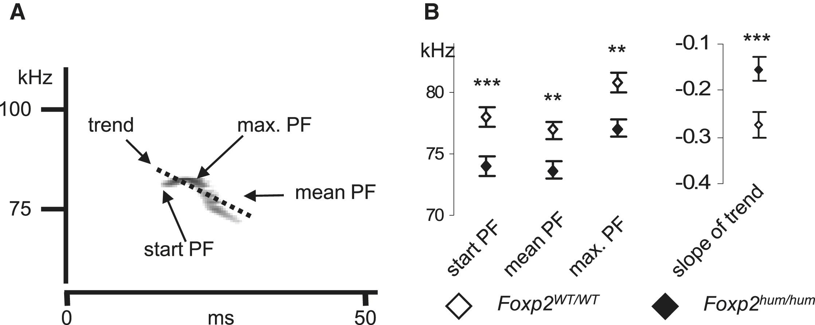
Foxp2^{hum} Affects the Structure of Pup Isolation Calls
Notes:
Foxp2^{hum} Affects the Structure of Pup Isolation Calls(A) Examples of acoustic parameters analyzed illustrated for typical call.(B) Plots of acoustic parameters differing between genotypes. Measurements are averaged across days and individuals (±SEM). The peak frequency (PF) refers to the frequency with the maximum amplitude in each analyzed time window of 0.21 ms. Asterisks indicate significant differences between genotypes (∗∗: < 0.01; ∗∗∗: < 0.001)

Slide 44
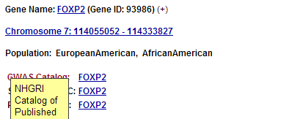
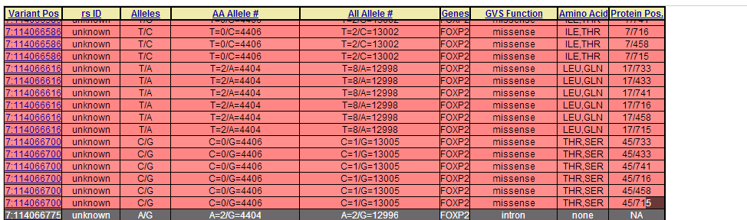
Novel mutations in human FOXP2
Exome Variant Server http://evs.gs.washington.edu/EVS/
Database of sequence variants appearing in cDNAs
11 people have protein changes in FOXP2

Slide 45
Ways to detect genes under positive selection
2. Lower Genetic Diversity
Heterozygosity (lower)/rare alleles (higher)
Selective sweep reduces genetic diversity at linked alleles.
If rare alleles are linked to the selected mutation, they increase in frequency by hitchhiking. So their frequency rises.
Notes:
As an allele increases in population frequency, variants at nearby locations on the same chromosome (linked variants) also rise in frequency. Such so-called “hitchhiking” leads to a “selective sweep,” which alters the typical pattern of genetic variation in the region. In a complete selective sweep, the selected allele rises to fixation, bringing with it closely linked variants; this eliminates diversity in the immediate vicinity and decreases it in a larger region. New mutations eventually restore diversity, but these appear slowly (because mutation is rare) and are initially at low frequency. Positive selection thus creates a signature consisting of a region of low overall diversity, with an excess of rare alleles.

Slide 46
Ways to detect genes under positive selection
3. High Frequency Derived Alleles
Most new alleles are at low frequency
One way for a derived allele to become high frequency is to by linked to an allele undergoing positive selection

Slide 47
Fig. 1. Time scales for the signatures of selection.
P C Sabeti et al. Science 2006;312:1614-1620
Published by AAAS
Notes:
Time scales for the signatures of selection. The five signatures of selection persist over varying time scales. A rough estimate is shown of how long each is useful for detecting selection in humans. (See fig. S1 for details on how the approximate time scales were estimated).

Slide 48
Look up Duffy red cell antigen
Rs2814778
C- protective from malaria
T- susceptible to malaria
Stuart = TT

Slide 49
Duffy red cell antigen (FY)
P. vivax malaria
Rs2814778
C- protective
T- susceptible
Duffy protein

Slide 50
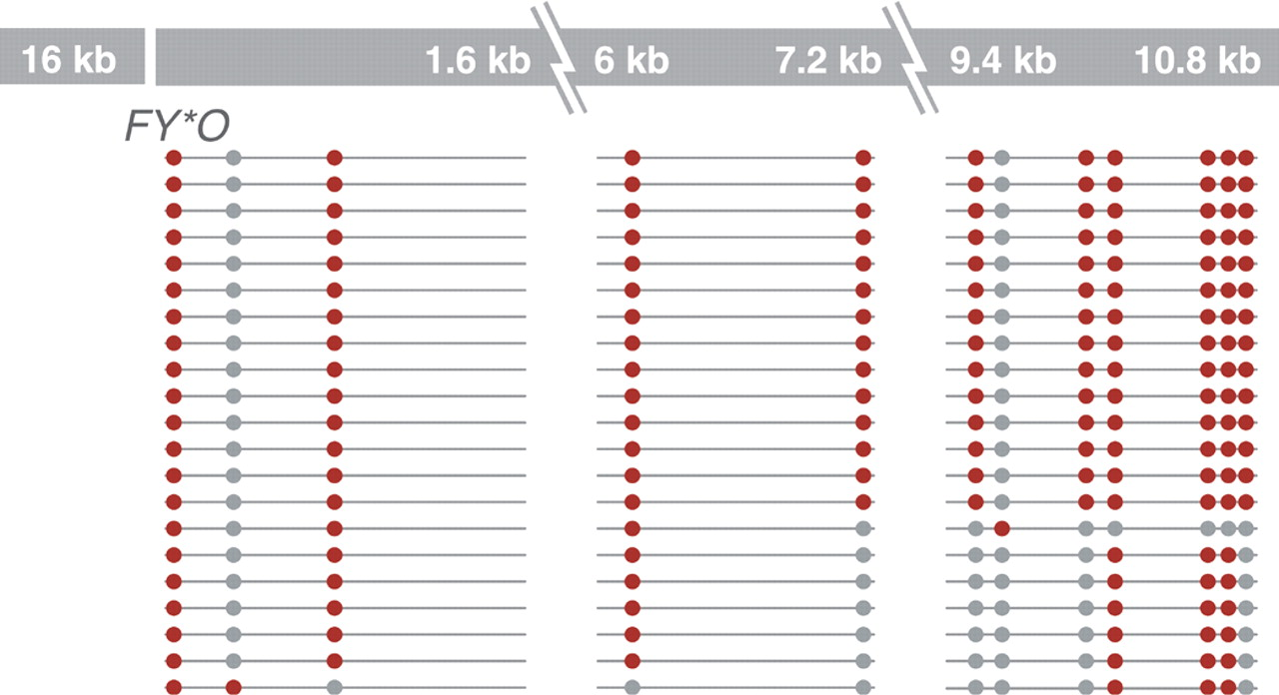
Excess of high-frequency derived alleles at the Duffy red cell antigen (FY) gene
Resistance to malaria.
= rs2814778 (C)
Red – derived. Gray – ancestral (Chimp)
P C Sabeti et al. Science 2006;312:1614-1620
Published by AAAS
Notes:
Excess of high-frequency derived alleles at the Duffy red cell antigen (FY) gene (34). The 10-kb region near the gene has far greater prevalence of derived alleles (represented by red dots) than of ancestral alleles (represented by gray dots).

Slide 51
Ways to detect genes under positive selection
4. Differences between populations
Different populations may have different selective pressures (domestication of cattle, resistance to malaria etc.)
Different alleles may be selected in different populations.

Slide 52
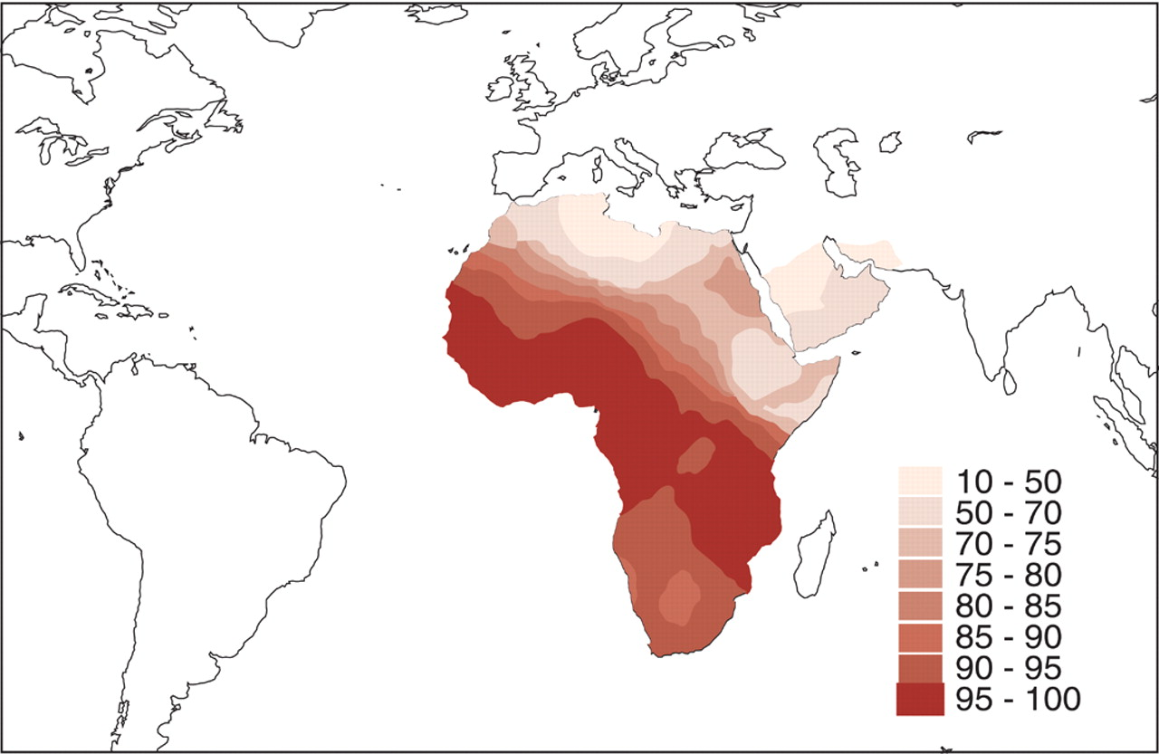
Extreme population differences in FY*O allele frequency.
P C Sabeti et al. Science 2006;312:1614-1620
Published by AAAS
Notes:
Extreme population differences in FY*O allele frequency. The FY*O allele, which confers resistance to P. vivax malaria, is prevalent and even fixed in many African populations, but virtually absent outside Africa (38).

Slide 53
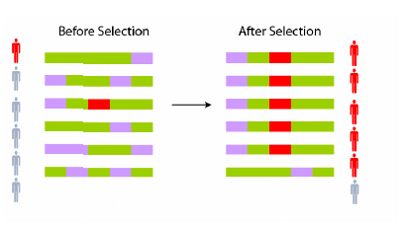
Ways to detect genes under positive selection
5. Long Haplotype
Notes:
A
selective sweep takes approximately 2ln(2N )/s
generations, where N is the effective population
size and s is the selection coefficient (72).
Using the estimated human effective population
size of 10,000 (67) and 25 years per generation,
sweeps with strong selection coefficients
will be complete in ∼10,000 years (s = 5%).

Slide 54
Fig. 1. Time scales for the signatures of selection.
P C Sabeti et al. Science 2006;312:1614-1620
Published by AAAS
Notes:
Time scales for the signatures of selection. The five signatures of selection persist over varying time scales. A rough estimate is shown of how long each is useful for detecting selection in humans. (See fig. S1 for details on how the approximate time scales were estimated).

Slide 55
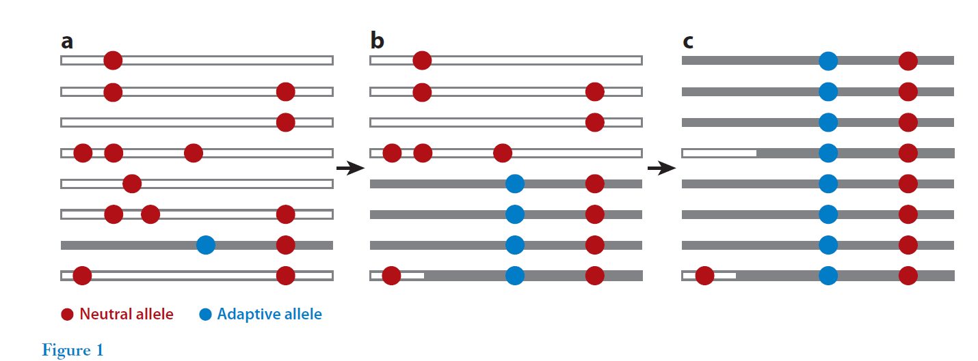
Notes:
The amount of variation remaining in the region
is highly dependent on the recombination
distance from the selected site. As new mutations
accumulate after a complete selective
sweep, there will be an excess of rare alleles in
the swept region as compared with neutral regions
that are unlinked to selected sites.

Slide 56
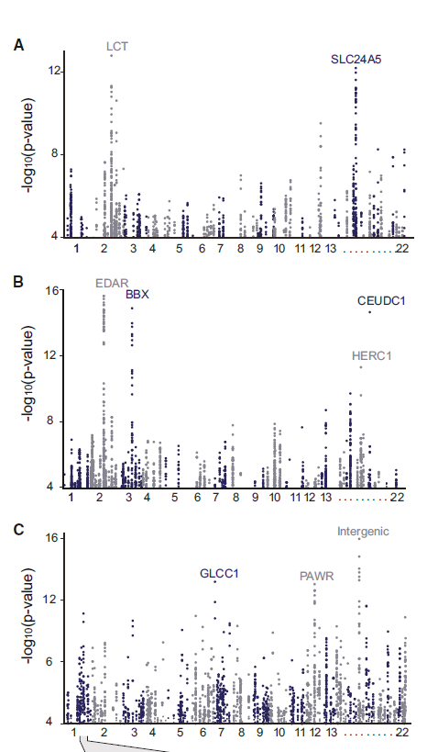
Positive Selection Regions
Europe
Asia
Africa
Grossman et al., Cell 2013
Notes:
SCL24A5 lighter skin
MATP lighter skin
LCT mild
EDAR hair thickness
ARHGEF3 bond density
BTLA rhematoid arthritis
ITPR3 Type 1 diabetes
TLR5 ifn secretion
Most of the changes are expression, only 35 are coding

Slide 57
Look up lactase rs4988235
A – derived, can drink milk
G – ancestral, lactose intolerant
Stuart = GG

Slide 58
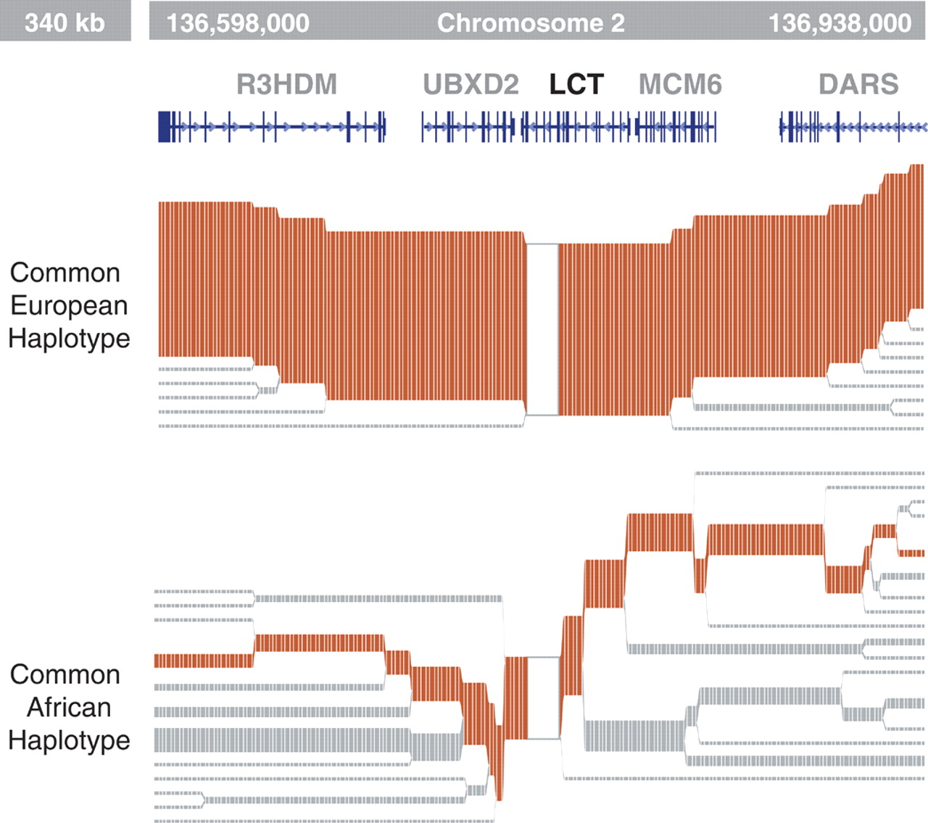
Long haplotype surrounding the lactase persistence allele.
P C Sabeti et al. Science 2006;312:1614-1620
Published by AAAS
Notes:
Long haplotype surrounding the lactase persistence allele. The lactase persistence allele is prevalent (∼77%) in European populations but lies on a long haplotype, suggesting that it is of recent origin (6).

Slide 59
Europeans
Lactase
  a mutation in a regulatory region near the
  gene for lactase (LCT) that allows lactose tolerance to persist into adulthood. This particular variant was apparently selected in parts of Europe after the domestication of cattle.

Slide 60
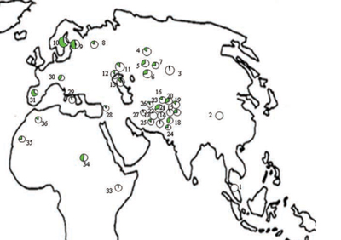
Frequency of the C/T-13910 allele in Lactase

Slide 61
The LCT region appears to have undergone a selective sweep 2000–20,000 years ago (4), coinciding with the domestication of cattle.
The high selection coefficient (between 0.014 and 0.15) distinguishes LCT as one of the most strongly selected loci in the human genome.

Slide 62
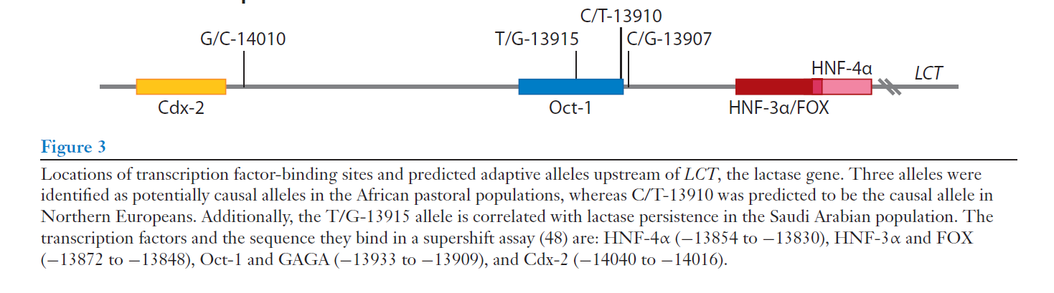
European
African

Slide 63
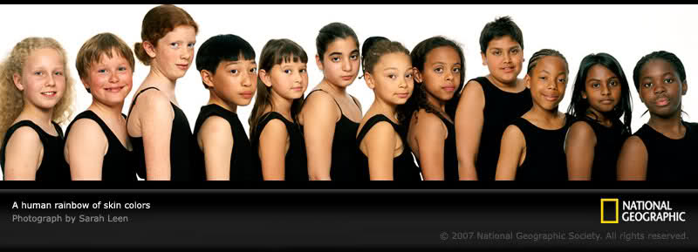
SLC24A5: skin color look up: rs1426654
(A), light-skinned european ancestry
(G), ancestral, dark skin
Stuart = GG

Slide 64
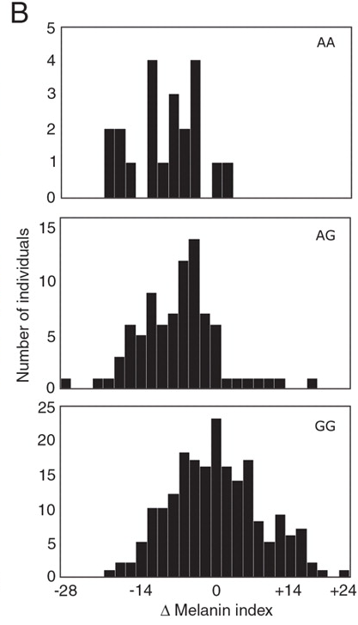
Fig. 6. Effect of SLC24A5 genotype on pigmentation in admixed populations.
Stuart = GG
R L Lamason et al. Science 2005;310:1782-1786
Published by AAAS
Notes:
Effect of SLC24A5 genotype on pigmentation in admixed populations. (A) Variation of measured pigmentation with estimated ancestry and SLC24A5 genotype. Each point represents a single individual; SLC24A5 genotypes are indicated by color. Lines show regressions, constrained to have equal slopes, for each of the three genotypes. (B) Histograms showing the distribution of pigmentation after adjustment for ancestry for each genotype. Values shown are the difference between the measured melanin index and the calculated GG regression line (y = 0.2113x + 30.91). The corresponding uncorrected histograms are shown in fig. S7. Mean and SD (in parentheses) are given as follows: for GG, 0 (8.5), n = 202 individuals; for AG, –7.0 (7.4), n = 85; for AA, –9.6 (6.4), n = 21.

Slide 65
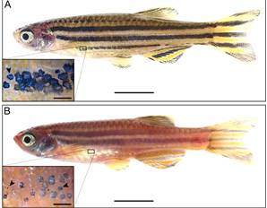
The zebrafish SLC24A5 ortholog (golden) controls skin color

Slide 66
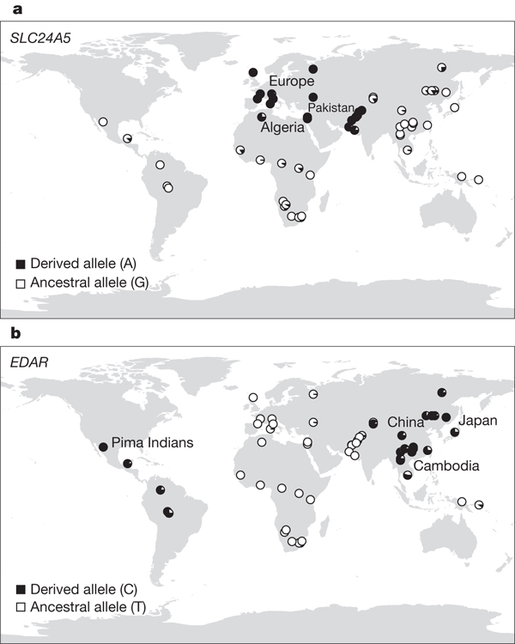
SLC24A5 involved in skin color. A111T .
SLC45A2: Also, an L374F substitution is at 100% frequency in the European sample, but absent in the Asian and African samples.

Slide 67

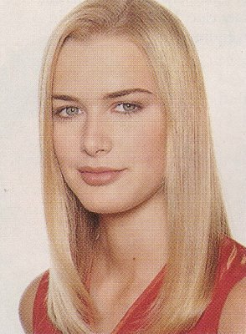
EDAR: Hair thickness

Slide 68
EDAR (rs3827760)
A = thin hair, 370Valine
G = thick hair, 370Alanine
Stuart = GG

Slide 69
Asian
EDAR and EDA2R
  Hair morphology
  have a central role in generation of the primary hair follicle
  A mutation encoding a V370A substitution in EDAR is near fixation in Asia and absent in Europe and Africa
  100% in Pima Indians and in parts of China, and 73% in Japan

Slide 70
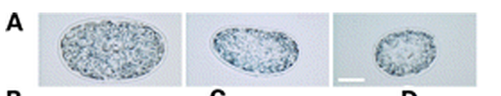
EDAR (rs3827760) hair thickness in Asians
G/G G/A A/A

Slide 71
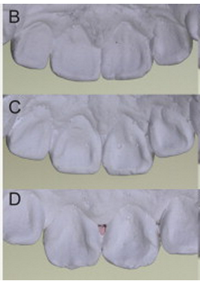
EDAR (rs3827760)
shovel teeth in Asians
AA
GA
GG
Kimura et al., AJHG 2009

Slide 72
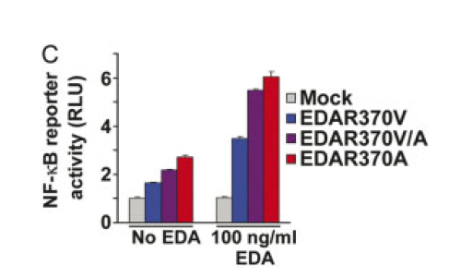
EDAR 370A is more active than 370V

Slide 73
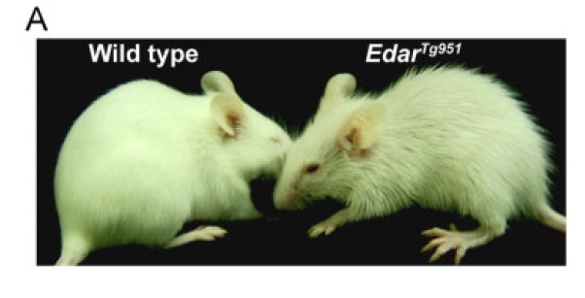
EDAR overexpression

Slide 74
Population distribution of EDAR

Slide 75

Region previously known to be associated with TB resistance
Also shows strong signal for positive selection
Grossman et al., Cell 2013

Slide 76
Lookup TLR5 rs5744174
G = derived, resistant to Salmonella 616F
A = ancestral, sensitive to Salmonella 616L
Stuart = AA

Slide 77

Toll Receptor 5
Shows positive selection in YRI
L616F in extracellular binding site Receptor for bacterial flagellin
Activates NFkB
Proinflammatory response
Differences in TLR5 affect response to Legionnaires disease, neonatal sepsis and Salmonella infection
Grossman et al., Cell 2013

Slide 78


Functional Characterization of TLR5 (L616F)
Transfect Jurkat cells with TLR5 carrying either 616L or 616F
Activate bacterial flagellin
measure NFkB activation
L (ancestral) gives higher activation than F (derived)
suggests that lower TLR5 activity provides protection from Legionnaires disease and neonatal sepsis
Grossman et al., Cell 2013

