Slide 1
Gene 210
Fetal/Prenatal Sequencing
May 19, 2015

Slide 2
Today’s Plan
Innovations in prenatal diagnosis (Gitler)
  Anneuploidy
  Mendelian disorders
  Non-invasive diagnostic technologies
Yair Blumenfeld, M.D.
  clinical aspects
  cell-free RNA and non-aneuploidy issues

Slide 3
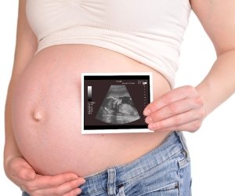
Prenatal Diagnosis
Fetal aneuploidy and other chromosomal defects affect 0.9% of live births
3,000 rare genetic disorders, which collectively are not rare (1%)

Slide 4
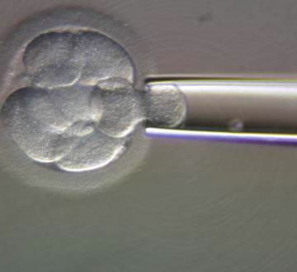
Pre-implantation Genetic Testing during IVF
Embryo biopsy of single blastomere at 6-8 cell stage
Most common autosomal dominant and recessive diseases (e.g. cystic fibrosis, thalassemias, sickle cell anemia, and Duchenne muscular dystrophy, Huntington Disease) as well as chromosomal translocations

Slide 5
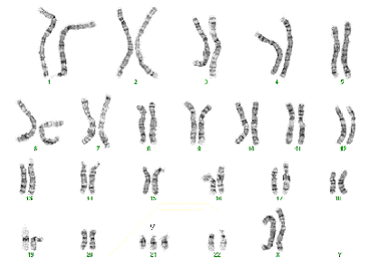
Human chromosomal aneuploidy syndromes

Slide 6

Trisomy 21 (Down Syndrome)
Most common chromosome abnormality in humans. Why?
~1 out of 691 births in US
Increased incidence of Alzheimer disease
Increased incidence of leukemia but decreased incidence of most other cancer types
Increased incidence of congenital heart disease

Slide 7
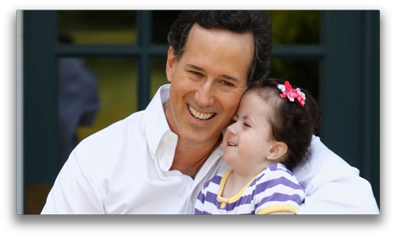
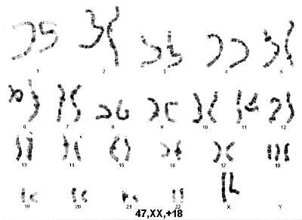
Trisomy 18 (Edwards Syndrome)
~1 out of 6,000 births in US
~80% females
Very low survival rate (median lifespan 5-15 days)
8% survive < 1 year
1% survive to age 10
Major heart, kidney, and other organ abnormalities

Slide 8
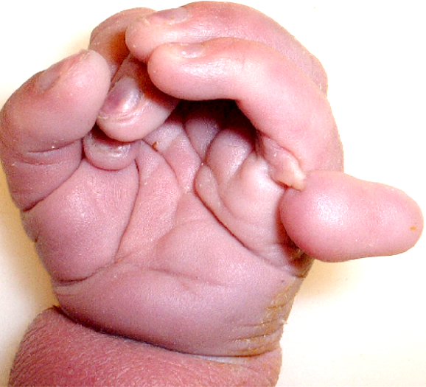
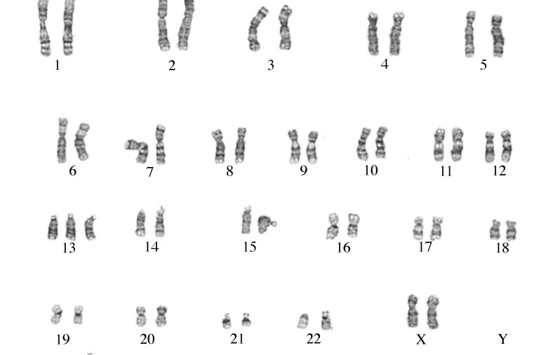
Trisomy 13 (Patau syndrome)
~1 out of 10,000 births in US
Multiple organ defects
Mental retardation and motor impairment
Holoprosencephaly
Polydactyly
>80% of children born with trisomy 13 die within 1st year of life

Slide 9
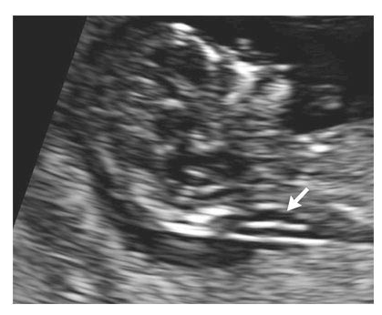
Prenatal Diagnosis
Non-invasive
Ultrasound results combined with additional non-invasive tests:
free beta-hCG/PAPP-A screen (85% sensitivity)
alpha-fetoprotein, unconjugated estriol, beta-hCG, and inhibin-Alpha (INHA) (15-20 weeks) (81% sensitivity)
Increased fetal nuchal translucency)
75-80% sensitivity, 5-6% false positive rate
Performed 11-14 weeks of gestation
Combined: 95% sensitivity, 5% false positive

Slide 10
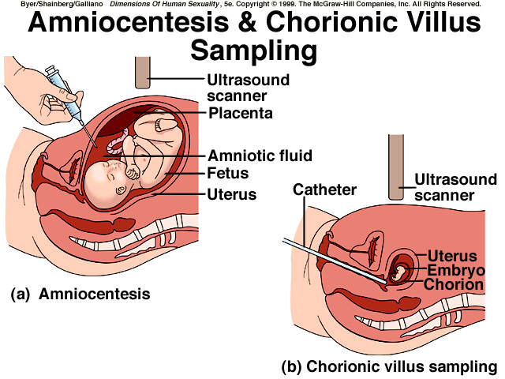
Prenatal Diagnosis
Invasive
Amniocentesis: A sample of the amniotic fluid surrounding the fetus is withdrawn through a needle inserted into the mother's uterus. Fetal chromosomes are analyzed. After 15 weeks of gestation. 1:200 risk of miscarriage.
Chorionic villus sampling (CVS): Cells taken from the embryo placenta can be used to analyze the fetal chromosomes. Typically performed between week 9 and 14. 1:100 risk of miscarriage.

Slide 11
Presence of fetal DNA in maternal plasma and serum
Dennis Lo et al., Lancet 1997
Fetus-derived Y sequences were detected in 24 (80%) of the 30 maternal plasma samples, and in 21 (70%) of the 30 maternal serum samples, from women bearing male fetuses.
These results were obtained with only 10 μL of the samples.
None of the 13 women bearing female fetuses, and none of the ten non-pregnant control women, had positive results for plasma, serum or nucleated blood cells.
“Our finding of circulating fetal DNA in maternal plasma may have implications for non-invasive prenatal diagnosis…”

Slide 12
Biology of circulating fetal DNA
Consists predominantly of short DNA fragments (80% <200bp)
Small fraction (3–6%) of cell-free DNA present in maternal plasma
Earliest gestational age detectable is day 18 after embryo transfer by assisted reproduction (i.e., IVF)
Fetal DNA concentration increases with gestational age
Rapidly cleared following delivery (mean half-life 16 minutes)
Placenta is predominant source of fetal DNA in maternal plasma

Slide 13
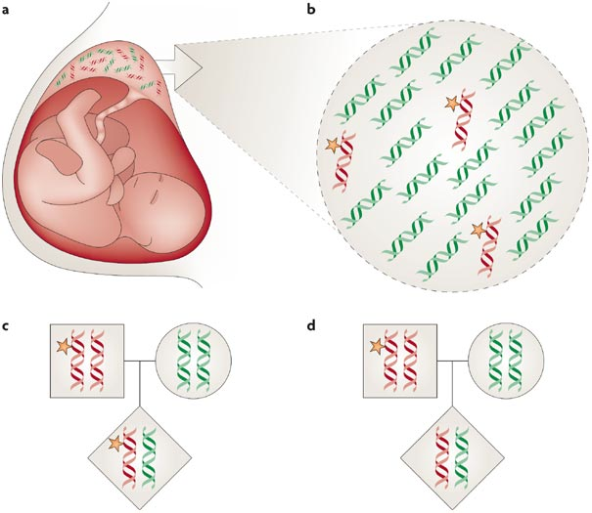
Lo et al., Nat Rev Genet 2007
Notes:
a | Release of fetal DNA into the maternal circulation. Before release, the numbers of paternally (red) and maternally inherited (green) DNA molecules are equal. The block arrow denotes the release of fetal DNA from the placenta into the maternal circulation. b | In maternal plasma, fetal DNA molecules circulate among a background of maternal DNA sequences. Because the fetal DNA allele that the fetus inherits from its mother (green) is genetically identical to the background maternal sequences (green), the allele that the fetus inherits from its father (red) is the most readily distinguishable fetal-specific sequence in maternal plasma. c | Non-invasive prenatal assessment of the fetal genotype could be made on the basis of the positive detection of a molecular feature (yellow star) that is unique to the paternally inherited fetal allele. Examples of unique molecular features include the Y chromosome, RHD blood antigen (when the mother is RHD-negative) and paternally inherited mutations or polymorphisms. d | Alternatively, non-invasive prenatal assessment could be made on the basis of excluding the inheritance of a molecular feature (yellow star) that is unique to the paternally inherited fetal allele. For example, non-invasive prenatal assessment of an autosomal recessive disease could be achieved by excluding the fetal inheritance of the paternal mutation if the mother and father each carry a different mutation. If the couple both carry an identical mutation, the disease could be excluded in the fetus through the detection of a polymorphism that is uniquely linked to the paternal wild-type allele.

Slide 14
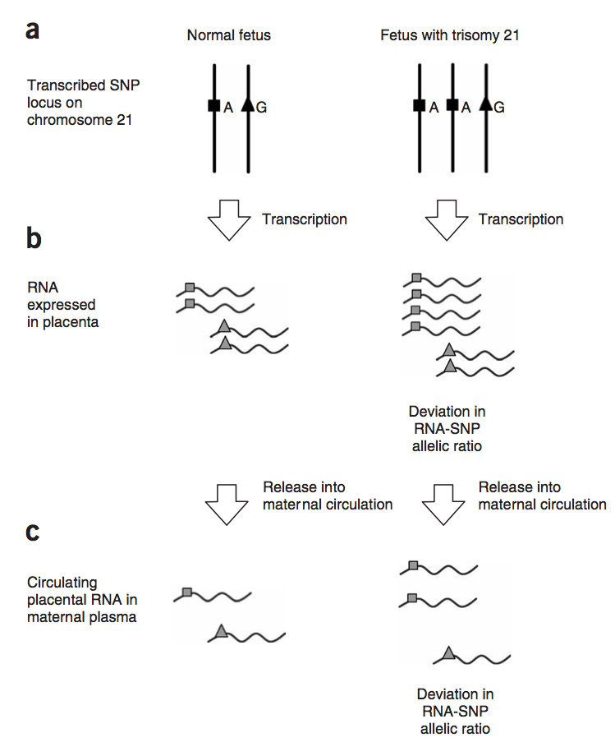

Slide 15
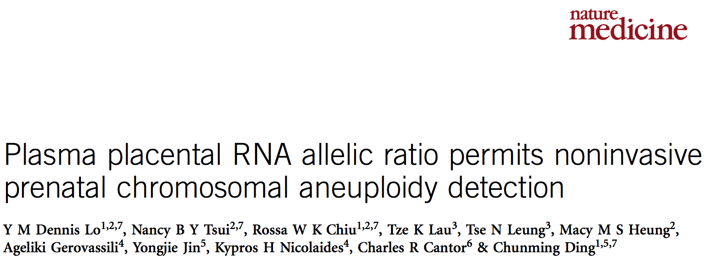
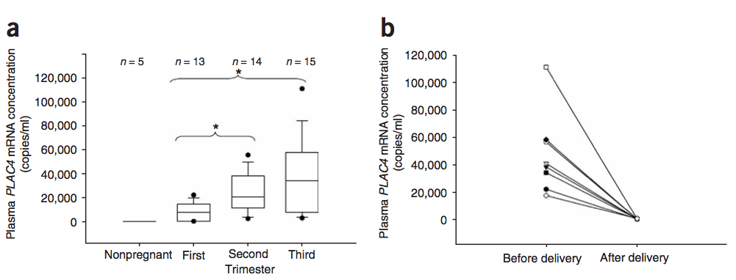

Slide 16
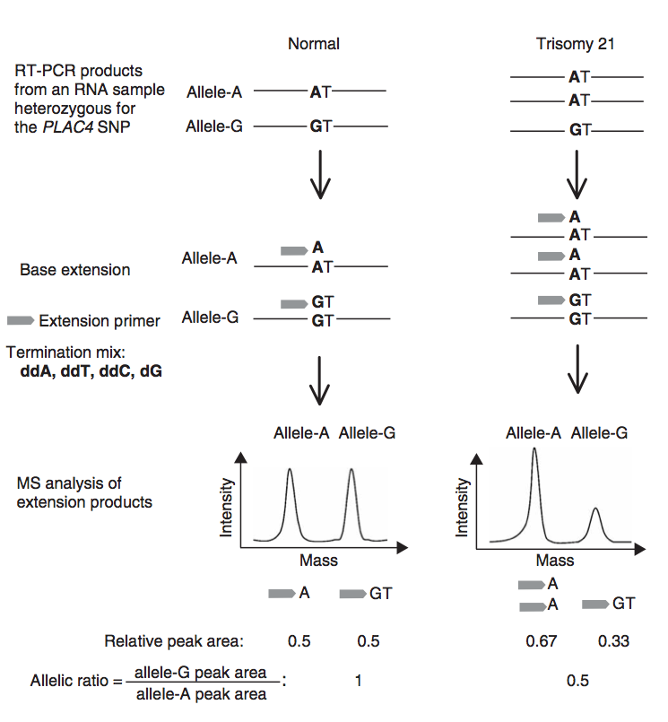

Slide 17
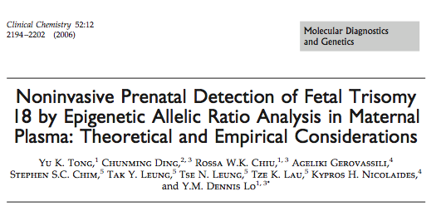
Placental-derived fetal-specific unmethylated maspin (SERPINB5) promoter sequences on human chromosome 18

Slide 18
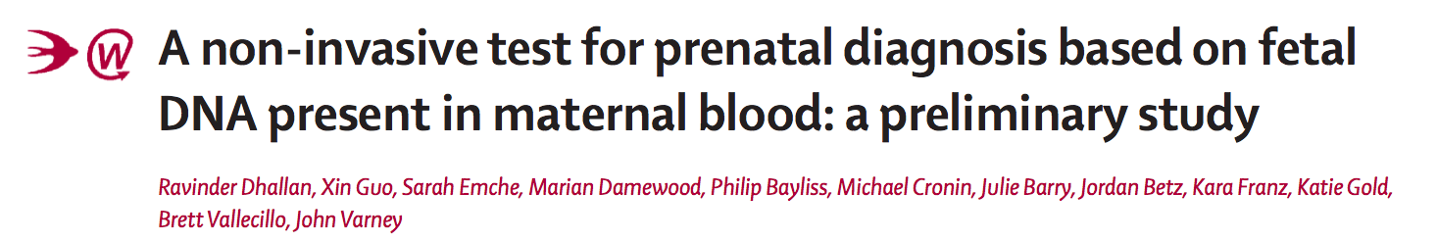

Slide 19
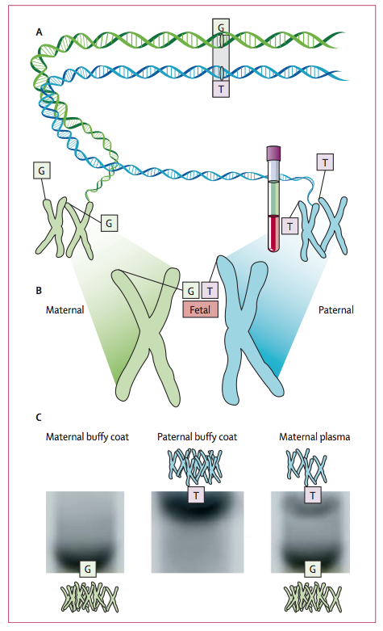
Notes:
Figure 1: Inheritance of single nucleotide polymorphisms
(A) Single nucleotide polymorphisms (SNPs) are the greatest single source of natural variation in the human genome and can be used to determine the copy number of fetal chromosomes. (B) At certain sites within the fetal genome, the inherited paternal allele (“T”) will differ from the inherited maternal allele (“G”). (C) Presence of the paternal allele in the plasma provides a genetic beacon to distinguish fetal DNA from maternal DNA.

Slide 20
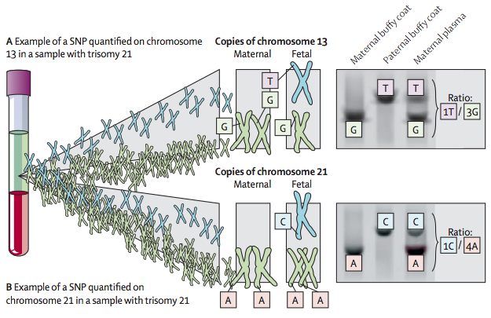
Establishing the copy number of fetal chromosomes through analysis of allele ratios in the maternal plasma
Notes:
Figure 3: Establishing the copy number of fetal chromosomes through analysis of allele ratios in the maternal plasma
(A) Example of a SNP quantified on chromosome 13 in a sample with trisomy 21; the ratio of unique fetal signal (“T”) to the combined maternal and fetal signal (“G”) in the plasma is 1 to 3 and over many SNPs, approaches a theoretical mean ratio of 0·333. (B) Example of a SNP quantified on chromosome 21 in a sample with trisomy 21; the ratio of unique fetal signal to combined maternal and fetal signal is reduced to 1 to 4 and over many SNPs, approaches a theoretical mean ratio of 0·25; consequently, the mean ratio for chromosome 21 will be substantially lower than the mean ratio for chromosome 13.

Slide 21
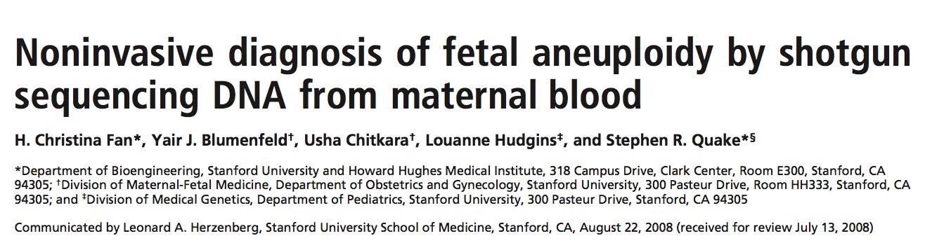
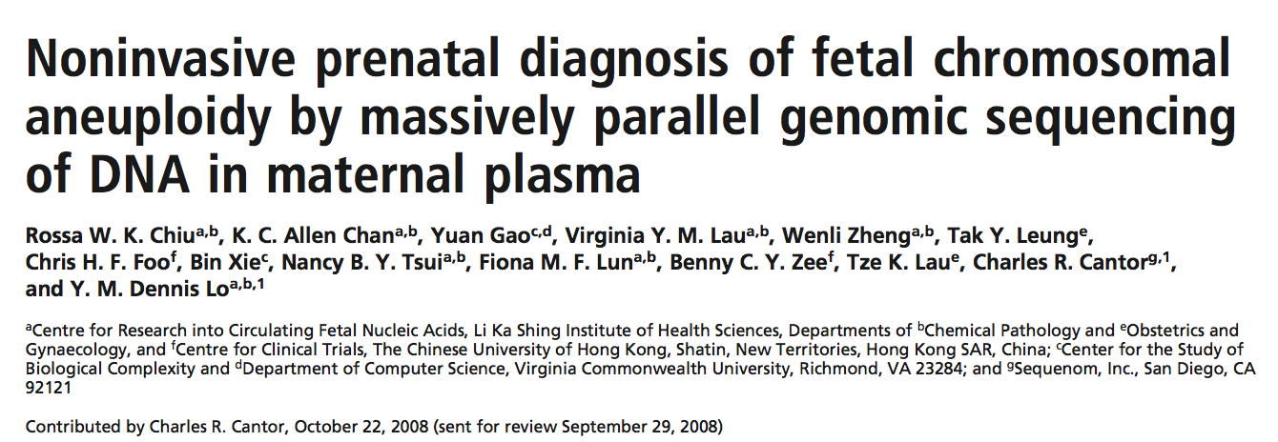

Slide 22
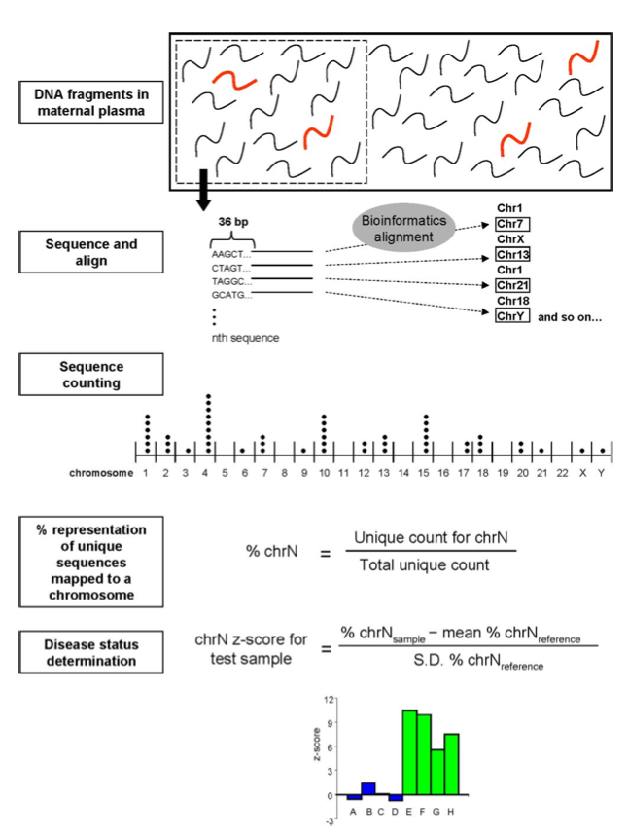

Slide 23
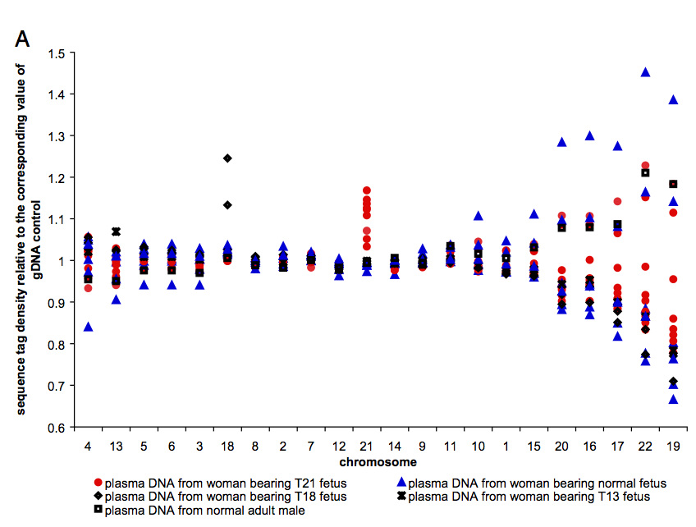

Slide 24
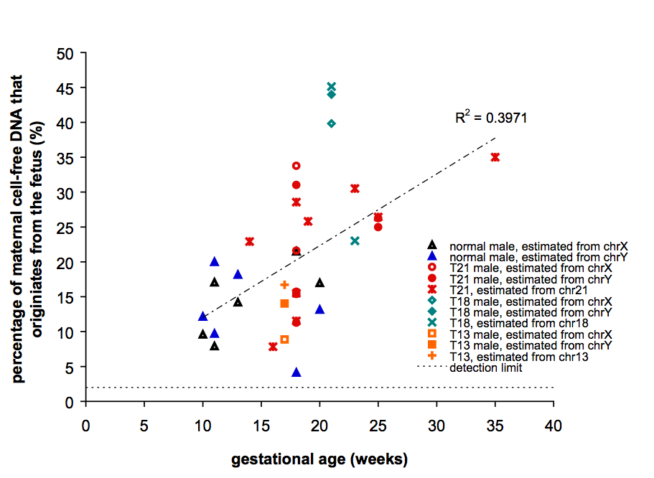

Slide 25




David Ferreiro, an investment banker at Oppenheimer based in New York, has estimated that the non-invasive prenatal-testing market could exceed $1 billion a year. So far, sales volumes reported by Sequenom — the only publicly traded company of the four — have “substantially exceeded expectations”, says Ferreiro.

Slide 26




Nature 2012
Blood Feuds
14 October 2005 Sequenom licenses a patent for non-invasive prenatal diagnosis.
10 August 2010 Sequenom’s lawyers send Verinata Health a letter warning that Verinata is developing tests that will infringe on Sequenom’s patent and patent application.
30 August 2011 Stephen Quake — founder of Verinata — and Hei-Mun Fan, both at Stanford University in California, are issued a patent for ‘Determination of fetal aneuploidies by massively parallel DNA sequencing’.
17 October 2011 Sequenom launches the MaterniT21 test.
6 December 2011 Sequenom sends Aria Diagnostics a letter warning about patent infringement.
19 December 2011 Aria files a complaint against Sequenom.
6 January 2012 Natera files a complaint against Sequenom.
24 January 2012 Sequenom sues Aria.
22 February 2012 Verinata and Stanford University sue Sequenom.
1 March 2012 Verinata launches the Verifi prenatal test.
7 May 2012 Ariosa (formerly Aria) launches the Harmony prenatal test.

Slide 27
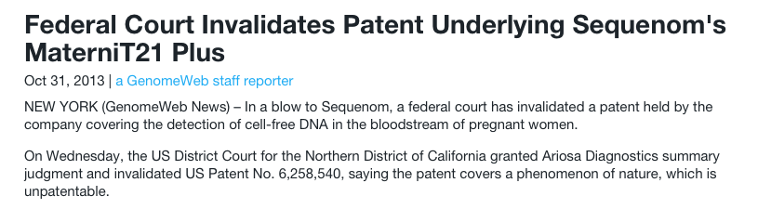
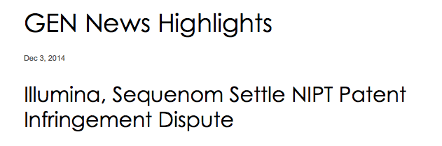

Slide 28
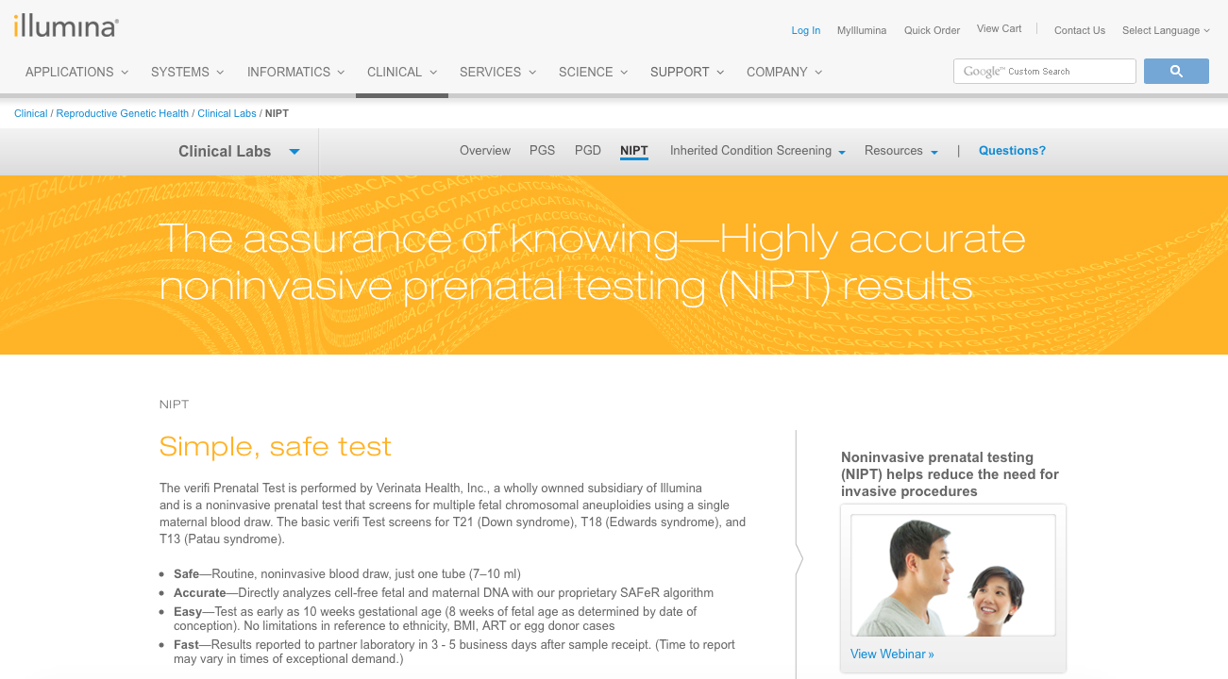
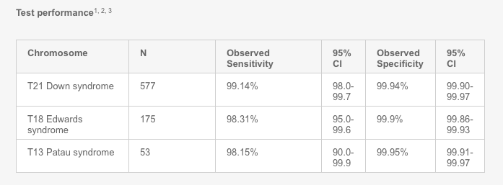

Slide 29
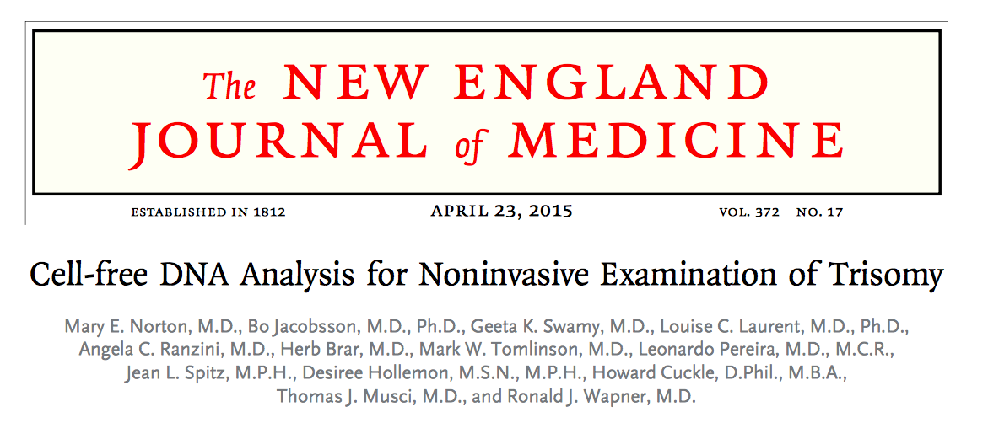

Slide 30
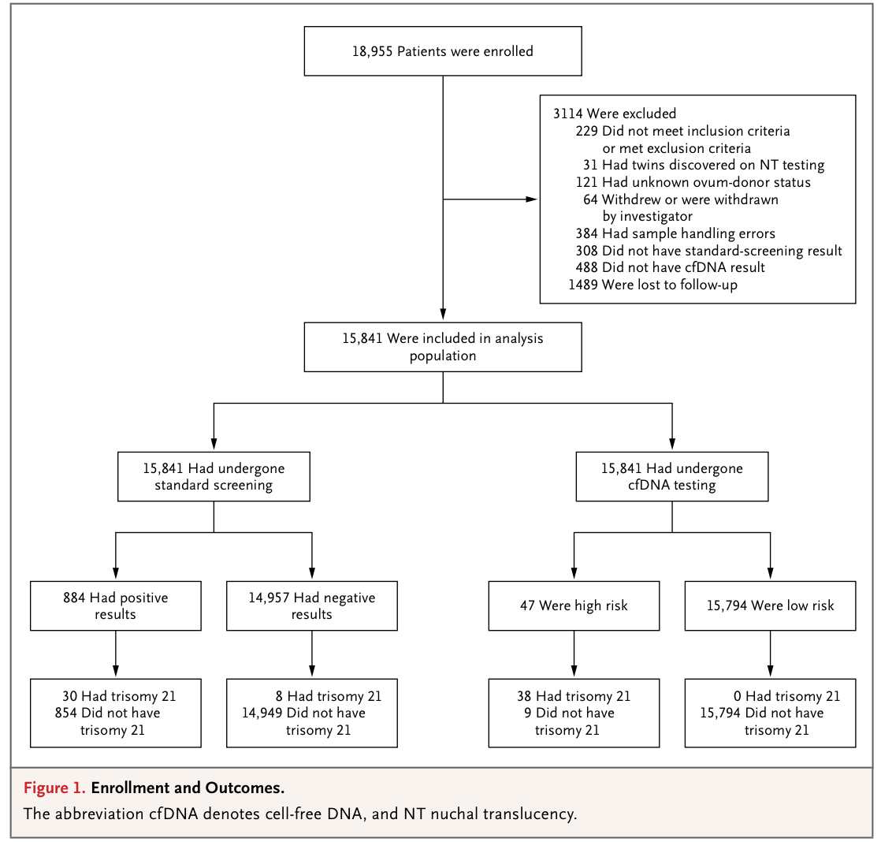

Slide 31
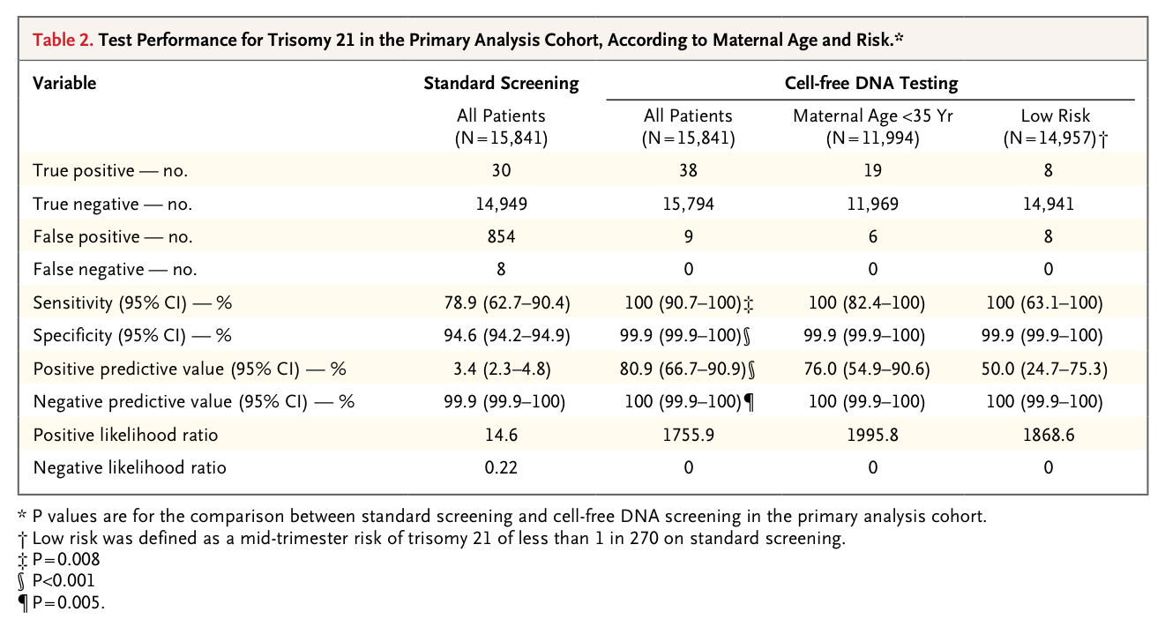
There were 9 false positives among the 15,803 women in the cfDNA-testing group without trisomy 21, for a false positive rate of 0.06% (95% CI, 0.03 to 0.11)
There were 854 false positive results for trisomy 21 on standard screening, for a false positive rate of 5.4% (95% CI, 5.1 to 5.8; P<0.001)
The positive predictive value was 80.9% (95% CI, 66.7 to 90.9) for cfDNA testing and 3.4% (95% CI, 2.3 to 4.8) for standard screening (P<0.001)

Slide 32
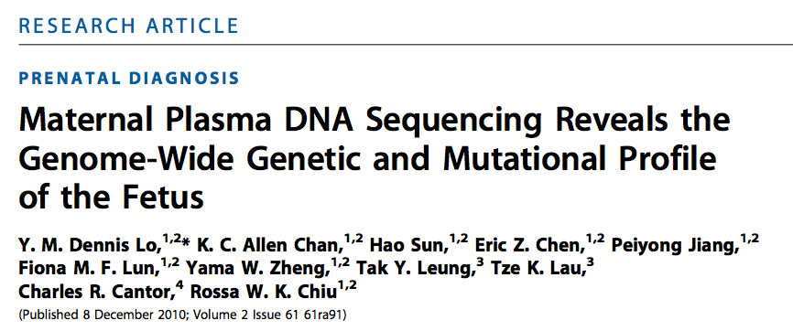
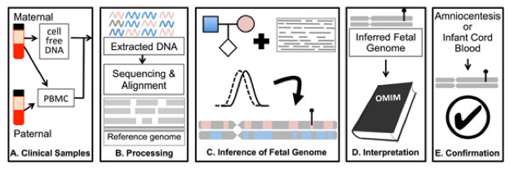
Notes:
Overview of noninvasive fetal whole genome sequencing. (a) Sample collection. Parental blood samples are collected in the first or second trimester. After centrifugation, parental DNA is extracted from peripheral blood mononuclear cells (PBMC) or buffy coat, while cfDNA is isolated from the maternal plasma. (b) Sample processing. Extracted DNA is amplified for library preparation and sequenced to high depth. Reads are aligned to a reference genome to identify variant alleles carried by one or both parents. (c) Inference of fetal genome. A statistical model combines known parental genotypes and alleles observed in cfDNA reads to predict fetal inheritance. High-impact mutations, whether inherited or de novo, are identified (lollypop). (d) Interpretation. Identified variants are compared with catalogs of known disease-associated mutations. (e) Confirmation. A subset of clinically actionable predicted mutations is confirmed with conventional procedures such as amniocentesis. Accuracy of genome inference can be assessed post hoc with DNA extracted from cord blood after delivery

Slide 33
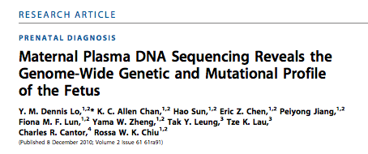
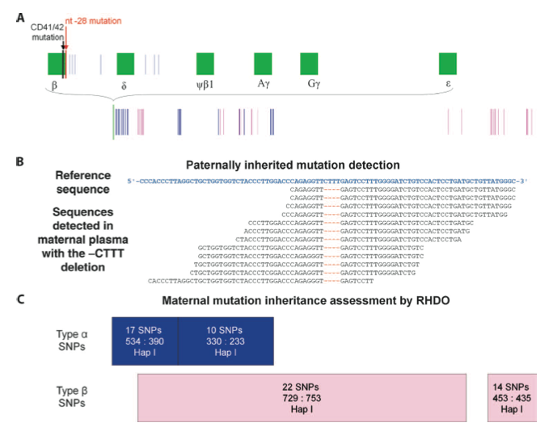
Prenatal diagnosis of β−thalassemia by sequencing from maternal plasma
Notes:
β-Thalassemia is an autosomal recessive disease characterized by severe anemia and is caused by mutations in the HBB gene encoding the β subunit of hemoglobin. To inherit the disease, the fetus must carry mutations from both parents. The pregnant mother carried one HBB gene mutation, and the father carried a different mutation. The authors conducted genome-wide genotyping of maternal and paternal DNA derived from blood cells for ~900,000 single-nucleotide polymorphisms (SNPs) and divided the SNPs into five categories. From the maternal plasma DNA sequencing data, they searched for and found the paternal mutation inherited by the fetus. They then used relative haplotype dosage (RHDO) analysis to see whether the fetus had inherited the genomic region that contained the maternal mutation. They found that the fetus had not inherited the maternal mutation and thus was a heterozygous carrier for β-thalassemia.

Slide 34
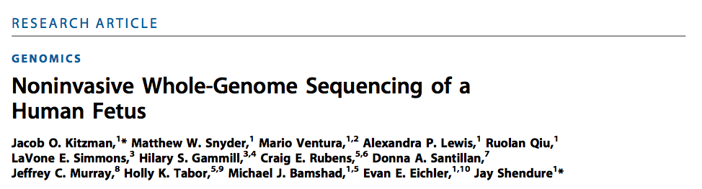

Slide 35
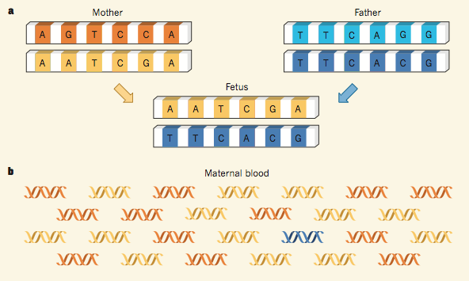
Bianchi Nature 2012
Notes:
The blood of a pregnant woman contains both her own DNA and that of her fetus. Therefore, for every haplotype, the blood- derived DNA will contain copies of the paternal sequence inherited by the fetus (blue), copies of the maternal sequence that is not passed to the fetus (orange) and copies of the maternal sequence that was inherited by the fetus (yellow), and which will therefore be present in excess relative to the orange sequence.

Slide 36
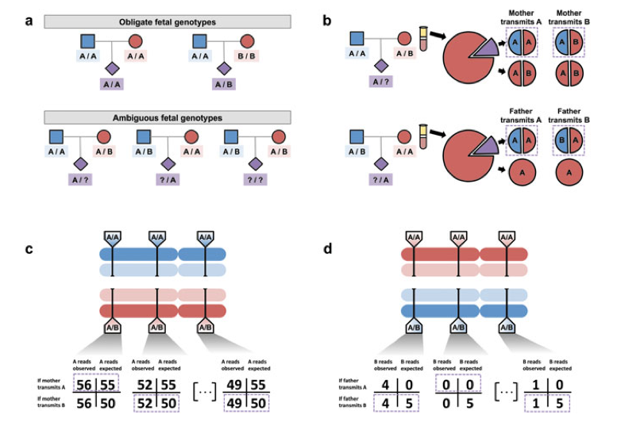
Inference of the fetal genome on a site-by-site basis
Notes:
Inference of the fetal genome on a site-by-site basis. (a) Observed parental genotypes at a given site constrain the possible fetal genotypes. At the vast majority of sites, both parents are homozygotes, and the fetal genotype is unambiguous. (b) Expected cfDNA makeup in the maternal plasma at maternal (top) and paternal (bottom) heterozygous sites. At these sites, either allele could be transmitted, yielding different expected allelic fractions. (c) Schematic of inference of fetal inheritance at maternal heterozygous sites. Numbers shown assume a constant sequencing depth of 100 at each site and do not represent real data. After sequencing the cfDNA, observed allele counts are compared with expected allele counts at each site, and in each case, the more likely scenario is chosen (purple boxes). (d) Schematic of inference of fetal inheritance at paternal heterozygous sites. Numbers are presented as in (c). At each site, presence of the B allele is unexpected in cases where the father transmits the ‘A’ allele. At the rightmost site, the single observed ‘B’ allele could be evidence of true ‘B’ transmission or an error introduced during the sequencing process

Slide 37
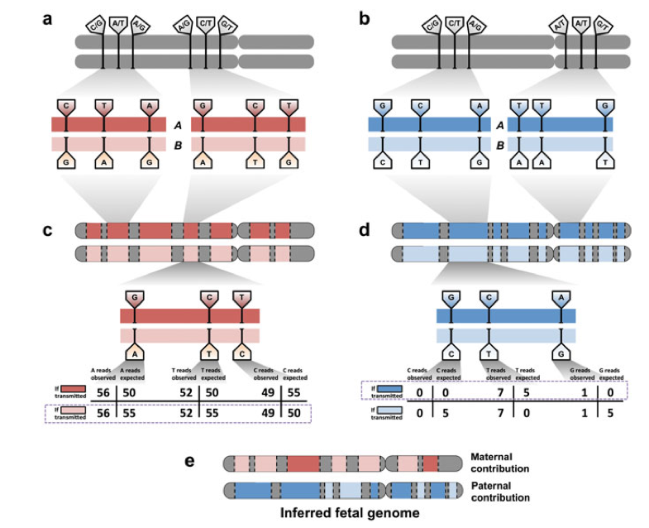
Inference of the fetal genome from haplotype blocks
Notes:
Inference of the fetal genome from haplotype blocks. (a) Phasing of maternal heterozygous sites into haplotype blocks (red bars). Haplotype blocks contain dozens or hundreds of such sites and cover over 300 kilobases on average. A single chromosome may have over 100 haplotype blocks; contiguity between blocks is not defined. Approximately 90% of all heterozygous sites are incorporated into haplotype blocks. Sites shown do not represent real data. (b) Phasing of paternal heterozygous sites into haplotype blocks (blue bars). Paternal and maternal blocks may overlap but are independently defined. (c) Schematic of inference of fetal inheritance of maternal haplotype blocks. Numbers shown assume a constant sequencing depth of 100 at each. After sequencing the cfDNA, evidence of deviations from expected allele counts is aggregated over each site in haplotype blocks ‘A’ and ‘B’, and the more likely block is predicted. Block-level predictions in turn determine predictions at each contained site. The site in the center of the block would be incorrectly predicted if sites were considered independently; its inclusion in a haplotype block mitigates sampling noise and corrects the prediction. (d) Schematic of inference of fetal inheritance of paternal haplotype blocks. Numbers are presented as in (c). The observed ‘G’ allele at the rightmost site, likely to cause an incorrect prediction if sites were considered independently, is now correctly identified as an error introduced during the sequencing process rather than evidence of transmission of the ‘G’ allele. (e) The inferred fetal genome is a composite of the parental haplotype blocks

Slide 38
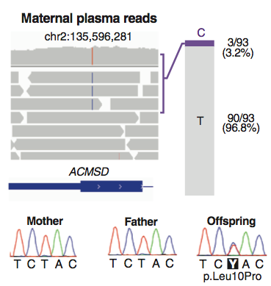
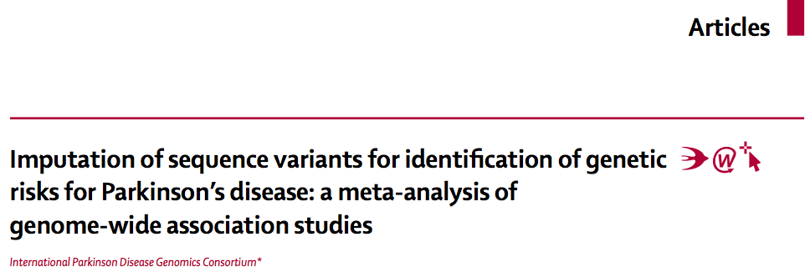
De novo missense mutation in the gene ACMSD detected

Slide 39
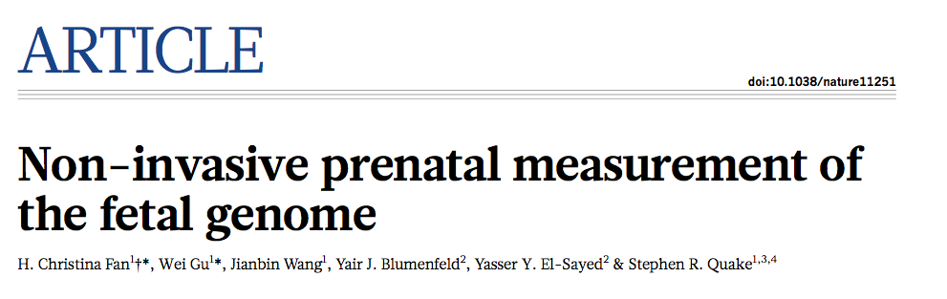

Slide 40
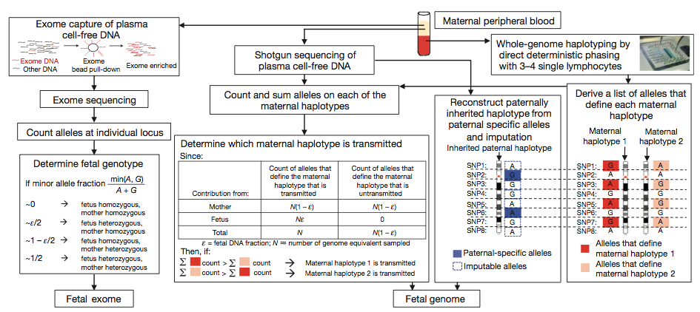
Molecular counting strategies for measuring the fetal genome non-invasively from maternal blood only

Slide 41
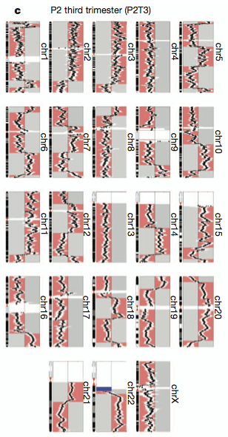
Prenatal diagnosis of DiGeorge Syndrome
Notes:
Over-representation of ‘maternal haplotype 2’ in P2T3 maternal plasma immediately adjacent to the DiGeorge syndrome associated deletion (blue) indicates fetal inheritance of the deletion, which agrees with fetal cord blood genotype.

Slide 42
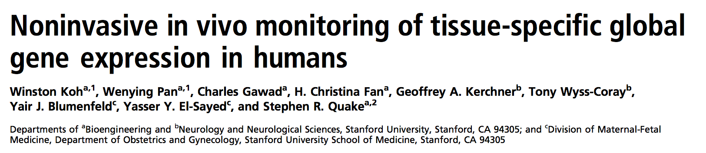
a longitudinal study on pregnant women and analyzed their combined cell-free RNA transcriptomes across all three trimesters of pregnancy and after delivery.
possible to track specific longitudinal phenotypic changes in both the mother and the fetus and that it is possible to directly measure transcripts from a variety of fetal tissues in the maternal blood sample.
studied the role of neuron-specific transcripts in the blood of healthy adults and those suffering from the neurodegenerative disorder Alzheimer’s disease and showed that disease specific neural transcripts are present at increased levels in the blood of affected individuals.

Slide 43
Non-Invasive Fetal Genome Sequencing: Opportunities and Challenges
Advantages
Earlier detection of genetic disorders allows for preparation for postnatal interventions (e.g., SCNA1 mutations cause seizures; spontaneous mutations causing multiple endocrine neoplasia --> prophylactic thyroidectomy)

Slide 44
Non-Invasive Fetal Genome Sequencing: Opportunities and Challenges
Might increase rates of elective pregnancy termination. But could make that safer, if performed early in gestation.
Societal pressure to terminate any fetus suspected to have a Mendelian condition?

Slide 45
Non-Invasive Fetal Genome Sequencing: Opportunities and Challenges
If access to genetic testing limited by cost, might result in children with Mendelian conditions disproportionately born to lower income families
What about variants identified beyond scope of study? E.g., variants that increase risk for a trait (How might this help parent?)

Slide 46
Non-Invasive Fetal Genome Sequencing: Opportunities and Challenges
The ACMSD de novo mutation identified by Kitzman et al – is pregnancy more vulnerable time to make decision – more weight given to information than warranted?
Does this information go in baby’s medical record? Updated and continually mined? Or destroyed? Who controls it?

Slide 47
Today’s Plan
Innovations in prenatal diagnosis (Gitler)
  Anneuploidy
  Mendelian disorders
  Non-invasive diagnostic technologies
Yair Blumenfeld, M.D.
  clinical aspects
  cell-free RNA and non-aneuploidy issues

