Slide 1
Gene 210
Genetics of
Neurodevelopmental and Neurospychiatric disorders
April 23, 2015

Slide 2
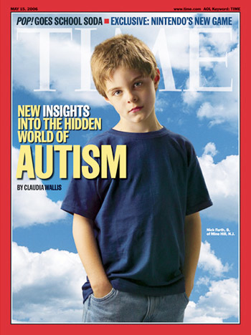
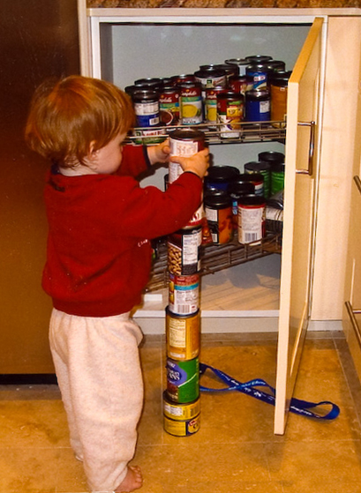
Autism Spectrum Disorders

Slide 3
Autism Spectrum Disorders
Autism: impairments in social interactions, communication, and imaginative play prior to age 3 years. Stereotyped behaviors, interests, and activities.
Asperger's Syndrome: impairments in social interactions and the presence of restricted interests and activities, with no clinically significant delay in language, and testing in the range of average to above average intelligence.
Pervasive Developmental Disorder - Not Otherwise Specified (PDD-NOS): child does not meet the criteria for a specific diagnosis, but there are severe and pervasive impairment in specified behaviors.
Rett Syndrome: a syndrome which occurs primarily in females and rarely in males. Period of normal development and then loss of previously acquired skills, loss of purposeful use of the hands replaced with repetitive hand movements beginning at the age of 1 to 4 years.
Childhood Disintegrative Disorder: characterized by normal development for at least the first two years, significant loss of previously acquired skills.

Slide 4
Autism is highly heritable
Relative risk of a child being diagnosed with autism is increased at least 25-fold over the population prevalence in families in which a sibling is affected.
Siblings and parents of an affected child are more likely than controls to show subtle cognitive or behavioral features that are qualitatively similar to those observed in probands.
Twin studies indicate that concordance rates for monozygotic twins (70–90%) are several-fold higher than the corresponding values for dizygotic twins (0–10%)
Abrahams and Geschwind, 2008

Slide 5
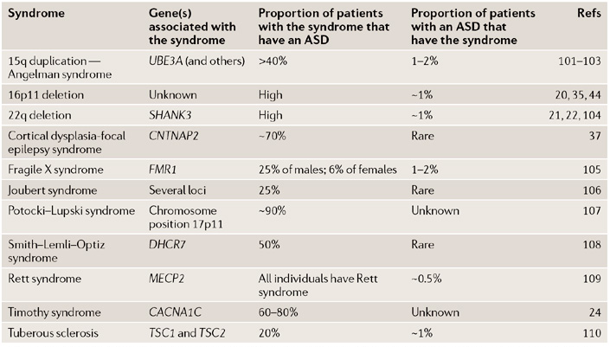
ASD-related syndromes
Biological themes: defective synaptic function and abnormal brain connectivity

Slide 6
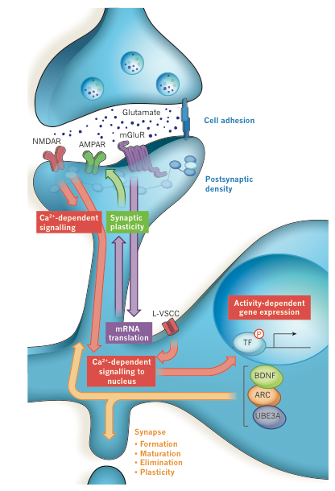
Regulation of synaptic function by neuronal activity
Ebert and Greenberg, 2013

Slide 7
Role of Rare Mutations in ASDs
6-7% of ASDs harbor chromosomal abnormalities (e.g., CNVs)
Inherited duplications of chromosomal region 15q11-15q13 are found in 1-2% of ASDs
  UBE3A and GABRB3 genes located in this region
Other regions implicated: 22q13 (SHANK3), 2q37, 5p15, 17p11, Xp22
Large Copy Number Variations (CNVs): 100kb to MBs
Abrahams and Geschwind, 2008

Slide 8
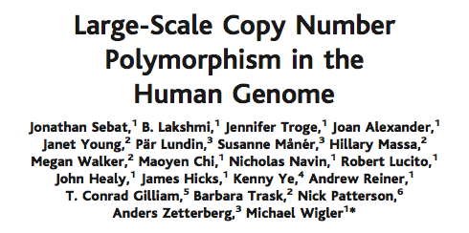
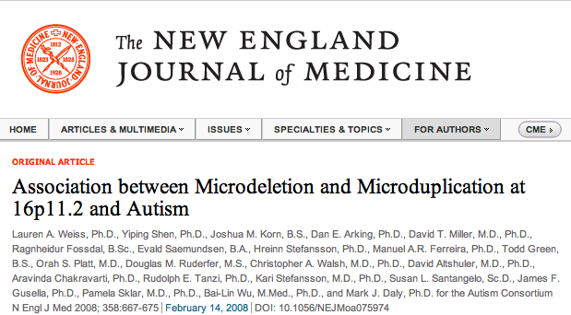
Copy Number Variations
On average, individuals differed by 11 CNVs, and the average length of a CNV interval was 465 kilobases

Slide 9
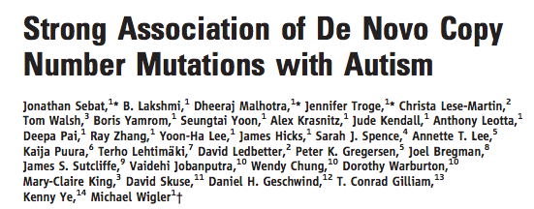
Copy Number Variations
Science, 2007
Confirmed de novo CNVs were significantly associated with autism (P = 0.0005)
CNVs were identified in 12 out of 118 (10%) of patients with sporadic autism vs. 2 out of 196 (1%) of controls and 2 out of 77 (3%) of inherited autism cases.

Slide 10
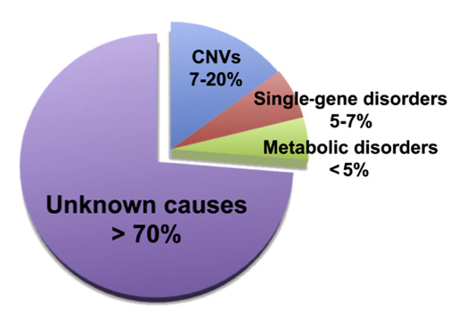
Autism Spectrum Disorders
Highly heritable – twin studies estimate 85-92%
Schaaf and Zoghbi, 2011
The most genetic of all developmental neuropsychiatric syndromes
Risk of 2-8% among siblings (20-80X higher than in general population)

Slide 11
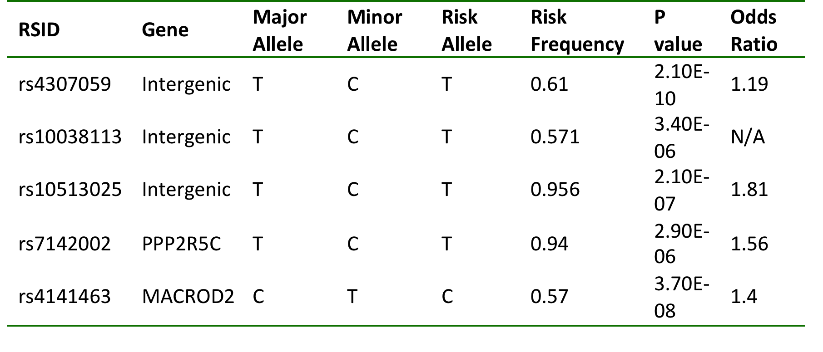
Common variants associated with ASDs
Wang et al., Nature 2009
Ma et al., Ann Hum Genet 2009
Weiss et al., Nature 2009
Anney et al., Hum Mol Genet 2010

Slide 12
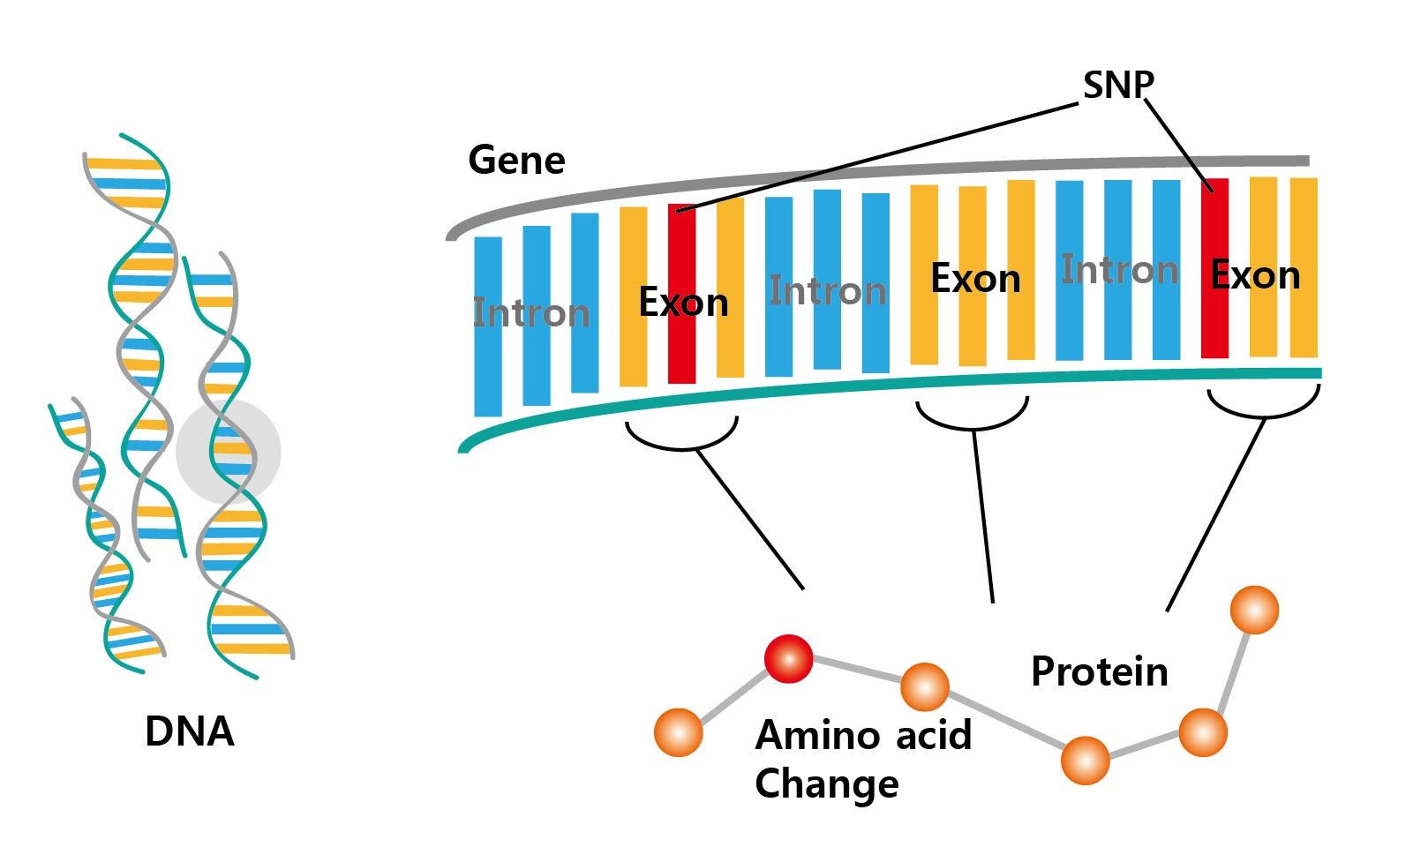
Exome Sequencing

Slide 13
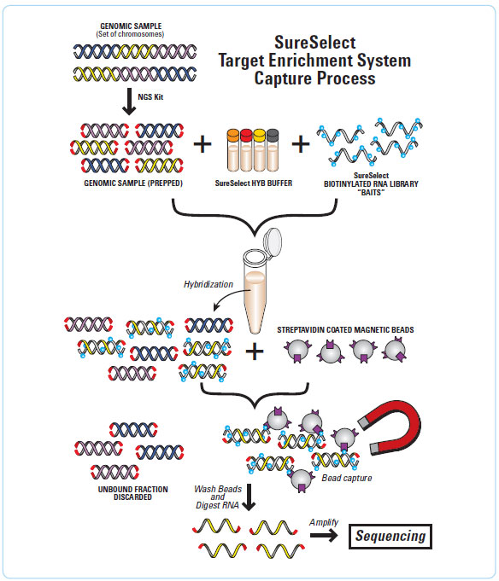
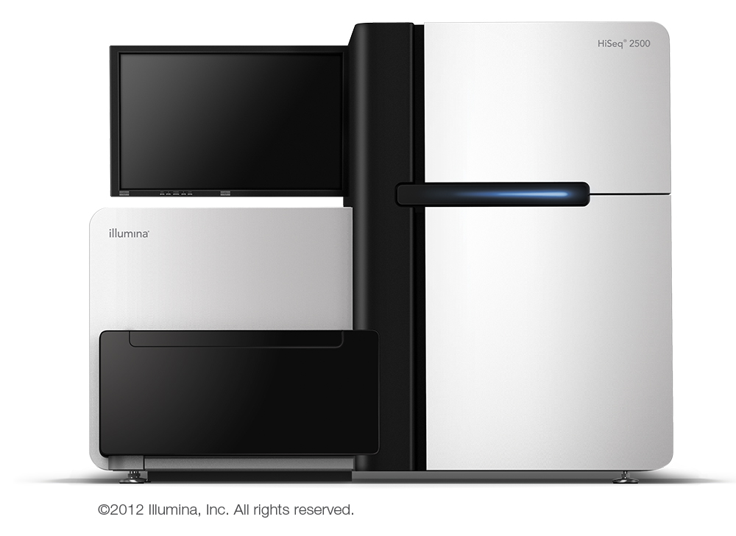
Exome Sequencing
AGGTCGTTACGTACGCTAC
GACCTACATCAGTACATAG
GCATGACAAAGCTAGGTGT
Mapping, alignment, variant calling
Notes:
Method: Prepare the Exome
Genomic DNA is sheared by sonication (Covaris, Adaptive Focused Acoustics)
Ends are repaired and A bases are added to 3’ end
Library adaptors are ligated
Method: Capture the Exome
DNA is hybridized to biotinylated RNA probes for target enrichment
Exons are captured by streptavidin coated magnetic beads
Indexes are added to each of the samples
Method: Sequence the Exome
Illumina Multiplexed Sequencing
DNA is attached via adaptors to surface and sequenced in parallel
Sequencing by synthesis
Randomly fragmented genomic DNA are attached to a planar, optically transparent surface.
Attached DNA fragments are extended and bridge amplified to create an ultra-high density sequencing flow cell with hundreds of millions of clusters, each containing ~1,000 copies of the same template.
DNA molecules are physically bound to a surface, and sequenced in parallel.
Sequencing by synthesis uses a DNA polymerase to determine the base sequence.
The Illumina platform uses reversible dye-terminators, adding one nucleotide at a time, detecting fluorescence at each position in real time, and allowing polymerization of another nucleotide by repeated removal of the blocking group.
Method: Analysis
Align reads to the genome using BWA (Burrows-Wheeler Aligner)
Removed Duplicates using Picard
Calculate coverage with GATK (Genome Analysis Tool Kit, Broad Institute)
Call variants with GATK
Annotate variants with SIFT, SeattleSeq
Filter variants observed in parents, dbSNP database, and 1000 Genomes Pilot Project Data

Slide 14
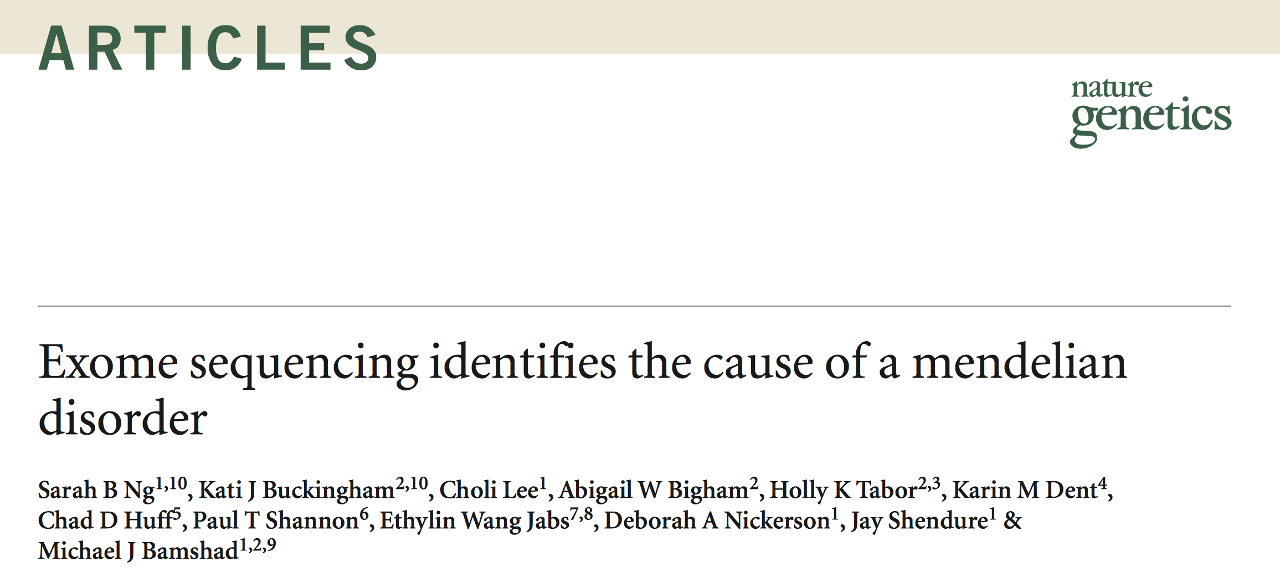

Slide 15
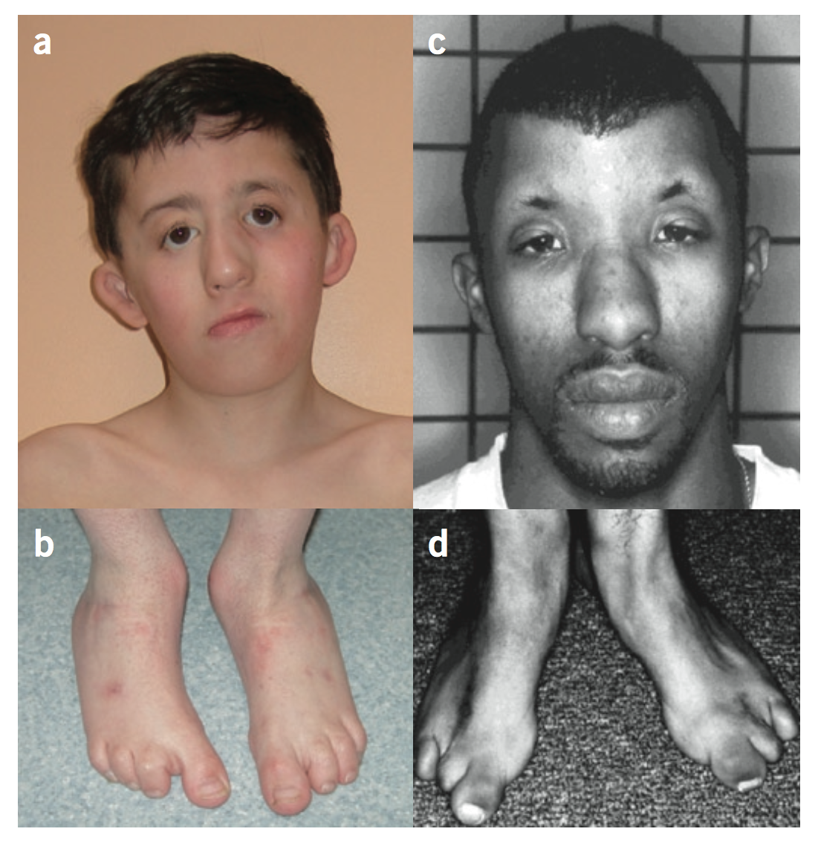
Miller Syndrome

Slide 16
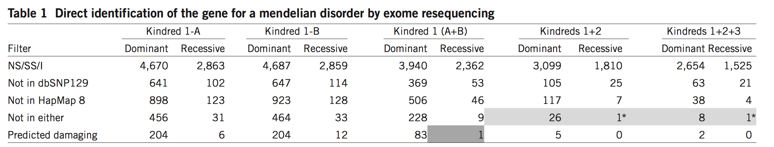
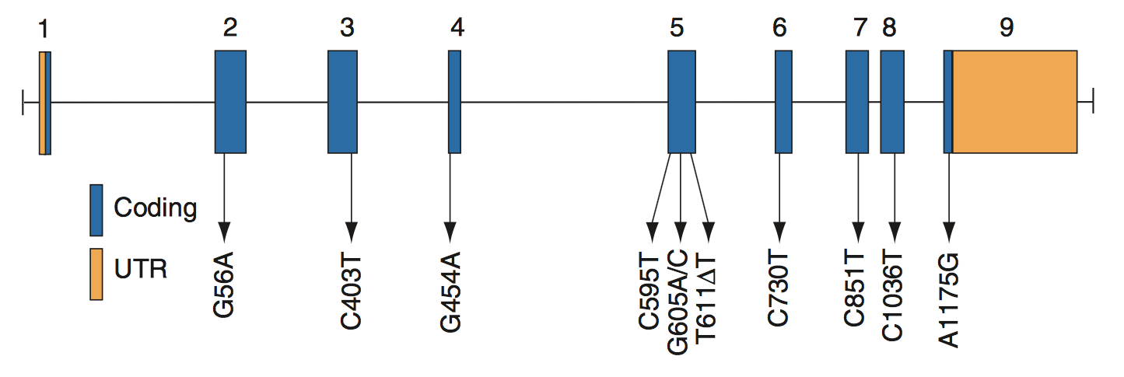
DHODH

Slide 17
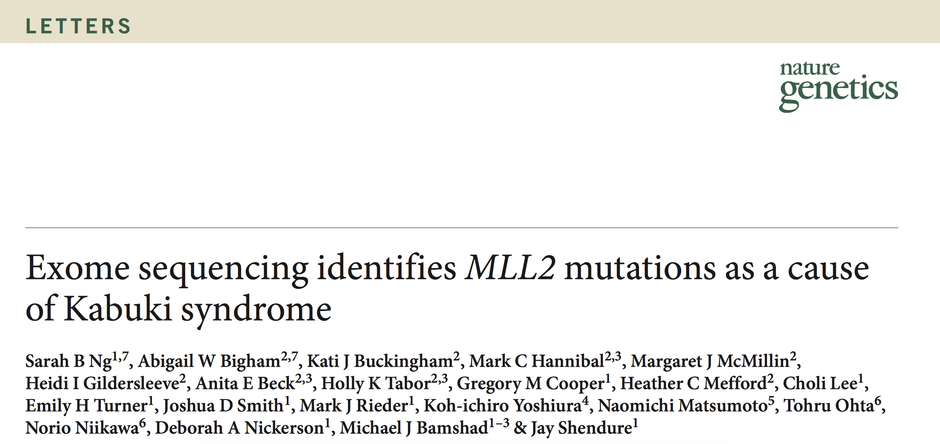
“Kabuki syndrome is a rare, multiple malformation disorder characterized by a distinctive facial appearance, cardiac anomalies, skeletal abnormalities, immunological defects and mild to moderate mental retardation.
Kabuki syndrome has an estimated incidence of 1 in 32,000 and approximately 400 cases have been reported worldwide. The vast majority of reported cases have been sporadic, but parent-to-child transmission in some cases.”

Slide 18
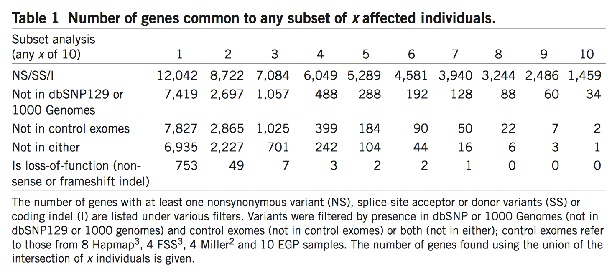
Sequenced exomes of 10 individuals with Kabuki Syndrome
“Under a dominant model in which each case was required to have at least one previously unidentified nonsynonymous variant, splice acceptor and donor site mutation or coding indel variant in the same gene, only a single candidate gene (MUC16) was shared across all ten exomes”
Why is MUC16 unlikely to be the disease gene?
Why didn’t they find the disease gene?

Slide 19
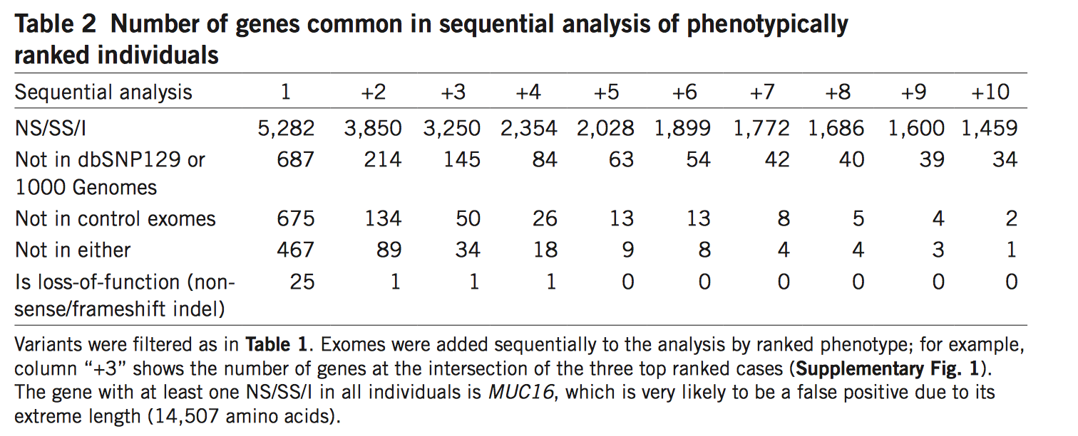

Slide 21
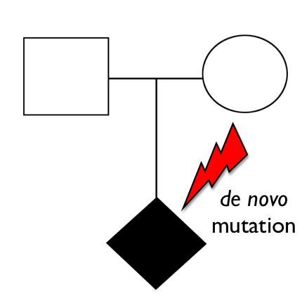
Rare de novo mutations in ASDs

Slide 22
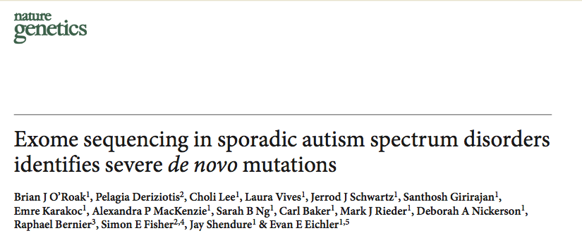
Sequenced 20 autism trios
Identified 21 de novo mutations (11 protein-altering)

Slide 23
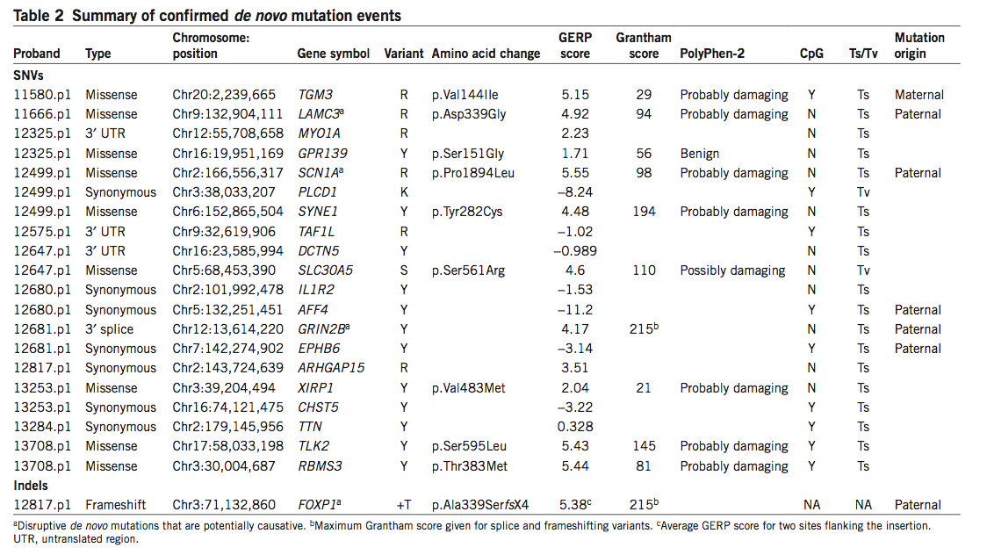

Slide 24
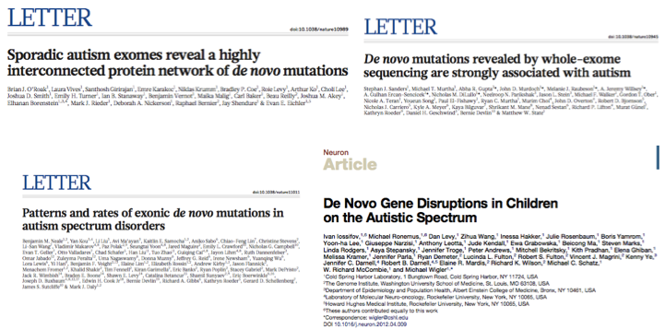
Rare de novo mutations in ASDs

Slide 25
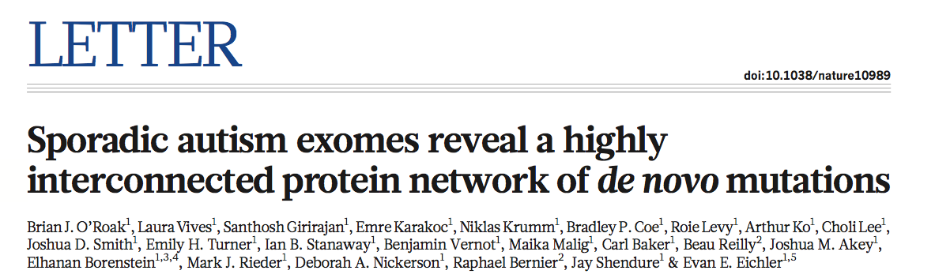
Sequenced exomes of 189 new trios (+ 20 original trios)
Also sequenced exomes of 50 unaffected siblings
Total of 677 exomes from 209 families

Slide 26
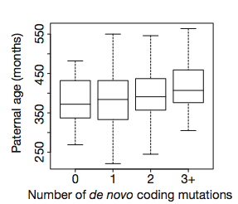
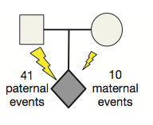
Number of de novo coding mutations increases with paternal age at conception
Paternally inherited de novo mutation bias

Slide 27
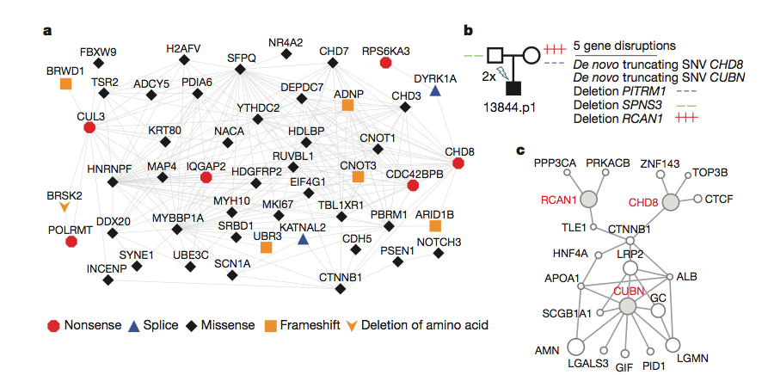
De novo mutations identified in protein-protein interaction networks

Slide 28
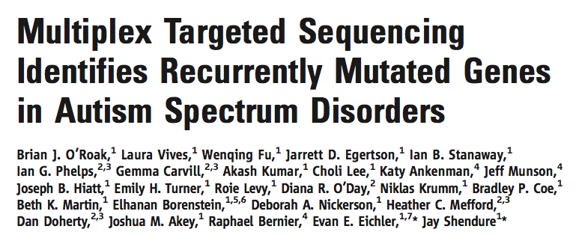
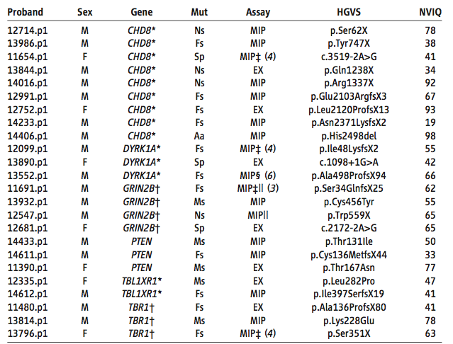
Re-sequenced 44 candidate genes in 2446 ASD probands
Estimate that recurrent disruptive mutations in six genes—CHD8, DYRK1A, GRIN2B, TBR1, PTEN, and TBL1XR1—may contribute to 1% of sporadic ASDs

Slide 29
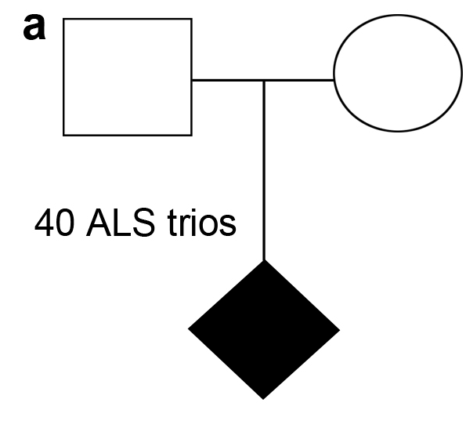

Do de novo mutations contribute to ALS?
de novo
mutation

Slide 31
Confirmed de novo mutations in ALS
Alexander, M.D., et al. Ann Neurol 52, 680-683 (2002) : SOD1
Dejesus-Hernandez, M., et al. Hum Mutat (2010) : FUS/TLS
Chio, A., et al. Neurobiol Aging 32, 553 e523-556 (2011) : FUS/TLS

Slide 32
Exome Sequencing ALS trios to identify de novo mutations
50 ALS trios
(patient + both unaffected parents = 150 exomes)

Slide 33
Exome Sequencing ALS trios to identify de novo mutations
What do we hope to find?
Increased frequency of severe de novo mutations in cases vs. controls
Recurring mutations in the same gene
Some mutations in known ALS genes (e.g., SOD1, TARDBP, FUS/TLS)

Slide 34
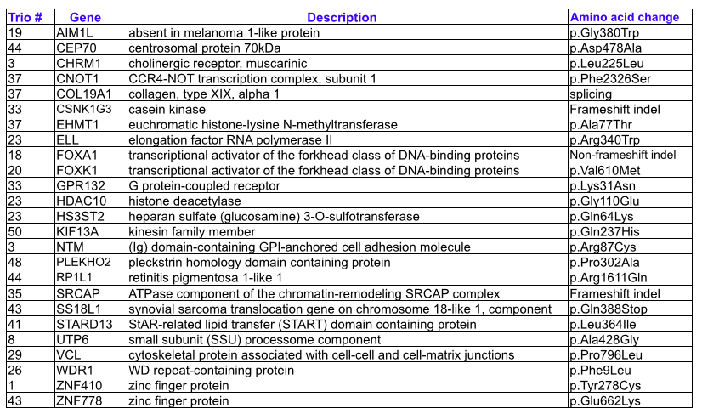
25 non-synonomous de novo mutations in ALS trios

Slide 36
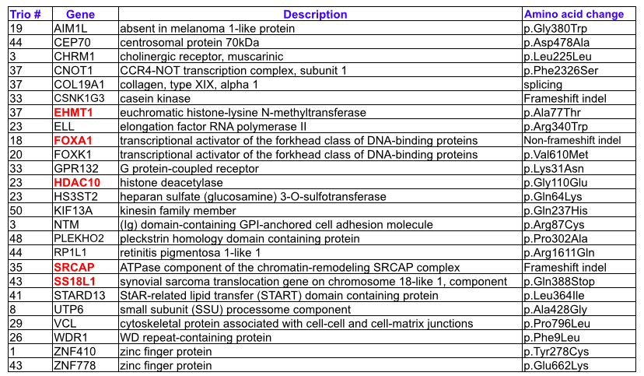
25 non-synonomous de novo mutations in ALS trios

Slide 37
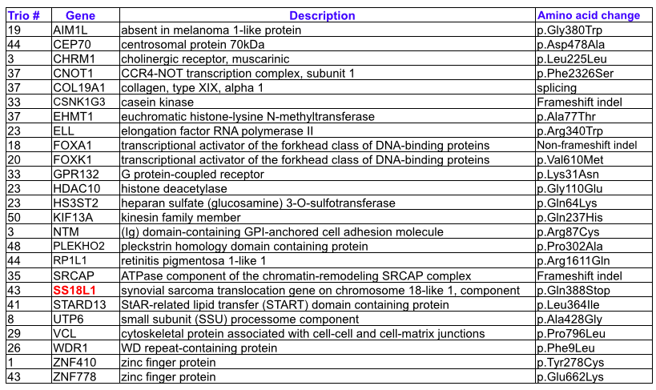
25 non-synonomous de novo mutations in ALS trios

Slide 38
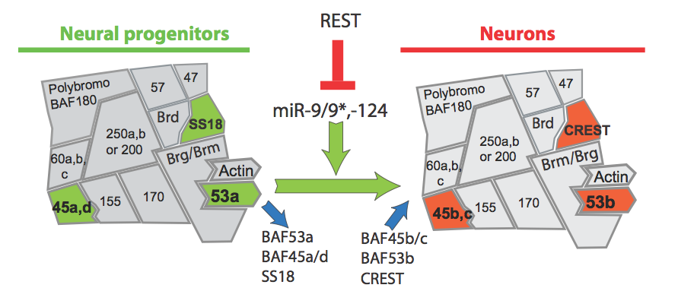
SS18L1/CREST function
Brett Staahl and Gerald Crabtree (Stanford)

Slide 39
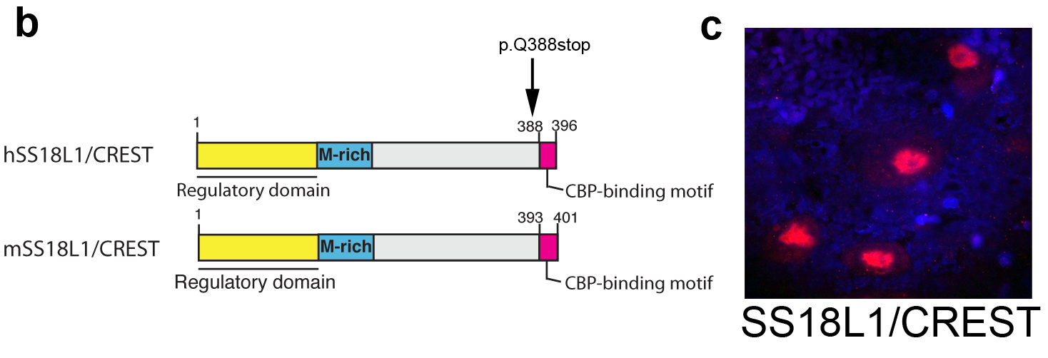
A de novo mutation in SS18L1/CREST deletes last 9 aa
expression in adult human spinal cord motor neurons

Slide 40
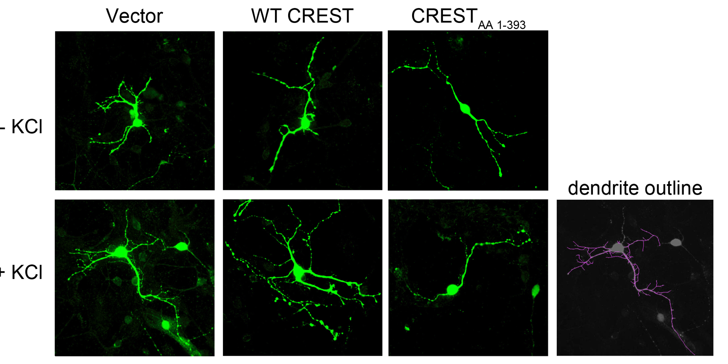
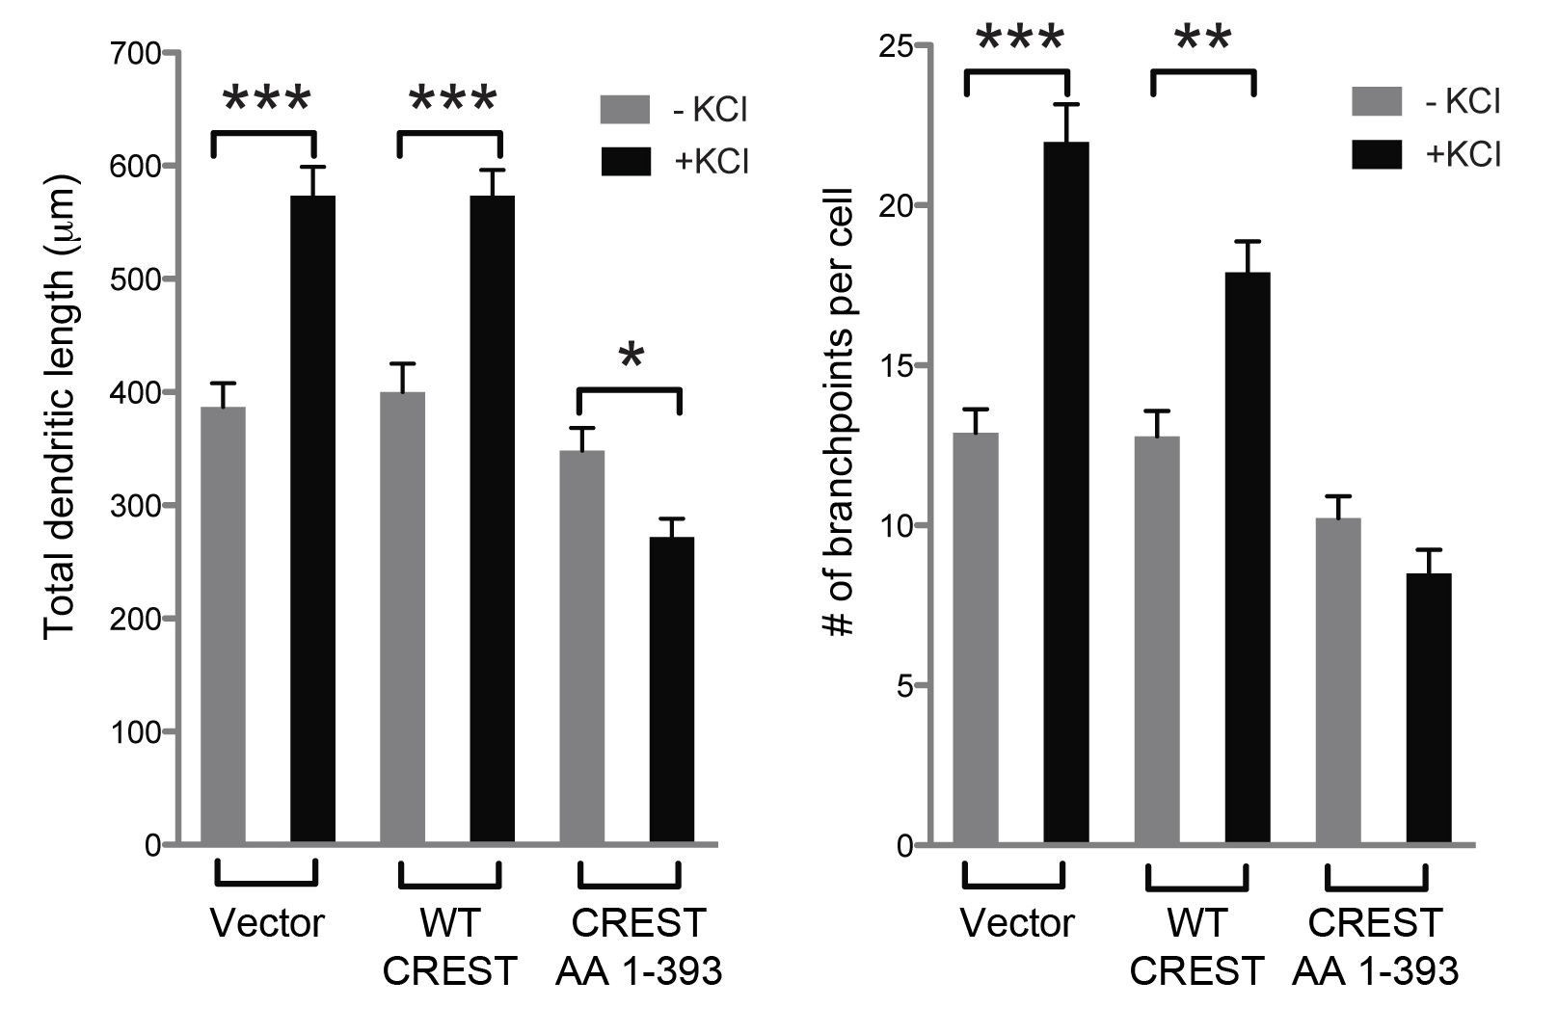
SS18L1/CREST de novo mutation causes dendrite outgrowth defects
with Brett Staahl and Gerald Crabtree (Stanford)

Slide 41
25 non-synonomous de novo mutations in ALS trios

Slide 42
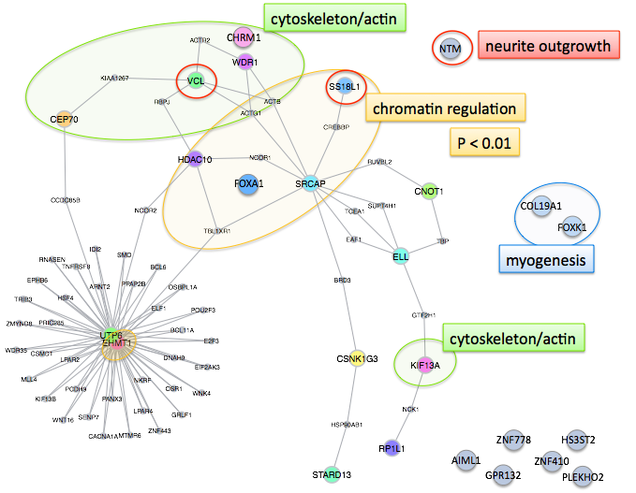

Slide 43
Can we replicate our results
in an independent ALS cohort?
Sequenced SS18L1/CREST
62 Australian FALS Cases
Screened for mutations in known ALS genes including C9ORF72, TARDBP, SOD1, FUS, PFN1, OPTN, VCP, UBQLN2, ANG, FIG4, DCTN1, and CHMP2B
with Ian Blair (Australia)

Slide 44
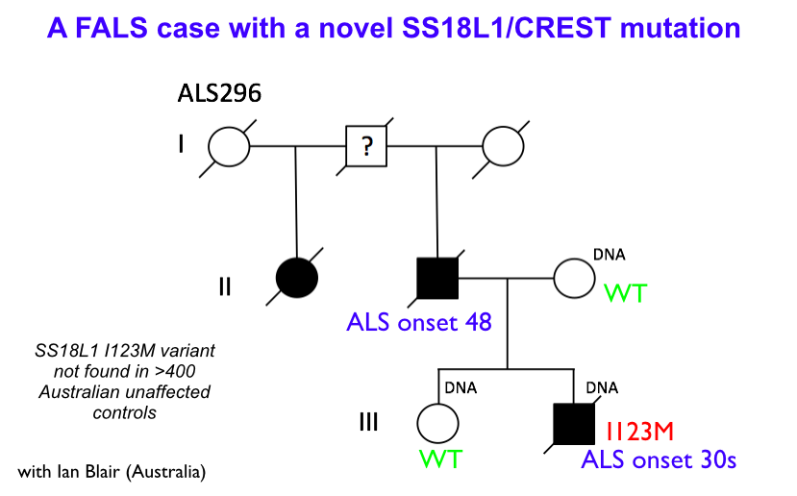

Slide 45
SS18L1/CREST function
Brett Staahl and Gerald Crabtree (Stanford)

Slide 46
25 non-synonomous de novo mutations in ALS trios

Slide 47
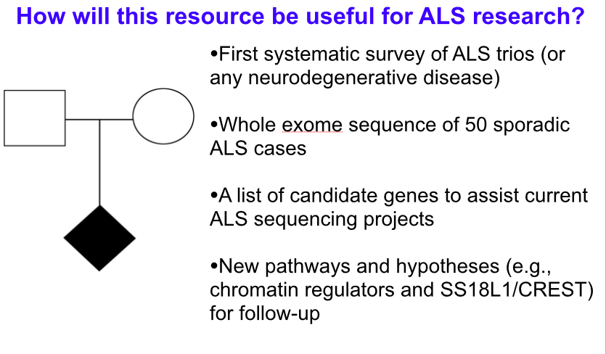

Slide 48
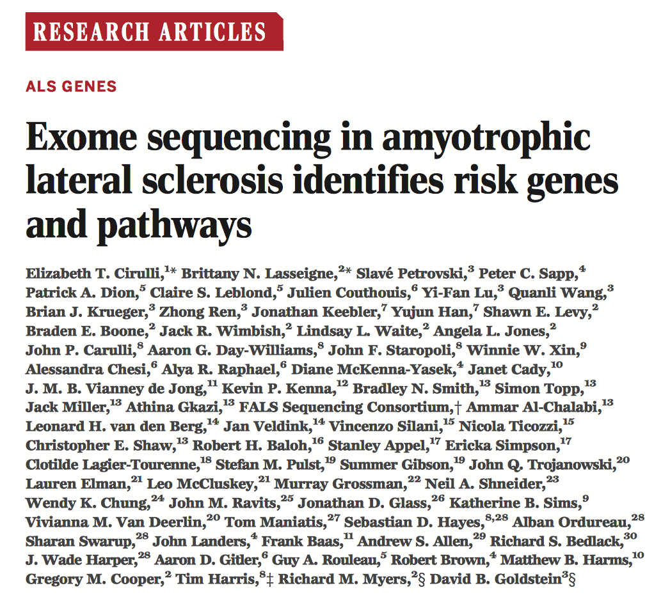

Slide 49
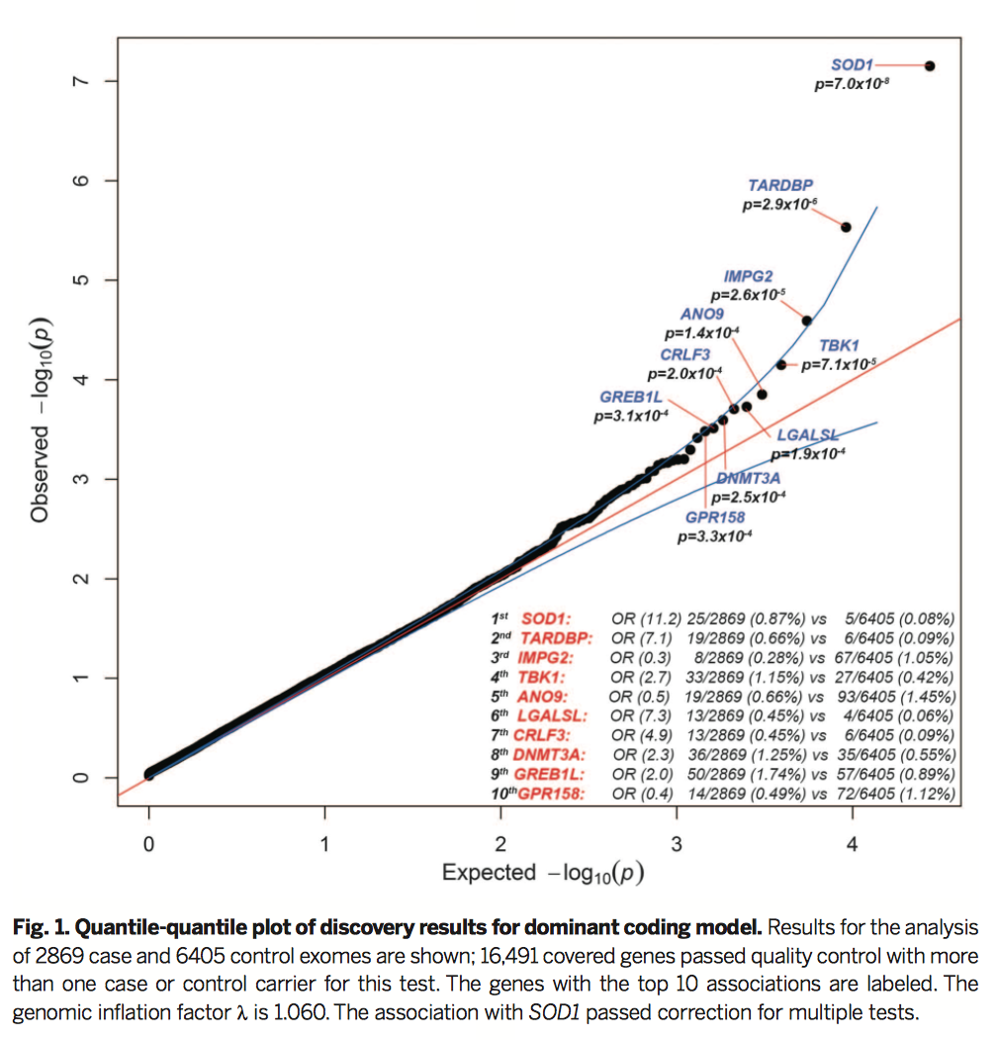

Slide 50
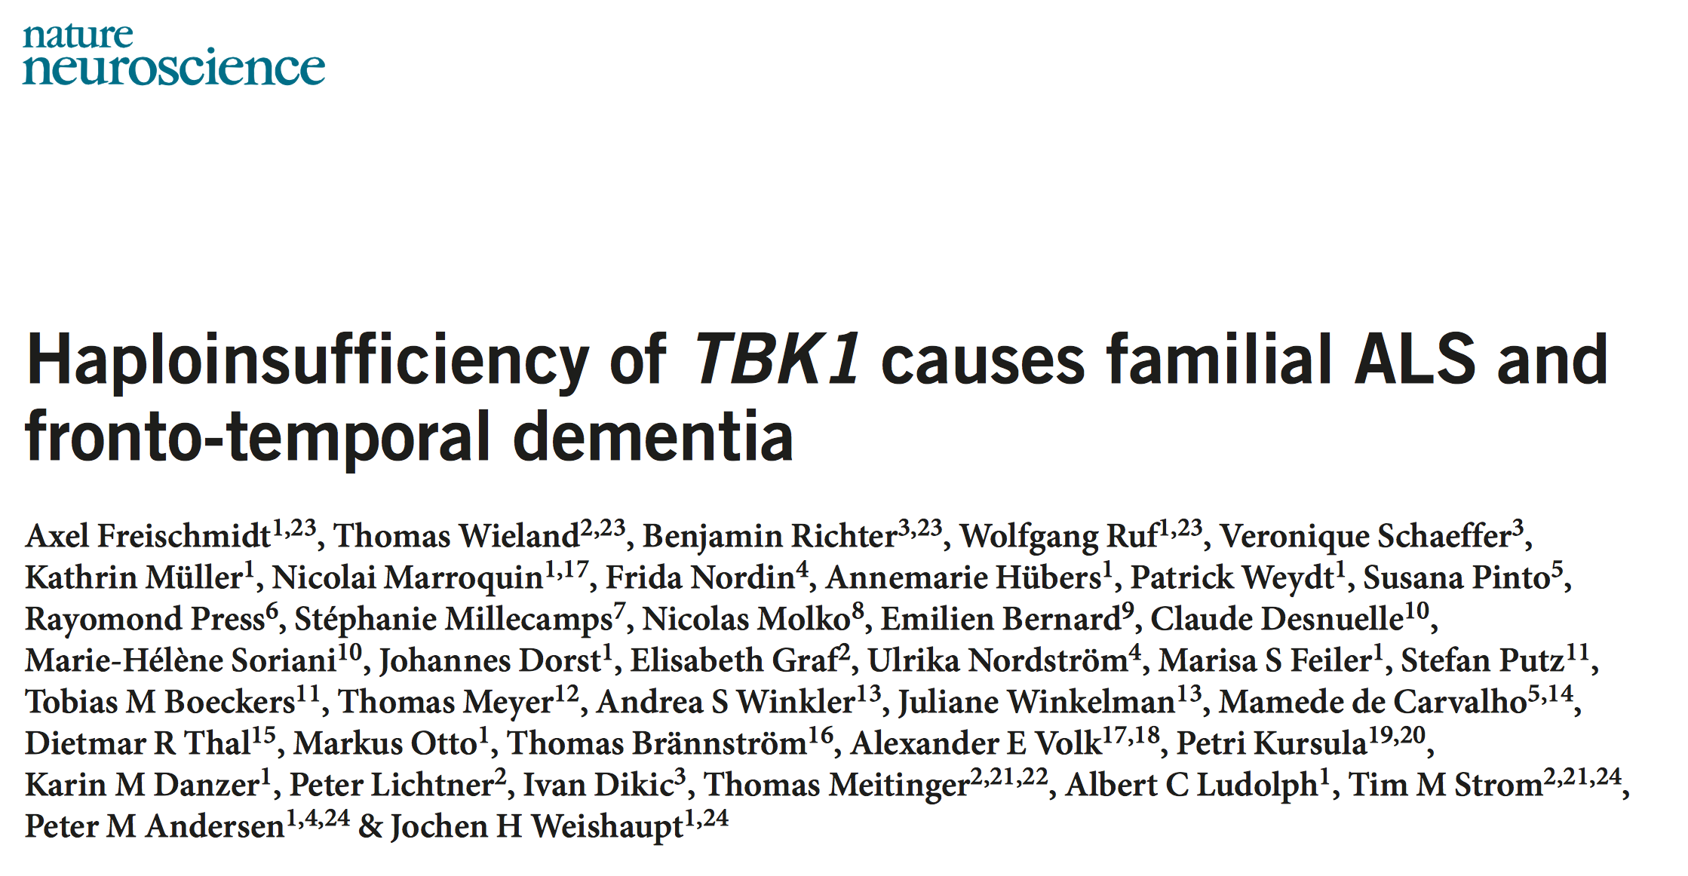
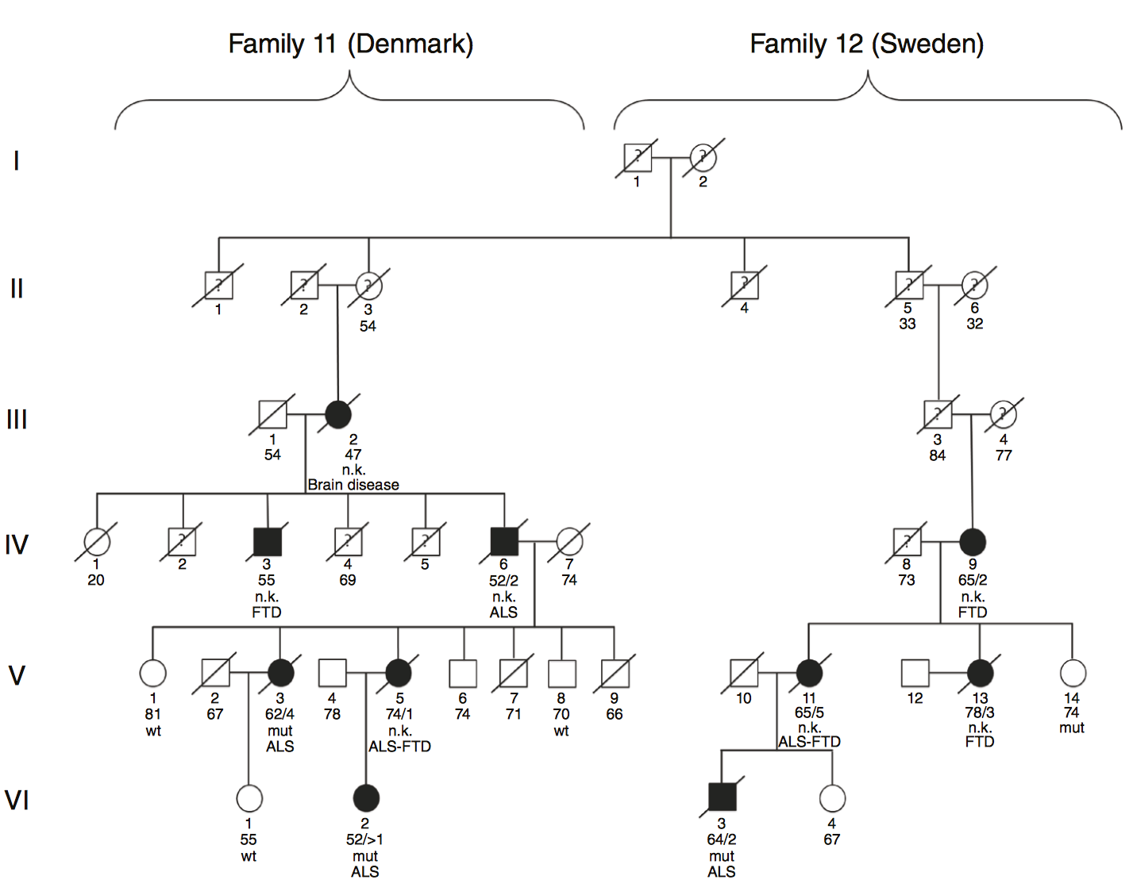

Slide 51
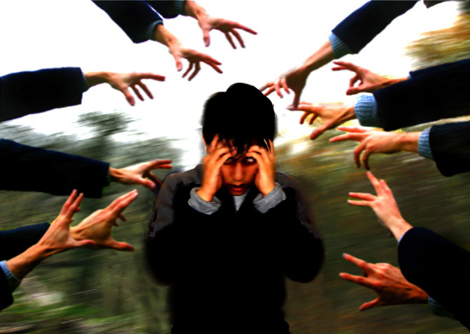
Schizophrenia

Slide 52
Schizophrenia
Schizophrenia is a severe mental disorder
Schizophrenia may result in some combination of hallucinations, delusions, and disordered thinking and behavior
Loss of interest in everyday activities, appearing to lack emotion, reduced ability to plan or carry out activities, neglect of personal hygiene, social withdrawal, loss of motivation
Lifetime risk of ~1%. Heritability ~80%

Slide 53
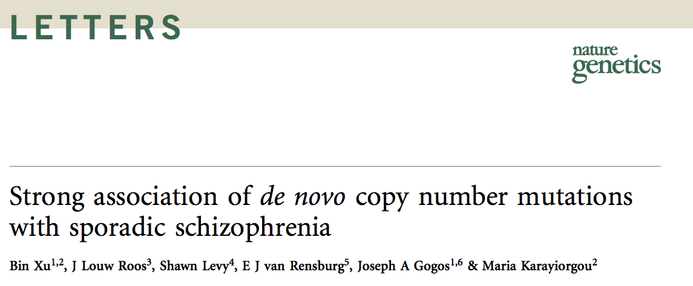
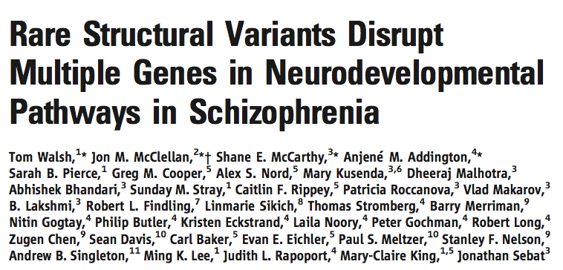
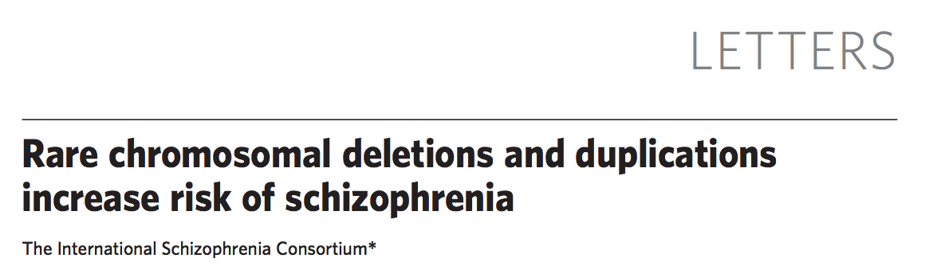
CNVs and schizophrenia

Slide 54
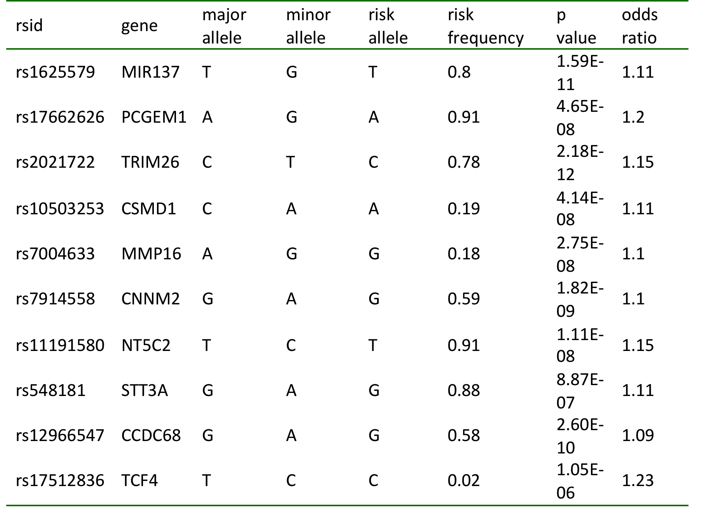
Common variants associated with schizophrenia

Slide 55
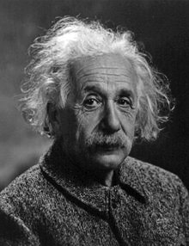
Intelligence

Slide 56
Intelligence
Intelligence in human populations is associated with a wide range of important life outcomes, including educational attainment, income, health and longevity, and intelligence in childhood is a predictor of those outcomes (Deary et al. 2012)
Twin, family and adoption studies have shown that intelligence, as measured by IQ tests, is one of the most heritable behavioral traits (Deary et al. 2009)

Slide 57



Slide 58

Common variants associated* with intelligence
*No individual SNP has reached genomewide significance

Slide 59

Davis et al., 2012
A SNP set using the 9 SNPs from the third stage of the analysis that were associated with g at the nominal significance level of P < 0.05. This SNP set correlates r = 0.11 with g, accounting for 1.2% of the variance. Or, to put it another way, each additional high-g associated allele increases g by 0.06 standard deviations or 0.92 IQ points.

Slide 60


Slide 61

Common variants associated with educational attainment
Science, 2013

Slide 62

Common variants associated with educational attainment

