Slide 1
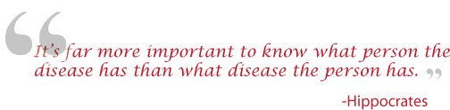
Genetics 210: Personalized Medicine and Genomics
For: MDs, PhDs and curious students
Spring term. Tue 2:15 – 4:05
Thur. 2:15-4:05
Genotyping : FREE!
Gene210.stanford.edu: info and FAQs

Slide 2
Today
Course overview (~20’)
Informed consent (~20’)
How to get genotyped (~10’)
Questions
Optional: pickup 23andme kit and spit (~15’)

Slide 3
Course Staff
Course Organizers:
  Stuart Kim (Dev. Bio., Genetics)
  Aaron Gitler (Genetics)
TAs:
  Andrew Roos (Epidemiology)
  Rachel Goldfeder (BMI)

Slide 4
Introductory Projects
Report on specific genetic locus. Published on SNPedia.com
Unanticipated opportunities that arise as you explore your genome

Slide 5
Advanced Projects = (project + final)
Annotate genome of your family
Write a grant for Kaiser-Permanente GWAS (n=110,000)
Make a class video for you tube
Run a class debate on the FDA regulations of DNA information

Slide 6
Gene210
Three Manuscripts
Textbook
Patent
Grant
iPhone App
in the news
Chicago Medicine Magazine (story on page 18)
Salon Web Magazine (9/2013)
Stanford Medicine - DNA testing improves learning (8/13)
San Jose Mercury News (5/2013)
Time (2/2013)
Nature
USA Today
San Francisco Chronicle Recap
San Francisco Chronicle
Genome Technology
Stanford Press Release
Nature Blogs
LA Times Blog
Genome Web
Center for Genetics and Society
Scientific American

Slide 7
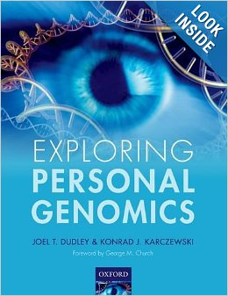
Exploring Personal Genomics
Available at Amazon.com

Slide 8
Joint Genotyping Task Force
2008-2010
Charles Prober Dean Hank Greely Law School
Russ Altman Genetics C. Braddock Med School
Pat Brown Biochem. Gil Chu Biochem
Mike Grecius Neur. Sean David Med. School
Carlos Bustamente Gen. Harry Greenberg Dean
Ralph Horwitz Psych Louanne Hudgins Epi
Anne James Legal Counsel Jesse Karmazin Med. School
Stuart Kim Dev. Bio. Mark Krasnow Biochem
Phil Lavori HRP David Magnus Cen. BME
Kelly Ormond Genetics Alan Schatzberg Psych.
Mike Snyder Genetics Atul Butte BMI
Keyan Salari Med. School Mildred Cho Pediatrics

Slide 9
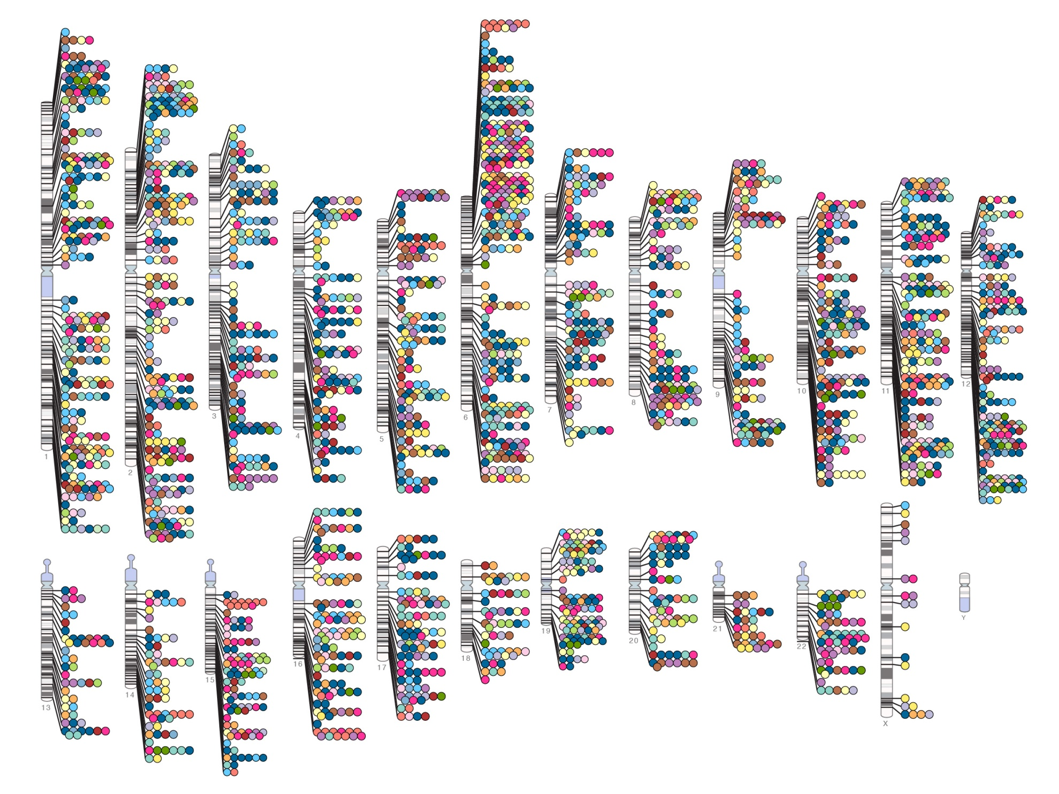
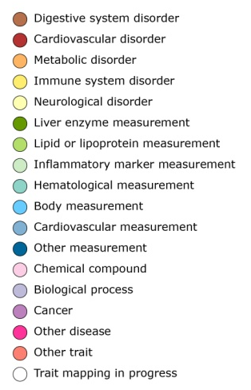

Published Genome-Wide Associations

Slide 10
Genetics 210: Personalized Medicine and Genomics
Less Stressful Information
  Diabetes
  Heart Disease
  Osteoporosis
  Schizophrenia
  Obesity
Not tested
  Huntington’s
  Most BRCA1 mutations

Slide 11
Genetics 210: Personalized Medicine and Genomics
Potentially Stressful Information
  Breast Cancer (BRCA1)
  Cystic Fibrosis Carrier
  Alzheimer’s (APOE4)
  Parkinson’s (LRK2)
  False parenthood!

Slide 12
Psychological outcome from genetic information
Anxiety/Stress
Confusion
Impact on family:
  Results reveal information about other family members

Slide 13
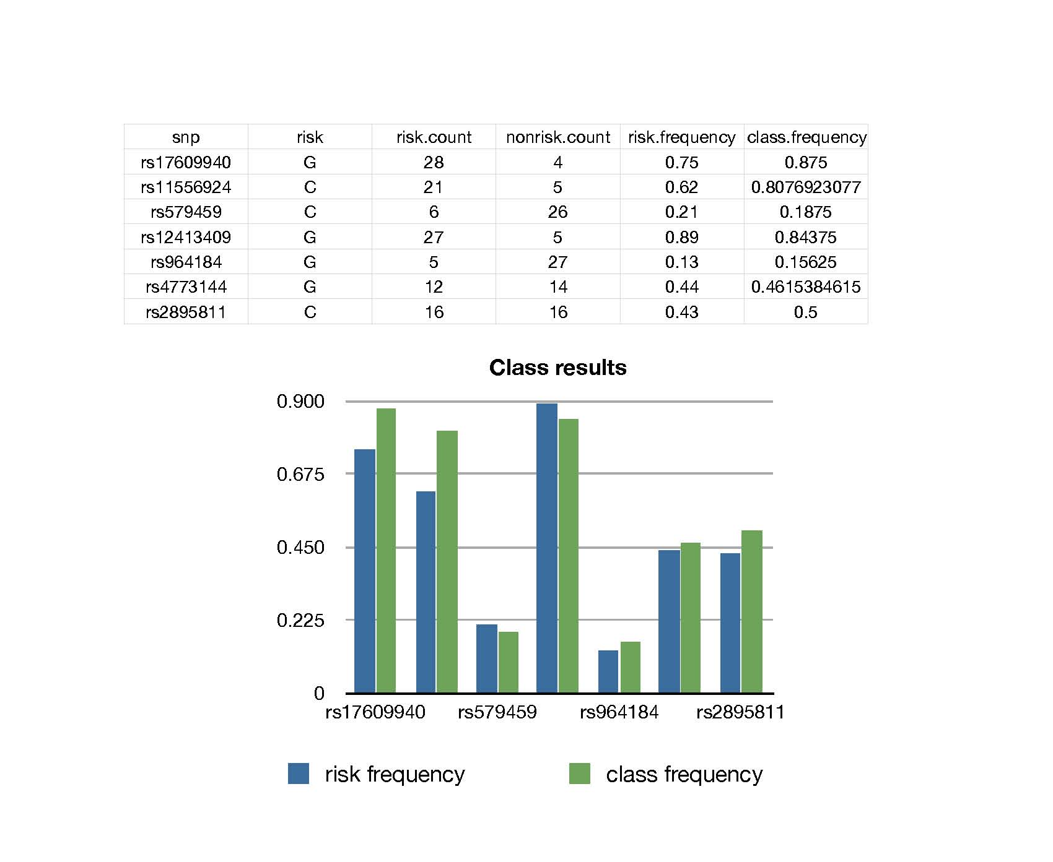

Slide 14
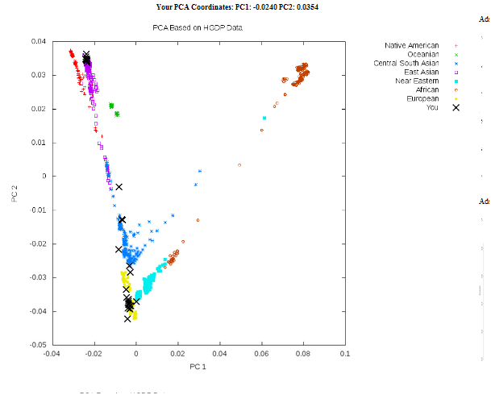
Human Ancestry

Slide 15
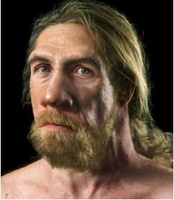
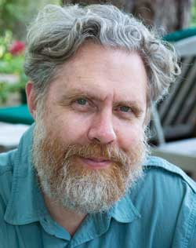
How Neanderthal are you?
Neanderthal
George Church,
Harvard Geneticist

Slide 16
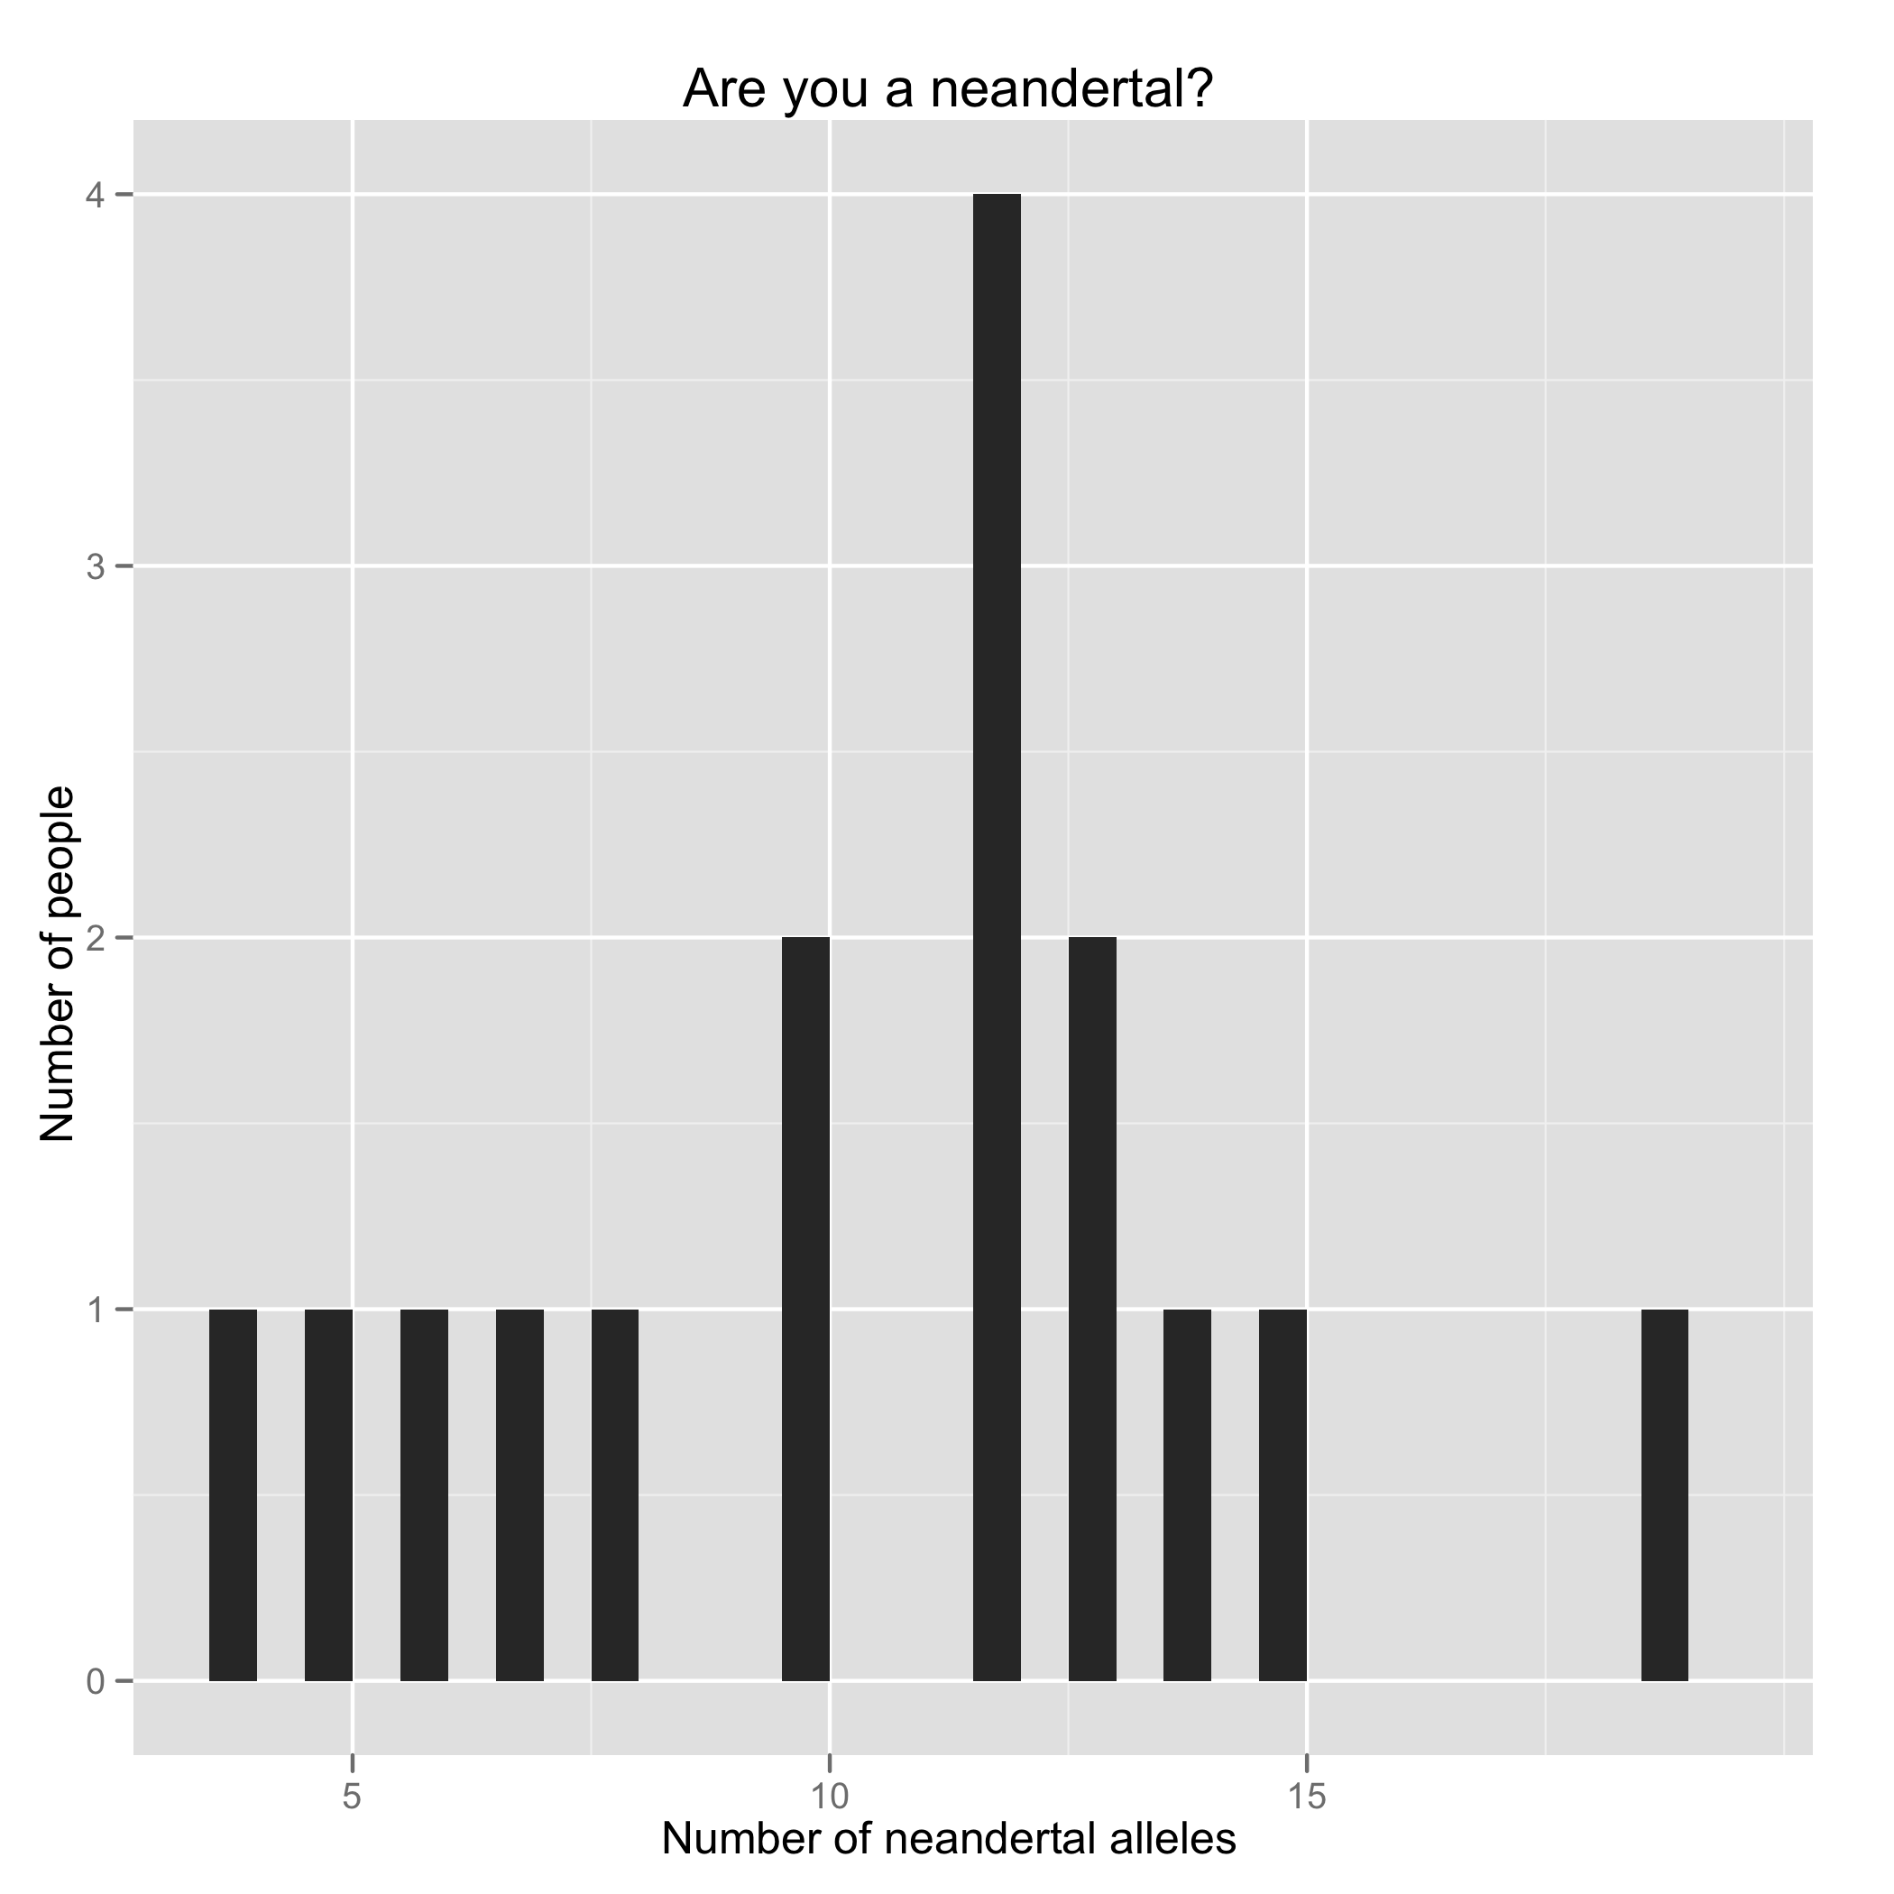
Stuart
All time record

Slide 17
Personal Genotyping
Voluntary. You can use a public genome file instead of your own.
Confidential – instructors will not know who opted to be genotyped.
You can use anonymous genomes to do the class exercises.
Private – Your own DNA information will not be revealed.
Counseling - genetic counseling via 23andMe and medical/psychological counseling via Dr. Alan Schatzberg (Psychology, Stanford).

Slide 18
23andme
Use your data for research
  42 Research Surveys (voluntary)
  23andme sells data to Pharma
Data stored at 23andme
Allow sharing with other users

Slide 19
Genetic Information Non-discrimination Act (2009)
Prevents health insurance plan from collecting genetic information including family medical history prior to, or in connection, with enrollment.
Prevents employers from requesting genetic information prior to employment

Slide 20
What GINA does not do
No protection against life insurance, disability insurance, or long term care insurance
Apply to diagnosed conditions
Apply to employers with fewer than 15 employees
Certain groups:
  Members of the US Military
  Veterans receiving care through the VA
  Federal employees enrolled in the Federal Employees Health Benefits
  Individuals using the Indian Health Service
  Professional Athletes?

Slide 21
If you have questions or concerns before or after testing:
Genetic counseling (paid by Stanford)
Psychological counseling (Alan Schatzberg Dept. Psych. Stanford)

Slide 22
How to get genotyping kits
Attend this information session.
Fill out informed consent form
Plan A: Get kit at end of class. Give kit to TA.
Plan B: Go to Sue Elliot, Beckman B300 and pick up kit. Bring samples back to Sue B300
We will ship the group of samples back to company Tuesday Jan. 29!!
Results in 6-8 weeks.
Class starts Tuesday March 31, 2015.

Slide 23
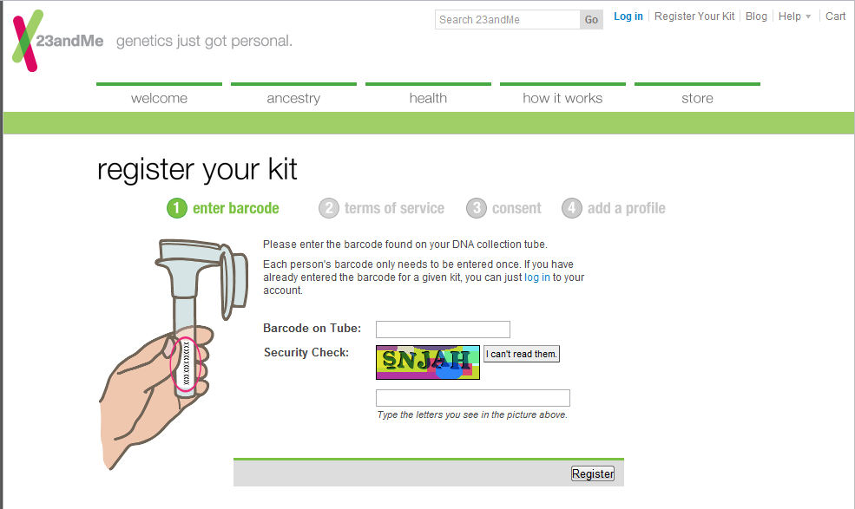
https://www.23andme.com/user/claim/

Slide 24
Kit Information
SPIT.
Fill out informed consent form!
Fill out sign out sheet with bar code, name, dept. This is in case the sample needs to be redone and we need to contact you.
If you bring in your sample to Sue Elliot (Beckman B300), we can mail them in together. This class has VIP status, so might lower your chance of getting lost in the shuffle if they go in as a group.
Mail in yourself.

