Slide 1

Genetics of gene expression
Stephen Montgomery
smontgom@stanford.edu
montgomerylab.stanford.edu
Stanford University School of Medicine

Slide 2
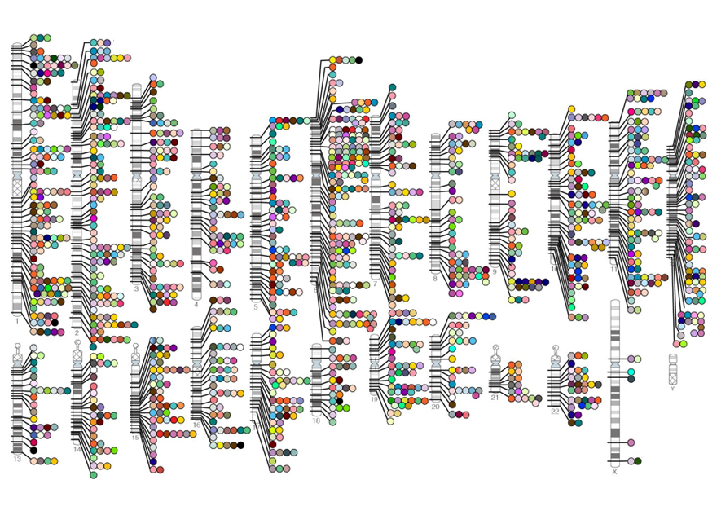
Chromosome map of disease-associated regions
Notes:
Represents a huge international investment in the billions of dollars!

Slide 3
“GWAS have so far identified only a small fraction of the heritability of common diseases, so the ability to make meaningful predictions is still quite limited”
Francis Collins, Director of the NIH, Nature, April 2010
Trait | Heritability | Individuals studied | Heritability explained
Coronary artery disease | 40% | 86995 | 10%
Type 2 Diabetes | 40% | 47117 | 10%
BMI | 50% | 249796 | 3%
Blood pressure | 50% | 34433 | 1%
Circulating lipids | 50% | 100000 | 25%
Height | 80% | 183727 | 12.5%

Slide 4
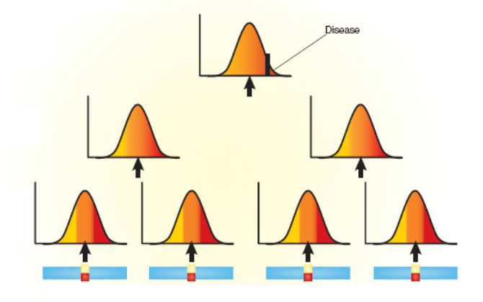
Disease starts at a cellular level
Disease
Individual
Organs and tissues
Cells
DNA
Understanding the influence of genetics on cells will
improve our ability to predict disease risk

Slide 5
Genetic studies of gene expression
Explore impact of genetic variation on transcriptome diversity
SNP
A
Expression of nearby genes
Cellular processes
Gene splicing/isoforms
Disease risk
Expression of distant genes
Notes:
DONE
Pretty pictures. Genetic variants affecting nearby and distant gene expression, splicing, downstream
Understand both the architecture of regulatory variation, and the mechanisms through which regulatory variation affects downstream XXXXX

Slide 6
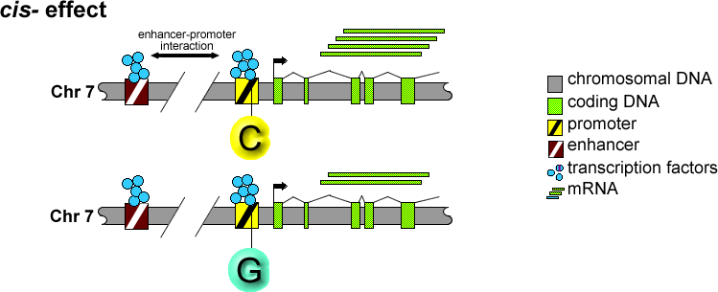
Canonical model

Slide 7
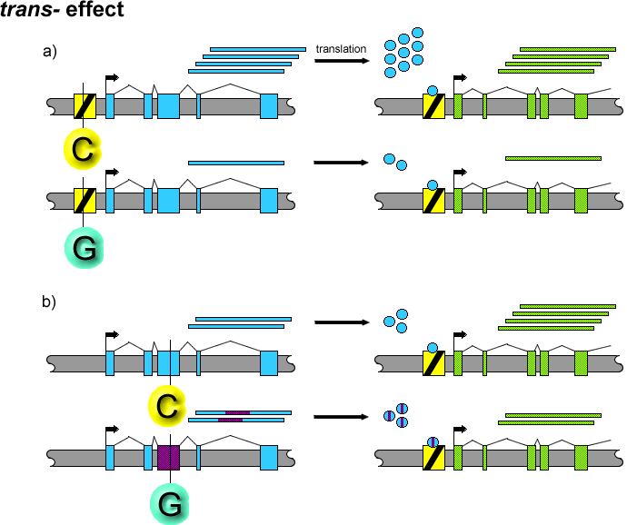

Slide 8
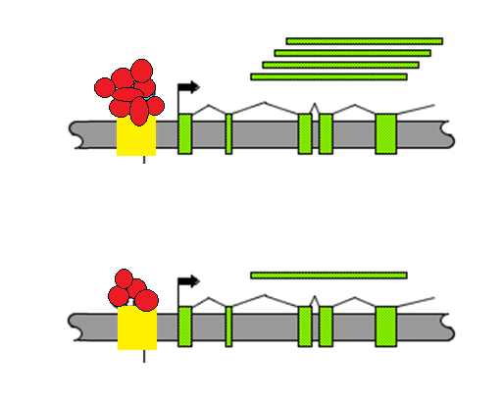
Genetic association can pinpoint regulatory haplotypes
Population Sample
C
Expression
CC CG GG
G
We can identify genetic variants impacting
gene expression (eQTLs)
Notes:
Simply this figure. Use boxplot instead of frequency. Direction on top needs to change compared to figure.
REVIEW2: Be accurate about haplotypes and connection to association

Slide 9
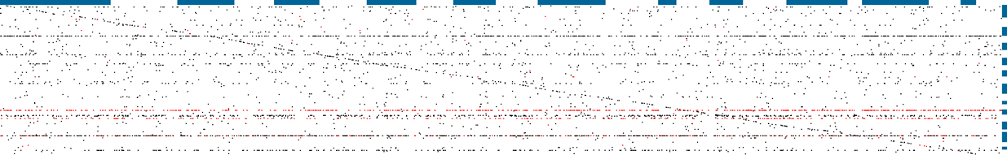
The landscape of regulatory variation
Chr1 Chr2 Chr3...
trans-effects
Chr1
Chr2
Chr3
...
Transcription
factor
cis-effects
Location of genetic variants by the gene’s whose expression they impact

Slide 10
Advantages to studying the genetics of gene expression
Can rapidly evaluate 1000s of quantitative traits
Can identify genetic regulatory networks
Can easily transform or perturb the system.
Variants are directly connected to cellular mechanism.

Slide 11
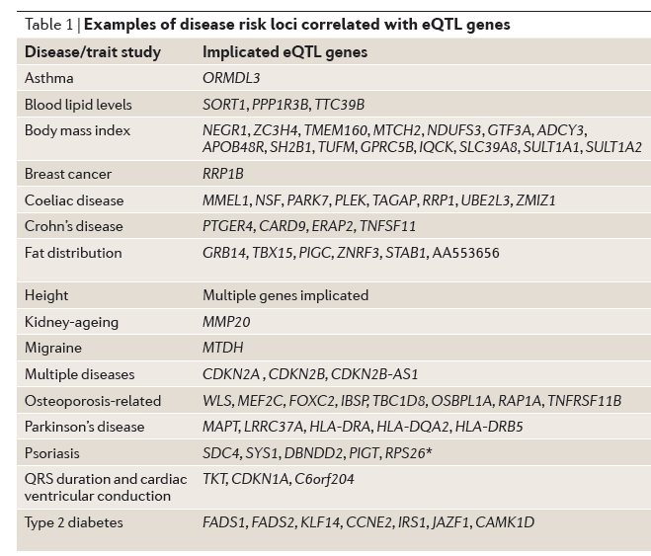
eQTL can aid in identifying candidate genes for GWAS variants
Sharing of association implicates genes and type of effect
Montgomery et al, Nat Rev Genetics, 2011

Slide 12
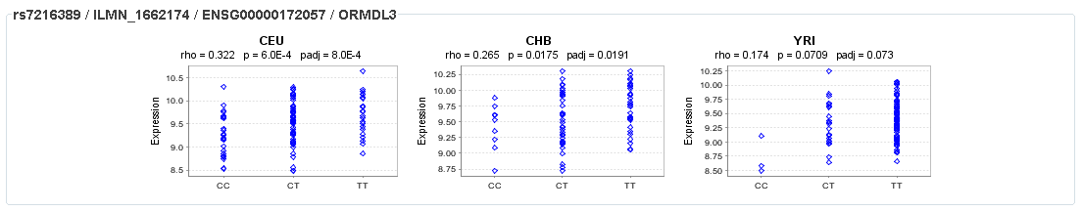
Class activity: What are my asthma variants doing?
In the subset of individuals for whom expression data are available,
the T nucleotide allele at rs7216389 (the marker most strongly associated with
disease in the combined GWA analysis) has a frequency of 62% amongst asthmatics
compared to 52% in non-asthmatics (P = 0.005 in this sample).
Moffatt, Nature, 2007

Slide 13
How are eQTL detected and reported?
Reported as the number of genes with significant
heritability, linkage or association compared to an FDR
Example 1:
“Of the total set of genes, 2,340 were found to be expressed, of which 31% had significant heritability when a false-discovery rate of 0.05 was used.”
- Monks, AJHG, 75(6): 1094–1105. 2004
Example 2:
“Applying this genome-wide threshold to 3,554 scans we would expect only 3.5 genome scans to show any linkage evidence with a P-value this extreme by chance. Instead we found 142 expression phenotypes with evidence for linkage beyond the P-value threshold, and in some cases far beyond, so we conclude that false-positive linkage findings are at most a small fraction of the significant results.”
- Morley, Nature, 430(7001): 743–747. 2004
Example 3:
“We detected 293, 274, 326 and 363 cis associations for CEU, CHB, JPT and YRI,
respectively, corresponding to 783 distinct genes and an FDR of 4–5%.”
- Stranger, Nat Genetics, 39, 1217–1224. 2007
Notes:
Say number of variants. Say what RED and BLACK are (legend). Maybe change color of labels. Array v RNA-seq indication. Better title. Maybe add circles for RNA-seq/array comparison (animation?)
REVIEW2: Discuss more this slide. Remove bold from slides. Remove numbers (too much data right now).

Slide 14
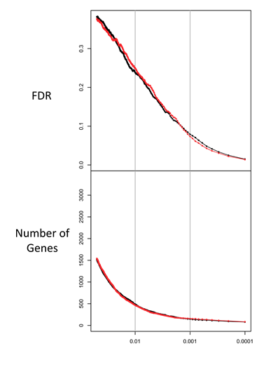
eQTL definition depends on false discovery reported
IMPORTANT: Understand the relationship
between false positive rate and eQTL
reported!
Permutation threshold

Slide 15
Discovery of eQTL depends on:
(A)Biological factors
(B) Technological factors

Slide 16
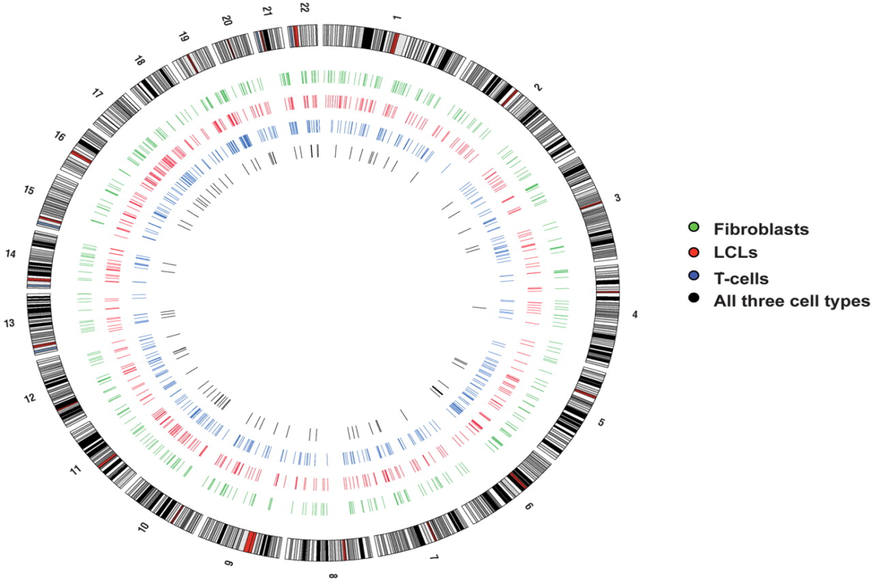
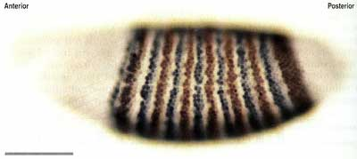
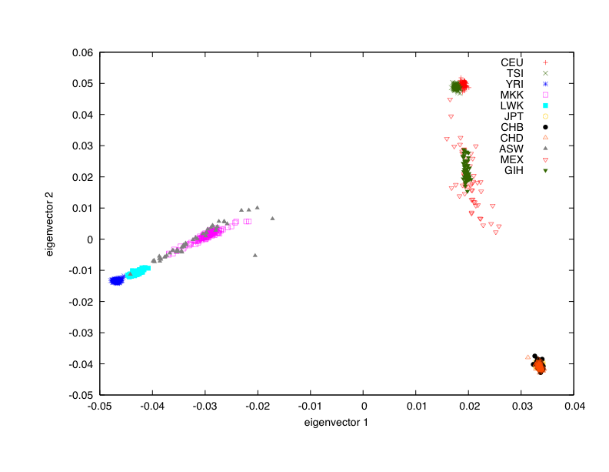
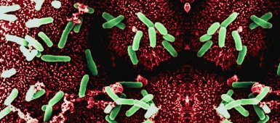
Biological factors influencing eQTL discovery
Trait biology
Dimas et al. Science, 2009
Ancestry
Environment
Stranger, PLoS Genetics, 2012

Slide 17
Biological factor: Cell or tissue type
How ubiquitous are eQTLs (and potential disease mechanisms) in different tissues.
i.e. if I find an eQTL in fat will it be informative of mechanism underlying disease risk for a disease based in muscle.

Slide 18
Probably not
Cell type-specific and cell type-shared gene associations
(0.001 permutation threshold)
69-80% of cis associations are cell type-specific
Dimas et al Science 2009
268
271
262
50% specific (adipose and blood)
No. of cell types with gene association
Emilsson et al Nature 2008
73
85
82
>50% specific (cortical tissue and peripheral blood)
86
86
86
Heinzen et al PloS Biology 2008
cell type
However, all estimates depend on eQTL discovery FDR and method for assessing sharing

Slide 19
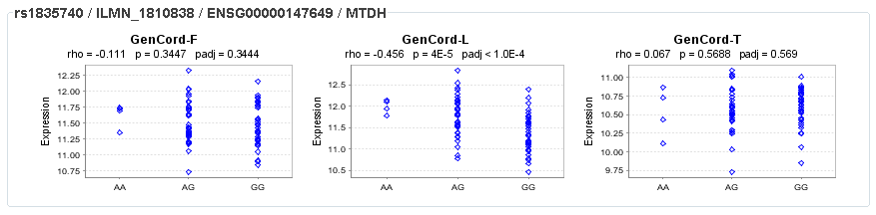
Class activity: What are my migraine variants doing in different tissues?
We identified the minor allele of rs1835740 on chromosome 8q22.1 to be associated with migraine (P = 5.38 × 10⁻⁹, odds ratio = 1.23, 95% CI 1.150–1.324) in a genome-wide association study of 2,731 migraine cases ascertained from three European headache clinics and 10,747 population-matched controls. In an expression quantitative trait study in lymphoblastoid cell lines, transcript levels of the MTDH were found to have a significant correlation to rs1835740 (P = 3.96 × 10⁻⁵, permuted threshold for genome-wide significance 7.7 × 10⁻⁵).
Anttila, Nature Genetics, 2011

Slide 20
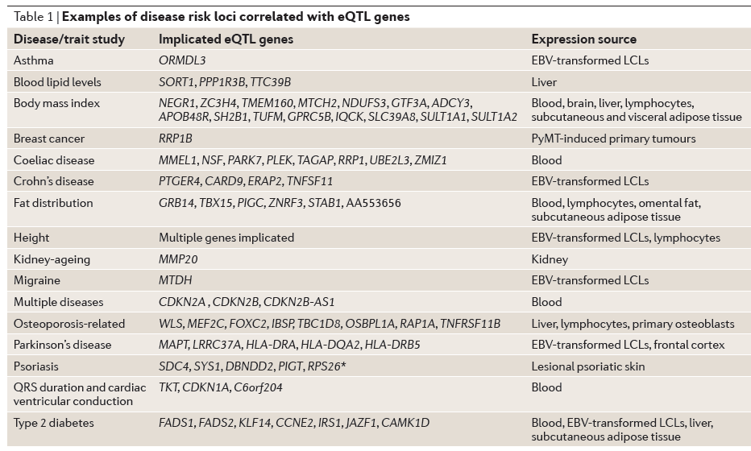
Many existing hypotheses could be in potentially unrelated tissues

Slide 21
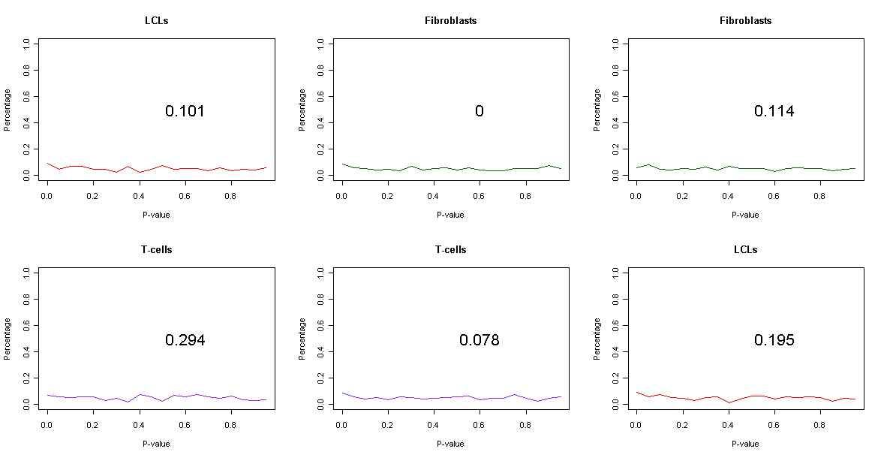
Example of tissue-specific GWAS-eQTL sharing
p ≤ 0.01
F: 306 eQTL genes
L: 377 eQTL genes
T: 299 eQTL genes

Slide 22
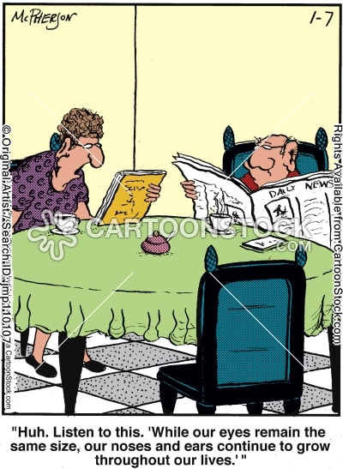
Biological factor: Development and aging
Determining how genetic variation and genes interact over time

Slide 23
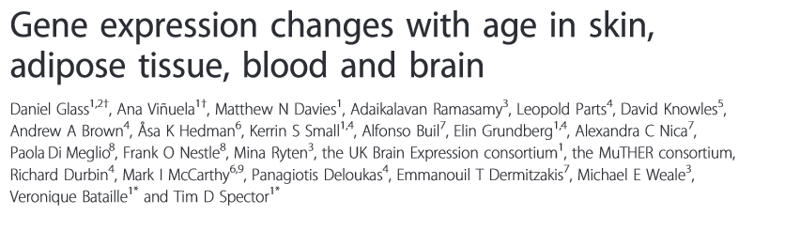
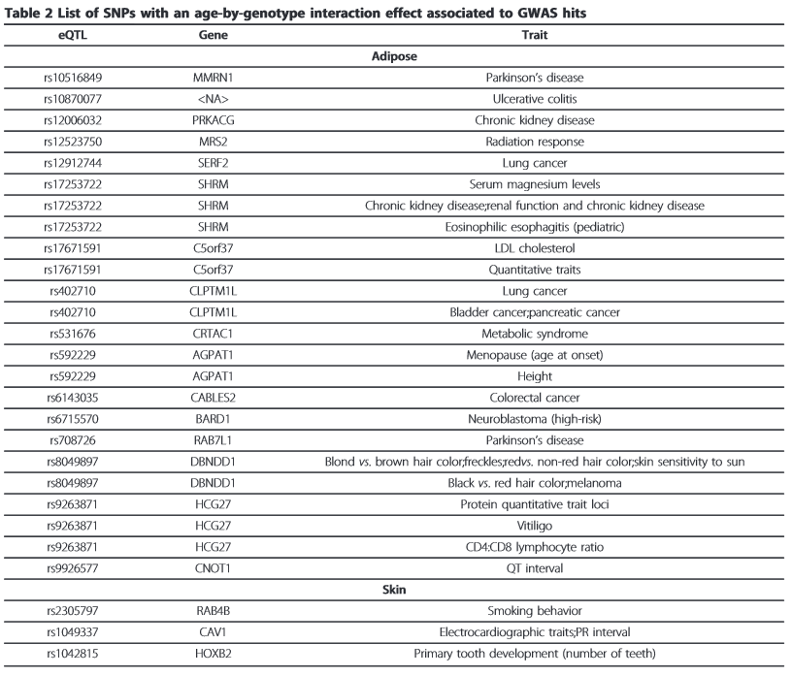
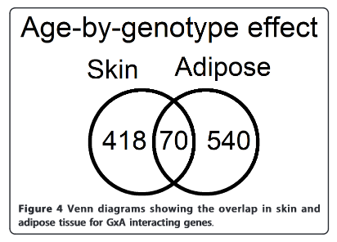

Slide 24
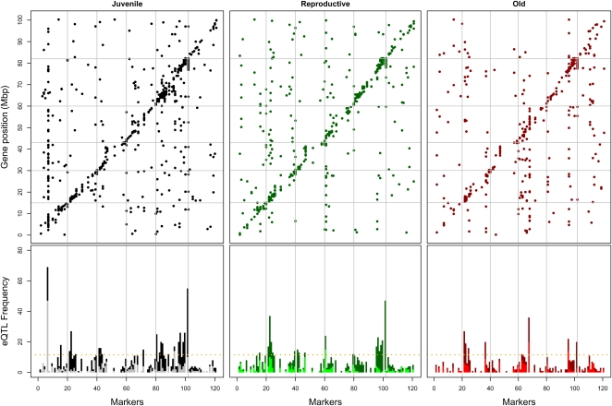
Less eQTLs in older worms
Recombinant inbred C.elegans
Any ideas why?
Viñuela A, Genome Research 20(7):929-37. 2010
Notes:
More interruption by somatic or environmental effects

Slide 25
Biological factor: Studied population
How ubiquitous are eQTLs (and potential disease mechanism) in different populations.
i.e. if I find an eQTL in Europeans will it be informative of mechanism underlying disease risk for a disease found in Chinese.

Slide 26
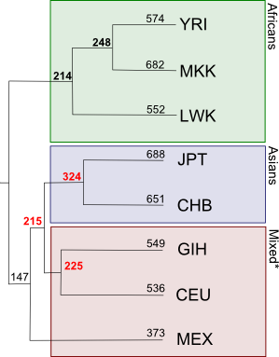
Not all eQTL shared across populations
“We have reported that many genes showing cis associations at the 0.001 permutation threshold are shared (about 37%) in at least two populations … In 95–97% of the shared associations, the direction of the allelic effect was the same across populations, and the discordant 3–5% was of the same order as the FDR.”
Stranger et al, Nat Genetics, 2007
If we know the etiology of a disease
can we predict its population frequency
from cellular models of that disease?
Stranger et al, PLoS Genetics, 2012

Slide 27
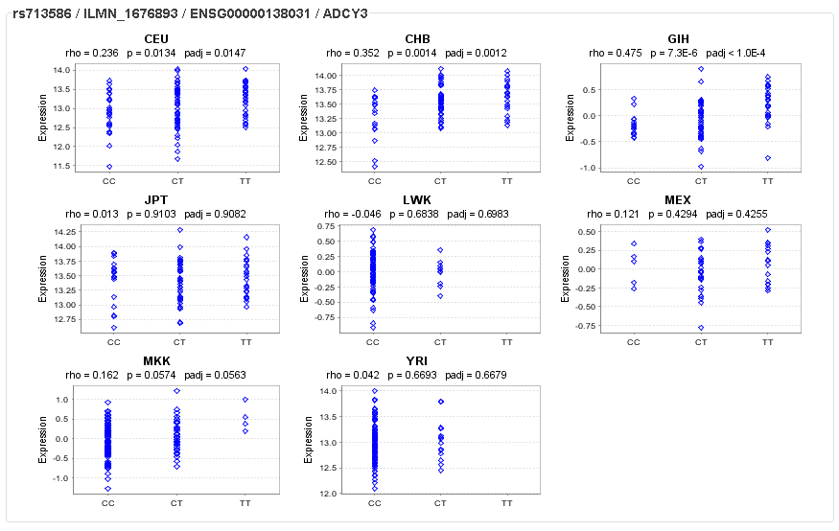
Class activity: What are my BMI variants doing in different populations?
rs713586 explained
0.06% of BMI variance
Speliotes, Nature Genetics, 2010

Slide 28
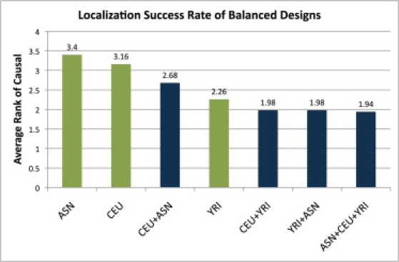
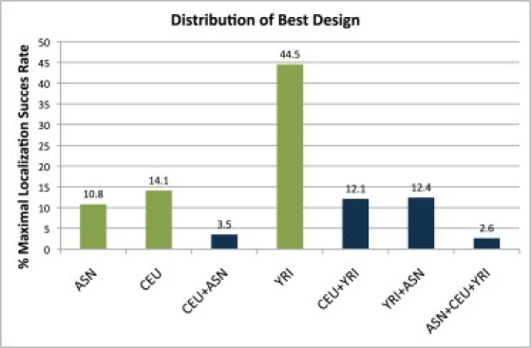
Multiple population study designs
Zaitlen, AJHG, ; 86(1): 23–33. 2010
Multiple populations do well at mapping causal variants; however their design results in
a reduction of power

Slide 29
Admixed populations
Challenges: Loss of power if local ancestry not known or inflation in significance if frequency differences are large and effect is trans-acting.
Eur: mean 3.0
Afr: mean 4.0
If mean expression invariant to genotype then
allele frequency differences will create false association
Solution: Add local ancestry as a covariate

Slide 30
Biological factor: Environment studies
Determining how eQTLs behave under stimulus
i.e. if I find an eQTL in resting state will it be informative of mechanism underlying an responsive state.

Slide 31
Answer: GxE discoveries have been study dependent
“We carried out large-scale induction experiments using primary human bone cells derived from unrelated donors of Swedish origin treated with 18 different stimuli (7 treatments and 2 controls, each assessed at 2 time points). … We found that 93% of cis-eQTLs at 1% FDR were observed in at least one additional treatment, and in fact, on average, only 1.4% of the cis-eQTLs were considered as treatment-specific at high confidence. “
- Grundberg PloS Genetics 7(1). 2011

Slide 32
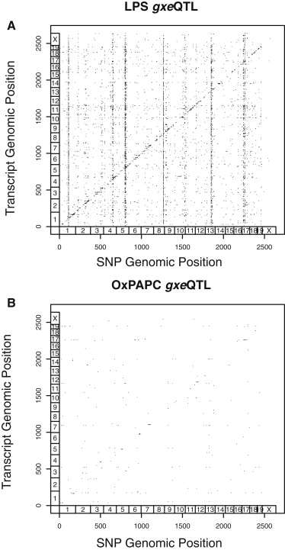
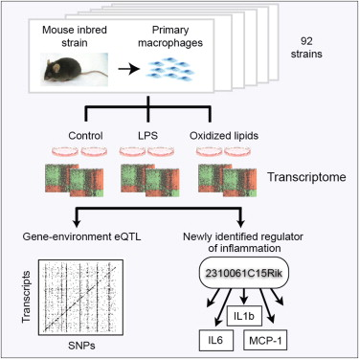
LPS response eQTLs
Orozco et al, Cell, 2012

Slide 33
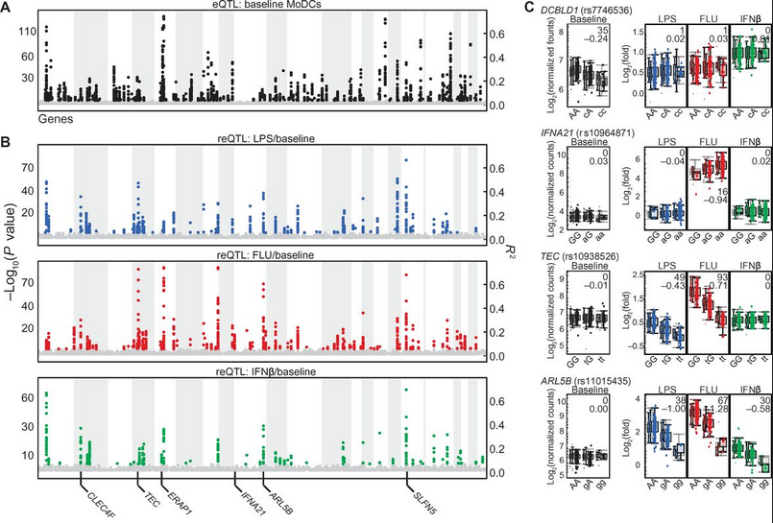
LPS, influenza, and interferon-β (IFN-β) response-eQTLs
Lee, Science, 2014
Approach reveals common alleles that explain interindividual variation in pathogen sensing and
provides functional annotation for genetic variants that alter susceptibility to inflammatory diseases.
Notes:
DCs in 534 people

Slide 34
Discovery of eQTL depends on technological factors
Gene expression technology
PCR-based, array-based, sequencing-based
Genotyping technology
array-based, sequencing-based
Sample size
More individuals and/or families yields more power to detect association with particular effect sizes. (Lowers FDR). Early studies used 18-30 families or 45-60 unrelated individuals.

Slide 35
The biases we don’t know about:
Hidden factors can cause false associations
Hidden technical and biological variables. i.e. population, sex, date of processing
However, correcting these factors can remove true signals (i.e. master regulators)

Slide 36
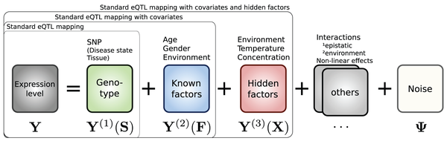
Methods to correct hidden factors
Factor analysis on 40 global factors has tripled eQTL discovery.
Surrogate variable analysis, has increased by 20% eQTL discovery
- Stegle, PLoS Computational Biology, 2010
- Leek, PLoS Genetics, 2007

Slide 37
eQTL data can open up new biology through reverse genetic approaches
Without traits and disease we can find variants influencing expression level.
We can speculate and investigate what these effects might do.

Slide 38
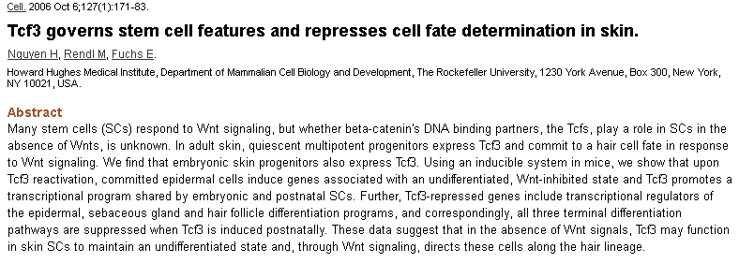

Class activity: What are my TCF3 variants doing
Notes:
T allele hairy?

Slide 39
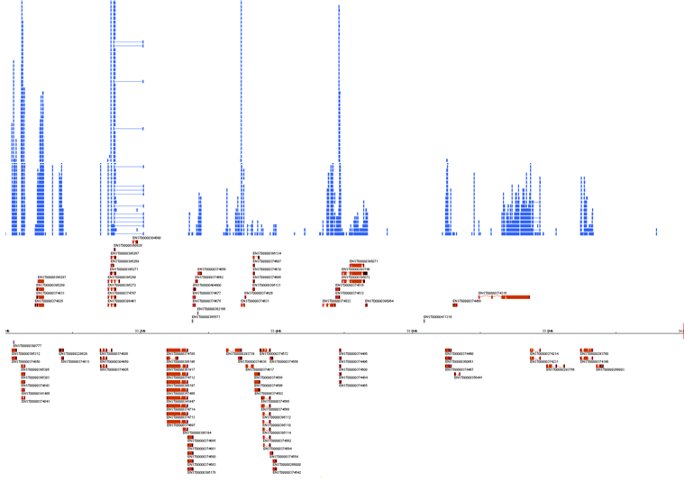
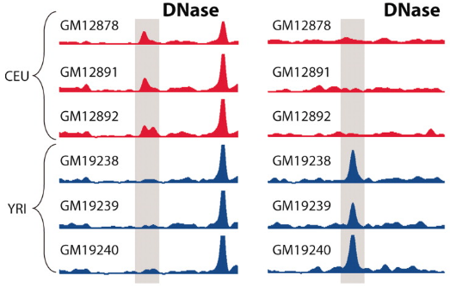
Next generation sequencing has increased our ability to survey the transcriptome.
RNA-Seq
Montgomery, Nature 2010
Pickrell, Nature 2010
ChIP-Seq
McDaniell, Science 2010
Notes:
Lots more quantitative traits

Slide 40
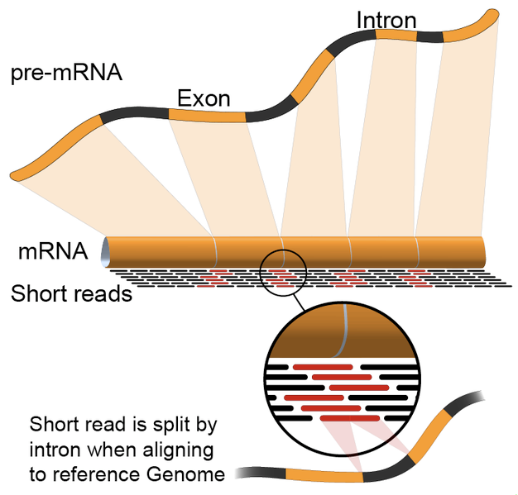
What is RNA-seq
High-throughput sequencing of cDNA to
understand/quantify a sample’s gene expression profile
Output: millions of short, single or paired-end sequences (reads)

Slide 41
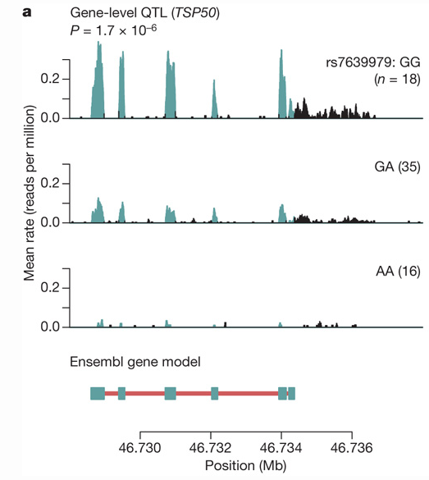
Genetics of gene expression using RNA-Seq

Slide 42
Increased resolution of transcriptome through RNA- sequencing
Hybrid transcripts
Fusion genes
Quantification
Alternative splicing
Transcript termination
Exons
Transcripts*
Genes*
.GAG... x50
.GAG... x50
..GGGU
.GAG
GTG..
.GAG
GTG..
..GGGTAGGA..
.TAG
GTC..
.TAG
GTC..
..GGGCAGGA..
.UAG... x25
.UAG... x25
..GGGCAGGA..
Sequencing read
Unannotated structure
..GGGU.. x50
..GGGTAGGA..
..GGGUAGGA..
..GGGCAGGA..
..GGGCAGGA..
..GGGC.. x25
Allele-specific expression,
Escape from X-inactivation
RNA Editing

Slide 43
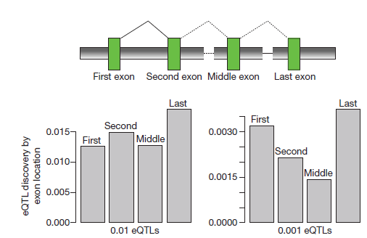
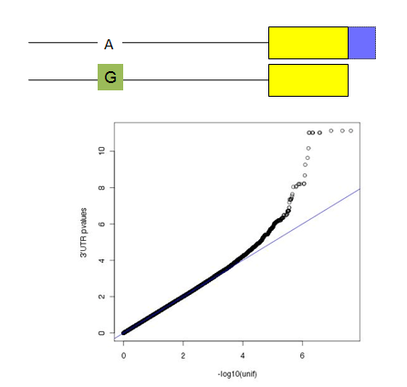
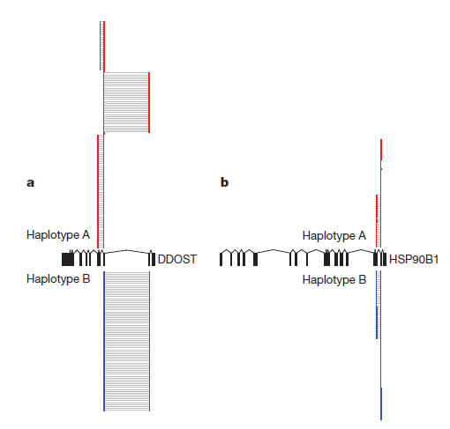
RNA-seq provides resolution of more QTLs
RNA-sequencing in 60 Europeans (HapMap genotypes; LCLs)
Found 2x more expression Quantitative Trait Loci (eQTLs) and...
Exon-eQTLs
UTR Length-QTLs
Splicing eQTLs
Rare eQTLs with allele specific expression-based approaches

Slide 44
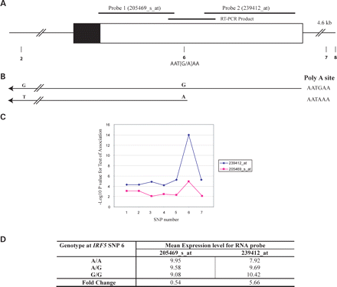
Class activity: rs10954213 creates a functional polyadenylation site
The A allele of rs10954213 creates a functional polyadenylation site
and the A genotype correlates with increased expression of a
transcript variant containing a shorter 3′-UTR. Expression levels of
transcript variants with the shorter or longer 3′-UTRs are inversely correlated.
Our data support a new mechanism by which an IRF5 polymorphism controls
the expression of alternate transcript variants which may have
different effects on interferon signaling
Cunninghame Graham et al., HMG, 2007

Slide 45
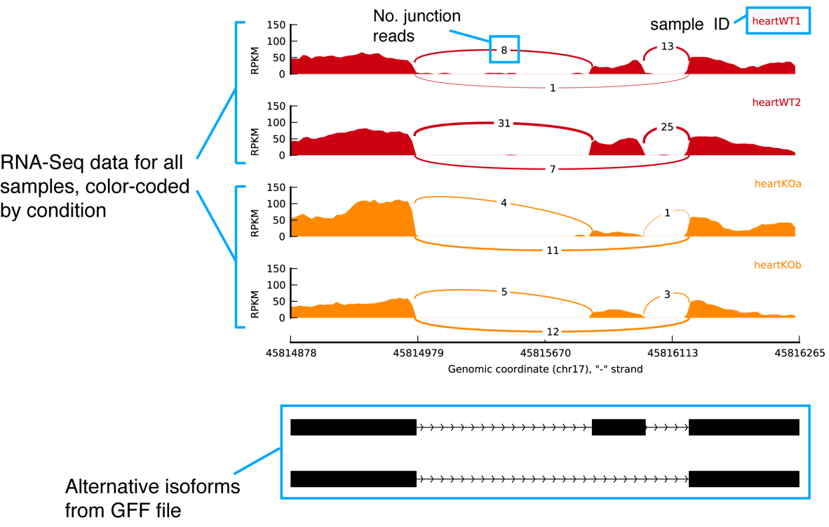
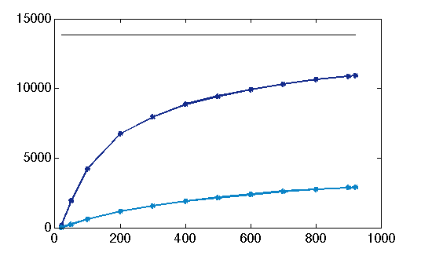
Splicing eQTL
Can investigate relative transcript ratios or reads across junctions.
Splicing also affected for many genes
cis eQTLs
10914
sQTLs
Number eQTLs
6738
2851
1158
200
400
600
800
1000
Number individuals
Battle et al, Genome Research, 2014
Katz et al, Nature Methods, 2010

Slide 46
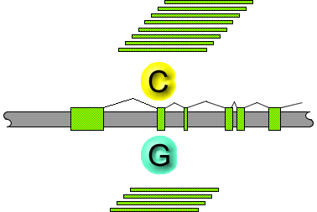
Advantages of ASE
Test within an individual allelic imbalance, given one has sufficient reads.

Slide 47
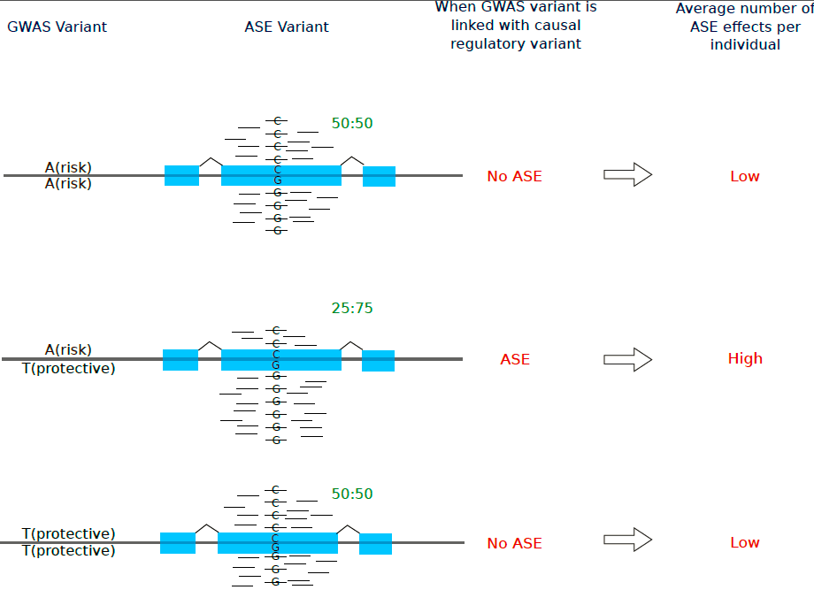
Using ASE to detect GWAS signals driven by multiple causal variants
GWAS variant genotype
LACK OF ASE
FOR HOMS
ABUNDANT ASE
FOR HETS
ASE
LACK OF ASE
FOR HOMS
Tests functional differences between alleles in population
Lucia Conde et al, AJHG, 2013

Slide 48
ASE can be used to map causal variants
POOL OF INDIVIDUALS
Putative regulatory SNP
- / -
NO ASE
- / -
NO ASE
NO ASE
- / -
/
NO ASE
/ -
ASE
/ -
ASE
Montgomery et al, PLoS Genetics, 2011

Slide 49
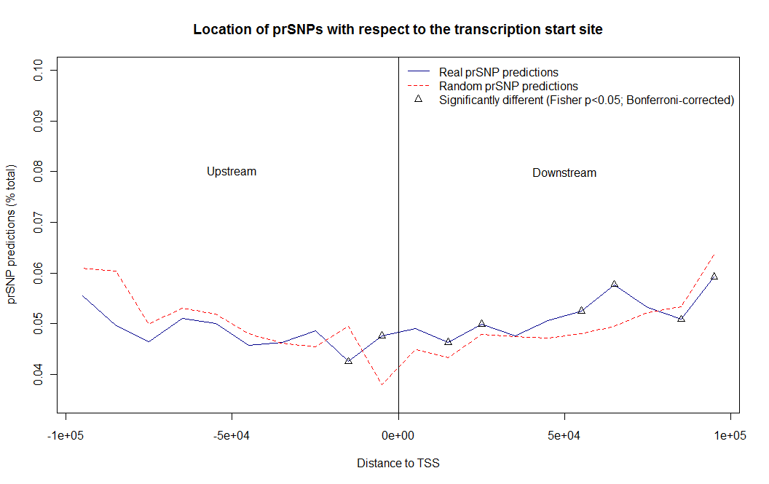
Putative regulatory SNPs
are enriched around TSS
% predictions
Distance to TSS

Slide 50
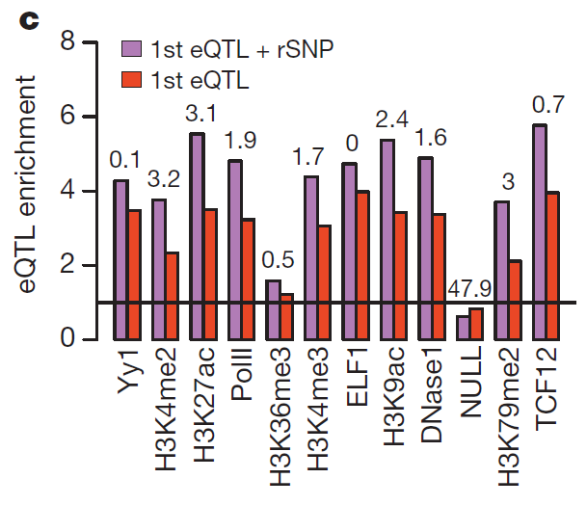
prSNPs that are also eQTL are enriched in functional annotations
Intersection of ASE-QTL and eQTL is more likely to localize a causal variant
Tuuli Lappalainen et al., Nature, 2013

Slide 51
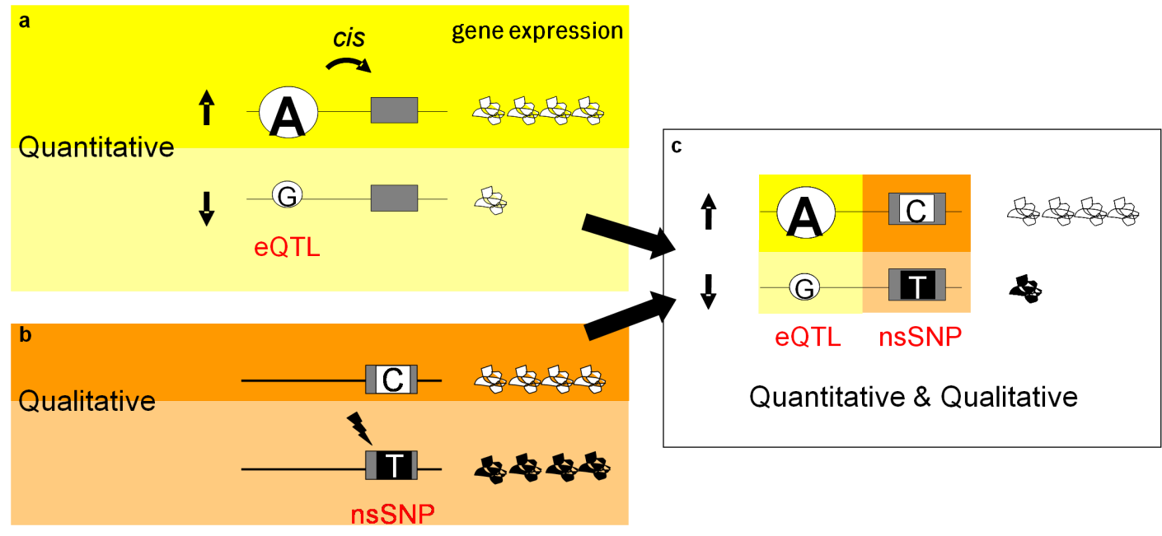
Abundant epistasis between regulatory
and protein coding variation
18.2% (1502 of 8233) Dimas, 2008
46.2% nonsynonymous sites where ASE can be detected are significant in 1 indiv.
Montgomery et al., PLoS Genetics, 2011
Lappalainen et al., AJHG, 2011
Notes:
REVIEW2: Use Dimas slide. Weight effects of rare nsSNP. Use “penetrance”. Depending on phasing penetrance is different. Use “modulates”. Be clear model from ASE.
Use representative instead of existing figure
Start with “

Slide 52
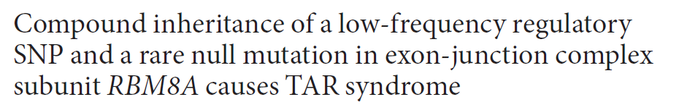
Compound inheritance of regulatory and coding polymorphism causes disease
The exon-junction complex (EJC) performs essential RNA processing tasks1–5. Here, we describe the first human disorder, thrombocytopenia with absent radii (TAR)6, caused by deficiency in one of the four EJC subunits.
The thrombocytopenia with absent radii (TAR) syndrome is characterized by a reduction in the number of platelets (the cells that make blood clot)
Albers, Nature Genetics, 2012

Slide 53
Allelic heterogeneity
of rare deleterious protein-coding
variation
Ten human tissues were collected post-mortem from a healthy 25-year-old Chinese male. RNA-Seq was performed on the ten tissues to quantify gene expression. Exome-Seq was performed on two tissues (bolded) to ascertain the heterozygous sites in the genome.
1/3 of all target variants have significant ASE
Kukurba, PLoS Genetics, May 2014

Slide 54
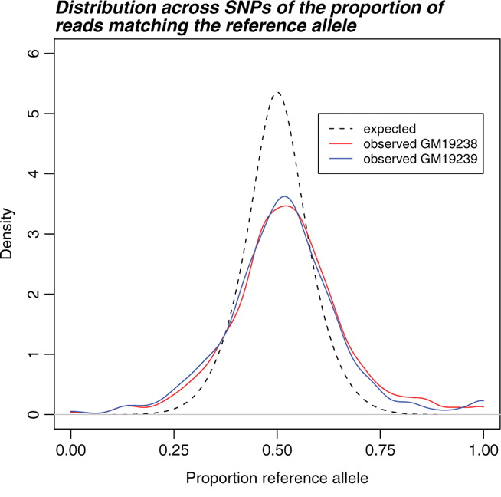
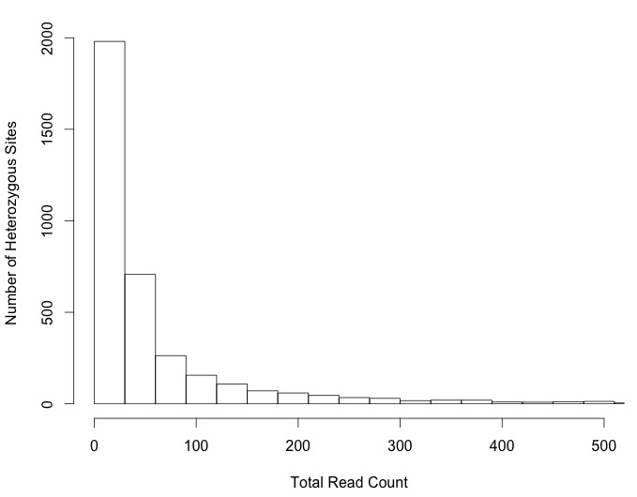
Challenges with calculating allele-specific
expression from RNA-Seq data
Mapping Depth
52.2% of expressed sites ≤ 30 reads
Jacob Degner et al., Bioinformatics, 2009

Slide 55
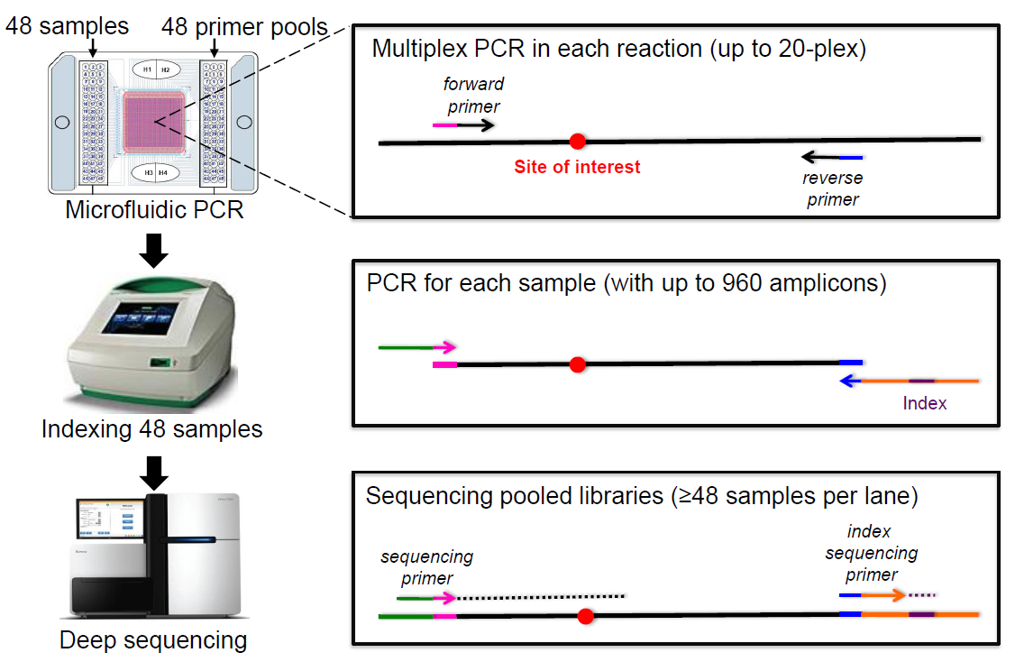
Increasing the resolution of ASE effects in an
individual and across tissues (mmPCR-seq)
Allelic expression for 48 samples for 960 loci per chip in ~2-3 days
Collab with Billy Li - Rui Zhang et al, Nat Methods, 2014
Notes:
why different than capture: amplify each loci, capture maintains dynamic

Slide 56
Application of mmPCR-Seq to rare deleterious and loss-of-function alleles
Selected all complete stop-gain sites (50 sites)
Selected all private and predicted deleterious and damaging nsSNPs (74 sites).
Control sites (160)

Slide 57
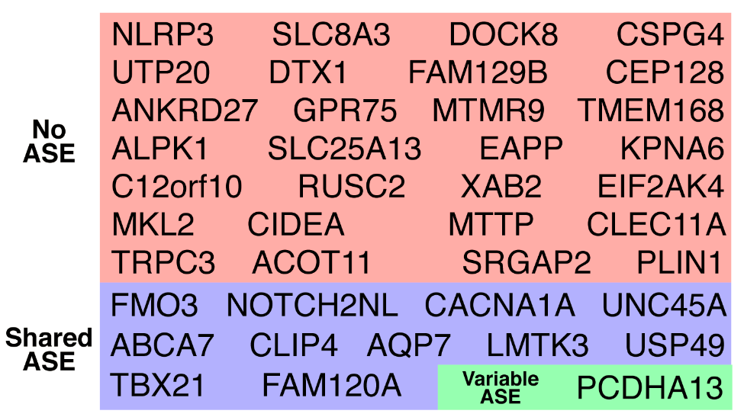
Identification of tissue-specific ASE in genes with rare, deleterious nsSNPs
~33% of genes show significant patterns of ASE
Notes:
Caption: We examined the expression of genes with rare, deleterious nsSNPs with mmPCR-Seq. The majority of the genes (21 of 40) do not show ASE in any tissue (orange box). Roughly one-third of the genes demonstrate ASE that is shared across divergent tissues (dark blue box). Approximately one-eighth of the genes demonstrate variable ASE (cyan blue box) across tissues. In all cases, the deleterious allele showed lower expression compared to the normal allele. In two genes with variable ASE, both the deleterious and the normal allele were preferred in different tissues. For example, the deleterious allele of PCDHA13 was over-expressed in the heart and skeletal muscle but under-expressed in the colon, frontal lobe, and stomach.

Slide 58

How will gene expression influence
decisions in the clinic?
Build cellular models of disease
Survey diagnostic responses to treatments
Identify diverse disease mechanisms; move us beyond protein coding mutations alone
Identify pathological tissues
Allow us to identify effects (or transferability) in different populations
Classify undiagnosed conditions
Cost-effective

Slide 59
“The field will transition from doing primarily association work to figuring out what implicated variants do biologically.”
David Goldstein, Director of the Center for Human Genome Variation, Duke University, Nature, Feb 2012

Slide 60
montgomerylab.stanford.edu
Further recommended reading:
1) Genome, epigenome and RNA sequences of monozygotic twins discordant for multiple sclerosis (2010, Nature)
2) 9p21 DNA variants associated with coronary artery disease impair interferon-γ signalling response (2011, Nature)

