Slide 1
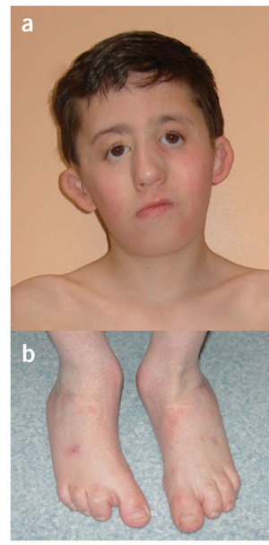
Miller Syndrome: DHODH
Cupped ears
coloboma of the lower eyelids,
prominent nose,
micrognathia
absence of the fifth digits of the feet
Ng, S.B. et al. Exome sequencing identifies the cause of a Mendelian disorder.
Nat. Genet. 42, 30–35 (2010).
Notes:
(a,b) A 9-year-old boy with Miller syndrome caused by mutations in DHODH. Facial anomalies (a) include cupped ears, coloboma of the lower eyelids, prominent nose, micrognathia and absence of the fifth digits of the feet (b). (c,d) A 26-year-old man with methotrexate embryopathy. Note the cupped ears, hypertelorism, sparse eyebrows and prominent nose (c) accompanied by absence of the fourth and fifth digits of the feet (d).

Slide 2
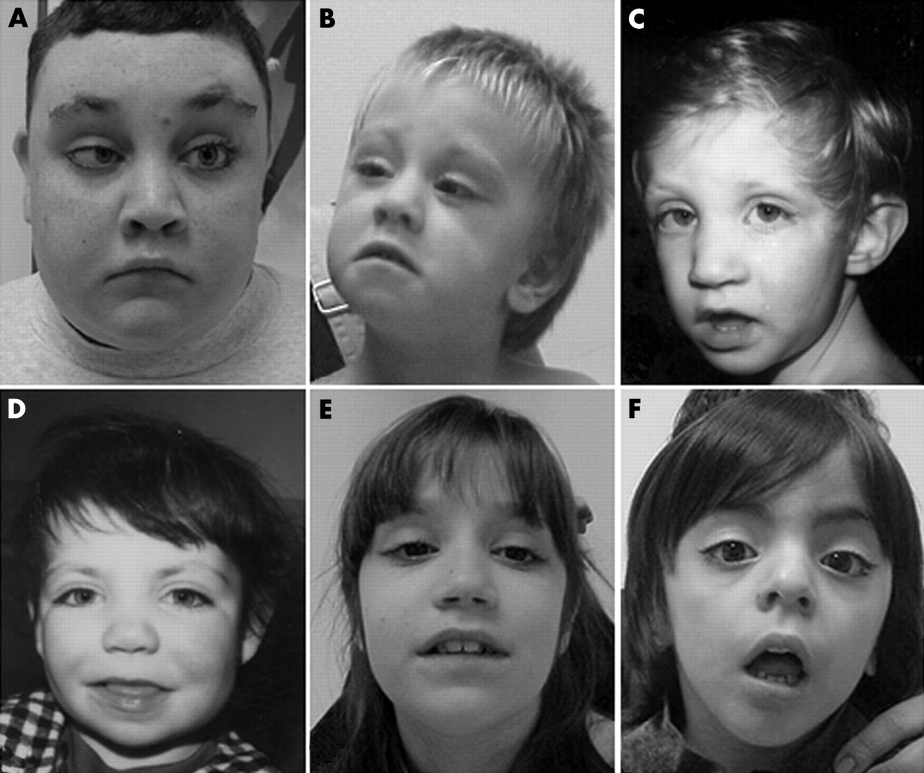
Kabuki Syndrome: MLL2
Ng, S.B. et al. Exome sequencing identifies MLL2 mutations as a cause of
Kabuki syndrome. Nat. Genet. 42, 790–793 (2010).
Notes:
Kabuki syndrome is a rare, multiple malformation disorder characterized by a distinctive facial appearance (Supplementary Fig. 1), cardiac anomalies, skeletal abnormalities, immunological defects and mild to moderate mental retardation

Slide 3
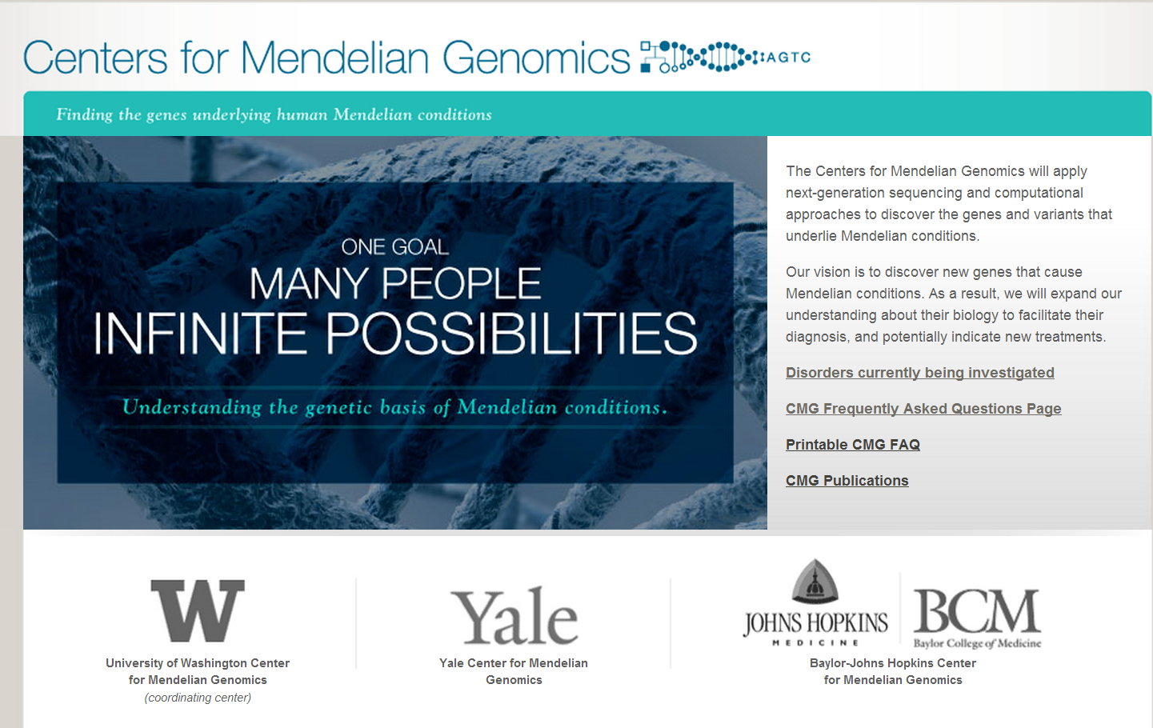
www.mendelian.org

Slide 4
www.mendelian.org
Large scale public effort to identify Mendelian mutations
UW/Yale/Hopkins/Baylor
Doctors send in samples
Centers sequence families, find mutations
Joint publication

Slide 5
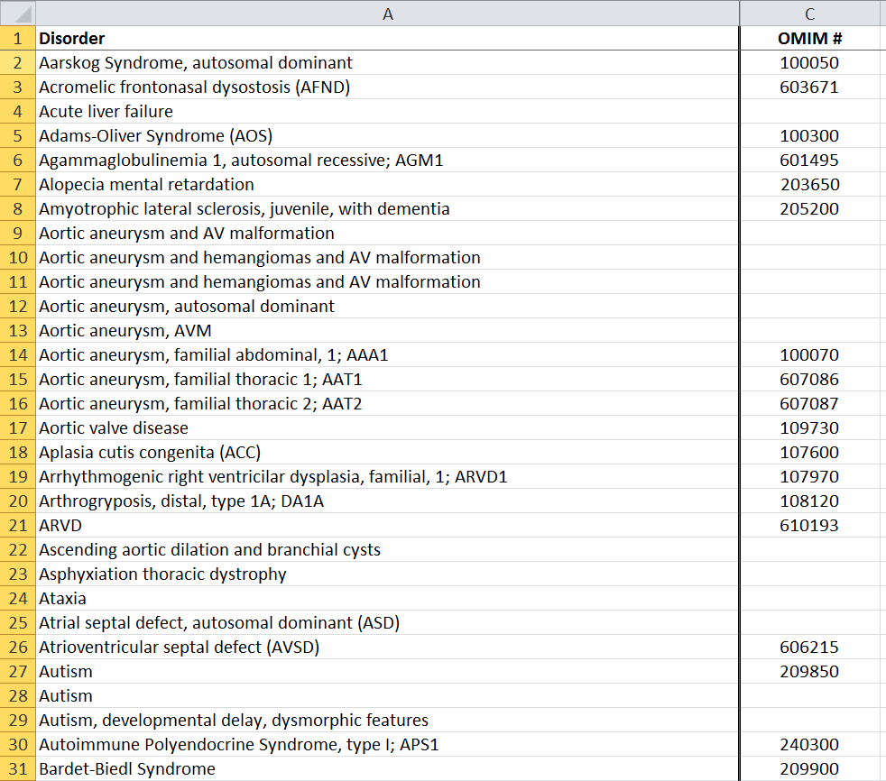
www.mendelian.org
Sequencing 500 Mendelian families
Either exome or wgs

Slide 6
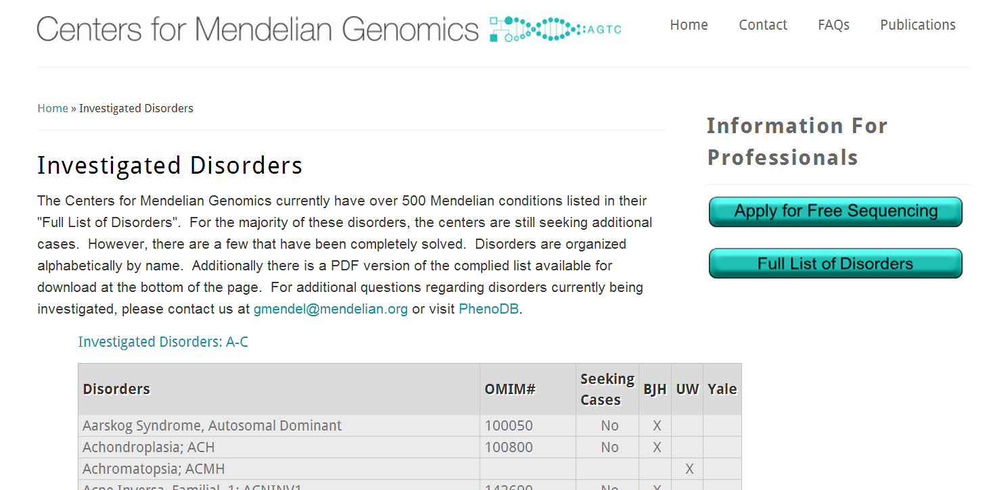

Slide 7
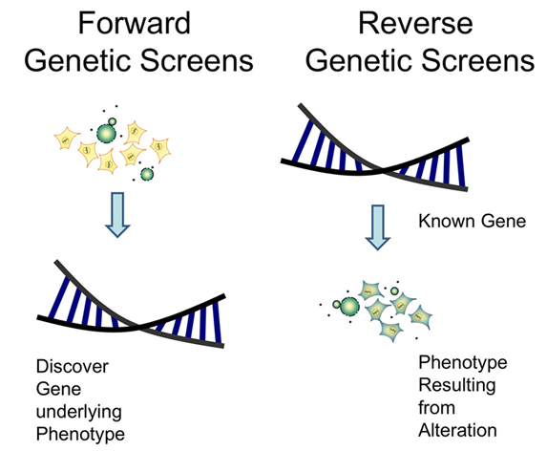

Slide 8
Mutational load in a normal person
Rare non-synonymous/splice site/insertions ~500
Rare, strong loss of function ~25
Genes with compound heterozygous mutations 1-3
stop
stop
stop
Glu -> Pro
homozygous
Compound heterozygous

Slide 9
Human knockout for NFATC2
Pro860Leu
NFATC2
His426Arg
Stuart Kim’s genome

Slide 10
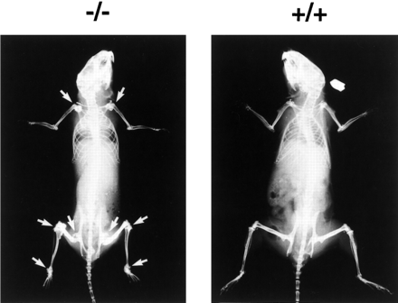
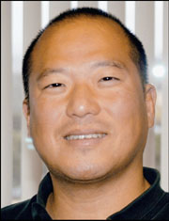

A human model for NFATC2
187 publications on NFATC2 in mice

Slide 11
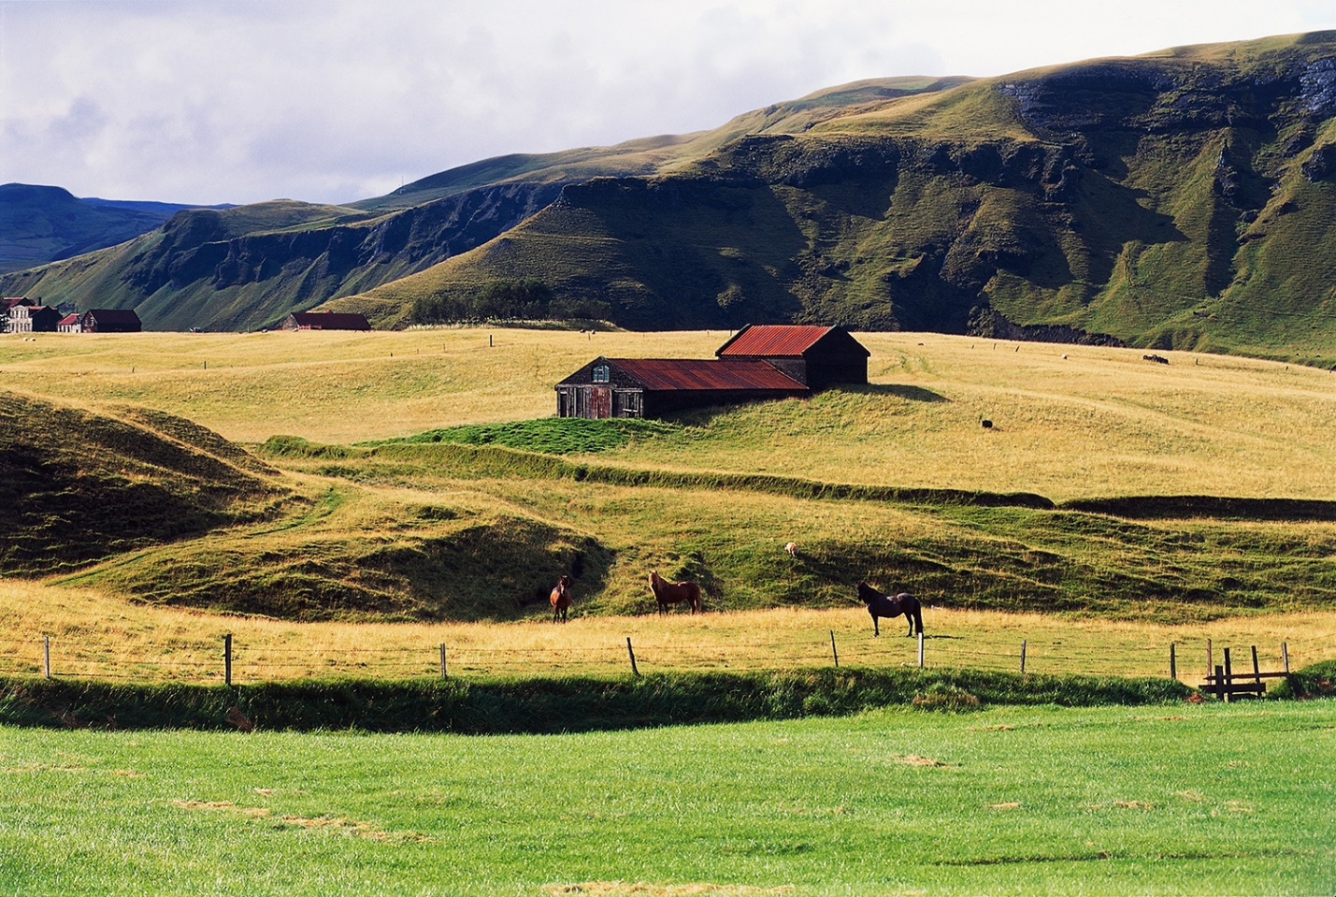
Human KO project
Sequencing Iceland

Slide 12
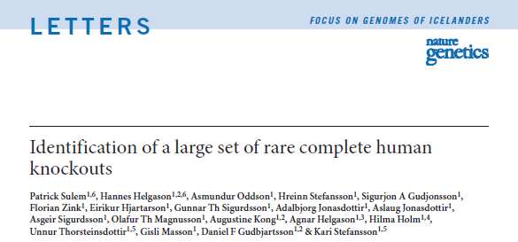

Slide 13
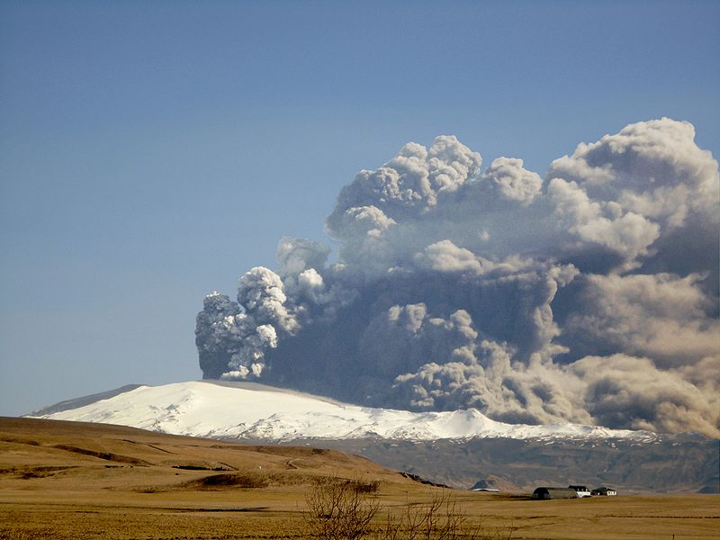
Iceland
Population: 329,100
area of 103,000 km² (40,000 sq mi)
making it the most sparsely populated country in Europe.
The capital and largest city is Reykjavík.
Iceland is warmed by the Gulf Stream and has a temperate climate, despite a high latitude just outside the Arctic Circle.
Settlement of Iceland began in 874 CE when the Norwegian chieftain Ingólfr Arnarson became the first permanent settler on the island
“Mating is not random in the population.” (p 449)

Slide 14
Data description
“Large-scale whole-genome sequencing of the Icelandic population”
Sequenced whole genomes of 2,636 Icelanders (20×)
Imputed these variants into 104,220 individuals down to a minor allele frequency of 0.1%

Slide 15
Loss of function mutations
Observed 6,795 loss-of-function mutations in 4,924 genes among the sequenced Icelanders; 3,979 SNPs and 2,816 indels
A single loss-of-function mutation was observed in 3,603 genes and 2 or more mutations were observed in 1,321 genes
Most loss-of-function mutations were rare, with 85% having a MAF below 0.5%.

Slide 16
Complete knock outs
Number of genes in the genome: 19,135
Completely knocked out genes: 1,171
Individuals with knocked out genes: 8,041
knocked out genes that give severe disease: 20
knocked out genes that give known condition: 68
knocked out genes in more than 1 individual: 381

Slide 17
Next steps: phenotyping
“The next phase of this work will be to phenotype the complete knockouts…We have identified 11 individuals who are homozygous or compound heterozygous for loss-of-function mutations in LRIG3, which is considered to be critical to formation of the lateral semicircular canal …

Slide 18
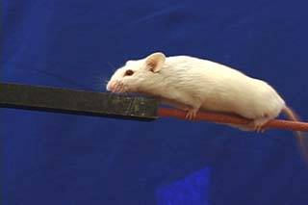
We intend to recruit together complete knockouts and to phenotype them meticulously, especially for their sense of balance.

