Slide 1
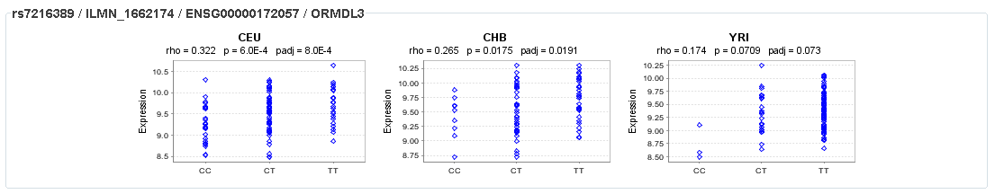
Class activity: What are my asthma variants doing?
In the subset of individuals for whom expression data are available,
the T nucleotide allele at rs7216389 (the marker most strongly associated with
disease in the combined GWA analysis) has a frequency of 62% amongst asthmatics
compared to 52% in non-asthmatics (P = 0.005 in this sample).
Moffatt, Nature, 2007
Stuart rs721638 TT Higher expression ↑ Asthma

Slide 2
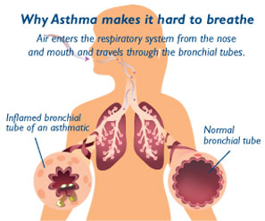
Asthma is a syndrome of unknown origins that is characterized by abnormal and inflamed mucosa of the airways, wheezing, and shortness of breath.
Asthma runs strongly in families, and its heritability has been estimated as 60%.

Slide 3
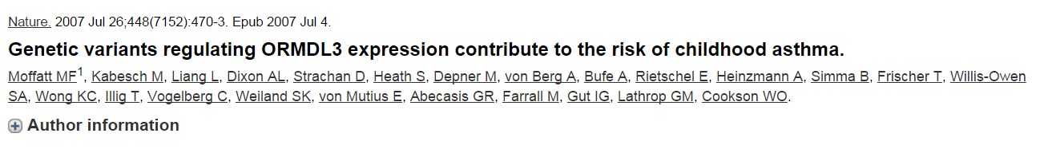
Pubmed ID = 17611496
317,000 SNPs in DNA from 994 patients with childhood onset asthma and 1,243 non-asthmatics
The SNP with the strongest evidence of association within the interval was rs7216389 (uncorrected P = 9 × 10⁻¹¹). Replicated
ORMDL3 is the third member of a novel class of genes of unknown function that encode transmembrane proteins anchored in the endoplasmic reticulum (ER)
rs7216389 is a strong eQTL with ORMDL3
more than one functional SNP underlies the locus

Slide 4
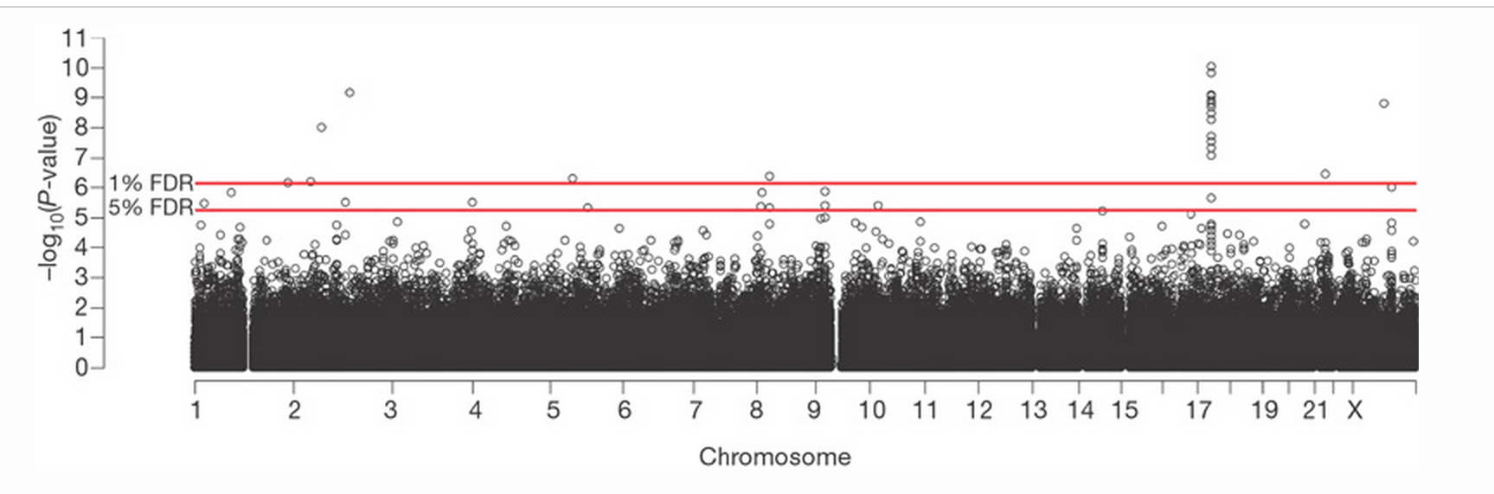

Slide 5
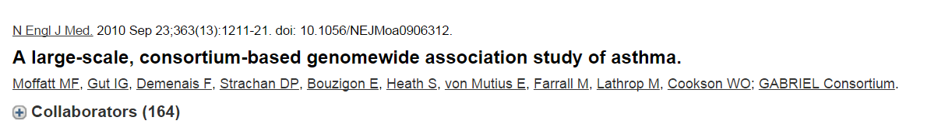
Pubmed ID = 20860503
10,365 persons with physician-diagnosed asthma and 16,110 unaffected persons
rs3771166 on chromosome 2, implicating IL1RL1/IL18R1 (P=3×10(−9));
rs9273349 on chromosome 6, implicating HLA-DQ (P=7×10(−14));
rs1342326 on chromosome 9, flanking IL33 (P=9×10(−10));
rs744910 on chromosome 15 in SMAD3 (P=4×10(−9));
rs2284033 on chromosome 22 in IL2RB (P=1.1×10(−8)).
Association with the ORMDL3/GSDMB locus on chromosome 17q21 was specific to childhood-onset disease (rs2305480, P=6×10(−23)).

Slide 6
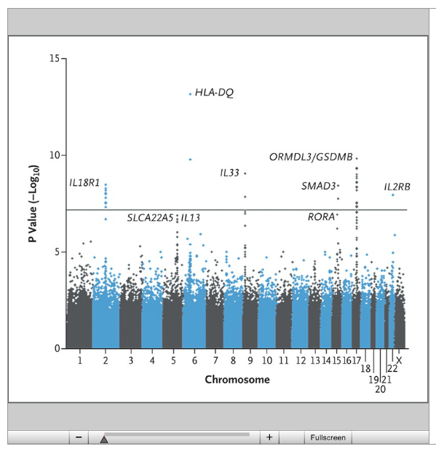

Slide 7
Interleukins/SMAD: indicate pathway that initiates type 2 helper T-cell (Th2) inflammation in response to epithelial damage
IL33 activates NF-κB and mitogen-activated protein (MAP) kinases and drives production of Th2-associated cytokines. IL33 may function as an endogenous danger signal to alert the immune system of epithelial damage during trauma or infection.

Slide 8
Area under the receiver-operating-characteristic curve was 0.58 (.50 – 1.00)
Estimation of the population attributable risk fraction for the joint action of the significant loci indicated that 38% (95% confidence interval [CI], 28 to 44) of cases of childhood-onset asthma were attributable to SNP combinations at these loci.
These results indicate that although the SNPs would not be effective in classifying the individual risk of asthma, the SNPs (or rather, the downstream functions of which they are markers) do have a substantial effect on the burden of asthma in the community.

Slide 9
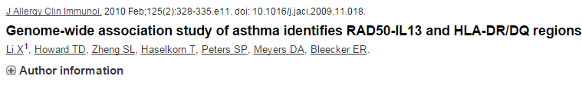
Pubmed ID = 20159242
473 cases and 1892 general population controls.
292,443 SNPs. Bonferroni correction is .05/ 292,443 = 1.8 x 10⁻⁷
“Multiple SNPs in the RAD50-IL13 region on chromosome 5q31.1 were associated with asthma: rs2244012 in intron 2 of RAD50 (P = 3.04E-07).”
Best SNP is not significant! No strong evidence for SNPs from this paper.

Slide 10
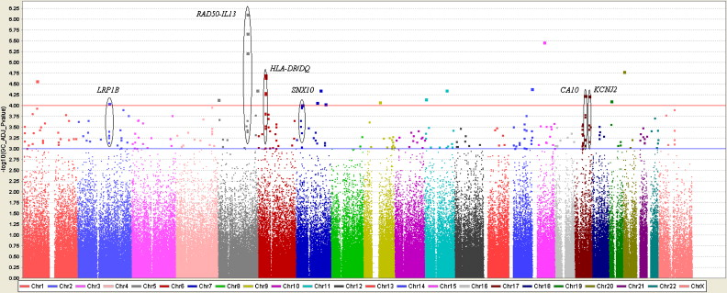
None of the SNPs are statistically significant (p < 1.7 x 10⁻⁷)

Slide 11
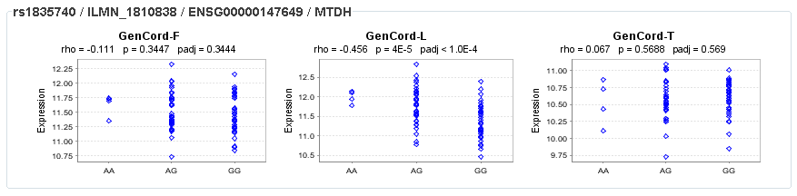
Class activity: What are my migraine variants doing in different tissues?
We identified the minor allele of rs1835740 on chromosome 8q22.1 to be associated with migraine (P = 5.38 × 10⁻⁹, odds ratio = 1.23, 95% CI 1.150–1.324) in a genome-wide association study of 2,731 migraine cases ascertained from three European headache clinics and 10,747 population-matched controls. In an expression quantitative trait study in lymphoblastoid cell lines, transcript levels of the MTDH were found to have a significant correlation to rs1835740 (P = 3.96 × 10⁻⁵, permuted threshold for genome-wide significance 7.7 × 10⁻⁵).
Anttila, Nature Genetics, 2011

Slide 12
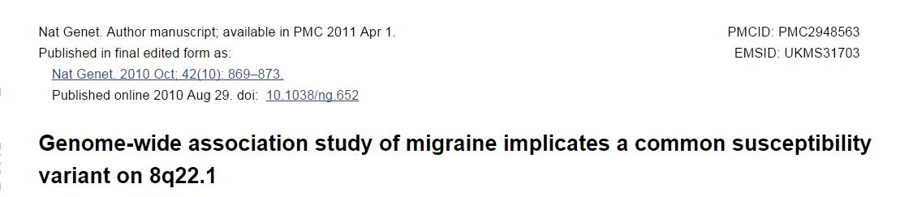
Pubmed ID = 20802479
Migraine is an episodic neurological disorder with complex pathophysiology, affecting 8% of males and 17% of females
Cases: 5950
Controls: 50809
Only one marker, rs1835740 on chromosome 8q22.1, showed genome-wide significant association to migraine. (replicated)
The proportion of genetic variance explained by the rs1835740 variant was estimated to be 1.5-2.5%.

Slide 13
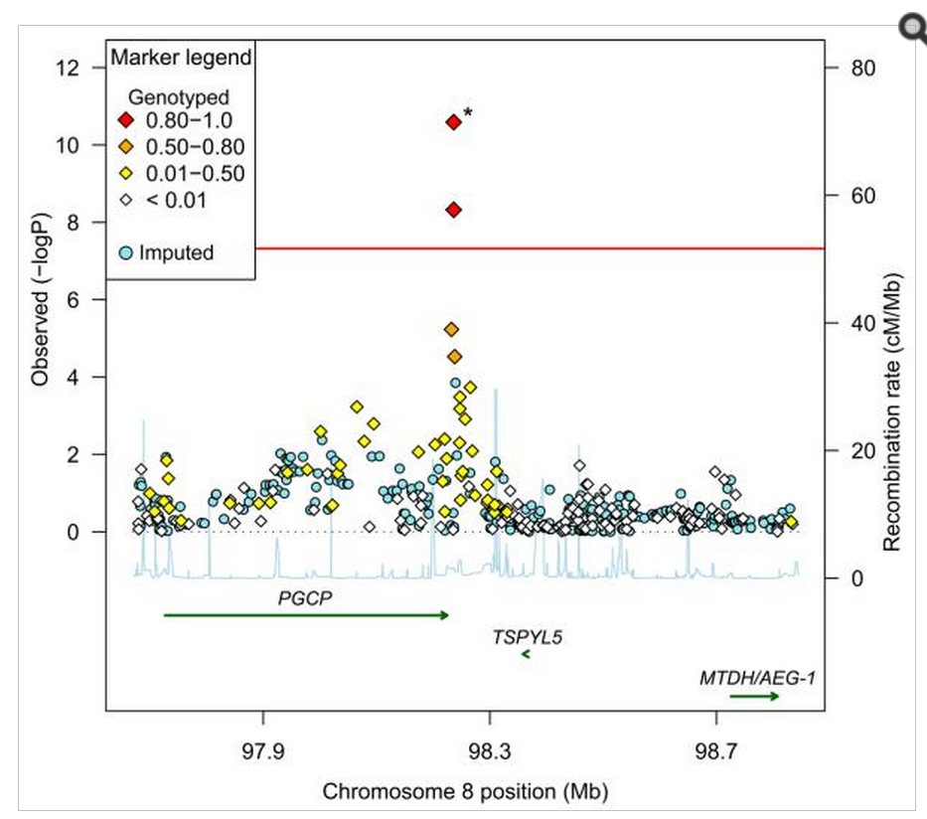

Slide 14
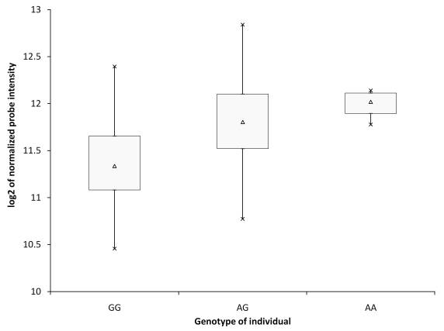
MTDH/AEG-1 expression based on genotype of rs1835740

Slide 15
Possible mechanism
Metadherin, also known as protein LYRIC or astrocyte elevated gene-1 protein (AEG-1)
AEG-1 acts as an oncogene in melanoma, malignant glioma, breast cancer and hepatocellular carcinoma.
MTDH/AEG-1 down-regulates EAAT2/GLT1, the major glutamate transporter in the brain.

Slide 16
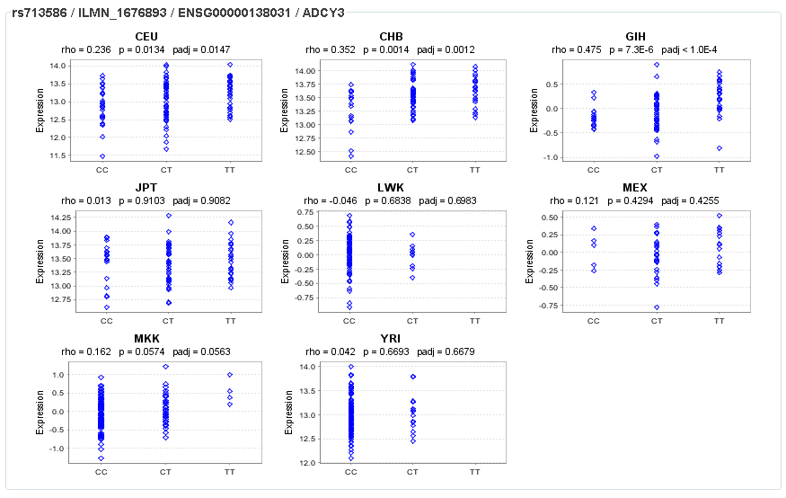
Class activity: What are my BMI variants doing in different populations?
rs713586 explained
0.06% of BMI variance
Speliotes, Nature Genetics, 2010

