Slide 1
polymorphisms
3 million/person
GWAS
10K-100K people
traits

Slide 2
polymorphisms
~18 million in dbSNP
Functional mutations
Protein changes
expression changes
genes
HMG CoA reduct.
LPA
Pathways
Cholesterol levels
Traits
Cardiovascular disease

Slide 3
polymorphisms
113 SNPs in actn3
Functional mutations
1 SNP is stop codon
Traits
Power muscle

Slide 4
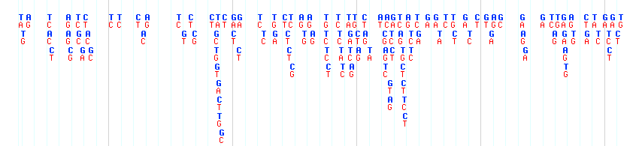
Functional mutations
MMP20
T
C
T
C
A
G
Coding SNPs
Expression SNP

Slide 5
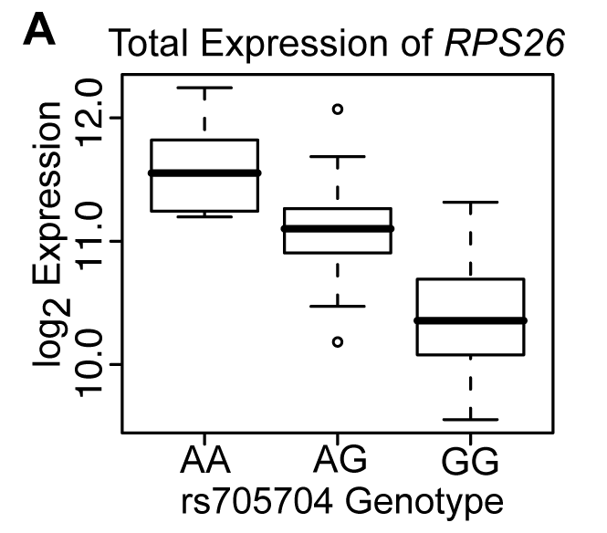
Total Expression Analysis
n=153
p=1.2x10⁻²⁰
Notes:
1041 SNPs in the promoter regions and 386 SNPs in the coding and untranslated regions

Slide 6
G
A
Look at expression in :
G/G
High
G/A
Medium
A/A
Low

Slide 7
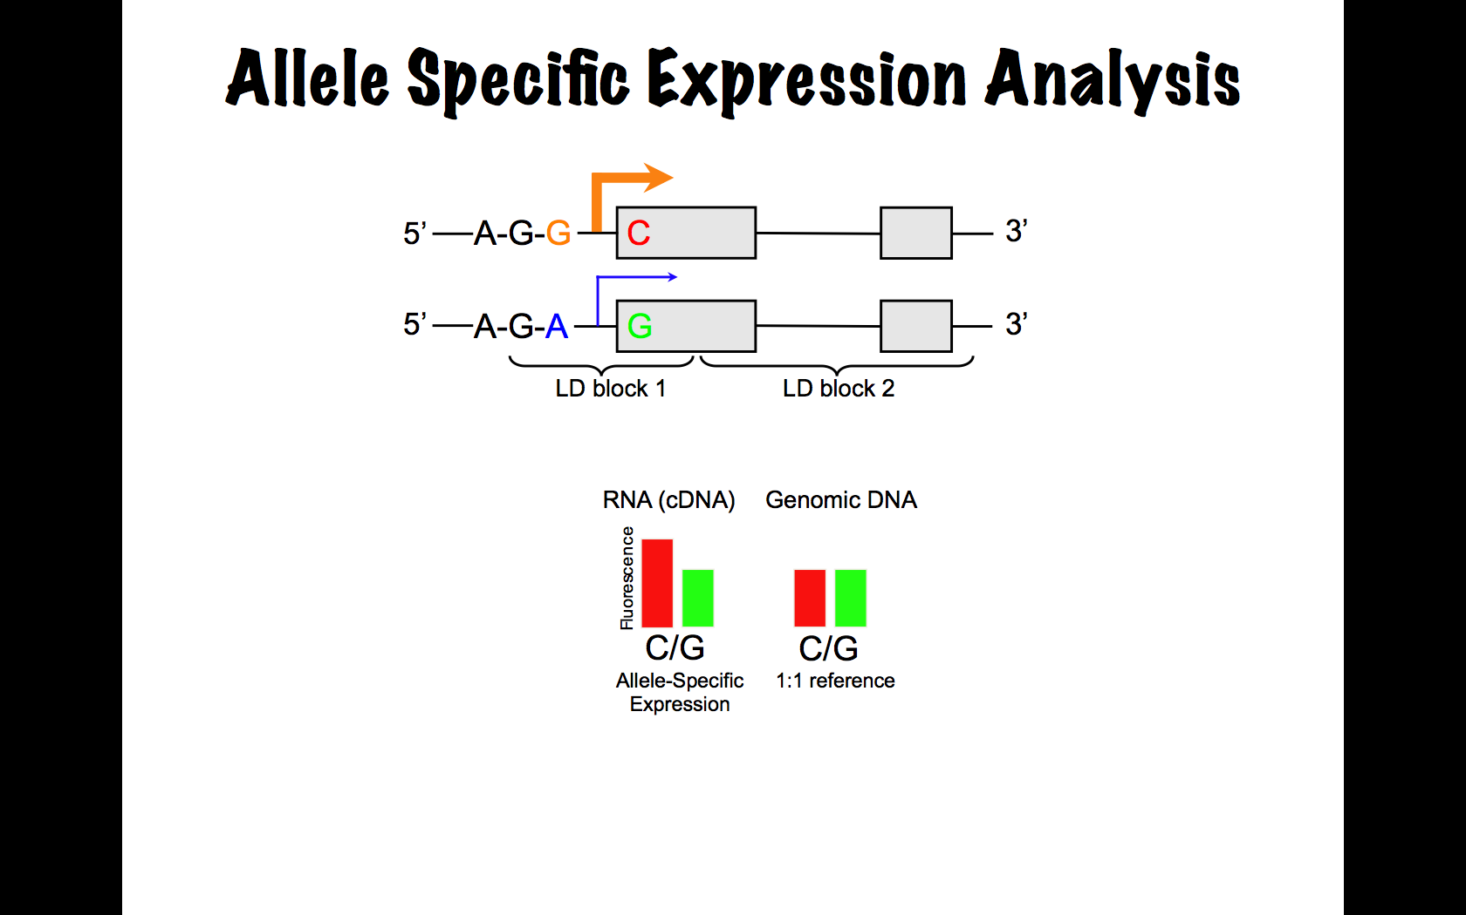
Allele-specific Expression
Make cDNA
Method 1: sequence cDNAs and count if C allele is more abundant than the G allele.
Method 2: use DNA arrays and see if the C oligo is more intense than the G oligo.
Notes:
95 Individuals Kidney DNA and RNA
309 SNPs in 225 Candidate Aging Genes were tested for Allelic Imbalance (AI)
(≥5 expressing heterozygotes)
105 SNPs in 93 Candidate Aging Genes Display AI
(≥50% of heterozgotes were required to have an RNA allele ratio greater than 2 SD above the DNA-defined 1:1 allele ratio)
Expand ASE method

Slide 8
Allele-specific Expression
*
*
Expressed in the same nucleus
Same genetic background
Same environment
Extremely sensitive
Notes:
95 Individuals Kidney DNA and RNA
309 SNPs in 225 Candidate Aging Genes were tested for Allelic Imbalance (AI)
(≥5 expressing heterozygotes)
105 SNPs in 93 Candidate Aging Genes Display AI
(≥50% of heterozgotes were required to have an RNA allele ratio greater than 2 SD above the DNA-defined 1:1 allele ratio)
Expand ASE method

Slide 9
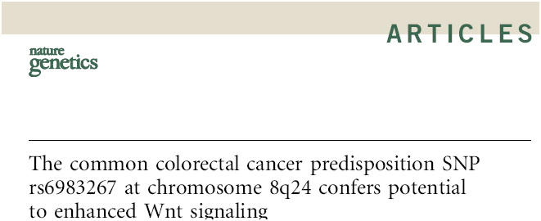
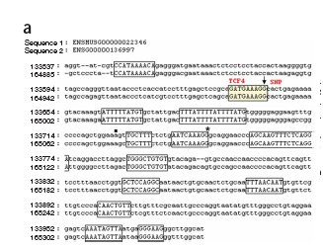
G/T
myc
rs6983267 is a G/T SNP in a TCF4
binding site near the myc oncogene
Nature Genetics 41, 885, 2009

Slide 10
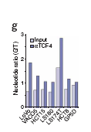
G/T
myc
The G allele shows stronger binding to TCF4 than
the T allele
Nature Genetics 41, 885, 2009

Slide 11
polymorphisms
~18 million in dbSNP
Functional mutations
Protein changes
expression changes
genes
All genes expressed in cardiovasculature
Genes that change expression in CVD
Pathways
Cholesterol levels
Traits
Cardiovascular disease

Slide 12
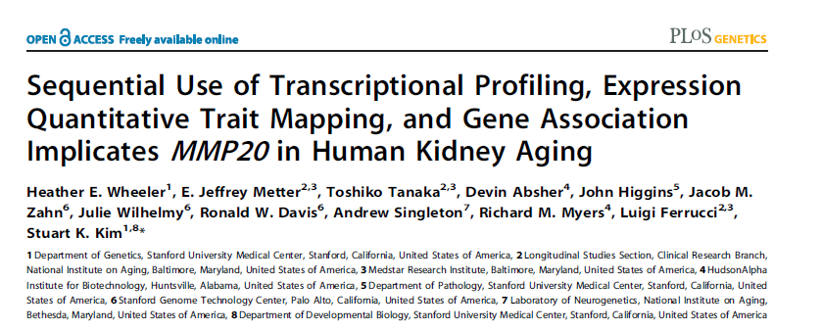
PLoS Genet 5 (2009): e1000685. doi:10.1371/journal.pgen.1000685.

Slide 13
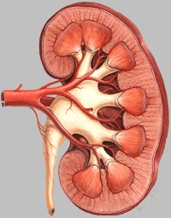
Kidney as a model for human aging
Filtration rate declines
with age
Easy to test function
Renal Pelvis
Cortex
Medulla
Notes:
Function: filtration rate goes down (easy to test)
Sectioned into cortex and medulla=>142 chips
Cortex: a primary function of the kidney is to remove toxins from the blood, which involves filtering plasma through specialized capillary beds
(glomeruli) in the cortex
Medulla: tubules within the medulla concentrate or dilute the urine to maintain fluid balance
Largest sample size ever
Normal tissue removed at nephrectomy for either removal of a tumor or transplantation
133 Hu133A, 133 Hu133B Chips; 44,000 probes

Slide 14
Genomic Convergence
Genome-wide transcriptional profile of human kidney aging
Test age-regulated genes for eSNPs
Test eSNP genes for association with GFR
Aging
SNP!

Slide 15
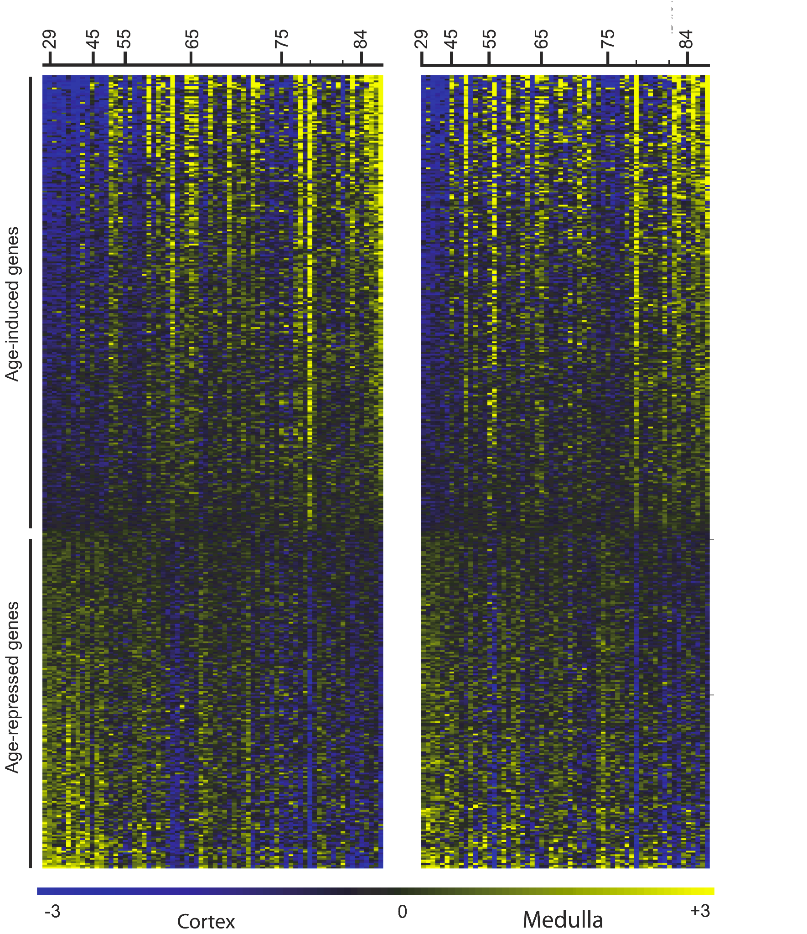
447 age-regulated genes in the human kidney
Each row is a gene
Yellow is high level expression
Blue is low level expression
Each column corresponds to a person, youngest to oldest
left: Cortex
right: medulla
Notes:
And this is what the result looks like in our group. Here we have a heatmap of all genes that change as a function of age with p<0.001. This gives a yield of 985 genes, which is significantly more than would be expected by chance…44…so this validates the approach…
Each column represents a patient…young to old…each row represents a gene…yellow is up…blue is down…so a large number of genes start with low expression in younger patients and increase with age…and a smaller number….

Slide 16
Differential expression from different alleles
*
*

Slide 17
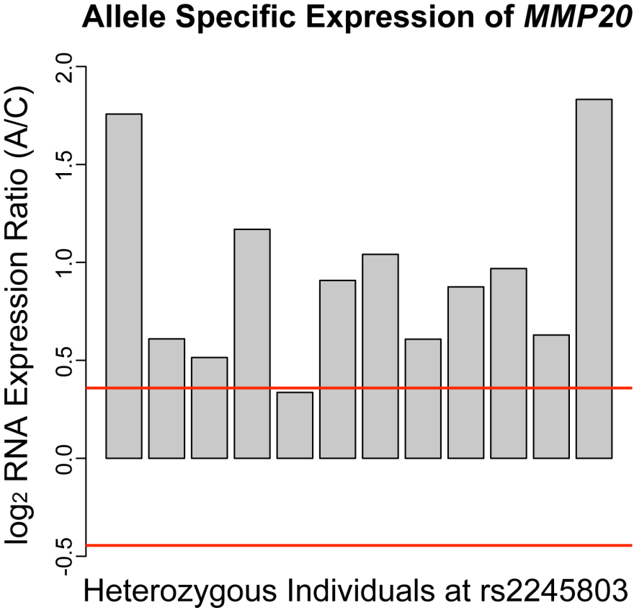
Allele-Specific Expression
Red lines indicate 95% confidence intervals
Example shows 11/12 heterozygotes have higher expression of A allele than C allele.

Slide 18
Genomic Convergence
Genome-wide transcriptional profile of human kidney aging
Test age-regulated genes for eSNPs
Test genes for association with GFR
Aging
SNP!
630 Candidate Aging Genes
101 genes with eQTLs

Slide 19
polymorphisms
~18 million in dbSNP
Functional mutations
Protein changes
expression changes
genes
All genes expressed in cardiovasculature
Genes that change expression in CVD
Pathways
GO, KEGG, networks etc.
Traits
Cardiovascular disease

