Slide 1
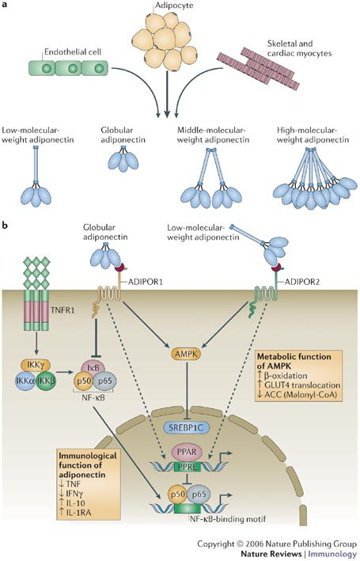
Adiponectin:
Understanding the regulation of a metabolically important protein hormone.
Bethany Schaffer
Personalized Medicine and Genomics
May 29, 2012

Slide 2
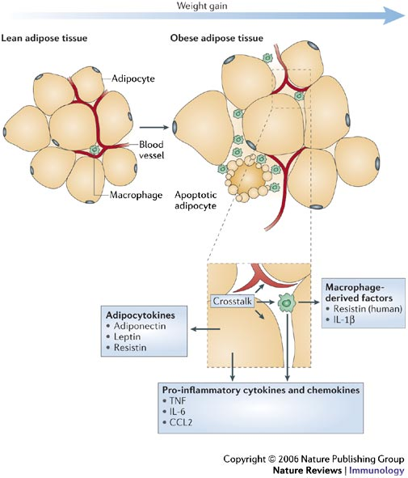

Tilg and Moschen Nature Reviews Immunology 6, 772–783 (October 2006) | doi:10.1038/nri1937
Notes:
From Review:
Adipose tissue is no longer considered to be an inert tissue functioning solely as an energy store, but is emerging as an important factor in the regulation of many pathological processes. Various products of adipose tissue have been characterized, and some of the soluble factors produced by this tissue are known as adipocytokines.
Adiponectin and leptin are the most abundant adipocytokines produced by adipocytes.
Obesity leads to improper production/secretion of cytokines, often pro-inflammatory. Macrophages in adipose tissue seem to be the main source of TNF, adipocytes contribute almost one third of the IL-6 concentration in the circulation of patients who are obese9.
In humans, adipocytokines function as hormones to influence energy homeostasis and to regulate neuroendocrine function.

Slide 3
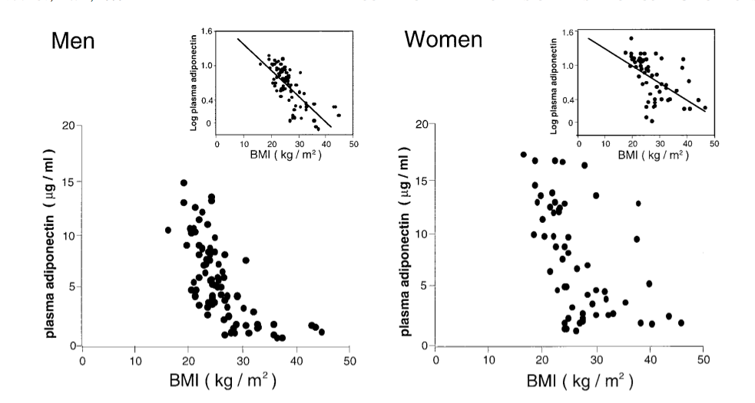
Serum adiponectin levels are decreased in obese individuals
Arita et al, 1999
Notes:
Adiponectin was abundantly present in the plasma of healthy volunteers in the range from 1.9 to 17.0 mg/ml. 1999 study that named adiponectin
Title of paper:
Paradoxical Decrease of an Adipose-Specific Protein, Adiponectin, in Obesity

Slide 4
Tilg and Moschen Nature Reviews Immunology 6, 772–783 (October 2006) | doi:10.1038/nri1937
Notes:
From Review:
Although adiponectin is synthesized mainly by adipocytes, it is also expressed by skeletal muscle cells, cardiac myocytes and endothelial cells
Full-length adiponectin can exist as: a trimer (known as low-molecular-weight adiponectin); a hexamer, which consists of two trimers linked by a disulphide bond (known as middle-molecular-weight adiponectin); and a high-molecular-weight 12- to 18-mer
Adiponectin circulates at high concentrations in human serum (5–10 mg
Serum levels of adiponectin are markedly decreased in individuals with visceral obesity and states of insulin resistance, such as non-alcoholic fatty liver disease, atherosclerosis and type 2 diabetes mellitus, and adiponectin levels correlate inversely with insulin resistance
It has been suggested recently that the ratio, and not the absolute amounts, of high-molecular-weight and low-molecular-weight adiponectin in the serum might be crucial in determining insulin sensitivity31. In support of the importance of circulating high-molecular-weight adiponectin in protecting against insulin resistance, moderate weight loss leads to a relative increase in the ratio of high-molecular-weight to middle-molecular-weight adiponectin and a decrease in the amount of low-molecular-weight adiponectin in the serum32.
Two receptors for adiponectin have been identified recently (ADIPOR1 and ADIPOR2). ADIPOR1 is expressed widely in mice, whereas ADIPOR2 is expressed mainly in the liver33. Whereas globular adiponectin seems to activate mainly ADIPOR1, ADIPOR2 engages mainly with the full-length variant of adiponectin33. In addition, T-cadherin, which is expressed by many cells including endothelial cells and smooth muscle cells, seems to function as a receptor for middle-molecular-weight and high-molecular-weight adiponectin, but not for the trimeric (low-molecular-weight) and globular forms34.
TNF suppresses the transcription of adiponectin in an adipocyte cell line, which might explain the lower levels of serum adiponectin in individuals who are obese35. Expression of adiponectin is also regulated by other pro-inflammatory mediators such as IL-6, which suppresses adiponectin transcription and translation in an adipocyte cell line36. Weight loss is a potent inducer of adiponectin synthesis37, as is activation of peroxisome-proliferator-activated receptor- (PPAR) by its ligands thiazolidinediones, which are important for the treatment of type 2 diabetes mellitus38, 39. Circulating levels of adiponectin, however, are affected by many other factors including gender, age and lifestyle.
Figure: a | Adiponectin is produced mainly by adipocytes, but other cell types, such as skeletal and cardiac myocytes and endothelial cells, can also produce this adipocytokine. Adiponectin exists as a full-length trimer (low-molecular-weight form), as well as a proteolytic cleavage fragment (globular adiponectin). The full-length trimer can dimerize to form a hexamer (middle-molecular-weight form), which can then oligomerize to form a polymer (high-molecular-weight form). It has been proposed that cleavage of full-length adiponectin by a leukocyte elastase secreted by activated monocytes and/or neutrophils generates the globular fragment. b | Adiponectin interacts with at least two known cellular receptors (ADIPOR1 and ADIPOR2). Activation of ADIPOR1 and/or ADIPOR2 by adiponectin stimulates the activation of peroxisome-proliferator-activated receptor- (PPAR), AMP-activated protein kinase (AMPK) and p38 mitogen-activated protein kinase33. Adiponectin regulates the expression of several pro- and anti-inflammatory cytokines. Its main anti-inflammatory function might be related to its capacity to suppress the synthesis of tumour-necrosis factor (TNF) and interferon- (IFN) and to induce the production of anti-inflammatory cytokines such as interleukin-10 (IL-10) and IL-1 receptor antagonist (IL-1RA). Activation of PPARs exerts anti-inflammatory effects through inhibition of the transcriptional activation of pro-inflammatory response genes. ACC, acetyl-CoA carboxylase; GLUT4, glucose transporter type 4; IKK, inhibitor of nuclear factor-B (IB) kinase; NF-B, nuclear factor-B; PPRE, peroxisome-proliferator response element; SREBP1C, sterol-regulatory-element-binding protein 1C; TNFR, TNF receptor.

Slide 5
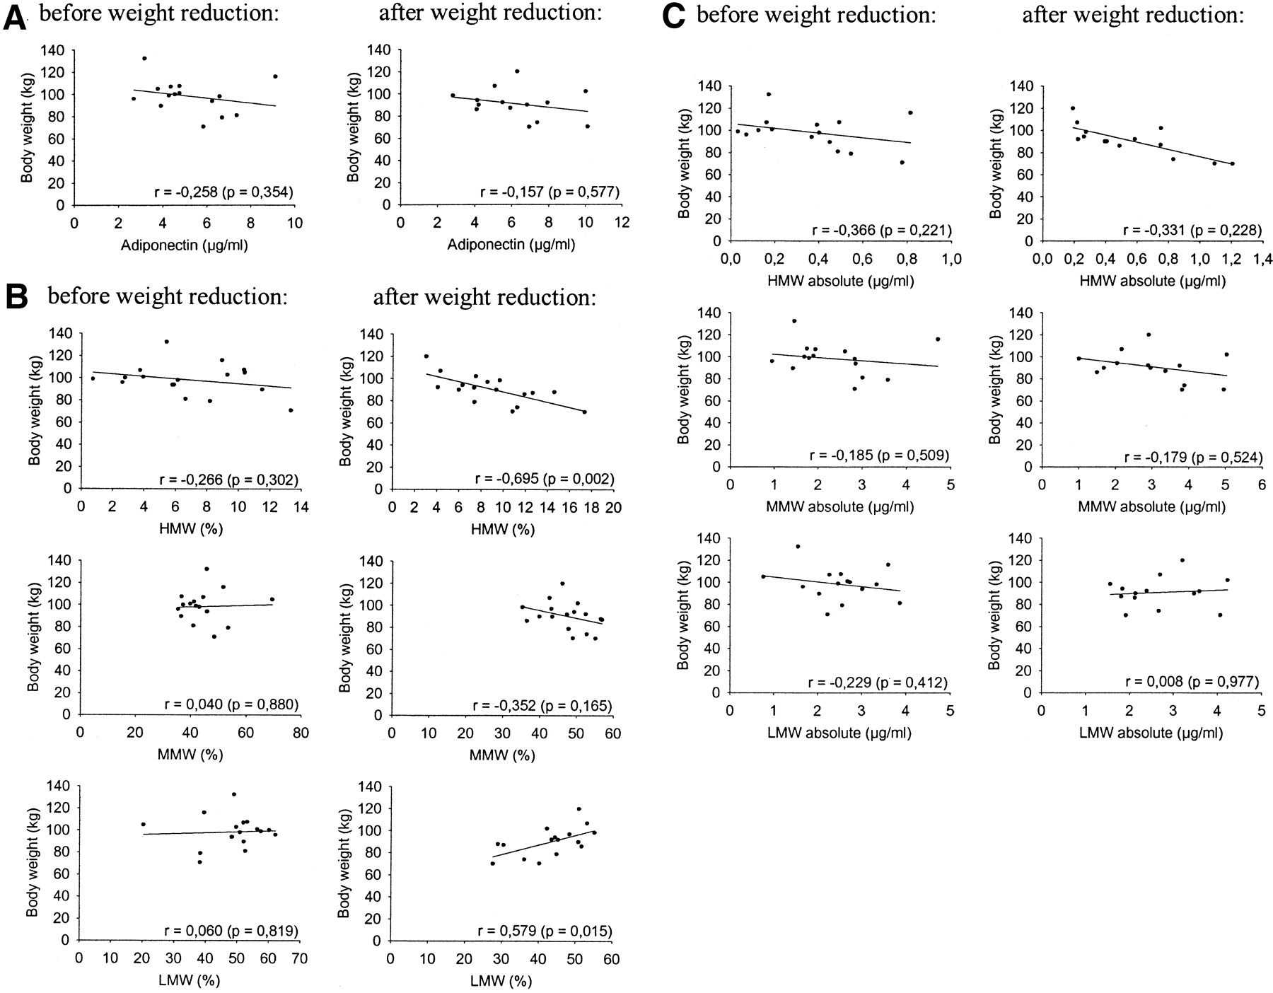

Weight loss raises high molecular weight adiponectin complexes
Bobbert T et al. Diabetes 2005;54:2712-2719
Copyright © 2011 American Diabetes Association, Inc.
Notes:
Correlation between total adiponectin (A) and body weight, relative amount of adiponectin oligomers and body weight (B), and absolute concentrations of adiponectin oligomers and body weight (C).
BMI decreased (35.1 +/- 1.2 to 32.8 +/- 1.1 kg/m(2), P < 0.001), which was associated with an improved metabolite profile. Total adiponectin increased from 5.3 +/- 0.5 to 6.1 +/- 0.6 microg/ml (P = 0.076). High (HMW) and medium molecular weight (MMW) adiponectin oligomers significantly increased during weight reduction (HMW: 0.37 +/- 0.07 to 0.4 +/- 0.08 microg/ml, P = 0.042; MMW: 2.3 +/- 0.2 to 2.9 +/- 0.3 microg/ml, P = 0.007), while low molecular weight (LMW) did not significantly change. Body weight inversely correlated with HMW (r = -0.695, P = 0.002) and positively with LMW (r = 0.579, P = 0.015).

Slide 6
Low serum adiponectin levels are associated with many diseases
Obesity
Insulin resistance & Type 2 Diabetes
Non-alcoholic fatty liver disease
Atherosclerosis
Coronary Artery Disease
Stroke
Inflammation
Decreases cell proliferation and seems to be anti-tumorigenic.
Notes:
Adiponectin has anti-angiogenic effects, through the inhibition of endothelial-cell proliferation and migration101. In a mouse tumour model, adiponectin markedly inhibited primary tumour growth in a caspase-dependent manner and it resulted in endothelial-cell apoptosis102. Prostate cancer is also associated with obesity, and full-length adiponectin inhibits the growth of prostate-cancer cells at physiological concentrations103. Many studies have investigated the effect of leptin on different cancer types in experimental cellular and animal models104. Most of the studies indicate that leptin can potentiate the growth of cancer cells (breast, oesophageal, gastric, pancreatic, colorectal, prostate, ovarian and lung carcinoma cell lines), whereas adiponectin seems to decrease cell proliferation.
Recently, it has been shown that patients with various types of cancer, including gastric, endometrial, prostate and breast cancer, have low levels of circulating adiponectin105, 106, 107, 108. Another study indicated an association of obesity and decreased adiponectin serum concentrations with colorectal adenomas and a higher risk of colorectal cancer109.
Serum levels of adiponectin are markedly decreased in individuals with visceral obesity and states of insulin resistance, such as non-alcoholic fatty liver disease, atherosclerosis and type 2 diabetes mellitus, and adiponectin levels correlate inversely with insulin resistance

Slide 7
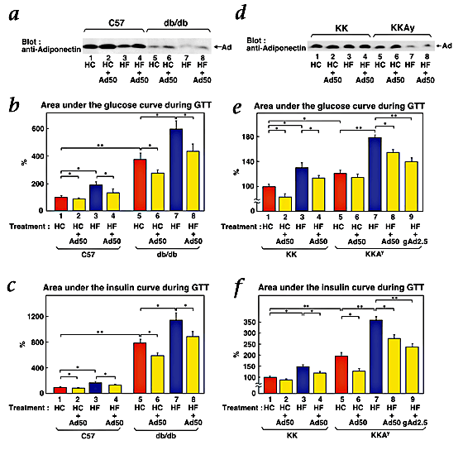
Adiponectin reverses insulin resistance in murine models of type 2 diabetes
Yamauchi et al, 2001
Notes:
Yamauchi et al, 2001: The fat-derived hormone adiponectin reverses insulin resistance associated with both lipoatrophy and obesity
From paper:
We next studied whether adiponectin can improve insulin resistance and diabetes in db/db and KKA^{y} mice (KK mice overexpressing agouti), two different mouse models of type 2 diabetes characterized by obesity, hyperlipidemia, insulin resistance and hyperglycemia1, 33. Serum adiponectin levels were decreased in wild-type mice on a high-fat diet (Fig. 4a, lane 3) compared with those in mice on a high-carbohydrate diet
GTT: glucose tolerance test

Slide 8
Adiponectin
Adiponectin
Leanness
Cold exposure
Adrenalectomy
Insulin-like growth factor 1
Ionomycin
Thiazolidinediones
Women
Obesity
Tumor Necrosis Factor-α
Glucocorticoids
Β-adrenergic agonists
Cyclic adenosine monophosphate
Men
Notes:
Its expression and/or secretion is increased by leanness, cold exposure, adrenalectomy, insulin-like growth factor 1, ionomycin, and thiazolidenediones, and decreased by obesity, tumor necrosis factor-, glucocorticoids, -adrenergic agonists, and cyclic adenosine monophosphate

Slide 9
Despite weight playing a major role in adiponectin levels, it is believed that the heritability accounts for 30-70% of adiponectin levels.
Notes:
Heid et all, 2010 Clear detection of ADIPOQ locus as the major gene for plasma adiponectin: Results of genome-wide association analyses including 4659 European individuals
Conclusion:
We demonstrated the ADIPOQ gene as the only major gene for plasma adiponectin, which explains 6.7% of the phenotypic variance. We further found that neither this gene nor any of the metabolic syndrome loci explained the sex differences observed for plasma adiponectin. Larger studies are needed to identify more moderate genetic determinants of plasma adiponectin.
Plasma adiponectin shows pronounced differences between men and women with about 1.5 times higher concentrations in women [10]. An explanation for these differences is lacking as plasma adiponectin is only moderately influenced by nutritional behavior, physical activity or other environmental components [5], [8] and [11]. However, there is clear evidence for a high heritability of about 50% [4], [12], [13] and [14] which one study even suggested to be sex-dependent [14]. In-line with lower plasma adiponectin in men, higher prevalences of type 2 diabetes and impaired fasting glucose were also reported in men [15].
The SNP rs17366568 showing the strongest association in our GWA study explained 3.8% of the variance and this number increased to 6.7% if all analyzable SNPs in the ADIPOQ region were included into the model. This pronounced difference of the explained variance between the two models can be explained by a large number of SNPs independently contributing to adiponectin levels. The SNPs contributing most to the explained variance are not only located in the three different LD blocks but also several genetic variants within each of at least two of the three blocks contribute to the explained variance. In total, the explained variance was very similar to the 8% reported earlier [10].

Slide 10
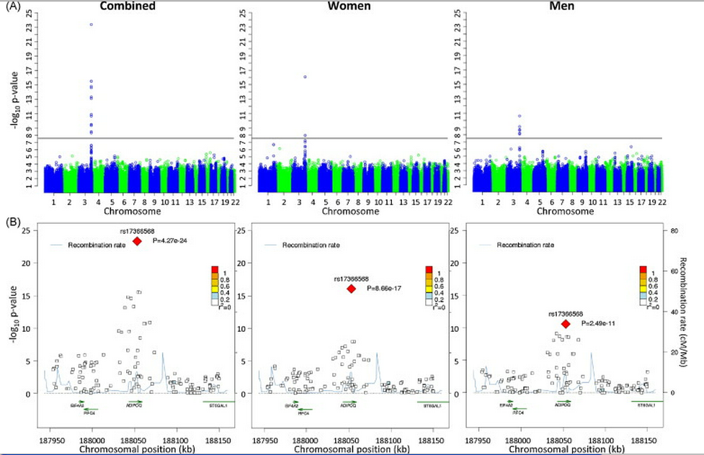
ADIPOQ contains all significant SNPs in European individuals
Heid et al, 2010
Notes:
Clear detection of ADIPOQ locus as the major gene for plasma adiponectin: Results of genome-wide association analyses including 4659 European individuals
4655 subjects, men and women
ADIPOQ was studied earlier as a candidate gene and the relationship to plasma levels has long been recognized. The SNP rs17366568 showing the strongest association in our GWA study explained 3.8% of the variance and this number increased to 6.7% if all analyzable SNPs in the ADIPOQ region were included into the model. This pronounced difference of the explained variance between the two models can be explained by a large number of SNPs independently contributing to adiponectin levels. The SNPs contributing most to the explained variance are not only located in the three different LD blocks but also several genetic variants within each of at least two of the three blocks contribute to the explained variance. In total, the explained variance was very similar to the 8% reported earlier
Methods:
We combined genome-wide association scans of three population-based studies including 4659 persons. For the replication stage in 13795 subjects, we selected the 20 top signals of the combined analysis, as well as the 10 top signals with p-values less than 1.0 × 10−4 for each the men- and the women-specific analyses. We further selected 73 SNPs that were consistently associated with metabolic syndrome parameters in previous genome-wide association studies to check for their association with plasma adiponectin.

Slide 11
rs17366568 in intron 1 of ADIPOQ
Explains 3.8% of variance, 6.7% if all ADIPOQ SNPs included
SNP only significant in Europeans
Could not find significant SNPs in ADIPOR1 or ADIPOR2
adjusted mean adiponectin levels in European women:
15.9ug/ml for G/G genotype
13.7ug/ml for A/G
9.3ug/ml for A/A
P = 0.00036
Notes:
Cohen et all, 2011: ADIPOQ, ADIPOR1, and ADIPOR2 Polymorphisms in Relation to Serum Adiponectin Levels and BMI in Black and White Women
Using cross-sectional interview data and blood samples collected from 990 black and 977 white women enrolled in the Southern Community Cohort Study (SCCS) from 2002 to 2006, we examined 25 SNPs in ADIPOQ, 19 in ADIPOR1, and 27 in ADIPOR2 in relation to serum adiponectin levels and BMI using race-stratified linear regression models adjusted for age and percentage African ancestry. SNP rs17366568 in ADIPOQ was significantly associated with serum adiponectin levels in white women only (adjusted mean adiponectin levels = 15.9 for G/G genotype, 13.7 for A/G, and 9.3 for A/A, P = 0.00036). No other SNPs were associated with adiponectin or BMI among blacks or whites.
Average BMI ~30
Interestingly, GG is more common in black women but does not correlate with adiponectin levels
Variance = 1.7%
Heritability estimates for adiponectin are high (ranging from 30 to 70%) (7,8) indicating that the genes encoding adiponectin and its receptors are plausible candidates for association with serum levels of the protein.
Adiponectin is a collagen-like protein secreted by adipose tissue and found in relatively high concentration in serum (1). Adiponectin plays an important role in several physiological pathways including those related to insulin action, inflammation, and atherogenesis (1,2) and is believed to affect the development and progression of several diseases including cardiovascular disease, diabetes, and cancer at several sites including breast, endometrial, and colorectal (3,4). Adiponectin levels show a strong inverse association with adiposity (1) and also vary by gender and race with lower levels in women compared to men (5) and in blacks compared to whites (6).

Slide 12
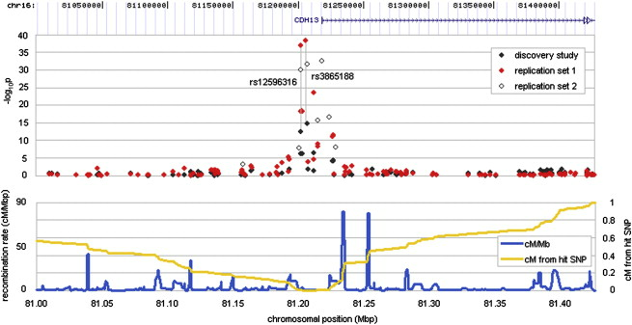
Two studies of Asian cohorts do not pick up SNPs in ADIPOQ, but in CDH13, an ADIPOQ receptor
Jee et al, 2010
Notes:
So, for adiponectin, SNPs near CDH13 (an adiponectin receptor) are highly associated with adiponectin levels:
1) Gene: CDH13
2) risk allele: T
3) Odds ratio: .09
4) p value: 2.82e-83
5) rs3865188
This SNP really only applies to Asian populations. SNP rs7195409 is also near CDH13 and is slightly correlated in European populations (p = 2e-5), but I will focus on rs3865188.
Korean: A reporter assay that evaluated the effects of a CDH13 promoter SNP in complete linkage disequilibrium with rs3865188 revealed that the major allele increased expression 2.2-fold. T allele increases frequency 2.2 fold, versus A. (dbSNP has T as major allele, but paper says AA…)
Human SNP Array 5.0 (Affymetrix) The association between high-molecular-weight adiponectin and rs3865188 was even stronger (p = 7.36 × 10−58) than seen with log10(total adiponectin).

Slide 13
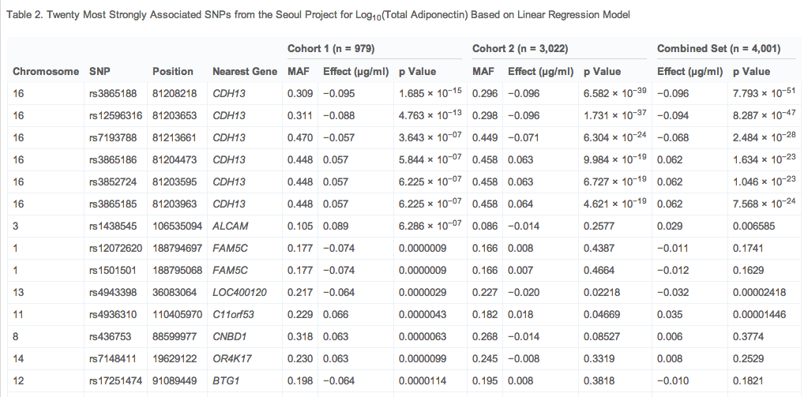
All significant SNPs were upstream of CDH13
Jee et al, 2010

Slide 14
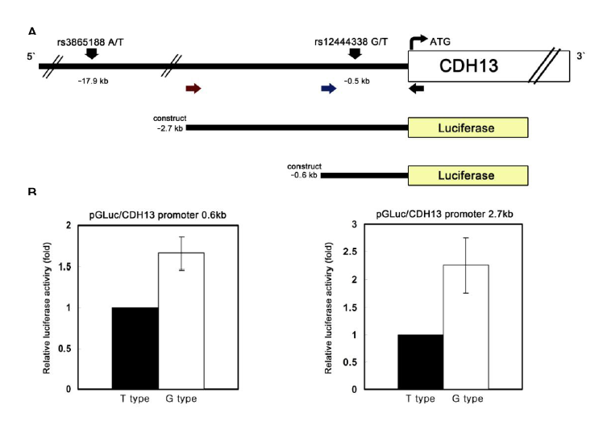
Major allele of rs3865188 associated with higher CDH13 expression
Jee et al, 2010
Notes:
From Jee et al, 2010 (Adiponectin Concentrations: A Genome-wide Association Study):
The cadherin 13 preprotein (CDH13; also known as T-cadherin) gene spans 1.2 Mb and contains 14 exons. CDH13 has been reported as an adiponectin receptor. [20] and [21] The most significant SNP, rs3865188, is located 17.9 kb upstream of CDH13 itself. T-cadherin was identified as a receptor for the hexameric and high-molecular-weight species of adiponectin, but not for the trimeric or globular species.20 T-cadherin is expressed in endothelial and smooth muscle cells, where it may interact with adiponectin. Although transcriptional regulation of CDH13 is not well understood, evidence that a nucleotide variant in the promoter region is associated with increased promoter activity of CDH13 suggests that this variant plays an important role in expression. Furthermore, we showed that the variants in LD with the promoter are positively associated with adiponectin levels. Thus, our findings suggest that level of the receptor, CDH13, may regulate adiponectin level.
Image is luciferase activity of the CDH13 promoter given a SNP in complete linkage disequiliburim with rs3865188

Slide 15
rs3865188 upstream of CDH13
dbSNP: major allele, T is risk allele (higher adiponectin) vs A
Paper cites A as the major allele
.09ug/ml decrease per allele
Association with higher weight adiponectin more significant than total adiponectin:
p = 7.36 × 10−58 vs p = 2.12 × 10−32

Slide 16
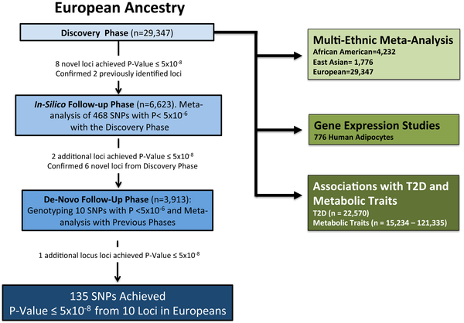
Recent meta-analysis GWAS study identified novel loci associated with adiponectin levels
Dastani et al, 2012
Notes:
Novel Loci for Adiponectin Levels and Their Influence on Type 2 Diabetes and Metabolic Traits: A Multi-Ethnic Meta-Analysis of 45,891 Individuals

Slide 17
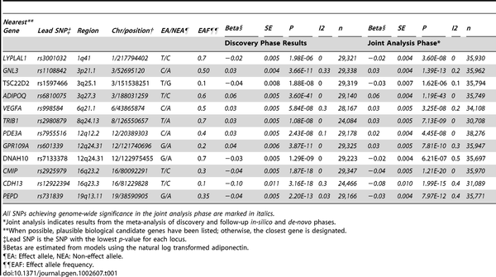
Recent meta-analysis GWAS study identified novel loci associated with adiponectin levels
Dastani et al, 2012
Notes:
Also confirmed ARL15 in genotyping

Slide 18
In Conclusion: regulating your adiponectin
Adiponectin levels are important for proper metabolic functioning but are controlled by a complicated interplay of factors, many of which are still unknown.
Some studies contradict or confirm each other, with discrepancies being due to multiple factors.
Best bet for keeping levels high: keep weight low.
Notes:
One study pointed to all the usual factors for this discrepancy: different methodologies, rare SNPs, common loci with small but additive effects. Also, population differences.

