Slide 1
Breast & Ovarian Cancer:
BRCA1 and BRCA2
Jennifer Hardee

Slide 2
Normal function of the genes
BRCA1 & BRCA2 are in the same DNA repair pathway
Despite names, do not share any protein structure
Both are tumor suppressors
  Losing their function promotes cancer
They help repair double-strand breaks in DNA
  Promote homologous recombination as the repair mechanism of choice
Pathway includes many other genes, including CHEK2

Slide 3

Loading the dice
For cancer to occur, a cell must accumulate a series of mutations over time
In BRCA carriers, the 1st mutation has already happened in every cell
Loss of heterozygosity (LOH) takes out the remaining good copy of the gene:
  The good allele is damaged in one cell by a mutagen or copying mistake
  The mutated allele is used as a template to repair it
  Suddenly, both copies of the gene are defective

Slide 4
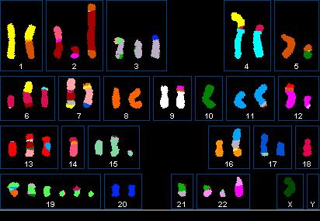
Cells gone wild
Show us your telomeres!
When DNA damage goes unfixed, the cell starts repairing it any way it can
Often introduces new mutations in the process
Broken chromosomes may be stitched back together incorrectly
Inevitably, some genes that control growth are affected
Breast cancer karyotype

Slide 5
What are the mutations?
Hundreds of mutations have been found in both BRCA genes
The damaging mutations usually lead to truncated proteins
  Frameshifts are common
Mostly occur de novo
But there are strong “founder effect” mutations in some populations
Notes:
1.4%
0.1%
1.0% vs. 0.5%

Slide 6
How are they inherited?
Carriers generally have one mutated copy of the gene
Inheritance pattern is dominant and autosomal
  All children, regardless of sex, have a 50% chance of inheriting the mutated allele
  Any child that does inherit the mutant allele will bear all the risks associated with it
Men are often considered “silent carriers” but this is overly simplistic

Slide 7
What is their effect?
BRCA families suffer from hereditary breast-ovarian cancer syndrome (HBOC)
Defects increase cancer risk for:
  Women: breasts, ovaries, fallopian tubes (rare)
  Men: prostate, testicles
  Both: pancreatic cancer, malignant melanoma, glioblastoma, some lymphomas
Why do BRCA mutations preferentially affect these organ systems?
We don’t know.

Slide 8
Lifetime cancer risk for women
Notes:
12 / 60/ 50
2 / 40 / 20

Slide 9
Breast cancer
Penetrance: 50-60% of BRCA carriers will develop breast cancer, compared to 12% of all women
BRCA1 carrier
BRCA2 carrier
Cancer appears 20 years earlier than normal
More often “triple-negative”
  No ER, PR, or Her2
  Cannot be treated with hormone therapy or herceptin
Cancer usually appears after menopause
  Can show up earlier, but danger spikes at menopause
Usually ER or PR positive
  Vulnerable to hormone therapy

Slide 10
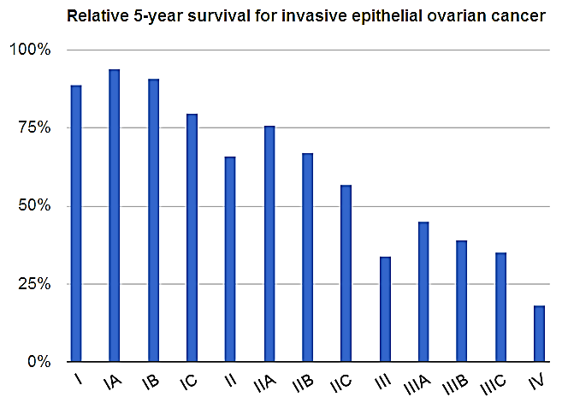
Ovarian cancer
Penetrance: 20-40% of BRCA carriers will develop ovarian cancer, compared to 2% of all women
Especially deadly because it’s hard to catch
  Blood test is often wrong
  60% of cases are caught at Stage III or IV
BRCAΔ tumors are more aggressive and have poorer prognoses

Slide 11
Risks to male carriers
Relative risk of breast cancer is high
Absolute risk is still low
Cancers with elevated risk for both sexes:
  Pancreatic, melanoma, glioblastoma, lymphoma
BRCA2 also increases prostate cancer risk 1.5-4x
  These cancers may be more aggressive
Notes:
0.1 / 2 / 6 / 12

Slide 12
Who should get tested?
Anyone:
With a close relative who has tested positive
With a strong family history of breast or ovarian cancer
Whose mother/daughter had cancer in both breasts
This applies to about 2% of adults
In cases of family history, it’s best to first test one of the people who has had the disease (if possible)
  If s/he tests positive, then other family members should also consider getting the test
Family history requirement is less stringent for people from ethnic groups with known founder-effect mutations

Slide 13

Testing, testing, 1-2-3
About 10% of breast and ovarian cancer patients carry a BRCA1 or BRCA2 mutation
23andMe tests for 10 specific mutations:
  CASP8, CHEK2, FGFR2, STXBP4, 2q35, 3p24, 16q12
  BRCA1 185delAG, BRCA1 5382insC, BRCA2 6174delT
Lots of other mutations are known
  e.g. BRCA2 999del5 in Iceland
So why doesn’t 23andMe test for them?

Slide 14
Limitations of testing
Testing for BRCA1 and BRCA2 is not straightforward
There are no “hot spots”: dangerous mutations can occur almost anywhere in the exons or introns
Human Gene Mutation Database lists 1,433 known mutations for BRCA1 and 1,183 for BRCA2
To be thorough, you would need:
  A test that sequenced the entire gene
  that checked against a database of known mutations
  and evaluated unknown mutations for risk based on how they changed the gene

Slide 15
Testing positive

Slide 16
What are the options?
There are three major options for carriers:
  Increased screening
  Preventative medication
  Prophylactic surgery
Most women opt for a combination of approaches
Lifestyle changes that reduce cancer risk in other women often do not provide meaningful protection to BRCA carriers

Slide 17
1. Surveillance screening
Goal is to find cancer early, when it’s most treatable
Does not lower lifetime risk of developing cancer
Breast cancer
Ovarian cancer
Clinical breast exams
Mammograms
  Men, too!
MRI of the breast
Clinical abdominal exams
Transvaginal ultrasound
CA-125 blood test
  High rates of false +/-

Slide 18

2. Preventative medication
Goal is to reduce the risk of developing cancer
Tamoxifen is an estrogen blocker that lowers breast cancer risk by about 50%
  Has unpleasant side effects, e.g. pseudo-menopause
Hormonal birth control for ~5 years in your late 20’s reduces ovarian cancer risk
  Timing ensures minimal increase to breast cancer risk

Slide 19
3. Prophylactic surgery
Goal is to actively prevent cancer by removing “at risk” tissue while it’s still healthy
Recommended procedures for BRCA carriers:
  Double mastectomy (both breasts)
  Salpingo-oophorectomy (ovaries and fallopian tubes)
Mastectomy causes disfigurement and loss of nerves/feeling
  Best procedure is incompatible with plastic surgery
Oophorectomy causes infertility and early menopause
  Recommended at around age 45

Slide 20
What if…?
What if you thought your family carried a BRCA mutation?
Would you get tested? Encourage your relatives?
If positive, what treatments would you choose?
How would it affect your future life choices?

