Slide 1
Systemic Lupus Erythematosus
Jenny Hsu
Gene 210
05-22-2012

Slide 2
Outline
Introduction
    Symptoms
    Pathogenesis
    Who is at risk?
Associated SNPs
    Overview
    rs10954213
Treatment
Notes:
First, I will talk about the disease itself: the symptoms, the biological mechanisms behind its pathogenesis, and who is at risk.
Then, I will give an overview of the SNPs associated with lupus, but will focus on the effect of a causal SNP.
Last, I will explain how our knowledge of the genetics of this disease affects its diagnosis and treatment.

Slide 3
What is Lupus?
Autoimmune disease
  immune responses intended for defense against invading microorganisms attack the body itself
Not fatal, but incurable
  five-year survival rate: 90%
  20-year survival rate: 80%
  Characterized by periods of increased disease activity (“flares”)
“Great Imitator”
  symptoms also seen in arthritis, blood disorders, diabetes, thyroid problems, many heart, lung, muscle, and bone diseases
Notes:
Lupus is an autoimmune disease, in which immune responses normally intended for defense against invading microorganisms attack the body itself. Lupus is not fatal, but it is incurable. The five-year survival rate is 90%, and the 20-year survival rate is 80%, but patients consistently undergo periods of increases in disease activity, called flares. As I will show later, lupus is characterized by many symptoms, and it is called a “great imitator” disease because these symptoms are also seen in many other autoimmune or organ diseases.

Slide 4
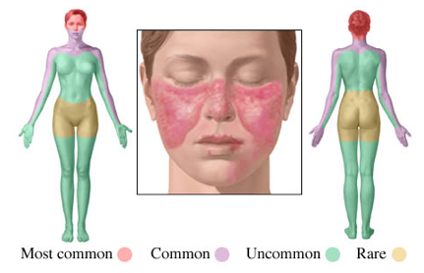
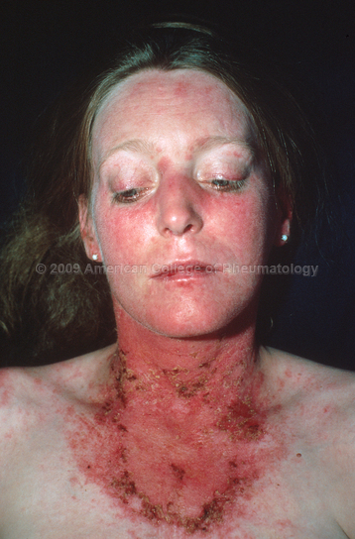
Symptoms
Rash (90%)
The most common symptom. Often brought on by sun exposure. Usually on face and scalp and can lead to hair loss (alopecia).
A.D.A.M Medical Encyclopedia
American College of Rheumatology
Notes:
The most common symptom of lupus is a rash. It is often brought on by sun exposure, and it is usually localized to the face. However, it can also be present on the scalp, causing hair loss, or on other areas of the skin.

Slide 5
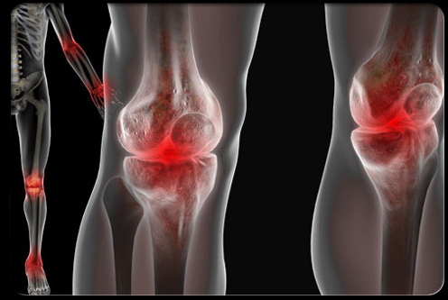
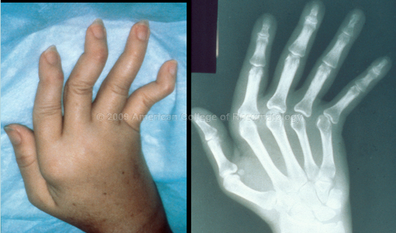
Symptoms
Joint Inflammation (90%)
Frequently involves hands, knees, and wrists, mimicking rheumatoid arthritis. Results in muscle weakness and loss of bone structure.
WebMD
American College of Rheumatology
Notes:
Joint inflammation also occurs frequently, and can be mistaken for arthritis. This may result in muscle weakness and loss of bone structure.

Slide 6
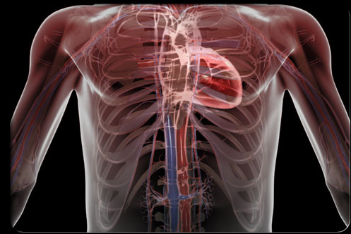
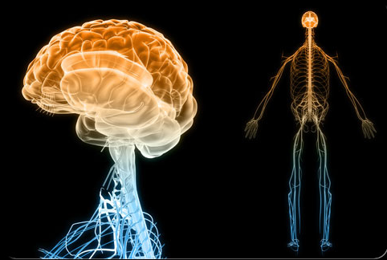
Symptoms
Pericarditis (80%)
Lupus Cerebritis (15%)
The sac containing the heart (pericardium) becomes inflamed. May lead to chest pain, arterial thickening, and heart attack.
Inflammation of cerebrum can lead to headaches, seizures, paralysis, depression, loss of movement, and stroke.
WebMD
Notes:
The pericardium, or the sac containing the heart, becomes inflamed in 80% of patients. This leads to chest pain, arterial thickening, and sometimes heart attacks. The cerebrum can also become inflamed, causing headache, seizures, paralysis, depression, ataxia (loss of movement), and stroke.

Slide 7
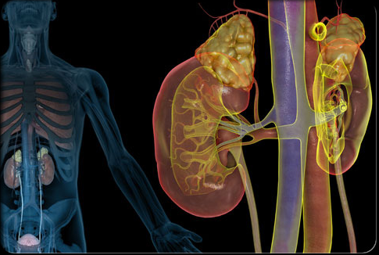
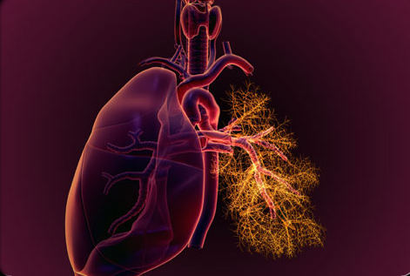
Symptoms
Lupus Nephritis (50%)
Lung Inflammation (50%)
Inflammation of the kidney; may result in renal failure.
The tissue around the lung becomes inflamed, which may lead to painful breathing, shortness of breath, or chest pain.
WebMD
Notes:
The kidney is inflamed in about 50% of patients, and this may lead to renal failure. In addition, the lungs are inflamed in 50% of patients, causing painful breathing, shortness of breath, and chest pain.

Slide 8
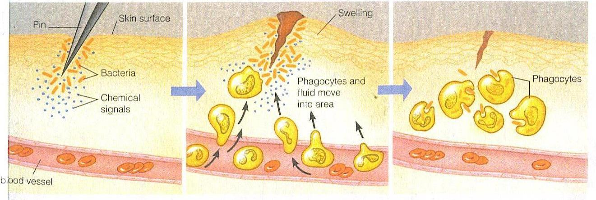
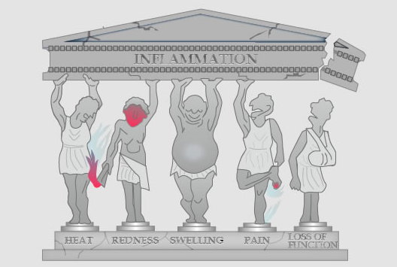
Inflammation in Immune Response
Leukocytes
Leukocytes
Adapted from Lawrence et al, 2002
Notes:
However, although inflammation is an underlying theme of lupus, it is also a defense mechanism in healthy individuals. Thus, I will give a brief overview of how the immune system normally functions, which will make it easier to understand the pathogenesis of lupus.
The immune response normally begins when the body encounters a pathogen such as bacteria. Specialized cells in the area of infection recognize the bacteria and release signaling molecules. These signals attract leukocytes, or white blood cells, to the infected area via chemotaxis. The signals also cause blood vessels to dilate and become more permeable, which allows the leukocytes to move more freely. At the infected area, the leukocytes can fight pathogens in a number of ways, including phagocytosis, or engulfment of bacteria. However, this free movement of leukocytes comes at a cost. The dilation of blood vessels also increases the rate of blood flow to the area, causing heat and redness. The permeability of the vessel membrane causes leakage of fluid, which leads to swelling. Some of the chemicals that are released can stimulate nerve endings, causing pain. Finally, the displacement of normal biological processes can cause the underlying tissue to eventually lose its functions.

Slide 9
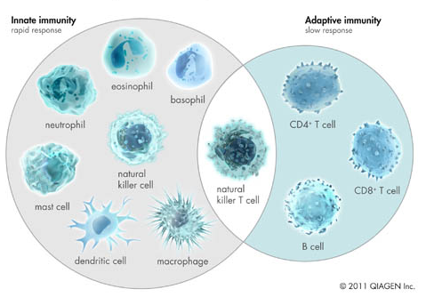
Innate vs. Adaptive Response
Notes:
In addition, sometimes the immediate immune response is not enough. A larger scale attack is required for a more systemic injury, or to remember pathogens in the case of a repeated injury. Thus, while some leukocytes are involved in mediating a rapid response, or innate immunity, others are involved in sustaining a more long-term attack, or adaptive immunity.

Slide 10
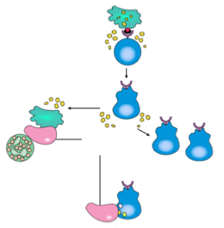
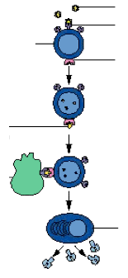
Adaptive Immune Response
T cells
B cells
antigen
antigen-specific
receptor
dendritic cell engulfs pathogen and produces antigen; presents antigen to precursor T cell
antigen is processed and presented to T cell
T cell differentiation
infected cell
T cell activates the B cell
activated B cell produces antibodies that bind to antigens; antibody-antigen binding enhances the activity of all leukocytes
become helper T cells
spur the growth of more T cells
become cytotoxic
Notes:
The main cells involved in the adaptive immune response are dendritic cells, T cells, and B cells. To activate T cells, a dendritic cell engulfs the pathogen and processes it to produce an antigen, or a peptide that can be used to recognize the pathogen. The precursor differentiates into an active T cell, which can assist the immune response by activating other cells, or can directly participate by becoming cytotoxic and releasing molecules for cell lysis. All T cells also proliferate abundantly, leading to large scale attack. B cells are activated differently in that free-floating antigens are recognized by a subset of precursor cells with the appropriate receptor. The antigen is taken in by the receptor and further processed into a form that can be taken up by T cells. The T cell activates the B cell to produce antibodies, proteins that recognize the antigens. By binding to antigens, antibodies target pathogens for more effective removal by leukocytes. Gradually, the antigen-antibody complexes are cleared and most cells of the immune system are destroyed, putting an end to inflammation.

Slide 11
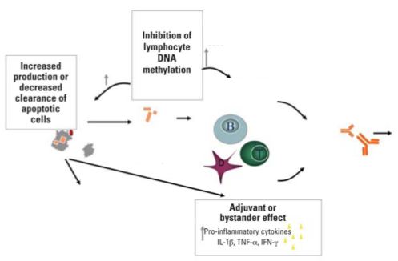
Inflammation in Lupus
T cells become autoreactive, overproduce cytotoxins
B cells become autoreactive and hyperactivated
Decreased clearance of antibody-antigen complexes and immune cells
B cells overproduce antibodies
T cells and immune complexes accumulate
chronic inflammation and tissue damage
release of self-antigens
innate immune response
Adapted from Cooper et al, 2008
Notes:
In lupus, multiple biological processes go awry to mount an immune response against the body’s own tissues. First, there is increased apoptosis or decreased clearance of apoptotic cells. This leads to the accumulation of intracellular components that would normally be cleared from the circulation – such as nucleosomes, DNA, and histones. These intracellular particles are sufficient to activate cells involved in innate immunity, but can also be recognized as antigens by T cells and B cells. Meanwhile, a decrease in DNA methylation in both T cells and B cells causes them to develop improperly and to target such self-antigens. These changes in methylation also cause T cells to overproduce cytotoxins, increasing lysis of cells in the affected area, and leads to upregulation of B cell activators, which causes B cells to produce more antibodies. In addition, in what is called the adjuvant or bystander effect, chemicals called cytokines are released that help sustain this adaptive immune response. Finally, there is a decreased clearance of antibody-antigen complexes and immune cells from the circulation. Taken together, these defects create an environment in which immune complexes continuously trigger an inflammatory response, and hyperactive immune cells continually secrete toxic chemicals. This eventually leads to chronic inflammation and tissue damage.

Slide 12

Who Is At Risk?
Affects “reproductive-age women” (between the ages of 20 and 40) 9 times more than men.
After menopause, women are 2.5 times more likely than men to develop lupus.
African Americans, Latinos, and Asians are 2-4 times more likely to develop lupus.
Pons-Estel et al, 2010
Notes:
The pathogenesis of lupus becomes more complex, however, when you consider that not everybody is equally at risk. Lupus affects “reproductive age women” (or women between the ages of 20 and 40), 9 times more than men. After menopause, women are still more likely than men to develop lupus, although only 2.5 times more likely. In addition, African Americans, Latinos, and Asians are 2-4 times more likely to develop lupus, depending on the study.

Slide 13

Who Is At Risk?
A sibling of the patient has 20 times the disease risk (2% versus 0.5-1.0%).
Concordance rate of 24%-57% in dizygotic twins.
10-fold lower concordance rate of 2-5% in monozygotic twins.
Tsao et al, 2002;
Deapen et al, 1992
Notes:
In addition, having a family history of lupus may mean that you are more susceptible to lupus. A sibling of a patient has 20 times the disease risk of a non-sibling (so a 2% chance versus a 0.5-1.0% chance). The concordance rate is from 24% to 57% in dizyogic twins, 10-fold higher than the concordance rate in monozygotic twins. Taken together, these statistics suggest that there is a genetic component to lupus.

Slide 14
Outline
Introduction
    Symptoms
    Pathogenesis
    Who is at risk?
Associated SNPs
    Overview
    rs10954213
Treatment
Notes:
First, I will talk about the disease itself: the symptoms, the biological mechanisms behind its pathogenesis, and who is at risk.
Then, I will give an overview of the SNPs associated with lupus, but will focus on the effect of a causal SNP.
Last, I will explain how our knowledge of the genetics of this disease affects its diagnosis and treatment.

Slide 15
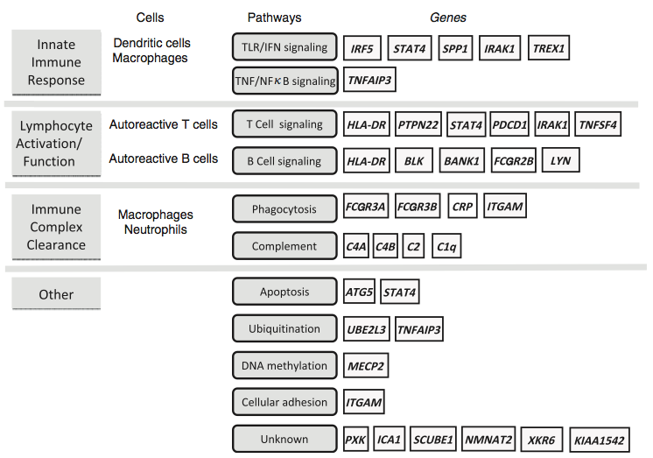
A Complex Genetic Disease
SNPs of modest effect size (odds ratio 1.15 - 2.0).
Genetic factors explain 15% of heritability.
Moser et al, 2009
Notes:
However, lupus is a very complex genetic disease, in that it results from the combined effects of variants in a large number of genes. Shown here are the genes that contain SNPs that have been associated with lupus. I like it because it groups the associated genes into the different components of the immune response. As of now, every SNP that has been found is of modest effect size (meaning their odds ratios are generally between 1.15 and 2.0), and it is proposed that all known SNPs explain only 15% of heritability. In addition, it is usually difficult to say whether a SNP is causative, or whether it is simply in linkage disequilibrium with a causative SNP. In fact, little is understood about how SNPs associated with lupus actually contribute to disease risk. Thus, instead of talking about all the SNPs, I will focus on one with a relatively clearer mechanism of action.

Slide 16
Focus on rs10954213
The Basics
(sorry for errors on Genotation!)
Ancestral Allele | Risk Allele | P-Value | Odds Ratio | Location
G | A | 2.8 E-5 | 1.54 | IRF5
Notes:
This is the SNP I will focus on. I’ll give you the basics really quickly because I messed up when I had to submit information on this SNP for Genotation. The ancestral allele is the G allele and the risk allele is the A allele. Its P-value is 2.8E-5 and its odds ratio is 1.54, which is not bad for a complex disease. It is located in interferon regulatory factor 5, a transcription factor that stimulates the production of signaling molecules that are widely used in the immune system, called interferons.

Slide 17
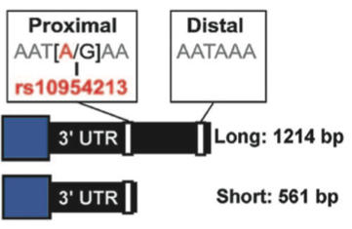
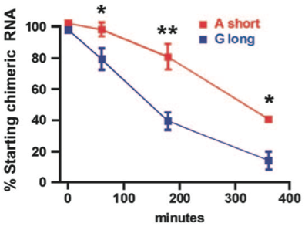
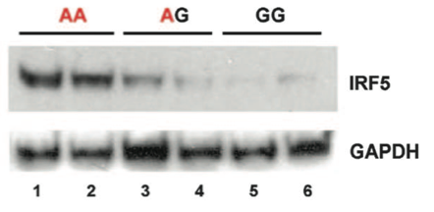
G->A substitution at rs10954213
AAUGAA vs. AAUAAA
(poly-A signal)
IRF5
enhanced mRNA stability
increased protein levels
Adapted from Graham et al, 2007
Notes:
At the most basic level, this SNP affects the pathogenesis of lupus by affecting the stability of IRF5. This SNP is located in a conserved motif in the 3’UTR region of IRF5, and the G to A substitution creates a poly adenylation signal sequence (AAUGAA → AAUAAA). The poly A signal sequence triggers polyadenylation and the end of transcription. Thus, transcripts with the ancestral G allele terminate at a later point, 648 bp downstream, while transcripts with the A allele terminate only ~12 bp downstream. The two different transcripts have different half lives. The short transcript, or the transcript associated with disease, is much more stable than the long transcript. In this experiment, cell lines were transfected with a fusion construct that consists of a reporter gene fused to either the long 3’UTR or the short 3’UTR. The construct was under the control of a tetracycline inducible promoter, such that transcription can be shut off, and the remaining levels of mRNA can be monitored. You can see that the percentage of starting RNA drops more quickly if the transcript has a long 3’UTR. Furthermore, the G->A substitution results in an increase in the amount of IRF5 protein. Here is a Western blot for IRF5 levels with GAPDH as a loading control. Two cell lines of each genotype were used, resulting in two lanes per genotype.

Slide 18
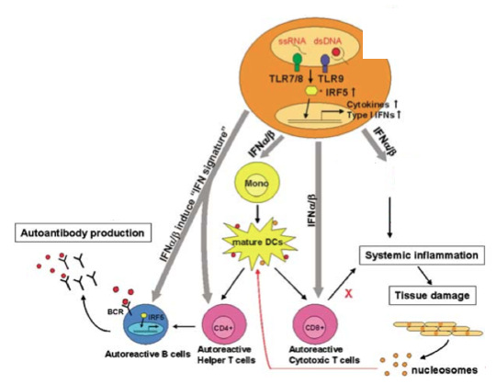
Effects of IRF5 overproduction
dendritic cell
innate immune response
antigens
Adapted from Kyogoku and Tsuchiya, 2007
Notes:
This is what happens when you overproduce IRF5. IRF5 is expressed primarily in dendritic cells, which, as you may recall, are the ones that engulf bacteria and present antigens. This engulfment activates IRF5, which translocates into the nucleus and increases transcription of the type 1 interferons. These consist primarily of interferon-alpha and interferon-beta, which do a number of different things. First, they can stimulate both B cells and helper T cells directly, resulting in production of antibodies. Second, they can promote the maturation of more dendritic cells, creating a positive feedback loop where the signal is amplified. Third, they can stimulate the production of cytotoxic T cells, and hence the production of chemicals to lyse more cells. Finally, they can attract more leukocytes to the target area as part of the innate immune response. These effects, taken together, lead to lysis of the tissue in the target area and production of more antigens. Thus, a slight increase in IRF5 can lead to a large effect because of all the feedback loops.

Slide 19
Outline
Introduction
    Symptoms
    Pathogenesis
    Who is at risk?
Associated SNPs
    Overview
    rs10954213
Treatment
Notes:
First, I will talk about the disease itself: the symptoms, the biological mechanisms behind its pathogenesis, and who is at risk.
Then, I will give an overview of the SNPs associated with lupus, but will focus on the effect of a causal SNP.
Last, I will explain how our knowledge of the genetics of this disease affects its diagnosis and treatment.

Slide 20
If you have risk alleles…
Don’t worry.
    Lupus is a complex genetic disease that also involves environmental and epigenetic factors
Avoid environmental triggers
    UV rays, sun-sensitizing drugs, smoking
Checking for signs of inflammation
    X-rays to detect fluid in chest and lungs
    Urinalysis to check protein levels in urine
Autoantibody tests
    FANA assay → for anti-nuclear antibodies
    Farr assay → for anti-dsDNA antibodies
Molokhia and McKeigue, 2006;
Hughes and Ul-Hassan, 2006
Notes:
Skin cells that are exposed to the sun may undergo apoptosis and release antigenic material.
FANA assay: >95% of lupus patients have elevated titers of anti-nuclear antibodies, or antibodies against the nucleus. In the assay to detect these antibodies, serum from the patient is added to fixed cells and a fluorescently labeled antibody is applied on top of the serum. The fluorescent antibody binds to the patient’s antibodies, allowing visualization of whether the patient’s antibodies localize to the nucleus.
Farr assay: Method to detect anti-dsDNA antibodies by applying the patient’s serum to a collection of double stranded DNA molecules.

Slide 21
Effects of SNPs on treatments
Currently not known
FDA-approved:
    Aspirin: relieve pain and swelling
    Glucocorticoids: turn down immune activity
    Hydroxychloroquine: an anti-malarial with proteolytic effects; decreases secretion of proteins with immunological roles
    Belimumab: blocks cytokines involved in survival of B cells
In clinical trials:
    Rituximab: B cell depletion
    Abatacept: block interaction between B and T cells
Notes:
Lupus is still treated with general anti-inflammatory agents. These include aspirin to relieve pain and swelling, and glucocorticoids to turn down immune activity. For patients with more severe symptoms, hydroxychloroquine is also prescribed. It is an anti-malarial with protelolytic effects, and it decreases secretion of proteins with immunological roles. The only FDA-approved targeted therapy is belimumab, which blocks cytokines involved in the survival of B cells. However, some drugs are in clinical trials. Rituximab has been shown to mediate B cell depletion, and abatacept blocks the interaction between B and T cells.
Hopefully, when the effects of other SNPs are known, more targeted therapies can be developed.

Slide 22
Thank You!

