Slide 1
rs3903239
Vanessa Burns
Gene 210 SNP

Slide 2
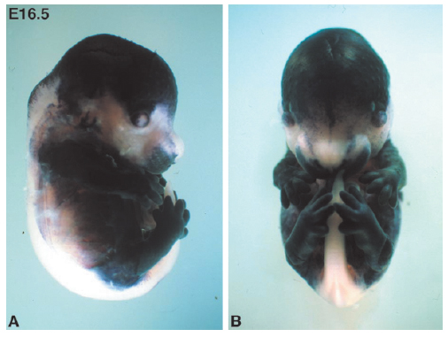
rs3903239
Involved in lung vascular development and skeletogenesis
PrrX1-/- mice are embryonic lethal
  Cleft palate
  Hypoplastic processes of the manible
Developing mesodermal muscle such as the heart

Slide 3
rs3903239
Correlated with Atrial fibrillation (p = 9.1x10^-11, discovery phase) in a European cohort (6,707 people with confirmed atrial fibrillation and 52,426 without)
Minor allele frequency (C) of 29.9% compared to the major allele (G), and a risk frequency of 1.14

Slide 4
rs3903239
Drawbacks:
  wide range of ages included
  high prevalence of potentially correlated atrial fibrillation-based traits, such as hypertension, relative body mass index, and diabetes
PrrX1-related SNPs have also been implicated in atrial fibrillation in other populations
Not being using for treatment or as a diagnosis for atrial fibrillation

Slide 5
References
1. Ellinor, P.T., et al., Meta-analysis identifies six new susceptibility loci for atrial fibrillation. Nature Genetics, 2012. Advance Online Publication.
2. GeneCards.org. "Paired Related Homeobox 1". [cited 2012 May 17]; Available from: http://www.genecards.org/cgi-bin/carddisp.pl?gene=PRRX1.
3. Martin, J.F., Bradley, A., Olson, E.N. (1995) Thepaired-like homeo box gene MHox is required for early event of skeletogenesis in multiple lineages. Genes & Development. 9:1237–1249.
4. Ihida-Stansbury, K., et al., Paired-related homeobox gene Prx1 is required for pulmonary vascular development. Circulation research, 2004. 94(11): p. 1507-1514.

