Slide 1
Back Propagation
Psychology 209
Jan 14 & 16, 2020

Slide 2
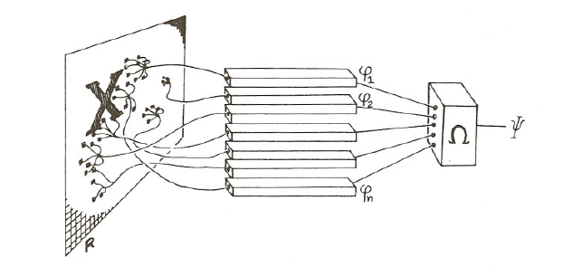
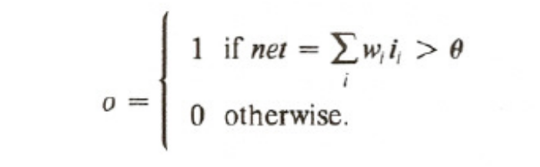

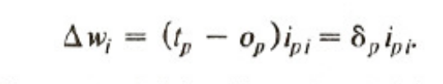
The Perceptron
For input pattern p, teacher t_{p} and output o_{p}, change the threshold
And weights as follows:

Slide 3
The Perceptron
With bias instead of threshold
+ b > 0
For input pattern p, teacher t_{p} and output o_{p}, change the threshold
And weights as follows:
Δb =

Slide 4
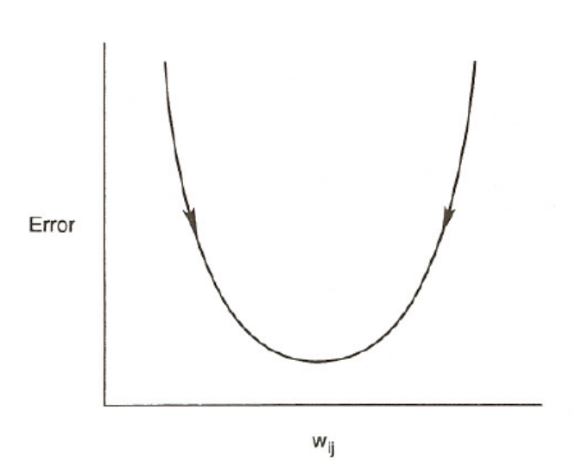

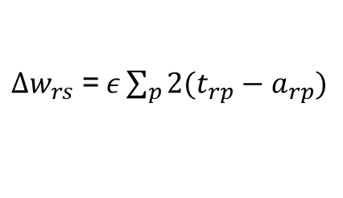

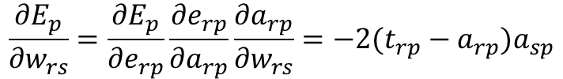

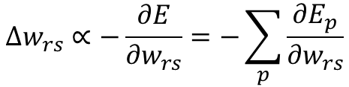
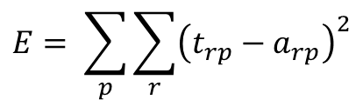

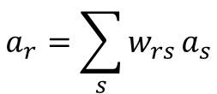

One-Layer Linear Associator
Output is a linear function of inputs and weights:
$$a_{r}$$
$$a_{r}=\sum_{s}{w_{rs}}a_{s}$$
$$w_{rs}$$
$$a_{s}$$
We want a learning rule to minimize the sum squared error:
$$E= \sum_{p}{\sum_{r}{{\left(t_{rp}−a_{rp}\right)}^{2}}}$$
Change each weight according to:
$$∆w_{rs}∝−\frac{∂E}{{∂w}_{rs}}=−\sum_{p}{\frac{{∂E}_{p}}{{∂w}_{rs}}}$$
E
Let $e_{rp}=\left(t_{rp}−a_{rp}\right) . Then$
$$w_{rs}$$
$$\frac{{∂E}_{p}}{{∂w}_{rs}}=\frac{{∂E}_{p}}{{∂e}_{rp}}\frac{{∂e}_{rp}}{{∂a}_{rp}}\frac{{∂a}_{rp}}{{∂w}_{rs}}=−2(t_{rp}−a_{rp})a_{sp}$$
We end up with: $a_{sp}$ where $ε$ is the learning rate
$∆w_{rs}$ =$ε\sum_{p}{2(t_{rp}−a_{rp})}$

Slide 5
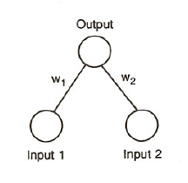
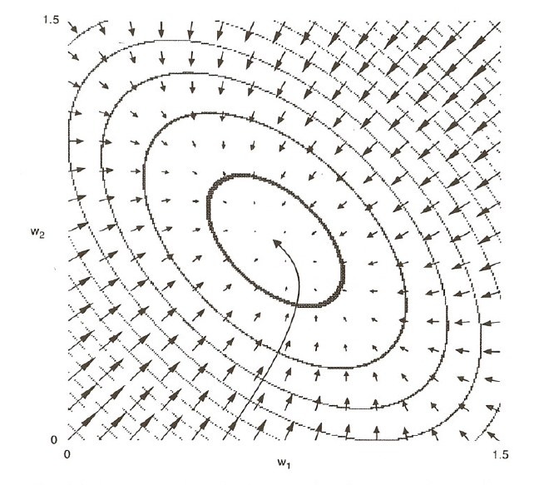
Error Surface for OR function in One-Layer Linear Associator
Or Problem
Input Output
0 0 0
1 0 1
0 1 1
1 1 1

Slide 6
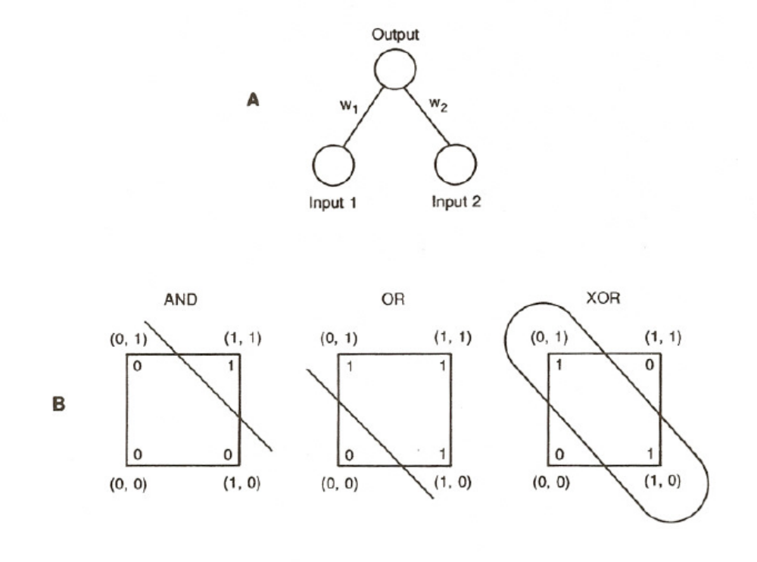
AND, OR, XOR
AND Problem
Input Output
0 0 0
1 0 0
0 1 0
1 1 1
OR Problem
Input Output
0 0 0
1 0 1
0 1 1
1 1 1
XOR Problem
Input Output
0 0 0
1 0 1
0 1 1
1 1 0

Slide 7
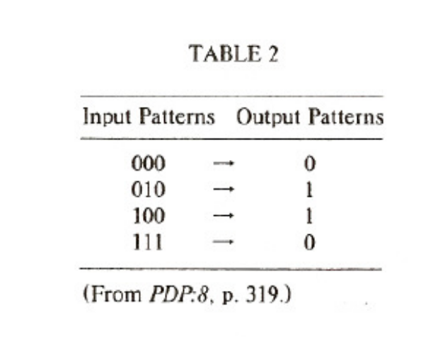
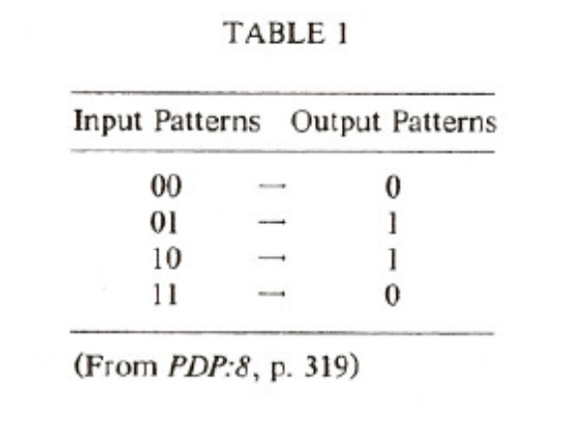
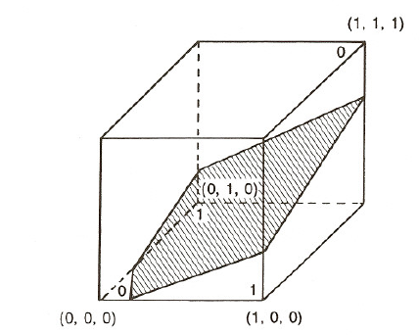
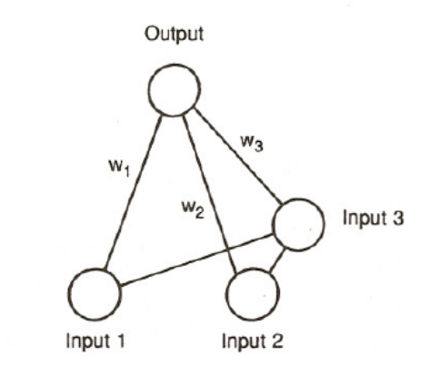
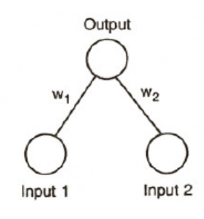
Adding a unit to make XOR solvable

Slide 8

What if we want to learn how to solve xor?
We need to figure out how to adjust the weights
into the ‘hidden’ unit, following the principle of
gradient descent:
$$∆w_{rs}∝−\frac{∂E}{{∂w}_{rs}}$$

Slide 9
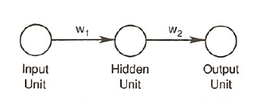
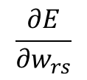

We start with an even simpler problem
0
1
2
Assume units are linear, both weights = 0, input = 1, t = 1.
$$∆w_{rs}∝−\frac{∂E}{{∂w}_{rs}}$$
$$\frac{∂E}{{∂w}_{rs}}$$
We use the chain rule to calculate for each weight.
Non-linear hidden units are necessary in general,
but understanding learning in linear networks is useful
to support a general understanding of the non-linear case

Slide 10
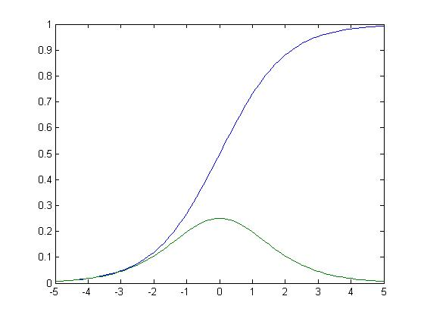
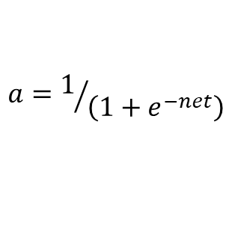
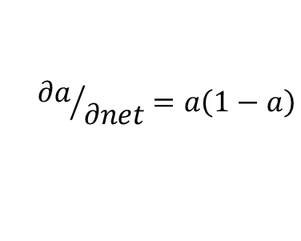
The logistic or ‘sigmoid’ function and its derivative
$$a=1/{\left(1+e^{−net}\right)}$$
Activation
$${∂a}/{∂net}=a\left(1−a\right)$$
Net input

Slide 11
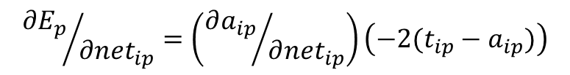


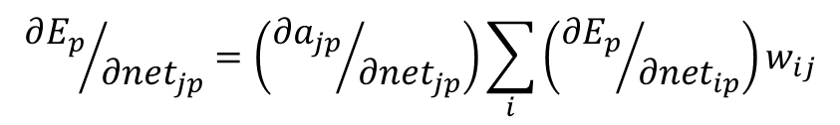
Expressions for ‘dEdnet’ and ‘dEdw’
For output unit i:
$${∂E_{p}}/{{∂net}_{ip}}=\left({∂a_{ip}}/{∂{net}_{ip}}\right)\left(−2(t_{ip}−a_{ip})\right)$$
b_{i}
For hidden unit j (can be iterated over many layers):
i
$${∂E_{p}}/{{∂net}_{jp}}=\left({∂a_{jp}}/{∂{net}_{jp}}\right)\sum_{i}{\left({∂E_{p}}/{{∂net}_{ip}}\right)w_{ij}}$$
w_{ij}
j
For all layers, the weight error derivatives
can be expressed as
$${∂E_{p}}/{{∂w}_{rs}}=\left({∂E_{p}}/{{∂net}_{rp}}\right)a_{s}$$
How about bias error derivatives?
$${∂E_{p}}/{{∂b}_{r}}=\left({∂E_{p}}/{{∂net}_{rp}}\right)$$

Slide 12
Back propagation algorithm
Propagate activation forward
Calculate error (‘loss’)
Propagate error derivatives backward
Change the weights
Variants:
  ‘Full Batch Mode’ (used in homework)
    Accumulate dEdw’s across all patterns in the training set before changing weights
  Stochastic gradient descent (batch size = N)
    Process patterns in permuted order from the training set and adjust weights after N patterns
    (Called mini-batch gradient descent in blog when N > 1)
    Batches of 16 to 32 are typical in Deep Learning

Slide 13
Why is back propagation important?
Provides a procedure that allows networks to learn weights that can solve any deterministic input-output problem.
  Contrary to expectation, it does not get stuck in local minima except in cases where the network is exceptionally tightly constrained.
Allows networks to learn how to represent information as well as how to use it.

Slide 14
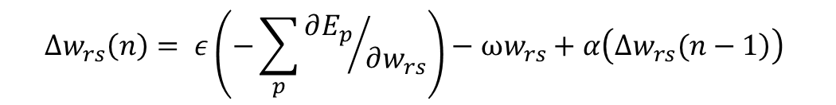
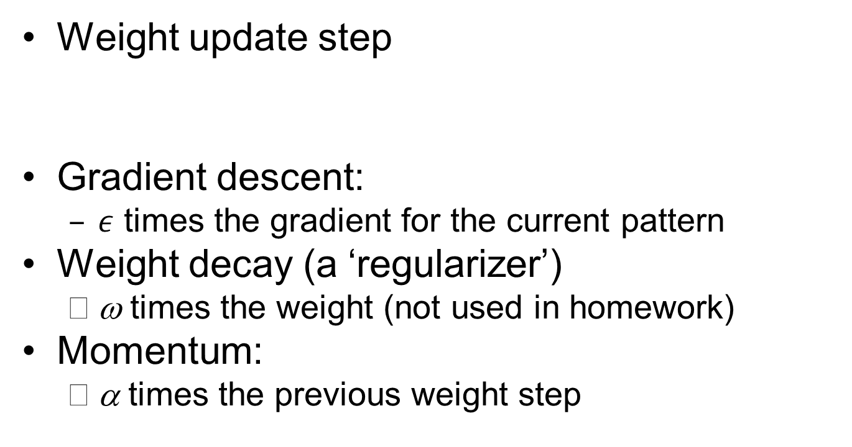
Adding Momentum and
Weight Decay
Weight update step
Gradient descent:
  $ε$ times the gradient for the current pattern
Weight decay (a ‘regularizer’)
  ω times the weight (not used in homework)
Momentum:
  α times the previous weight step
$$∆w_{rs}\left(n\right)= ε\left(−\sum_{p}{{∂E_{p}}/{∂w_{rs}}}\right)−ωw_{rs}+α\left(\left.∆w_{rs}(n−1\right)\right)$$

Slide 15
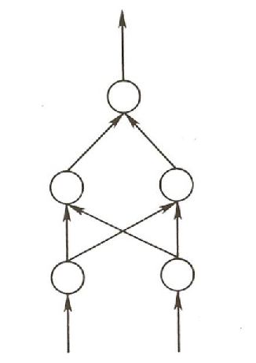
XOR Problem from Homework
Uses the network architecture at right.
Uses batch mode with momentum and no weight decay for first part of exercise.
Will allow you to get a feel for the gradient and other issues and explore effects of variation in parameters.
Is implemented in PyTorch but that will stay under the hood for now.

Slide 16
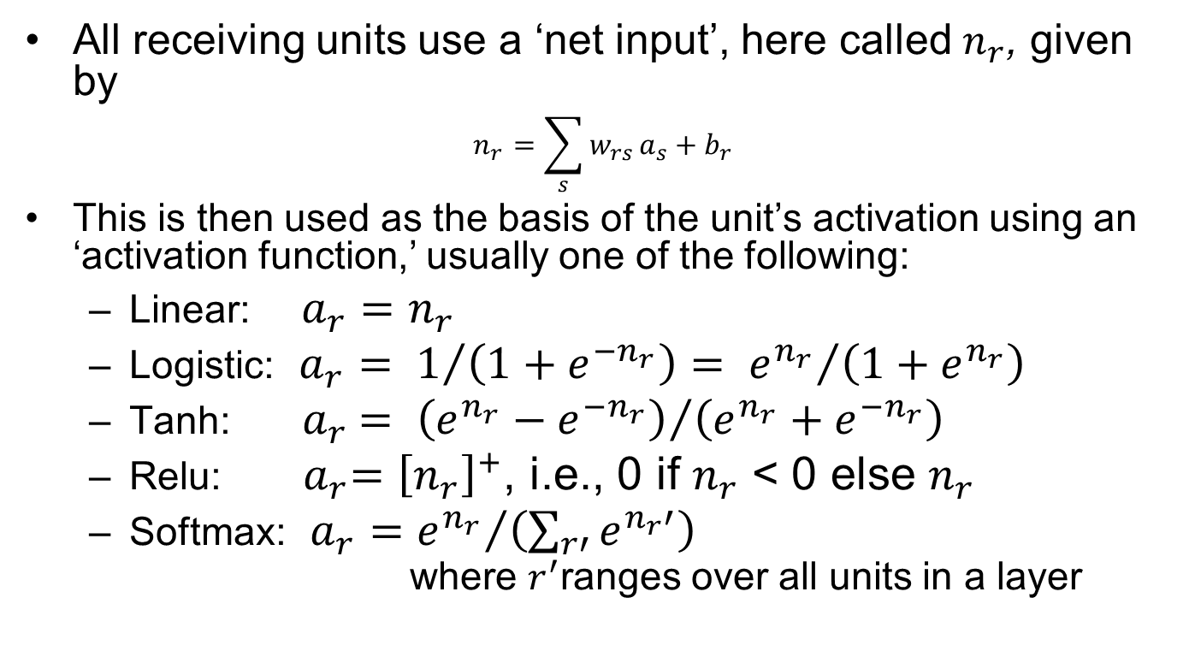
Neural network activation Functions
All receiving units use a ‘net input’, here called $n_{r}$, given by
$$n_{r}=\sum_{s}{w_{rs}}a_{s}+b_{r}$$
This is then used as the basis of the unit’s activation using an ‘activation function,’ usually one of the following:
  Linear: $a_{r}=n_{r}$
  Logistic: $a_{r}= 1/{\left(1+e^{{−n}_{r}}\right)= {e^{n_{r}}}/{\left(1+e^{n_{r}}\right)}}$
  Tanh: ${ a}_{r} = {\left(e^{n_{r}}−e^{{−n}_{r}}\right)}/{\left(e^{n_{r}}+e^{{−n}_{r}}\right)}$
  Relu: ${ a}_{r}={\left[n_{r}\right]}^{+}$, i.e., 0 if $n_{r}$ < 0 else $n_{r}$
  Softmax: $a_{r}={e^{n_{r}}}/{\left(\sum_{r′}{e^{n_{r}′}}\right)}$
  where $r^{′}$ranges over all units in a layer

Slide 17
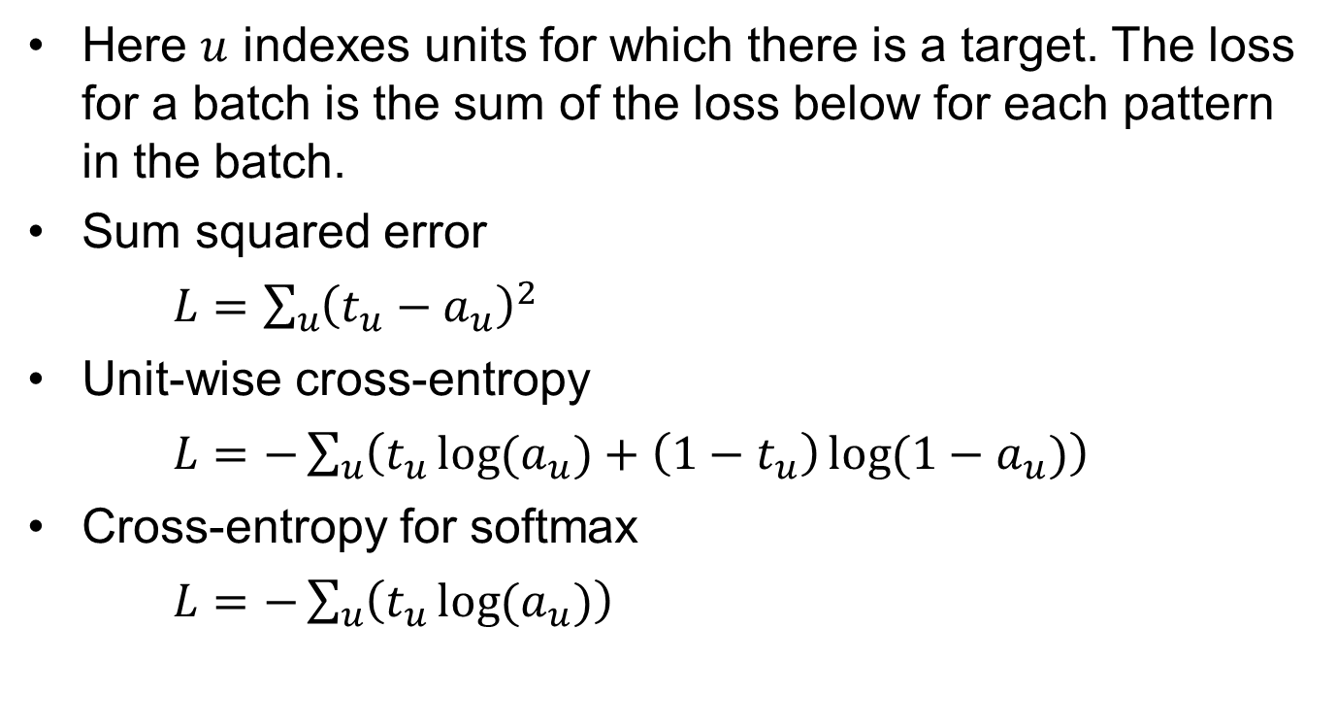
Neural Network Loss Functions
Here $u$ indexes units for which there is a target. The loss for a batch is the sum of the loss below for each pattern in the batch.
Sum squared error
$L=\sum_{u}{{\left(t_{u}−a_{u}\right)}^{2}}$
Unit-wise cross-entropy
$L=−\sum_{u}{\left(t_{u}\log{{(a}_{u})}+\left(1−t_{u}\right)\log{(1−a_{u})}\right)}$
Cross-entropy for softmax
$L=−\sum_{u}{\left(t_{u}\log{{(a}_{u})}\right)}$

Slide 18


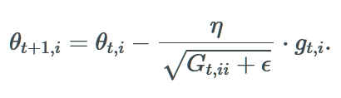

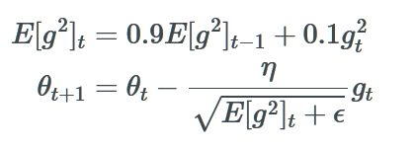
Some Optimization Algorithms
(notation from blog – different from ours)
Vector of weights + biases
Vector of dL/dw
Batch Gradient Descent
Momentum
AdaGrad
RMSprop
Sum of Squares of g_{t’,i}
up to time t
g_{t}² is the vector of squares
of the g_{t,i}
Corresponds to RMS[g]_{t}

Slide 19
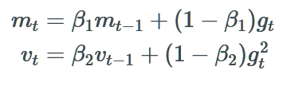
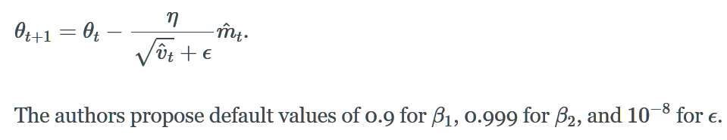
Adam
Two running averages:
Update depends on momentum normalized by variance:

Slide 20
The algorithms in action

Slide 21
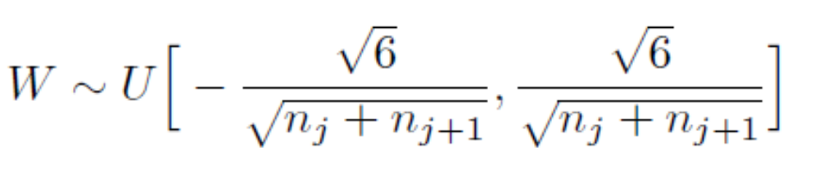
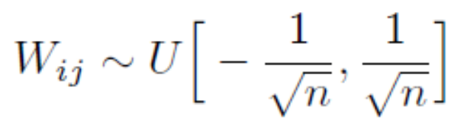
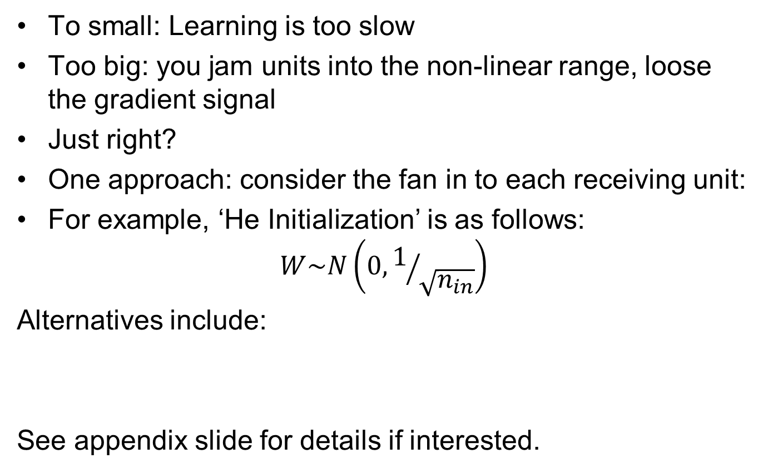
Weight Initialization
To small: Learning is too slow
Too big: you jam units into the non-linear range, loose the gradient signal
Just right?
One approach: consider the fan in to each receiving unit:
For example, ‘He Initialization’ is as follows:
$$W\sim N\left(0,1/{\sqrt{n_{in}}}\right)$$
Alternatives include:
See appendix slide for details if interested.

Slide 22
Is Backprop biologically plausible?
Neurons probably do net send error signals backward across their weights through a chain of neurons at least not at the rates necessary for standard implementations of BP
But we shouldn’t be too literal minded about the actual biological implementation of the learning rule
Some neurons appear to use error signals, and there are ways to use differences between activation signals to carry error information
With the renewed interest in back propagation these days, there is renewed investigation of this issue

Slide 23
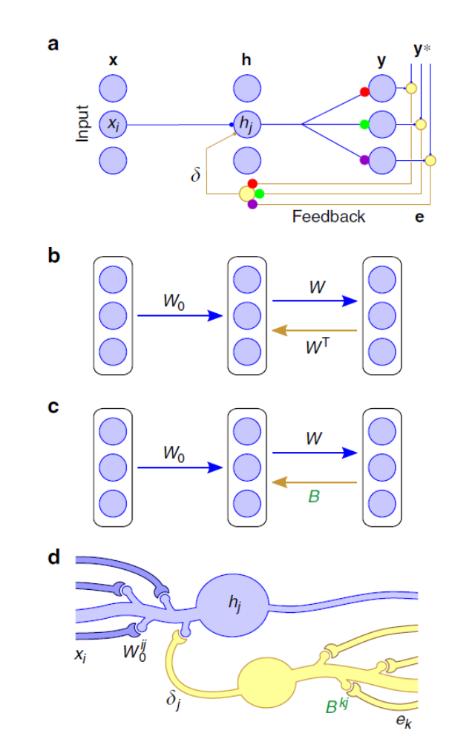
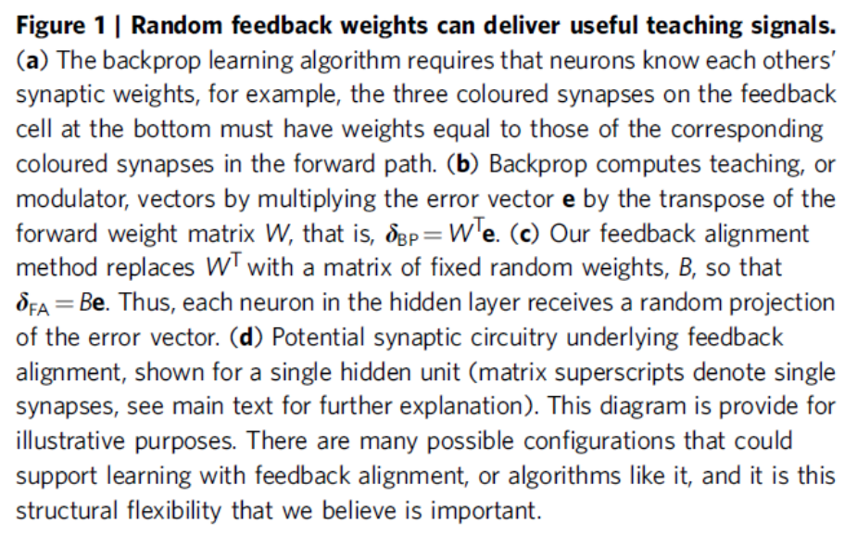
Random feedback weights can deliver useful teaching signals
Lillicrap TP, Cownden D, Tweed DB, Akerman CJ: Random synaptic feedback weights support error backpropagation for deep learning. Nat Commun 2016, 7:13276 http://dx.doi.org/ 10.1038/ncomms13276.

Slide 24
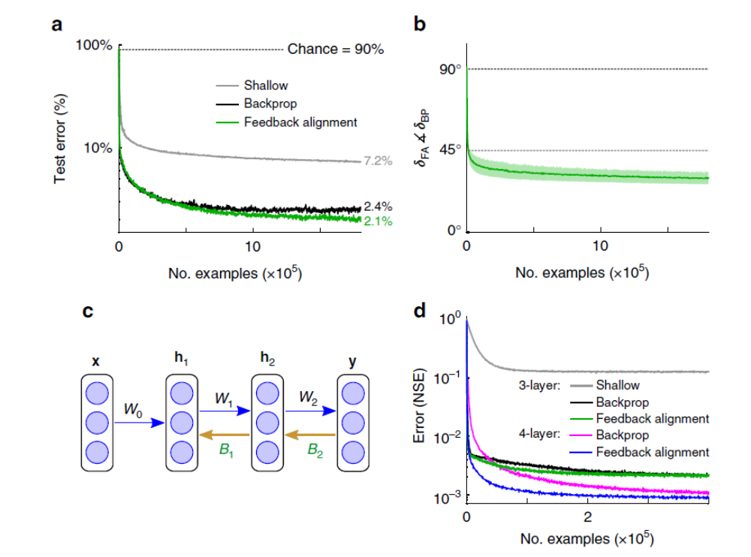
‘Feedback Alignment’ Equals or Beats BackProp on MNIST in 3 and 4 layer nets

Slide 25
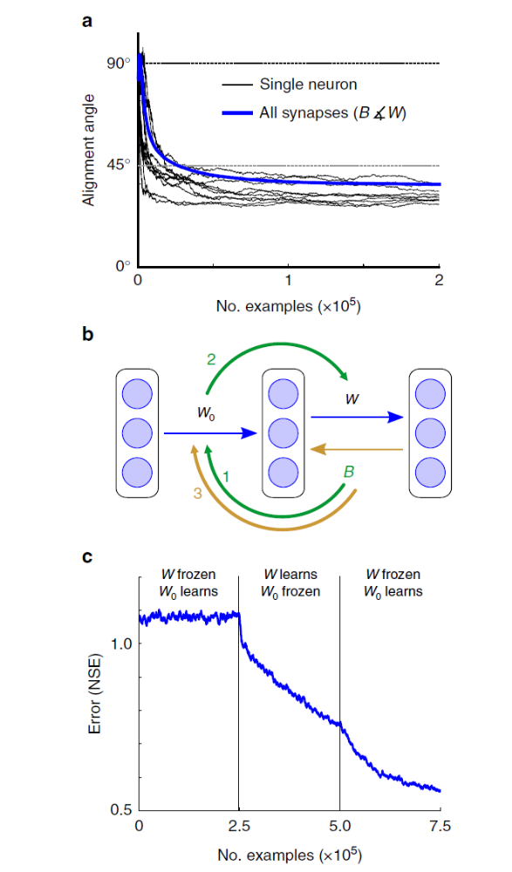
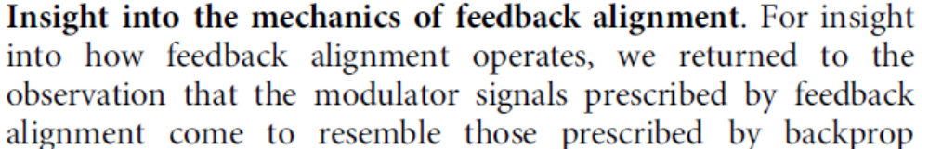
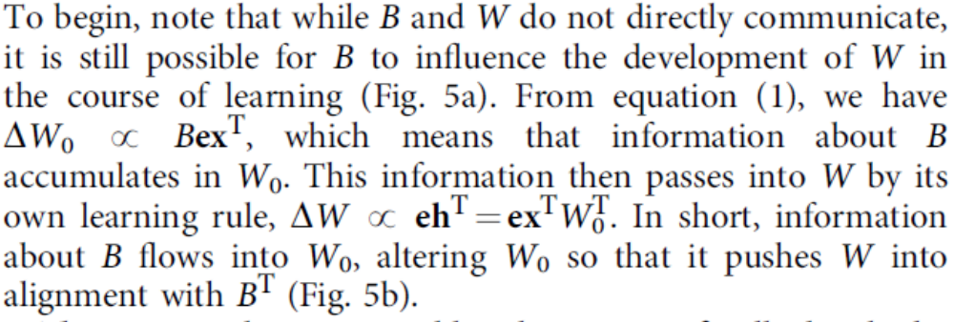
How it works

Slide 26
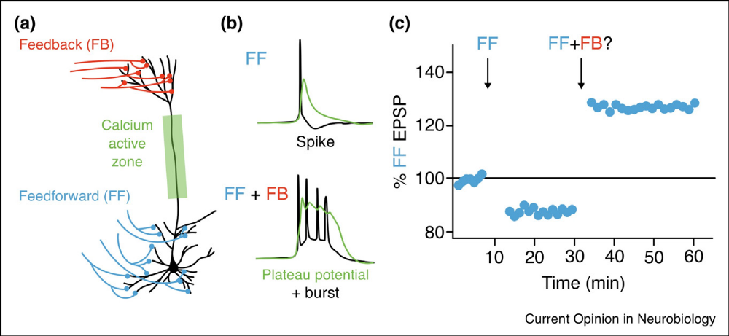
Can we make it work using Hebbian Learning?
Link to article in Science Direct

Slide 27
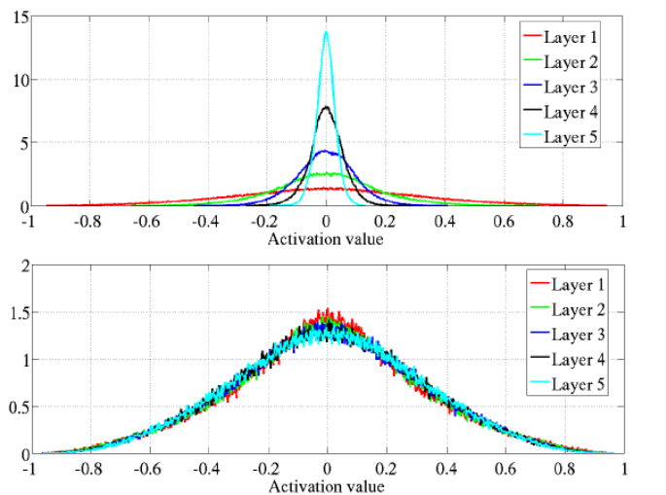
Normalized Initialization
Start with a more uniform
distribution:
This often works ok
But it leads to degenerate
activations at initialization when a tanh function is used.
‘Normalized initialization’ solves the problem (figure) and produces improvement with tanh nonlinearity:
Now we know even better ways, but we’ll consider these later

