Slide 1
Basketball’s Cinderella Stories:
What Makes a Successful Underdog in the NCAA Tournament?
Alinna Brown

Slide 2
NCAA Tournament 2016:
A Year for Upsets
Ten double digit seeds won a first round game
Friday 3/18: Crazy day for upsets
Eight teams of 11th seed or worse made it to the second round

Slide 3

#11 Northern Iowa vs. #6 Texas (75-72)

Slide 4
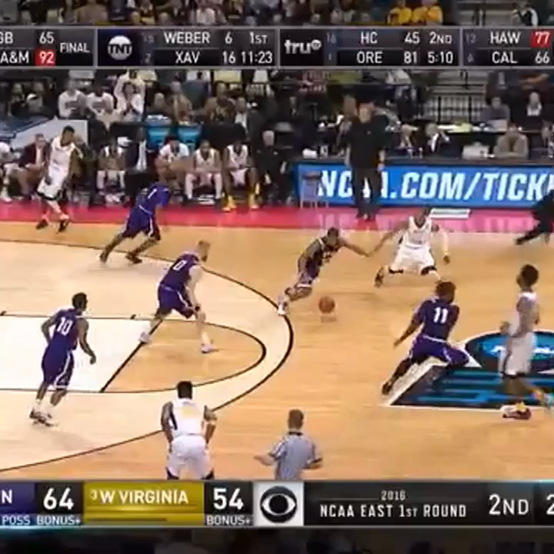
#14 SF Austin vs. #3 West Virginia (70-56)

Slide 5
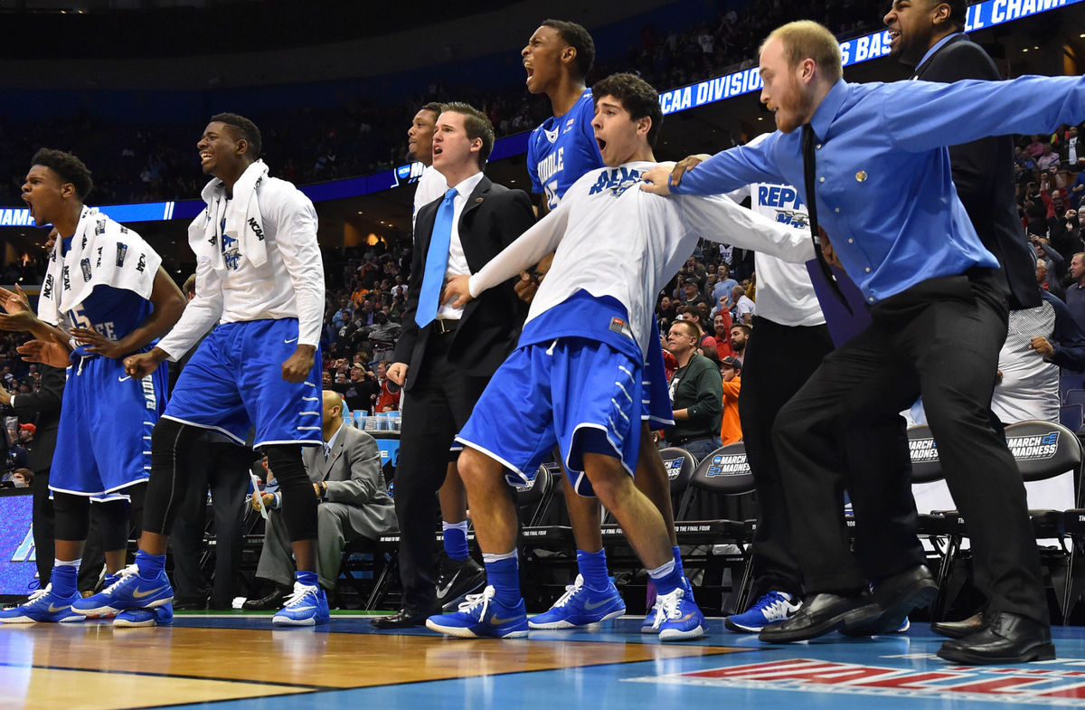
#15 Middle Tennessee State vs. #2 Michigan State (90-81)
Notes:
http://bloximages.newyork1.vip.townnews.com/gwinnettdailypost.com/content/tncms/assets/v3/editorial/c/4f/c4f84524-d6a4-5c00-a92b-72d922b890fc/56ec95ff8aa2f.image.jpg?resize=1200%2C785

Slide 6
2016 NCAA Tournament:
By the Numbers
40 million Americans
70 million brackets (More than 66 million votes cast for President Obama in 2012)
$9 billion wagered (More than double $3.9 billion on Super Bowl)

Slide 7
Past Research
Stephen Pettigrew, Five Thirty Eight
Dean Oliver, Basketball on Paper
Harvard Sports Analysis Collective
Blog: Risk taking

Slide 8
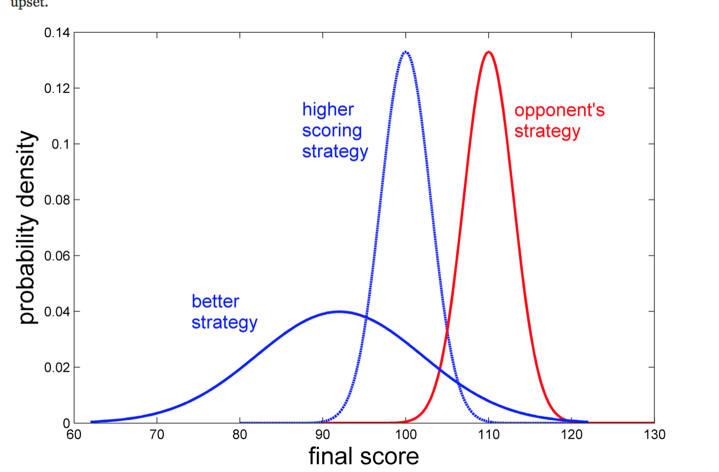
“Risk is the Ally of the Underdog”

Slide 9
My Research
Question: What statistics are correlated with underdog success?
    offensive rebounds, defensive rebounds, steals, turnovers, blocks, assists, personal fouls, three pointers made
Data: Kaggle.com March Madness Machine Learning Mania
  2003-2016 Regular Season Data
  2003-2015 Tournament Data
  2016 Tournament Data from ESPN

Slide 10
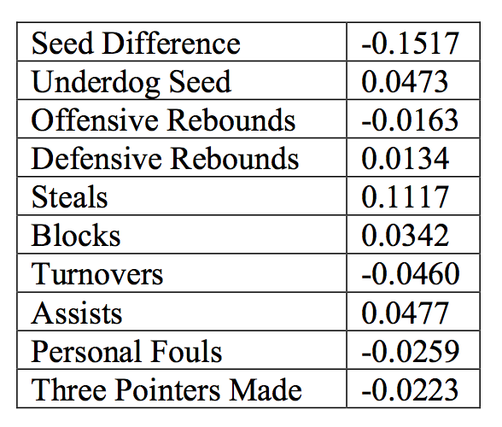
Regression Coefficients

Slide 11
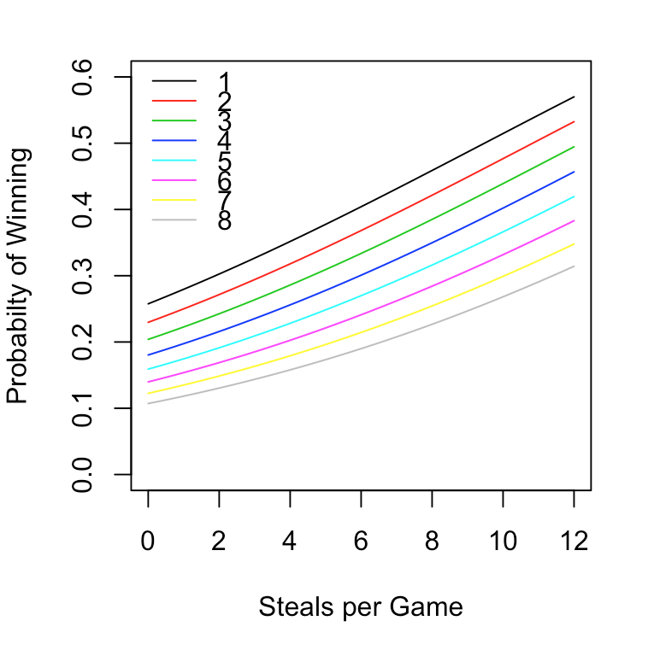
Steals
Benjamin Morris, Five Thirty Eight, “The Hidden Value of the NBA Steal”
Underrated in PER
“Irreplaceable”
Worth 9.1 Points per game

Slide 12
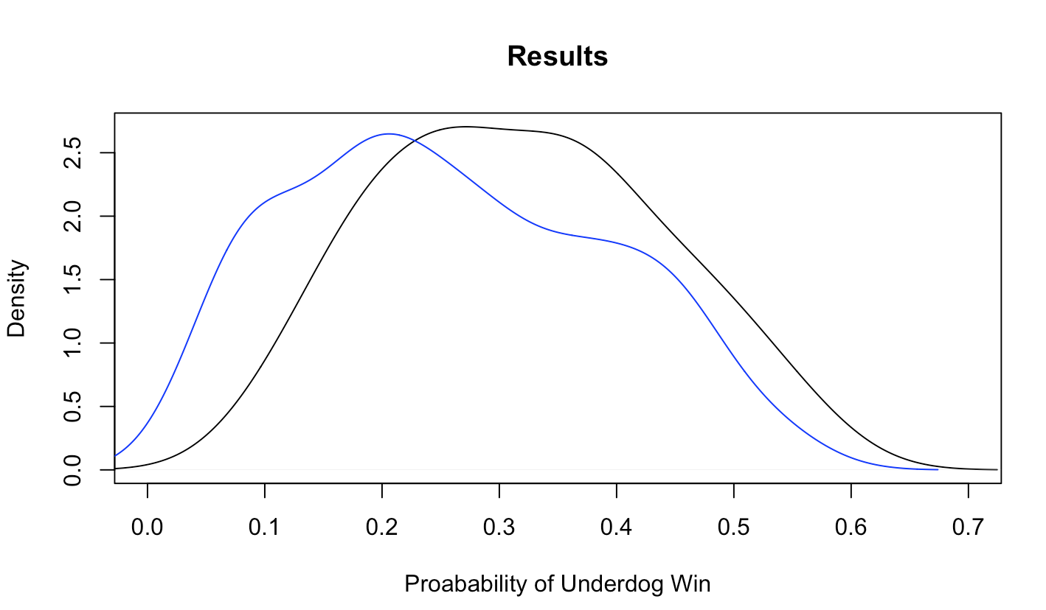
How good was my model?

Slide 13
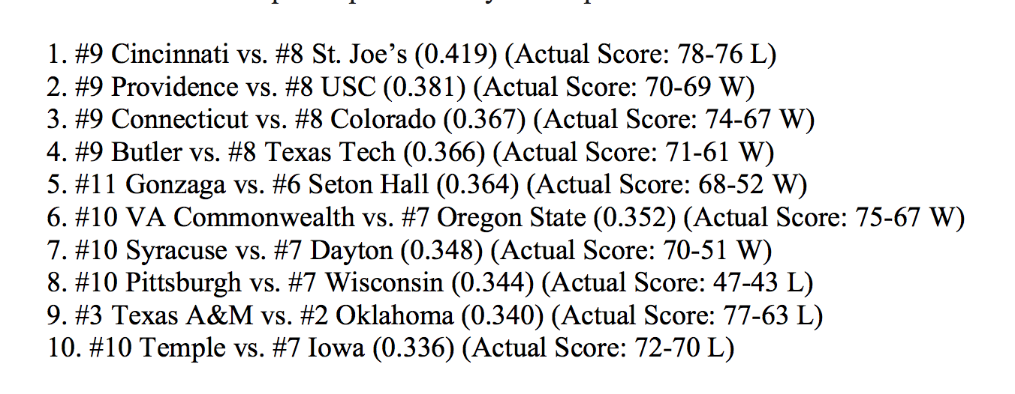
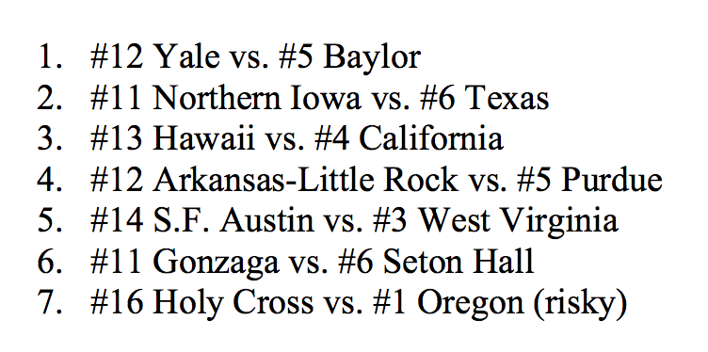
Predictions
<= My model
New York Times =>

Slide 14
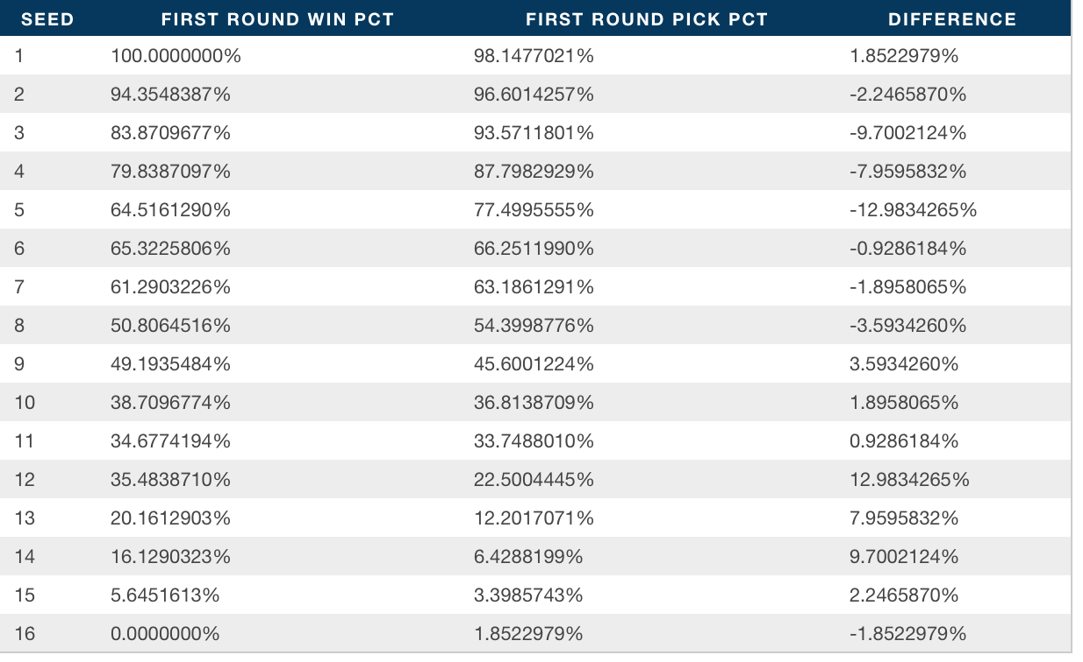
Gambler’s Mistakes

Slide 15
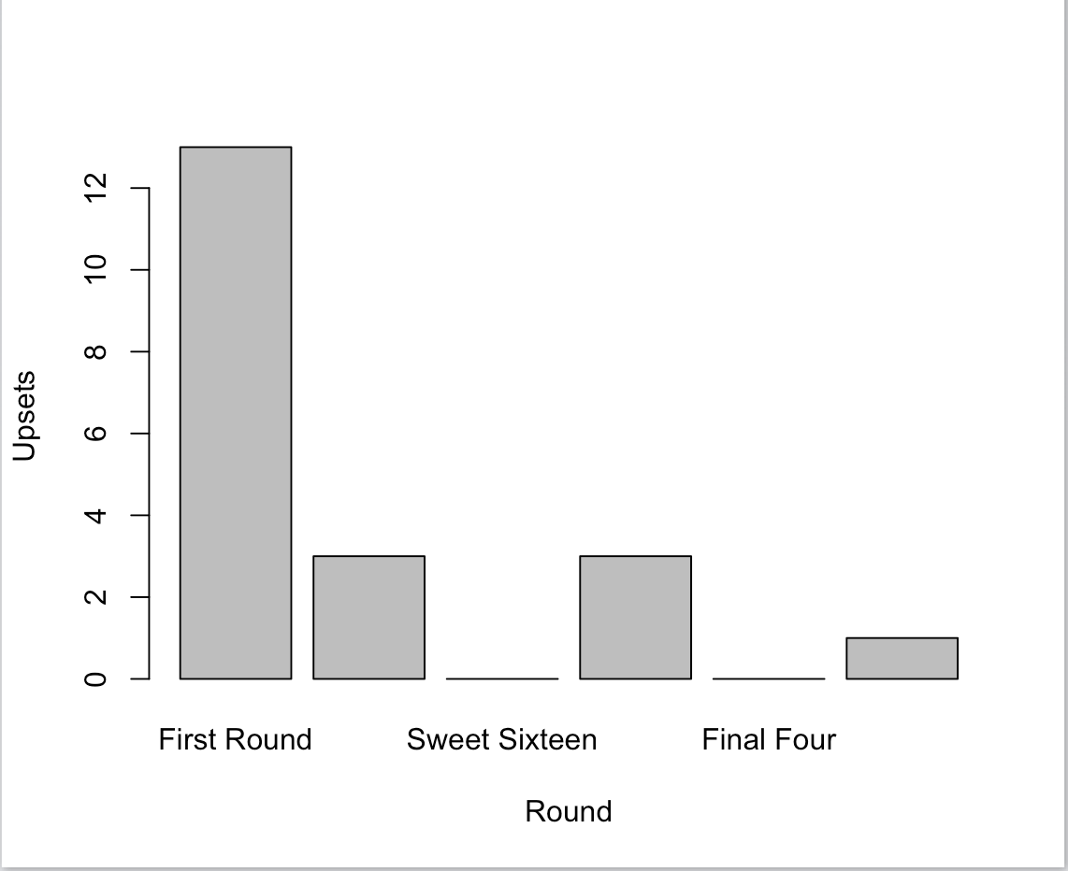
Directions for Future Research

Slide 16
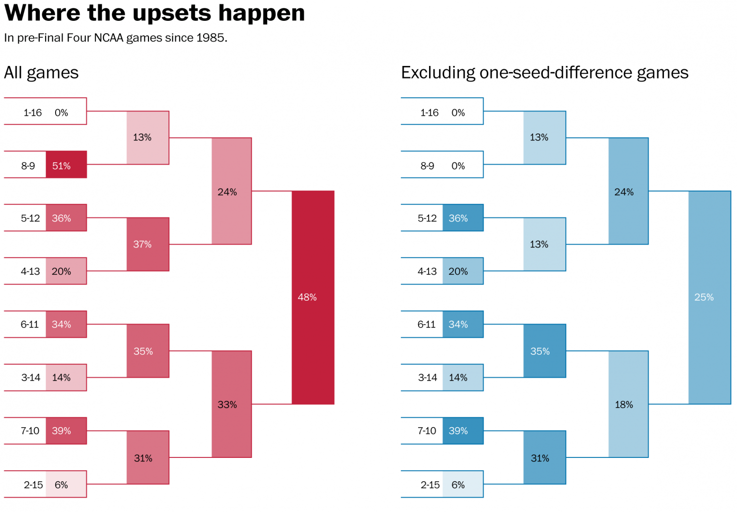
Directions for Future Research

Slide 17
References
Brian. “Risk is the ally of the underdog.” Gravity and Levity. 21 Dec. 2010. Web. 2 June 2016. <https://gravityandlevity.wordpress.com/2010/12/21/risk-is-the-ally-of-the-underdog/>
Bump, Philip. “Where to expect upsets on your NCAA bracket.” Washington Post. 17 Mar. 2015. Web. 2 June 2016. <https://www.washingtonpost.com/news/wonk/wp/2015/03/17/where-to-expect-upsets-on-your-ncaa-bracket/>
Ezekowitz, John, and Andrew Cohen. “Putting Theories to the Test: Does Slow Tempo Aid NCAA Tournament Upsets?” The Harvard Sports Analysis Collective. 11 Feb. 2010. Web. 2 June 2016. https://harvardsportsanalysis.wordpress.com/2010/02/11/putting-theories-to-the-test-does-slow-tempo-aid-ncaa-tournament-upsets/.
Greenberg, Neil. “2016 NCAA tournament: The most likely upsets for the first round.” Washington Post. 13 Mar. 2016. Web. 2 June 2016. https://www.washingtonpost.com/news/fancy-stats/wp/2016/03/13/2016-ncaa-tournament-the-most-likely-upsets-for-the-first-round/
Lyons, Tom. “What wins Basketball Games: Review of “Basketball on Paper: Rules and Tools for Performance Analysis” By Dean Oliver.” Strauss Factor Laing & Lyons. Web. 2 June 2016. http://www.sfandllaw.com/Articles/What-Wins-Basketball-Games-a-Review-of-Basketball-on-Paper-Rules-and-Tools-for-Performance-Analysis.shtml
“March Madness: Upsets, Upsets, and More Upsets.” The New York Times. 18 Mar. 2016. Web. 2 June 2016. <http://www.nytimes.com/interactive/projects/cp/sports/2016-ncaa-tournament/michigan-state-loses-to-middle-tennessee>.

Slide 18
References
Mathis-Lilly, Ben. “Understanding the Underdog: How Gladwell Got Basketball Wrong.” New York Magazine. 11 May 2009. Web. 2 June 2016. http://nymag.com/daily/intelligencer/2009/05/malcolm_gladwell_isnt_a_basket.html
Morris, Benjamin. “The Hidden Value of the NBA Steal.” FiveThirtyEight. 25 Mar. 2014. Web. 2 June 2016. http://fivethirtyeight.com/features/the-hidden-value-of-the-nba-steal/
Oliver, Dean. Basketball on Paper. Web. 2 June 2016. <http://www.basketballonpaper.com>.
Pettigrew, Stephen. “How To Tell If A March Madness Underdog Is Going to Win.” FiveThirtyEight.19 Mar. 2015. <http://fivethirtyeight.com/features/how-to-tell-if-a-march-madness-underdog-is-going-to-win/>.
Purdum, David. “Estimated 40 million fill out brackets.” ESPN. 12 Mar. 2015. Web. 2 June 2016. <http://espn.go.com/chalk/story/_/id/12465741/estimated-70-million-brackets-9-million-bets-ncaa-tournament>
Rutherford, Mike. “NCAA Tournament 2016: The best and worst from the wildest day in March Madness History.” SB Nation. 19 Mar. 2016. Web. 2 June 2016. <http://www.sbnation.com/college-basketball/2016/3/19/11267698/ncaa-tournament-2016-march-madness-scores-upsets-highlights-schedule-bracket>
Tracy, Marc, and Zach Schonbrun. “Potential NCAA Bracket Busters. You’ve Been Warned.” New York Times. 14 Mar. 2015. Web. 2 June 2016. <http://www.nytimes.com/interactive/2016/03/14/sports/march-madness-upsets-ncaa-tournament-bracket.html>

Slide 19
References
Data:
Kaggle, ESPN
Images:
http://bloximages.newyork1.vip.townnews.com/gwinnettdailypost.com/content/tncms/assets/v3/editorial/c/4f/c4f84524-d6a4-5c00-a92b-72d922b890fc/56ec95ff8aa2f.image.jpg?resize=1200%2C785
http://ftw.usatoday.com/2016/03/watch-northern-iowas-incredible-half-court-buzzer-beater-to-defeat-texas
http://www.sbnation.com/college-basketball/2016/3/18/11266364/2016-ncaa-tournament-bracket-stephen-f-austin-west-virginia

