Slide 1
Statistics in Baseball
How do players perform under different counts?

Slide 2
Introduction
Goal
League averages
Sample size
What can we see from this?

Slide 3
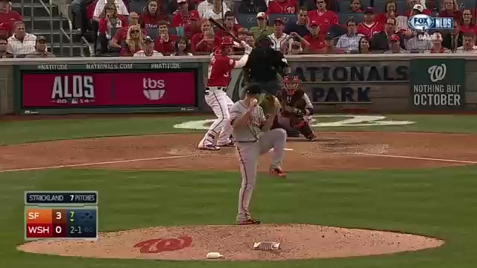
Why batters love 2-1 counts

Slide 4
Joey Votto
Background
Data collected
- Splits

Slide 5
Joey Votto Splits
2015 1-2 count batting average | 2015 2-1 count batting average | 2012-2015 batting average after 1-2 count (on base percentage) | 2012-2015 batting average after 2-1 count (on base percentage)
.192 | .459 | .216 (.332) | .294 (.521)

Slide 6
Data to Keep in Mind
League average for pitchers getting ahead is 60%.
Votto had 310 plate appearances behind in the count and 315 ahead.
Votto uses his eye to his advantage.
.279 after 0-1. .324 after 1-0 in 2015.

Slide 7
Brett Gardner
Outfielder for New York Yankees.
Swings at first pitch only 8.4% of the time.
How does this affect his stats?

Slide 8
Brett Gardner Splits 2015
308 plate appearances when ahead. 302 Plate appearances when behind. Gets ahead more than league average.
.234 after 0-1. .271 after 1-0. All players rely on getting ahead.

Slide 9
Batting Average on 0-0 count 2015
Brett Gardner | Joey Votto | Bryce Harper | Mike Trout | Chris Davis
.382 | .418 | .417 | .192 | .486

Slide 10
0-0 Count Results
Why don’t more players swing at the first pitch?
League average in 2014 on 0-0 pitch was .342.
Pitch has to be perfect to swing at.

Slide 11
Ahead vs. Behind 2015
Collecting data from 2015 is difficult.
At least 100 at bats.

Slide 12
Ahead in count 2015 leaders (2015/2016 batting average)
Ender Inciarte | Bryce Harper | Salvador Perez | Dee Gordon | Francisco Lindor
.444 (.303/.219) | .417 (.330/.246) | .394 (.260/.276) | .390 (.333/.266) | .385 (.313/.318)

Slide 13
Ahead in count underperformers (2015/2016 batting average)
Hanley Ramirez | Chase Utley | Jordy Mercer | Joc Pederson | Zack Cozart
.222 (.249/.311) | .237 (.212/.291) | .233 (.244/.307) | .232 (.210/.254) | .217 (.258/.312)

Slide 14
How can we use this model to make predictions?
Assess data to draw conclusions.
Steven Souza jr. batting .656 when ahead in the count leading to a .273 batting average with 9 home runs in 2016.
Brandon Phillips batting just .067. Batting .241 with 6 home runs in 2016.

Slide 15
Conclusions
Plate discipline and patience are extremely important.
These stats can lead to somewhat accurate predictions.

