Slide 1
A Descriptive Model for NBA Player Ratings
Using Expected Value Points per Possession
Chris Pickard
May 25, 2016

Slide 2
Model Structure | Drivers
Basketball Game Objective
Score more points than the opponent.
Proposition
A player’s value should be measured according to the number of points per possession he contributes towards his team while on the court.
Question
How many points per possession is a given player expected to contribute while on the court?
Key Feature
Accounting for the likelihood that a given event occurs during a possession while a player is on the court and the corresponding impact it has on the expected points for that possession.

Slide 3
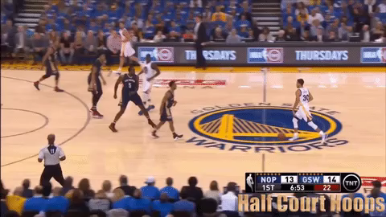
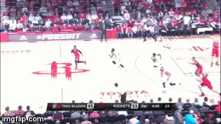
Model Structure | Importance of Event Propensity

Slide 4
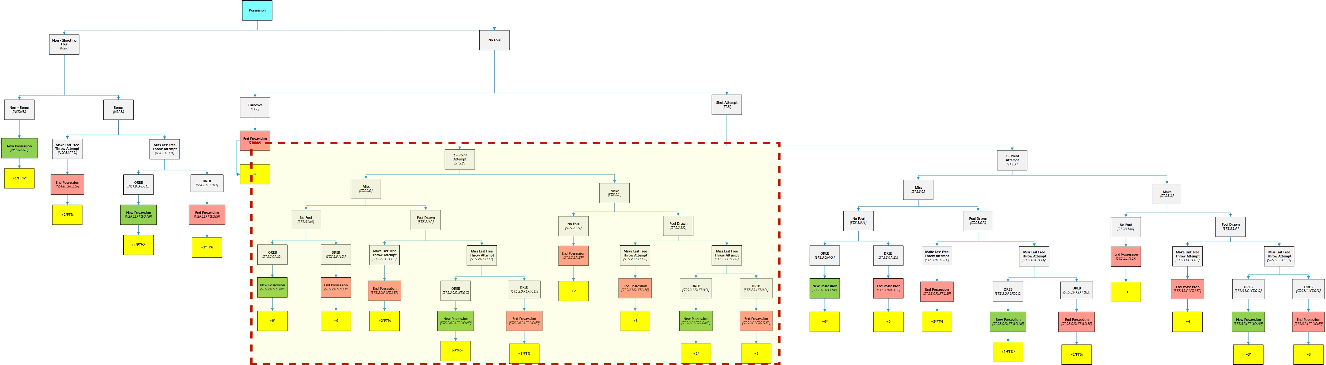
Model Structure | Possession Event Tree
NBA Offensive Possession
Notes:
Chris

Slide 5
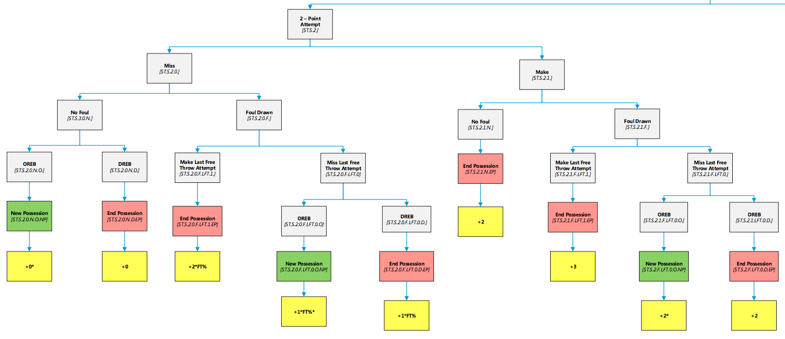
Model Structure | Possession Event Tree

Slide 6
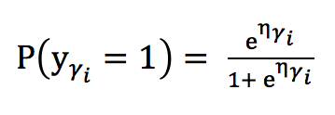
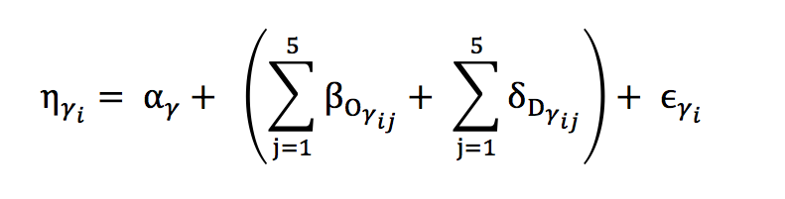
Model Structure | Individual Player Model
Rasch Model
Probability that a given event occurs for player i is modeled as:
Where
For shot specific attempts
Data source
2015 – 2016 NBA Play-by-Play data [NBAstuffer]

Slide 7
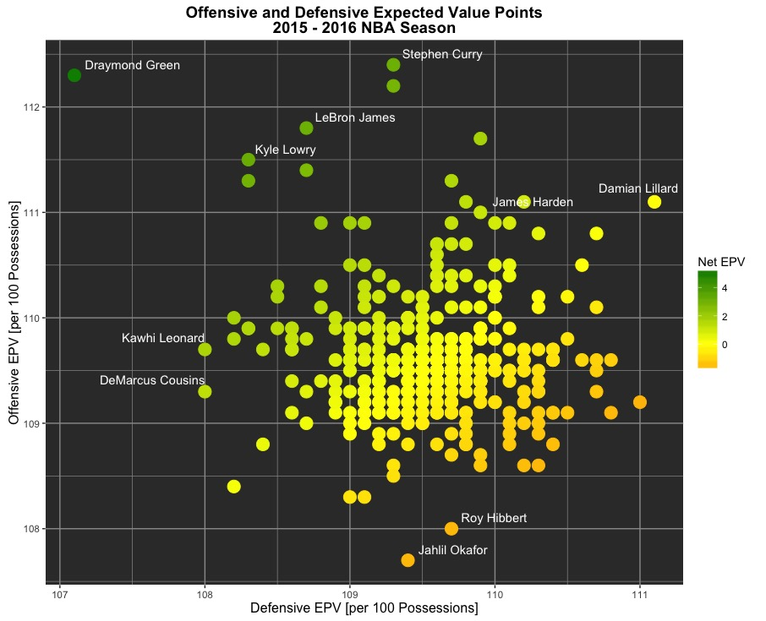
Analysis | Total Player Value

Slide 8
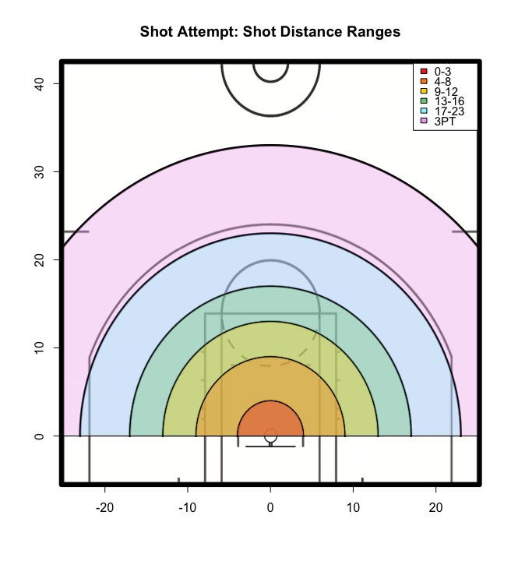
Analysis | Shot Specific Evaluation
Assumption
Event is shot and distance is known.
Proposition
Players will perform better towards their strengths and this can be observed based on shot attempt distance.
Question
How does a player’s expected point contribution change given specific shot attempt occurs?
Purpose
Identify players that perform well in known situations – i.e. what players match up best against “small Ball” or three-point orientated lineups.

Slide 9
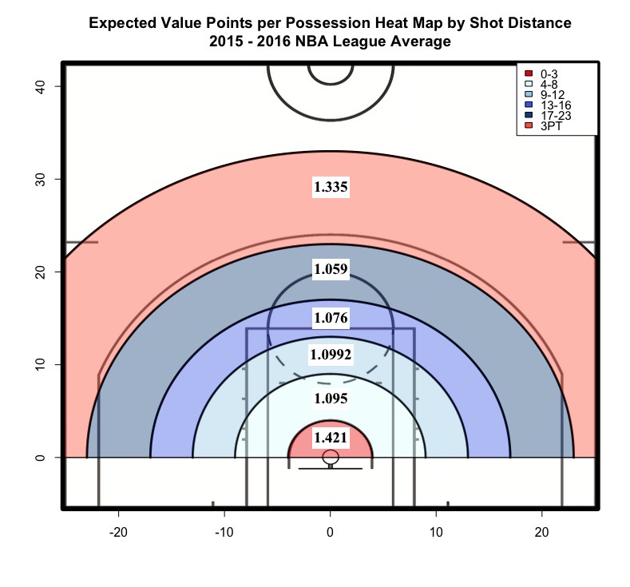
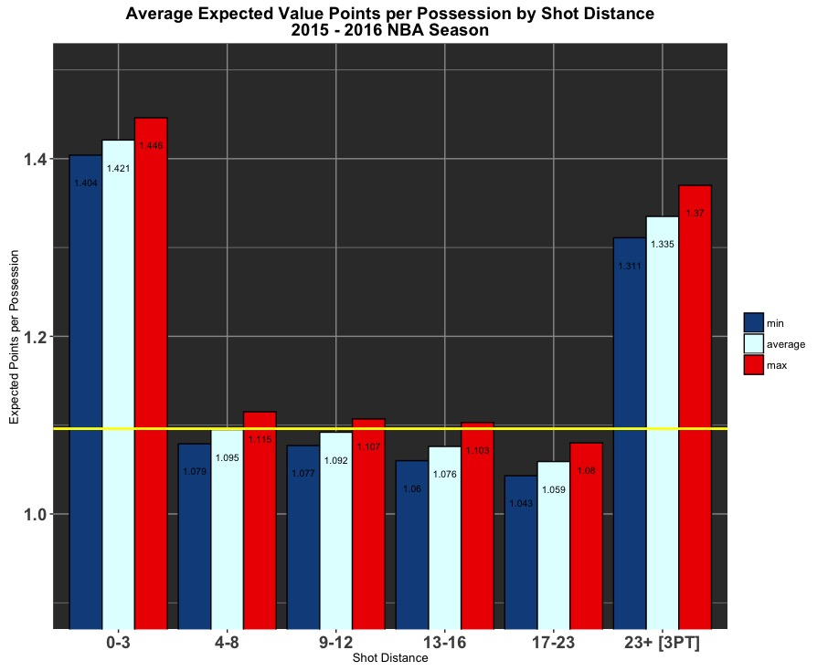
Analysis | Shot Specific Value – League Trends

Slide 10
Analysis | 3PT Defensive Impact Players
Point Guard
Player |  | EPV/POSS | Delta
1 | Deron Williams | 1.317 | -0.018
2 | Elfrid Payton | 1.320 | -0.014
3 | Goran Dragic | 1.324 | -0.011
4 | Steph Curry | 1.325 | -0.011
5 | Tony Parker | 1.326 | -0.001
Shooting Guard
Player |  | EPV/POSS | Delta
1 | Arron Afflalo | 1.318 | -0.017
2 | Kyle Korver | 1.321 | -0.015
3 | Wesley Matthews | 1.321 | -0.014
4 | Danny Green | 1.322 | -0.013
5 | Klay Thompson | 1.323 | -0.012
Small Forward
Player |  | EPV/POSS | Delta
1 | Kawhi Leonard | 1.322 | -0.013
2 | Paul George | 1.324 | -0.011
3 | Rudy Gay | 1.324 | -0.011
4 | Joe Johnson | 1.325 | -0.010
5 | Nicolas Batum | 1.325 | -0.010
Power Forward
Player |  | EPV/POSS | Delta
1 | Draymond Green | 1.319 | -0.016
2 | Kevin Love | 1.320 | -0.015
3 | Luol Deng | 1.322 | -0.013
4 | Thaddeus Young | 1.322 | -0.013
5 | Derrick Favors | 1.327 | -0.008
Center
Player |  | EPV/POSS | Delta
1 | Andre Drummond | 1.318 | -0.017
2 | DeMarcus Cousins | 1.319 | -0.016
3 | Ian Mahinmi | 1.323 | -0.012
4 | Andrew Bogut | 1.324 | -0.011
5 | Tim Duncan | 1.324 | -0.010

Slide 11
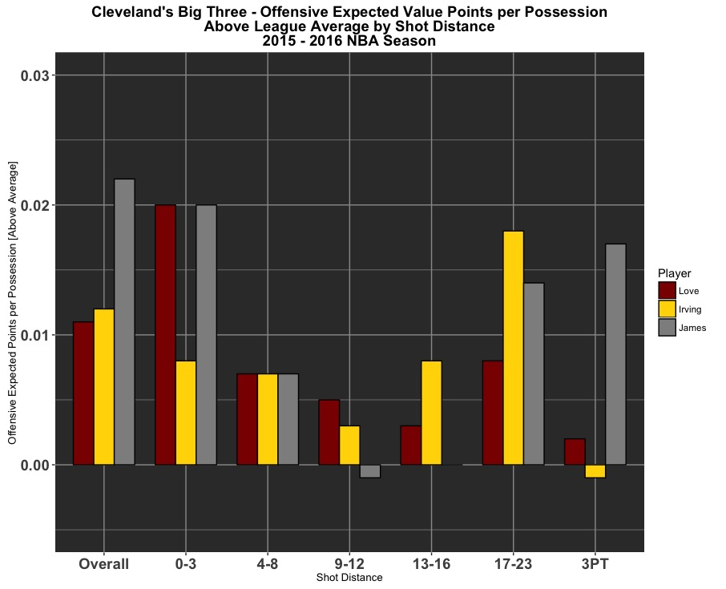
Analysis | Cleveland’s “Big Three” - Offense

Slide 12
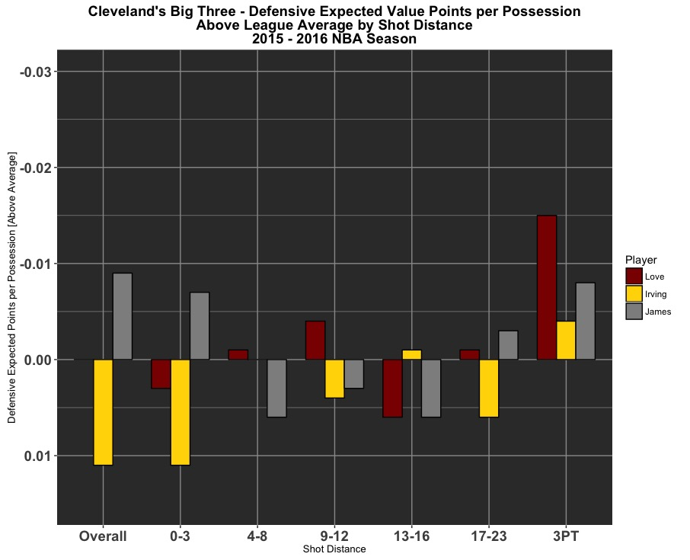
Analysis | Cleveland’s “Big Three” - Defense

Slide 13
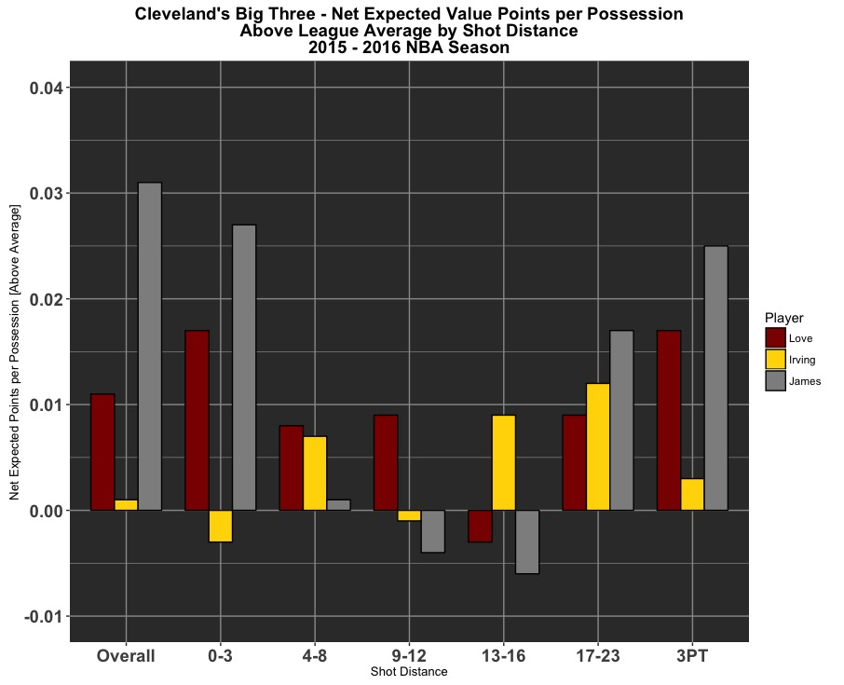
Analysis | Cleveland’s “Big Three” – Net Expectancy

Slide 14
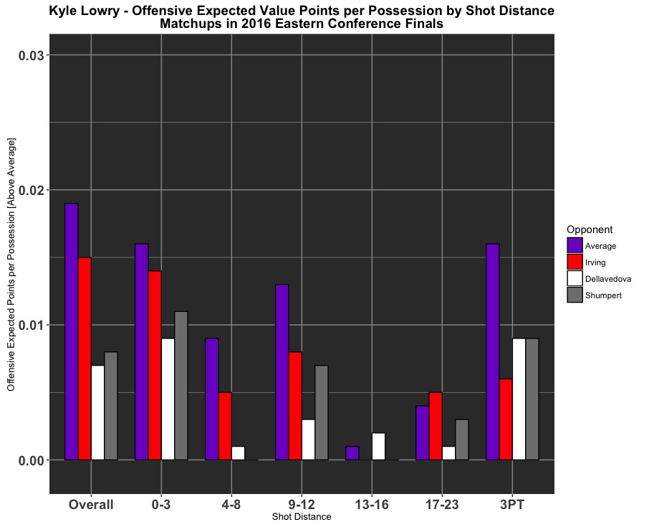
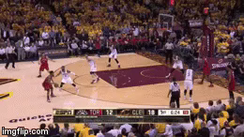
Analysis | Cleveland’s Lowry Problem

Slide 15
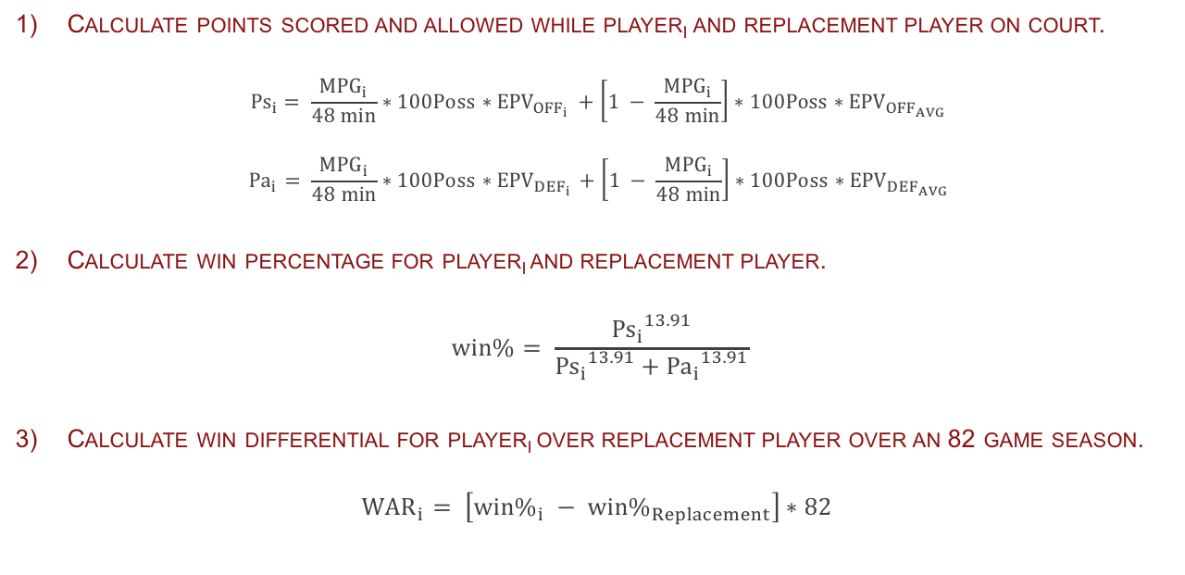
Analysis | Wins Above Replacement
Calculate points scored and allowed while player_{i} and replacement player on court.
$${Ps}_{i}= \frac{{MPG}_{i}}{48 min}∗100Poss∗{EPV}_{{OFF}_{i} }+\left[1 − \frac{{MPG}_{i}}{48 min}\right]∗100Poss∗{EPV}_{{OFF}_{AVG} }$$
$${Pa}_{i}= \frac{{MPG}_{i}}{48 min}∗100Poss∗{EPV}_{{DEF}_{i} }+\left[1 − \frac{{MPG}_{i}}{48 min}\right]∗100Poss∗{EPV}_{{DEF}_{AVG} }$$
2) Calculate win percentage for player_{i} and replacement player.
$$win\%= \frac{{{Ps}_{i}}^{13.91}}{{{Ps}_{i}}^{13.91}+{{Pa}_{i}}^{13.91}}$$
3) Calculate win differential for player_{i} over replacement player over an 82 game season.
$${WAR}_{i}= \left[{win\%}_{i} − {win\%}_{Replacement}\right]∗82$$

Slide 16
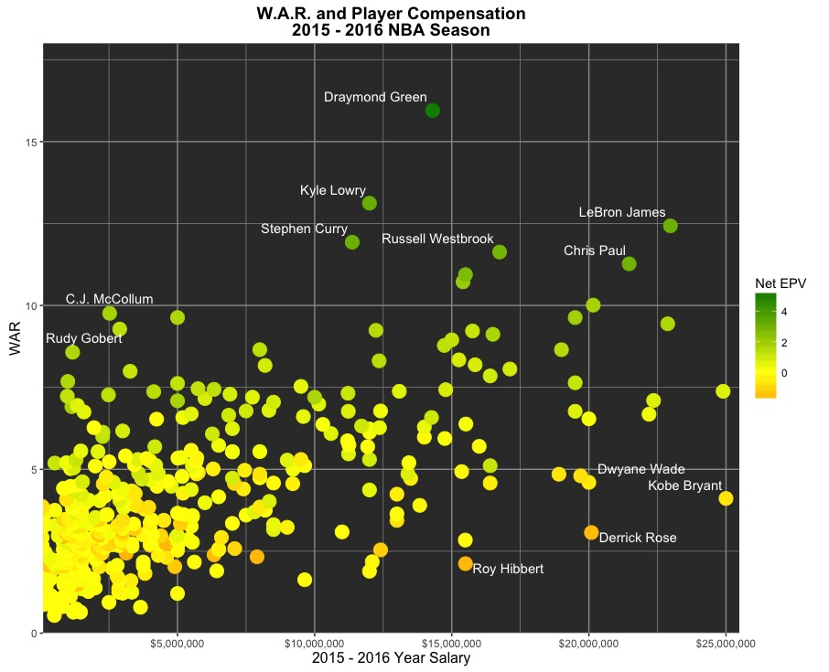
Analysis | WAR and Player Market Value

Slide 17
Model | Take Always
Model values dynamic players involved in high yield point events.
      Draymond Green
Model is built to encourage inquiry about why results are the case.
      Kyle Lowry’s success against Cleveland
Model provides opportunity for insight that is untouched in results.
      Lineup specific events

Slide 18
Thank you!
Questions?

