Slide 1
Index card question for today
What is an example of a feature that Wittgenstein mentions characterizes some games but not others?

Slide 2
Wittgenstein and Word Meaning
Think 53: Food Talks
Dan Jurafsky & Yoshiko Matsumoto
Thursday, April 20, 2017

Slide 3
What do words mean?
First thought: look in a dictionary
http://www.oed.com/

Slide 4
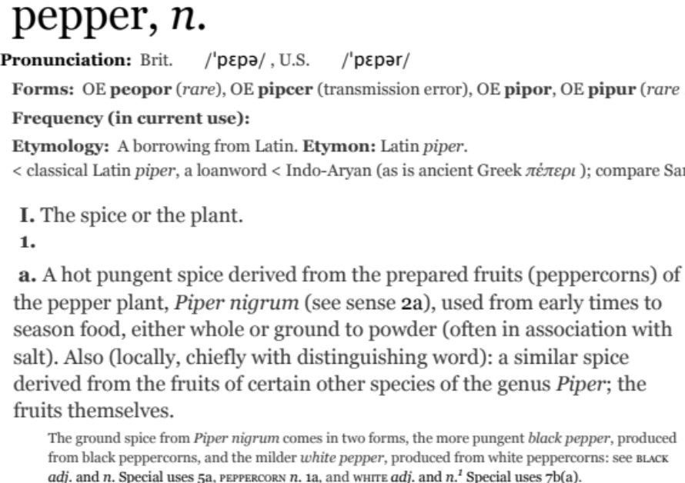
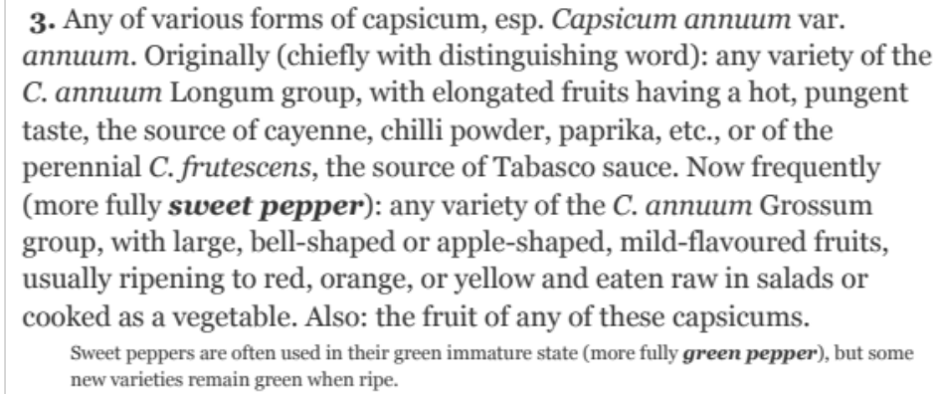
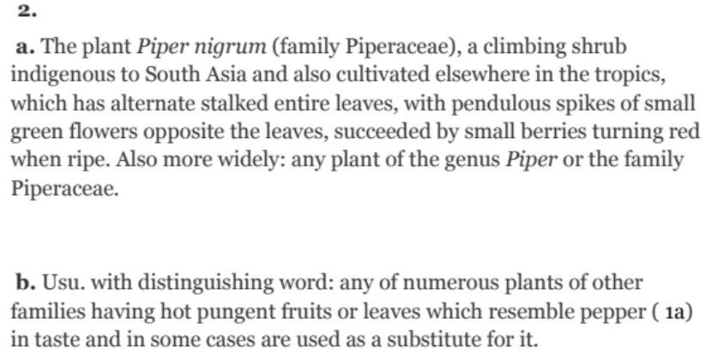
Words, Lemmas, and Senses
lemma
sense

Slide 5
Lemma pepper
Sense 1: spice from pepper plant
Sense 2: the pepper plant itself
Sense 3: another similar plant (Jamaican pepper)
Sense 4: another plant with peppercorns (California pepper)
Sense 5: capsicum (i.e. chili, paprika, bell pepper, etc)

Slide 6
A sense or “concept” is the meaning component of a word
But what is that meaning?

Slide 7
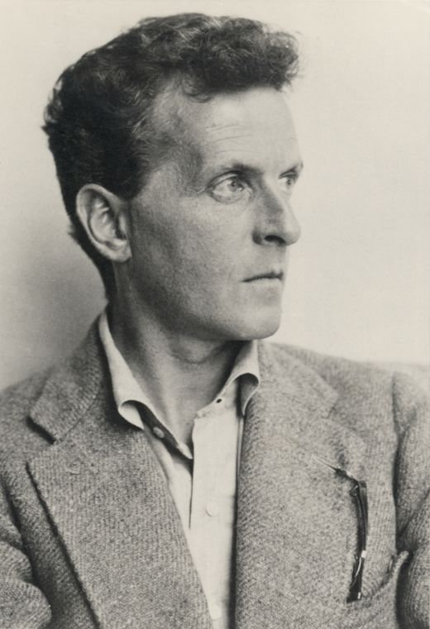
Ludwig Wittgenstein (1889-1951)
Philosopher of language
In his late years, a proponent of studying “ordinary language”
Our reading is from his
  Philosophical Investigations
Part I completed in 1945, published posthumously in 1953

Slide 8
Wittgenstein the person
History:
  Born in Vienna 1889 to a very wealthy family
  Youngest of 8, 3 brothers committed suicide
  He considered it as well, and consistently feared mental illness
  Family later escaped in the 30s to England
Anecdotes
  Wittgenstein arrives at Cambridge to study with Russell
    Constantly follows him home after classes still talking
  Once famously threatens Karl Popper with a hot poker
  Kept leaving academics (to be a gardener, a hospital porter, soldier, rural schoolteacher etc.)
  Alan Turing calls him a “very peculiar man”
Alan Turing, one of his students described him as “a very peculiar man”

Slide 9
Wittgenstein in Cambridge lectures
"It is hardly correct to speak of these meetings as 'lectures', although this is what Wittgenstein called them. For one thing, he was carrying on original research in these meetings... Often the meetings consisted mainly of dialogue. Sometimes, however, when he was trying to draw a thought out of himself, he would prohibit, with a peremptory motion of the hand, any questions or remarks. There were frequent and prolonged periods of silence, with only an occasional mutter from Wittgenstein, and the stillest attention from the others. During these silences, Wittgenstein was extremely tense and active. His gaze was concentrated; his face was alive; his hands made arresting movements; his expression was stern. One knew that one was in the presence of extreme seriousness, absorption, and force of intellect... Wittgenstein was a frightening person at these classes.”
Malcolm “Ludwig Wittgenstein: A Memoir”

Slide 10
What do words mean?
At the beginning of Philosophical Investigations, Wittgenstein quotes St. Augustine about how he learned as a child what words mean:
“When my elders named some object, and accordingly moved toward something, I saw this and I grasped that the thing was called by the sound they uttered when they meant to point it out. Their intention was shown by their bodily movements… Thus as I heard words repeatedly used in their proper places in various sentences, I gradually learnt to understand what objects they signified”
  Augustine, Confessions, I, 8, (~ 400CE)

Slide 11
Augustine’s theory of meaning, according to Wittgenstein
“Words name objects” and “Sentences are combinations of such names”
Wittgenstein thinks this is a very primitive model of meaning, only imaginable for simple nouns like “table” and “chair” and not “this”.
PI #38: “Naming appears as a queer connection of a word with an object. And you get such a queer connection when the philosopher tries to bring out the relation between name and thing by staring at an object in front of him and repeating a name or even the word “this” innumerable times. For philosophical problems arise when language goes on holiday.

Slide 12
Philosophical problems arise when language goes on holiday
PI #43:
  "The meaning of a word is its use in the language"

Slide 13
Classical (“Aristotelian”) Theory of Concepts
The meaning of a word:
a concept defined by necessary and sufficient conditions
A necessary condition for being an X is a condition C that X must satisfy in order for it to be an X.
    If not C, then not X
    ”Having four sides” is necessary to be a square.
A sufficient condition for being an X is condition such that if something satisfies condition C, then it must be an X.
    If and only if C, then X
    The following necessary conditions, jointly, are sufficient to be a square
      x has (exactly) four sides
      each of x's sides is straight
      x is a closed figure
      x lies in a plane
      each of x's sides is equal in length to each of the others
      each of x's interior angles is equal to the others (right angles)
      the sides of x are joined at their ends
Example from Norman Swartz, SFU

Slide 14
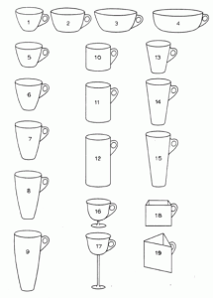
The features are complex and may be context-dependent
William Labov. 1975
What are these?
Cup or bowl?

Slide 15
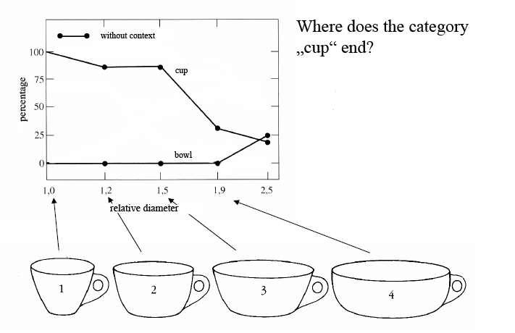
The category depends on complex features of the object (diameter, etc)

Slide 16
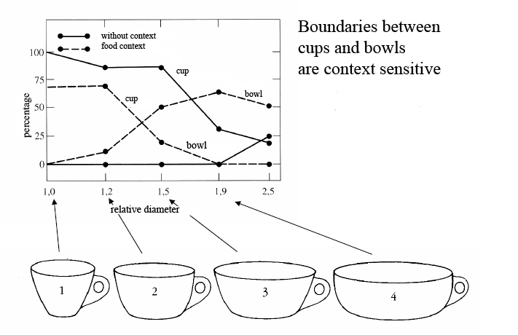
The category depends on the context! (If there is food in it, it’s a bowl)

Slide 17
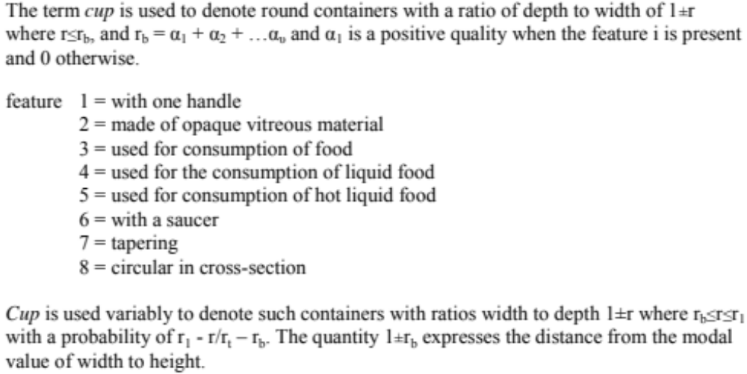
Labov’s definition of cup

Slide 18
What is a bachelor?

Slide 19
Necessary and sufficient conditions
What are the conditions that define “Bachelor”?
  Unmarried
  Male
  Adult
  Human

Slide 20
Necessary and sufficient conditions can be difficult
What are the conditions that define “Bachelor”?
  Unmarried
  Male
  Adult
  Human
Victor is an unmarried adult male, but has been living with his girlfriend Roberta for 30 years in a happy relationship. Is Victor a bachelor?

Slide 21
Necessary and sufficient conditions can be difficult
What are the conditions that define “Bachelor”?
  Unmarried
  Male
  Adult
  Human
Victor is an unmarried adult male. He is a monk living in a monastery. Is Victor a bachelor?

Slide 22
Wittgenstein’s thought experiment on “game”
PI #66:
  ”Don’t say “there must be something common, or they would not be called `games’”—but look and see whether there is anything common to all”
    Is it amusing?
    Is there competition?
    Is there long-term strategy?
    Is skill required?
    Must luck play a role?
    Are there cards?
    Is there a ball?

Slide 23
Family Resemblance
Game 1 | Game 2 | Game 3 | Game 4
ABC | BCD | ACD | ABD
“each item has at least one, and probably several, elements in common with one or more items, but no, or few, elements are common to all items” Rosch and Mervis

Slide 24
Categories are extensible
They don’t have finite boundaries.
New types of games can be created at any point:
  "Video games"
Even in math, where we have precise definitions, they can change
  “Number”
    Originally meant integers
    Then extended to rational numbers
    Then real, complex, transfinite, etc.

Slide 25
Another problem with classical categories
Categories lie at different levels of abstraction
And one level seems distinguished from the others, better than the others for many purposes
This level is called the "basic level", and these are "basic level categories"

Slide 26
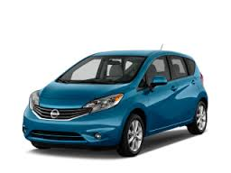
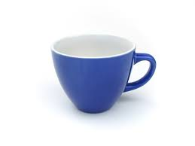
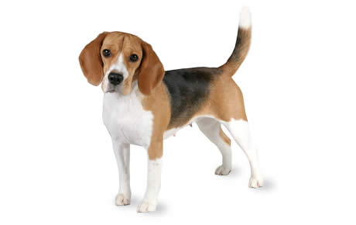

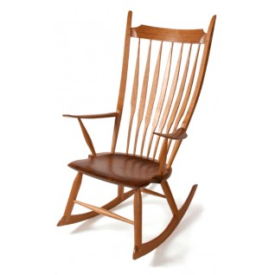
Name these items

Slide 27
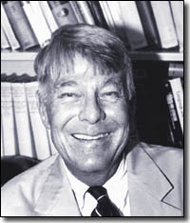
Roger Brown (1925-1997)
Psychologist of Language
“How Shall a Thing be Called (1958)
”The dime in my pocket is not only a dime. It is also money, a metal object, a thing, and, moving to subordinates, it is a 1952 dime, in fact a particular 1952 dime with a unique pattern of scratches, discolorations, and smooth places. The dog on the lawn is not only a dog, but is also a boxer, a quadruped, an animate being” (p. 14)

Slide 28
Basic Level Categories
chair office chair
piano chair rocking chair
furniture lamp torchiere
desk lamp
table end table coffee table
Superordinate Basic Subordinate
Notes:
So if you look at the hierarchical category structure for, say, furniture.
At one end, have furniture, and at the other end, very specific types of furniture {read}.
In between, in the middle level – e.g. chair, table, lamp – are basic-level categories
The other levels can be named too:
Superordinate – the level above the basic-level category, contains basic level categories
Subordinate is the level below
But in what respects are these basic-level categories considered psychologically or cognitively basic? [next slide]

Slide 29
More subordinate examples
Granny Smith
Hatchback
Manx cat
Dessert spooon

Slide 30
Brown on the “basic level”
While a dime can be called a coin or money or a 1952 dime, we somehow feel that dime is its real name. The other categorizations seem like achievements of the imagination” (Brown 1965, p 320)
Such “real names” are shorter, more likely to be used.
They also correlate with non-linguistic action
  In charades we might symbolize flowers by leaning forward and sniffing, or cats by stroking the air as if petting them
  But there are no actions that distinguish different species of flowers from one other, or varieties of cats

Slide 31
Cluster of Interactional Properties
Basic level things are “human-sized”
Consider chairs
  We know how to interact with a chair (sitting)
  Not so clear for superordinate categories like furniture
    “Imagine a furniture without thinking of a bed/table/chair/specific basic-level category”

Slide 32
The basic level according to Brown
Is the level of distinctive actions
Is the level which is learned earliest and at which things are first named
It is the level at which names are shortest and used most frequently
Is a natural level of categorization, as opposed to a level created by “achievements of the imagination”

Slide 33

Brent Berlin
Berlin B, Breedlove D and Raven P. 1974. Principles of Tzeltal plant classification. APress, 1974.
Berlin B. Ethnobiological classification. 1978. In: Rosch E and Lloyd B (eds) Cognition and categorization.
Looked at speakers of Tzeltal in Tenejapa
Tzeltal: a Mayan language spoken in Chiapas, Mexico
Notice that the genus (oak, maple, rabbit, raccoon) was psychologically basic
For example in a naming task
  consultants could name 40-50 plants,
  but tended to name genus (oak, maple)
  not species (sugar maple, live oak),
  even though they could, and had names for them

Slide 34
Genus as the middle level of folk taxonomy
  Unique beginner: plant, animal
  Life form: tree, bush, bird, fish
  Intermediate: leaf-bearing tree, needle-bearing tree
  Genus: pine, oak, maple, elm
  Species: sugar maple, live oak
  Varietal: cutleaf staghorn sumac
Lakoff 1983

Slide 35
The genus
People name things more readily at that level
Languages have simpler names for things at that level
Categories at that level have greater cultural significance
Things are remembered more readily at that level
At that level, things are perceived holistically, while at a lower level, specific details (distinctive features) have to be picked out to distinguish, for example, among the kinds of oak
Children learn genus names for plants first
Folk categories correspond to scientific categories at this level, but not others
Lakoff 1983

Slide 36
Folk categories correspond to scientific categories at the genus level
Not a coincidence: Linnaeus used psychological criteria in defining genus
A J. Cain (1958) ”Logic and Memory in Linnaeus’s System of Taxonomy” (p 148)
  “The Essential Character of a genus is that which gives some characteristic peculiar to it… which will instantly serve to distinguish it from all others”
  i.e., perception, like the use of the shape of the fruit, which is easy to perceive and describe
  And the botanist and zoologist “must know and remember all genera”

Slide 37
Folk categories correspond to scientific categories at the genus level
In other words, the genus is the level of biological taxonomy at which humans could most easily perceive, agree on, remember, and name the discontinuities
The genus is the psychological basic level of folk biology.

Slide 38
Basic level categories
Perception:
  The highest level at which category members have similarly perceived overall shapes
Interaction:
  The highest level at which a person uses similar motor actions for interacting with category members
Knowledge Organization:
  The level at which subjects are fastest at identifying category members
  The level with the most commonly used labels for members
Communication:
  The first level named and understood by children
  The level with the shortest words
  The level used in neural contexts

Slide 39
Languages seem to be very sensitive to these taxonomies
Different languages mark nouns with classes
  Called “gender” if there are 2 or 3 classes
    Masculine, feminine, neuter
  Called “noun classes” if more than 2-3 (Chinese, Japanese, Bantu)
    Chinese has around 125
    匹pi "classifier for horses"
    本ben "classifier for books"
    只zhi "classifier for animals"

Slide 40
Languages seem to be very sensitive to these taxonomies
We saw in Yoshiko's lecture in week 1 that noun classes affect people’s conceptions
  German speakers think of bridges differently than Spanish speakers
    German (fem.) – beautiful, elegant, fragile, peaceful, pretty, slender
    Spanish (masc.) – big, dangerous, long, strong, sturdy, towering
There is also a relationship to word taxonomies

Slide 41
German has 3 genders
Masculine der Apfel (the apple)
Feminine die Traube (the grape)
Neuter das Obst (the fruit)

Slide 42
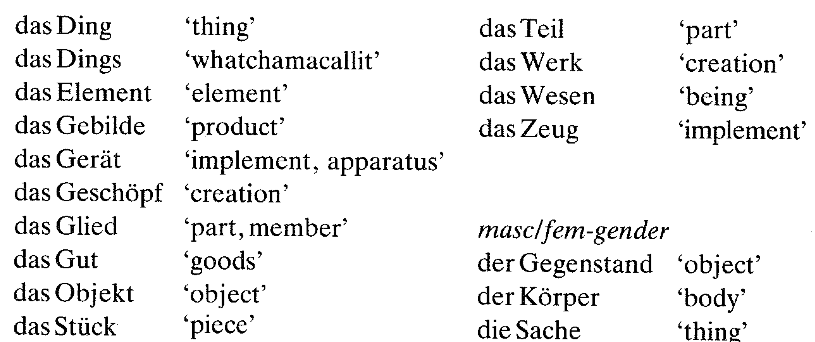
Genders mark the taxonomic level
Zubin and Koepcke 1986 “Gender and folk taxonomy”
German Neuter gender (“das”) used for very abstract words

Slide 43
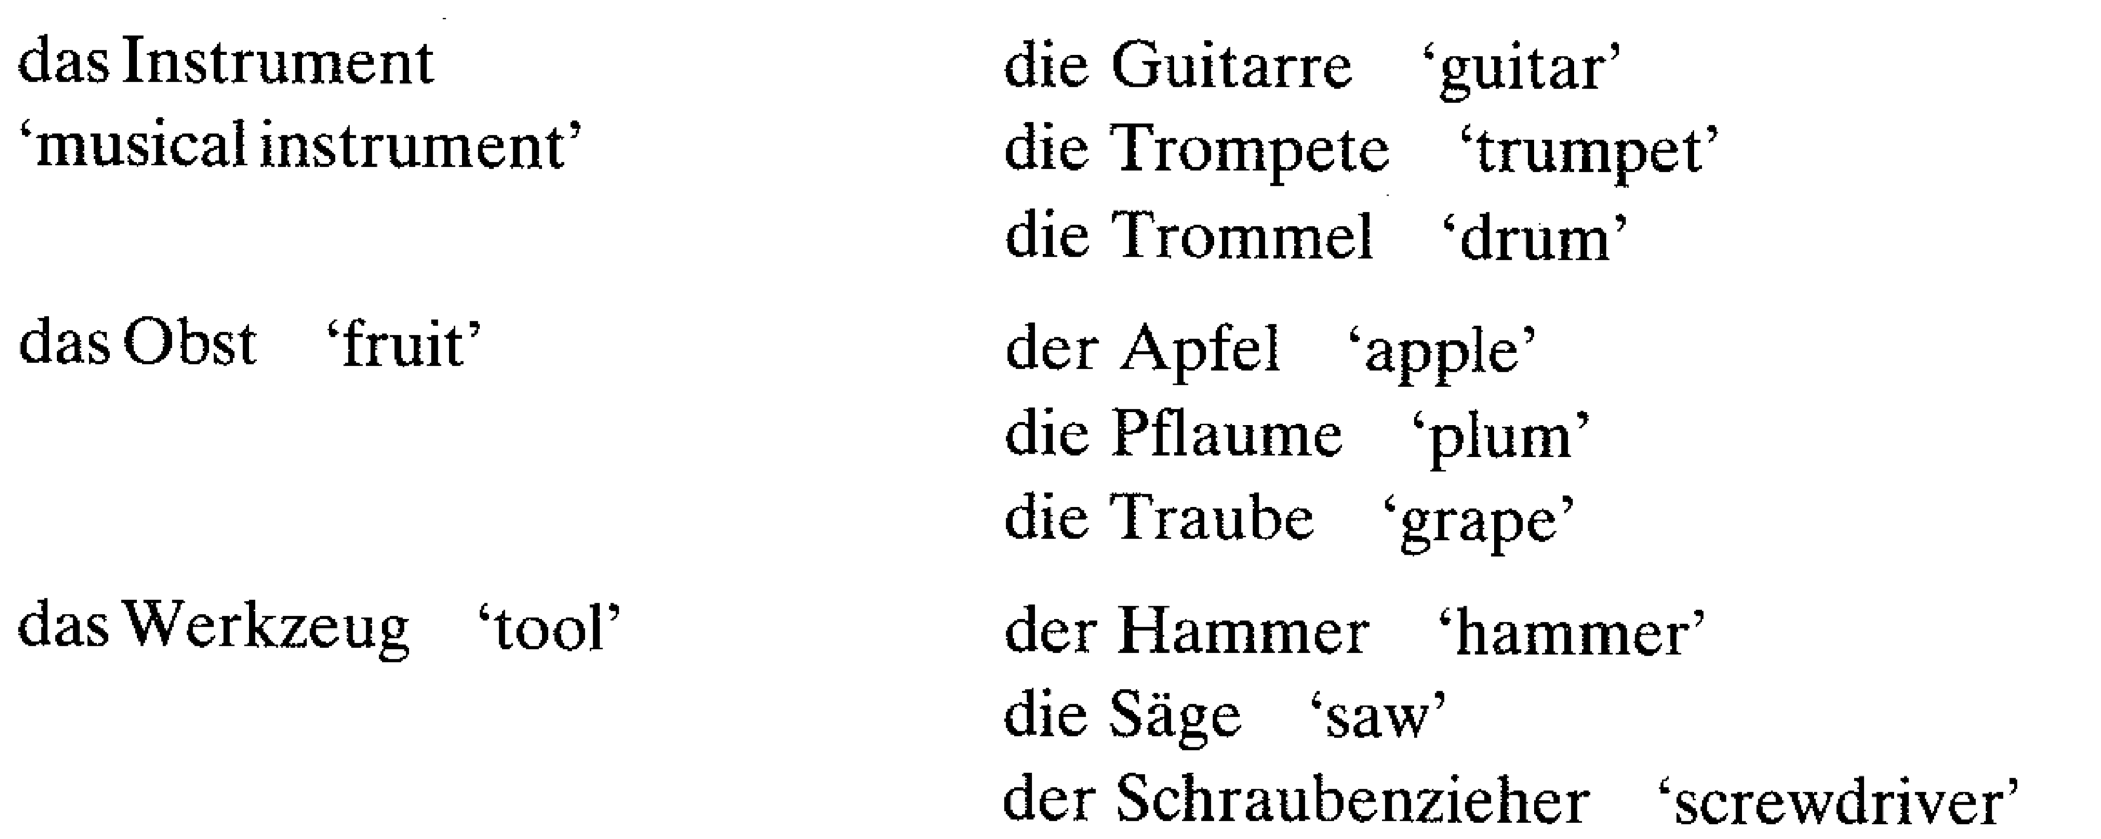
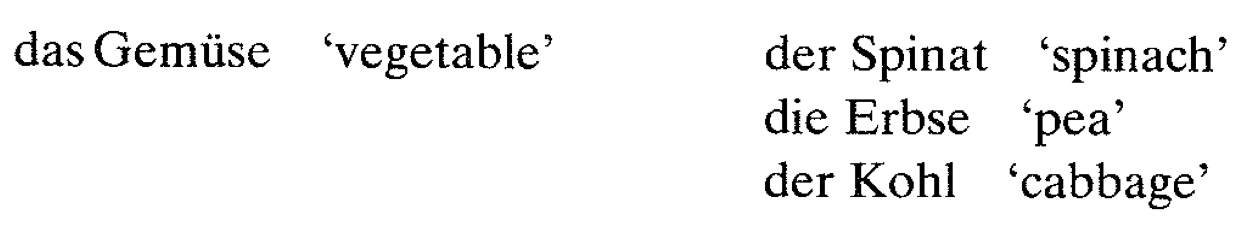
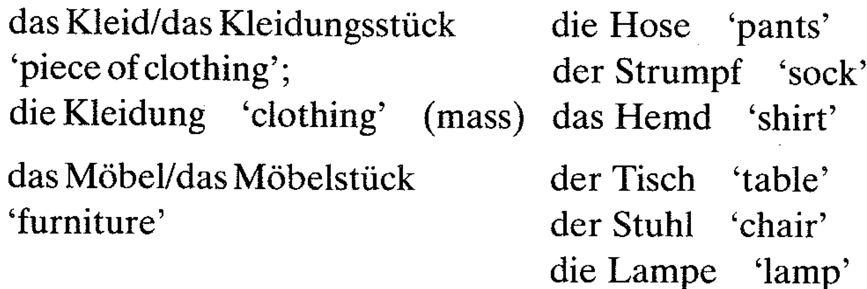
Neuter gender used for superordinates
Superordinate Basic Level

Slide 44
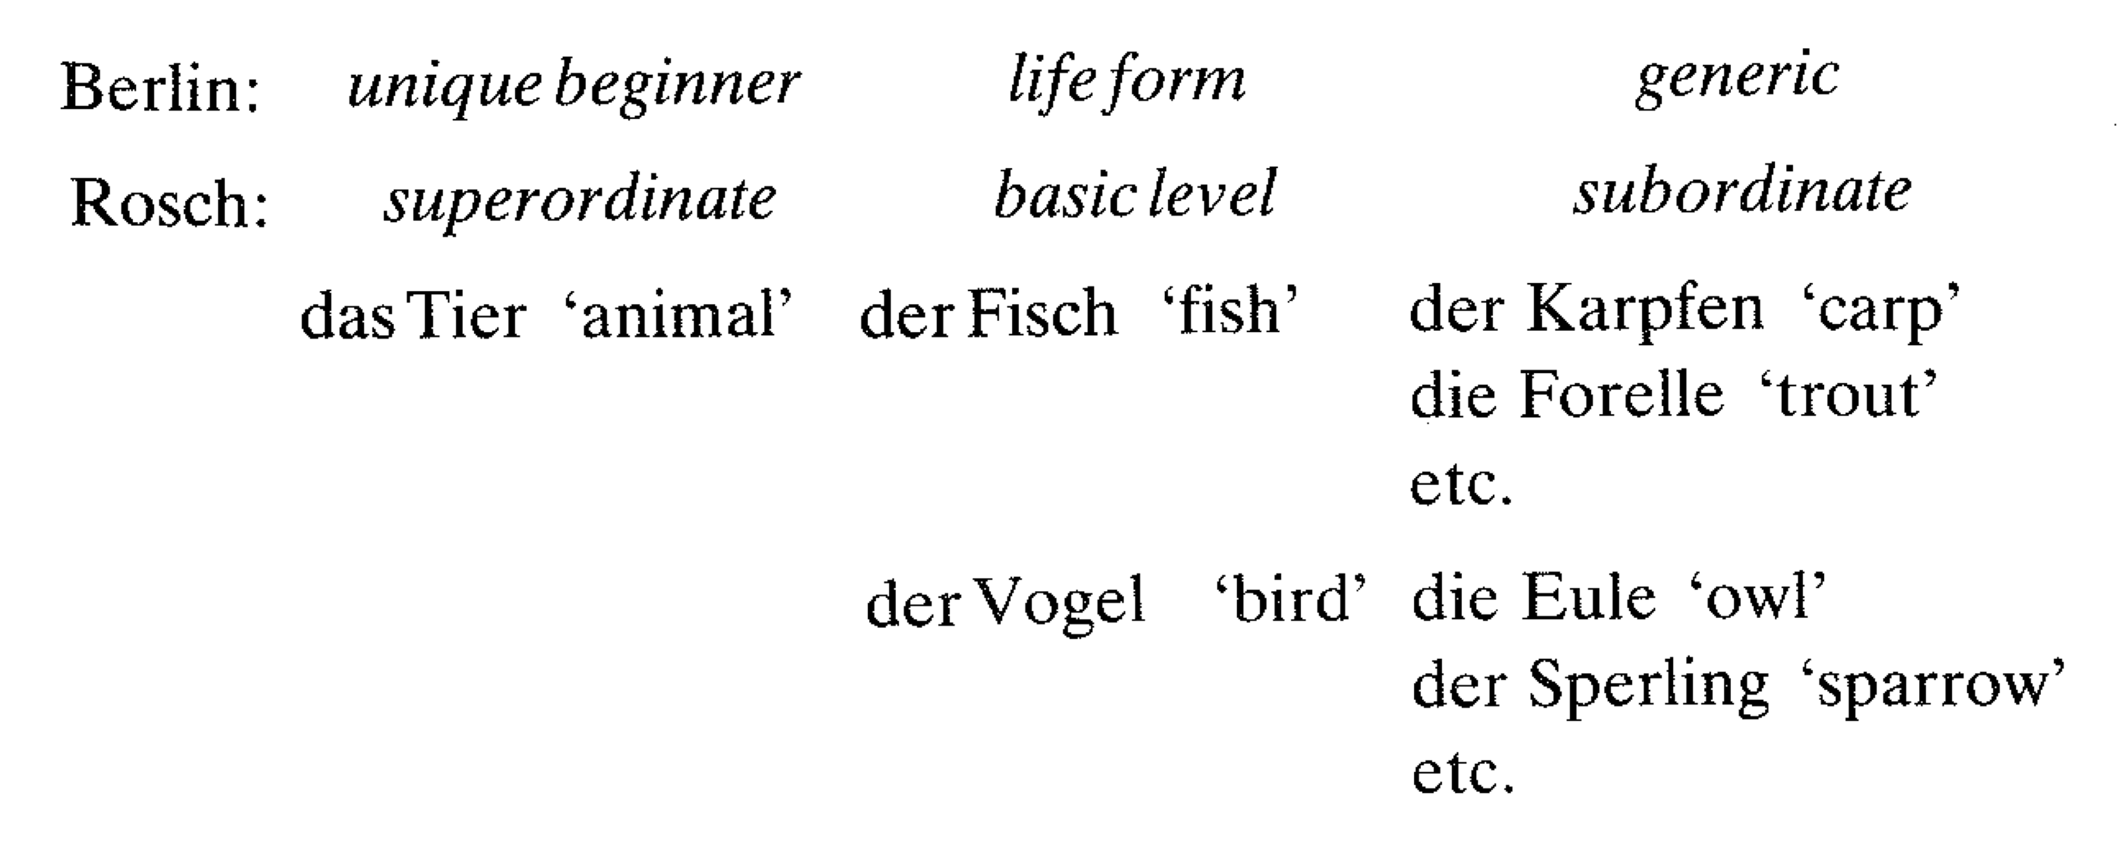
Conflict between Berlin and Rosch definition of basic levels

Slide 45
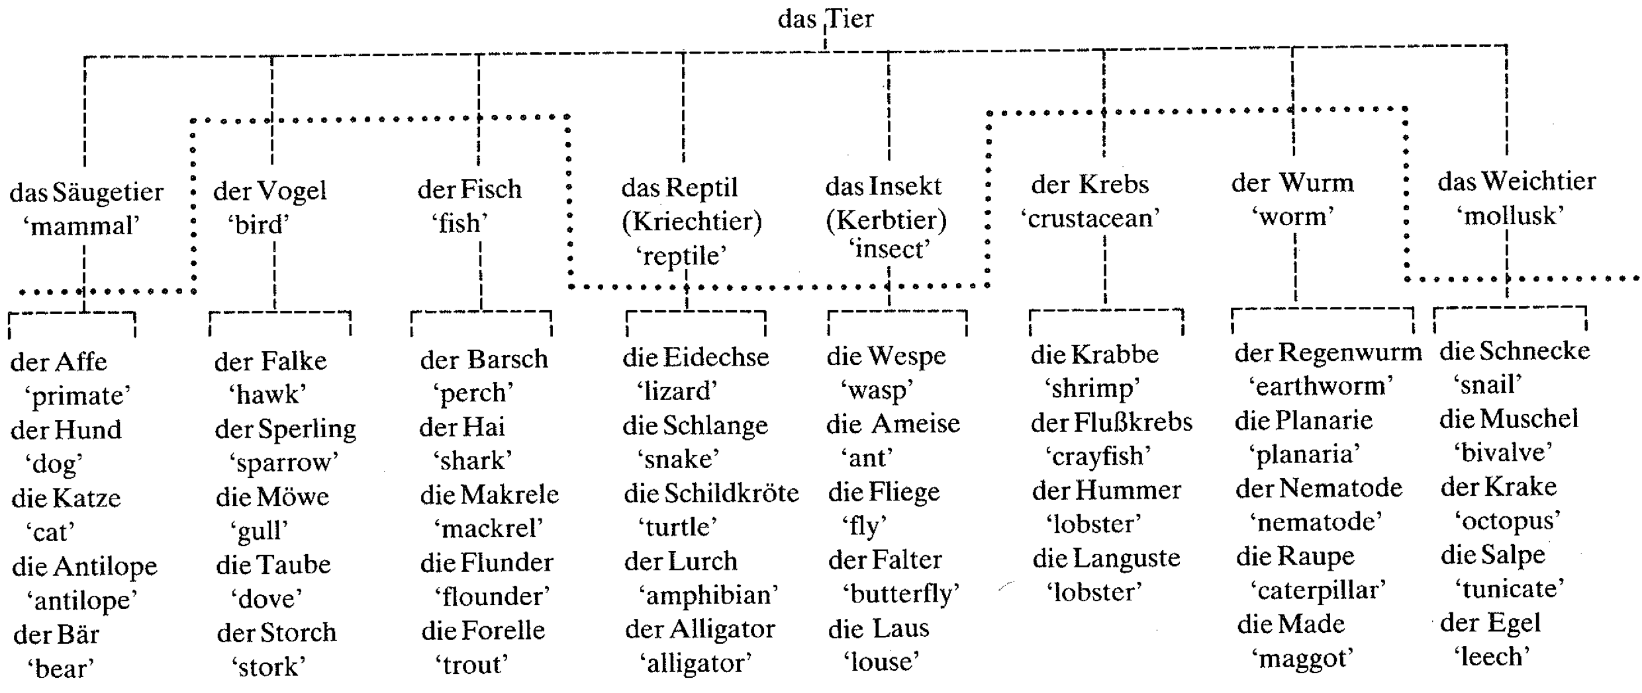
Neuters as superordinate

Slide 46
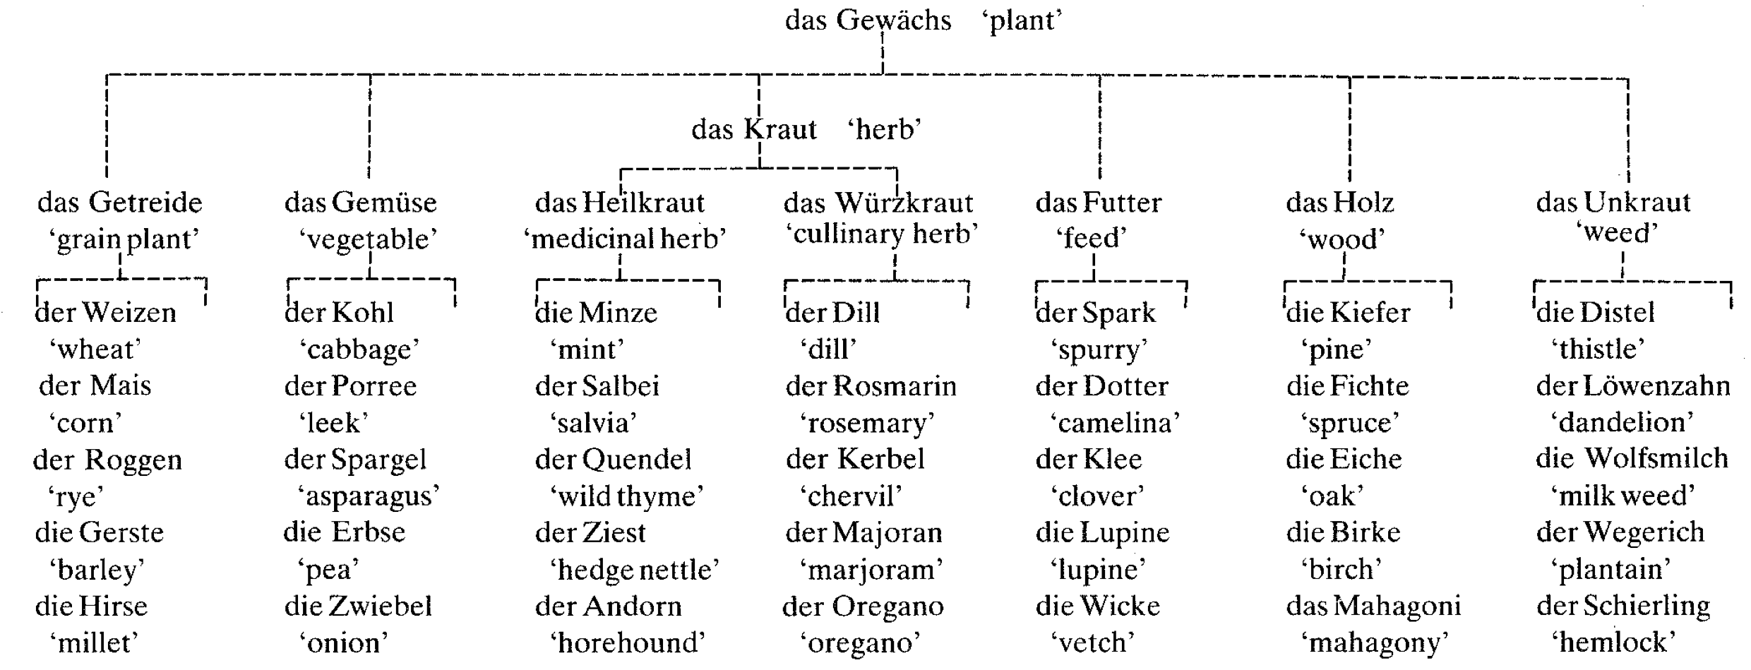
Neuters as superordinate

Slide 47
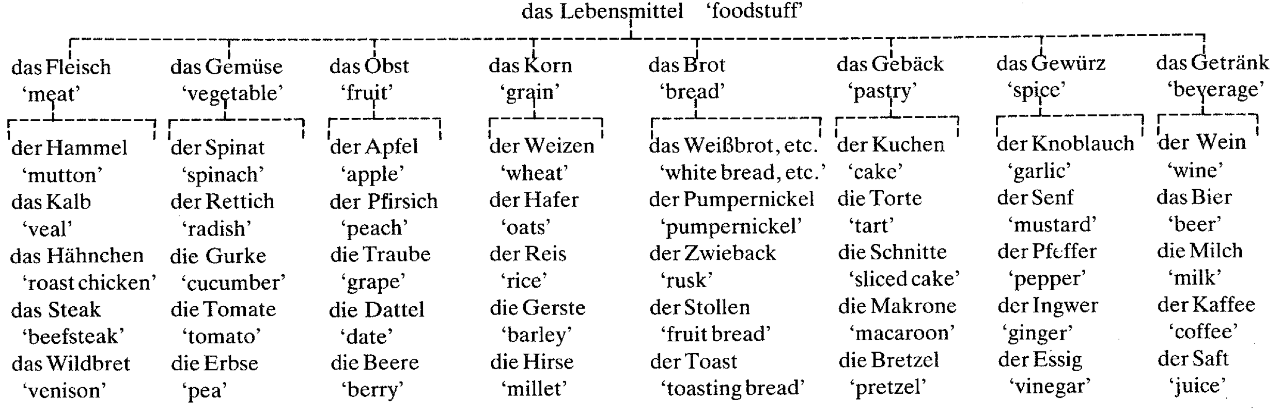
Neuters as superordinate

Slide 48
Yet another problem with classical categories
Categories seem to have internal structure
For example:
  Some members of a category are “better examples” than others

Slide 49
Focal colors: Berlin and Kay
If colors simply had necessary and sufficient conditions
"Blue" would just be anything in a category of particular wavelengths
When Berlin and Kay asked speakers of different languages asked to say what is the “best example” of blue.

Slide 50
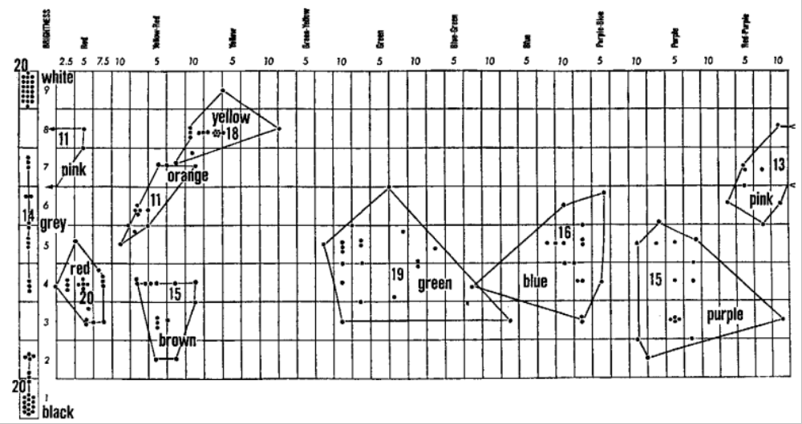
Berlin and Kay 1969: People can tell you the “best” example of blue

Slide 51
Implication
People can tell you which is the “best example” of blue
Means that the category “blue” is not uniform.
It has internal structure of some sort

Slide 52
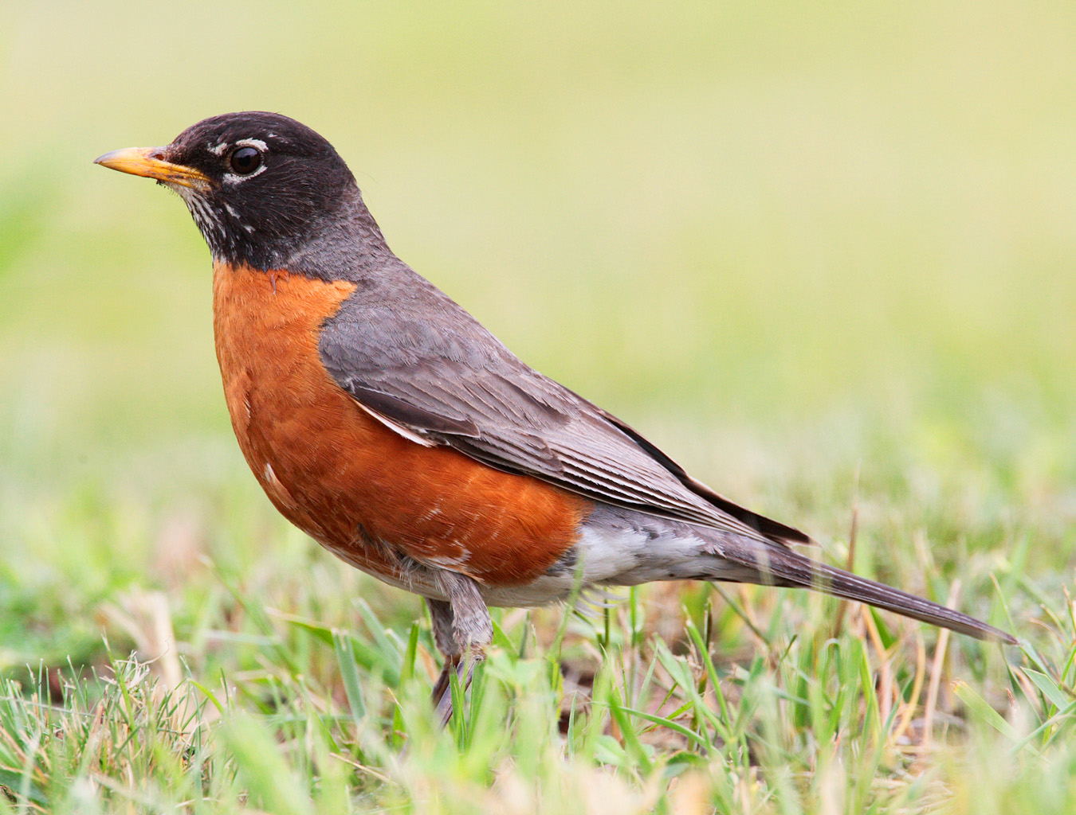
A categorization experiment?
Is this a bird?

Slide 53
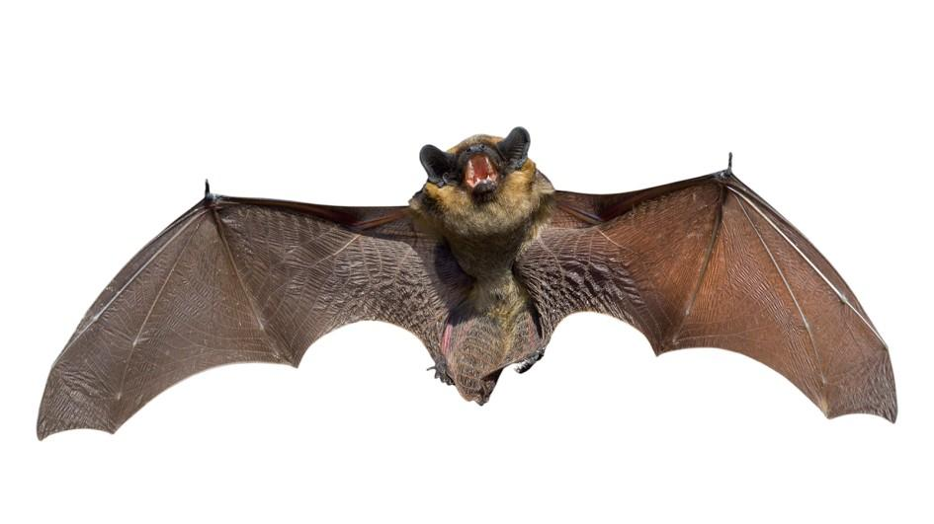
A categorization experiment?
Is this a bird?

Slide 54
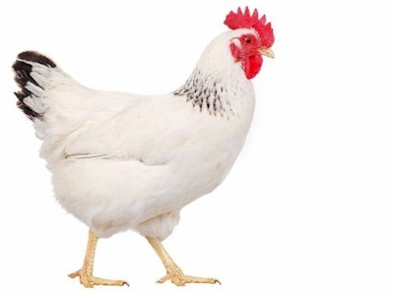
A categorization experiment?
Is this a bird?

Slide 55
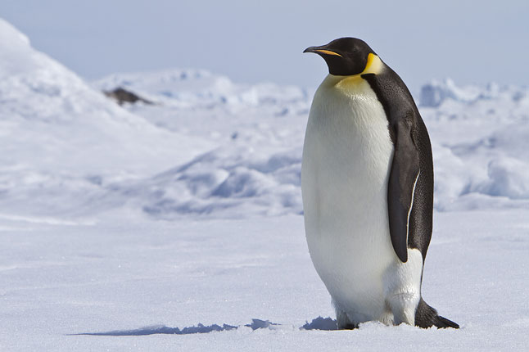
A categorization experiment
Is this a bird?

Slide 56
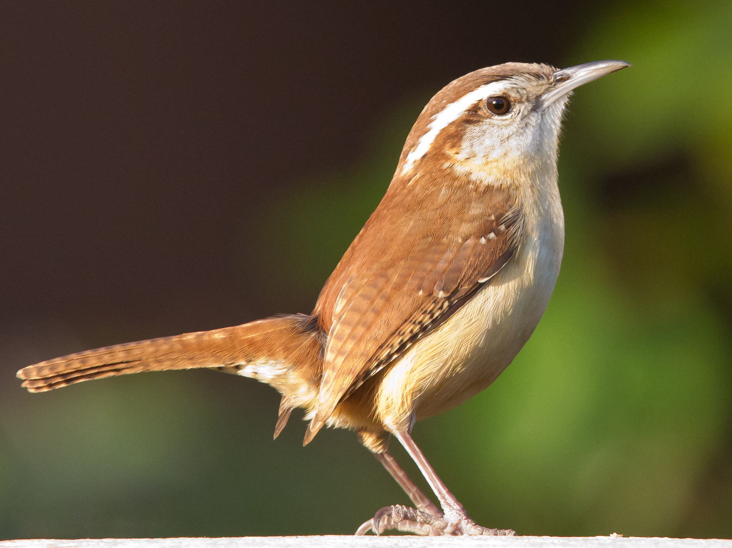
A categorization experiment
Is this a bird?

Slide 57
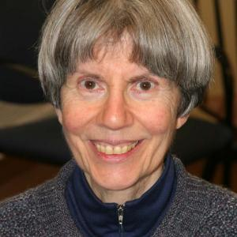
Eleanor Rosch
Psychologist at UC Berkeley
Found that some categories have more “representative members”
She called them “prototypes”
A wide variety of experimental results has shown that concepts exhibit prototype effects
Rosch, E., Mervis, C. B., Gray, W., Johnson, D., & Boyes-Braem, P. (1976). Basic objects in natural categories. Cognitive Psychology, 8, 382-439
Rosch, E., & Mervis, C. B. (1975). Family resemblances: Studies in the internal structure of categories. Cognitive Psychology, 7, 573-605

Slide 58
Prototype effects
Rate the following from 1-7 as examples of vegetables
  1: very good example
  2: good example
  3: fairly good example
  4: moderately good example
  5: fairly poor example
  6: bad example
  7: very bad example/not an example
Turnip, eggplant, rhubarb, pea, zucchini, parsley, potato, lemon, tomato, carrot, cabbage
(Carrot was the prototype, at least for Battig and Montegue 1969)

Slide 59
Goodness of Exemplar tasks: Answer with “Yes” or “No”
All robins are birds
All fish can swim
Some birds can swim
A bat is a bird
All birds can fly
Some birds are fish
An ostrich is a bird
All birds are robins
Measure the time it takes people to answer

Slide 60
Results of these Goodness-of-Exemplar tasks
Order of mention: prototypical member mentioned earlier
Overall frequency: mentioned more frequently
Order of acquisition: prototypical members acquired first by children
Vocabulary learning: is better if definitions of new words rely on prototypes
Speed of verification: faster for prototypes
Direct rating: Participants rate on a scale of 1 to 7 how good an example of a category (e.g., BIRD) something is.
Asymmetry in similarity rating: Less prototypical members are more similar to prototypes than the reverse.

Slide 61
Another problem with classical categories
The focus on necessary and sufficient conditions
Is a focus on attributes or properties as if they exist out there in the world
  Suggests that members of a category are similar because they have similar attributes
  Similarity is what makes them all members
But this ignores the knowledge that people bring to the category.

Slide 62
What makes an animal unclean?
Murphy and Medin 1985 “The role of theories in Conceptual Coherence”
Dietary rules from Leviticus
  Unclean: camels, ostriches, crocodiles, mice, sharks, eels
  Clean: gazelles, frogs, most fish, grasshoppers, some locusts
If these were classical categories, we should be able to come up with shared attributes that make the class of “clean animals” coherent

Slide 63
The “Theory Theory”
Categories are coherent to the extent that humans have a coherent explanatory structure for them
“Gender, Pocky, Noun Classes”
“Things you might study in Food Talks"
Labov’s cup versus mug
  A cup is something whose purpose is drinking and so it should have the appropriate shape for drinking;
  A bowl’s purpose is eating with a spoon
  Our understanding of how and why we interact with cups and mugs explains Labov’s complex equation
  Instead of Labov’s list of arbitrary features: a theory

Slide 64
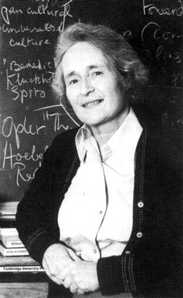
The “Theory Theory” applied to unclean foods
Mary Douglas. 1966. “Purity and Danger”
There should be a correlation between habitat, biological structure, and locomotion
  Creatures of the water should have fins and scales, and swim
  Creatures of the land should have four legs and jump or walk
  Creatures of the air should fly with feathered wings
Hence:
  Ostriches are unclean because they don’t fly
  Crocodiles are unclean because their front appendages look like hands and yet they walk on all fours
  Clean animals don’t cohere by virtue of being similar in visual properties, but by corresponding to the explanatory theory,

Slide 65
A final question about names: who gets to decide?
Is a tomato a fruit or a vegetable?
The idea of the “division of linguistic labor”
The role of the social in determining meaning

Slide 66
“The division of linguistic labor” for meaning: fruit
Botantically: (American Heritage dictionary):
  “The ripened ovary or ovaries of a seed-bearing plant, together with accessory parts, containing the seeds and occurring in a wide variety of forms.”

Slide 67
“The division of linguistic labor” for meaning: fruit
Legally: Supreme court Nix v. Hedden, 149 U.S. 304 (1893)
Is tomato a fruit or a vegetable wrt the Tariff Act of 1883, which taxed imported vegetables but not fruit:
  “The court takes judicial notice of the ordinary meaning of all words in our tongue…Tomatoes are "vegetables," and not "fruit," within the meaning of the Tariff Act …
  …In the common language of the people, whether sellers or consumers of provisions, all these are vegetables which are grown in kitchen gardens, and which, whether eaten cooked or raw, are, like potatoes, carrots, parsnips, turnips, beets, cauliflower, cabbage, celery, and lettuce, usually served at dinner in, with, or after the soup, fish, or meats which constitute the principal part of the repast, and not, like fruits generally, as dessert.

Slide 68
Conclusion: Aspects of word meaning
Meanings are associated with senses of lemmas, not with words
Classical categories
  Necessary and sufficient conditions
  Complex functions of features/properties
Family Resemblance
Prototype effects
Basic Levels
Explanatory theories
Division of linguistic labor

Slide 69
After you finish the reading for next Tuesday:
If you hear someone say:
“Reviewers praised the chef.”
What do you think the reviewers praised?
If the praise was:
“Nice haircut!”
Why is this funny?

