Slide 1
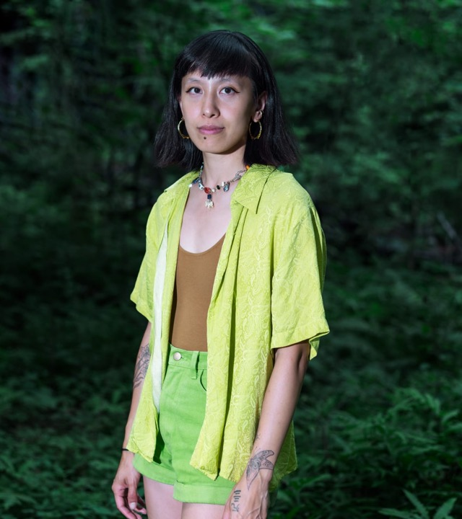
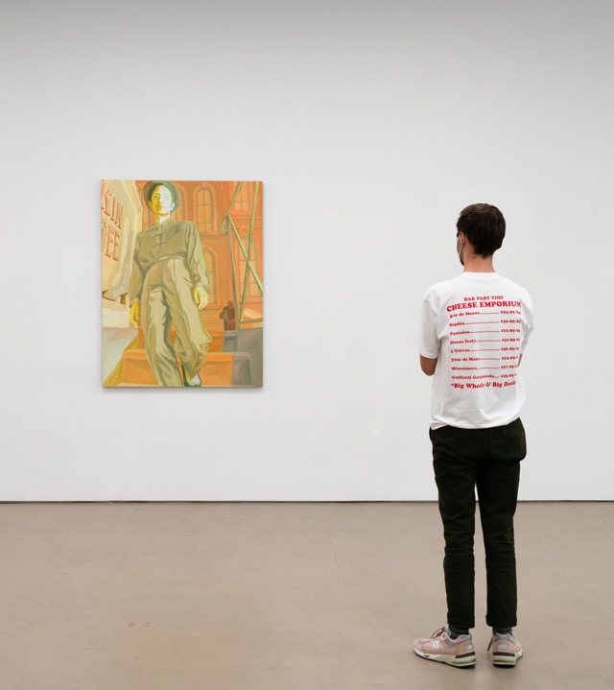
Livien Yin: Thirsty
Halperin Gallery, 211, Aug. 21, 2024 – Feb. 2 2025

Slide 2
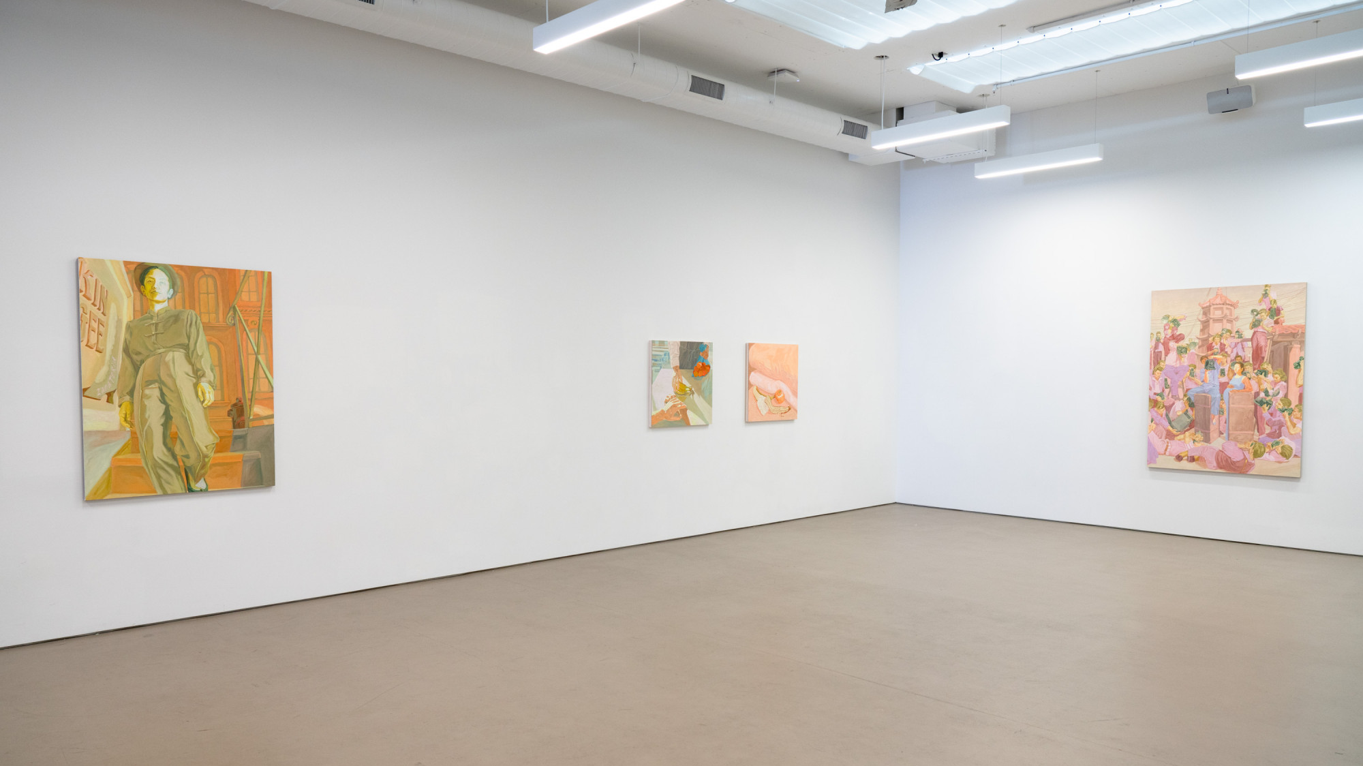
Livien Yin (b. 1990, MA)
-BA from Reed College, MFA from Stanford (2019)
-Headlands Center for the Arts Graduate Fellow
-Currently a Silver Art Projects artist-in-residence (NYC)
-This will be her first solo museum show

Slide 3
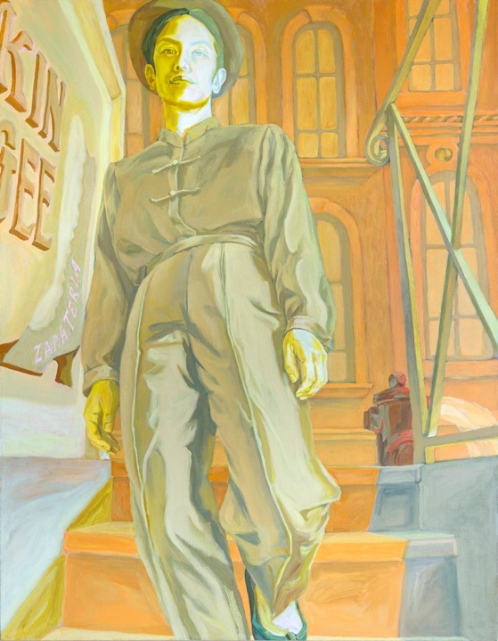
Livien Yin
Kin Gee Zapateria, 2021
Acrylic on linen
42 x 54 inches
Gift of Pamela and David Hornik in support of the Asian American Art Initiative, 2022.39
*Please note: the following artworks are shown as examples and only some are on the checklist at this moment*

Slide 4
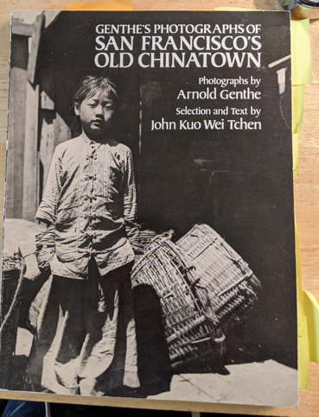
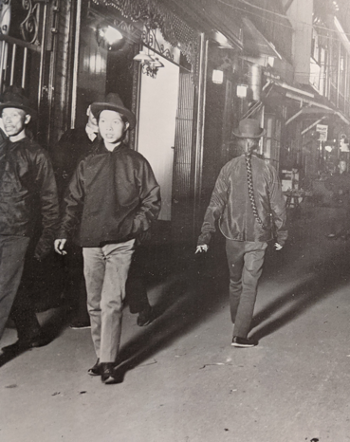
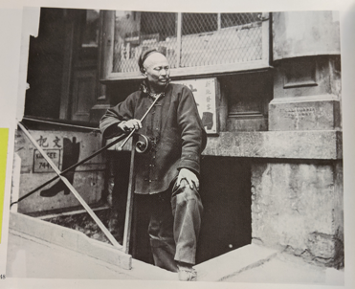
“I was looking at before and after photos of how Arnold Genthe retouched Chinatown scenes, omitted English signage, and presented more exotic views. It was invigorating in a way because I thought if historical photos could shape perceptions of Chinese people to seem more foreign and less assimilable, then I could use painting to reimagine the scenes I’ve encountered and not yet seen in Asian American history.”

Slide 5
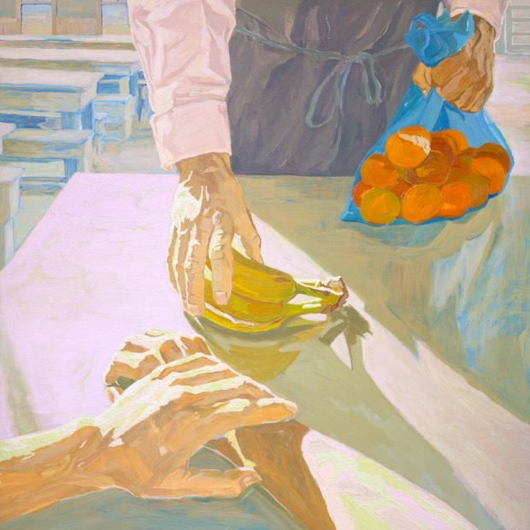
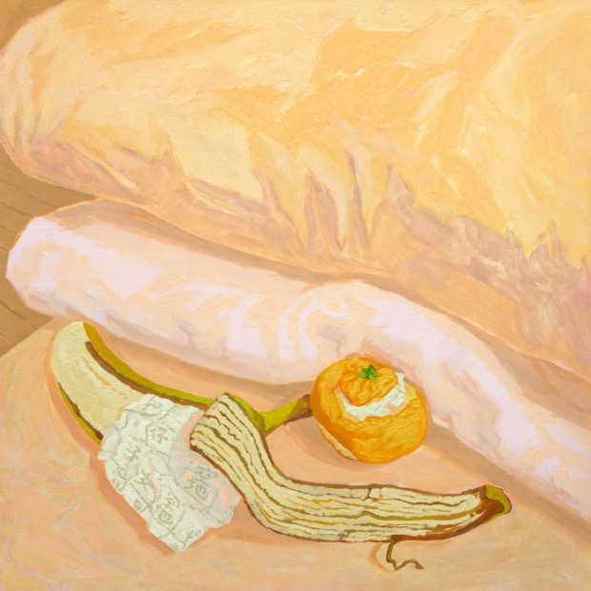
Coaching Notes I, 2021
Acrylic on gessoboard
30 x 30 inches
Coaching Notes II, 2021
Acrylic on gessoboard
30 x 30 inches

Slide 6
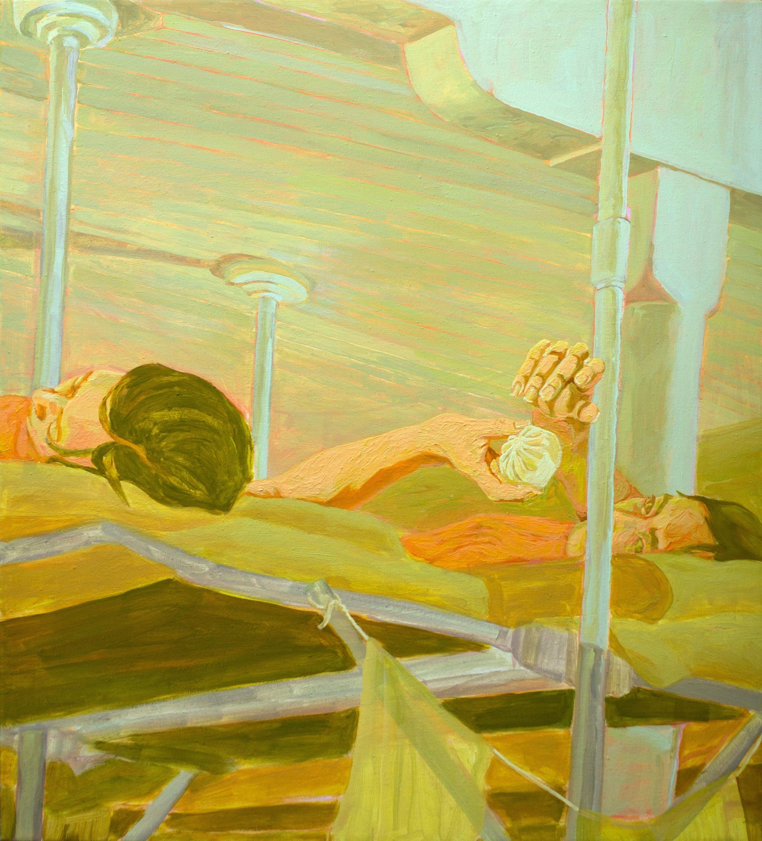
“Views of coaching notes which helped Chinese applicants pass the interrogations at Angel Island Immigration Station. Relatives smuggled notes into Angel Island through gift packages or with the assist of kitchen staff and mutual aid org's formed by detainees. Immigration officials found notes hidden in oranges, bananas, pork buns and peanut shells.”
Key Ideas:
Archival fugitives
Opacity
The concept of “lawlessness”
Precarity
Reimagining the historical
Speculative iconographies
Coaching Notes III, 2022
Flashe & acrylic on linen
38 x 42 in

Slide 7
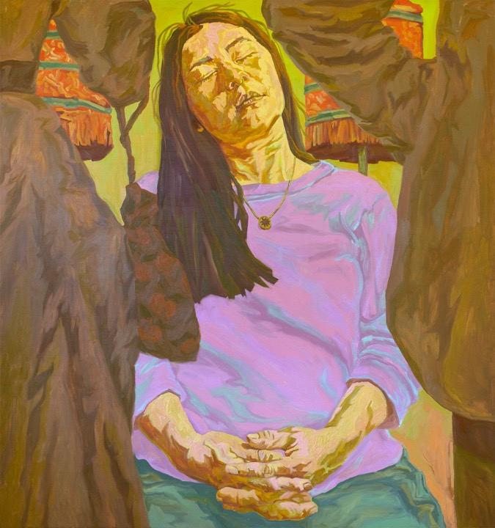
Dreaming, 2022
Oil on canvas
62 x 66 in
“This piece is based on anecdotes of the "Chinese Beauty" who was mostly asleep during her appearance at the 1893 World's Columbian Exposition. I painted my friend Ashley drifting off to sleep in front of fairgoers who expected her visual engagement. It's not known if the original Chinese Beauty was tired, dgaf or chose to defy the expectation to perform but regardless, I loved the idea that she might be daydreaming of where she'd rather be.”

Slide 8
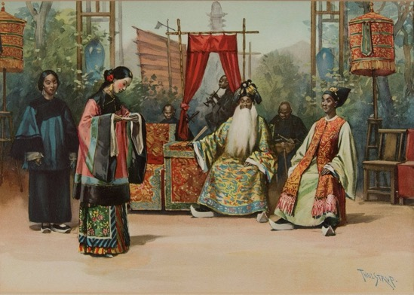
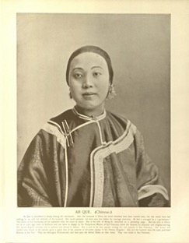
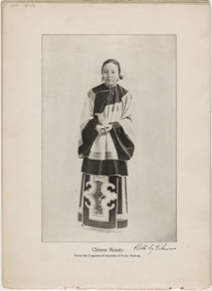

Slide 9
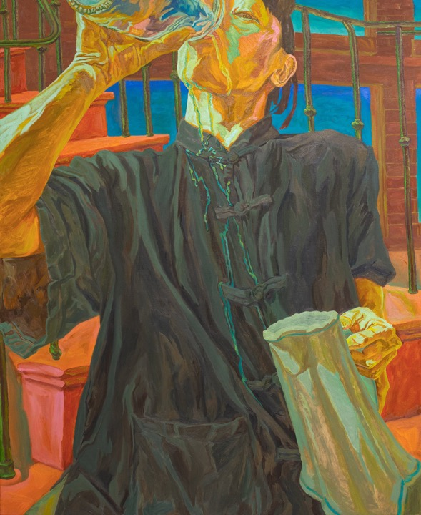
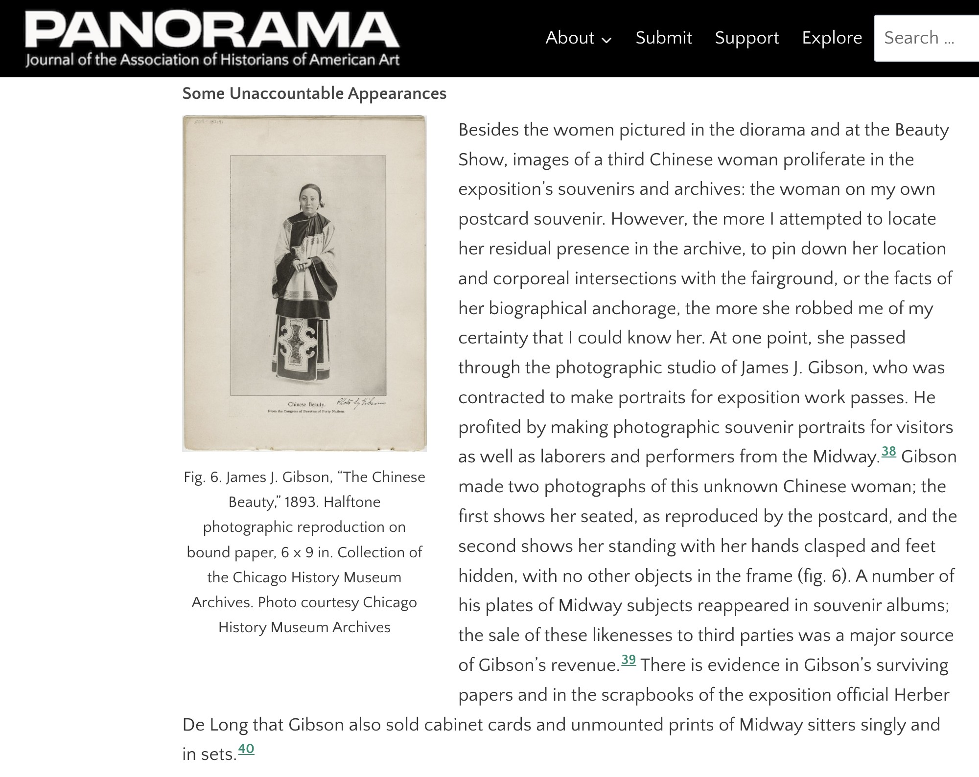
Thirsty No. 3, 2022
Oil on linen
54 x 66 in

Slide 10
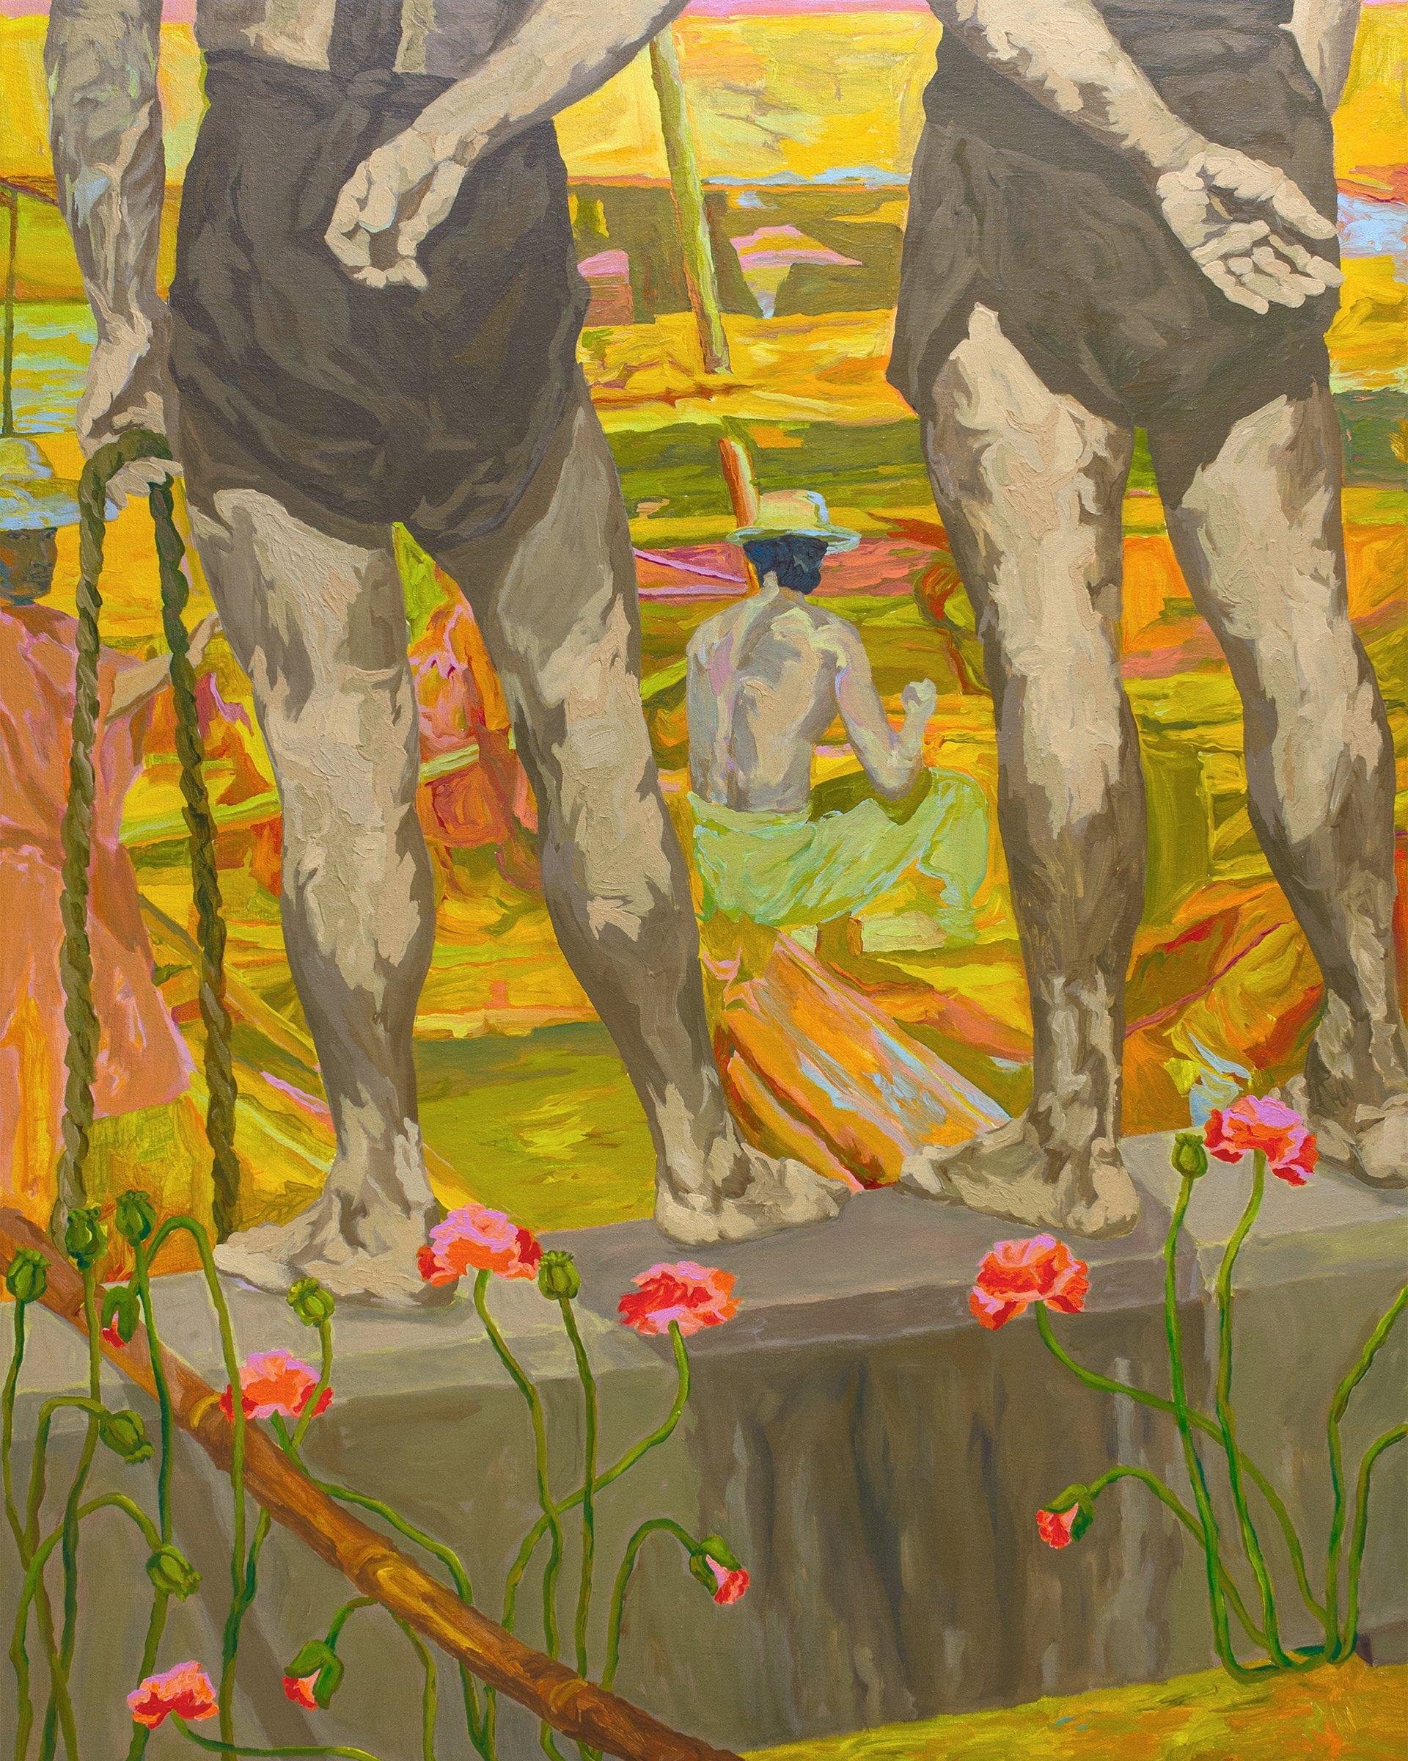
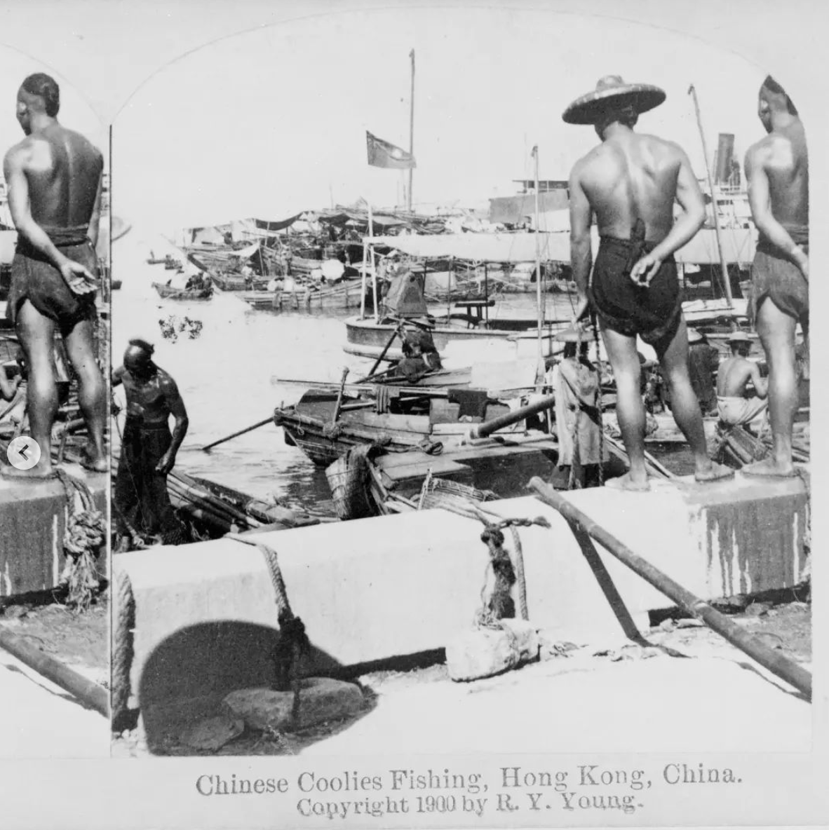
Poppies, 2022
Acrylic on linen
42 x 54 in
‘“Poppies" is based on a 1900 stereograph captioned "Chinese Coolies Fishing, Hong Kong, China." My painting closes in on the view that I imagined the two men to be gazing at. I added poppy flowers growing in the harbor. These poppies consider the role of the British opium trade in fueling the emigration of Asian indentured labor to sites across the Americas.”

Slide 11
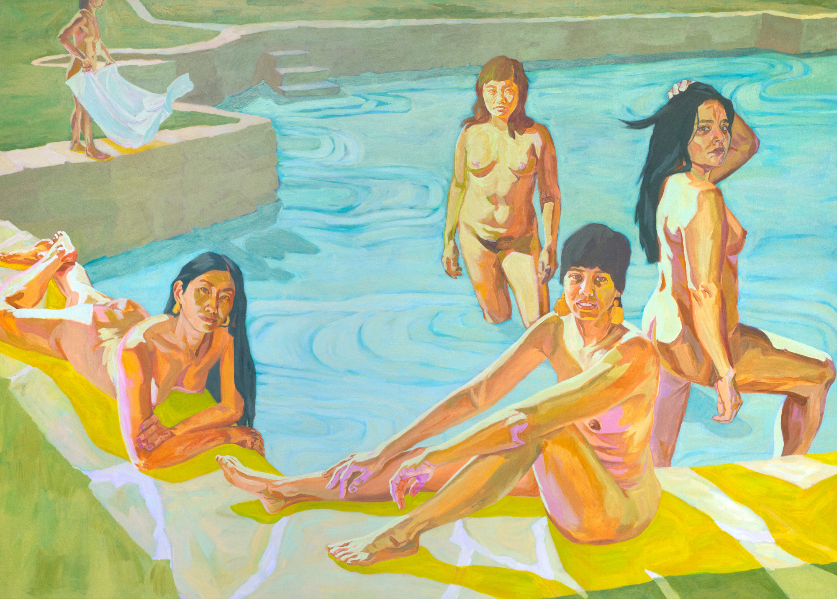
After Washerwoman’s Lagoon, 2021
Acrylic on cotton canvas
84 x 60 inches
San Jose Museum of Art
“Just below the Presidio, where the Marina is now, this small lake had been used by Indigenous and Spanish women to wash clothes, lending to its name. The clamor of the Gold Rush in the 1850s fueled a lucrative demand for garment washing, leading to a proliferation of Chinese laundry businesses by the lagoon and across San Francisco, and then anti-immigration labor sentiment and anti-laundry legislation throughout the city. Yin has recreated this lagoon, depicting Bay Area artists and friends as the lounging sunbathers. In repurposing historical imagery, this site has become a vignette not of labor and racialized anxieties, but of collective care.”

Slide 12
