Slide 1
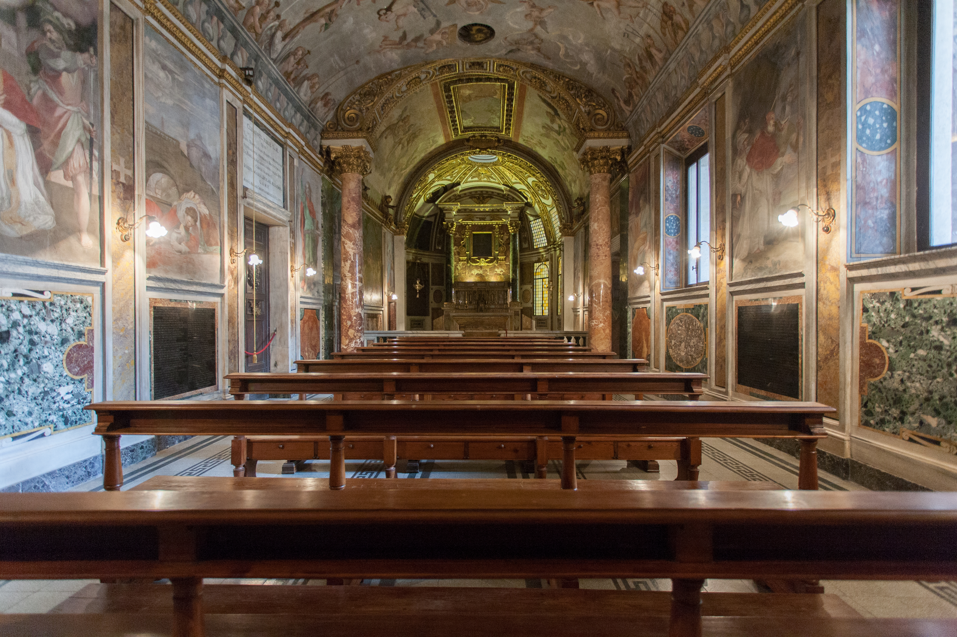
Chiesa di Sant'Aniceto

Slide 2

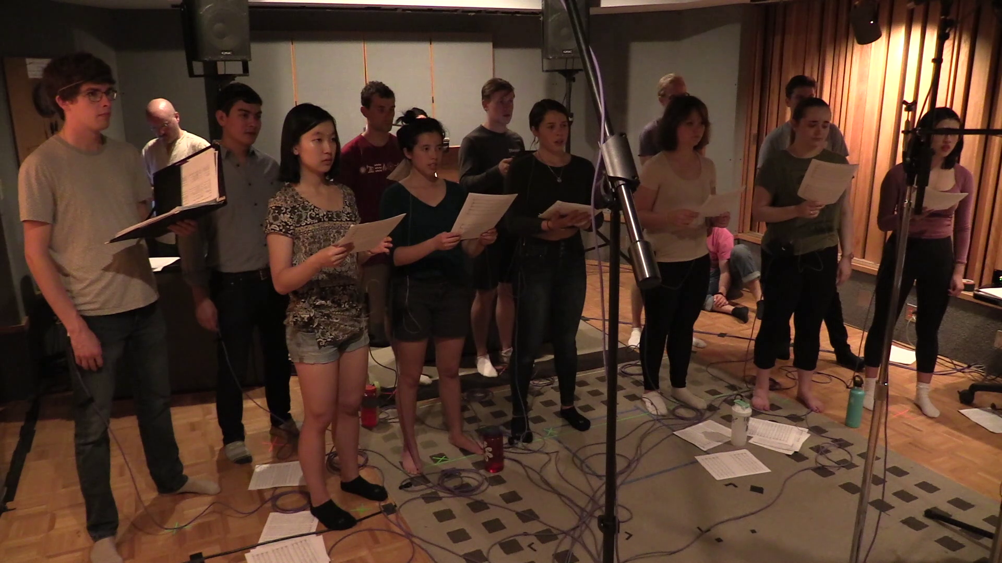
Virtual Sant'Aniceto
Dry Studio
Virtual Model Live in Studio
Virtual Model
Twice the Size of the Original
Live in Studio
For Video Copy/Paste: https://vimeo.com/352994103/d2321e1c04

