Slide 1
Inverse Design Phased Array for LiDAR
Dries Vercruysse, Neil V. Sapra, Logan Su, Rahul Trivedi and Jelena Vuckovic
2019/05/31
Notes:
Thank you for the introduction.
Im DV. And I am a post doc in group of Jelena Vuckovic.

Slide 2
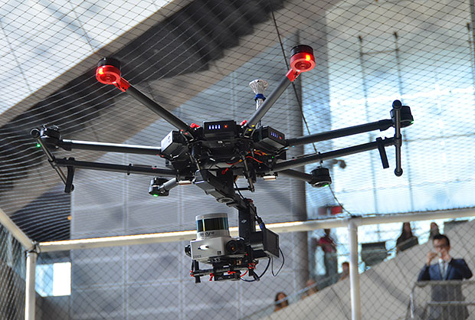
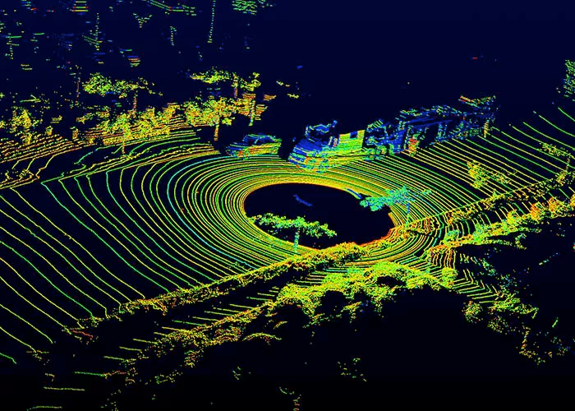

LiDAR
Evan Ackerman/IEEE Spectrum
velodyne
Uploadvr
Notes:
Autonomous vehicles
Drone and robotics: SLAM Simulaneous Localization and Mapping
BIM (building information methods) Building inspection -> AR

Slide 3
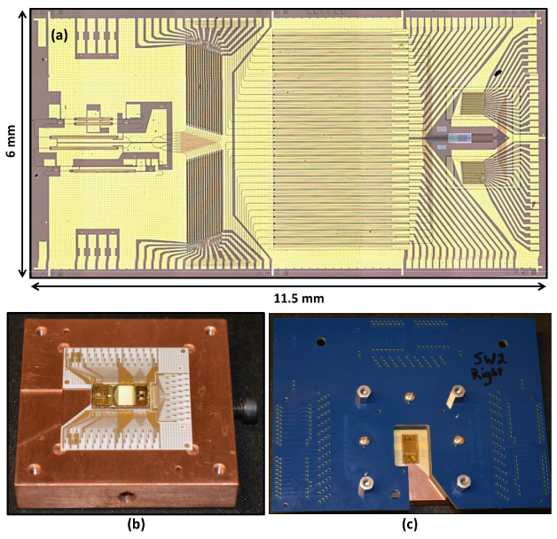
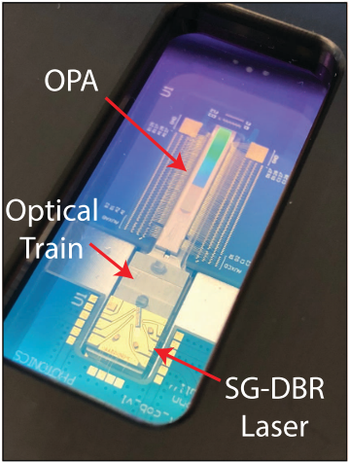
Full integration of LIDAR / beam steerings system
OPA
laser
detector
Hulme JC, et al. Opt Express 2015;23:5861–74
C. V. Poulton, et al., 2018 IEEE 15th International Conference on Group IV Photonics (GFP), Cancun, 2018, pp. 1-2.
Notes:
Hulme 23°transverse 3.6°longitudinal
Watts group 56x15º

Slide 4
Outline
Photonic Inverse design
Optical Phased Array
  Slow light
  Mode converter
  Antenna

Slide 5
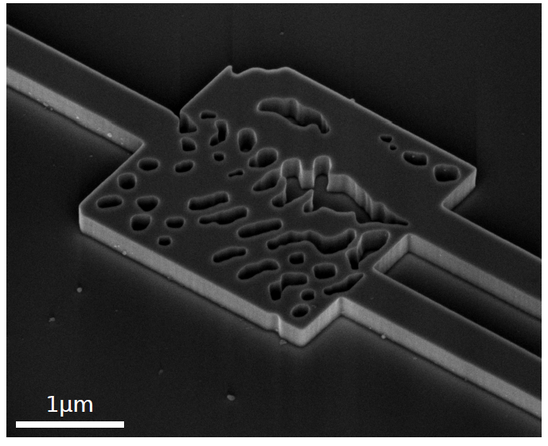
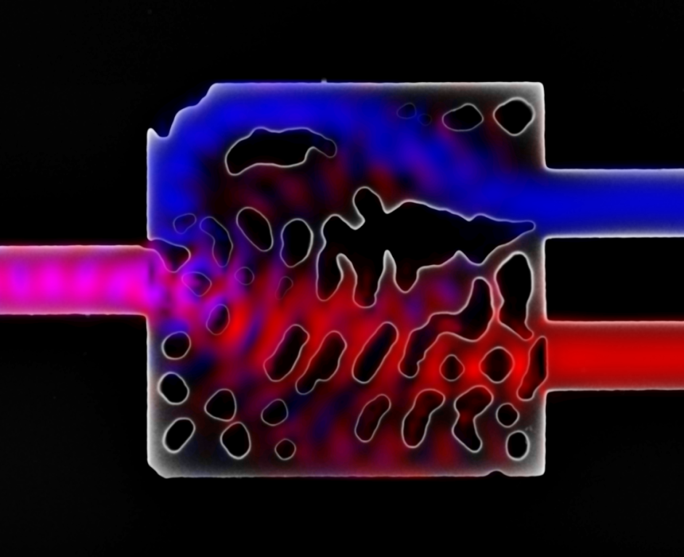
Photonic Inverse Design
2.8𝜇m
1.3𝜇m
1.5𝜇m
Jesse Lu and Jelena Vučković, "Nanophotonic computational design," Opt. Express 21, 13351-13367 (2013)
A. Y. Piggott et al, Nature Photonics 9, 374–377 (2015)
Inverse design in nanophotonics, Sean Molesky, Zin Lin, Alexander Y. Piggott, Weiliang Jin, Jelena Vučković, Alejandro W. Rodriguez, Nature Photonics, vol. 12, pp. 659–670 (2018)
Notes:
Typical device designed with inverse design.
Splitter. Non intuitive pattern. Computer design
Jelena started this 2013 - has attracted a lot attention.

Slide 6
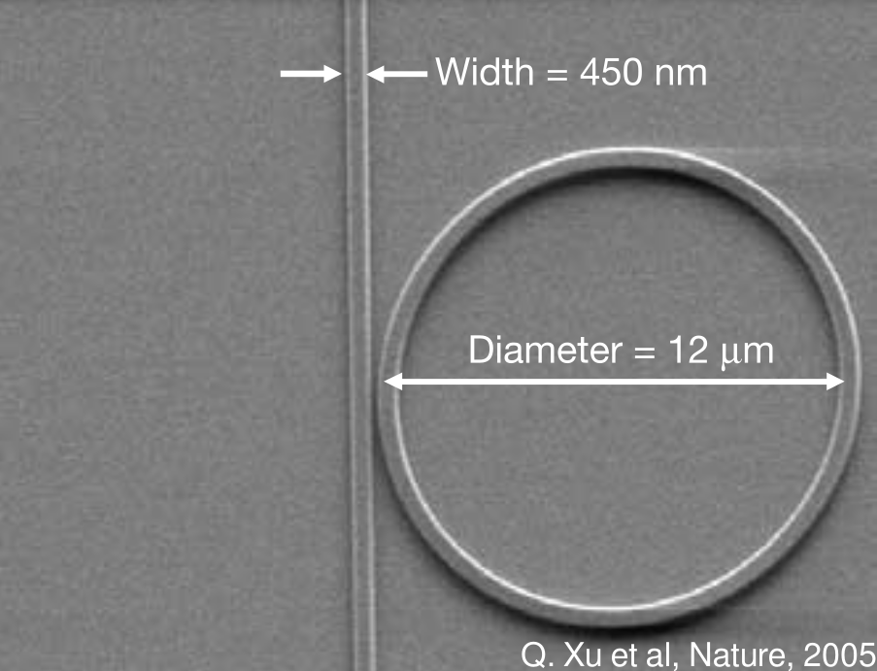
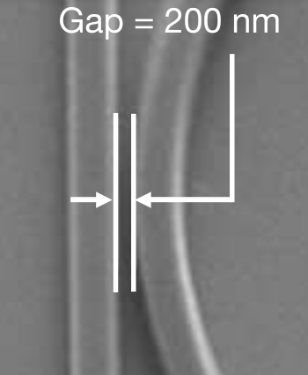
Photonic Design: Classical design
Notes:
filter. Ring resonator. (limited parameters)
(understandable, easy to engineer, not neccary the best, in area and new functionality. )

Slide 7
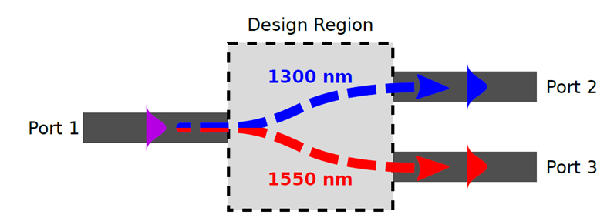
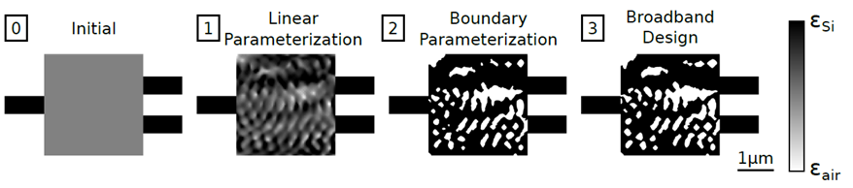
Photonic Design: Inverse Design
A. Y. Piggott et al, Nature Photonics 9, 374–377 (2015)
Notes:
Adjoint
optimizatoin space (2800/40)=4900
2^4900

Slide 8
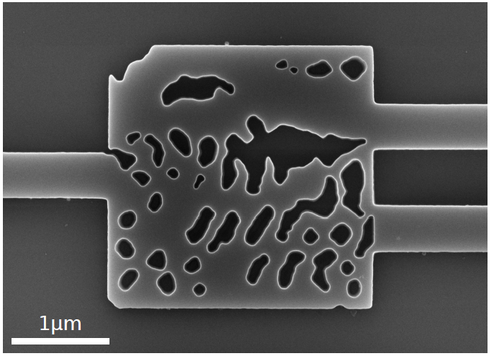
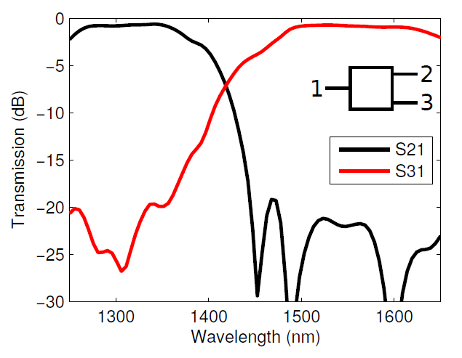
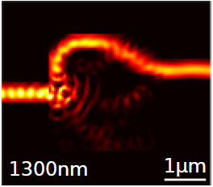
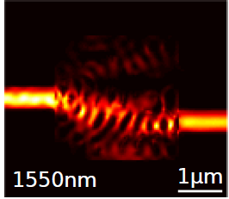
Broadband Splitter
A. Y. Piggott et al, Nature Photonics 9, 374–377 (2015)

Slide 9
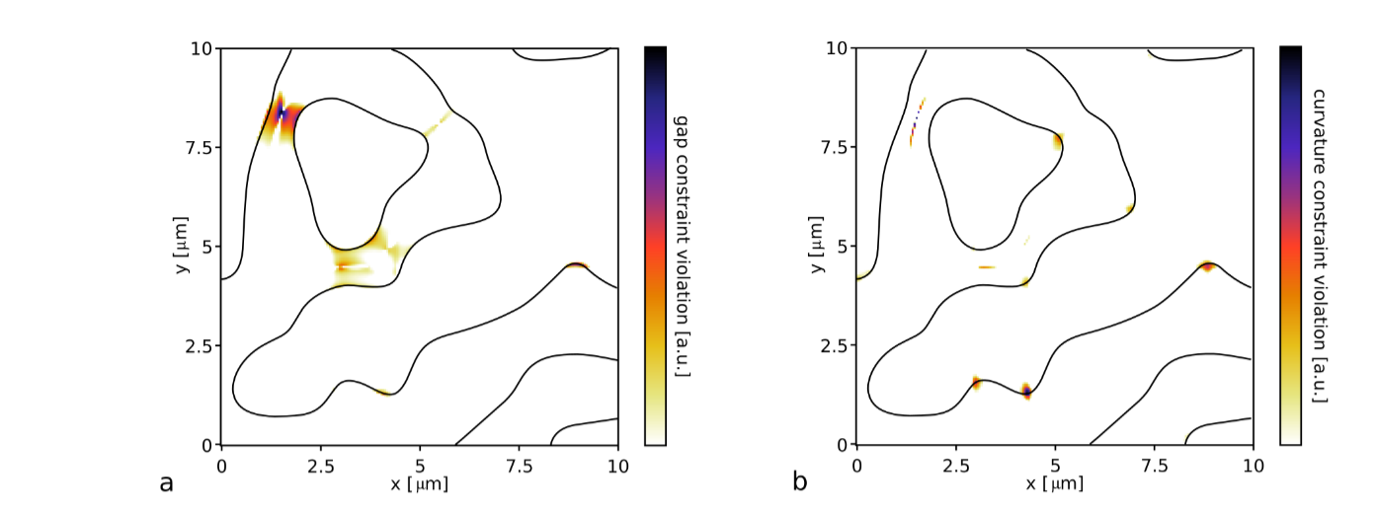
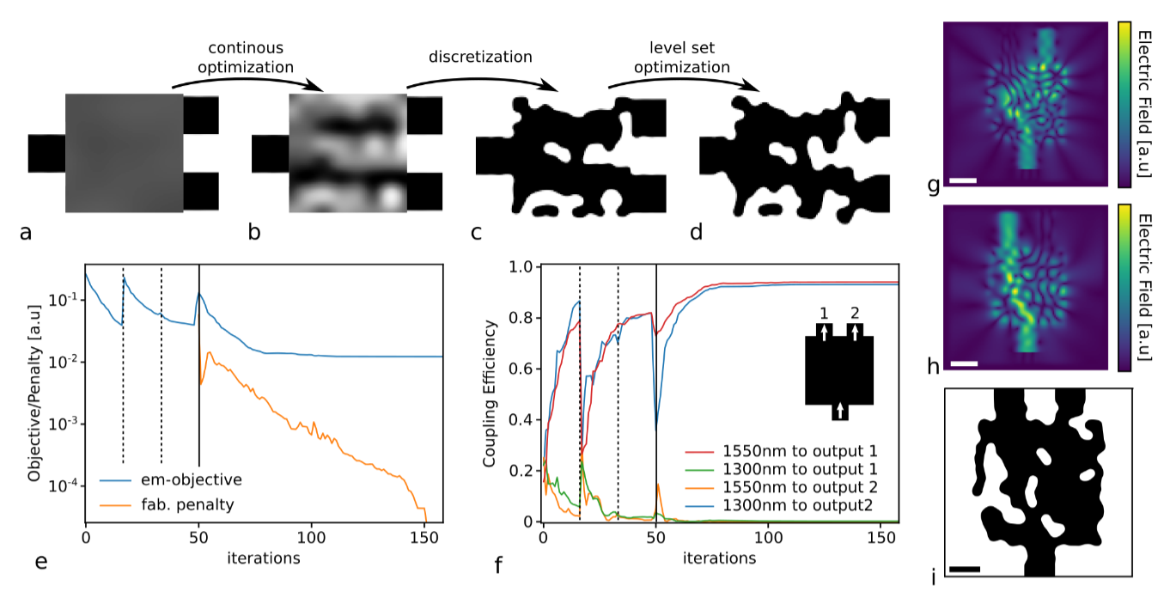
Fabrication Constraints
Gap and Curvature penalty
Waveguide demultiplexer
Dries Vercruysse et al.

Slide 10
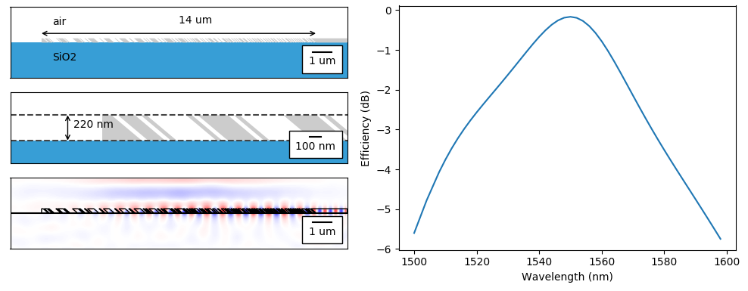
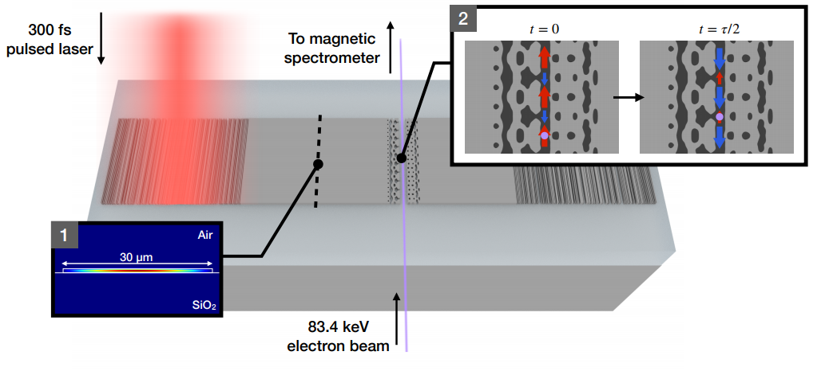
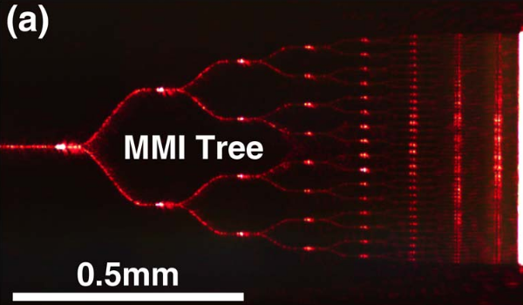
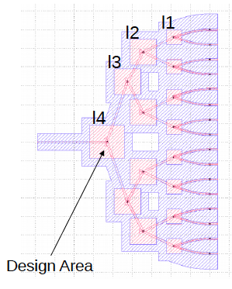
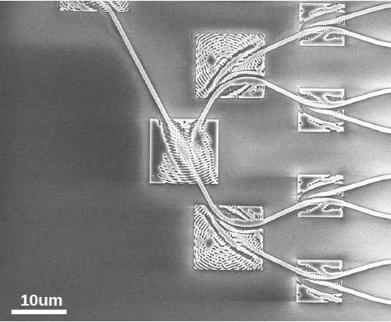
Inverse Design
High efficiency grating couplers
Dielectric Laser Accelerator
Su Logan, et al. Express, 26(4), 4023–4034.
Sapra V. Neil, et al.
Low index contrast (cladded SiN) splitter tree
Poulton et al., Optics Letters, 42(1), 2017
Dries Vercruysse et al.
Notes:
common problem is coulping light: 0.18dB loss for fabricable structures! (97% coupling efficiency)
Very new problem: ACHIP accellaration on chip evanacent field ar optimized so as t have fields that acc
SPitter tree

Slide 11
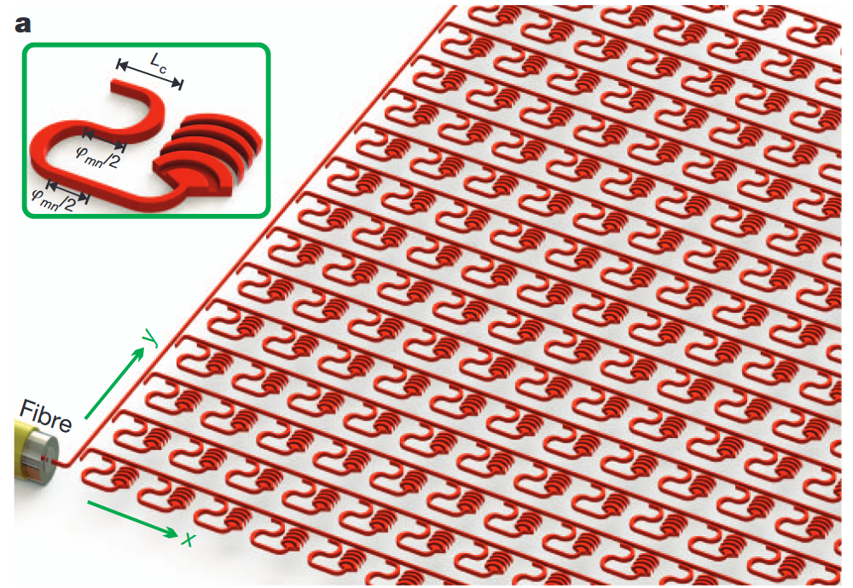
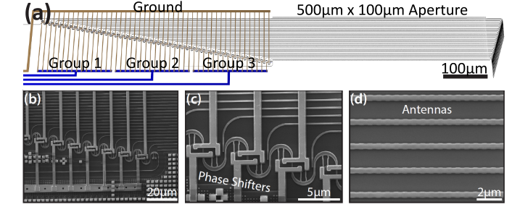
LiDAR / Phased array
2.8𝜇m
1.3𝜇m
1.5𝜇m
Poulton, C. V, et. al Optics Letters, 42(20), 4091. (2017)
Sun, J., Nature, 493(7431), 195–199.
Notes:
Crucial part of a integrated lidar setup
Functionality and denstiy
(Demonstration nice: )

Slide 12
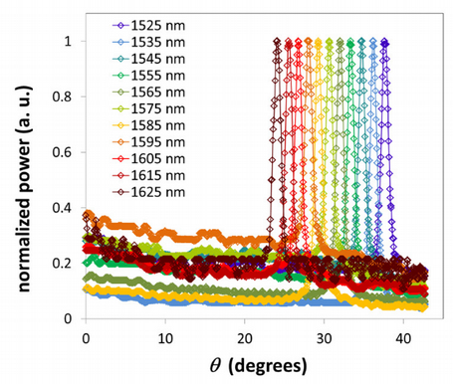
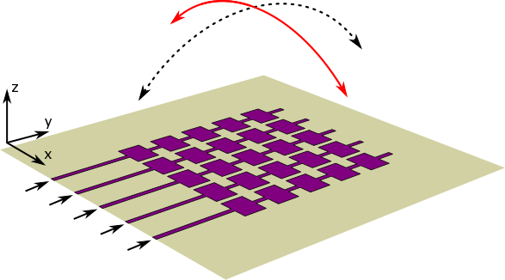
Phased Array with 2D Steering
2D-array
Longitudinal Wavelength steering
Transverse steering: wavelength change
Doylend, J. K., et. al, Optics Express, 19 (22), 21595 (2011)
Longitudinal steering: modulator input phase of a waveguide

Slide 13
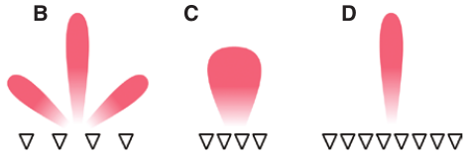
Phased Array Design Challenges
  Small antenna spacing
  Large array size
  Small tuning bandwidth
  Large steering range
M. Heck, Nanophotonics 2017; 6(1): 93–107
Steering range
Tuning bandwidth
Doylend, J. K., et. al, Optics Express, 19 (22), 21595 (2011)

Slide 14

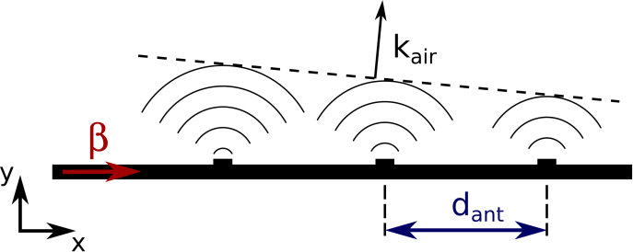
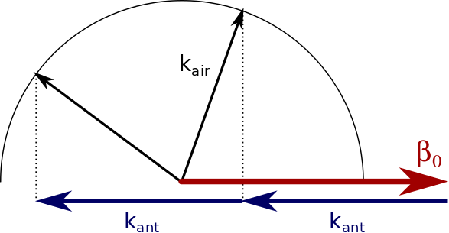
Wavelength v. Steering range
Grating equation:
k_{ant}=2𝜋/d_{ant}

Slide 15
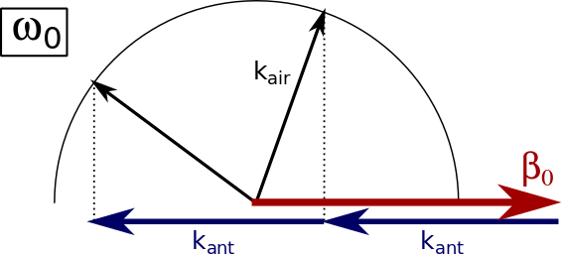
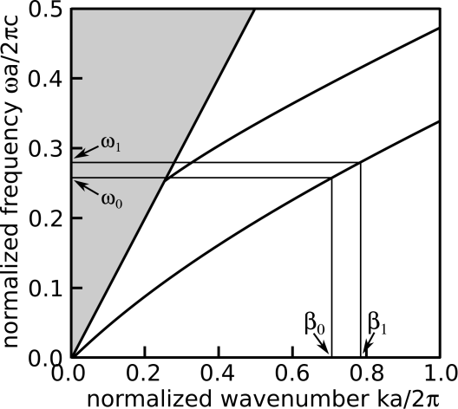
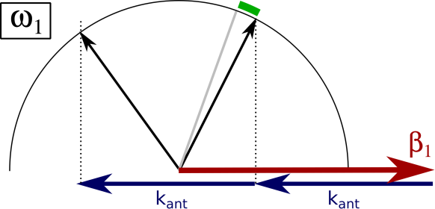
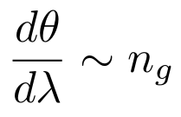
Wavelength vs. Steering range
Strip waveguide

Slide 16
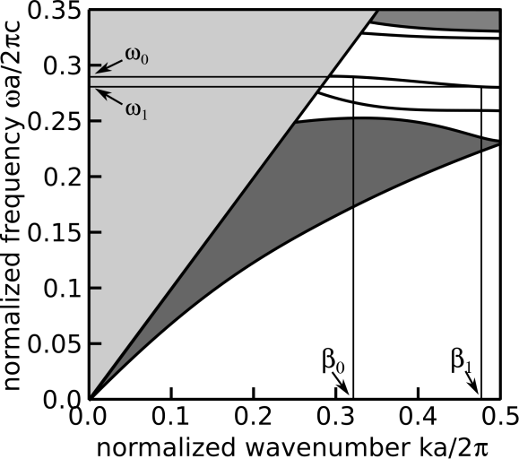
Wavelength v. Steering range
Strip waveguide
Slow light waveguide
Takeuchi M. et al., Optics Express, 26(9), 11529. (2018)
Abe, H., et al., Optics Express, 26(8), 9389. (2018)

Slide 17
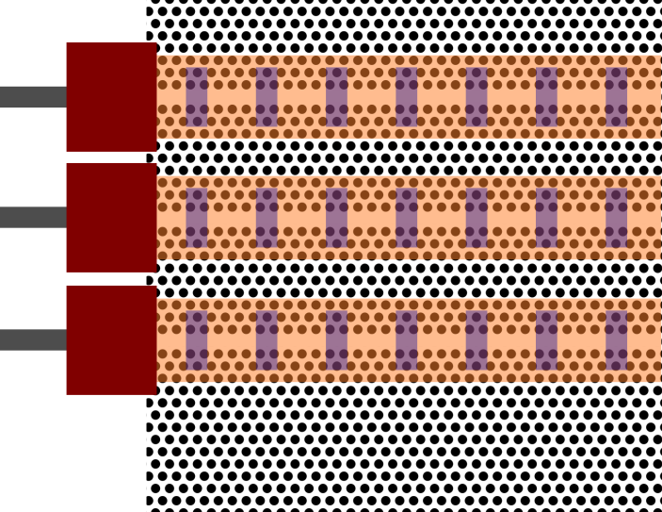
Slow Light Inverse Designed Phased Array
Dispersion engineered waveguide
Slow light mode converter
Periodic scatterers

Slide 18
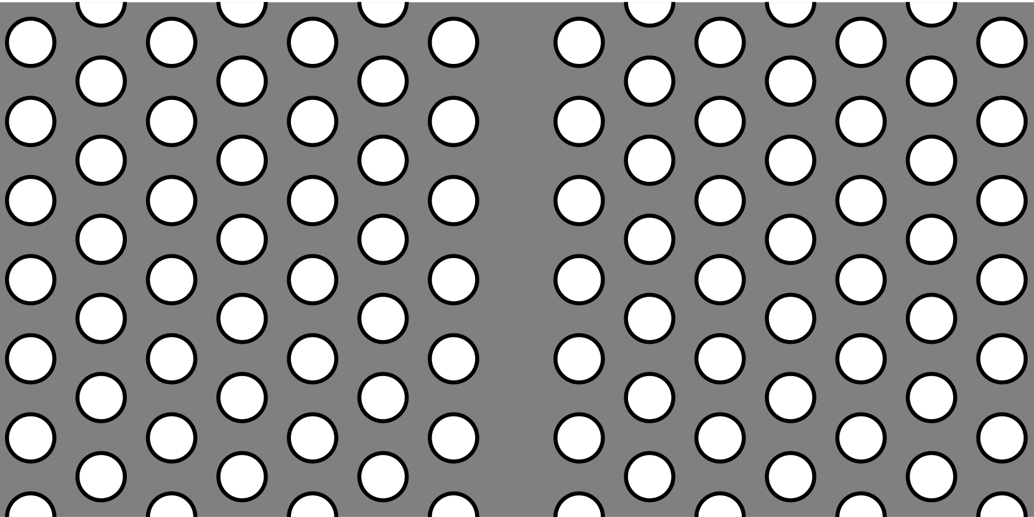
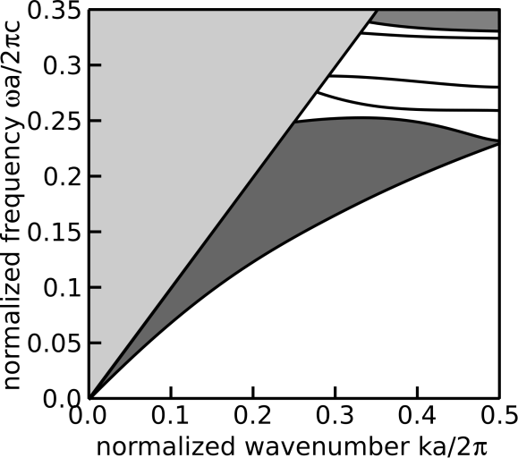
Dispersion Engineered Waveguide
Photonic crystal waveguide
2.8𝜇m
B
1.3𝜇m
A
1.5𝜇m
A
B

Slide 19
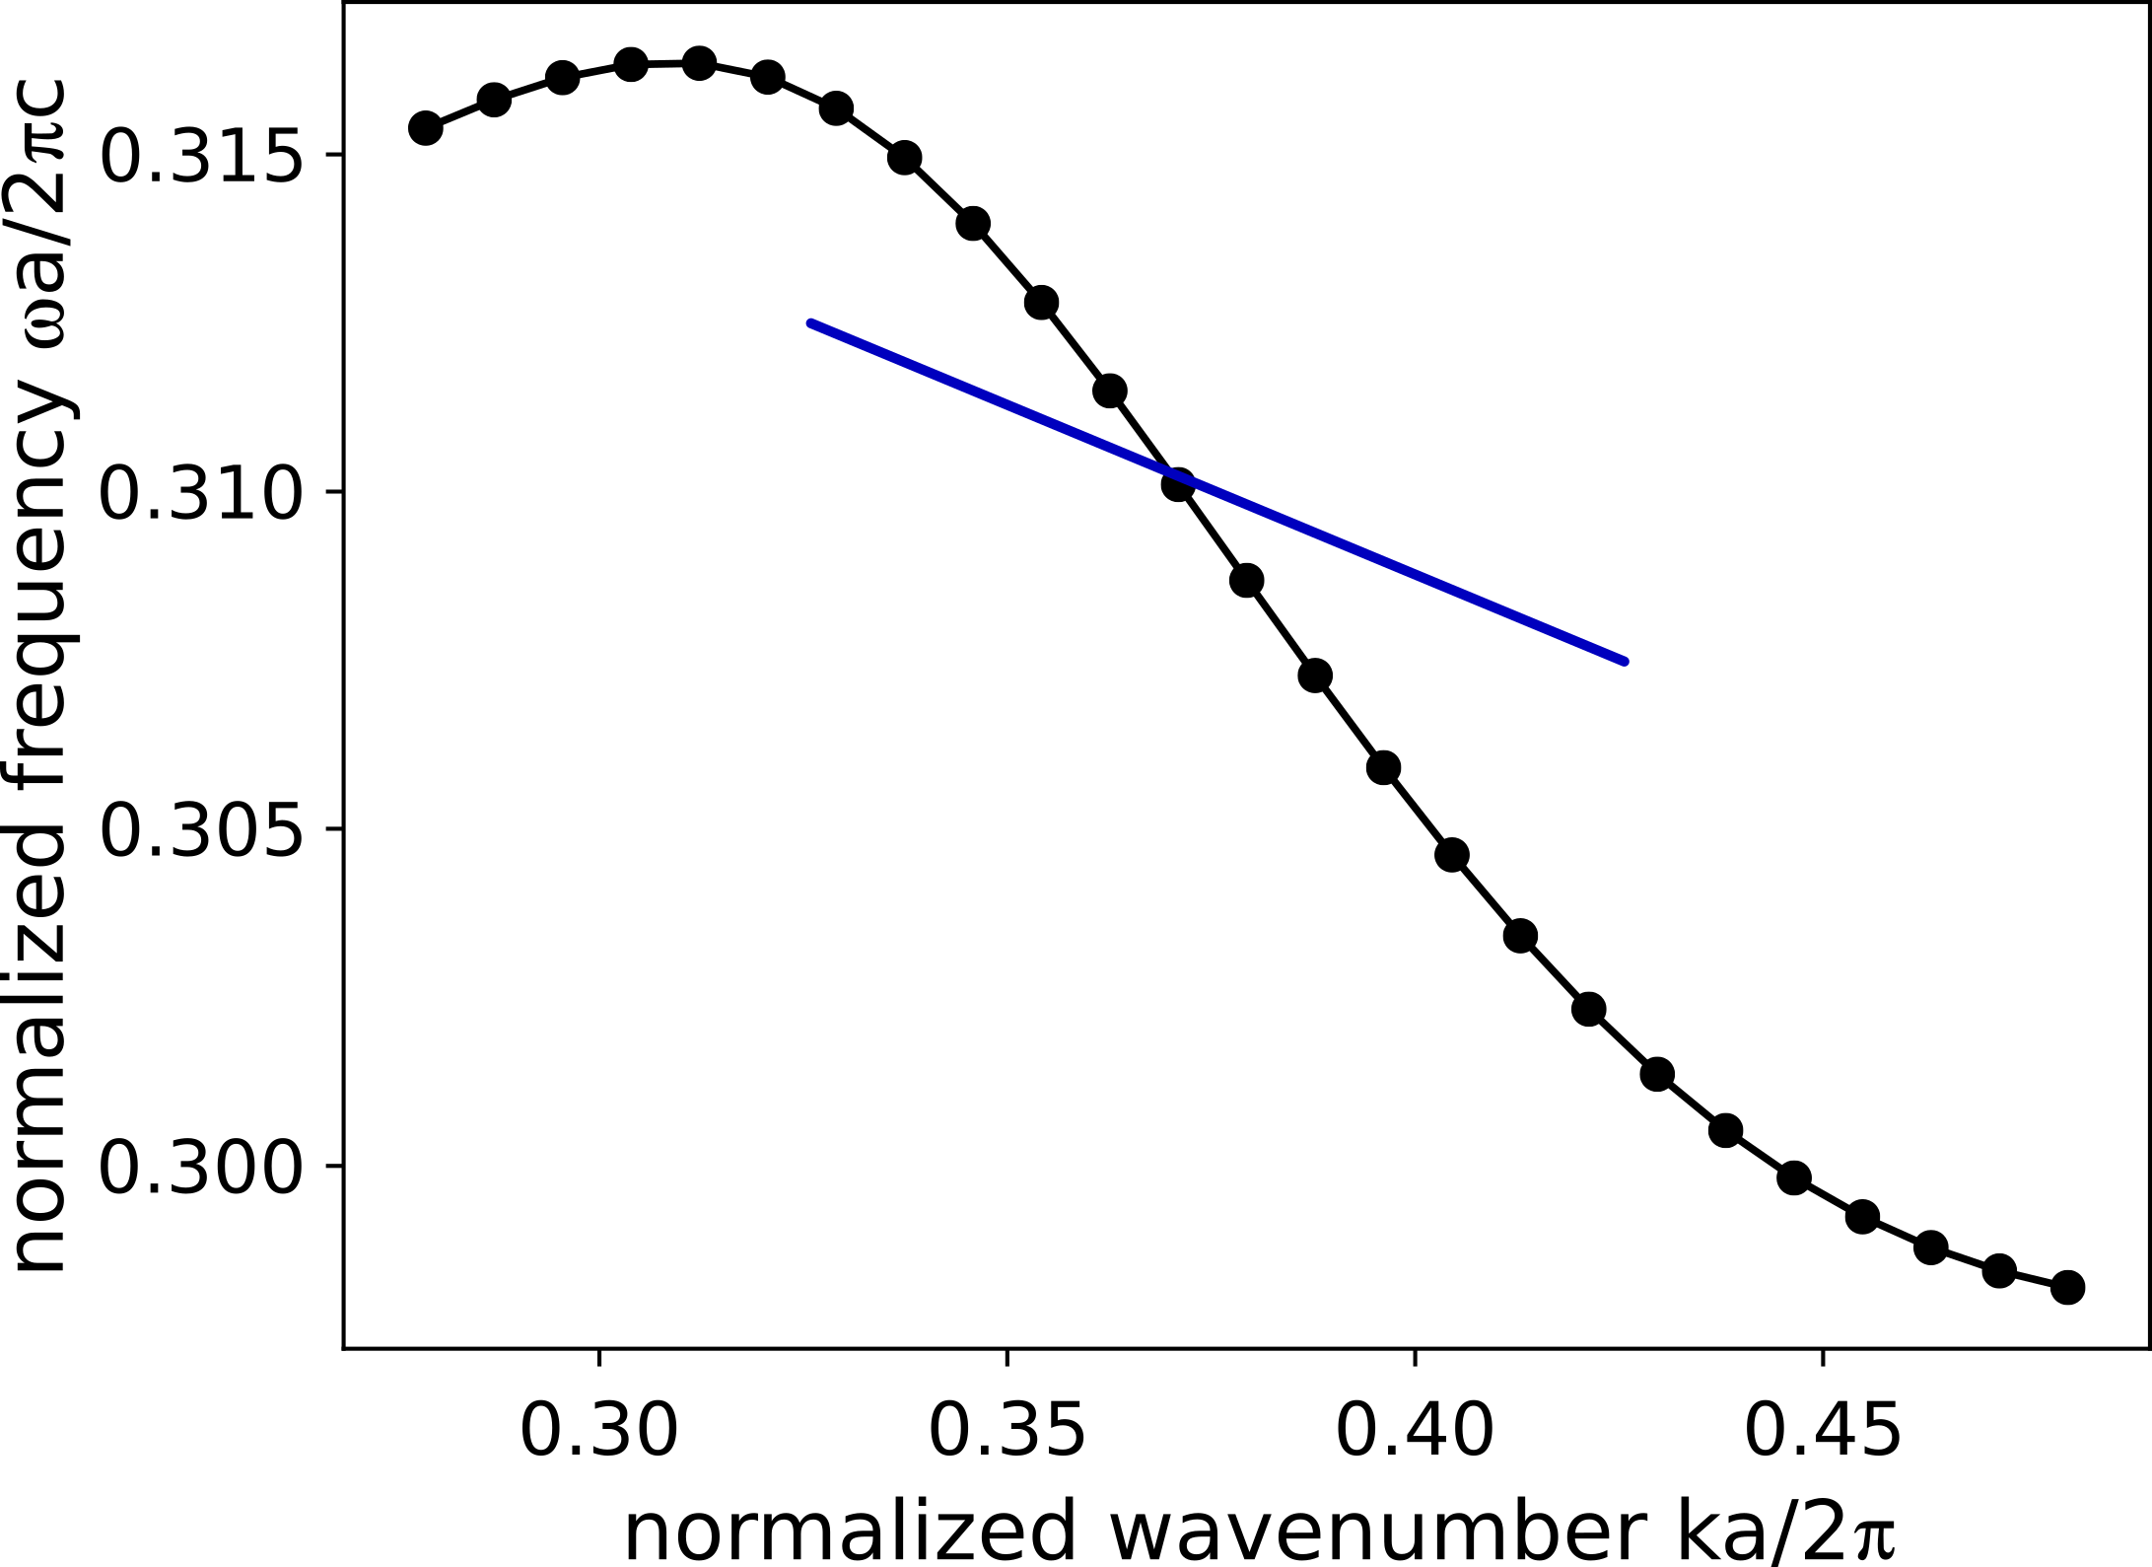
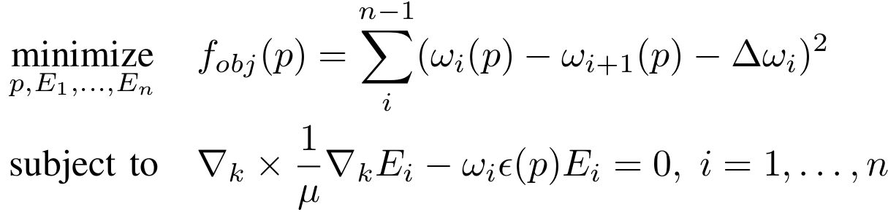
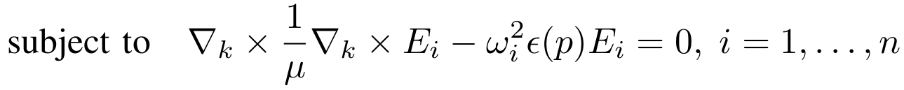
Optimization Problem
Inverse Design Optimization Problem:
𝛥𝛽

Slide 20

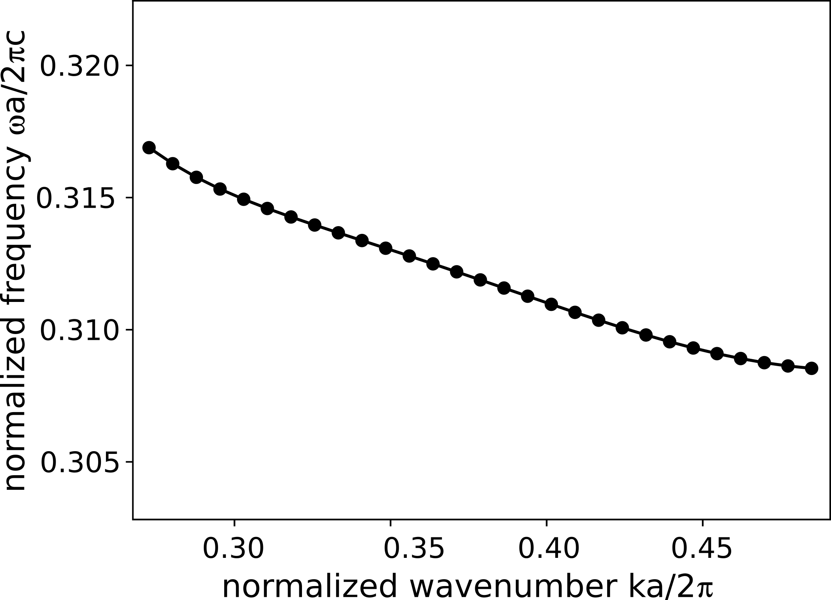
Optimization Results
Initial condition:
Final structure:

Slide 21
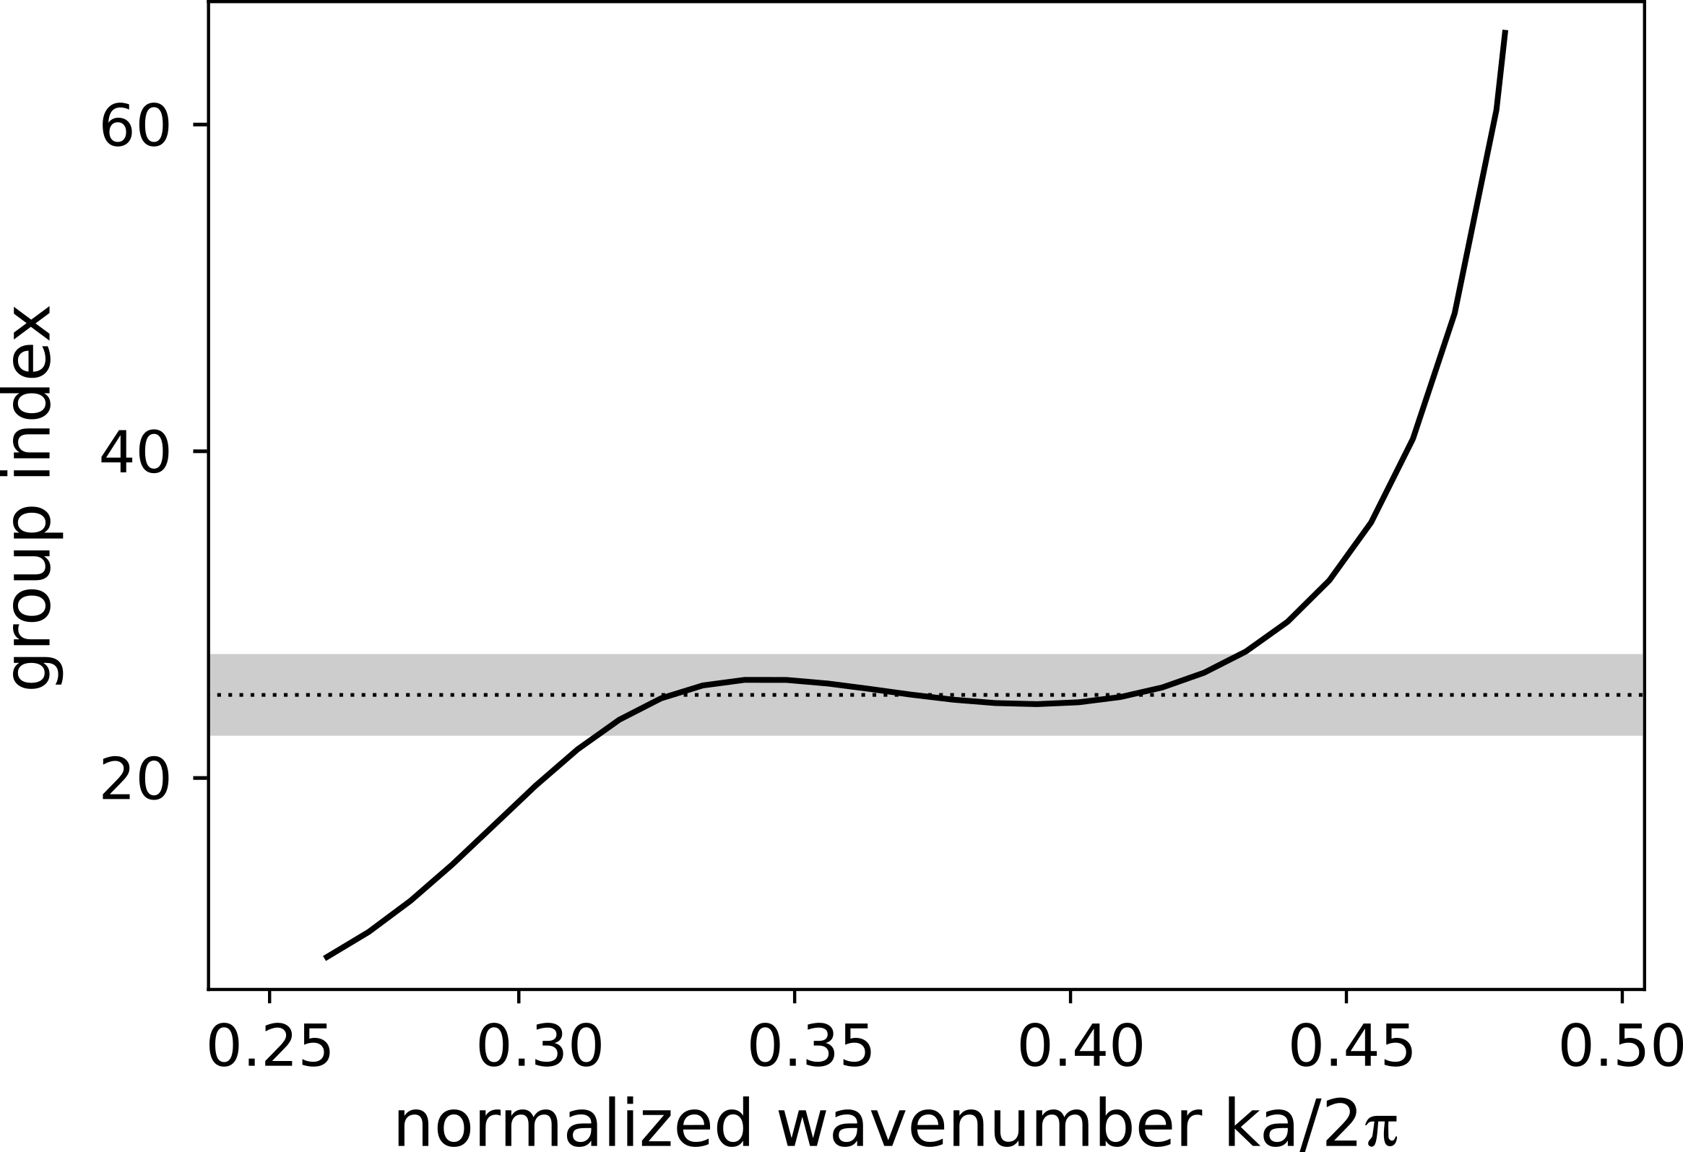
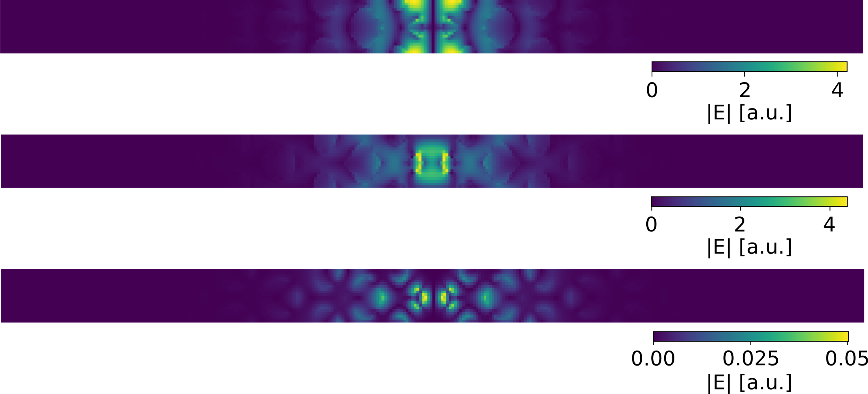
Optimization results: group index
E_{x}
E_{y}
E_{z}
n_{g}=25.1, NBGP=0.38

Slide 22
Slow Light Waveguide Coupler
Strip waveguide
Slow light waveguide

Slide 23
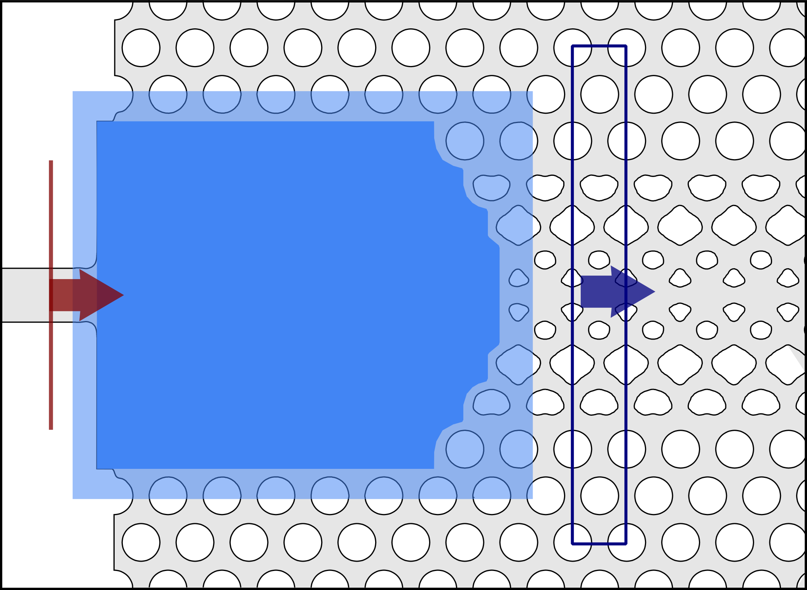
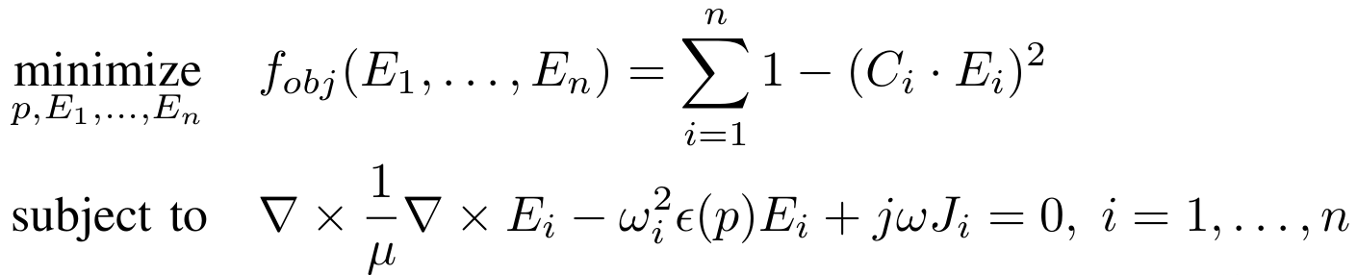
Mode convertor optimization problem
Inverse Design Optimization Problem:
Design Area

Slide 24
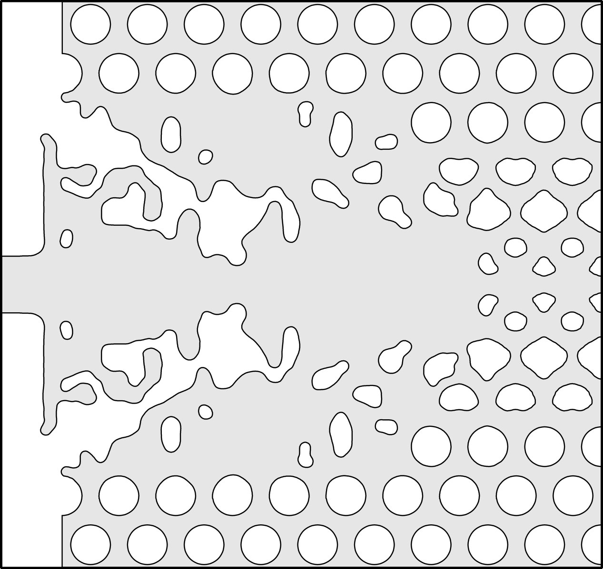
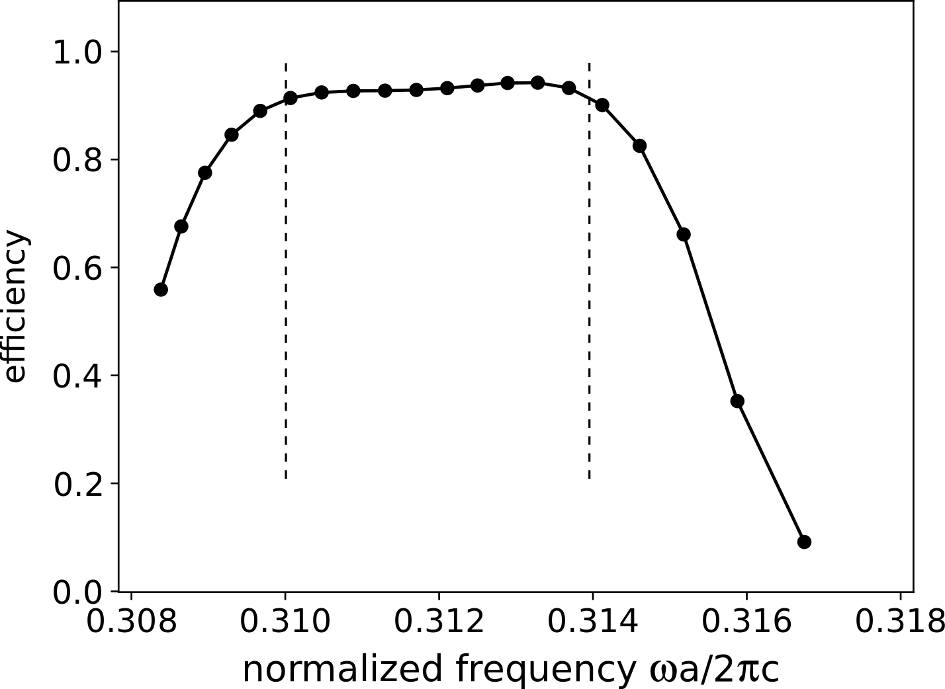
Optimization Result

Slide 25
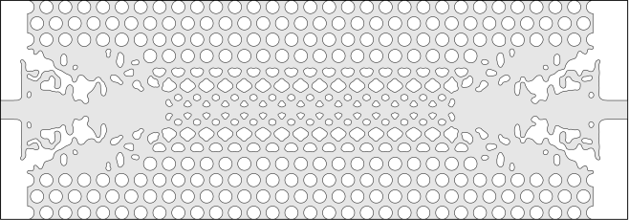
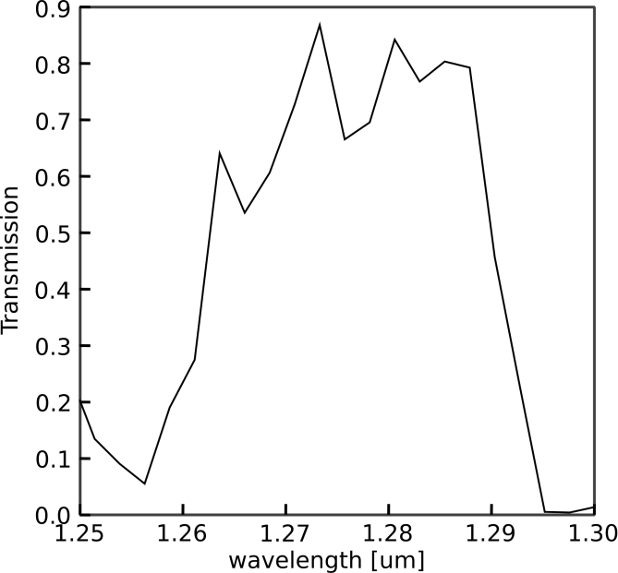
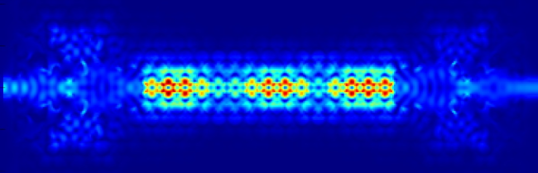
Slow Light System

Slide 26
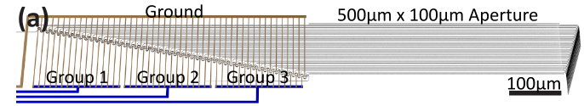

Slow light waveguide antennas
Antenna
Poulton, C. V, et al. Optics Letters, 42(20), 4091 (2017).

Slide 27



Optimization problem
Inverse Design Optimization Problem:

Slide 28



Far Field Objective
z
𝜑
𝜃
y
𝜑
x

Slide 29


Optimization Result
Lambda | Transmission | Far Field
1327nm | 0.969 | 0.008
1332nm | 0.971 | 0.007
1336nm | 0.968 | 0.005
1332nm
𝜑

Slide 30

Combined Design
Waveguide:
n_{g} = 20
𝛥𝜆 = 30nm
𝜆_{c} = 1331nm
d_{ant} = 2800nm
Beam steering:
𝜃_{c} = -7.2
𝛥𝜃 = 22.1
Slow light waveguide phased array: 𝛥𝜃 = 22.1º in 𝛥𝜆 = 30nm
(Strip waveguide phased array: 𝛥𝜃 = 14º in 𝛥𝜆 = 100nm)

Slide 31
Conclusion and outlook
  Phased arrays base on slow light waveguides can increase the steering range and decrease the operating bandwidth, compared to those based on strip waveguides
  We demonstrated how inverse design enables efficient designs for this system.
  Experimental verification of the designs are the focus of current efforts.
  Future work, aims at decreasing the antenna spacing and increasing the angle steering range further.

Slide 32








Acknowledgements
Inverse design team
Neil Sapra
Neil Sapra
Rahul Trivedi
Kiyoul Yang
Jinhie Skarda
Geun Ho Ahn
Principal Investigator
Jelena Vuckovic

Slide 33


Coupling odd mode

