Slide 1

Innovate with Stanford:
Dr. Avnesh Thakor ROS CANCER DIAGNOSTIC
Apr 2024
Notes:
Ying-Li

Slide 2
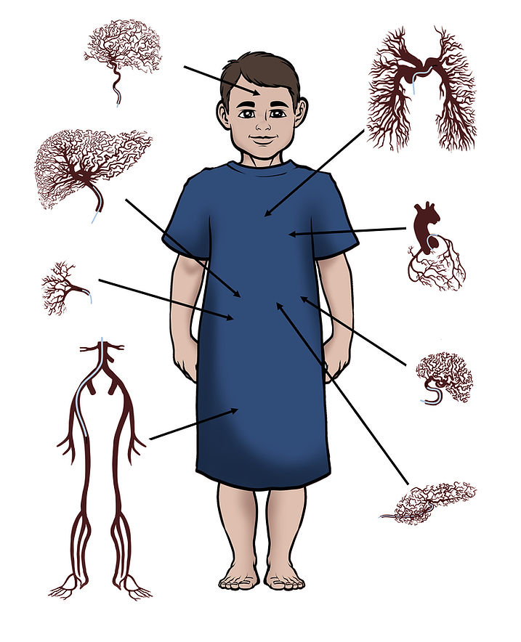
Interventional Radiology Innovation at Stanford (IRIS)
Dr. Avnesh Thakor, MD, PhD
  Adult and pediatric Interventional Radiologist and Physician-Scientist
  Member, Royal College of Radiologists
  Fellow of the Society of Interventional Radiology
Focus on precision therapies and diagnostics

Slide 3
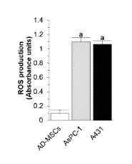
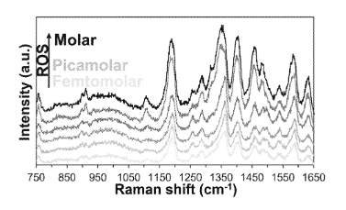
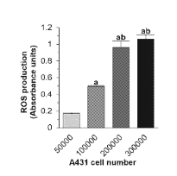
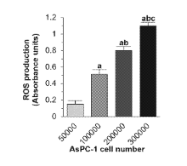
S19-246: A Novel Surface Enhanced Ramen Scattering Gold Nanoparticle for Imaging Tumor Oxidative Stress
Summary: Reactive oxygen species (ROS)-sensing nanoparticle for use in cancer detection - comprised of a gold core (AuNP), DHR123 Raman layer, mesoporous SiO2 shell, and cysteine knot peptide. The cysteine knot peptide targets integrin alpha B beta 6, which is overexpressed in several cancers. The technique is called surface enhanced Raman scattering (SERS).
Patent: PCT published 2020
Publication: J. Biomed. Nanotechnology, 2019
Stage of Development: In vivo data

Slide 4
What Stanford is seeking:
Licensees to commercialize this technology
Research partners/sponsors to develop and commercialize this technology
Investors to help fund and support the creation of a start-up company around this technology

Slide 5



Contact Us
415 Broadway Street, 2nd Floor,
Redwood City, CA 94063
otl.stanford.edu
otl-connect@stanford.edu
SPOTLIGHT Newsletter

