Slide 1

Innovate with Stanford:
Dr. Avnesh Thakor HEMODIALYSIS CATHETER
Apr 2024
Notes:
Ying-Li

Slide 2
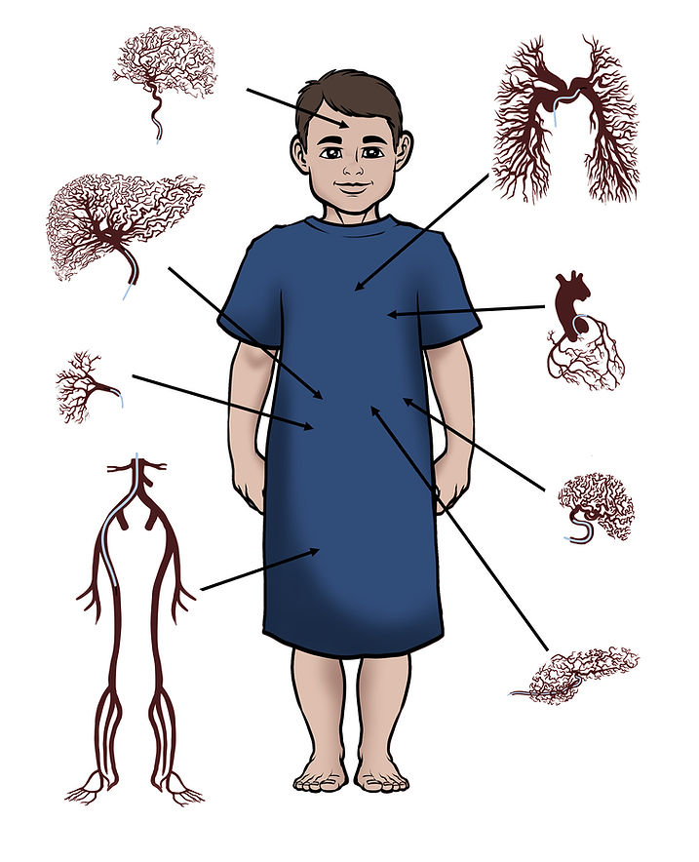
Interventional Radiology Innovation at Stanford (IRIS)
Dr. Avnesh Thakor, MD, PhD
  Adult and pediatric Interventional Radiologist and Physician-Scientist
  Member, Royal College of Radiologists
  Fellow of the Society of Interventional Radiology
Focus on precision therapies and therapeutic delivery

Slide 3
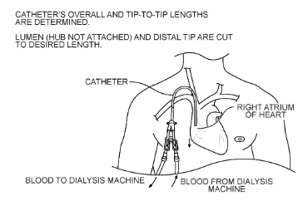
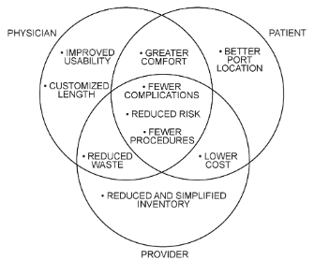
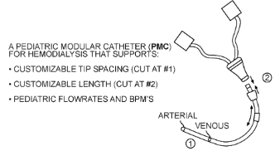
S20-034: A Customizable, Modular Catheter for Hemodialysis Patients of All Ages
Summary: AKA “Kid Cath”, a small caliber central venous catheter that has an adjustable cuff to allow for various lumen lengths.
Patent: PCT published 2021
Publication: No publication
Stage of Development: Proof of Concept

Slide 4
What Stanford is seeking:
Licensees to commercialize this technology
Research partners/sponsors to develop and commercialize this technology
Investors to help fund and support the creation of a start-up company around this technology

Slide 5



Contact Us
415 Broadway Street, 2nd Floor,
Redwood City, CA 94063
otl.stanford.edu
otl-connect@stanford.edu
SPOTLIGHT Newsletter

