Slide 1

Innovate with Stanford:
MIKE SNYDER PORTFOLIO
2024
Notes:
Ying-Li

Slide 2
Elevator Pitch
The Snyder lab specializes in the analysis of complex genomes, other -omes, and regulatory networks, with myriad applications for human health
Technologies are available that can offer novel targets, personalized medicine approaches, risk mitigation, greater efficiency, and much more - with applications for cancer, diabetes, pregnancy and related conditions, diagnostics, and –omics tools for human and environmental health monitoring
These technologies are available for licensing and/or co-development, open to investment and startup creation

Slide 3
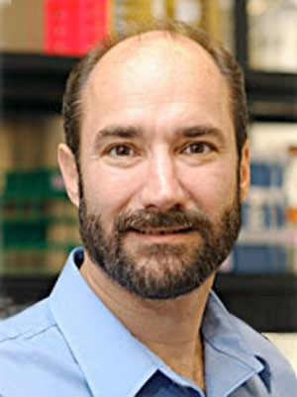
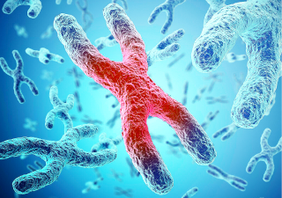
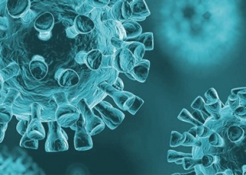
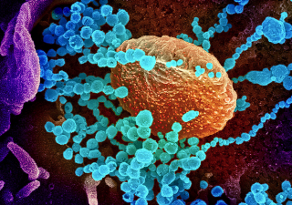
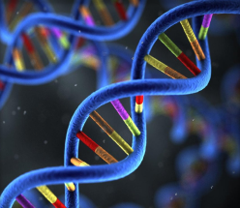
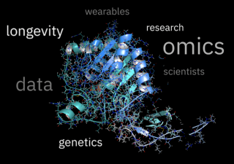
Snyder Lab
Michael Snyder, Ph.D.
  Chair, Dept. of Genetics and Director, Center for Genomics and Personalized Medicine
  Elected Member, American Academy of Science
Stanford Healthcare Innovation Lab
  Blog
  Develops and uses a variety of approaches to analyze genomes, other omes, and regulatory networks, applying these approaches to understand human variation and health

Slide 4
Cancer
Docket | Title | Publications | Patent Apps | Stage | Slide
S19-163 | High-Throughput Screening for Chemical Inhibitors of Histone Acetyltransferase | HAT1 Coordinates Histone Production and Acetylation via H4 Promoter Binding: Molecular Cell | US patent pending | In vitro | 5
S21-166 | First Report of Small Molecule inhibitors of Histone Acetyltransferase 1 (HAT1) with Anti-Tumor Activity | An acetyl-click screening platform identifies a small molecule inhibitor of Histone Acetyltransferase 1 (HAT1) with anti-tumor activity (biorxiv.org) | PCT pending | In vivo | 6
S22-104 | Synthetic Transcription Elongation Factors to Target Mutations in Cancer Genomes | N/A | US patent pending | In vitro | 7

Slide 5
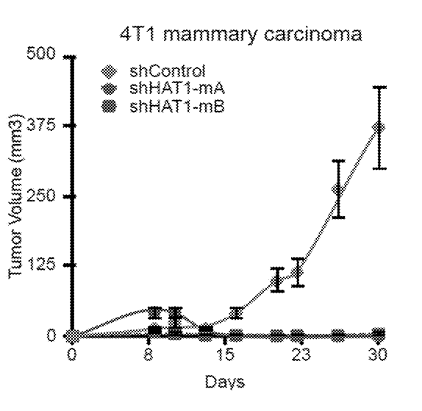
S19-163: High-Throughput Screening for Chemical Inhibitors of Histone Acetyltransferase
Summary
A new method to identify drugs targeting HAT1, an enzyme crucial for cancer development. It uses a click-chemistry based assay to quickly and efficiently screen for HAT1 inhibitors, which could lead to novel cancer therapies.
Patent: US patent pending
Publication: HAT1 Coordinates Histone Production and Acetylation via H4 Promoter Binding: Molecular Cell
Stage of Development: In vitro
Fig 42. Growth curves of 4T1 mammary carcinoma tumors transduced with shRNAs for HAT1 and grafted into bilateral mammary fat pads of mice, utilized in various embodiments.

Slide 6
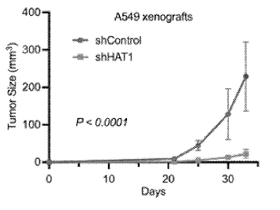
S21-166: First Report of Small Molecule inhibitors of Histone Acetyltransferase 1 (HAT1) with Anti-Tumor Activity
Summary
The first small molecule inhibitors of HAT1, an enzyme linked to various diseases including cancer. These riboflavin analogs block HAT1 activity and suppress tumor growth, opening a new avenue for HAT1-targeted cancer treatment.
Patent: PCT pending
Publication: An acetyl-click screening platform identifies a small molecule inhibitor of Histone Acetyltransferase 1 (HAT1) with anti-tumor activity (biorxiv.org)
Stage of Development: In vivo mouse models
Fig 31. Inhibition of tumor growth in mice treated with short-hairpin RNA of HAT 1 , generated in accordance with various embodiments. A549 cells were treated with either control lentivirus shRNA or 3 separate lentiviral shRNAs targeting the HAT1 mRNA, then injected into bilateral flanks of NSG mice. *p< 0.0001

Slide 7
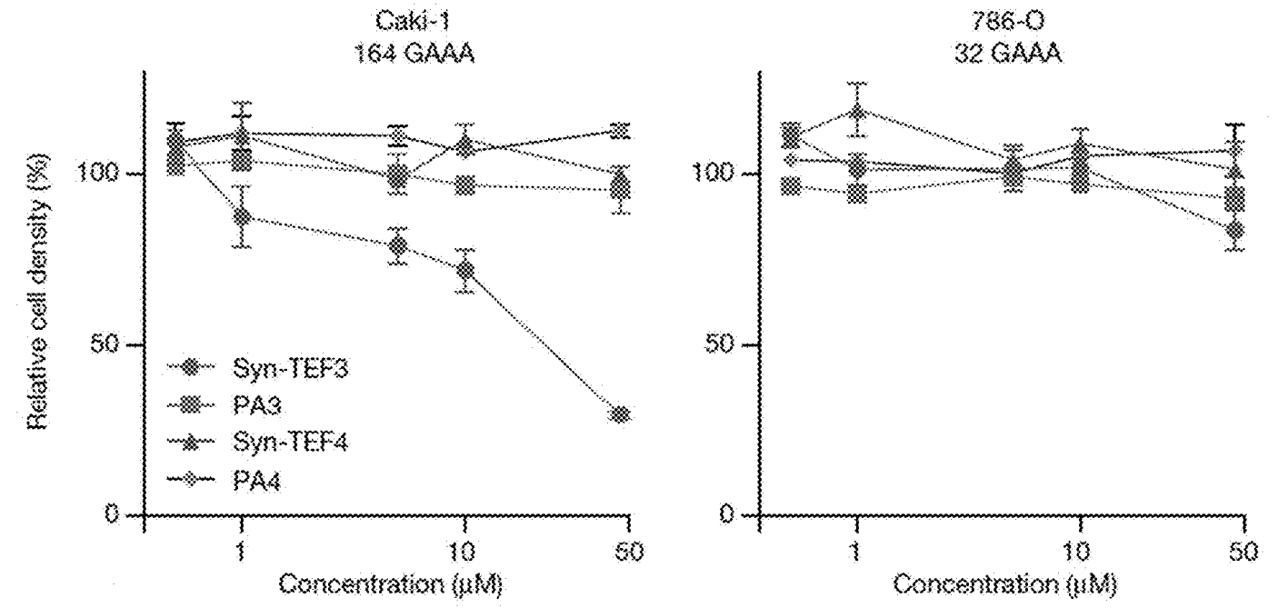
S22-104: Synthetic Transcription Elongation Factors to Target Mutations in Cancer Genomes
Summary
Synthetic molecules (Syn-TEFs) that target specific DNA sequences linked to cancer, like GAAA repeats. These bifunctional molecules have shown promise in treating kidney cancer, paving the way for personalized therapies tackling specific cancer mutations.
Patent: US patent pending
Publication: N/A
Stage of Development: In vitro in cancer cell lines
Fig 5B. Relative cell density of RCC cell lines Caki-1 and 786-o following treatment (72 h) with compounds, as indicated. Relative cell density was measured with CCK-8 assay.

Slide 8
Diabetes
Docket | Title | Publications | Patent Apps | Stage | Slide
S18-198 | Continuous glucose monitoring classification algorithm to identify glucotypes at diabetes risk | N/A | US patent issued | Proof of Concept | 9
S18-279 | Health Monitoring Using Big Data - Diabetes | A longitudinal big data approach for precision health | Nature Medicine | Provisional patent pending | Proof of Concept | 10
S20-463 | Immunoglobulin therapy for the treatment of insulin resistance and type 2 diabetes | N/A | US patent pending | In vivo | 11
S21-137 | Metabolic Subphenotype Predictor – software for continuous glucose monitoring | N/A | US patent pending | In vivo | 12

Slide 9
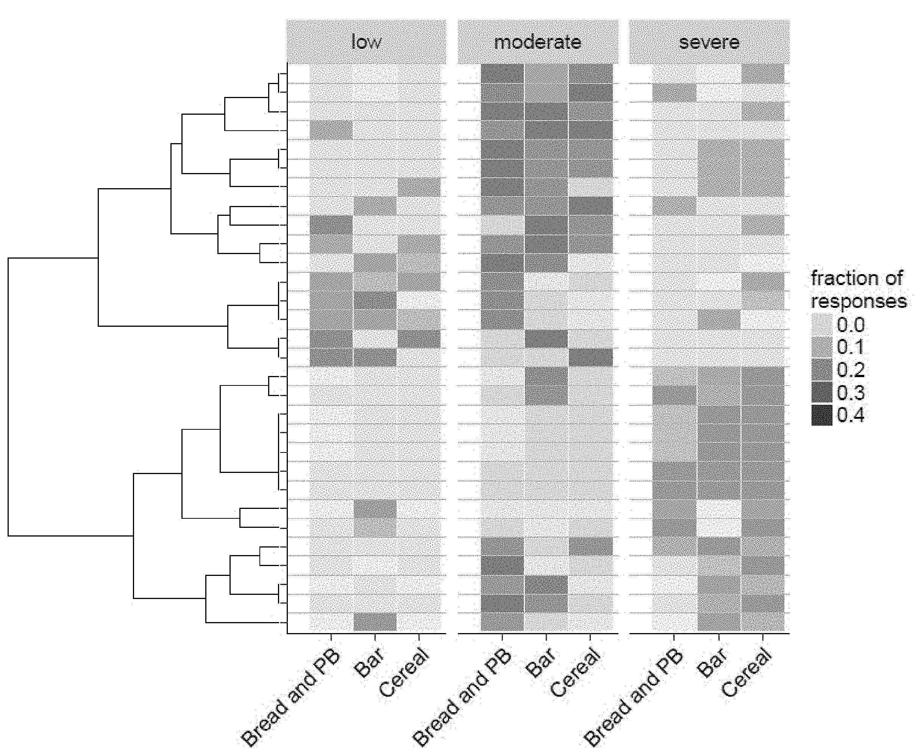
S18-198: Continuous glucose monitoring classification algorithm to identify glucotypes at diabetes risk
Summary
A method using continuous glucose monitoring data and spectral clustering identifies distinct "glucotypes" representing different patterns of glycemic variability, providing earlier detection of diabetes risk and enabling personalized dietary and treatment interventions.
Patent: US patent issued
Publication: N/A
Stage of Development: Proof of Concept
Figure 16. Results of responses of three glycemic pattern classes to three different standardized meals, generated in accordance with an embodiment of the invention.

Slide 10
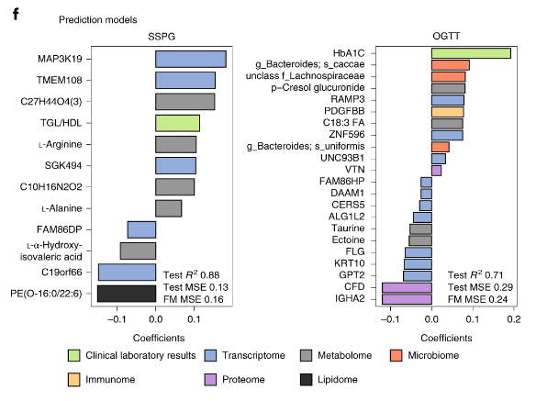
S18-279: Health Monitoring Using Big Data - Diabetes
Summary
A multi-analyte test using longitudinal multi-omics data and detailed clinical assessments to provide an inexpensive, rapid and easier way to predict diabetes risk, detect insulin resistance earlier, and enable personalized diabetes treatment compared to existing methods.
Patent: Provisional patent pending
Publication: A longitudinal big data approach for precision health | Nature Medicine
Stage of Development: Proof of Concept
Fig 3f. Molecules selected in SSPG and OGTT prediction models and associated coefficients. For steady-state plasma glucose (SSP)G prediction, lipidomics data were used in addition to the multi-omics measures. MSE, mean square error.

Slide 11

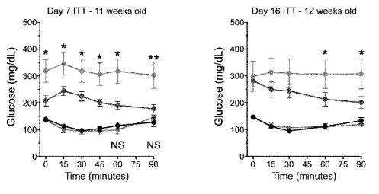
S20-463: Immunoglobulin therapy for the treatment of insulin resistance and type 2 diabetes
Summary
A new immunoglobulin therapy that improves insulin sensitivity in animal models, potentially offering a novel treatment for type 2 diabetes.
Patent: US patent pending
Publication: N/A
Stage of Development: In vivo mouse data
Fig 35. Data graphs depicting longitudinal insulin tolerance test following IPIG in leptin receptor deficient (db/db) mice and control (C57BL6) mice. IPIG = intraperitoneal IgG, ITT = insulin tolerance test

Slide 12
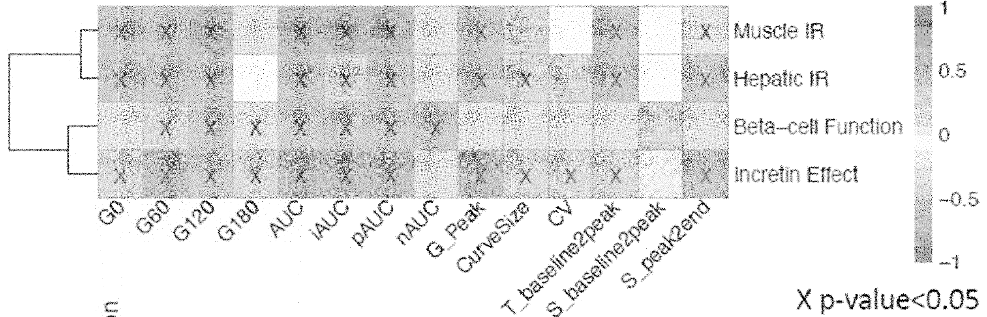
S21-137: Metabolic Subphenotype Predictor – software for continuous glucose monitoring
Summary
A software program that uses continuous glucose monitoring data to identify insulin resistance, offering a more accessible and personalized approach to diagnosing pre-diabetes.
Patent: US patent pending
Publication: N/A
Stage of Development: In vivo data
Fig 19. A heatmap schematic depicting a relationship between OGTT glucose time series features and metabolic subphenotypes. Pearson correlation coefficient (−1<r<1) was used to determine the strength of each relationship, where r=1 “dark red” means strong positive correlation, and r=−1 “dark blue” means strong negative correlation. The “x” in some of the heatmap cells means that the correlation is statistically significant (p-value <0.05) between the curve feature and the corresponding metabolic subphenotype.

Slide 13
Pregnancy and Related Conditions
Docket | Title | Publications | Patent Apps | Stage | Slide
S19-383 | Therapeutic interventions for pregnancy and related non-pregnancy conditions | N/A | US patent pending | In vivo | 14
S19-384 | Prediction of gestational age using urine metabolites | Multiomics Characterization of Preterm Birth in Low- and Middle-Income Countries | Global Health | JAMA Network Open | JAMA Network | US patent pending | Proof of Concept | 15
S19-394 | Using pregnancy urine samples and untargeted metabolomics profiling for gestational age prediction | N/A | US patent pending | In vitro | 16
S20-384 | Predicting Gestational Age and Time to Delivery in Pregnant Women | Metabolic Dynamics and Prediction of Gestational Age and Time to Delivery in Pregnant Women: Cell | US patent pending | Proof of Concept | 17

Slide 14
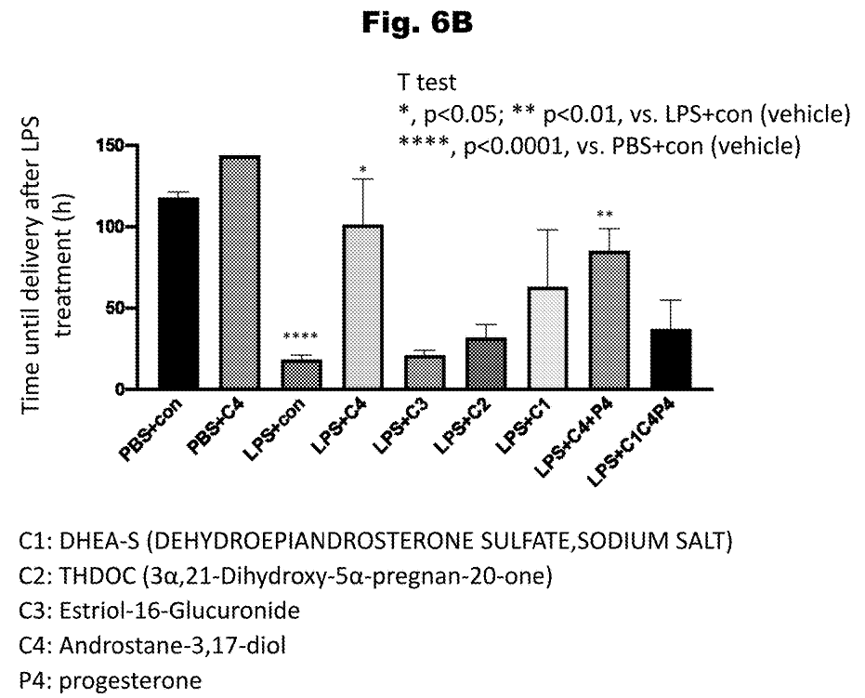
S19-383: Therapeutic interventions for pregnancy and related non-pregnancy conditions
Summary
Identification of molecular regulators for personalized hormone treatment plans in pregnancy (miscarriage, infertility, preterm labor) and other conditions (amenorrhea, abnormal bleeding, cancers).
Patent: US patent pending
Publication: N/A
Stage of Development: In vivo mouse data
Fig 6B. Graphical results of treating a murine model of moderate preterm delivery with various compounds, utilized in accordance with various embodiments. con = Control

Slide 15
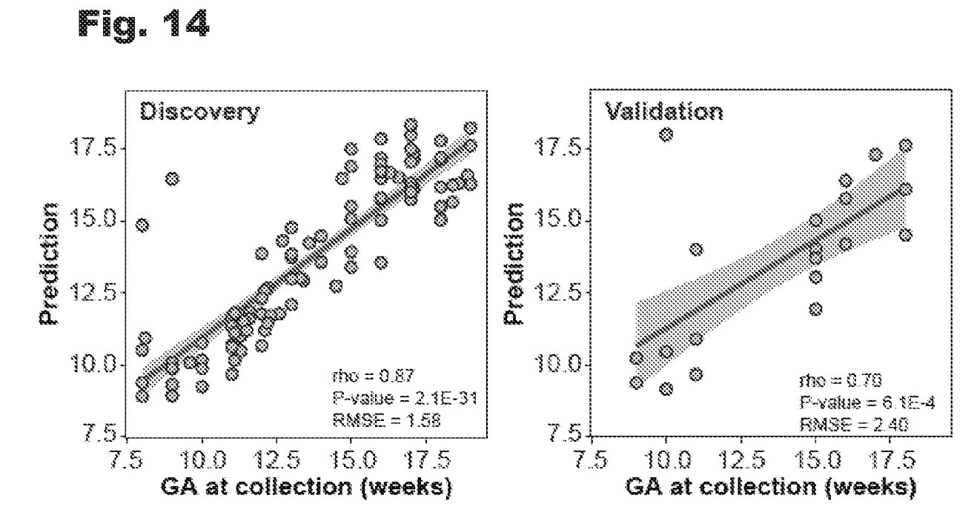
S19-384: Prediction of gestational age using urine metabolites
Summary
A non-invasive and inexpensive urine test that can accurately predict gestational age by measuring specific metabolites in the mother's urine, providing an accessible alternative to ultrasound examinations for determining fetal age.
Patent: US patent pending
Publication: Multiomics Characterization of Preterm Birth in Low- and Middle-Income Countries | Global Health | JAMA Network Open | JAMA Network
Stage of Development: Proof of Concept
Fig 14. Data plots depicting performance of the restricted RF prediction model ofGA that uses three metabolites (C19H26O7S, C24H30O9 and estriol glucuronide) and all the samples in the study (n = 99), generated in accordance with various embodiments. The model was validated in an independent cohort (n = 20). The shaded area represents the 95% confidence interval.

Slide 16
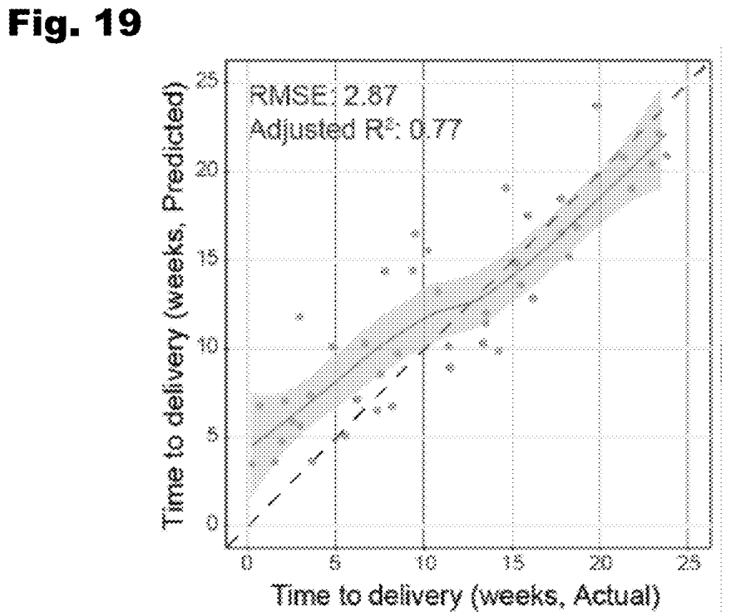
S19-394: Using pregnancy urine samples and untargeted metabolomics profiling for gestational age prediction
Summary
A non-invasive method to accurately predict gestational age developed using untargeted metabolomics profiling of pregnancy urine samples and machine learning, enabling easy determination of fetal age without the need for ultrasound examinations.
Patent: US patent pending
Publication: N/A
Stage of Development: In vitro data
Fig 19. Data graph depicting the ability of a time-to-delivery prediction model utilizing 21 metabolites as features in an external validation data set, generated in accordance with various embodiments.

Slide 17
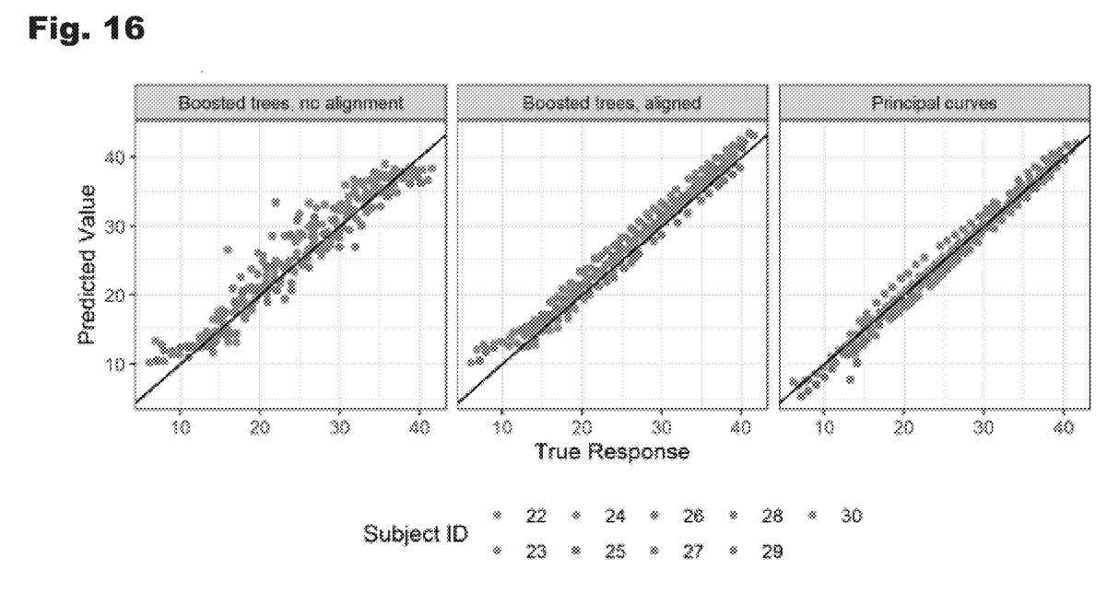
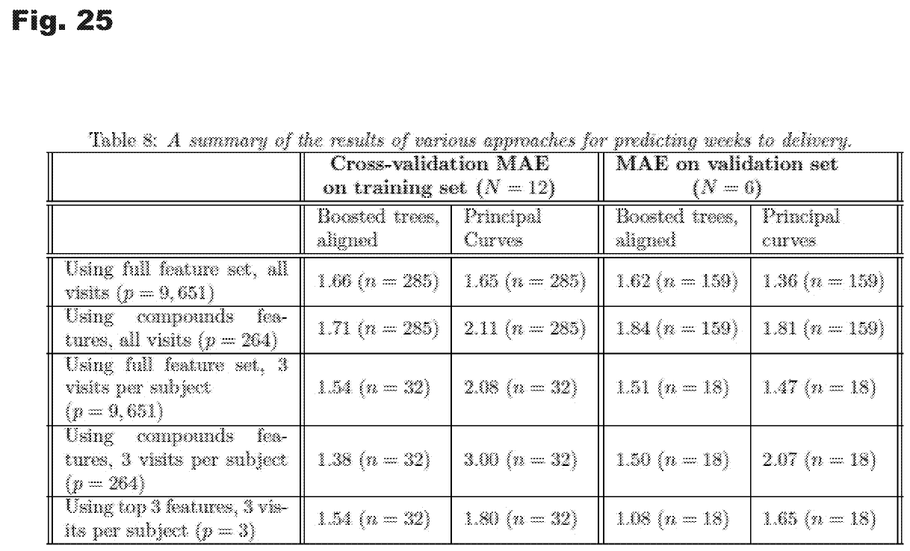
S20-384: Predicting Gestational Age and Time to Delivery in Pregnant Women
Summary
Computational modeling methods that leverage blood metabolite profiles to accurately predict gestational age and time to delivery in pregnant women, significantly improving upon current techniques like ultrasound which can have suboptimal accuracy and accessibility limitations.
Patent: US patent pending
Publication: Metabolic Dynamics and Prediction of Gestational Age and Time to Delivery in Pregnant Women: Cell
Stage of Development: Proof of Concept
Fig 16. Graph depicting alignment and prediction of gestational age with one of various computational models using temporally aligned measurement data, generated in accordance with various embodiments.
Fig 25. A table summarizing the results of various approaches for predicting time to gestation, generated in accordance with various embodiments.

Slide 18
Disease Diagnosis
Docket | Title | Publications | Patent Apps | Stage | Slide
S11-082 | Method and System for the Use of Biomarkers for Regulatory Dysfunction in Disease | N/A | US patent issued | Proof of Concept | 19
S17-285 | A clinical test for early diagnosis of abdominal aortic aneurysm | Decoding the Genomics of Abdominal Aortic Aneurysm: Cell | US patent pending | Proof of Concept | 20
S23-075 | Oxidative Stress is characteristic of ME-CFS, Long COVID and some autoimmunity patients | Oxidative Stress is a shared characteristic of ME/CFS and Long COVID | bioRxiv | Provisional patent pending | In vitro data | 21

Slide 19
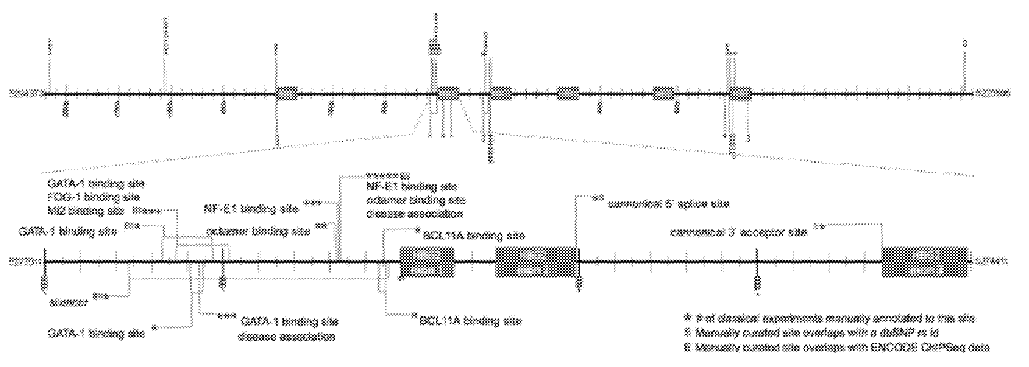
S11-082: Method and System for the Use of Biomarkers for Regulatory Dysfunction in Disease
Summary
A method and system for using biomarkers related to regulatory dysfunction, such as transcription factor binding events, in the diagnosis and prognosis of diseases like rheumatoid arthritis and type 2 diabetes, which are known to involve regulatory disruptions as part of their pathogenesis; by profiling regulatory components and processes from easily obtained patient samples like blood, it enables more comprehensive and biologically-relevant clinical assessment compared to current genetic variant or protein expression testing alone.
Patent: US patent issued
Publication: N/A
Stage of Development: Proof of Concept
Fig 6. A sample curation of the beta-globin locus according to an embodiment of the present invention.

Slide 20
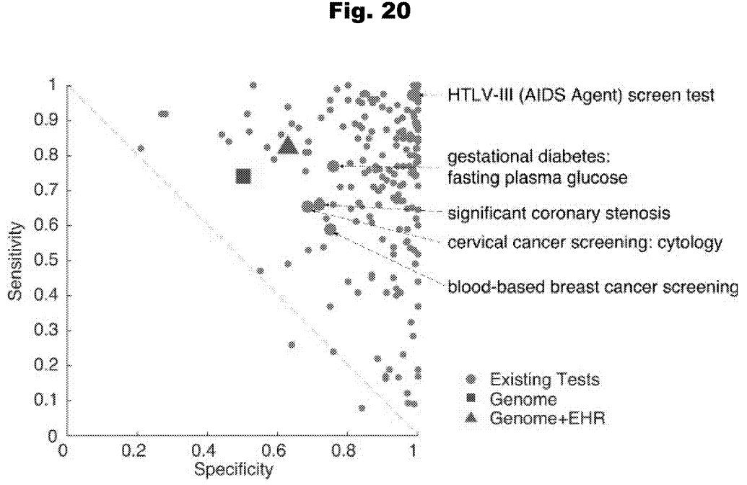
S17-285: A clinical test for early diagnosis of abdominal aortic aneurysm
Summary
A novel machine learning-based clinical screening test that leverages genetic mutations and patient data to enable early diagnosis of abdominal aortic aneurysms, a common cardiovascular disease often detected too late, addressing a significant unmet need.
Patent: US patent pending
Publication: Decoding the Genomics of Abdominal Aortic Aneurysm: Cell
Stage of Development: Proof of Concept
Fig 20. A graph detailing the performance of HEAL (the system described in the patent) as compared to existing clinical tests generated in accordance with various embodiments of the invention.

Slide 21
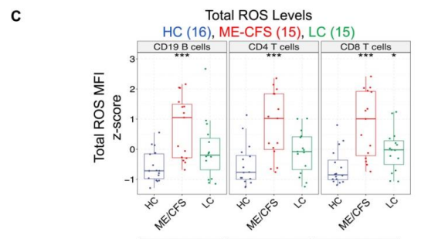
S23-075: Oxidative Stress is Characteristic of ME-CFS, Long COVID, and Some Autoimmunity Patients
Summary
A precision medicine platform using blood tests to diagnose fatigue-based conditions like myalgic encephalomyelitis/ chronic fatigue syndrome and Long COVID based on a molecular signature of oxidative stress biomarkers. This could help identify therapeutic leads that can reduce oxidative stress in affected individuals.
Patent: Provisional patent pending
Publication: Oxidative Stress is a shared characteristic of ME/CFS and Long COVID | bioRxiv
Stage of Development: In vitro data
Fig 1C. Comparing 16 HC, 15 LC, and 15 ME/CFS donor lymphocytes, DCFDA staining shows higher total median fluorescence intensity (MFI) ROS levels in ME/CFS (CD4T p = 5.60*10-4, CD8T p = 1.91*10-4, CD19B p = 3.04*10-4) and LC (CD4 T cells p = 0.104, CD8 T cells p = 0.0210, CD19 B cells p = 0.0727) lymphocytes compared to healthy controls. Reactive oxygen species (ROS) indicator 2',7'-dichlorodihydrofluorescein diacetate (DCFDA) are shown for CD4 T cells for a single healthy control (HC), Long COVID (LC), and ME/CFS donor. Y-axis represents normalized events to the mode. * indicates p < 0.05, ** indicates p < 0.01, *** indicates p < 0.001 based on a two-sided t-test

Slide 22
Genomics and Other -Omics Tools
Docket | Title | Publications | Patent Apps | Stage | Slide
S11-077B | A Method and System to Phase an Individual Genome With or Without Family Members in the Context of Clinical Interpretation-B | N/A | US patent issued | Proof of Concept | 23
S18-182 | Systematic Identification of Silencer Elements in the Human Genome | Systematic identification of silencers in human cells | Nature Genetics | US patent pending | In vitro data | 24
S19-470 | Hummingbird: Predicting Best Configurations for Genomics Cloud Computing | Hummingbird: efficient performance prediction for executing genomic applications in the cloud | Bioinformatics | Oxford Academic (oup.com) | N/A | Prototype | 25
S21-450 | AgeIndex: A Whole-Genome Epigenetic Aging and Rejuvenation Index | PRC2 clock: a universal epigenetic biomarker of aging and rejuvenation | bioRxiv | PCT pending | Prototype | 26
S22-315 | Multiomic Microsampling using a single drop of blood | Multi-omics microsampling for the profiling of lifestyle-associated changes in health | Nature Biomedical Engineering | PCT pending | Proof of Concept | 27

Slide 23
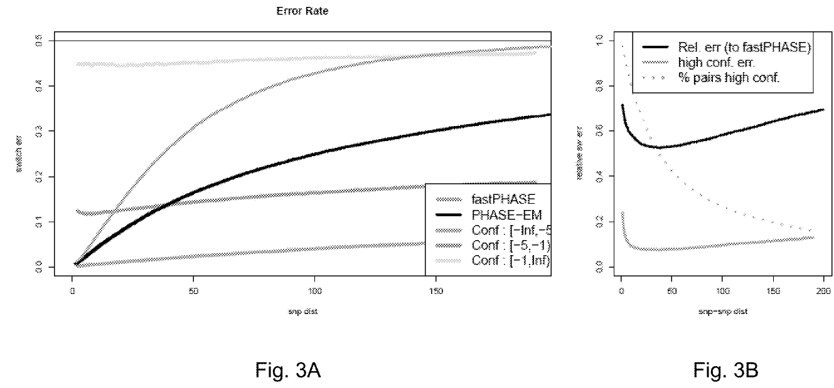
S11-077B: A Method and System to Phase an Individual Genome With or Without Family Members in the Context of Clinical Interpretation-B
Summary
A method and system that uses public datasets, phasing algorithms, Mendelian inheritance analysis, and experimental data to accurately phase an individual's genome for comprehensive clinical interpretation of both inherited and de novo genetic variants.
Patent: US patent issued
Publication: N/A
Stage of Development: Proof of Concept
Fig 3A and 3B. Graphs of error rate in the panel of 200 Mexican haplotypes using PHASE-EM according to an embodiment of the present invention. PHASE-EM is an embodiment of the present invention.

Slide 24
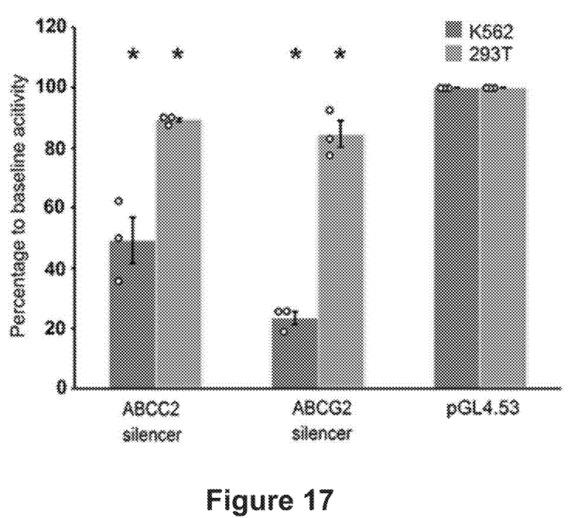
S18-182: Systematic Identification of Silencer Elements in the Human Genome
Summary
A new method (ReSE) to systematically identify silencer elements, which are important for gene regulation, in the human genome.
Patent: US patent pending
Publication: Systematic identification of silencers in human cells | Nature Genetics
Stage of Development: In vitro data
Fig 17. Luciferase assays to determine the repressive activity of silencers from within ABCC2 and ABCC2 genes in K562 cells. 293T cells were used as the control cell line and empty pGL4.53 plasmid was used as the control for baseline luciferase activity. The y-axis represents the percentage of luciferase activity compared to pGL4.53 empty plasm ids in the respective cells. (n=3 biological independent samples; the bars show the mean value±S.E.M.; P value<0.05, calculated using two-sided Student's t test).

Slide 25
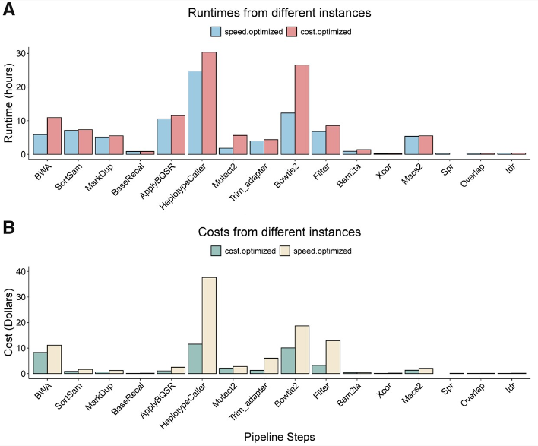
S19-470: Hummingbird: Predicting Best Configurations for Genomics Cloud Computing
Summary
Hummingbird predicts the cheapest, fastest, and most efficient cloud configurations for running genomics pipelines, saving researchers time and money.
Patent: N/A
Publication: Hummingbird: efficient performance prediction for executing genomic applications in the cloud | Bioinformatics | Oxford Academic (oup.com)
Stage of Development: Prototype
Fig 3A and 3B. Best instance types optimized for different purposes have a large impact on runtime and cost. (A) runtimes from speed-optimized compute instance (blue) and cost-optimized compute instance (red) for each pipeline step. (B) Compute cost from cost-optimized instance (green) and speed-optimized instance (yellow) for each pipeline step.

Slide 26
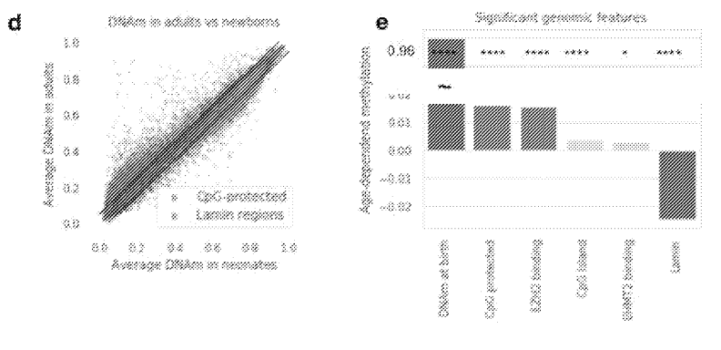
S21-450: AgeIndex: A Whole-Genome Epigenetic Aging and Rejuvenation Index
Summary
AgeIndex is the first whole-genome method to measure biological age by analyzing epigenetic information loss in cells, potentially enabling researchers to assess anti-aging treatments.
Patent: PCT pending
Publication: PRC2 clock: a universal epigenetic biomarker of aging and rejuvenation | bioRxiv
Stage of Development: Prototype
FIG 1D and 1E. Analyses based on all CpGs covered in Methyl450, excluding SNPs and sex chromosomes. d, Comparison of DNA methylation levels in neonates and adults (GSE152027). Globally, CpG- rich regions gain DNA methylation and lamin-associated CpG-poor regions (Zhou et al. 2018) lose DNA methylation, e, The effect of each feature on age-dependent changes in DNA methylation, controlling for other features. Each genomic feature (e.g. CpG-density and EZH2/EHMT2 DNA-binding) independently contribute to the gain of DNA methylation.

Slide 27
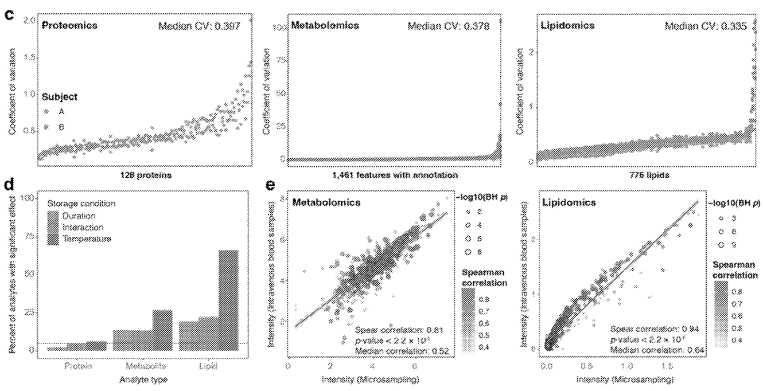
S22-315: Multiomic Microsampling using a single drop of blood
Summary
A method that allows for measuring thousands of molecules in health monitoring from a single drop of blood collected at home, potentially enabling personalized medicine and disease prediction.
Patent: PCT pending
Publication: Multi-omics microsampling for the profiling of lifestyle-associated changes in health | Nature Biomedical Engineering
Stage of Development: Proof of Concept
Fig 1E. Overview of the microsampling multi-omics workflow and stability analysis. c, The coefficient of variation distribution for proteins, metabolites, and lipids across all the samples in the stability analysis. d, The percentage of analytes is significantly affected by storage duration, temperature, and interactions (linear regression). The red line shows the expected proportion of nominally significant results at the alpha level of 5% (p-value= 0.05). e, The Spearman correlations between microsamples and intravenous blood samples (n = 34) for metabolites and lipids, respectively.

Slide 28
Other Technologies
Docket | Title | Publications | Patent Apps | Stage | Slide
S17-024 | Device for Monitoring Environmental Exposures | Dynamic Human Environmental Exposome Revealed by Longitudinal Personal Monitoring (cell.com) | US patent issued | Prototype | 29
S17-024B | B docket for 17-024 CIP | N/A | Provisional patent pending | Prototype | 30

Slide 29
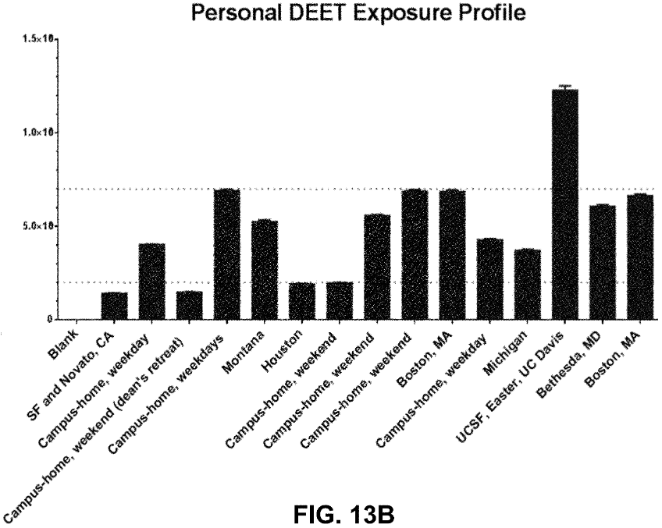
S17-024: Device for Monitoring Environmental Exposures
Summary
A device that monitors environmental exposures (chemicals, allergens) in personal (wearable) or public settings, potentially enabling precision medicine by linking exposure data to an individual's genes.
Patent: US patent issued
Publication: Dynamic Human Environmental Exposome Revealed by Longitudinal Personal Monitoring (cell.com)
Stage of Development: Prototype
Fig 13B. Graph that shows, according to an exemplary embodiment of the invention, levels of diethyltoluamide (DEET) levels from environment exposure samples collected with the zeolite 13X adsorbents.

Slide 30
S17-024B: B docket for 17-024 CIP
Summary
Continuation of S17-024B
Patent: Provisional patent pending
Publication: N/A
Stage of Development: Prototype

Slide 31
Next Steps
Stanford is seeking licensees to commercialize one or more of these technologies
Stanford is seeking research partners/sponsors to develop and commercialize one or more of these technologies
Stanford is seeking investors to help fund or support the creation of a start-up company around one or more of these technologies

Slide 32



Contact Us
415 Broadway Street, 2nd Floor,
Redwood City, CA 94063
otl.stanford.edu
otl-connect@stanford.edu
SPOTLIGHT Newsletter

