Slide 1

Effects of Black Carbon on Clouds and Climate
Mark Z. Jacobson
Atmosphere/Energy Program
Dept. of Civil & Environmental Engineering
Stanford University
Department of Meteorology, San Jose State University
February 1, 2012

Slide 2
Important Physical Processes Affecting BC Climate Response
Direct effect (dependent on evolution of mixing state)
Indirect effects I and II
Cloud absorption effects I and II
Semidirect effect
Effect on snow and sea ice albedo
Water evaporation effect
All processes involve nonlinear feedback and coupling →must be treated simutaneously. Effects cannot be linearly added.

Slide 3
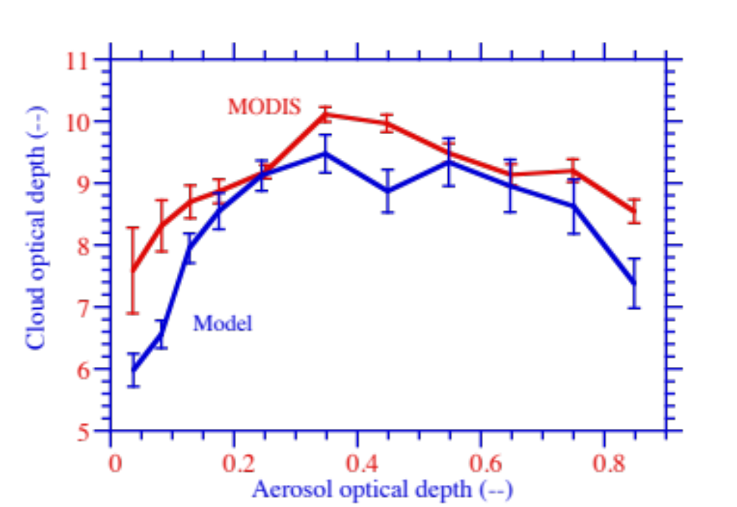
Boomerang Curve
Indirect + Cloud Absorption+ Semidirect Effects
COD v. AOD Over Biomass Burning in Brazil Sept ‘06
GATOR-GCMOM
Model
Ten Hoeve et al. ACP 11, 3021 (2011)
Notes:
This is cloud optical depth versus aerosol optical depth over the braz domain (highest resolution) for the MODIS Aqua satellite over the time period of the simulation. You can see the boomerang shape in AOD, which has been attributed to both radiative effects as well as satellite retrieval artifacts.

Slide 4
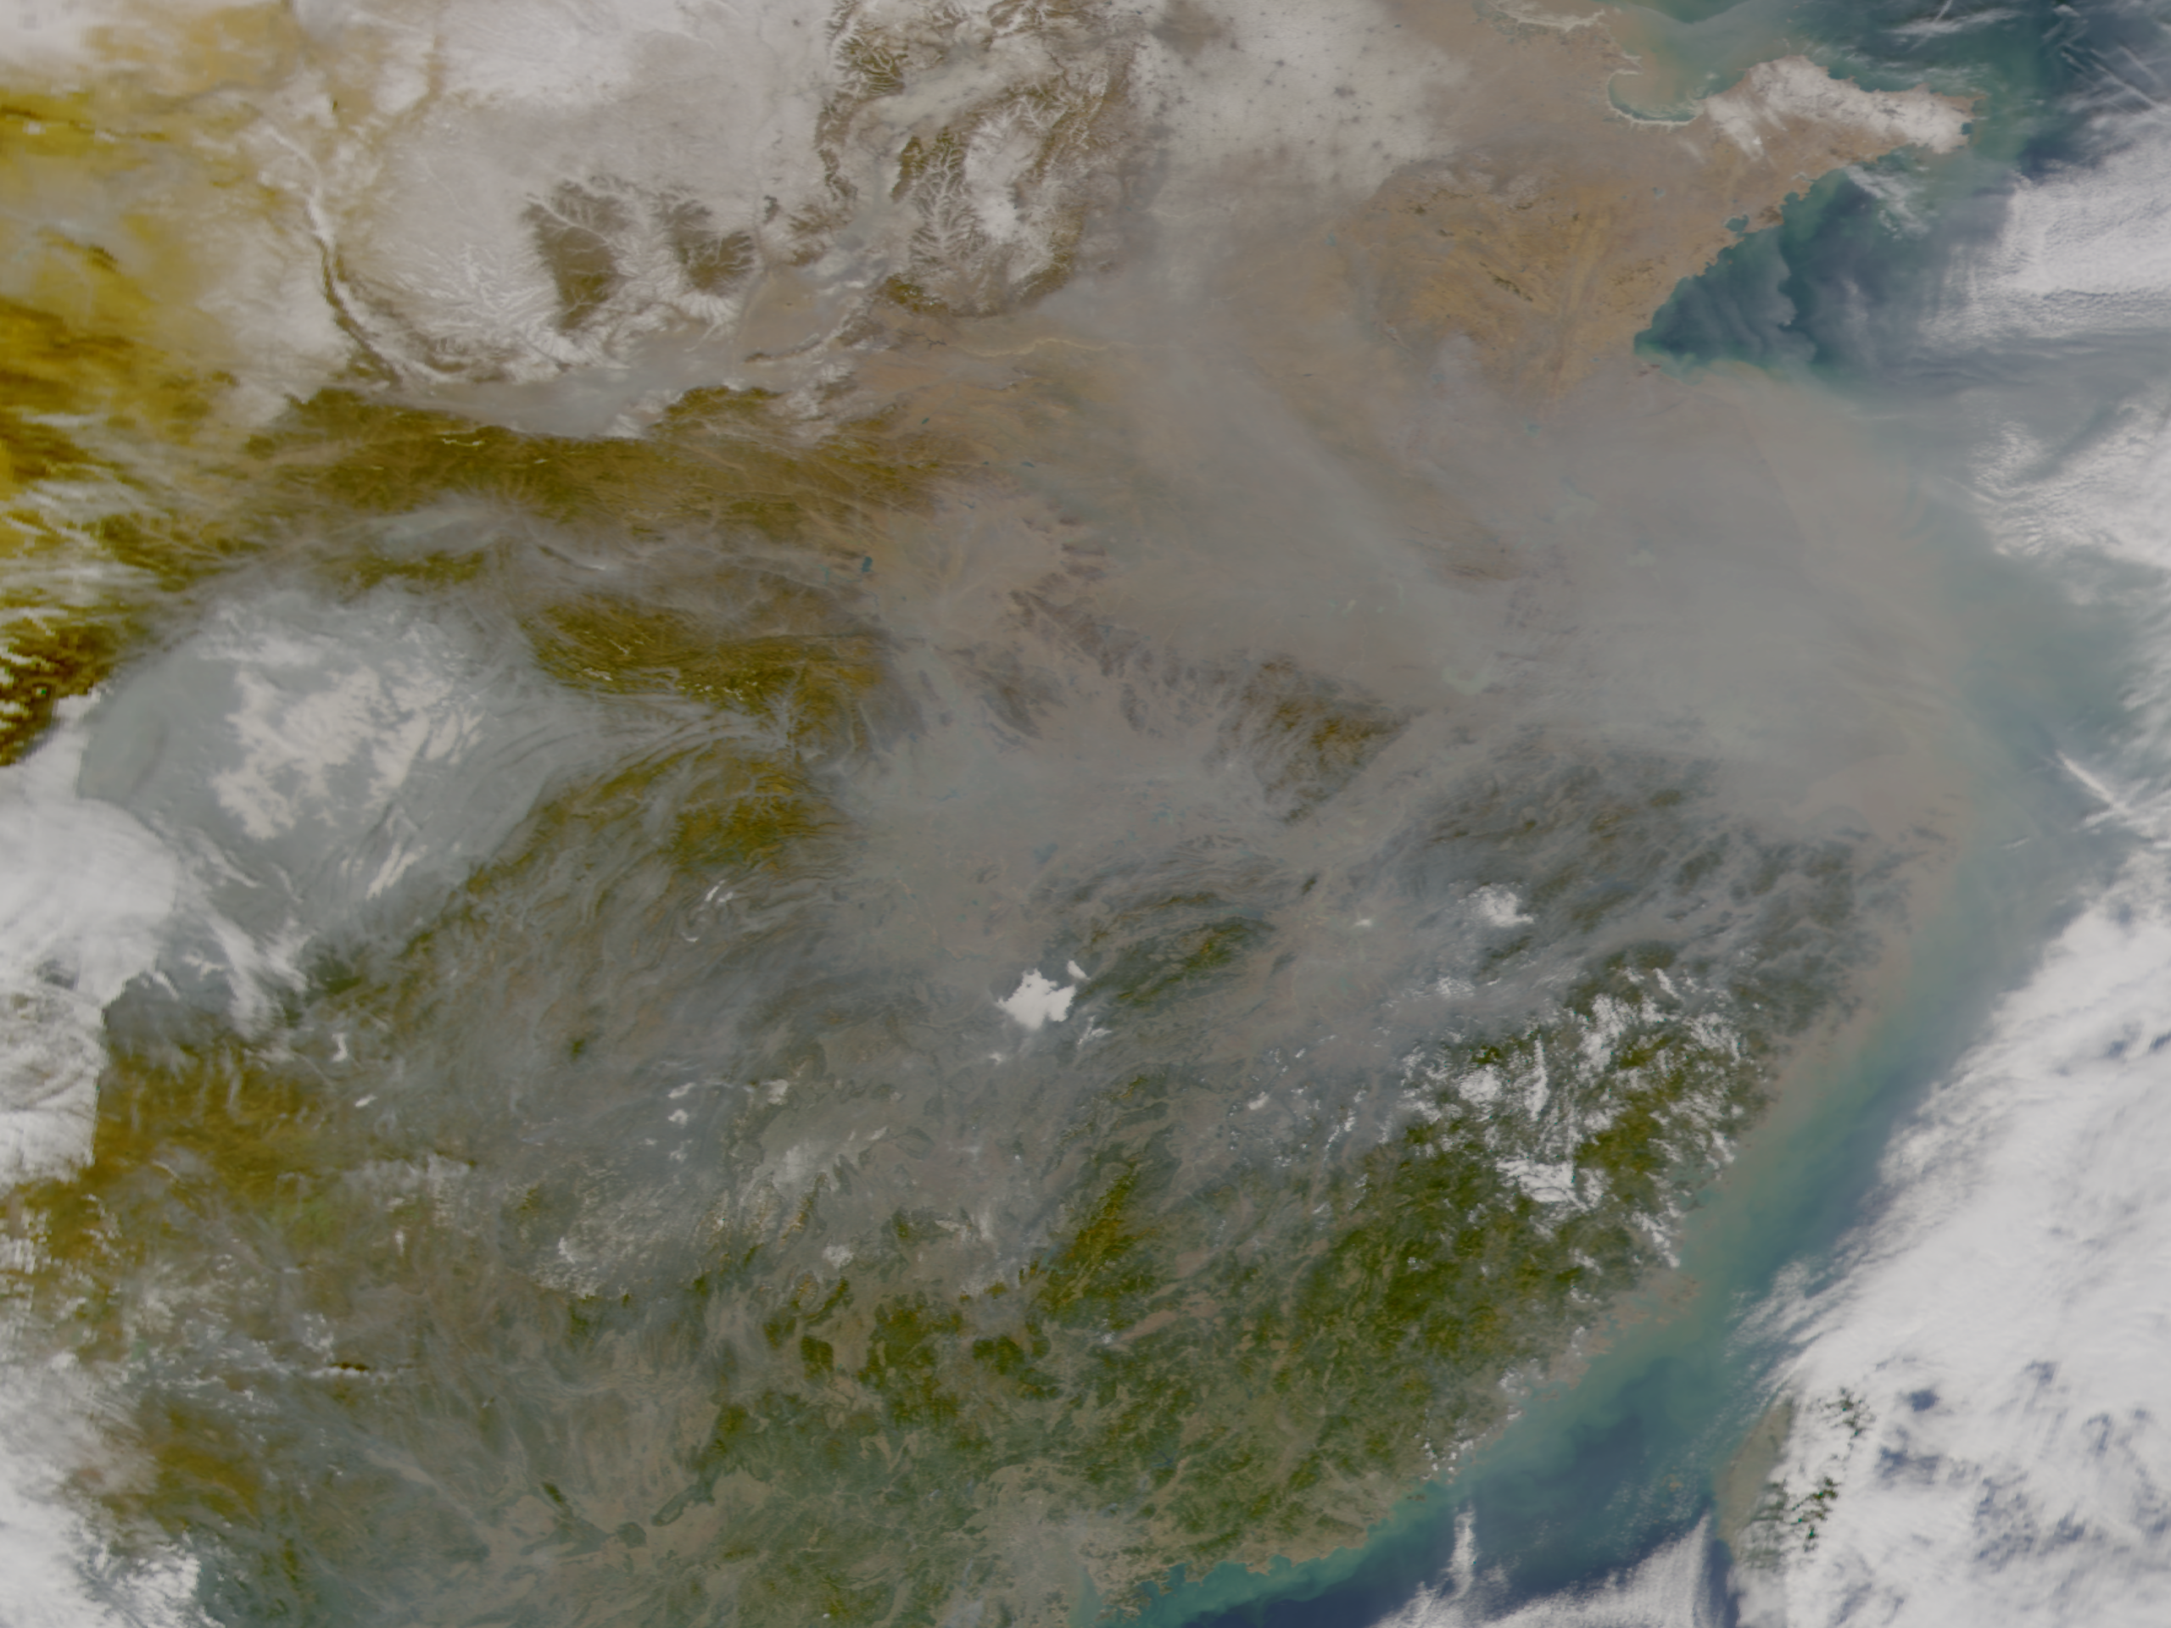
Smog Over Asia Decreasing Cloudiness
NASA/ORBIMAGE

Slide 5
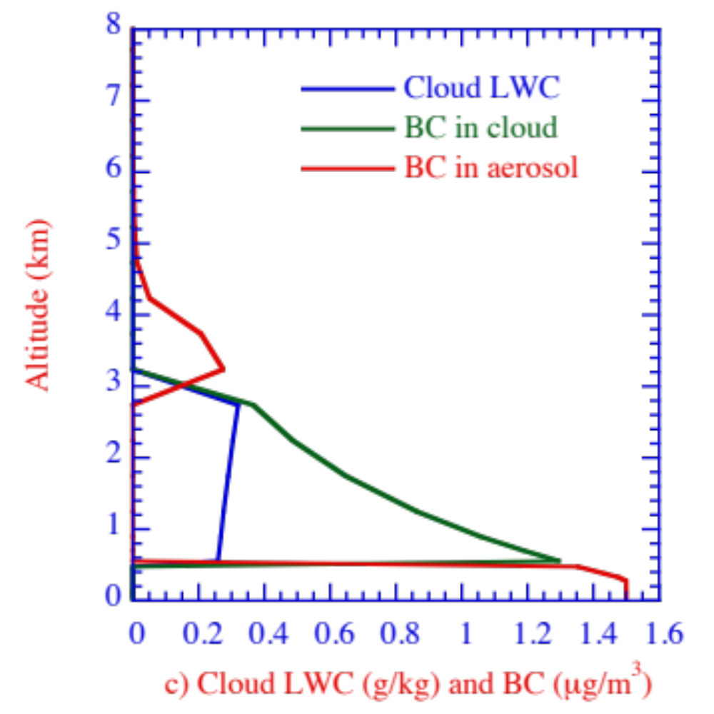
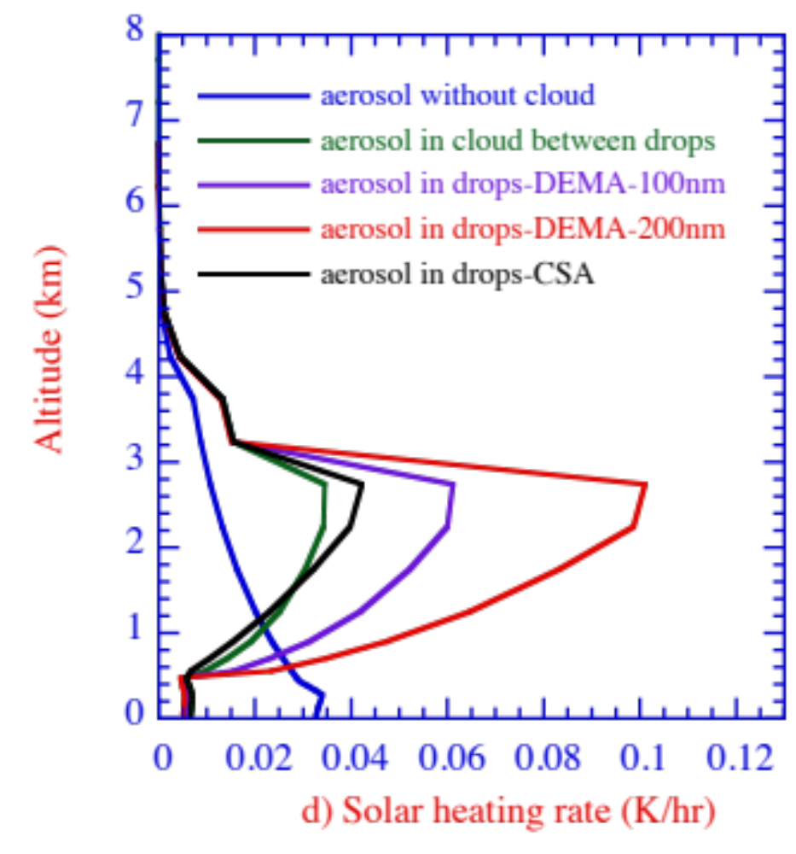
Heating Rate Due to BC in Middle Cloud Inclusions, Interstitially Between Cloud Particles, and in the Clear Sky
Cloud LWC and BC
In Cloud & Clear Sky
Column-integrated heating rate of inclusions 2.8 times that of BC in clear sky, 2.4 times that of interstitial BC

Slide 6
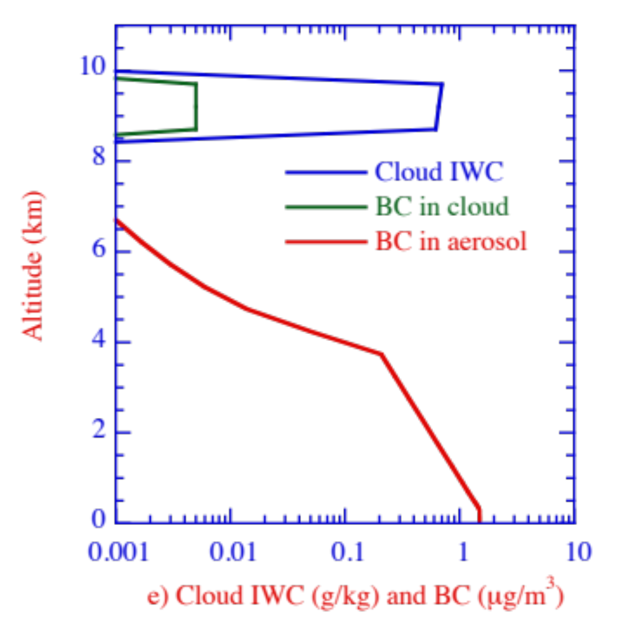
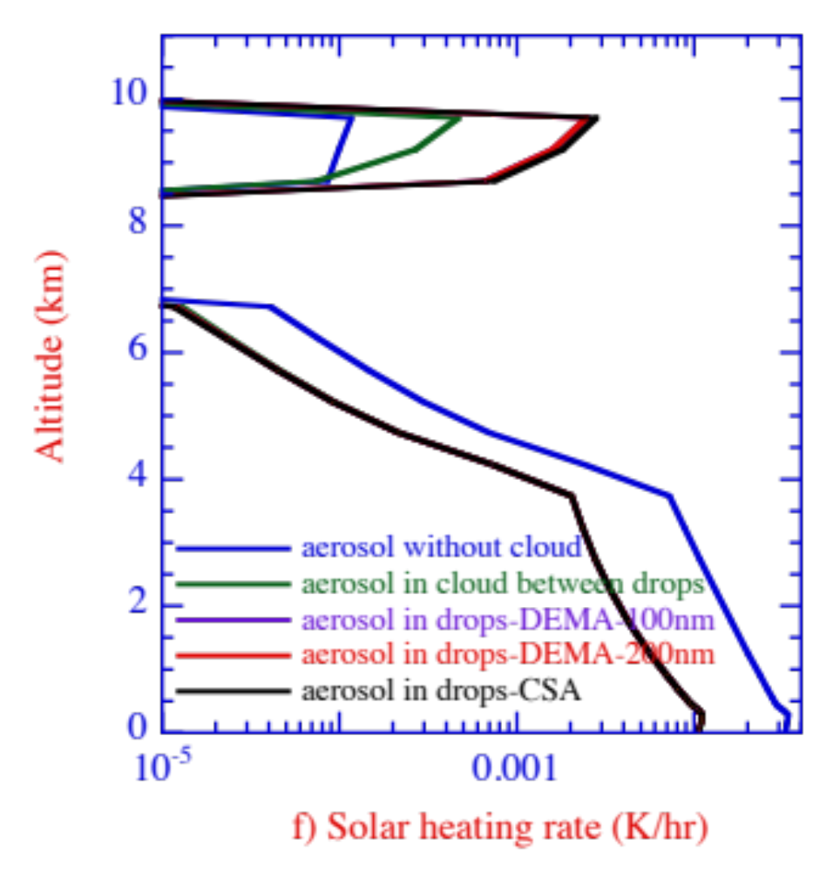
Heating Rate Due to BC in Contrail Inclusions, Interstitially Between Contrail Particles, and in the Clear Sky
Conrail IWC and BC In Contrail & Clear Sky
Heating rate of inclusions 30 times that of BC in clear sky, 6 times that of interstitial BC

Slide 7
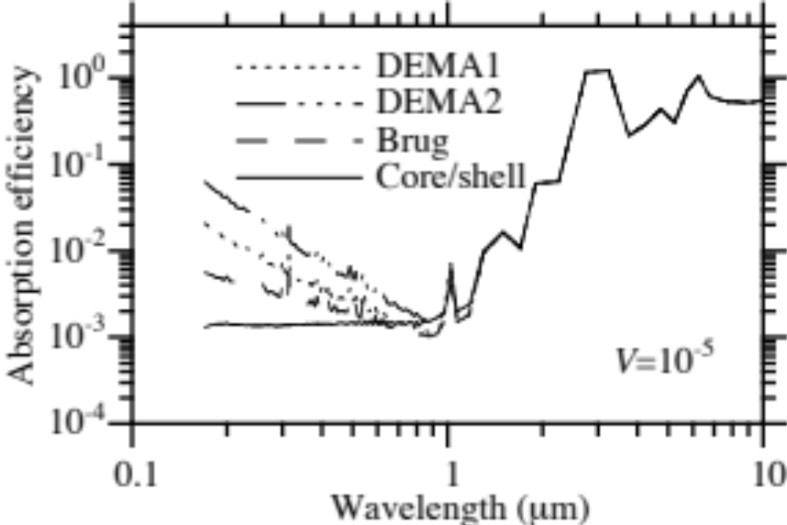
Cloud Absorption Should be Treated with DEMA (Multiple BC Inclusions in Drops)
Jacobson, J. Phys. Chem. (2006)
Absorption Efficiency 12.6-Micron Cloud Drops
DEMA1,2=0.1-, 0.2-micron BC inclusions; Brug=Bruggeman (BC well-mixed); Core/shell=single BC core
Notes:
In the model simulation, we also see a boomerang shape in the baseline COD vs. the baseline AOD for the same time period and area as the previous satellite-derived slide (left panel). In the model, CODs are about twice as large as the satellite-derived AODs. The right slide represents the baseline minus the sensitivity simulation, so the y-axis represents the CHANGE in COD by adding biomass burning aerosol. The fact that the COD is always positive indicates that at all AODs, addition of biomass burning aerosol serves to INCREASE cloud optical depth. At higher CODs between 0.6 and 1, the aerosol increases the COD to a lesser extent than at lower aerosol optical depths. This results in the boomerang shape shown in the left panel of this figure.

Slide 8
Why Does Interstitial Cloud (IC) BC Heat More Than Clear-Sky BC and In-Cloud-Drop BC Heat More Than IC BC?
1) BC between cloud drops (interstitial) heats more than aerosol BC due to enhanced scattering of light between cloud drops thus more photons hitting BC in the cloud than outside the cloud.
2) BC in cloud drops heats more than BC between cloud drops due to optical focusing of enhanced scatter cloud light into drops and multiple internal reflections of such light to BC inclusions.
Notes:
In the model simulation, we also see a boomerang shape in the baseline COD vs. the baseline AOD for the same time period and area as the previous satellite-derived slide (left panel). In the model, CODs are about twice as large as the satellite-derived AODs. The right slide represents the baseline minus the sensitivity simulation, so the y-axis represents the CHANGE in COD by adding biomass burning aerosol. The fact that the COD is always positive indicates that at all AODs, addition of biomass burning aerosol serves to INCREASE cloud optical depth. At higher CODs between 0.6 and 1, the aerosol increases the COD to a lesser extent than at lower aerosol optical depths. This results in the boomerang shape shown in the left panel of this figure.

Slide 10
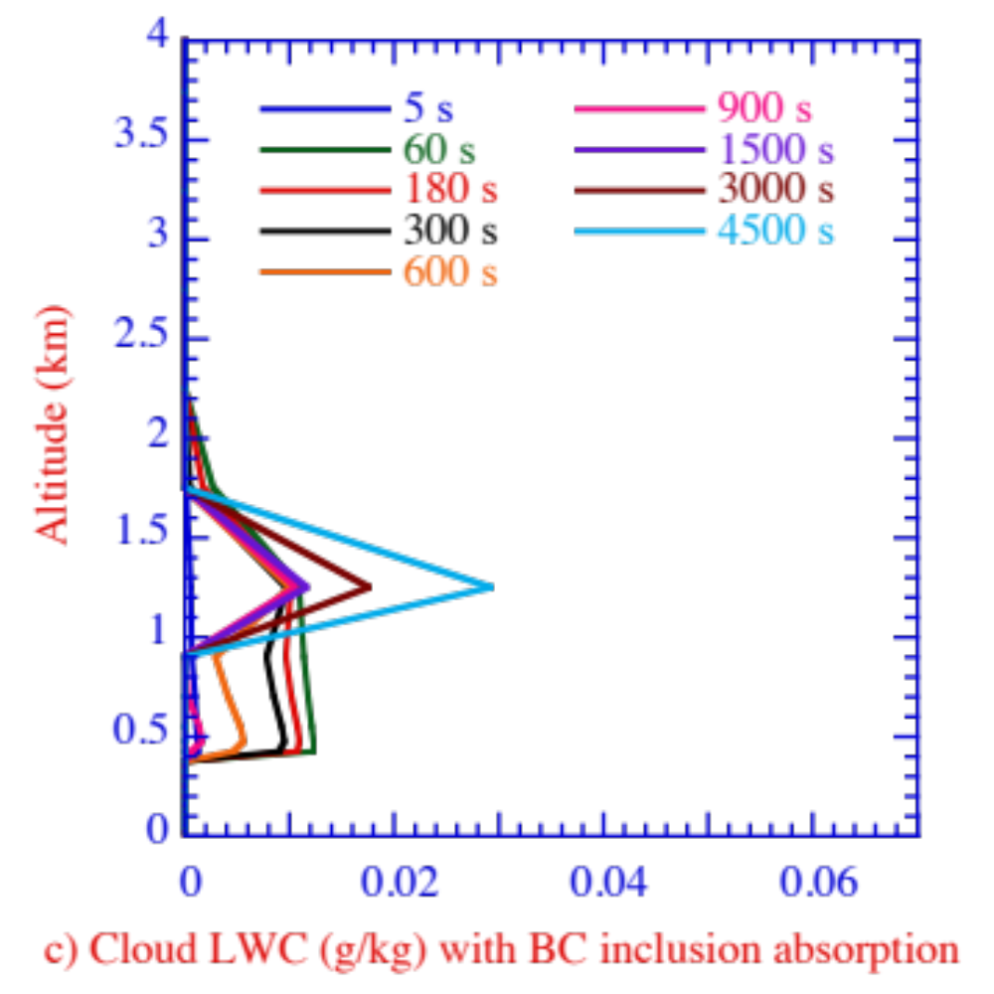
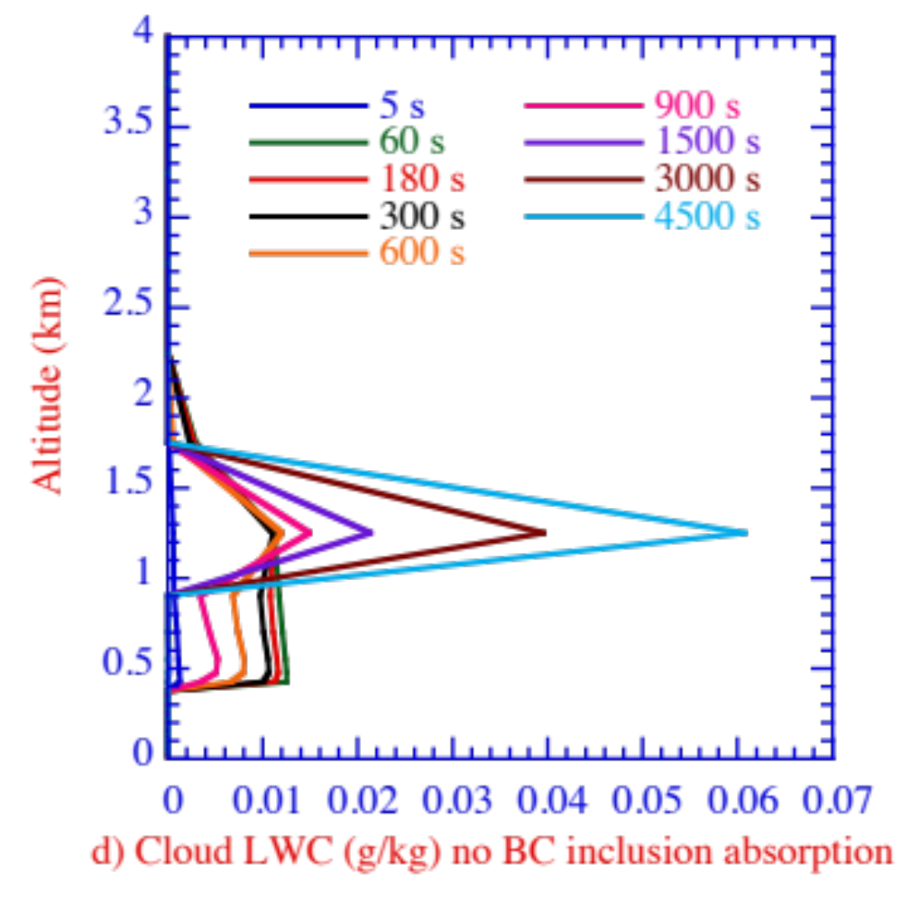
Cloud Evolution With Versus Without Absorption by BC Inclusions
With Absorption
Without Absorption
Absorption by BC inclusions speed up cloud dissipation, allowing more sunlight to reach surface in positive feedback

Slide 11
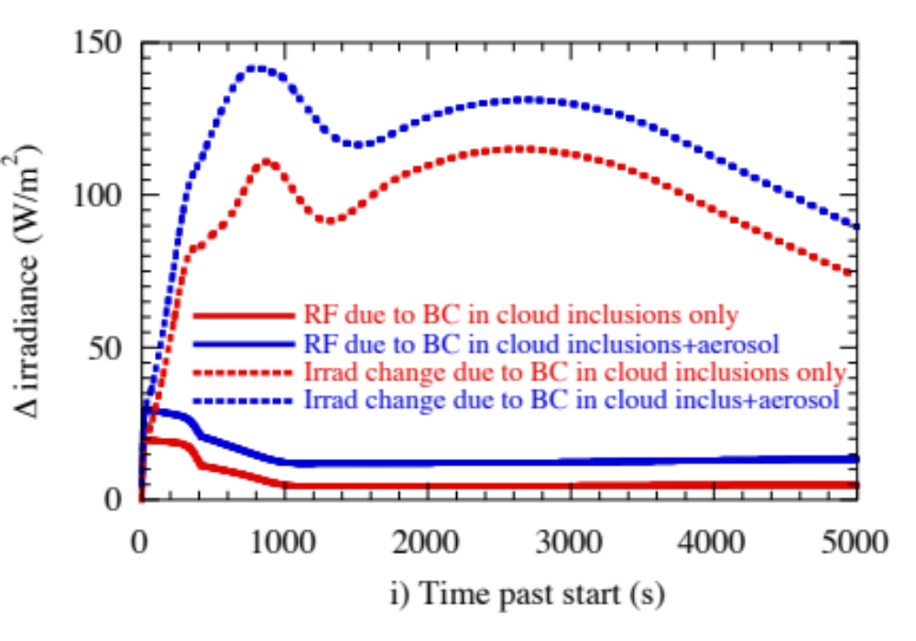
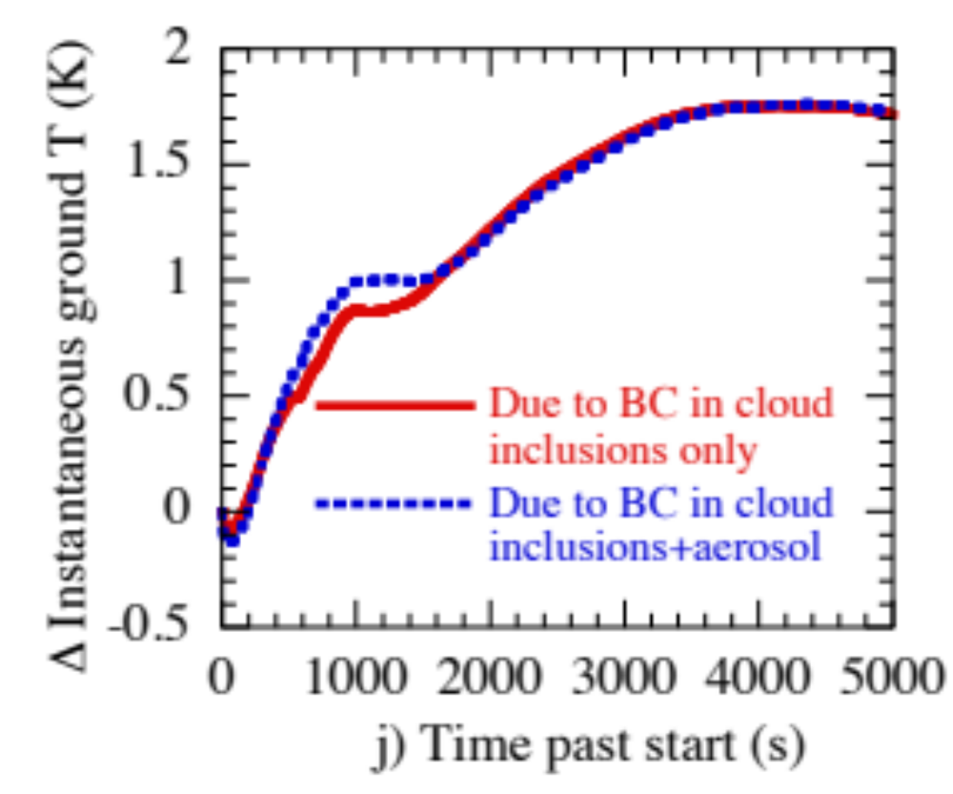
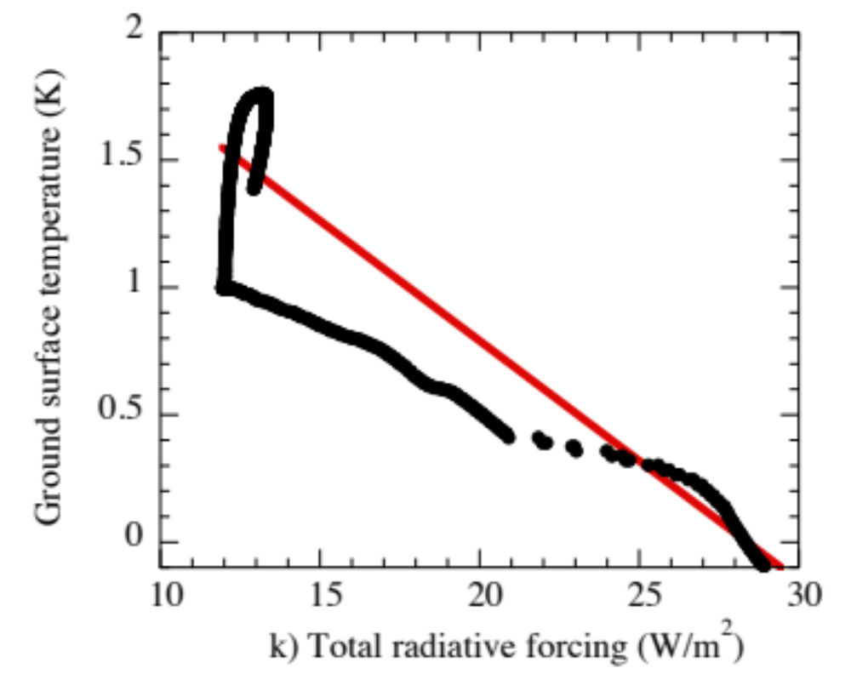
Cloud Evolution With Versus Without Absorption by BC Inclusions
Irradiance (dots) and radiative forcing (solid) due to BC inclusions (lower curves) and BC inclusions + aerosol (upper curves)
Temperature change due to BC inclusions only and inclusions+aerosol (accounting for indirect effects)
Anti-correlation between radiative forcing and surface temperature
Instantaneous radiative forcing and surface temperature change are anti-correlated in the case of cloud absorption

Slide 12
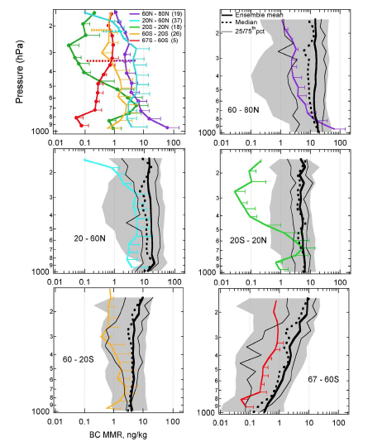
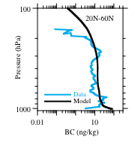
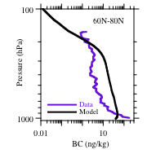
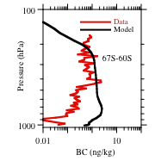
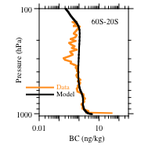
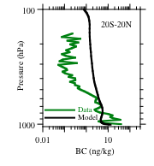
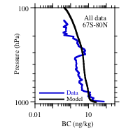
Models v. HIPPO BC Data Pacific
GATOR-GCMOM vs HIPPO
(1.4% column diff. all data)
Schwartz et al. (2010) 14 Models vs. HIPPO
(“Models overpredict by factor of five”)
60 – 20S 20 - 60N All Data
60 – 20S 20 - 60N All Data
60 - 80N 20S - 20N 67 - 60S
60 - 80N 20S - 20N 67 - 60S

Slide 13
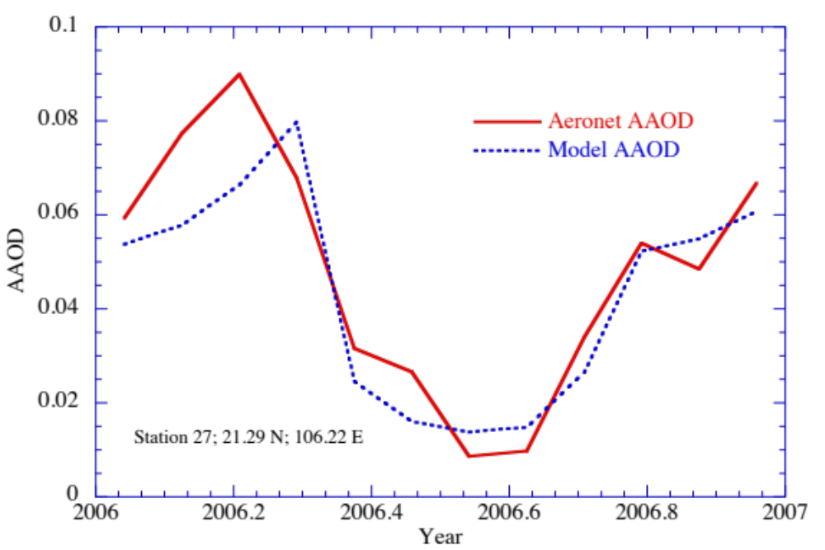
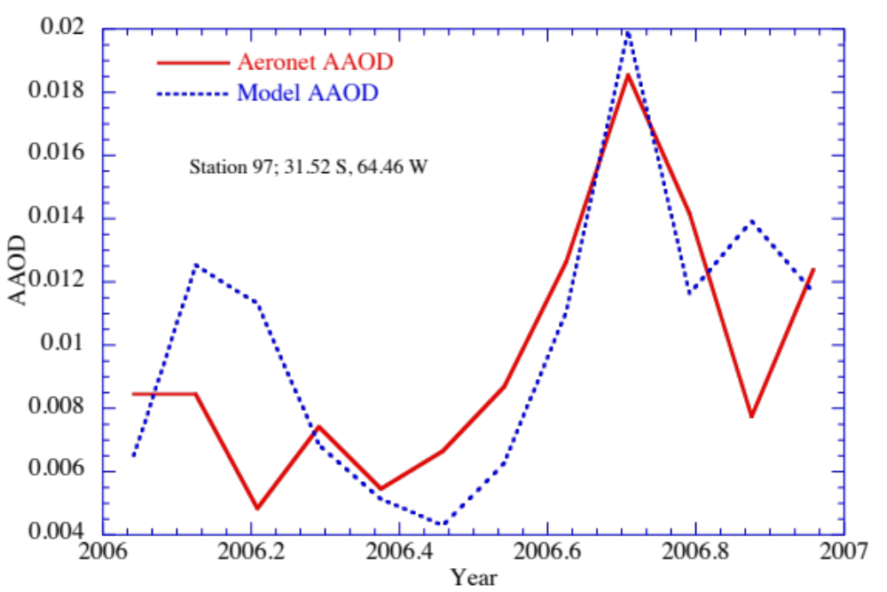
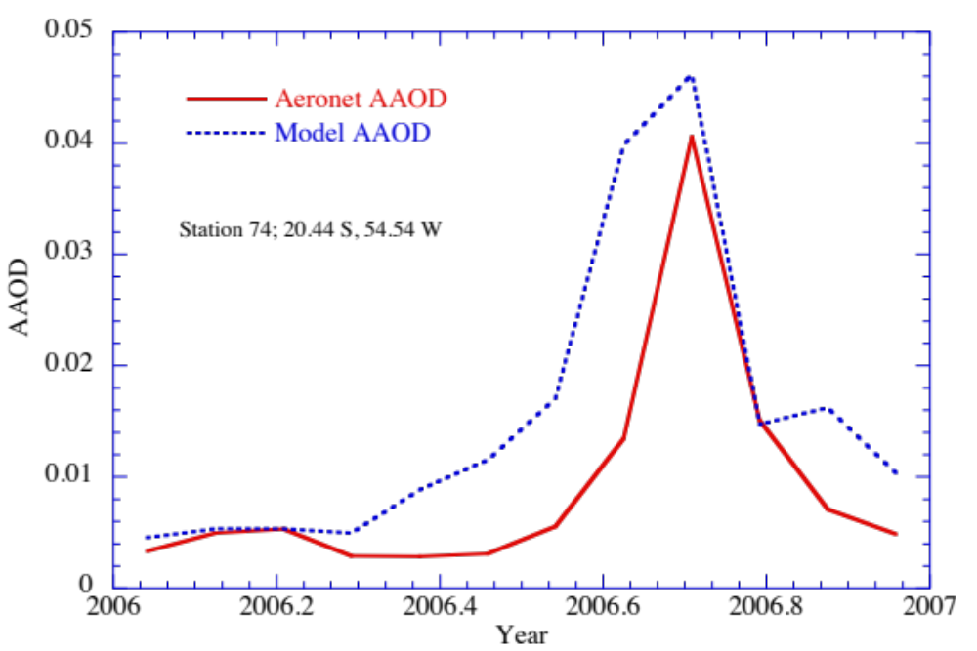
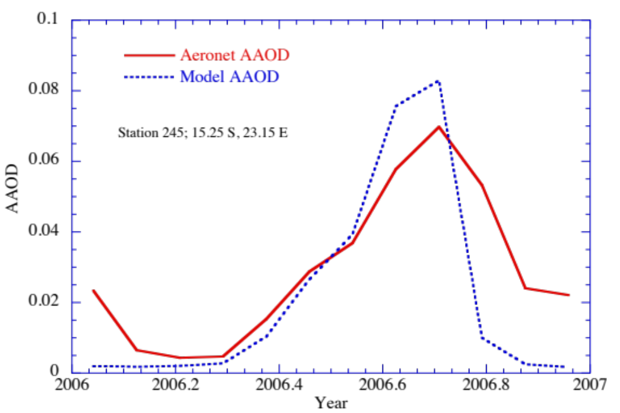
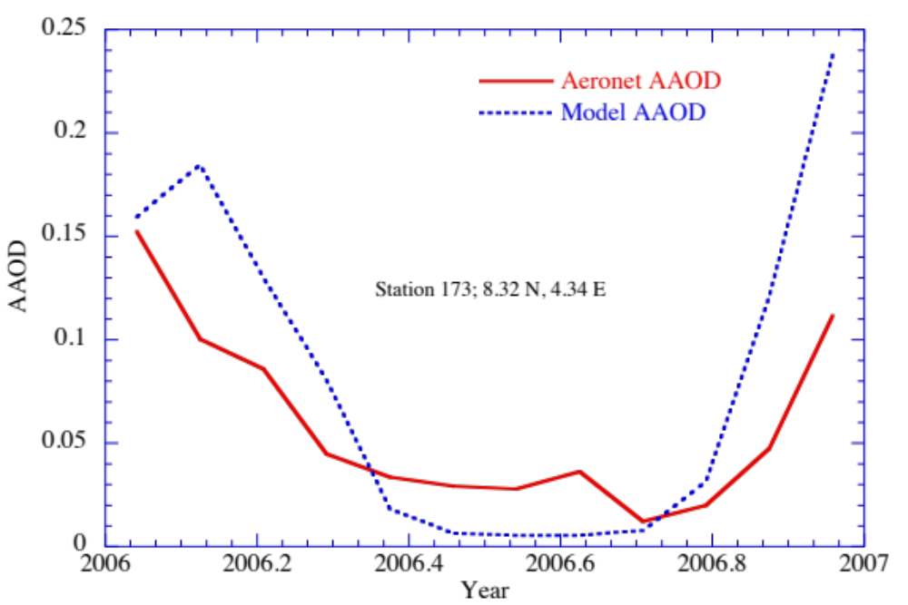
Modeled (4ºx5º) Versus AERONET AAOD

Slide 14
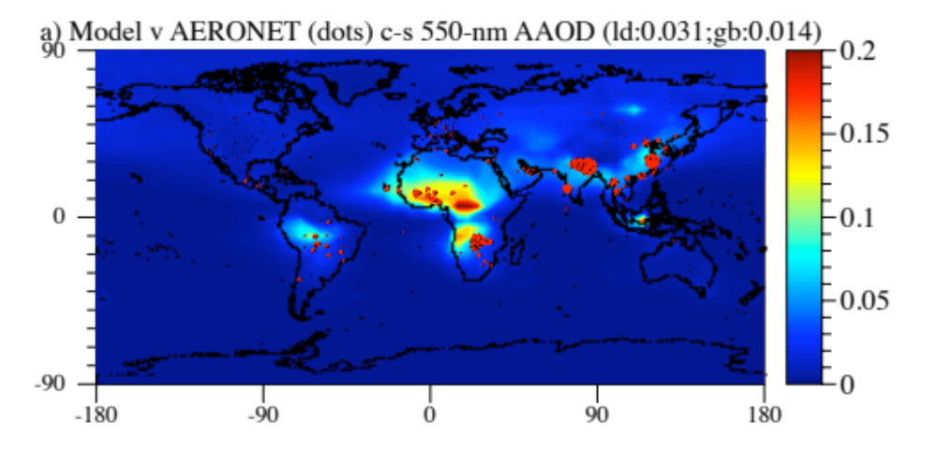
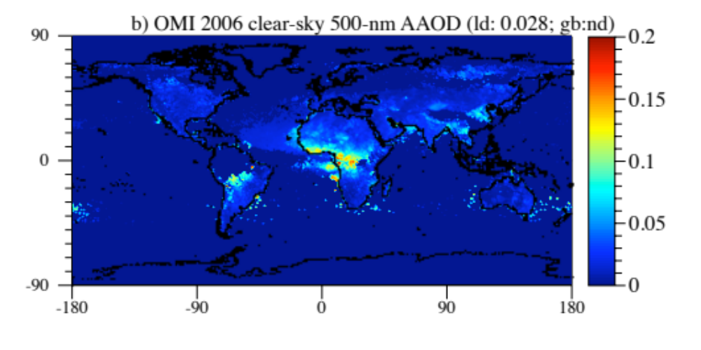
Modeled vs. OMI and AERONET AAOD
Model (4ºx5º resolution) calculates AAOD slightly higher than AERONET but lower than OMI at AERONET sites. Model correlates better with AERONET and OMI separately better than OMI correlates with AERONET

Slide 15
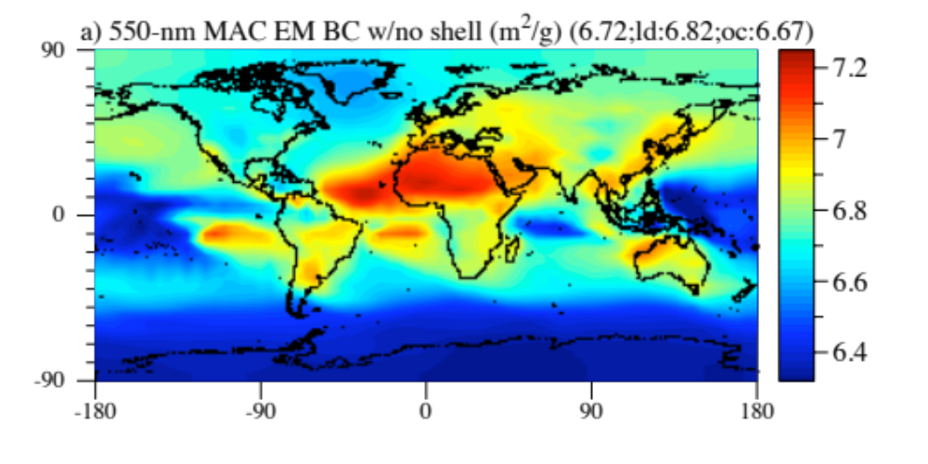
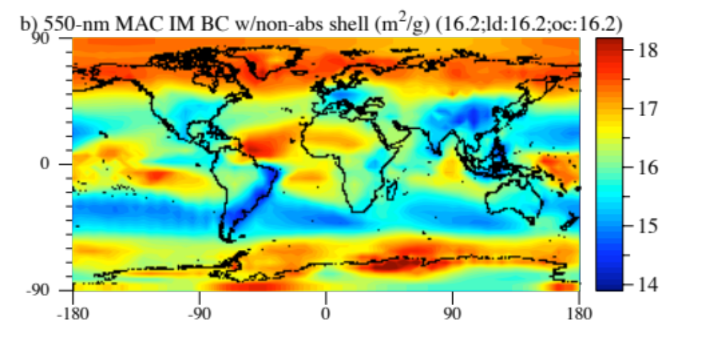
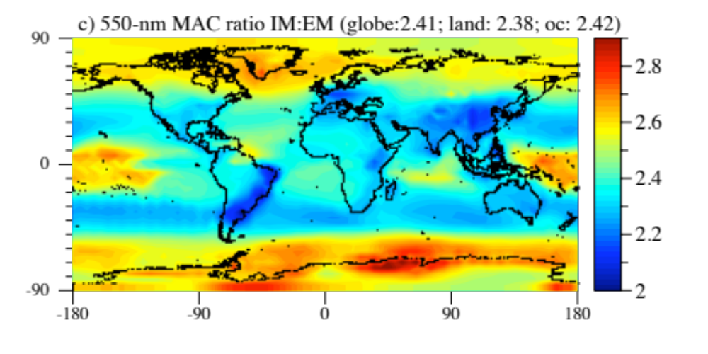
Modeled Mass Absorption Coefficients and Enhancement Factors
MAC of EM BC (Avg=6.7)
MAC of IM BC (Avg=16.2)
Internal-mixing enhancement factor: IM:EM MAC (Avg = 2.4 – highest where RH is high)

Slide 16
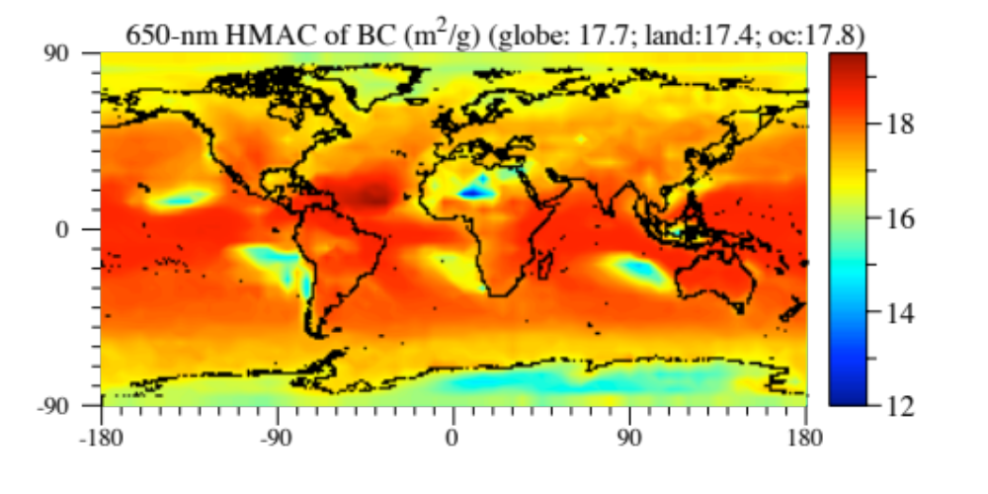
MAC of BC in Cloud Drop Inclusions
Average = 17.7, >9% higher than that of IM aerosol BC

Slide 17
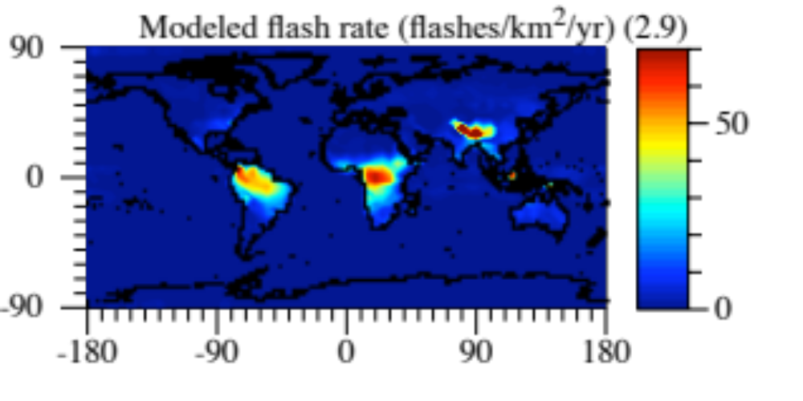
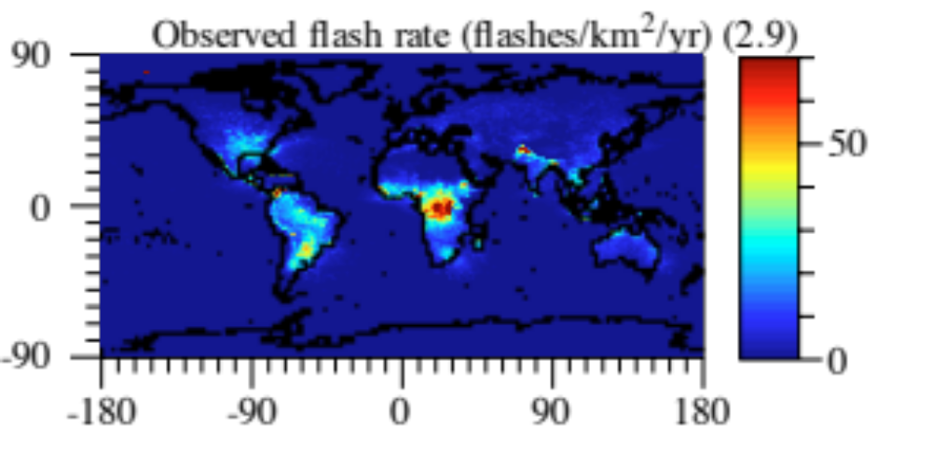
Modeled vs. Measured Annual Lightning Flash Rate
Data from NASA LIS/OTD Science Team
Model (4ºx5º resolution) calculates lightning by accounting for size-resolved bounceoffs and charge separation in clouds. Results follow from new drop breakup algorithms.

Slide 18
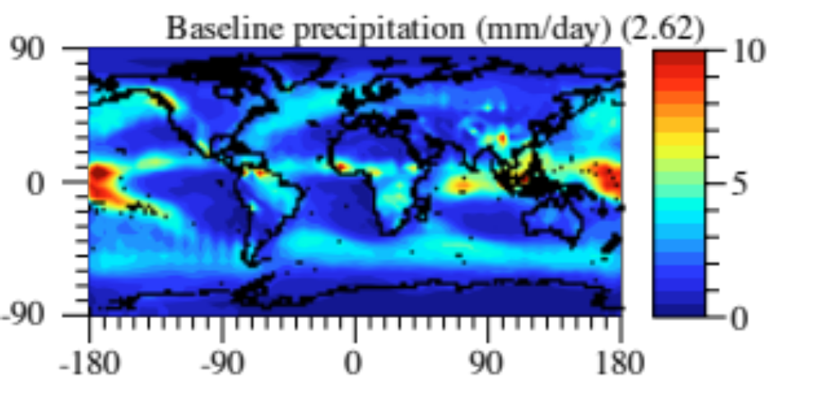
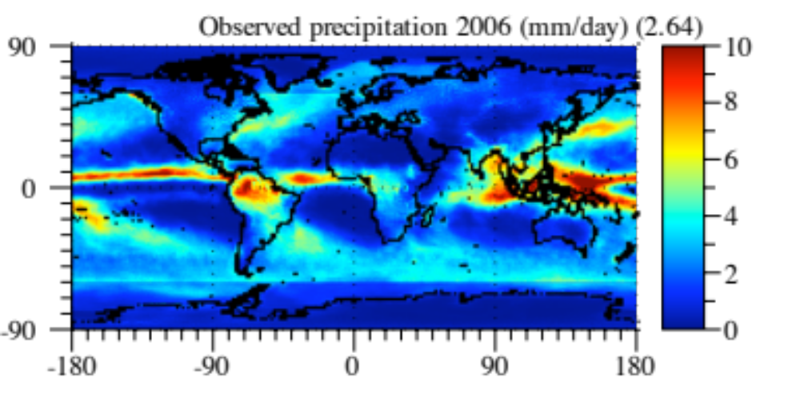
Modeled vs. Measured Precipitation
Data from Huffman et al (2007)
Despite factor of 20 lower resolution than data, model predicts locations of main features of observed precipitation and, with no flux adjustment, correctly does not produce a double ITCZ

Slide 19
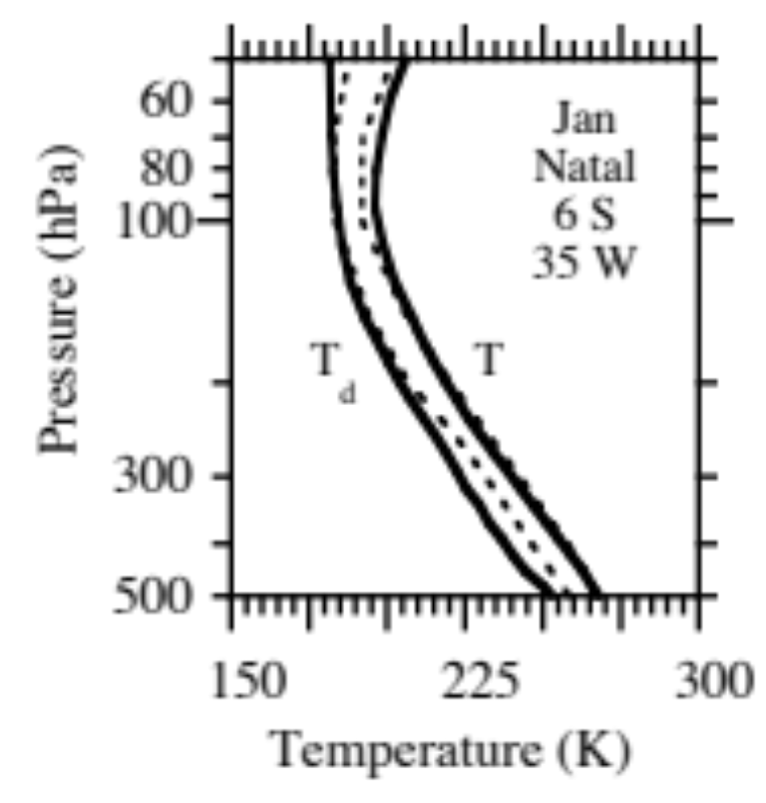

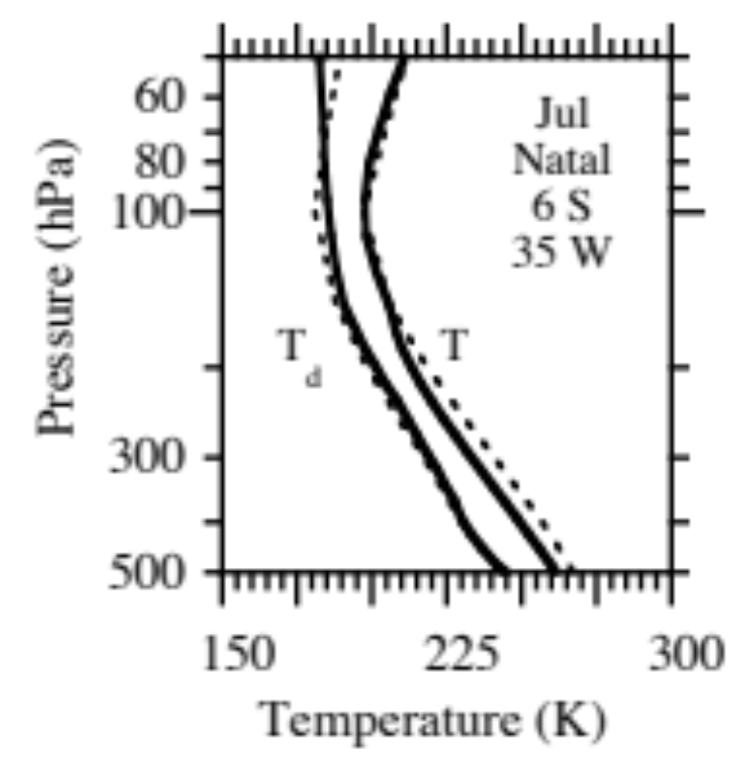
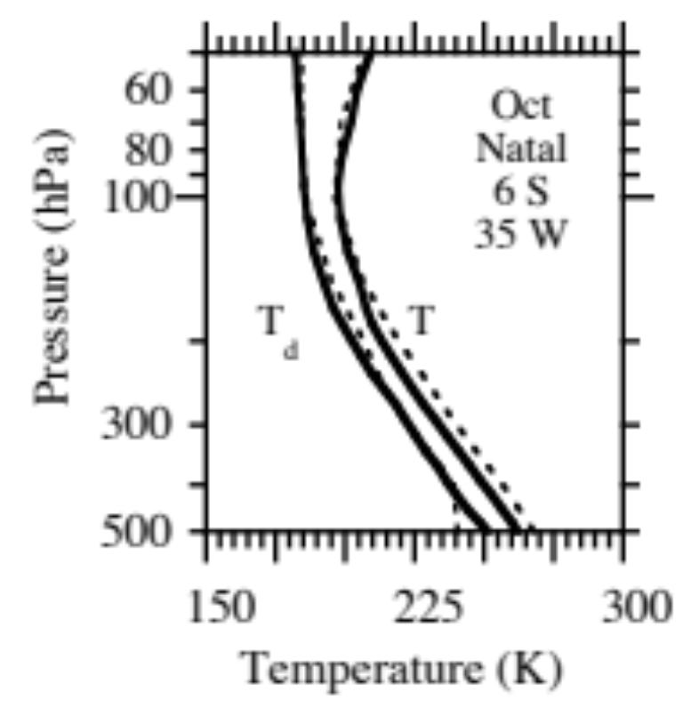
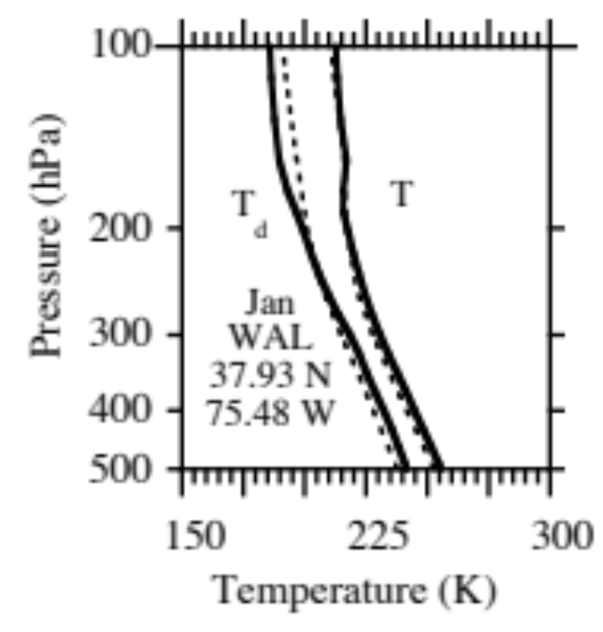
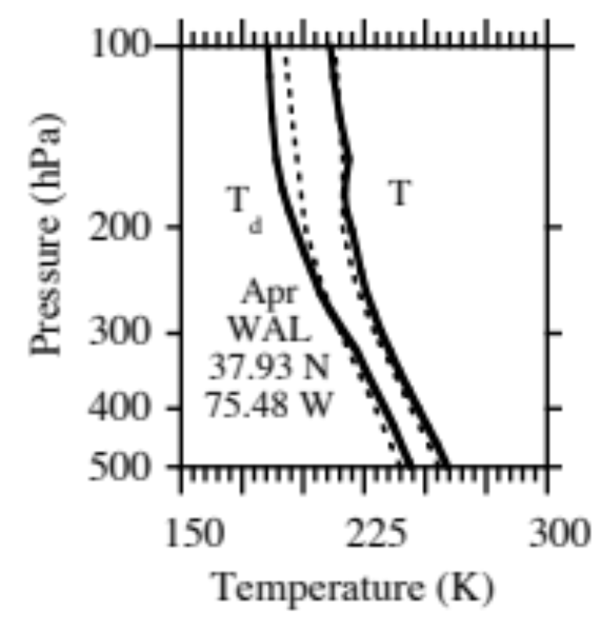
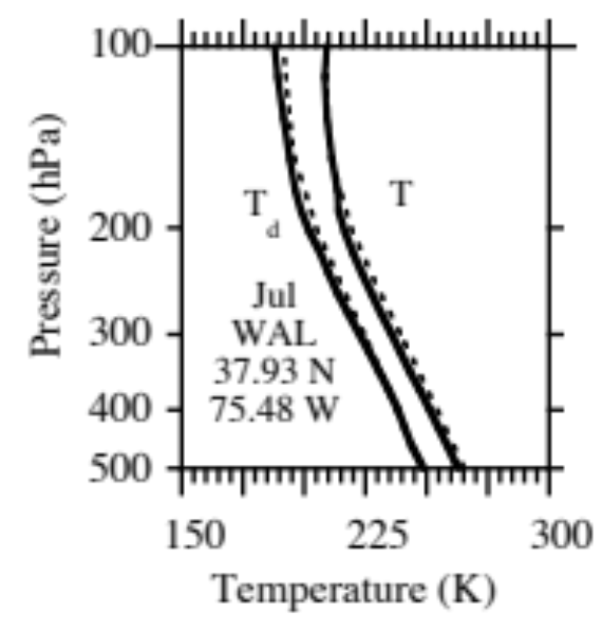

Modeled vs. Measured Paired in Space Monthly T/T_{d}
Global domain
U.S. domain
Little numerical diffusion of water vapor or energy to stratosphere
Data from FSL (2008)

Slide 20
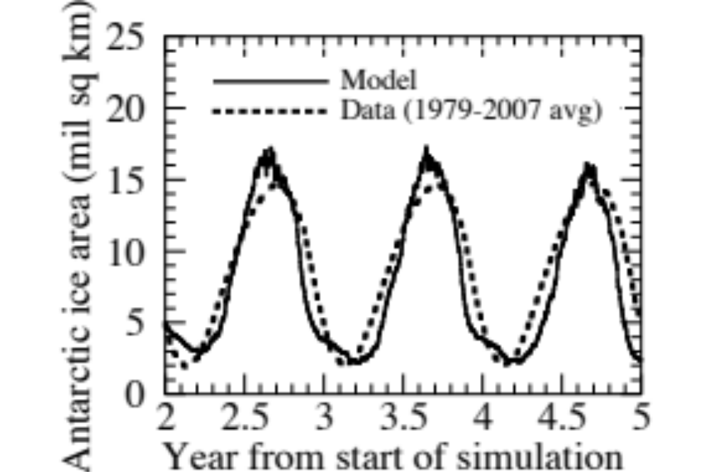
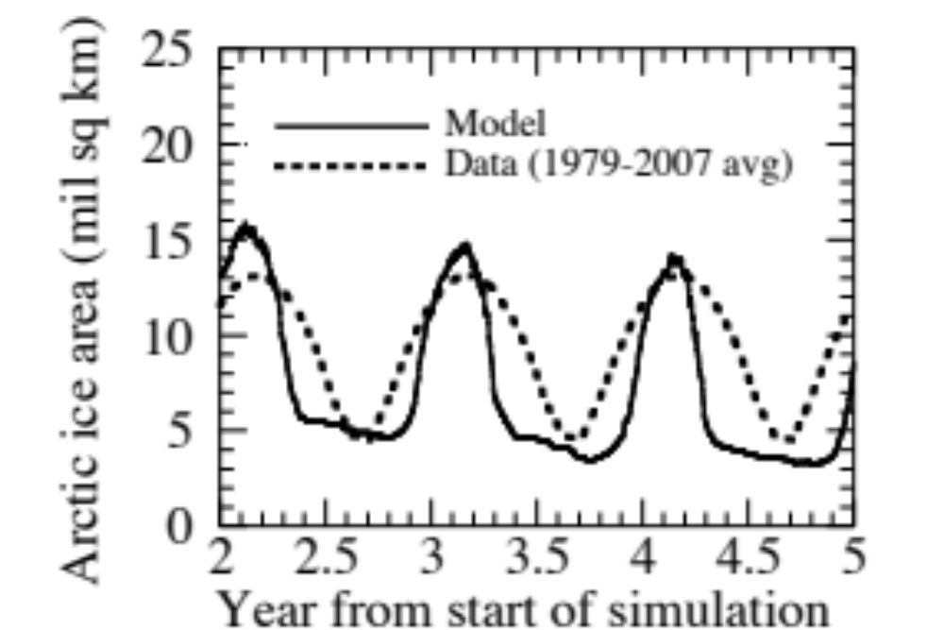
Modeled vs. Measured Sea Ice Area
Antarctic
Arctic
Model (at 4 x 5 degree resolution) predicts stable sea ice area
Data from NASA Team (2009)

Slide 21
Aerosol Size Distributions
Two distributions, each with multiple size bins and components per bin
Emitted fossil-fuel soot (EFFS)
Emission sources: fossil-fuel combustion
Internally-mixed (IM)
Emission sources: biofuel burning, biomass-burning, sea spray, soil dust, road dust, volcanos, pollen, spores, bacteria
Homogeneous nucleation: H₂SO₄-HNO₃-H₂O into IM distribution
Coagulation:
EFFS + EFFS = EFFS
EFFS + IM = IM
IM + IM = IM
Growth: Organic matter, H₂SO₄, HNO₃, HCl, NH₃ H₂O grow on both EFFS & IM
Clouds: Both distributions activate size-resolved liquid, ice, graupel clouds

Slide 22
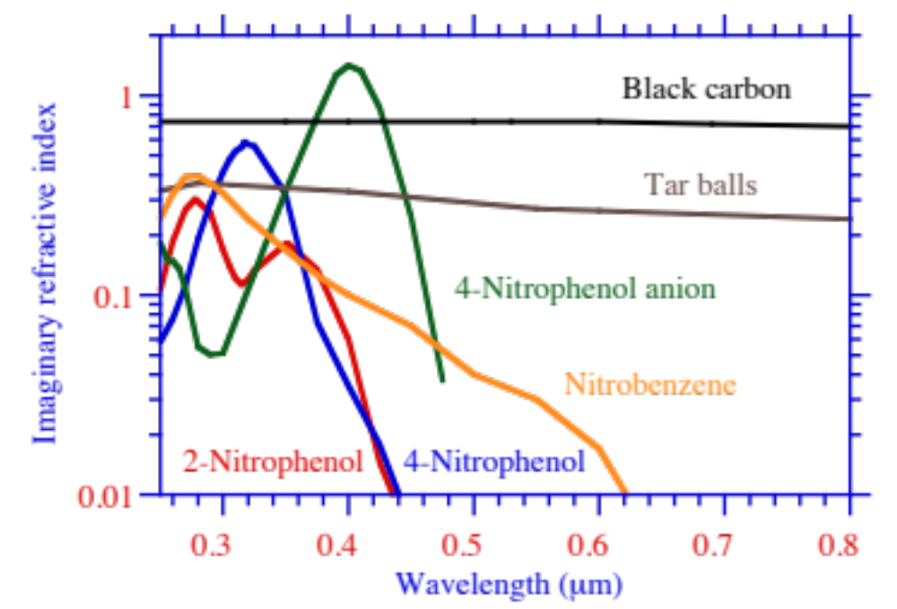
Imag. Ref. Indices Organic & Black Carbon
BC: Bergstrom; nitrated & aromatics: Jacobson, 1999; Tar balls: Alexander et al., 2008 )

Slide 23
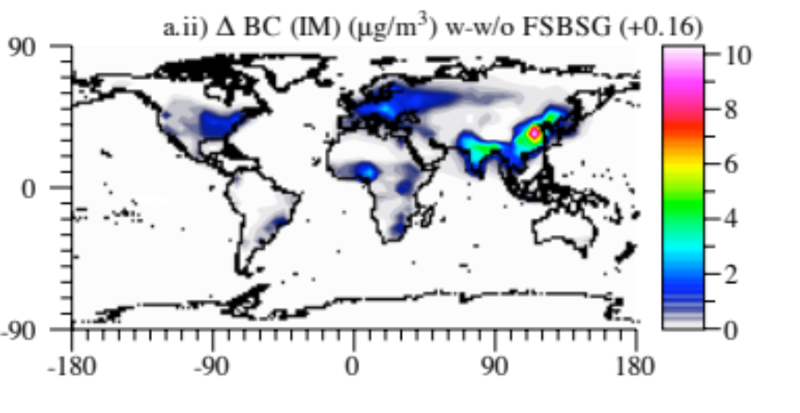
Black Carbon From Fossil- and Bio-fuel Soot
BC from FF soot is about half that of BC from FF+BF soot

Slide 24
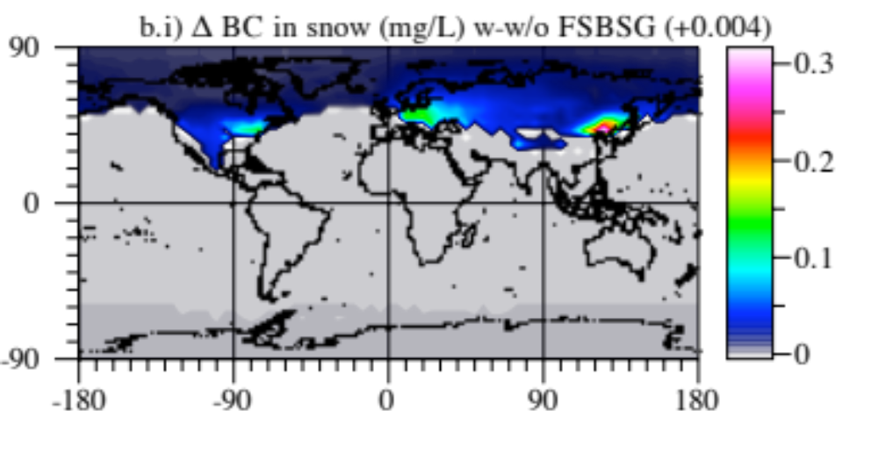
Black Carbon in Snow and Sea Ice

Slide 25
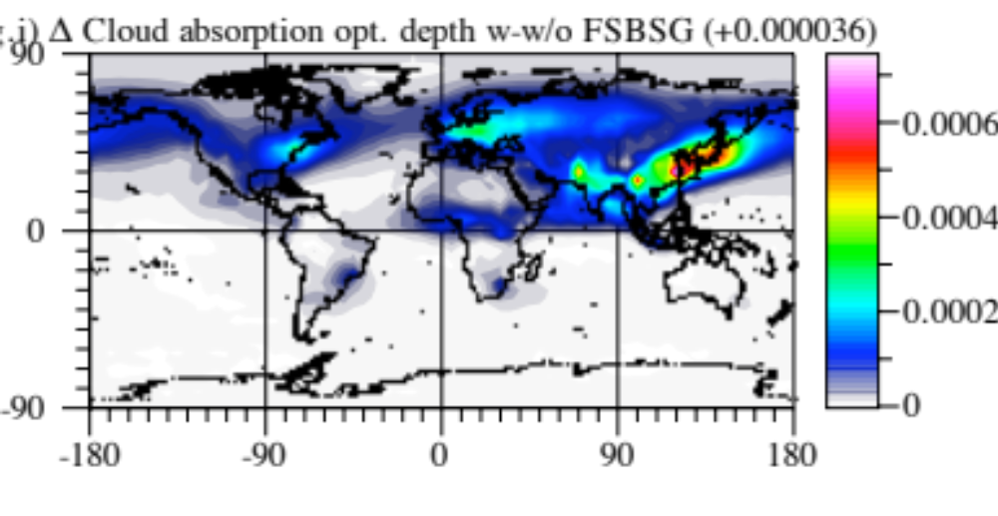
Black Carbon Absorption in Clouds

Slide 26
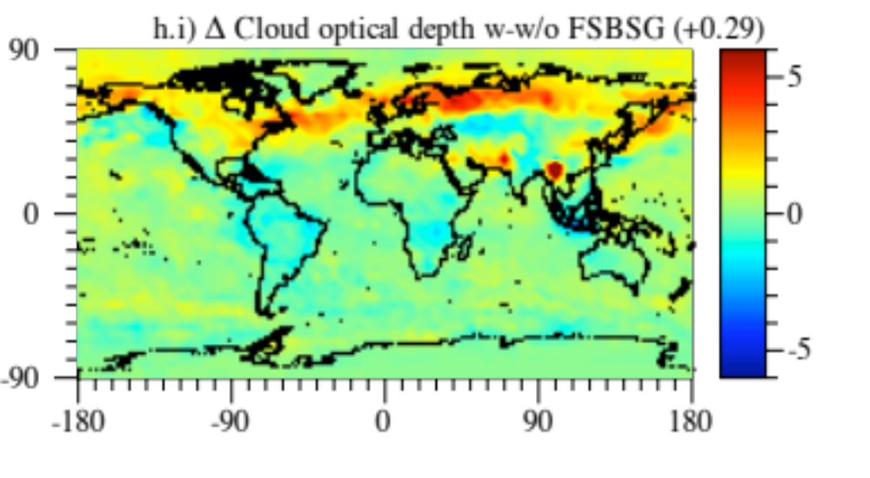
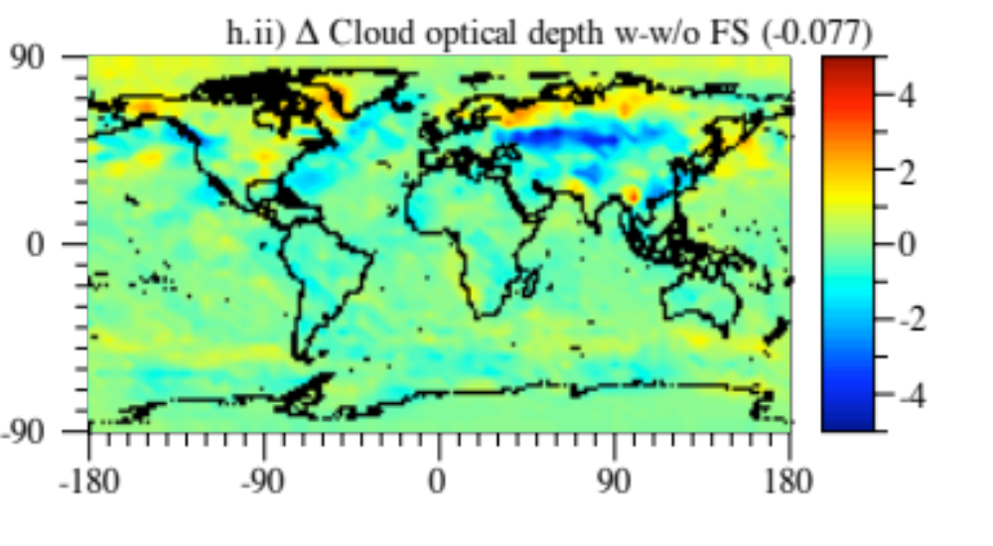
COD Changes Due to FF+BF Soot + BF gases and to FF Soot Alone
Cloud OD change due to
FF+BF soot + BF gases
Cloud OD change due
to FF soot
FF+BF soot +BF gases increased COD; FF soot decreased COD

Slide 27
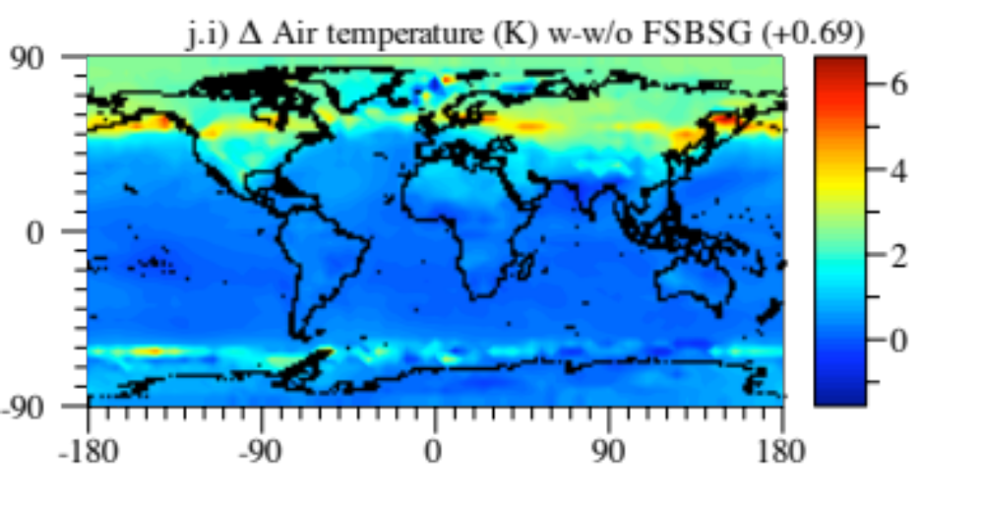
Surface Air Temperature Changes Due Fossil-Fuel Soot Plus Biofuel Soot and Gases

Slide 28
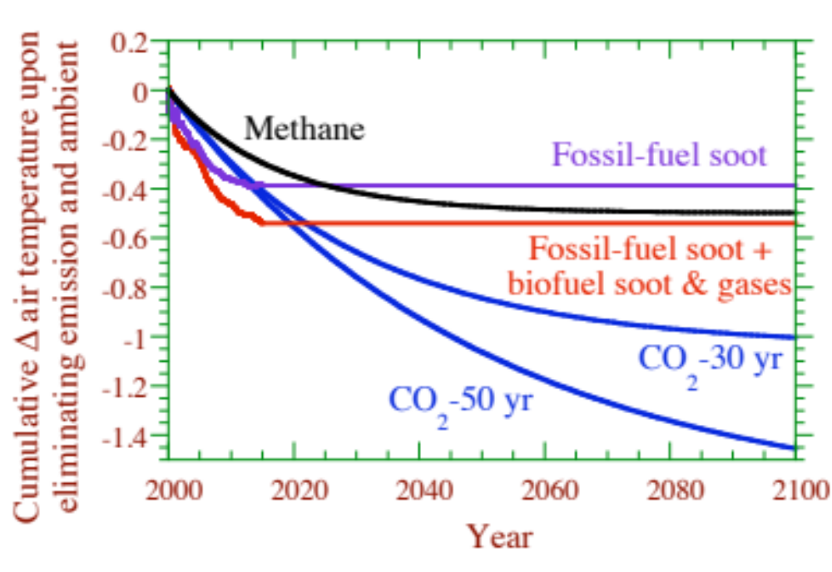
Fossil-Fuel Soot and Biofuel Soot & Gas Controls may be Fastest Method of Slowing Global Warming and Saving Arctic Ice
www.stanford.edu/group/efmh/jacobson/controlfossilfuel.html

Slide 29

11.5% loss/decade
81,400 km² loss/year
nsidc.org/arcticseaicenews

Slide 30

Contributors to Global Warming
Jacobson (2010, JGR 115, D14209)

Slide 31
Some Climate Response Estimates of BC
Ramanathan and Carmichael (2008) 0.5-1 K (all BC)
Chung and Seinfeld (2005) 0.37 K (all BC internally mixed)
Hansen et al. (2005) > 0.3 K (BC from fossil fuels)
Jacobson (2010) 0.4-0.7 K (BC, organic matter, and other particle components from fossil fuels and biofuels)

Slide 32

Annual Deaths Due to Fossil-Fuel and Biofuel Soot
Deaths due to BF soot (1.5 million/yr) ~7 times those due to FF soot (200,000/yr)

Slide 33

Effects of Rerouting Flights Around Arctic Circle
Reroute flights >500 mi, >50 seats, and origin+destination airports below Arctic Circle.
Number of cross-polar flights 2004-2010

Slide 34

Rerouting One Flight (Frankfurt to Anchorage)
Cooper et al. (2011)

Slide 35


Rerouting 2006 Cross-Arctic Flights (40,399)
Before After
Jacobson et al. (2011)

Slide 36


Global Modeled Temperature Change Due to Rerouting Over 22 years
Jacobson et al. (2011)

Slide 37
Summary
FSBSG soot may be the second-leading cause of global warming behind CO₂ and ahead of CH₄. FS causes 3 x the warming of BSG, but BSG causes ~7x more deaths than FS.
Strong warming mainly due to cloud absorption effect, semidirect effect, internal mixing of aerosol, snow absorption effect, and feedback to water evaporation.
Net global warming (0.7-0.8 K) appears due to gross warming from FF GHGs (2-2.4 K) and FSBSG (0.4-0.7 K) offset by cooling due to non-FSBSG aerosol particles (-1.7 to -2.3 K). FS and FSBSG may contribute to 13-16% and 17-23% of gross warming due to atmospheric pollutants.
Control of FS, FSBSG is fastest method of reducing Arctic loss
www.stanford.edu/group/efmh/jacobson/Articles/VIII/controlfossilfuel.html

