Slide 1
Presentation Slides for
Chapter 14 of
Fundamentals of Atmospheric Modeling 2nd Edition
Mark Z. Jacobson
Department of Civil & Environmental Engineering
Stanford University
Stanford, CA 94305-4020
jacobson@stanford.edu
March 30, 2005

Slide 2
Sources of New Particles
Emission
Sea spray
Soil dust
Volcanic
Biomass burning
Fossil-fuel combustion
Industrial
Miscellaneous
Homogeneous nucleation
Homomolecular
Binary
Ternary

Slide 3
Sea Spray Emission
Form when winds and waves force air bubbles to burst at sea surface
Contain composition of sea water
Spume drops
Drops larger than sea spray formed when winds tear off wave crests.
Sea-spray acidification
Reduction in chloride in sea spray drops as sulfuric acid or nitric acid enter the drops.
Dehydration
Water loss when drop evaporates in low relative-humidity air

Slide 4
Constituents of Sea Water
Constituent Mass percent
Water 96.78
Sodium 1.05
Chlorine 1.88
Magnesium 0.125
Sulfur 0.0876
Calcium 0.0398
Potassium 0.0386
Carbon 0.0027
Table 14.1

Slide 5
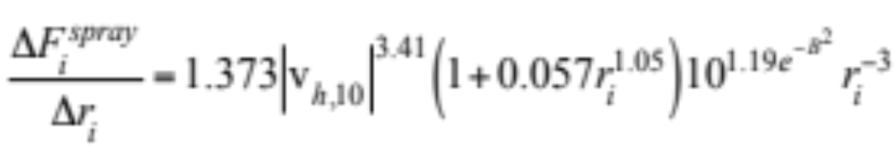
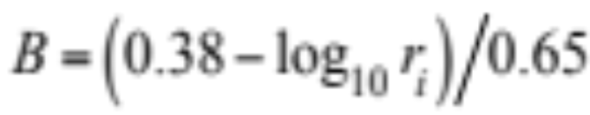
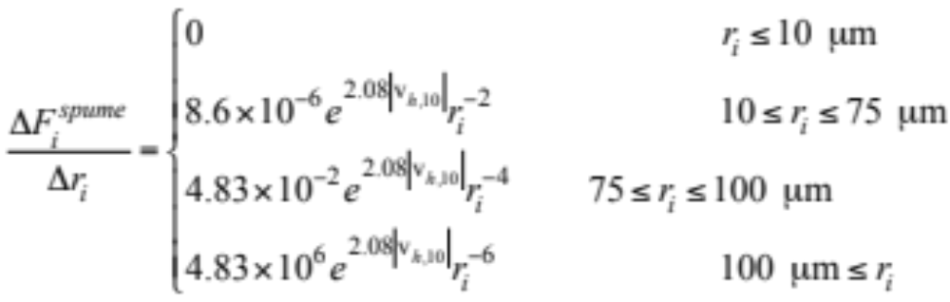
Sea Spray Emission
Flux of sea spray drops per unit radius interval (Monahan)
(14.1)
(14.2)
Flux of spume drops per unit radius interval (14.1)

Slide 6
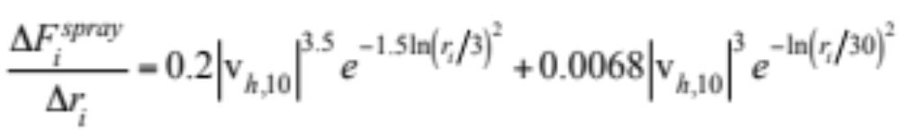
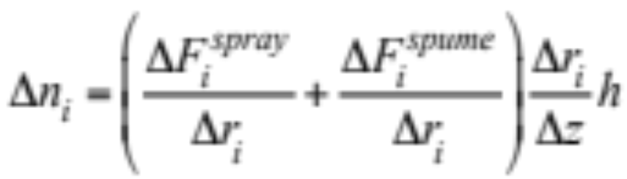
Sea Spray Emission
Flux of sea spray drops per unit radius interval (Guelle) (14.4)
Change in number concentration of sea spray particles (14.5)

Slide 7
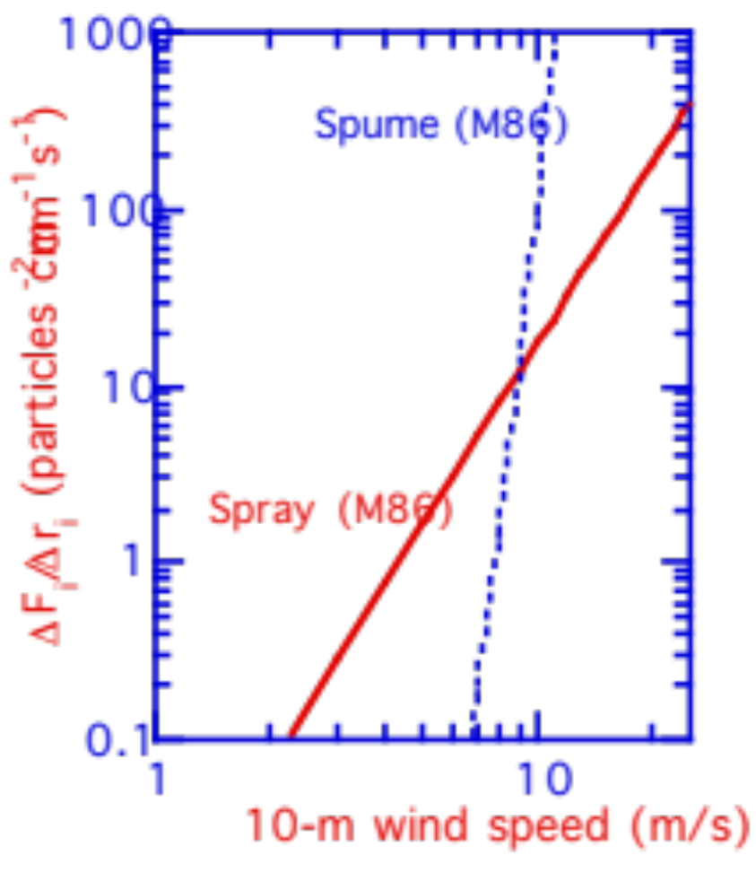
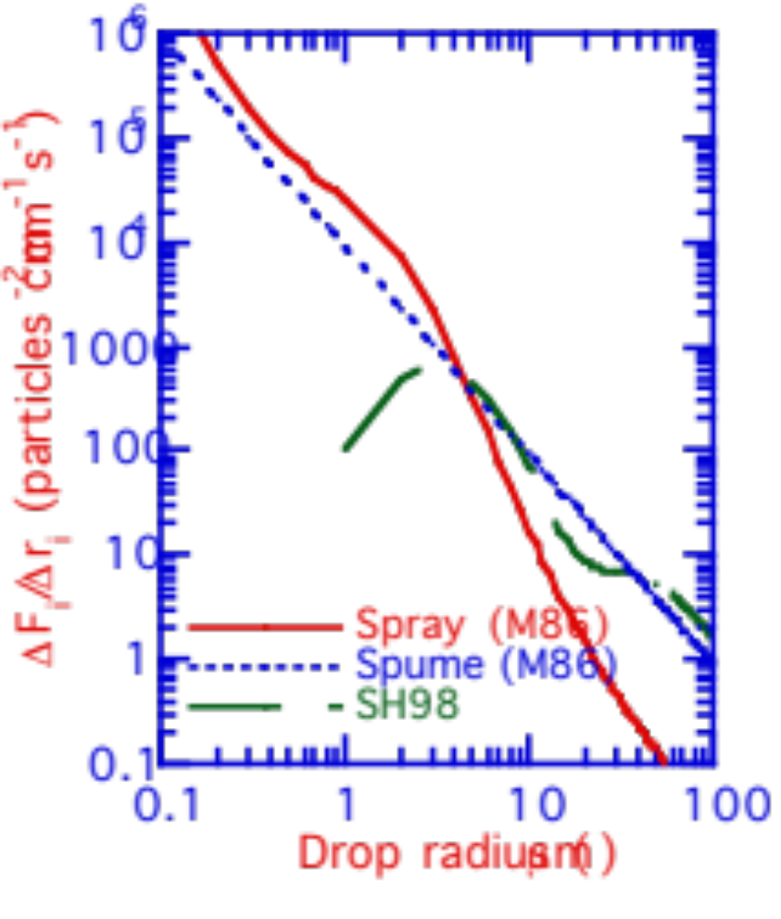
Sea Spray Emission
ΔF/Δr (particles cm⁻² cm⁻¹ s⁻¹)
ΔF/Δr (particles cm⁻² cm⁻¹ s⁻¹)
Fig. 14.1

Slide 8
Soil Dust Emission
Soil
Natural, unconsolidated mineral and organic matter lying above bedrock on the surface of the Earth. Originates from the breakdown of rocks and decay of dead plants and animals.
Rocks
Sedimentary: Cover 75 percent of Earth’s surface and form by deposition and cementation of carbonates, sulfates, chlorides, shell fragments. Example: chalk.
Igneous: Form by cooling of magma. Example: Granite.
Metamorphic: Form by structure transformation of existing rocks due to high temperatures and pressures. Example: Marble.

Slide 9
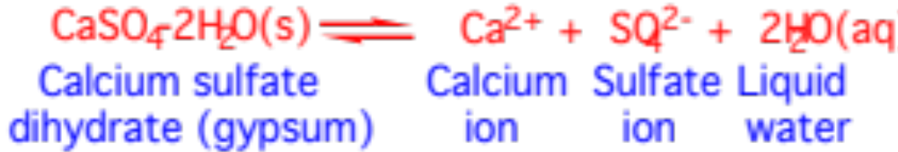
Breakdown of Rocks to Soil
Physical weathering
Disintegration of rocks and minerals by processes not involving chemical reactions. Examples: when stress applied to a rock. Stresses arise due to high pressure under soil or when rocks freeze/thaw or when saline solutions enter cracks and cause disintegration/fracture.
Chemical weathering
Disintegration of rocks and minerals by chemical reaction. Example: Dissolution of gypsum in water:

Slide 10
Types of Minerals in Soil Dust
Quartz - SiO₂(s) - clear, colorless, resistant to chemical weathering
Feldspars - 50 percent of rocks on Earth’s surface
Potassium feldspar - KAlSi₃O₃(s)
Plagioclase feldspar - NaAlSi₃O₃-CaAl₂Si₂O₈(s)
Hematite - Fe₂O₃(s) - reddish brown
Calcite - CaCO₃(s) - found in limestone
Dolomite - CaMg(CO₃)₂(s)
Gypsum - CaSO₄-2H₂O(s)- colorless to white
Clays - soft, compact, odorous minerals resulting from weathering
Kaolinite - Al₄Si₄O₁₀(OH)₈(s)
Illite
Smectite
Vermiculite
Chlorite
Organic matter - plant litter or animal tissue broken by bacteria

Slide 11
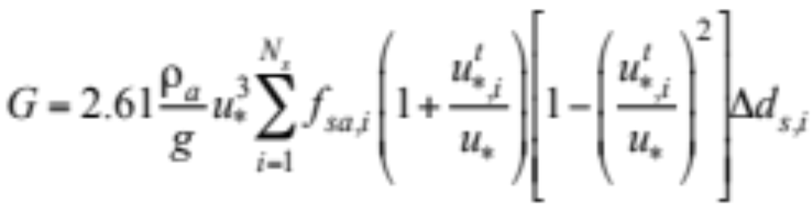
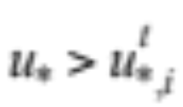
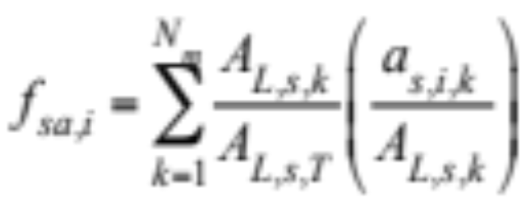
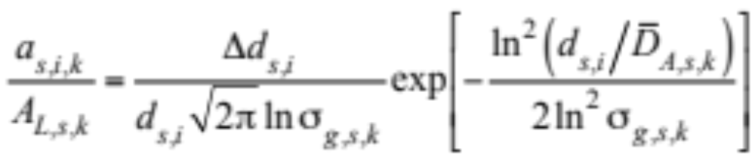
Soil Dust Emission
Horizontal flux, integrated vertically, of soil dust in saltation layer (14.6)
Fractional cross-sectional area soil grain concentration in size bin (14.7)
(14.8)

Slide 12
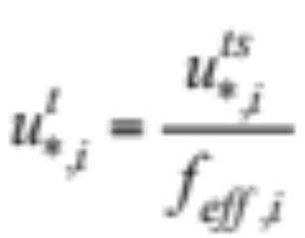
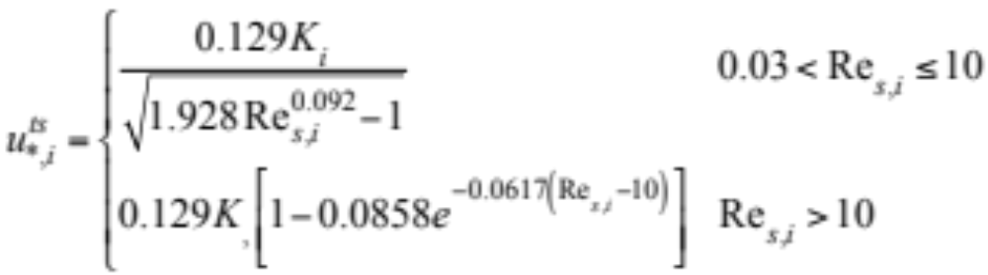
Soil Dust Emission
Threshold friction wind speed (14.9)
Threshold friction wind speed over smooth surface (14.10)

Slide 13
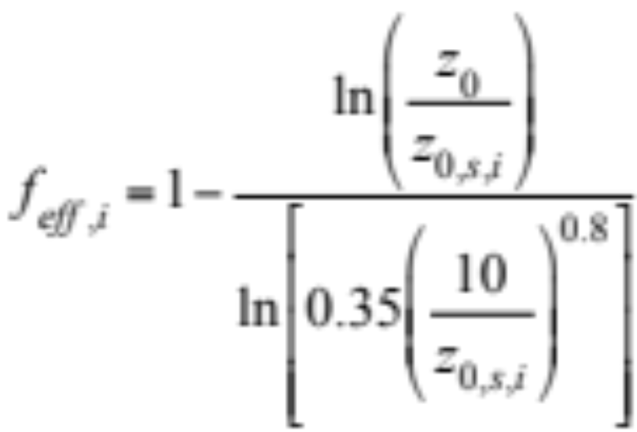
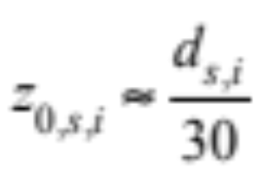
Soil Dust Emission
Ratio of friction wind speed over smooth to actual surface (14.11)
Roughness length over smooth soil (14.14)

Slide 14
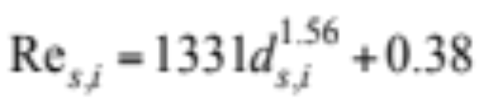
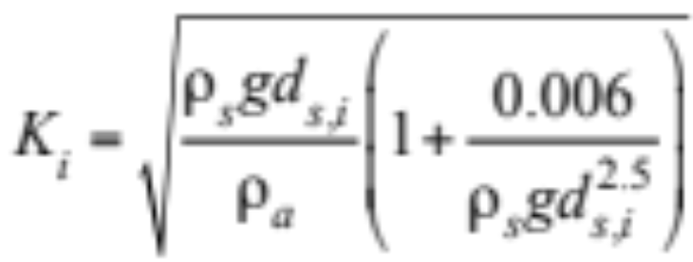
Soil Dust Emission
Friction Reynolds number (14.12)
Threshold wind speed prefactor (14.13)

Slide 15
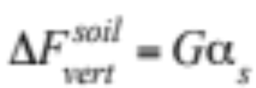
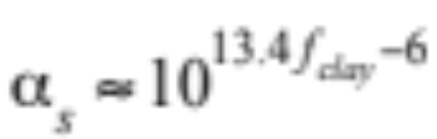
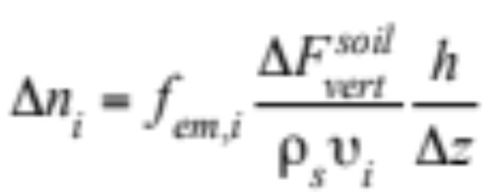
Soil Dust Emission
Vertical soil dust flux (14.15)
Ratio of vertical to horizontal dust flux (14.16)
Change in soil dust concentration above saltation layer (14.17)

Slide 16
Volcanic Emission
Over 500 volcanos currently active
Magma contains 1-4 percent gas by mass.
Water vapor makes up 50-80 percent of gas mass
Some other constituents:
CO₂ SO₂
OCS N₂
CO H₂
S₂ HCl
Cl₂ F₂
Particles
Most abundant are silicate minerals.
Range in size from <0.1 to 100 μm

Slide 17
Biomass-Burning Emission
Burning of evergreen forests, deciduous forests, woodlands, grasslands, agricultural land either to clear land, stimulate grass growth, manage forest growth, or satisfy a ritual
Gas constituents
CO, CO₂
CH₄, NO_{x}
ROGs SO₂
Particle constituents
Ash, plant fibers, soil dust, organic matter, soot (black carbon plus organic matter)
Composition of soot
High temperatures: Higher ratio of BC:OM in soot.

Slide 18
Fossil Fuels
Coal
Combustible brown-to-black carbonaceous sedimentary rock formed by compaction of partially decomposed plant material.
Stages of coal metamorphosis
Peat (unconsolidated, brown-black)
Peat coal (consolidated, brown-black)
Lignite coal (brown-black)
Bituminous (soft) coal (dark brown to black)
Anthracite (hard) coal (black)
Oil (petroleum)
Natural greasy, viscous, combustible hydrocarbon liquid that forms from geological-scale decomposition of plants and animals.

Slide 19
Fossil Fuels
Natural gas
Colorless, flammable gas, made primarily of methane, often found near petroleum deposits.
Kerosene
Combustible, oily, water-white liquid with strong odor distilled from petroleum
Diesel
Combustible liquid distilled from petroleum after kerosene.

Slide 20
Fossil-Fuel Combustion Emission
Gases
NO_{x}, ROGs, CO, CO₂, CH₄, SO₂
Particles
Soot (BC+OM), OM alone, SO₄²⁻, metals, fly ash
Fly ash
Contains O, Si, Al, Fe, Ca, Mg.

Slide 21
Industrial Emission
Source Metals in Fly Ash
Smelters Fe, Cd, Zn
Oil-fired power plants V, Ni, Fe
Coal-fired power plants Fe, Zn, Pb, V, Mn, Cr, Cu, Ni, As,
Co, Cd, Sb, Hg
Municipal waste incineration Zn, Fe, Hg, Pb, Sn, As, Cd, Co, Cu,
Mn, Ni, Sb
Steel-mill furnaces Fe, Zn, Cr, Cu, Mn, Ni, Pb
Table 5.5

Slide 22
Miscellaneous Particle Sources
Tire-rubber particles
Pollen
Spores
Bacteria
Viruses
Plant debris
Meteoric debris

Slide 23
Composition and Sources of Particles
Nucleation Mode Accumulation Mode Coarse Mode
Nucleation Fossil-fuel emission Sea-spray emission
H₂O(aq), SO₄²⁻, BC, OM, SO₄²⁻ H₂O(aq), Na⁺, Ca²⁺,
NH₄⁺ Fe, Zn Mg²⁺, K⁺, Cl⁻, SO₄²⁻,
Br⁻, OM
Fossil-fuel emission Biomass-burning Soil-dust emission
BC, OM, SO₄²⁻, BC, OM, SO₄²⁻, Cl⁻ Si, Al, Fe, Ti, P, Mn,
Fe, Zn Fe, Mn, Zn, Pb, V, Co, Ni, Cr, Na⁺, Ca²⁺
Cd, Cu, Co, Sb, As, Mg²⁺, K⁺, SO₄²⁻, Cl⁻
Ni, Cr CO₃²⁻, OM
Table 14.3

Slide 24
Composition and Sources of Particles
Nucleation Mode Accumulation Mode Coarse Mode
Biomass burning Industrial emission Biomass-burning ash,
BC, OM, SO₄²⁻,Cl⁻ BC, OM, Fe, Al, S industrial fly ash,
Mn, Zn, Pb, V, P, Mn, Zn, Pb, Ba tire-particle emission
Cd, Cu, Co, Sb,As, Sr, V, Cd, Cu, Co
Ni, Cr Hg, Sb, As, Se, Ni,
H₂O(aq), NH₄⁺, Na⁺,
Ca²⁺, K⁺, SO₄²⁻,
NO₃⁻, Cl⁻, CO₃²⁻
Cond./dissolution Cond./dissolution Cond./dissolution
H₂O(aq), SO₄²⁻, H₂O(aq), SO₄²⁻, H₂O(aq), NO₃⁻
NH₄⁺, OM NH₄⁺, OM
Coagulation Coagulation

Slide 25
Anthropogenic Particle Constituents Emitted in Greatest Abundance in L.A.
Silicon
Organic carbon
Aluminum
Iron
Calcium
Sulfate
Potassium
Black carbon
Chloride
Titanium
Sulfur
Carbonate ion
Sodium
Manganese
Phosphorous
Nitrates
Zinc
Lead
Barium
Ammonium
Strontium
Vanadium
Copper
Cobalt
Nickel
Chromium
Table 14.4

Slide 26
Nucleation
Homogeneous homomolecular
Single gas nucleates away from a surfaces
Homogeneous binary
Two gases nucleate in tandem away from a surfaces
Homogeneous ternary
Three gases nucleate in tandem away from a surfaces
Heterogeneous homomolecular
Single gas nucleates on an existing surface
Heterogeneous binary
Two gases nucleate in tandem on a surface

Slide 27
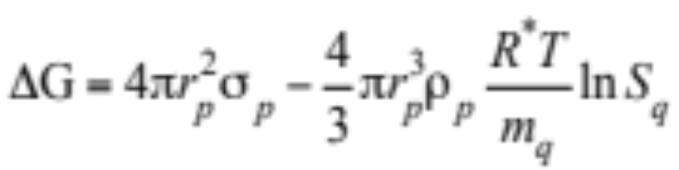
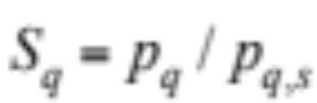
Classical Nucleation Theory
Change in Gibbs free energy (J) during cluster aggregation (14.18)
Saturation ratio

Slide 28
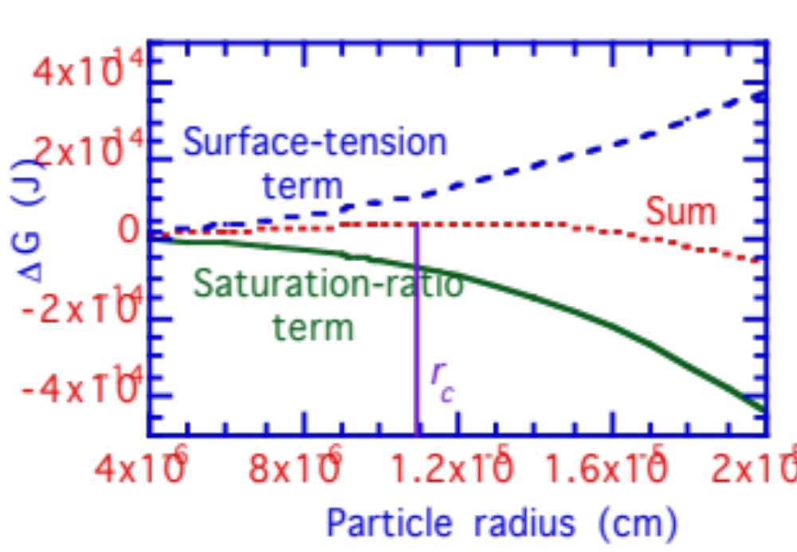
Classical Nucleation Theory
Change in free energy versus cluster radius
ΔG (J)
Fig. 14.3

Slide 29
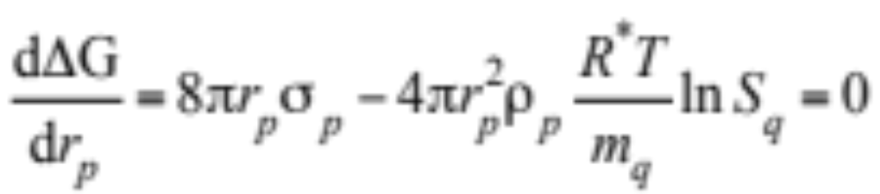
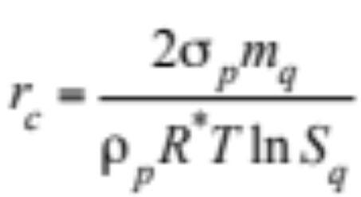
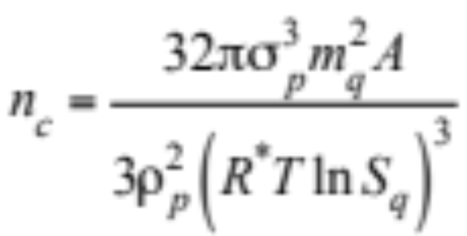
Critical Radius
Minimize Gibbs free energy (14.20)
Solve for critical radius (14.21)
Number of molecules in a critical cluster
Divide 4πr_{c}³/3 by molecular volume [m_{q}/(ρ_{p}A)] (14.22)

Slide 30
Critical Radius
Critical radii and number of water molecules in a critical cluster when T = 288 K, σ_{p} = 7.5 x 10⁻⁶ J cm⁻², ρ_{p} = 1.0 g cm⁻³, and m_{q} = 18 g mol⁻¹
Saturation Critical Number of
Ratio Radius Molecules
1 ∞ ∞
1.01 0.11 2.03 x 10⁸
1.02 0.055 2.58 x 10⁷
1.10 0.011 2.32 x 10⁵
1.5 0.0028 3010
2.0 0.0016 603
5.0 0.0007 48
10.0 0.00048 16
Table 14.5

Slide 31
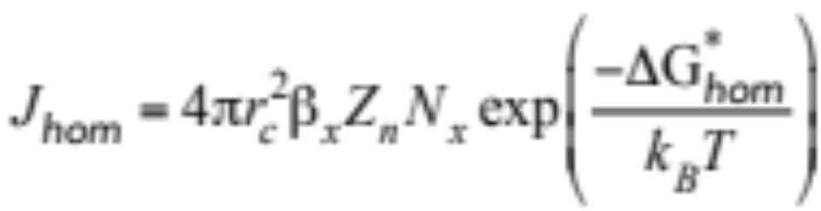
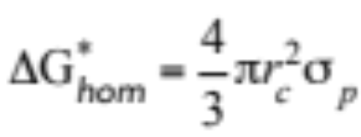
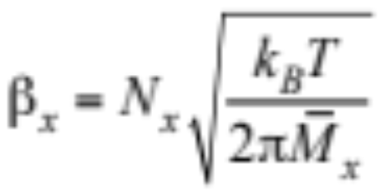
Homogen. Homomolecular Nucleation
Rate (particles cm⁻³ s⁻¹) (14.23)
Combine (14.18) and (14.20) (14.24)
Number of gas molecules striking cluster surface per second (14.25)

Slide 32
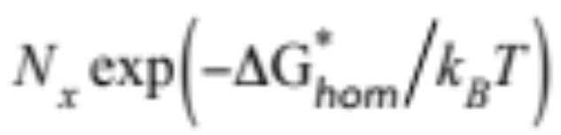
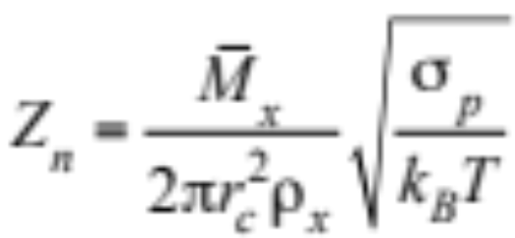
Homogen. Homomolecular Nucleation
Equilibrium no. concentration of clusters of critical radius
Zeldovich non-equilibrium factor
Accounts for the difference between an equilibrium and nonequilibrium cluster concentration (14.24)

Slide 33
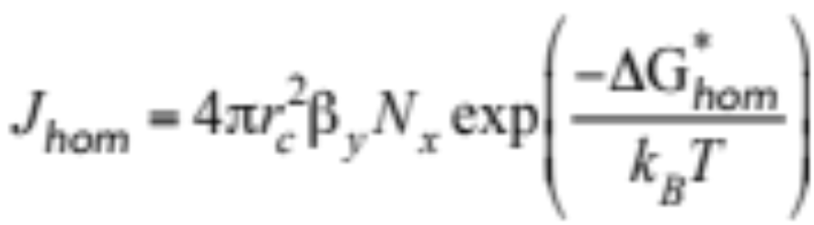
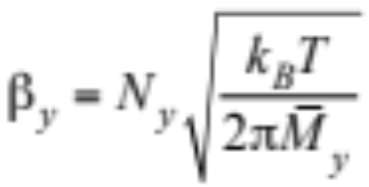
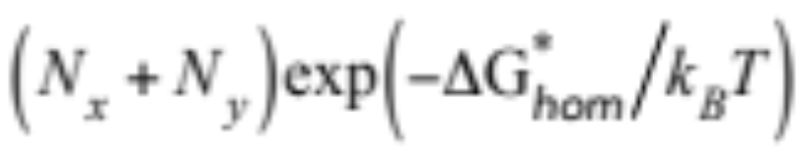
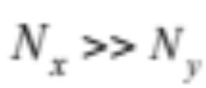
Homogeneous Binary Nucleation
Rate (particles cm⁻³ s⁻¹) (14.27)
Number of gas molecules striking cluster surface per second (14.11)
Equilibrium no. concentration of cluster of critical radius
->

Slide 34
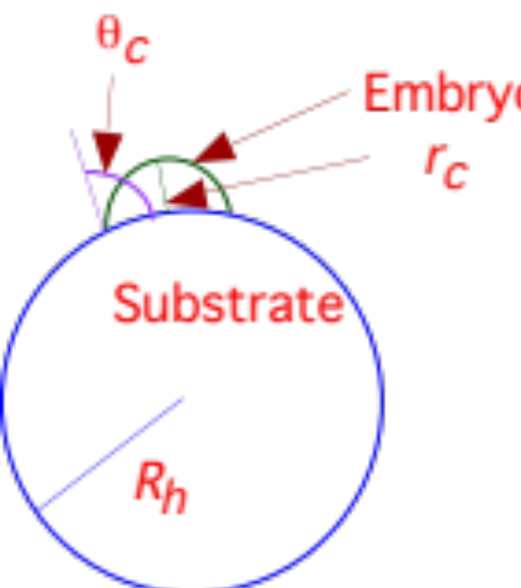
Heterogeneous Nucleation Rate
Formation of critical embryo on a surface
Fig. 14.4
Contact angle (θ_{c})
= 0 --> surface wettable, embryo forms easily
= 180º --> surface non-wettable, no embryo forms

Slide 35
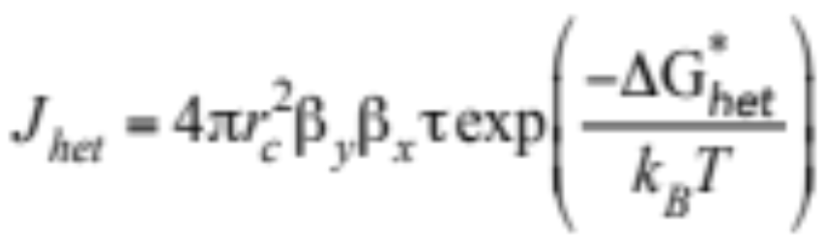
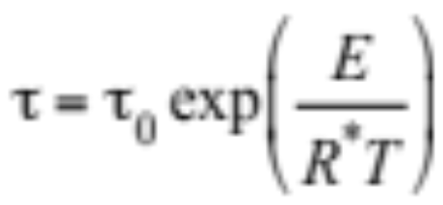
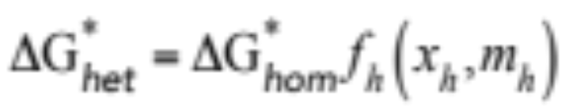
Heterogeneous Nucleation Rate
Heterogeneous nucleation rate (no. embryos cm⁻² s⁻¹) (14.32)
Time a gas molecule spends on surface before bouncing off
(14.33)
Change in Gibbs free energy (14.30)

Slide 36
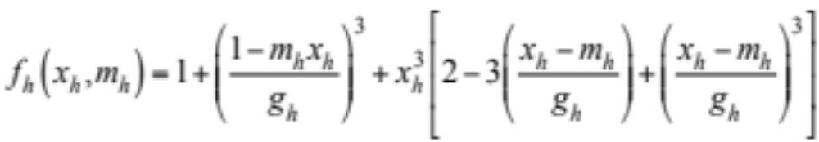
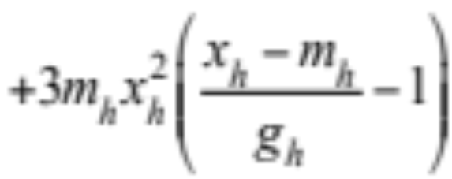
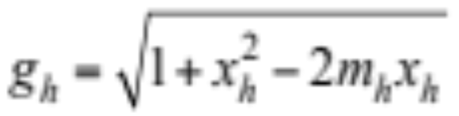
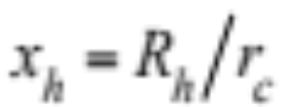
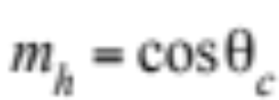
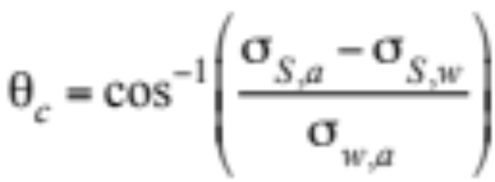
Correction Factor
(14.31)
Contact angle (14.29)

Slide 37
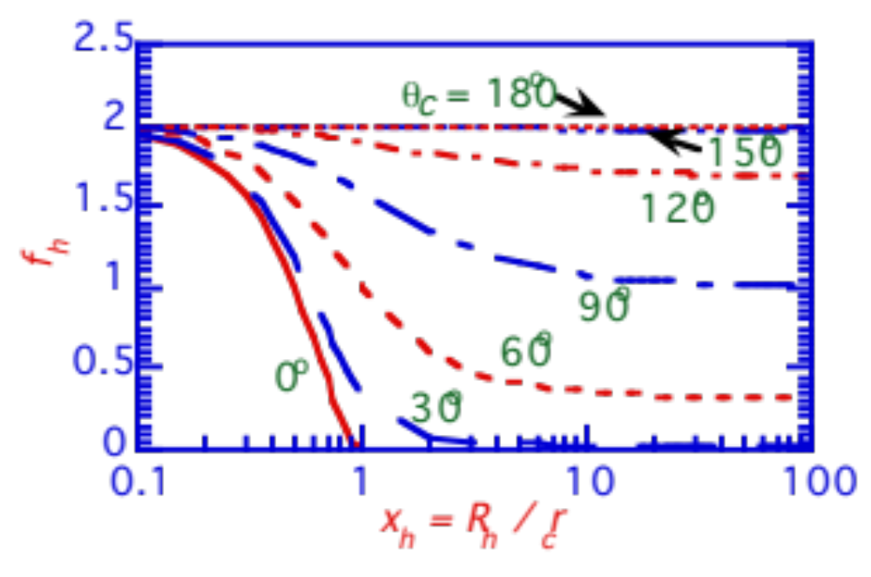
Correction Factor
Correction factor versus x_{h} for different contact angles
f_{h}
Fig. 14.5

Slide 38
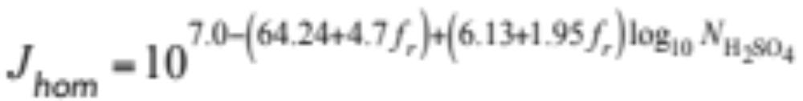
Parameterized Nucleation
Parameterized homogeneous binary nucleation rate (14.33)
For sulfuric acid-water in remote marine boundary layer
Example
f_{r} = 0.9
m_{H2SO4} = 0.005 μg m⁻³
---> N_{H2SO4} = 3.1 x 10⁷ molec cm⁻³
---> J_{hom} = 2.6 x 10⁻⁵ partic. cm⁻³ s⁻¹
m_{H2SO4} = 0.05 μg m⁻³
---> N_{H2SO4} = 3.1 x 10⁶ molec cm⁻³
---> J_{hom} = 3.1 x 10⁵ partic. cm⁻³ s⁻¹

