Slide 1
Presentation Slides for
Chapter 17, Part 1 of
Fundamentals of Atmospheric Modeling 2nd Edition
Mark Z. Jacobson
Department of Civil & Environmental Engineering
Stanford University
Stanford, CA 94305-4020
jacobson@stanford.edu
March 31, 2005

Slide 2
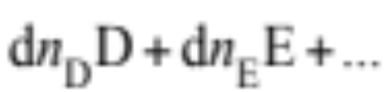

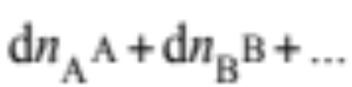
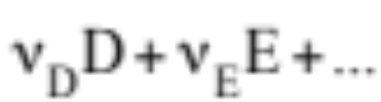
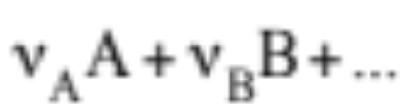
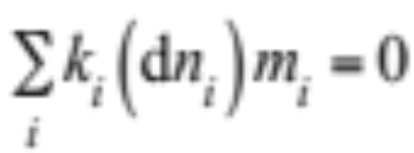
Types of Equilibrium Equations
Reversible chemical reaction (17.1)
Divide each dn_{i} by smallest value of dn_{i} (17.2)
Mass conservation (17.3)

Slide 3
Types of Equilibrium Equations
Solvent
Substance in which species dissolve in (e.g., water)
Solute
The dissolving species
Solution
Combination of solute and solvent
Solids
Suspended material not in solution

Slide 4






Gas-Particle Equilibrium
Gas-particle reversible reaction (17.4)
Gas in equilibrium with solution at gas-solution interface
Examples
Sulfuric acid (17.5)
Nitric acid
Hydrochloric acid
Carbon dioxide
Ammonia

Slide 5
Electrolytes, Ions, and Acids
Electrolyte
Substance that undergoes partial or complete dissociation into ions in solution
Ion
Charged atom or molecule
Dissociation
Molecule breaks into simpler components, namely ions. Degree of dissociation depends on acidity.
Acidity
Measure of concentration of hydrogen ions (H⁺, protons) in solution

Slide 6
Electrolytes, Ions, and Acids
Acidity measured in terms of pH (17.6)
pH = -log₁₀[H⁺]
[H⁺] = molarity of H⁺ (mol-H⁺ L⁻¹-solution)
Protons in solution donated by acids
Strong acids (dissociate readily at low pH)
HCl = hydrochloric acid
HNO₃ = nitric acid
H₂SO₄ = sulfuric acid
Weak acids (dissociate readily at higher pH)
H₂CO₃ = carbonic acid

Slide 7
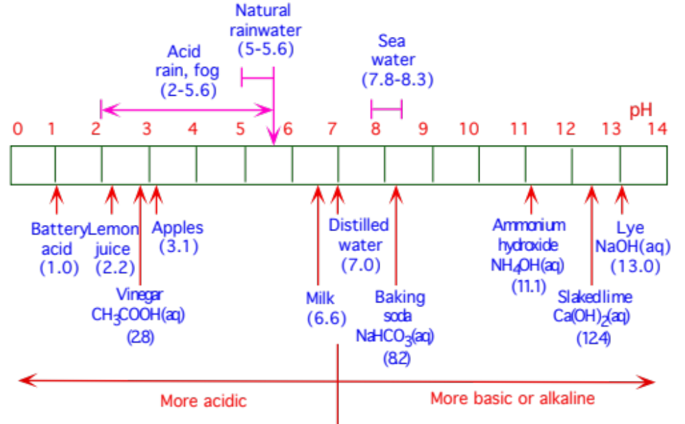
pH Scale
Fig. 17.1

Slide 8
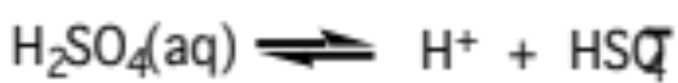
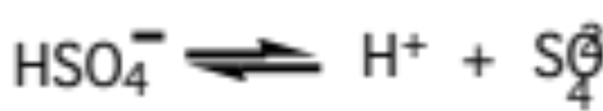
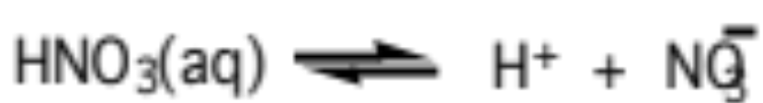
Electrolytes, Ions, and Acids
Sulfuric acid dissociation (pH above -3) (17.7)
Bisulfate dissociation (pH above 2) (17.7)
Nitric acid dissociation (pH above -1) (17.8)

Slide 9

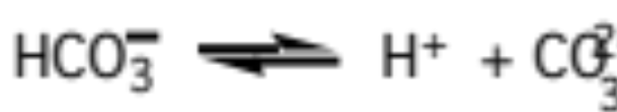
Electrolytes, Ions, and Acids
Hydrochloric acid dissociation (pH above -6) (17.9)
Carbon dioxide dissociation (pH above 6) (17.10)
Bicarbonate dissociation (pH above 10) (17.10)

Slide 10

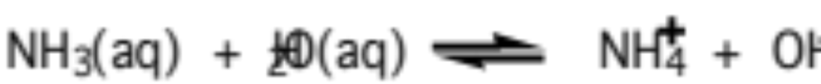
Bases
Base
Donates OH⁻ (hydroxide ion)
Hydroxide ion combine with hydrogen ion to form liquid water, increasing pH of solution (17.11)
Ammonia complexes with water and dissociates (17.12)

Slide 11
Solid Electrolytes
Suspended electrolytes not in solution
Precipitation / crystallization
Formation of solid electrolytes from ions
Dissociation
Separation of solid electrolytes into ions

Slide 12
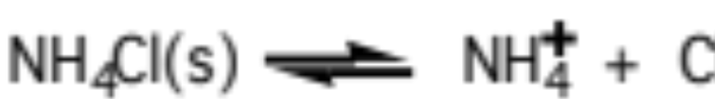
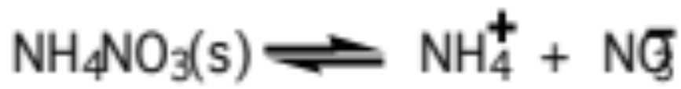
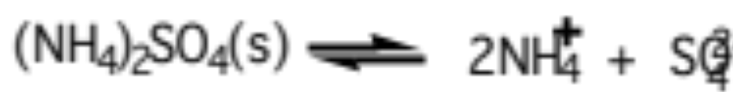
Solid Electrolytes
Ammonium-containing solid reactions (17.15)

Slide 13

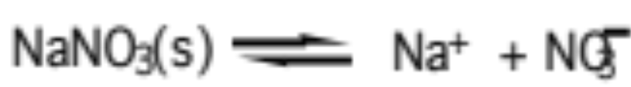
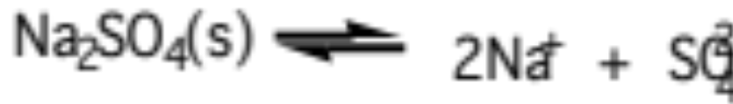

Solid Electrolytes
Sodium-containing solid reactions (17.16)
Solid formation from the gas phase on surfaces (17.17)

Slide 14
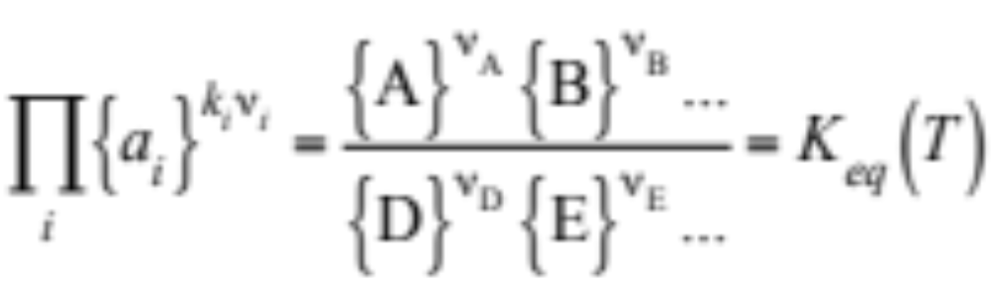
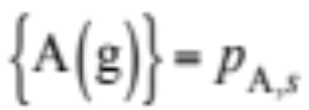
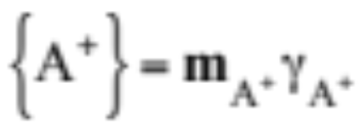
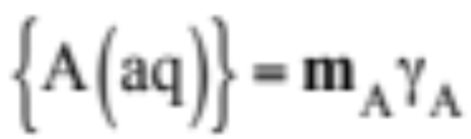
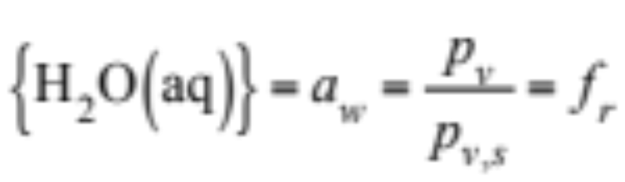
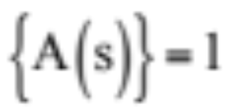
Equilibrium Relation and Constant
Equilibrium coefficient relation (17.18)
{}... = Activity
Effective concentration or intensity of substance
(gas) (17.19)
(ion) (17.20)
(dissolved molecule) (17.20)
(liquid water) (17.21)
(solid) (17.22)

Slide 15
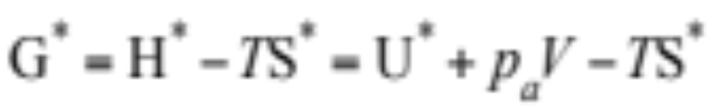
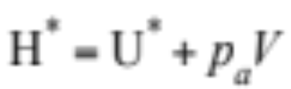
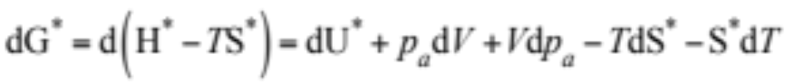
Equilibrium Coefficient Relation
Gibbs free energy (17.23)
Enthalpy
Change in Gibbs free energy
Measure of maximum amount of useful work obtained from a change in enthalpy or entropy of the system (17.24)

Slide 16
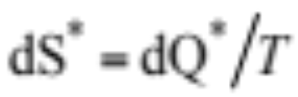
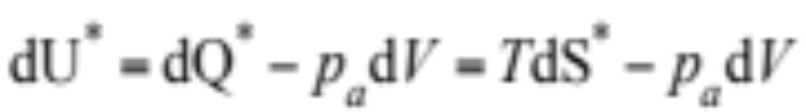
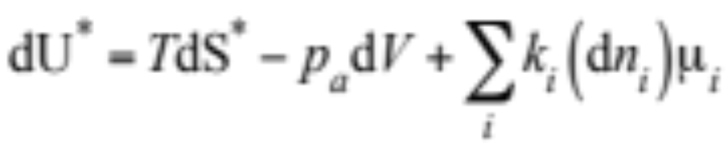
Equilibrium Coefficient Relation
Change in entropy
Change in internal energy (17.25)
Change in internal energy in presence of reversible reactions (17.26)

Slide 17
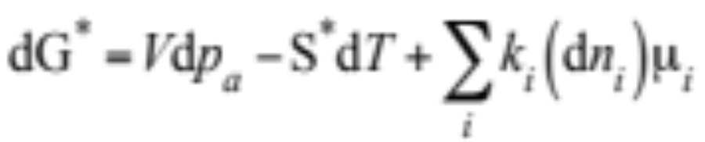
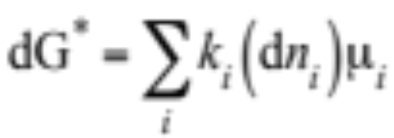
Equilibrium Coefficient Relation
Substitute (17.26) into (17.24) (17.27)
Hold temperature and pressure constant (17.28)

Slide 18
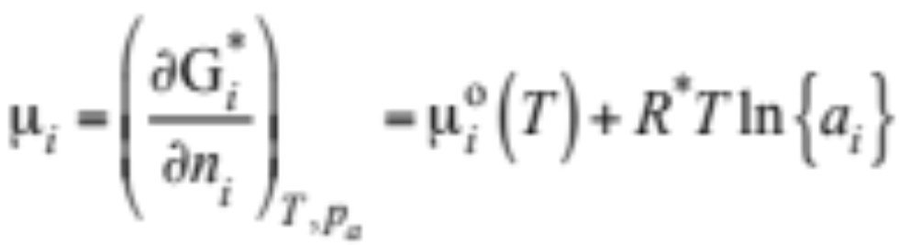
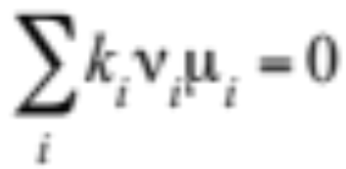
Equilibrium Coefficient Relation
Chemical potential (μ_{i} )
Measure of intensity of a substance or the measure of the change in free energy per change in moles of a substance = partial molar free energy (17.29)
Equilibrium occurs when dG* = 0 in (17.28) (17.30)

Slide 19
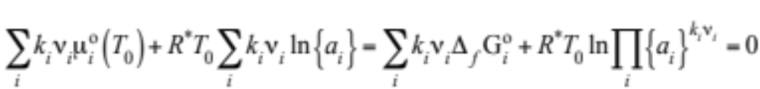
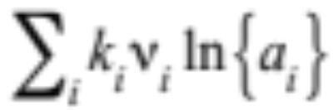
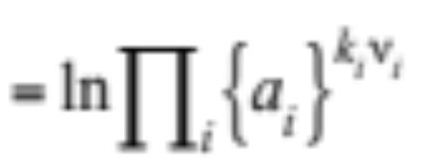
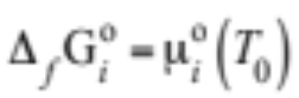
Equilibrium Coefficient Relation
Substitute (17.29) into (17.30) (17.31)
where
Standard molal Gibbs free energy of formation

Slide 20
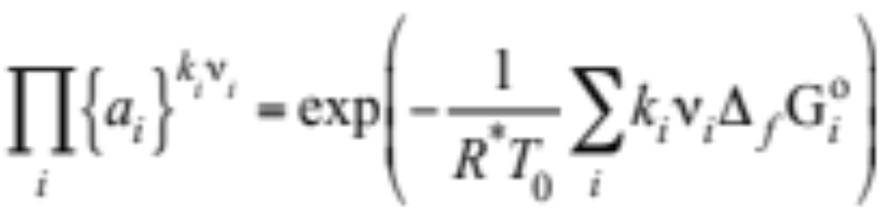
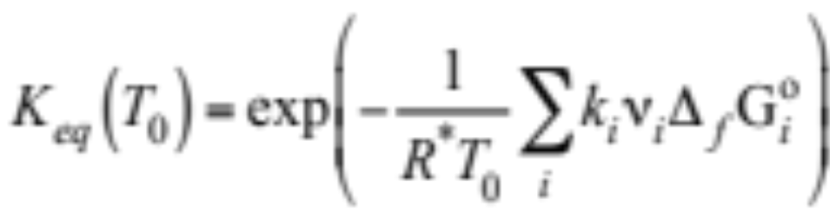
Equilibrium Coefficient Relation
Rearrange (17.31) (17.32)
The right side of (17.32) is the equilibrium coefficient (17.33)

Slide 21
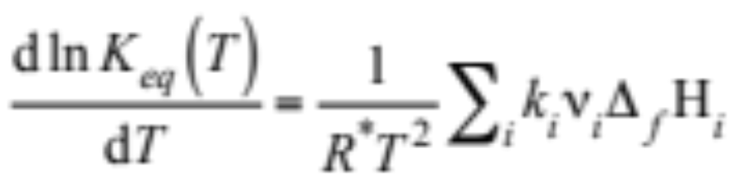
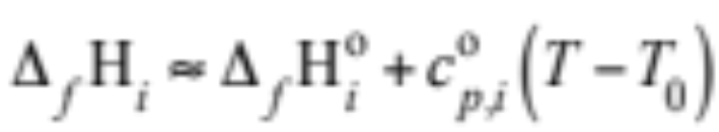
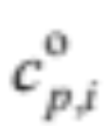
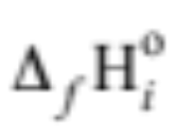
Temperature Dependence of Equilibrium Coefficient
Van't Hoff equation (similar to Arrhenius equation) (17.34)
Molal enthalpy of formation (J mol⁻¹) of a substance (17.35)
= Standard molal heat capacity at constant pressure
= standard molal enthalpy of formation

Slide 22
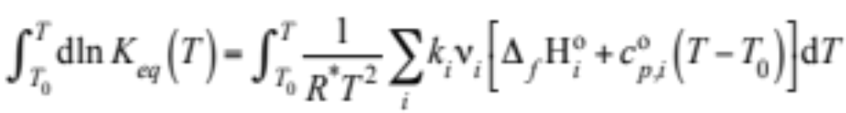
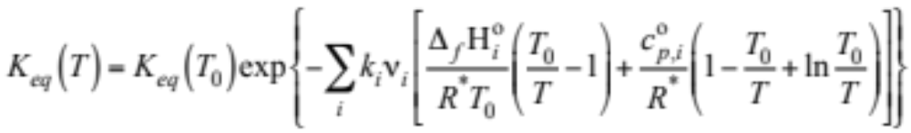
Temperature Dependence of Equil Const
Combine (17.34) and (17.35) and write integral (17.36)
Integrate (17.37)

Slide 23
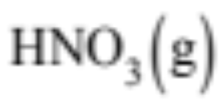

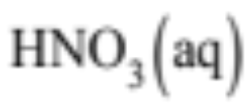
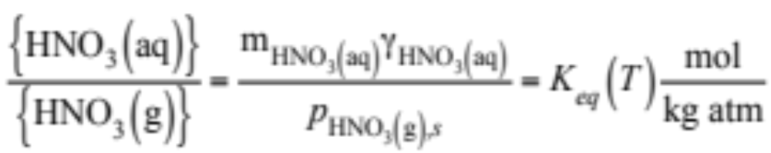
Forms of Equilibrium Equation
Henry's law
In a dilute solution, the pressure exerted by a gas at the gas-liquid interface is proportional to the molality of the dissolved gas in solution
Henry's law relationship
Equilibrium coefficient relationship (17.38)

Slide 24
Activity Coefficients (γ)
Account for deviation from ideal behavior of a solution.
Infinitely dilute solution, no deviations, γ = 1
Relatively dilute solutions, deviations from Coulombic (electric) forces of attraction and repulsion γ < 1
Concentrated solutions, deviations caused by ionic interactions, γ < 1 or γ > 1

Slide 25
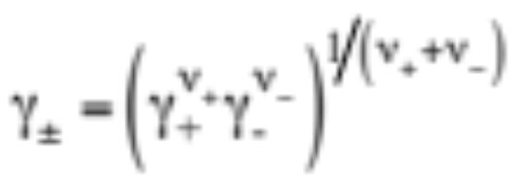
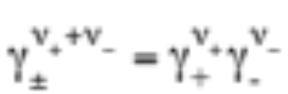
Activity Coefficients
Geometric mean binary activity coefficient (17.40)
Rewrite (17.41)

Slide 26
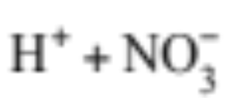






Electrolyte Dissociation
Univalent electrolyte
---> = 1 and = 1
---> = +1 and = -1
Multivalent electrolyte
---> = 2 and = 1
---> = +1 and = -2

Slide 27


Electrolyte Dissociation
Symmetric electrolyte
Charge balance requirement

Slide 28







Equilibrium Rate Expression
1. (17.39)
2. (17.42)

Slide 29




Equilibrium Rate Expression
3. (17.43)

Slide 30



Equilibrium Rate Expression
4. (17.44)

Slide 31


Equilibrium Rate Expression
5. (17.45)

Slide 32


Mean Binary Activity Coefficients
Pitzer's method of determining binary activity coefs. (17.46)
(17.47)

Slide 33


Mean Binary Activity Coefficients
(17.48)
β’s are Pitzer parameter’s specific to individual electrolytes
Ionic strength of solution (mol kg⁻¹)
Measure of the interionic effects resulting from attraction and repulsion among ions (17.49)

Slide 34

Mean Binary Activity Coefficients
Alternatively, fit a polynomial expression to mean binary activity coefficient data (valid to high molality) (17.51)

Slide 35

Mean Binary Activity Coefficients
Comparison of measured (Hammer and Wu) and calculated (Pitzer) activity coefficient data
ln (binary activity coefficient)
Fig. 17.2

Slide 36


Mean Binary Activity Coefficients
Equilibrium coefficient expression for hydrochloric acid
(17.50)
Equilibrium coefficient expression for nitric acid

Slide 37





Temp Dependence of Mean Binary Activity Coefficient
Temperature dependent equation (17.52)
Temperature-dependent parameters (17.53)

Slide 38





Temp Dep of Mean Binary Activity Coef
Polynomial for relative apparent molal enthalpy (17.54)
Polynomial for apparent molal heat capacity
= binary activity coefficient at temperature T
φ_{L} = relative apparent molal enthalpy (J mol⁻¹)
= apparent molal heat capacity (J mol⁻¹ K⁻¹)
= apparent molal heat capacity at infinite dilution

Slide 39




Temp Dep of Mean Binary Activity Coef
Combine (17.51) - (17.54) --> (17.55)
Coefficients for equation (17.56-7)
F₀ = B₀
j = 1...

Slide 40

Sulfate and Bisulfate
Binary activity coefficients of sulfate and bisulfate, each alone in solution. Results valid for 0 - 40 m.
Binary activity coefficient
Fig. 17.3

Slide 41





Mean Mixed Activity Coefficients
Bromley's method (17.58-61)
Binary activity coefficient of an electrolyte in a mixture of many electrolytes.

Slide 42




Mean Mixed Activity Coefficients
Molalities of binary electrolyte found from (17.62)
Molalities of cation, anion alone in solution
Molality of binary electrolyte giving ionic strength of mixture (17.63)

