Slide 1
Presentation Slides for
Chapter 20 of
Fundamentals of Atmospheric Modeling 2nd Edition
Mark Z. Jacobson
Department of Civil & Environmental Engineering
Stanford University
Stanford, CA 94305-4020
jacobson@stanford.edu
March 10, 2005

Slide 2
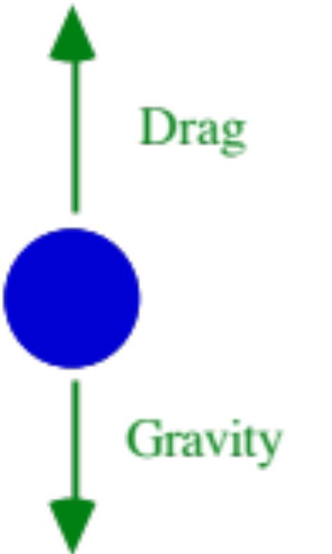
Particle Sedimentation
Vertical forces acting on a particle
Fig. 20.1

Slide 3

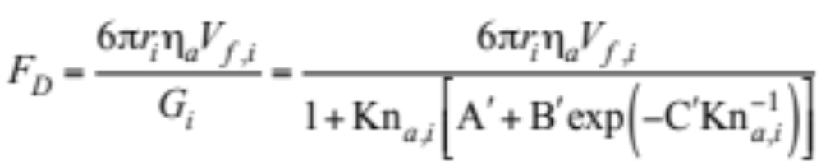
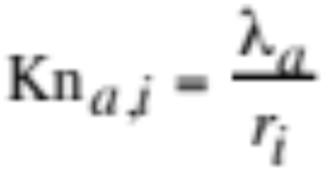
Drag and Gravitational Forces
Drag during Stokes flow (20.1)
Where particle radius > mean free path of air molecule (e.g., 68 nm) but small enough so its inertial force < viscous force.
Drag during slip flow (20.2)
Particle radius < mean free path of an air molecule
Knudsen number of particle in air

Slide 4
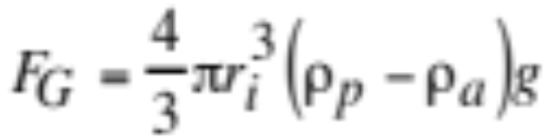
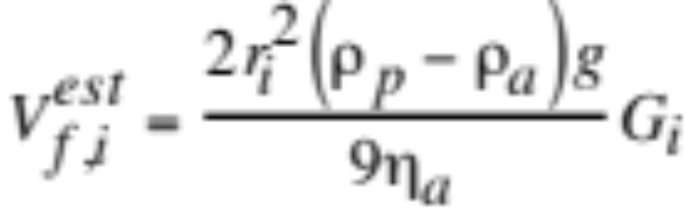
Particle Sedimentation
Gravitational force (20.3)
Equate gravity with drag to estimate fall speed (20.4)
Small particles
Less resistance to motion ---> diffusion and fall speed enhanced at small particle sizes
Large particles
Fall speed decreases due to physical properties effect --> need to correct fall speed for large particles

Slide 5
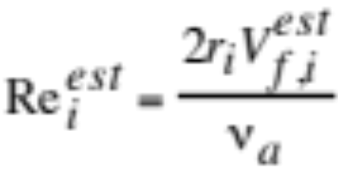
Estimated Reynolds Number
Estimate Reynolds number from estimated fall speed. (20.4)
Recalculate Reynolds number for three flow regimes
    slip flow around a rigid sphere ( «1-20 μm diameter)
    continuum flow around a rigid sphere (20 μm - 1 mm)
    continuum flow around equilibrium-shaped drop (1-5 mm)

Slide 6
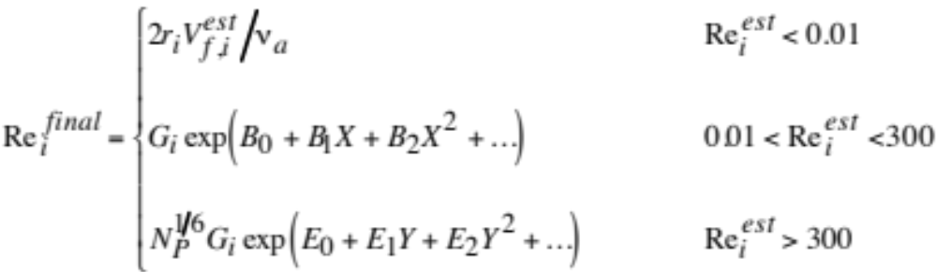
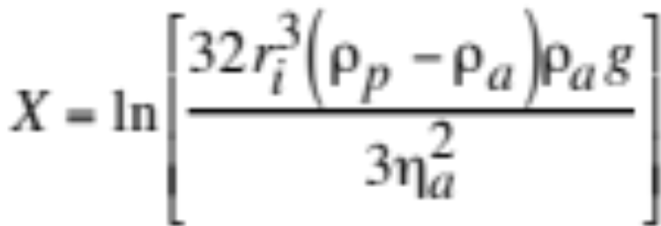
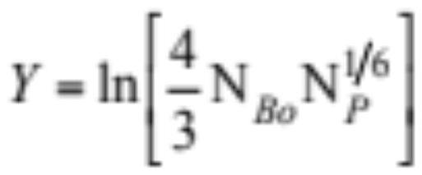
Final Reynolds Number
(20.6)
Parameters affected by physical properties (e.g., temperature, density, viscosity, surface tension, gravity) (20.7)

Slide 7
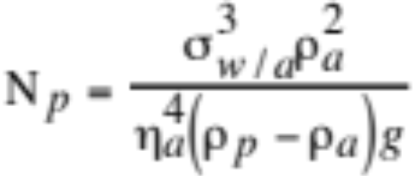
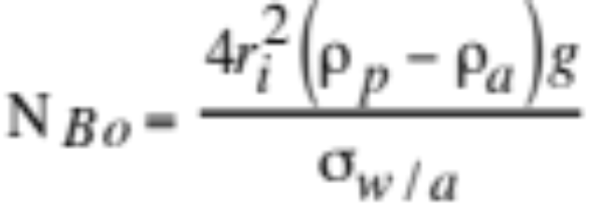
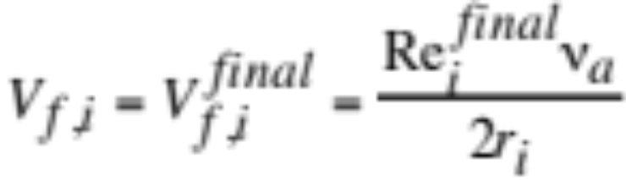
Physical Properties Correction
Physical property number (20.8)
Bond number (20.8)
Final fall speed from final Reynolds number (20.9)

Slide 8
Sedimentation Times
Time for a particle (or gas molecule for the smallest size) to fall 1 km in the atmosphere due to sedimentation
Diameter (μm) | Time to Fall 1 km | Diameter (μm) | Time to Fall 1 km
0.0005 | 9630 y | 4 | 23 d
0.02 | 226 y | 5 | 14.5 d
0.1 | 36 y | 10 | 3.6 d
0.5 | 3.2 y | 20 | 23 h
1 | 326 d | 100 | 1.1 h
2 | 89 d | 1000 | 4 m
3 | 41 d | 5000 | 1.8 m
Table 20.2

Slide 9
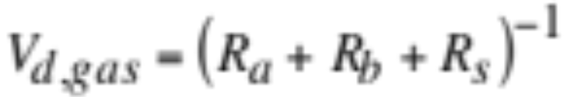
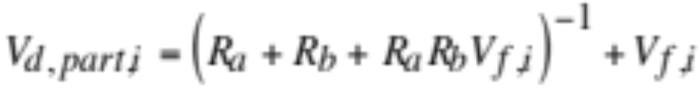
Dry Deposition
Dry deposition
Removal of gas molecules or particles from the air when they stick to or react with a surface
Gas dry deposition speed (20.10)
Particle dry deposition speed (20.11)

Slide 10
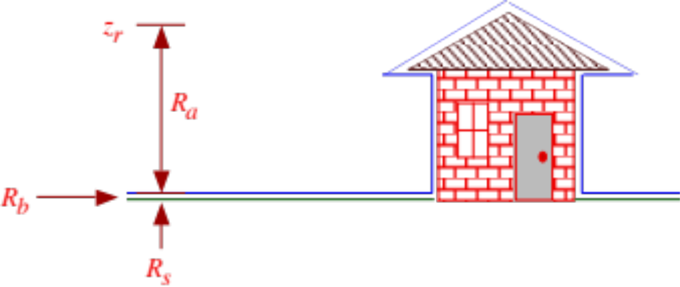
Dry Deposition Resistances
Fig. 20.2

Slide 11
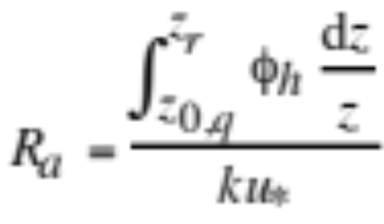
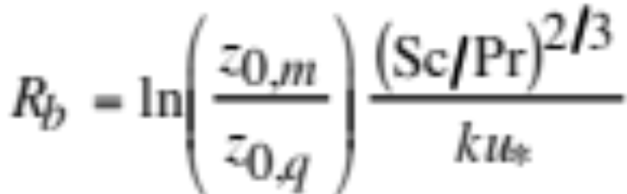
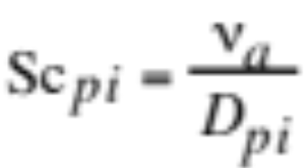
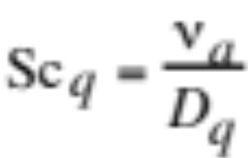
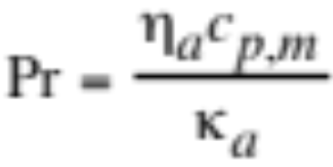
Dry Deposition Resistances
Aerodynamic resistance (20.12)
Resistance to diffusion in laminar sublayer (20.14)
Particle and gas Schmidt numbers, Prandtl number (15.36)

Slide 12
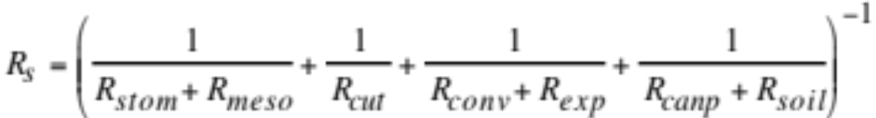
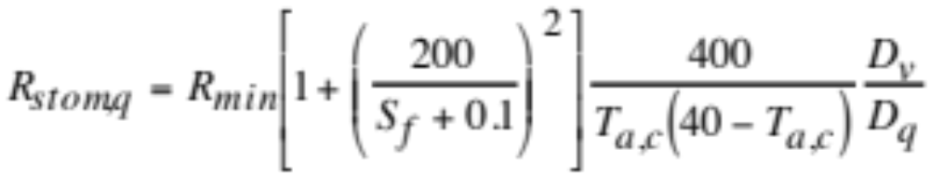
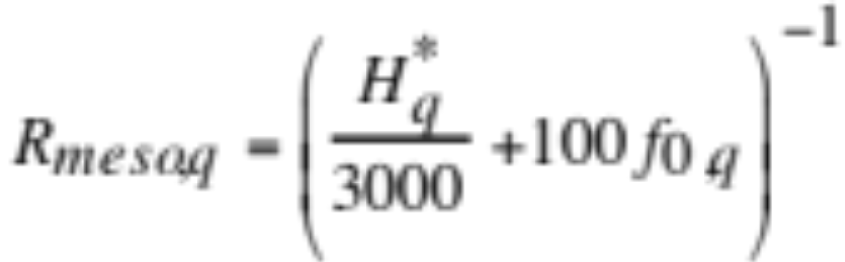
Surface Resistance
Surface resistance due to biological interactions (20.15)
Stomatal resistance (20.16)
Resistance to entering openings in leaf surfaces
Leaf mesophyll resistance (20.17)
Resistance to dissolving in or reacting with water within leaves

Slide 13
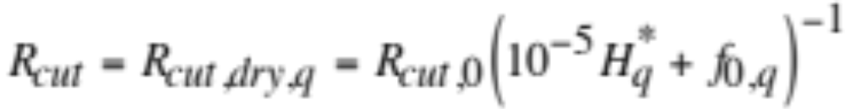
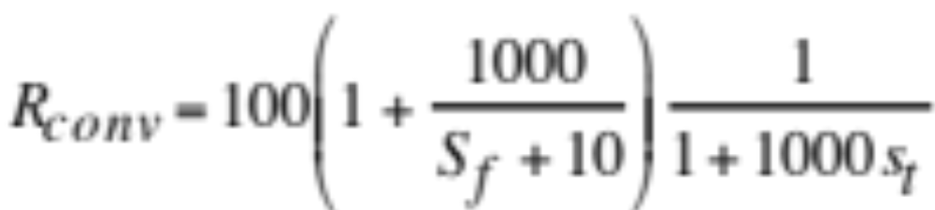
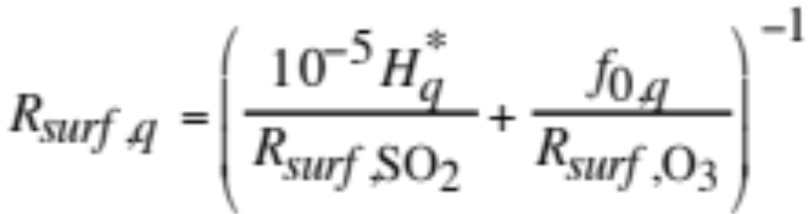
Surface Resistance
Resistance to deposition on leaf cuticles (waxy surface) (20.18)
Resistance to buoyant convection in canopy (20.19)
Resistance to deposition on bark, exposed surfaces (20.20)

Slide 14
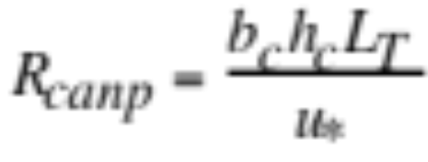
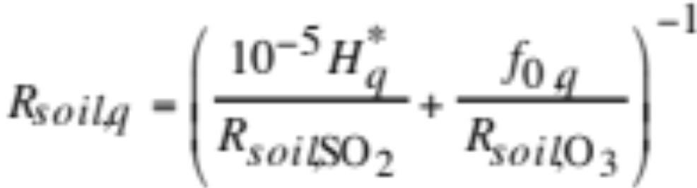
Surface Resistance
In-canopy resistance (20.21)
Accounts for canopy leaf density
One-sided leaf area index (L_{T})
Integrate foliage area density from surface to height h_{c}
Foliage area density
Area of plant surface per unit volume of space. Thus, the leaf-area index measures canopy area density
Resistance to deposition on soil and leaf litter at ground (20.22)

Slide 15
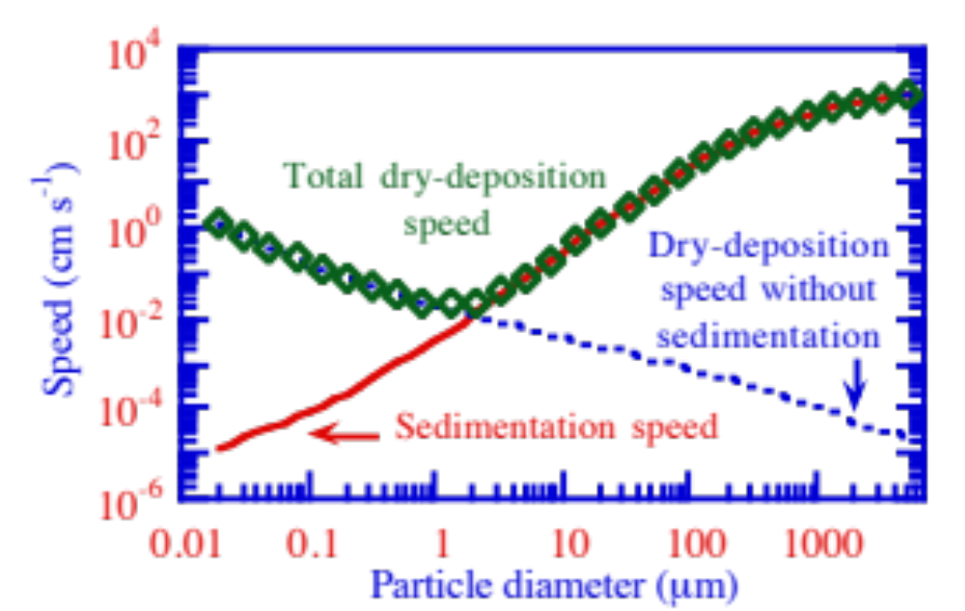
Dry Deposition, Sedimentation Speeds
Speed (cm/s)
Fig. 20.3

Slide 16
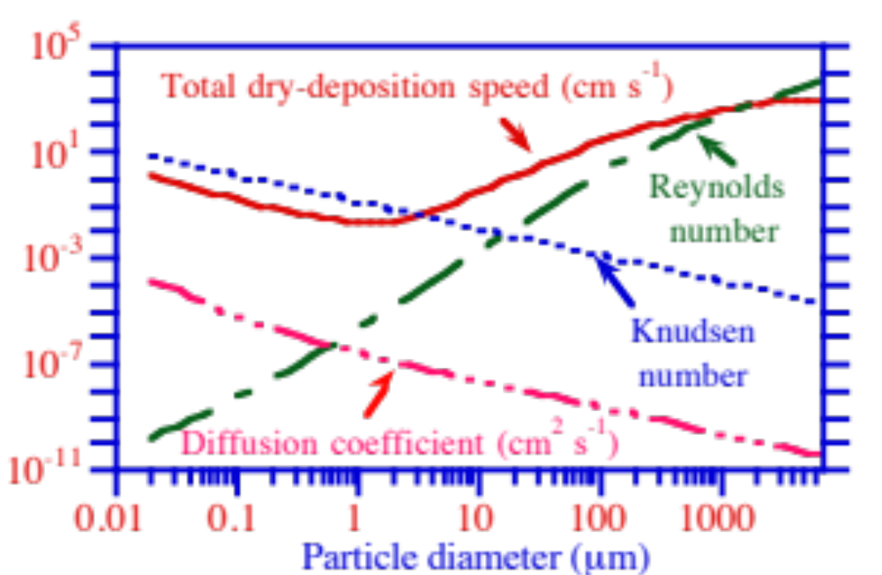
Several Parameters Versus Size
Fig. 20.4

Slide 17
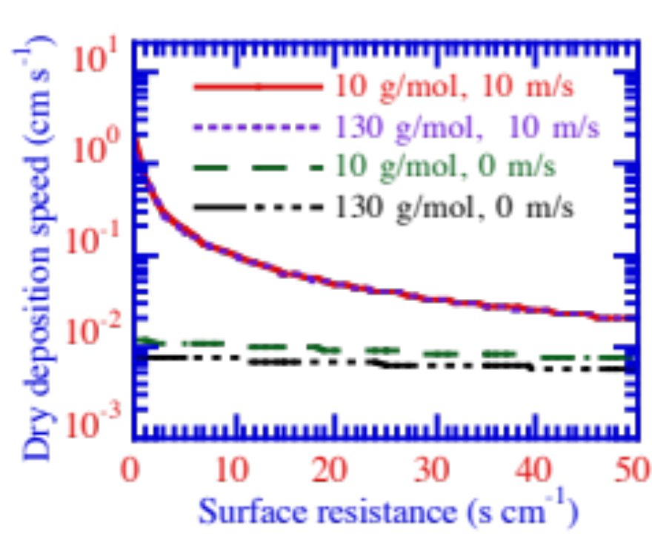
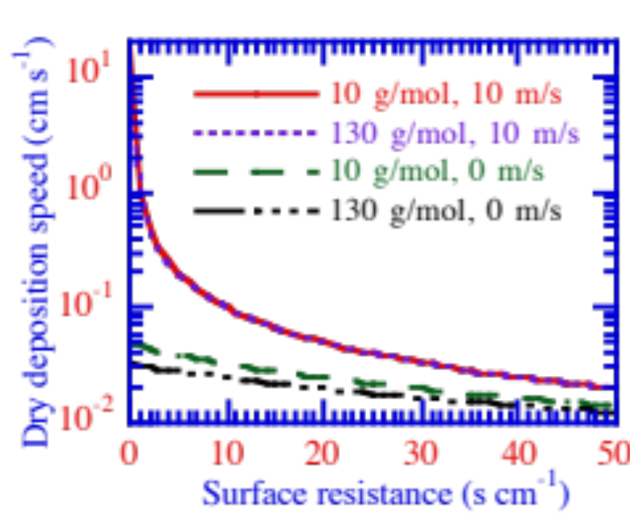
Gas Dry Deposition Speeds
(a) z_{0,m}=3 m
(b) z_{0,m}=0.01 m
Dry deposition speed (cm/s)
Dry deposition speed (cm/s)
Fig. 20.5a,b

Slide 18
Scientific Questions
How has ocean composition and pH changed since 1750?
How will ocean composition and pH change during the next 100 y?
How will this feed back to air pollution?

Slide 19
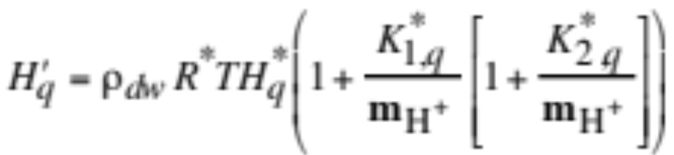
Method of Solving Nonequilibrium Air-Sea Exchange
Carbon dioxide dissolution and dissociation in seawater at equilibrium
Dimensionless effective Henry’s constant for total carbon
= relative fraction of carbon in seawater v. air at equilibrium

Slide 20
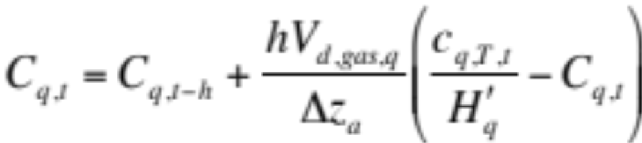
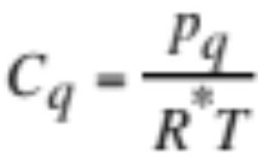

Air-Sea Fluxes
Change in concentration of a gas at the air-sea interface (20.23)
Mole concentration of a gas (20.24)
Mole concentration of a gas dissolved in seawater (20.25)

Slide 21
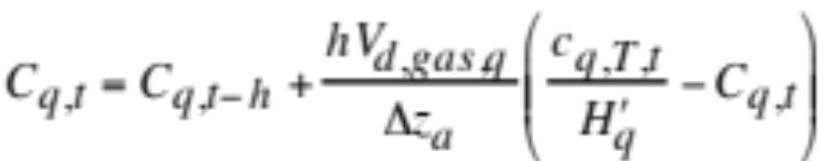
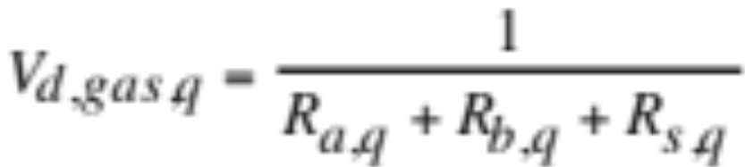
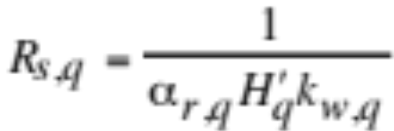
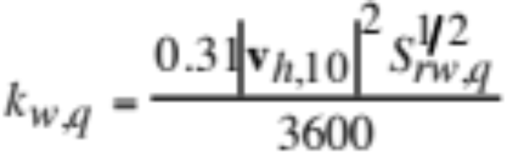
Air-Sea Exchange
Change in gas concentration due to air-sea exchange
(20.23)
Transfer speed between air and ocean (20.10, 20.34)
Transfer speed across ocean surface (Wanninkhof) (20.37)

Slide 22
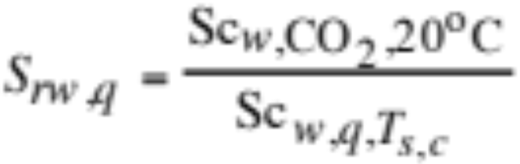
Air-Sea Exchange
Schmidt number ratio in water (20.36)
Schmidt number is kinematic viscosity / diffusion coefficient

Slide 23
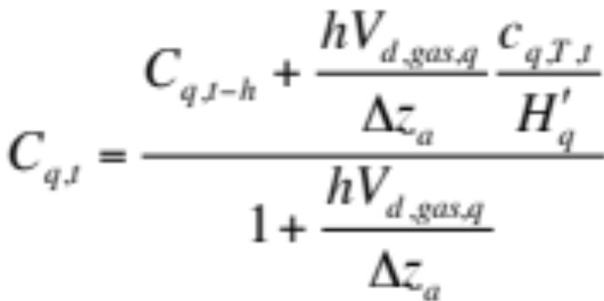
Air-Sea Exchange
Change in gas concentration due to air-sea exchange
(20.23)
Rearrange
(20.39)

Slide 24
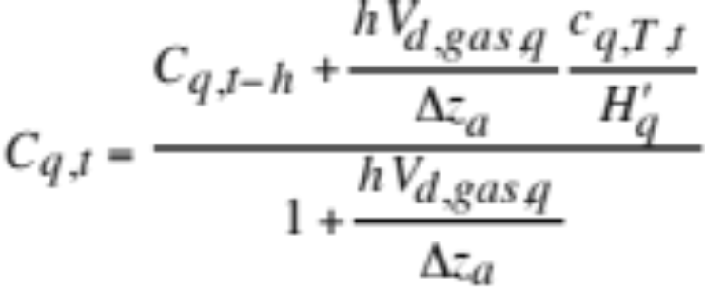
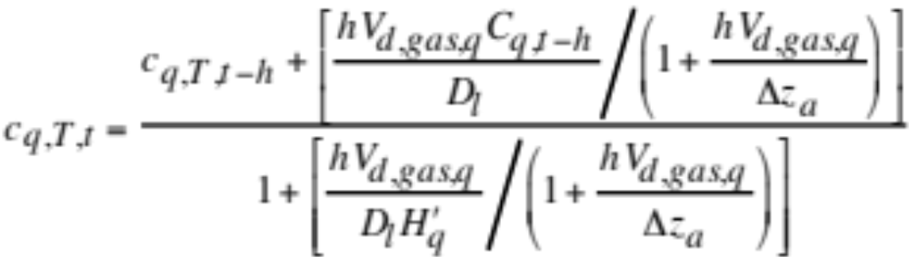
Air-Sea Exchange
Mole balance between ocean and atmosphere
(20.40)
Equation 20.39
Substitute (20.39) into (20.40) -→ final ocean conc.
Unconditionally stable, positive-definite, mole conservative, noniterative

Slide 25
Ocean Equilibrium Chemistry
Coupled with operator-splitting to ocean-atmosphere exchange. Equilibrium solution unconditionally stable, positive-definite, mole conservative, iterative, treats ocean activities
Na⁺
Ca²⁺
Mg²⁺
K⁺
H⁺
Sr²⁺
Li⁺
NH₄⁺
Cl⁻
Br⁻
OH⁻
HSO₄⁻
HCO₃⁻
CO₃²⁻
B(OH)₄⁻
SiO(OH)₃⁻
H ₂PO₄⁻
HPO₄²⁻
PO₄³⁻
HNO₃⁻
H₂O(aq)
H₂CO₄(aq)
H₂SO₄(aq)
H₃PO₄(aq)
HF(aq)
H₂S(aq)
CaCO₃(s)
& other solids

Slide 26
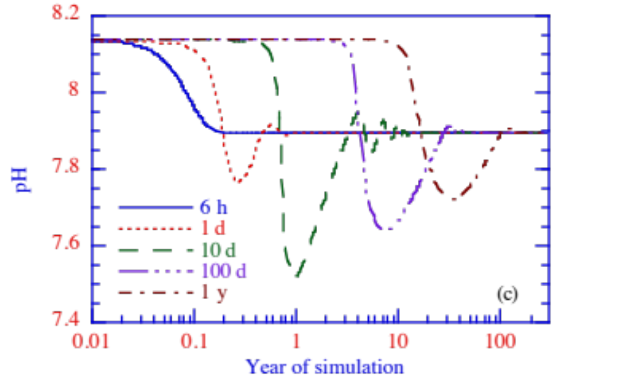
Stability Test
Air-sea transfer plus chemistry of CO₂ with time steps of 6 h to 1 y
pH

Slide 27
1-D Ocean, 2-Box Atmosphere Test

Slide 28
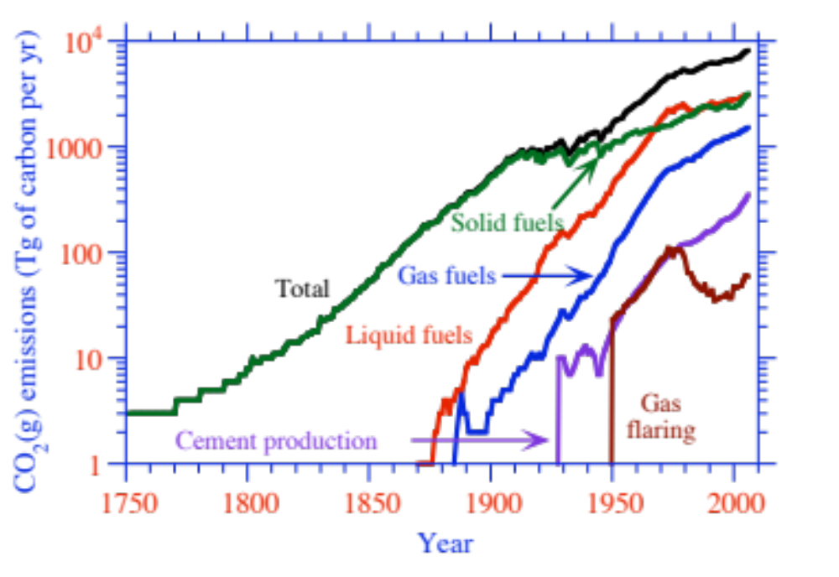
Carbon Dioxide Emission 1750-2008
Figure 12.9

Slide 29
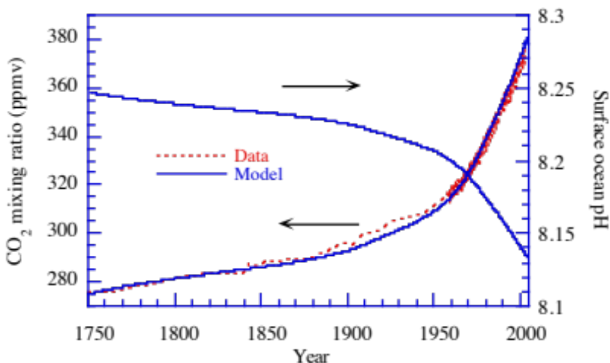
Modeled CO₂(g) and Modeled v Measured Ocean pH 1751-2003
CO₂(g) mixing ratio (ppmv)
Surface ocean pH
Data from Friedli et al. (1986) and Keeling and Whorf (2003)

Slide 30
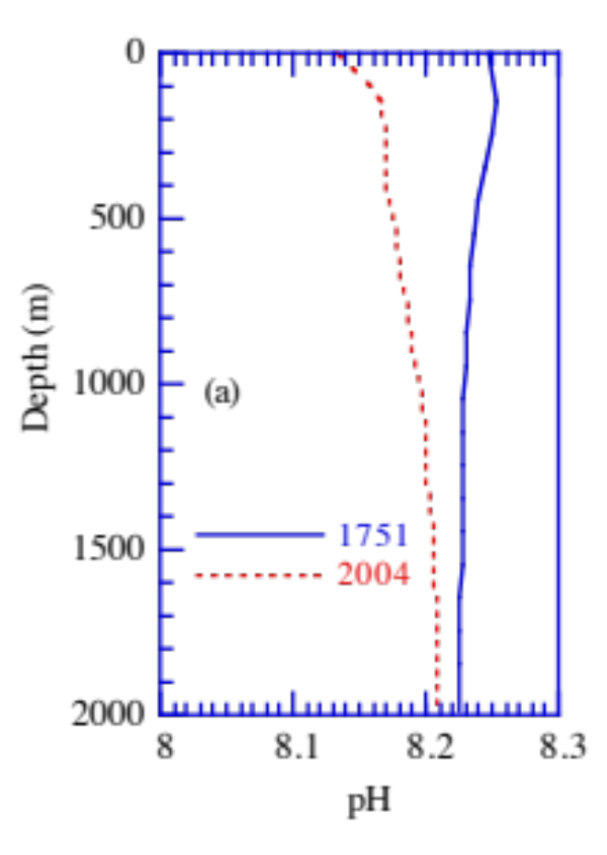
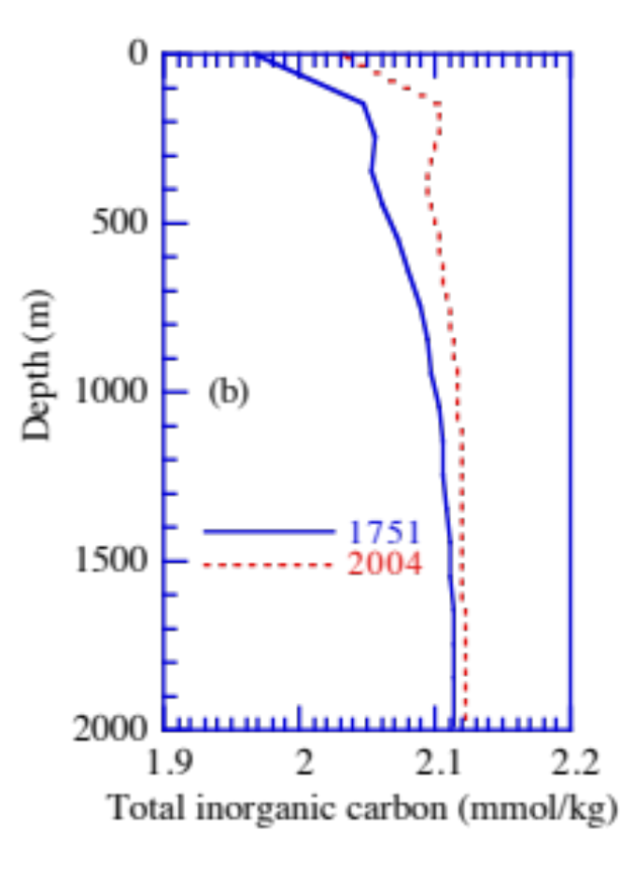
Modeled Ocean Profiles 1751; 2004
Depth (m)
Depth (m)

Slide 31
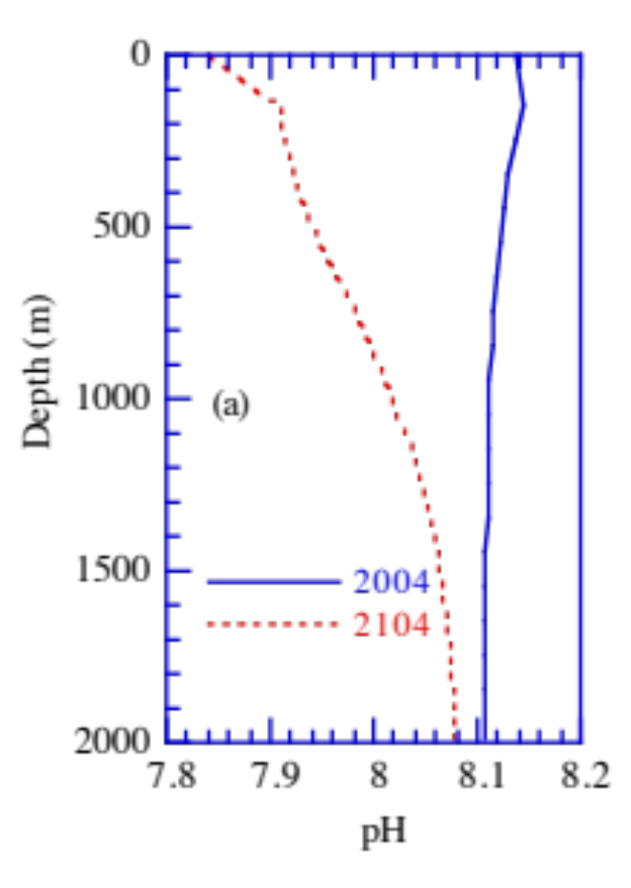
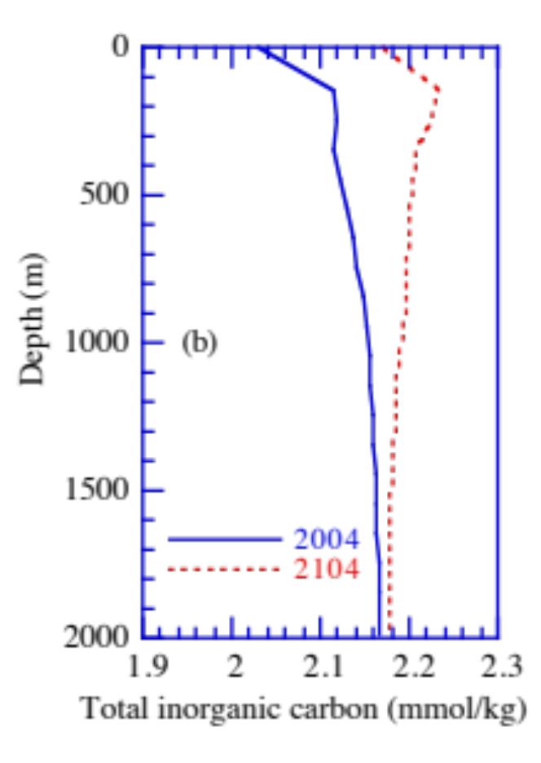
Modeled Ocean Profiles 2004; 2104 Under SRES A1B Emission Scenario
Depth (m)
Depth (m)

Slide 32

Sensitivity of Future Results
CO₂(g) mixing ratio
Surface ocean pH
To wind speed (m/s)
Higher wind speed results in faster mixing of CO₂(g) into ocean

Slide 33


Sensitivity of Future Results
To mean ocean
diffusion (m²/s)
CO₂(g) mixing ratio
Surface ocean pH
To biomass burning
emission (Tg-C/yr)
CO₂(g) mixing ratio
Surface ocean pH

Slide 34

Effect of CO₂(g) on Atmospheric Acids
Assumes trace gases initialized but not emitted
Mixing ratio (ppbv)

Slide 35
Air-Sea Exchange Summary
Globally-averaged surface ocean pH may have decreased from about 8.25 to 8.14 between 1751 and 2004
Under the SREAS A1B emission scenario, pH may decrease to 7.85 by 2100, for an increase in the hydrogen ion by a factor of 2.5 from1751 to 2100.
Ocean acidification may slightly increase concentrations of atmospheric acids and more significantly decrease those of bases, thereby affecting cloud and radiative properties and ocean nutrient availability.

Slide 36


Effect of Calcite and Aragonite
Precipitation reaction forming calcite/aragonite (20.42)
Ca²⁺+CO₃²⁻⬄CaCO₃(s)
Formation of solid when (20.43)
Molality of carbonate ion (20.44)

