Slide 1
Presentation Slides for
Chapter 3 of
Fundamentals of Atmospheric Modeling 2nd Edition
Mark Z. Jacobson
Department of Civil & Environmental Engineering
Stanford University
Stanford, CA 94305-4020
jacobson@stanford.edu
March 10, 2005

Slide 2


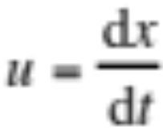
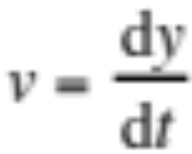
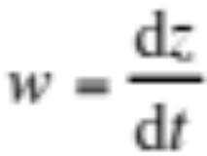
Wind Speed and Velocity
Velocity
Rate at which the position of a body changes with time
Velocity vector (3.1)
Horizontal velocity vector (3.1)
i,j,k = unit vectors in x-, y-, and z-directions
Scalar components of velocity (3.2)

Slide 3
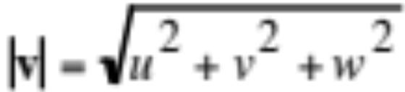
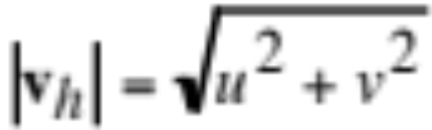
Wind Speed
Wind speed
Magnitude of velocity vector (3.3)
Horizontal wind speed (3.3)

Slide 4
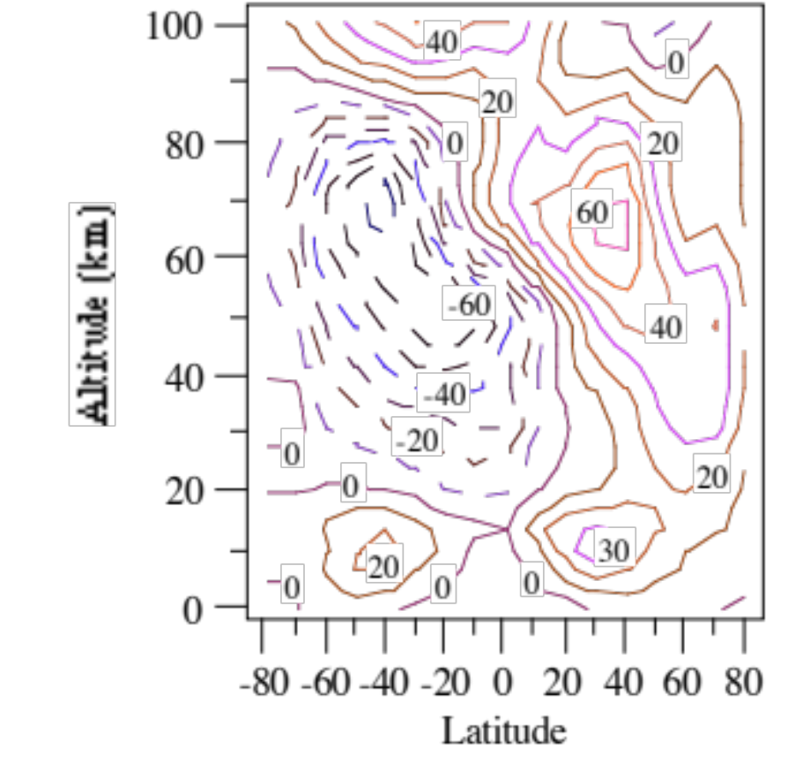
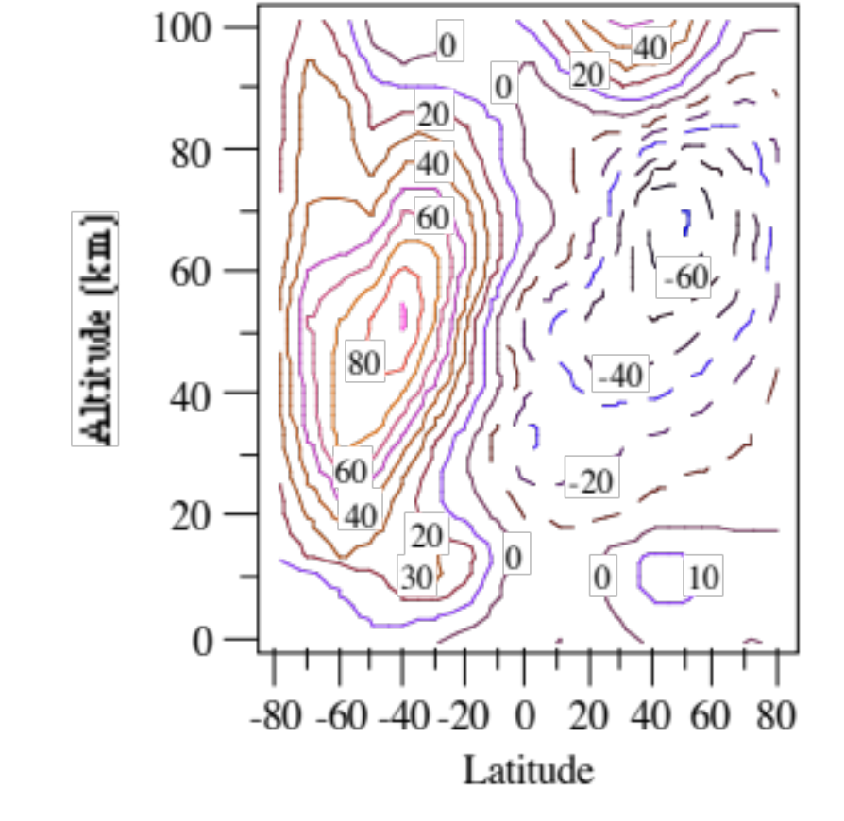
Zonally-Averaged Velocities
January July
Altitude (km)
Altitude (km)
Fig. 3.1

Slide 5
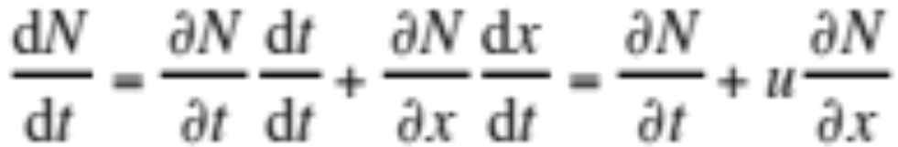
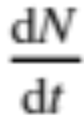
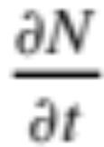
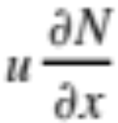
Local and Total Differentiation
Expand total derivative with chain rule (3.4)
Total derivative. Time rate of change along trajectory
Local derivative. Time rate of change at a fixed point
Advection term. Time rate of change due to advection

Slide 6
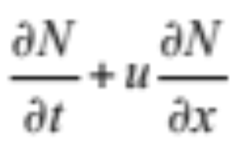
Eulerian vs. Lagrangian
Eulerian frame of reference
Frame of reference of a point fixed in space
Lagrangian frame of reference
Frame of reference of moving parcel

Slide 7
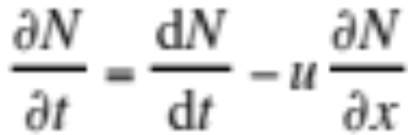
Example 3.1
Assume balloon traveling with the wind from east to west
dN/dt = 10⁸ molec. cm⁻³ s⁻¹
∂N/∂x = 10¹⁰ molec. cm⁻³ km⁻¹
u = -10 m s⁻¹
Find time-rate-of-change in concentration at fixed point

Slide 8
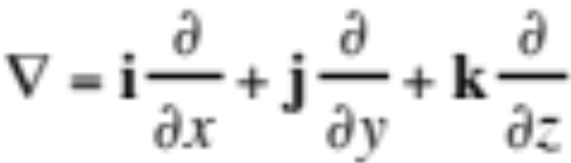
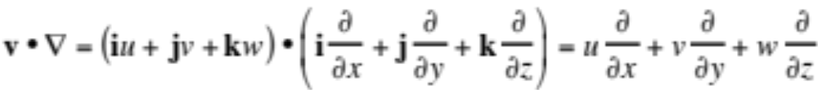
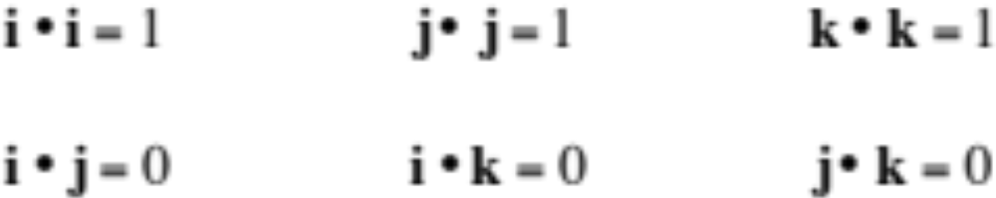
Gradient Operator
Gradient operator in Cartesian-altitude coordinates (3.6)
Dot product of velocity vector with gradient operator (3.7)

Slide 9
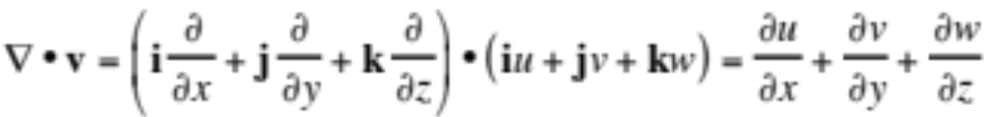


Gradient Operator
Dot product of gradient operator with velocity vector (3.8)
Divergence term
Dot product of gradient operator with velocity vector not symmetric
Dot product of two vectors is symmetric

Slide 10
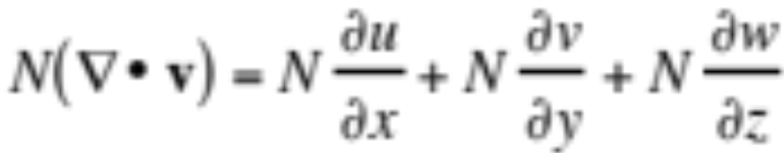
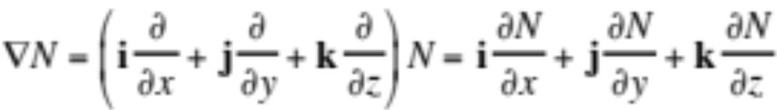
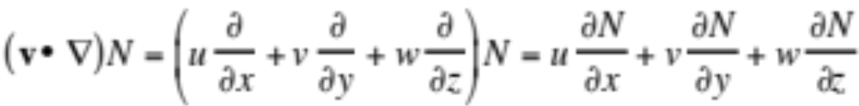
Gradient Operator
Product of concentration and divergence term is scalar (3.9)
Gradient of a scalar is a vector (3.10)
Advection term is a scalar (3.11)

Slide 11
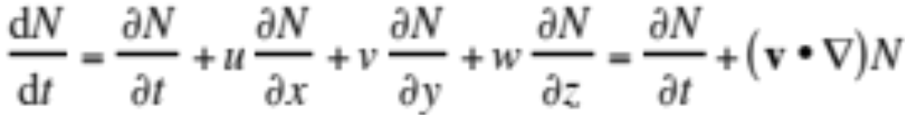
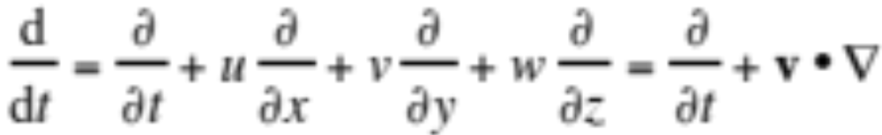
Gradient Operator
Total derivative of scalar concentration (3.12)
Advection term (3.11)
Generalized and expanded form of total derivative (3.13)

Slide 12
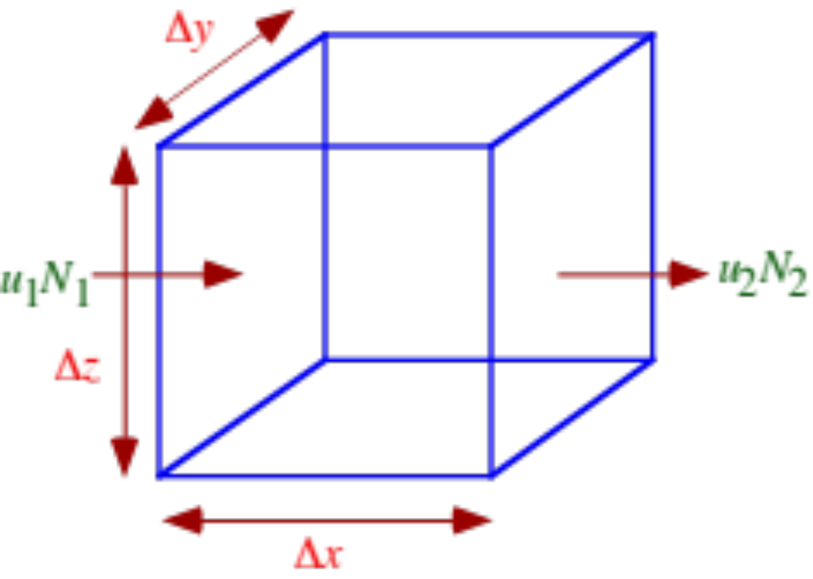
Scalar Continuity Equation
Accumulation = inflow minus outflow (3.14)

Slide 13
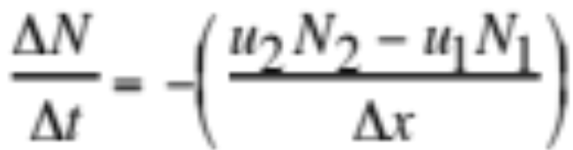
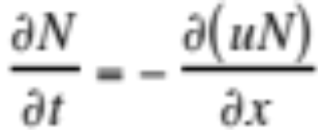
Scalar Continuity Equation
Accumulation = inflow minus outflow (3.14)
Divide both sides by Δt and box volume (ΔxΔyΔz) (3.15)
Let Δt, Δx-->0 (3.16)
Flux-divergence form of continuity equation

Slide 14
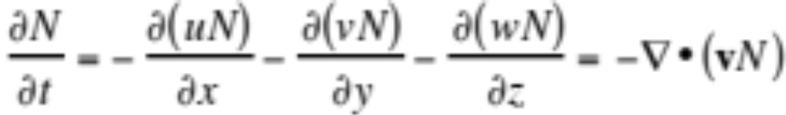

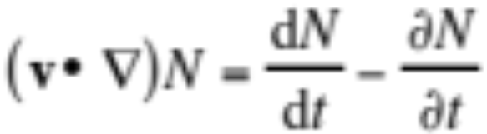
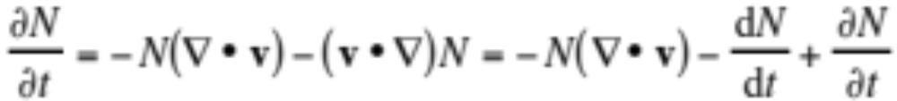
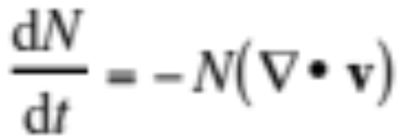
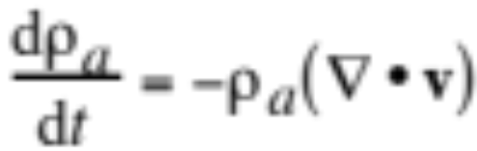
Scalar Continuity Equation
Flux-divergence form of continuity equation in 3-D (3.17)
Expand with chain rule (3.18)
From definition of total derivative (3.21)
Substitute (3.21) into (3.18)
--> Velocity divergence continuity equation (and for air) (3.22,3)

Slide 15
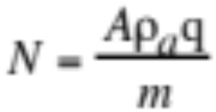
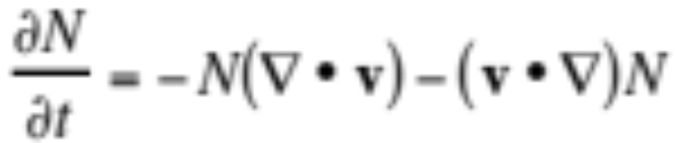
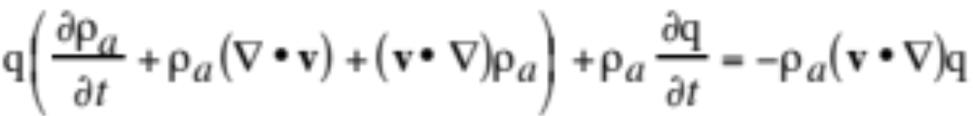
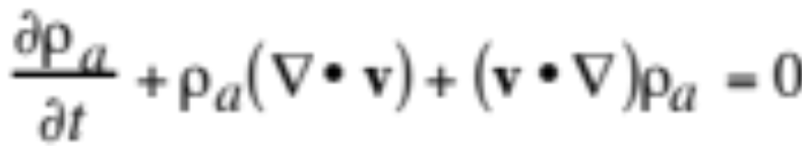
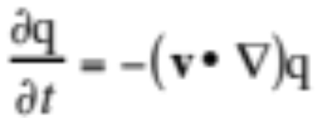
Mixing Ratio Continuity Equation
Number conc. as function of moist-air mixing ratio (3.24)
Substitute into continuity equation for number conc. (3.19)
to obtain (3.25)
Note that
--> Continuity equation for moist-air mass mixing ratio (3.26)

Slide 16
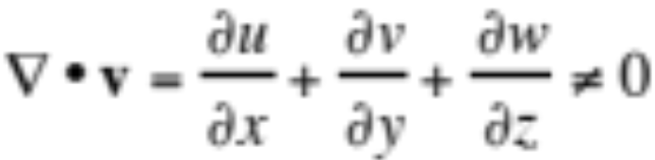
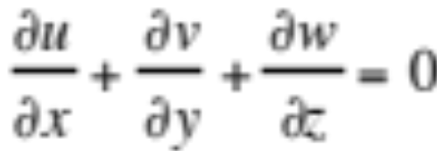
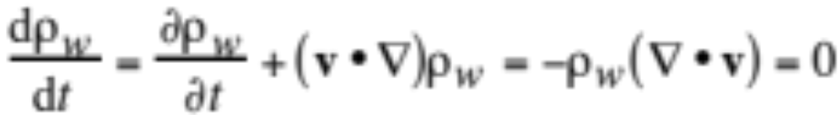
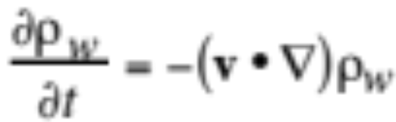
Compressible/Incompressible
Compressible fluid
Volume of an air or water parcel changes over time
Incompressible fluid (3.27)
Volume of an air or water parcel is constant over time
Density of incompressible fluid constant along motion (3.28)
Density of incompressible fluid changes at fixed point (3.29)

Slide 17
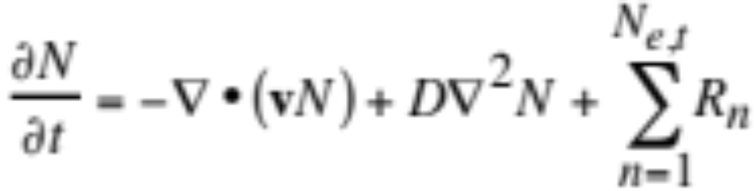
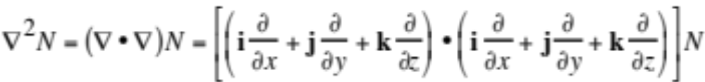
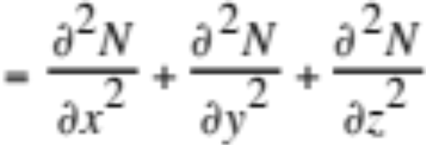
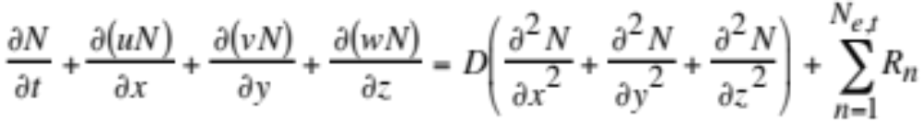
Expanded Continuity Equation
Expanded continuity equation (3.30)
Substitute (3.31)
to obtain (3.32)

Slide 18
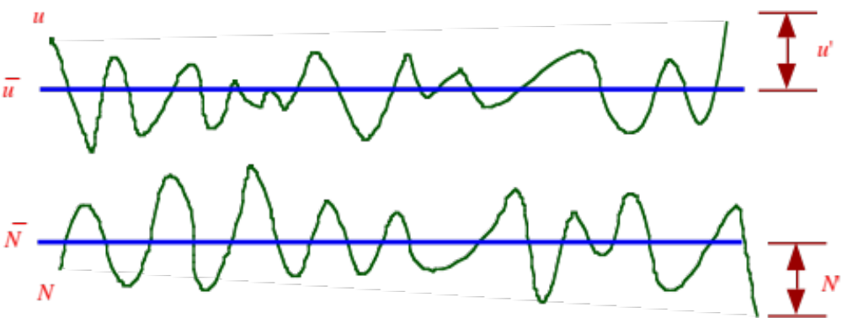

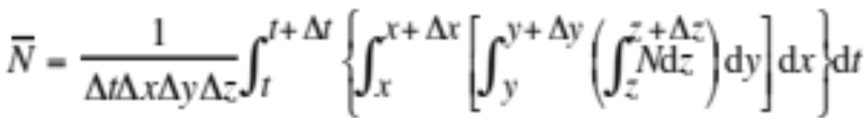
Reynolds Averaging
Fig. 3.3. Precise, mean, and perturbation components of scalar velocity and number concentration
Precise gas concentration (3.33)
Time- and grid-volume average concentration (3.34)

Slide 19
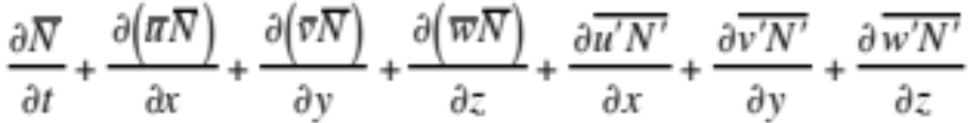
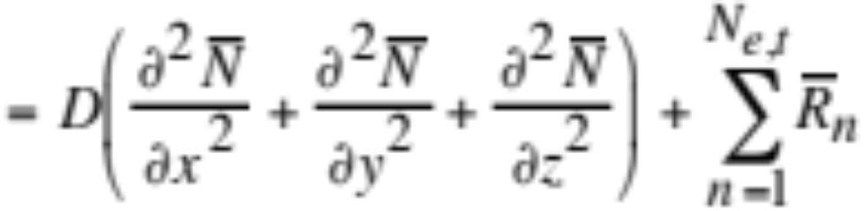
Expanded Continuity Equation
Expanded continuity equation (3.32)
Substitute precise concentrations and velocities and eliminate zero terms (3.40)

Slide 20
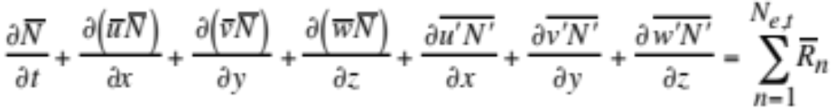
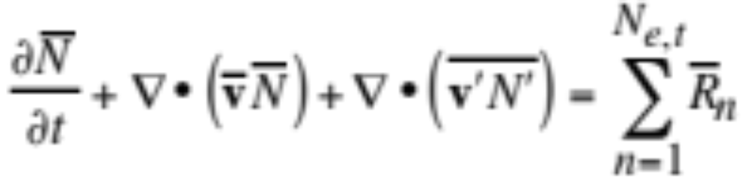
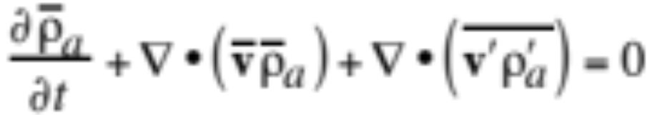
Expanded Continuity Equation
Turbulent diffusion >> molecular diffusion --> (3.41)
Number conc. continuity equation in vector notation (3.42)
Continuity equation for air in vector notation (3.43)

Slide 21




Mixing Ratio Continuity Equation
Moist-air mass mixing ratio continuity equation (3.44)
Continuity equation for air (3.20)
Sum continuity equations (3.45)
Continuity equation after Reynolds averaging (3.49)

Slide 22



K-theory
Relates turbulent fluxes of one parameter to the gradient of the mean value of the parameter
Kinematic turbulent flux terms (3.50)
K= eddy diffusion coefficient for energy (cm² s⁻¹)
Substitute into continuity equation (3.49)

Slide 23



Gas Continuity Equation
Continuity equation for gas concentration (3.52)
Continuity equation for moist-air mass mixing ratio (3.54)
Eddy diffusion tensor (3.53)

Slide 24


Continuity Equations
Expanded continuity equation for gas concentration (3.56)
Continuity equation for air (3.55)
Ignore turbulent flux divergence and external source/sink terms

Slide 25



Particle Continuity Equation
Continuity equation for particle number concentration (3.58)
Volume concentration (3.57)
Continuity equation for particle volume concentration (3.59)

Slide 26



Water Continuity Equation
Continuity equation for water vapor (3.61)
Continuity equation for liquid water (3.62)
Continuity equation for ice (3.63)

Slide 27


Bulk vs. Size-Resolved
Size-resolved treatment of water (3.60)
Bulk treatment of water

Slide 28


Thermodynamic Energy Equation
First law of thermodynamics (2.82)
Differentiate with respect to time, substitute α _{a}=1/ρ_{a} (3.64)
Thermodynamic energy equation in terms of temperature along line of motion of parcel
Time-rate-of change of temperature in a parcel is affected by diabatic sources/sinks and adiabatic expansion/contraction

Slide 29



Thermodynamic Energy Equation
Differentiate θ_{v}=T_{v}(1000 hPa/p_{a})^{κ} (3.65)
Thermodynamic energy equation (3.64)
Substitute dT_{v}/dt from (3.65) into (3.64) (3.66)

Slide 30





Thermodynamic Energy Equation
Sum the result (3.67)
Define energy density (J m⁻³)
Substitute into (3.67) (3.73)

Slide 31


Thermodynamic Energy Equation
Decompose variables (assume ρ’_{a} small) (3.60)
Perform Reynolds averaging (3.70)
Thermodynamic energy equation
Turbulent flux divergence terms (3.73)

Slide 32




Thermodynamic Energy Equation
Turbulent flux divergence tensor (3.60)
Thermodynamic energy equation turbulence tensor (3.74)
Expand diabatic source/sink term (3.75,6)

