Slide 1
Presentation Slides for
Atmospheric Pollution:
History, Science, and Regulation
Chapter 8: International Regulation of Urban Smog Since the 1940s
By Mark Z. Jacobson
Cambridge University Press, 399 pp. (2002)
Last update: March 30, 2005
The photographs shown here appear in the textbook and are provided to facilitate their display during course instruction. Permissions for publication of photographs must be requested from individual copyright holders. The source of each photograph is given below the figure and in the back of the textbook.

Slide 2
Air Pollution Review 1940s, 1950s
1940s: Smog severe in Los Angeles
1947: Los Angeles Air Pollution Control District forms
1948: Donora, Pennsylvania smog disaster
1949: National symposium on air pollution in Los Angeles
1951: Oregon approves agency to control air pollution
1952: Air pollution disaster in London
mid-1950s: Ozone levels in Los Angeles reach 0.65 ppmv
1955: Eisenhower asks Congress to examine air pollution

Slide 3
Air Pollution Laws 1950s
U.S. Air Pollution Control Act of 1955
Federal technical assistance to state air pollution control
Funding of Public Health Service for studies of air pollution
Amended 1960 to study health effects of automobile exhaust
Did not impose regulations on air pollution
Delegated regulation to state and local level
English Clean Air Act of 1956
Controlled household, industrial dark smoke emission in London
No control of sulfur dioxide
Smokeless zones in London.
Relocation of many power plants to rural areas

Slide 4
U. S. Air Pollution Laws
1959
California Motor Vehicle Control Board set first automobile emission standard worldwide. 1963 model cars required to reroute crankcase hydrocarbon emissions back to manifold for reburning.
1960
Silent Spring by Rachel Carson
Clear Air Act of 1963
Gave federal government authority to regulate interstate pollution
Emission standards for stationary sources (power plants, steel)
No automobile controls

Slide 5
U. S. Air Pollution Laws
Motor Vehicle Air Pollution Control Act of 1965
First regulation of automobiles at federal level
Emission standards to reduce tailpipe HCs 72%, CO(g) 56%
For 1968 model cars; patterned after California for 1966 cars
More than half of 1968 and 1969 cars did not meet standards
Air Quality Act of 1967
U.S. divided into Air Quality Control Regions (AQCR)
Required publication of Air Quality Criteria (AQC) reports
Science reports about effects of pollutants on health/welfare
Provide suggestions about acceptable levels of pollution
States required to set own air quality standards based on AQC
State Implementation Plans (SIP)
State plan for regulation submitted to federal government
If no state enforcement, federal government could sue state

Slide 6
Clean Air Act Amendments of 1970
Creation of U. S. Environmental Protection Agency (USEPA)
National Ambient Air Quality Standards (NAAQS)
Primary: to protect public health (e.g., asthmatics, elderly)
Secondary: to protect public welfare (e.g., visibility, buildings)
Criteria Air Pollutants
Originally: CO(g), NO₂(g), SO₂(g), TSP, HCs, oxidants
Lead added in 1976
Oxidants change to O₃(g) in 1979
HCs removed in 1983
TSP changed to PM₁₀, a PM_{2.5} standard added in 1997

Slide 7
Clean Air Act Amendments of 1970
Attainment areas
Regions where primary standards met
Nonattainment areas
Regions where primary standards were not met
New Source Performance Standards (NSPS)
Set by USEPA to limit emission from new stationary sources
National Emission Standards for Hazardous Pollutants (NESHAPS)
For pollutants causing mortality, severe illness
Initially, for, asbestos, beryllium, mercury. List expanded in 1984
Congressional control of automobile emissions
Required 90% reduction HCs, CO(g) by 1975 and NO_{x} by 1976

Slide 8
Catalytic Converter
1975: Single-bed catalyst
Converts CO(g) and HCs to CO₂(g)
1976: Duel-bed catalyst
Additional bed to convert NO_{x}(g) to N₂(g)
1979: Three-way catalyst
Converts CO(g), HCs, NO_{x}(g) in single bed
Exhaust gas travels for 50 milliseconds over the metals platinum/palladium or platinum/rhodium, which are spread over ceramic or metallic honeycombs to increase surface area
Catalytic converter --> significant reduction in pollutant gases

Slide 9
Clean Air Act Amendments of 1977
Prevention of Significant Deterioration (PSD) in areas already under attainment. Three classes of regions designated:
Class I: Pristine areas (parks, wilderness) no new sources
Class II: Moderate changes allowed but regulations desired
Class III: Major growth allowed if NAAQS not exceeded
PSD permit needed for growth in region allowing growth
New source must use Best Available Control Technology (BACT)
Computer modeling mandated to check whether new pollution sources might result in standard exceedence
Control of CFCs

Slide 10
Clean Air Act Amendments of 1990
1990: 96 cities still in violation of ozone NAAQS
--> nonattainment areas divided into six categories
“Extreme:” Los Angeles: must attain by 2010
“Severe:” Baltimore, New York: must attain by 2007
“Severe:” Chicago, Houston,…: must attain by 2005
New sources in nonattainment areas must achieve
Lowest Achievable Emissions Rate (LAER) by adopting Reasonably Achievable Control Technology (RACT)
Hazardous Air Pollutants (HAPs)
Emission limits for 189 toxic chemicals using Maximum Achievable Control Technologies (MACTs)
More control of CFCs

Slide 11
Clean Air Act Revision of 1997
Change in ozone standard
0.08 ppmv over 8-hour average instead of
0.12 ppmv over 1-hour average
Addition of PM_{2.5} standard

Slide 12
Federal U.S. Emission Standards for Light-Duty Vehicles
HCs CO NO_{x} Pb PM
Year (g/mi) (g/mi) (g/mi) (g/gal) (g/mi)
1968-70 3.2 33 -- -- --
1971-2 4.6 47 4.0 -- --
1972 3.4 39 -- -- --
1973-4 3.4 39 3.0 -- --
1975-6 1.5 15 3.1 -- --
1977-9 1.5 15 2.0 0.8 --
0.41 7.0 2.0 0.5 --
1981 0.41 3.4 1.0 0.5 --
1982-6 0.41 3.4 1.0 0.5 0.6
1987-92 0.41 3.4 1.0 0.5 0.2
Tier 1. Intermediate Useful Life Standards
0.25 3.4 0.4 0.5 0.08
Tier 2. Full-Life Standards
1993- 0.31 4.2 0.6 0.5 0.10
Table 8.1

Slide 13
California, U.S. Ambient Standards
Federal Federal
California Primary Secondary
Pollutant Standard Standard Standard
Ozone
1-h average 0.09 ppmv 0.12 ppmv Same as primary
8-h average -- 0.08 ppmv Same as primary
Carbon monoxide
1-h average 20 ppmv 35 ppmv --
8-h average 9.0 ppmv 9.5 ppmv --
Nitrogen dioxide
1-h average 0.25 ppmv -- --
Annual average -- 0.053 ppmv Same as primary
Sulfur dioxide
1-h average 0.25 ppmv -- --
3-h average -- -- 0.5 ppmv
24-h average 0.05 ppmv 0.14 ppmv --
Annual average -- 0.03 ppmv --
Table 8.2

Slide 14
California, U.S. Ambient Standards
Federal Federal
California Primary Secondary
Pollutant Standard Standard Standard
PM₁₀
24-h average 50 μg m⁻³ 150 μg m⁻³ Same as primary
An. arith. mean 50 μg m⁻³ Same as primary
PM_{2.5}
24-h average 65 μg m⁻³ Same as primary
An. arith. mean 15 μg m⁻³ Same as primary
Lead
30-d average 1.5 μg m⁻³ -- --
Calendar quarter -- 1.5 μg m⁻³ Same as primary
Particulate sulfate
24-h average 25 μg m⁻³ -- --
Table 8.2

Slide 15
Smog Alerts
Ozone 1-h
Health Standard Level Mixing Ratio (ppmv)
California standard 0.09
Federal standard 0.12
Health advisory 0.15
Stage 1 smog alert 0.20
Stage 2 smog alert 0.35
Stage 3 smog alert 0.50
Table 8.3

Slide 16
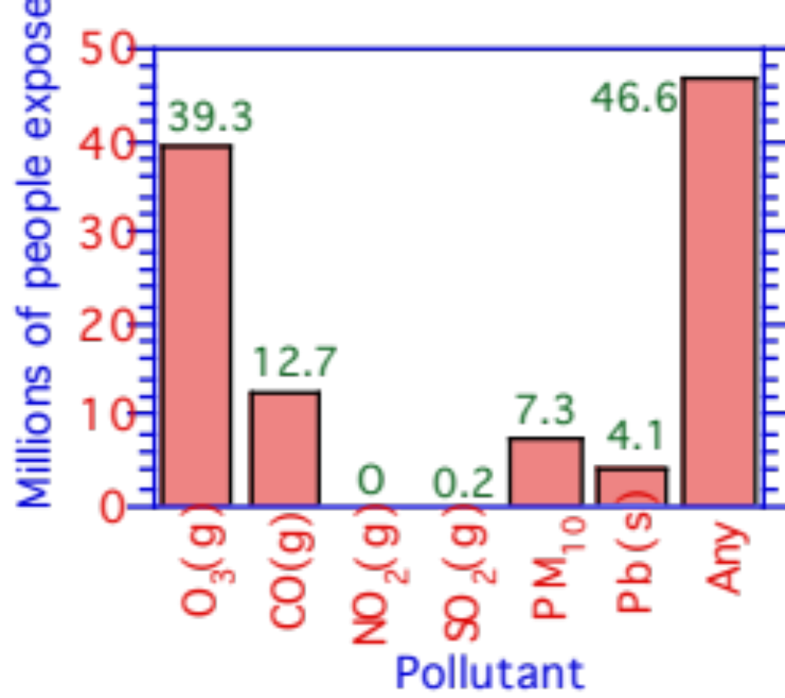
People Exposed to at Least One U.S. NAAQS violation 1996
Millions of people exposed
Figure 8.1

Slide 17
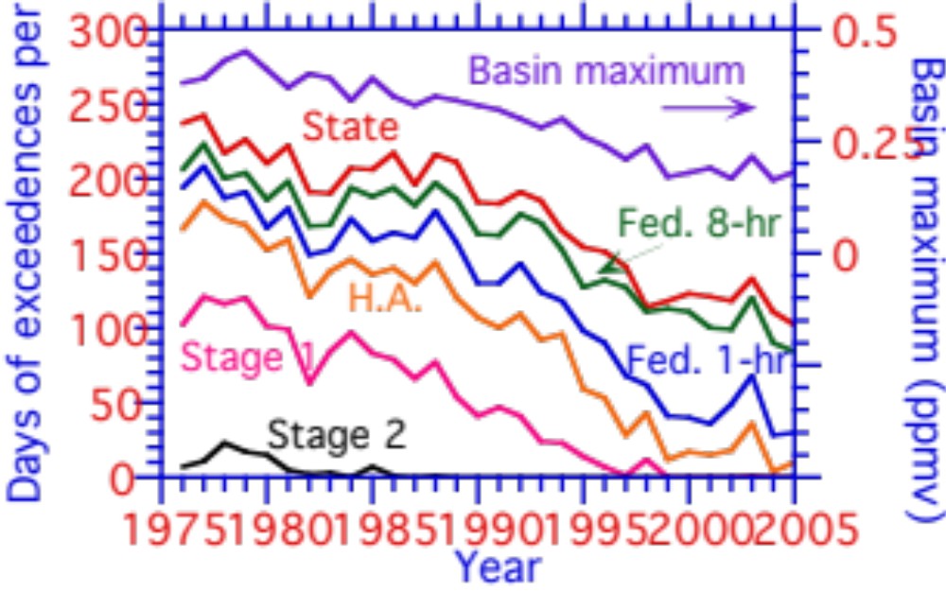
Days per Year that Ozone in Los Angeles Exceeded Given Standard
Figure 8.2, SCAQMD

Slide 18
Changes in Ambient Standard Exceedences and Emissions
Percent Change in Percent
Federal Standard Change in
Exceedences Emission
Pollutant 1988-1997 1988-1997
Ozone -19 --
Carbon monoxide -38 -25
Nitrogen dioxide -14 -1
Sulfur dioxide -39 -12
PM10 -26 -12
Lead -67 -44
Reactive organics -- -20
Table 8.4, USEPA Office of Air and Radiation

Slide 19
Visibility-Standard Exceedences in Los Angeles
Location 1990 1994
Azusa No data 91
Burbank 180 No data
Lancaster 14 No data
Long Beach 155 No data
Los Angeles 154 No data
Ontario 250 No data
Riverside 200 No data
San Bernardino 200 176
Table 8.5, SCAQMD

Slide 20
Contributions of Pollutant Particles to Visibility Reduction
Pollutant West East
Sulfates 25-65 >60
Organic carbon 15-35 10-15
Nitrates 5-45 10-15
Black carbon 15-25 10-15
Soil dust 10-20 10-15
Table 8.6, USEPA Office of Air Quality Planning and Standards

Slide 21
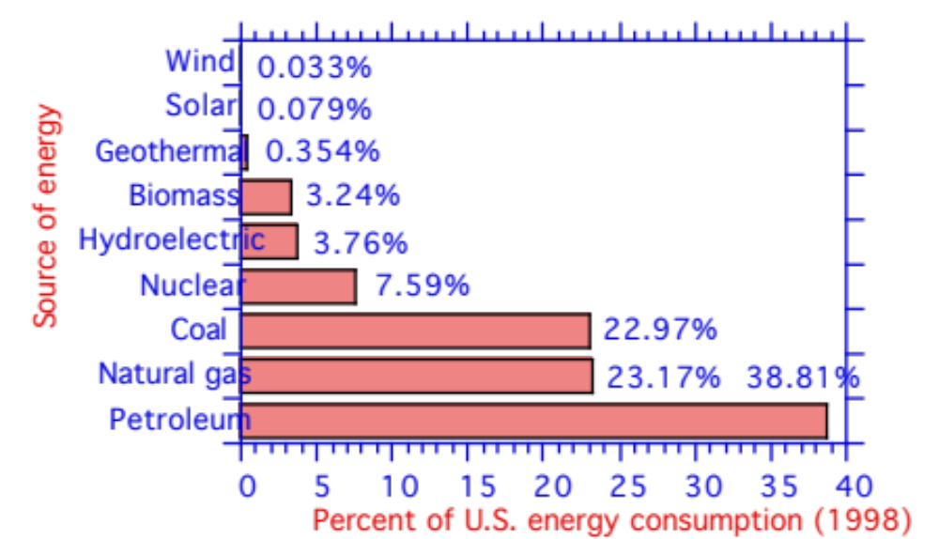
Sources of Pollution: U.S. Energy Consumption by Source (1998)
Source of energy
Figure 8.3

Slide 22
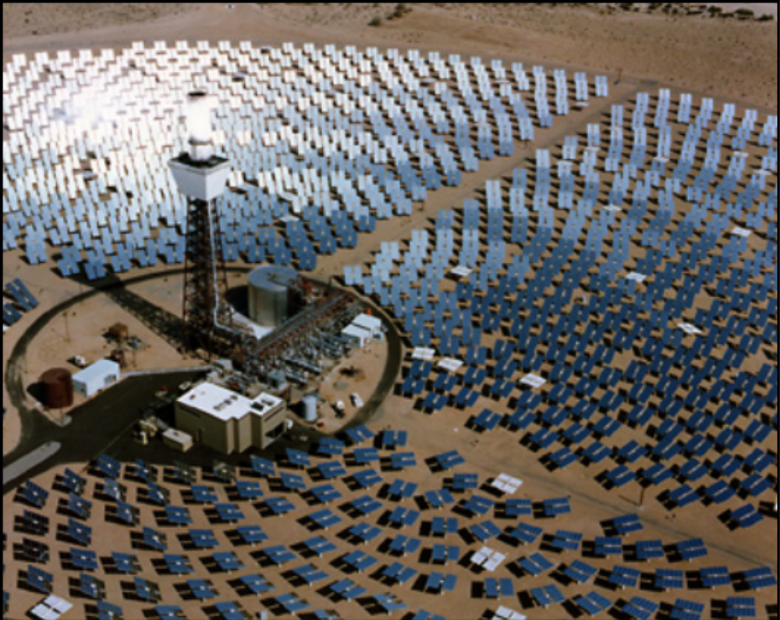
Solar One (Barstow, California)
Sandia National Laboratory, available from
National Renewable Energy Laboratory, U.S. Department of Energy

Slide 23
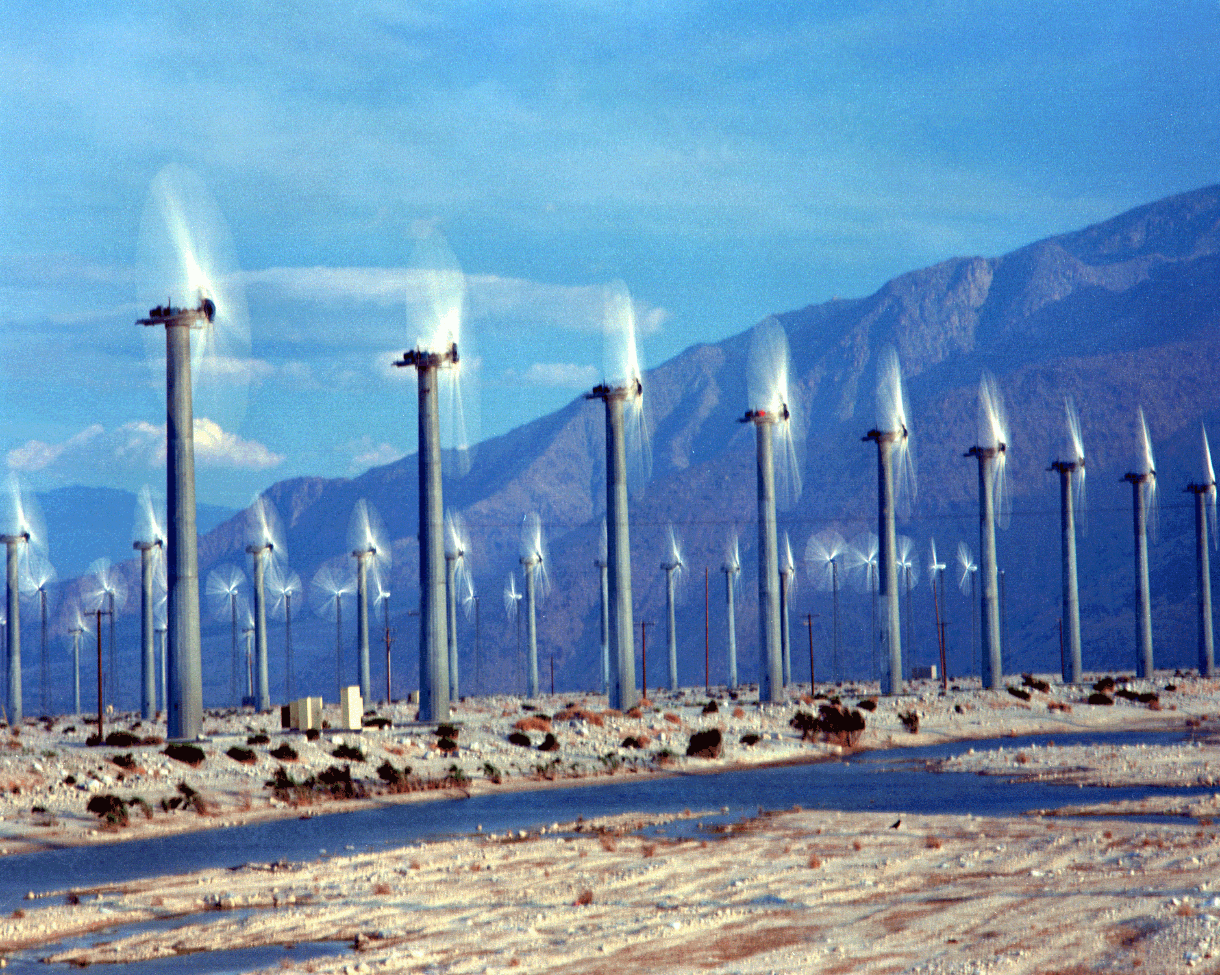
Wind Turbines (Palm Springs, California)
Warren Gretz, available from National Renewable Energy Laboratory

Slide 24
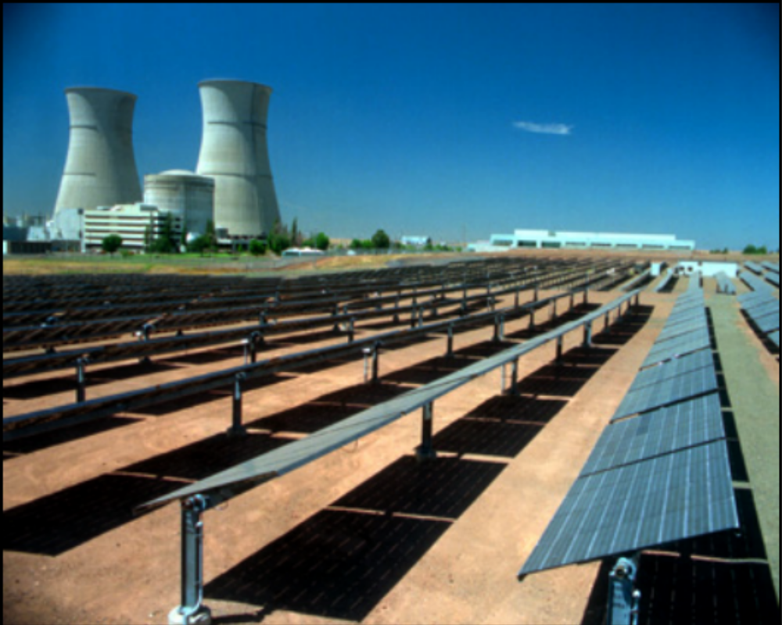
Solar Photovoltaics Co-Located With Nuclear Power Plant (Sacramento, California)
Warren Gretz, available from National Renewable Energy Laboratory

Slide 25
Health Effects of Air Pollution
Los Angeles
1600 premature deaths per year
Children have 10-15% lower lung function
Exposure to particles in exceedence of NAAQS > 42 days/yr
--> 33% greater risk of bronchitis
--> 74% greater risk of asthma
--> 37% greater risk of cancer
75% of young people who died had airspace inflammation
27% had severe lung damage
39% had severe illness to bronchial glands

Slide 26
Worldwide Mortality From Pollution, Some Other Sources
World Health Organization (2002)
Indoor air pollution 1.62 million deaths/year
Outdoor air pollution 0.80
Climate change 0.15 (disease, heat stress)
Tobacco smoke 4.91
Water pollution 1.73
Malnutrition 3.75
High blood pressure 7.14

Slide 27
Worldwide Pollution Trends/Control
Canada
Regulations routinely imposed through Environment Canada. Acid deposition a problem in east.
Mexico
Mexico City the most populous city worldwide and most dangerous for children in terms of air pollution. City surrounded by mountains and under high pressure.
Brazil
Ethanol fuel program since 1973 --> PAN problems
Chile
Santiago has high particle concentrations

Slide 28
Worldwide Pollution Trends/Control
European Union (originally European Community in 1957)
Directive
Pollution regulation binding on all member nations but takes into account needs of specific country.
Regulation
Law applied uniformly to all member nations
Decision
Direction for specific member nation
United Kingdom
1956 United Kingdom Clean Air Act
Reduced dark smoke in London
1968 United Kingdom Clean Air Act
Required tall chimneys for industry
1972. Joined European Union

Slide 29
Worldwide Pollution Trends/Control
France
Air pollution monitoring beginning in 1956
Heavy reliance on nuclear power
Spain
Vehicles a large source of pollution
Heavy reliance on fossil energy
Germany
1800s to 1980s, coal the largest source of energy in Germany
Coal from Ruhr region (high in sulfur)
Coal burning in 1920s-1980s caused significant pollution
East Germany, lignite burned.
Sulfur triangle between Dresden, Prague, Krakow
7000 deaths/year in mid 1970s due to air pollution in triangle
Reunification --> lignite mines/plants shut down
Today, strong wind industry

Slide 30
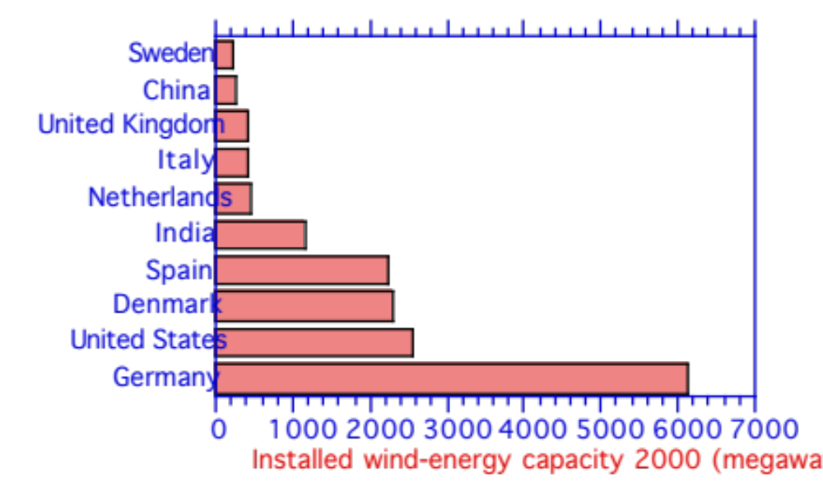
Wind-Energy Capacity by Country (2000)
Figure 8.7

Slide 31
Worldwide Pollution Trends/Control
Russia
Air pollution levels exceed standards for more than 65 million
About 14,000 deaths in 1999 due to pollution
15% of Russian territory “ecologically unfavorable”
Israel
Sets standards similar to to E.U. standards
Egypt
Lead contamination a problem in Cairo
Iran
Tehran among most polluted cities worldwide
India
1880s to today, Calcutta (near coal fields) most polluted city.
Colonial regulation reduced smoke emission 1910s-1950s
Today, New Delhi and Calcutta significantly polluted
Indoor burning of biomass and coal a major problem

Slide 32
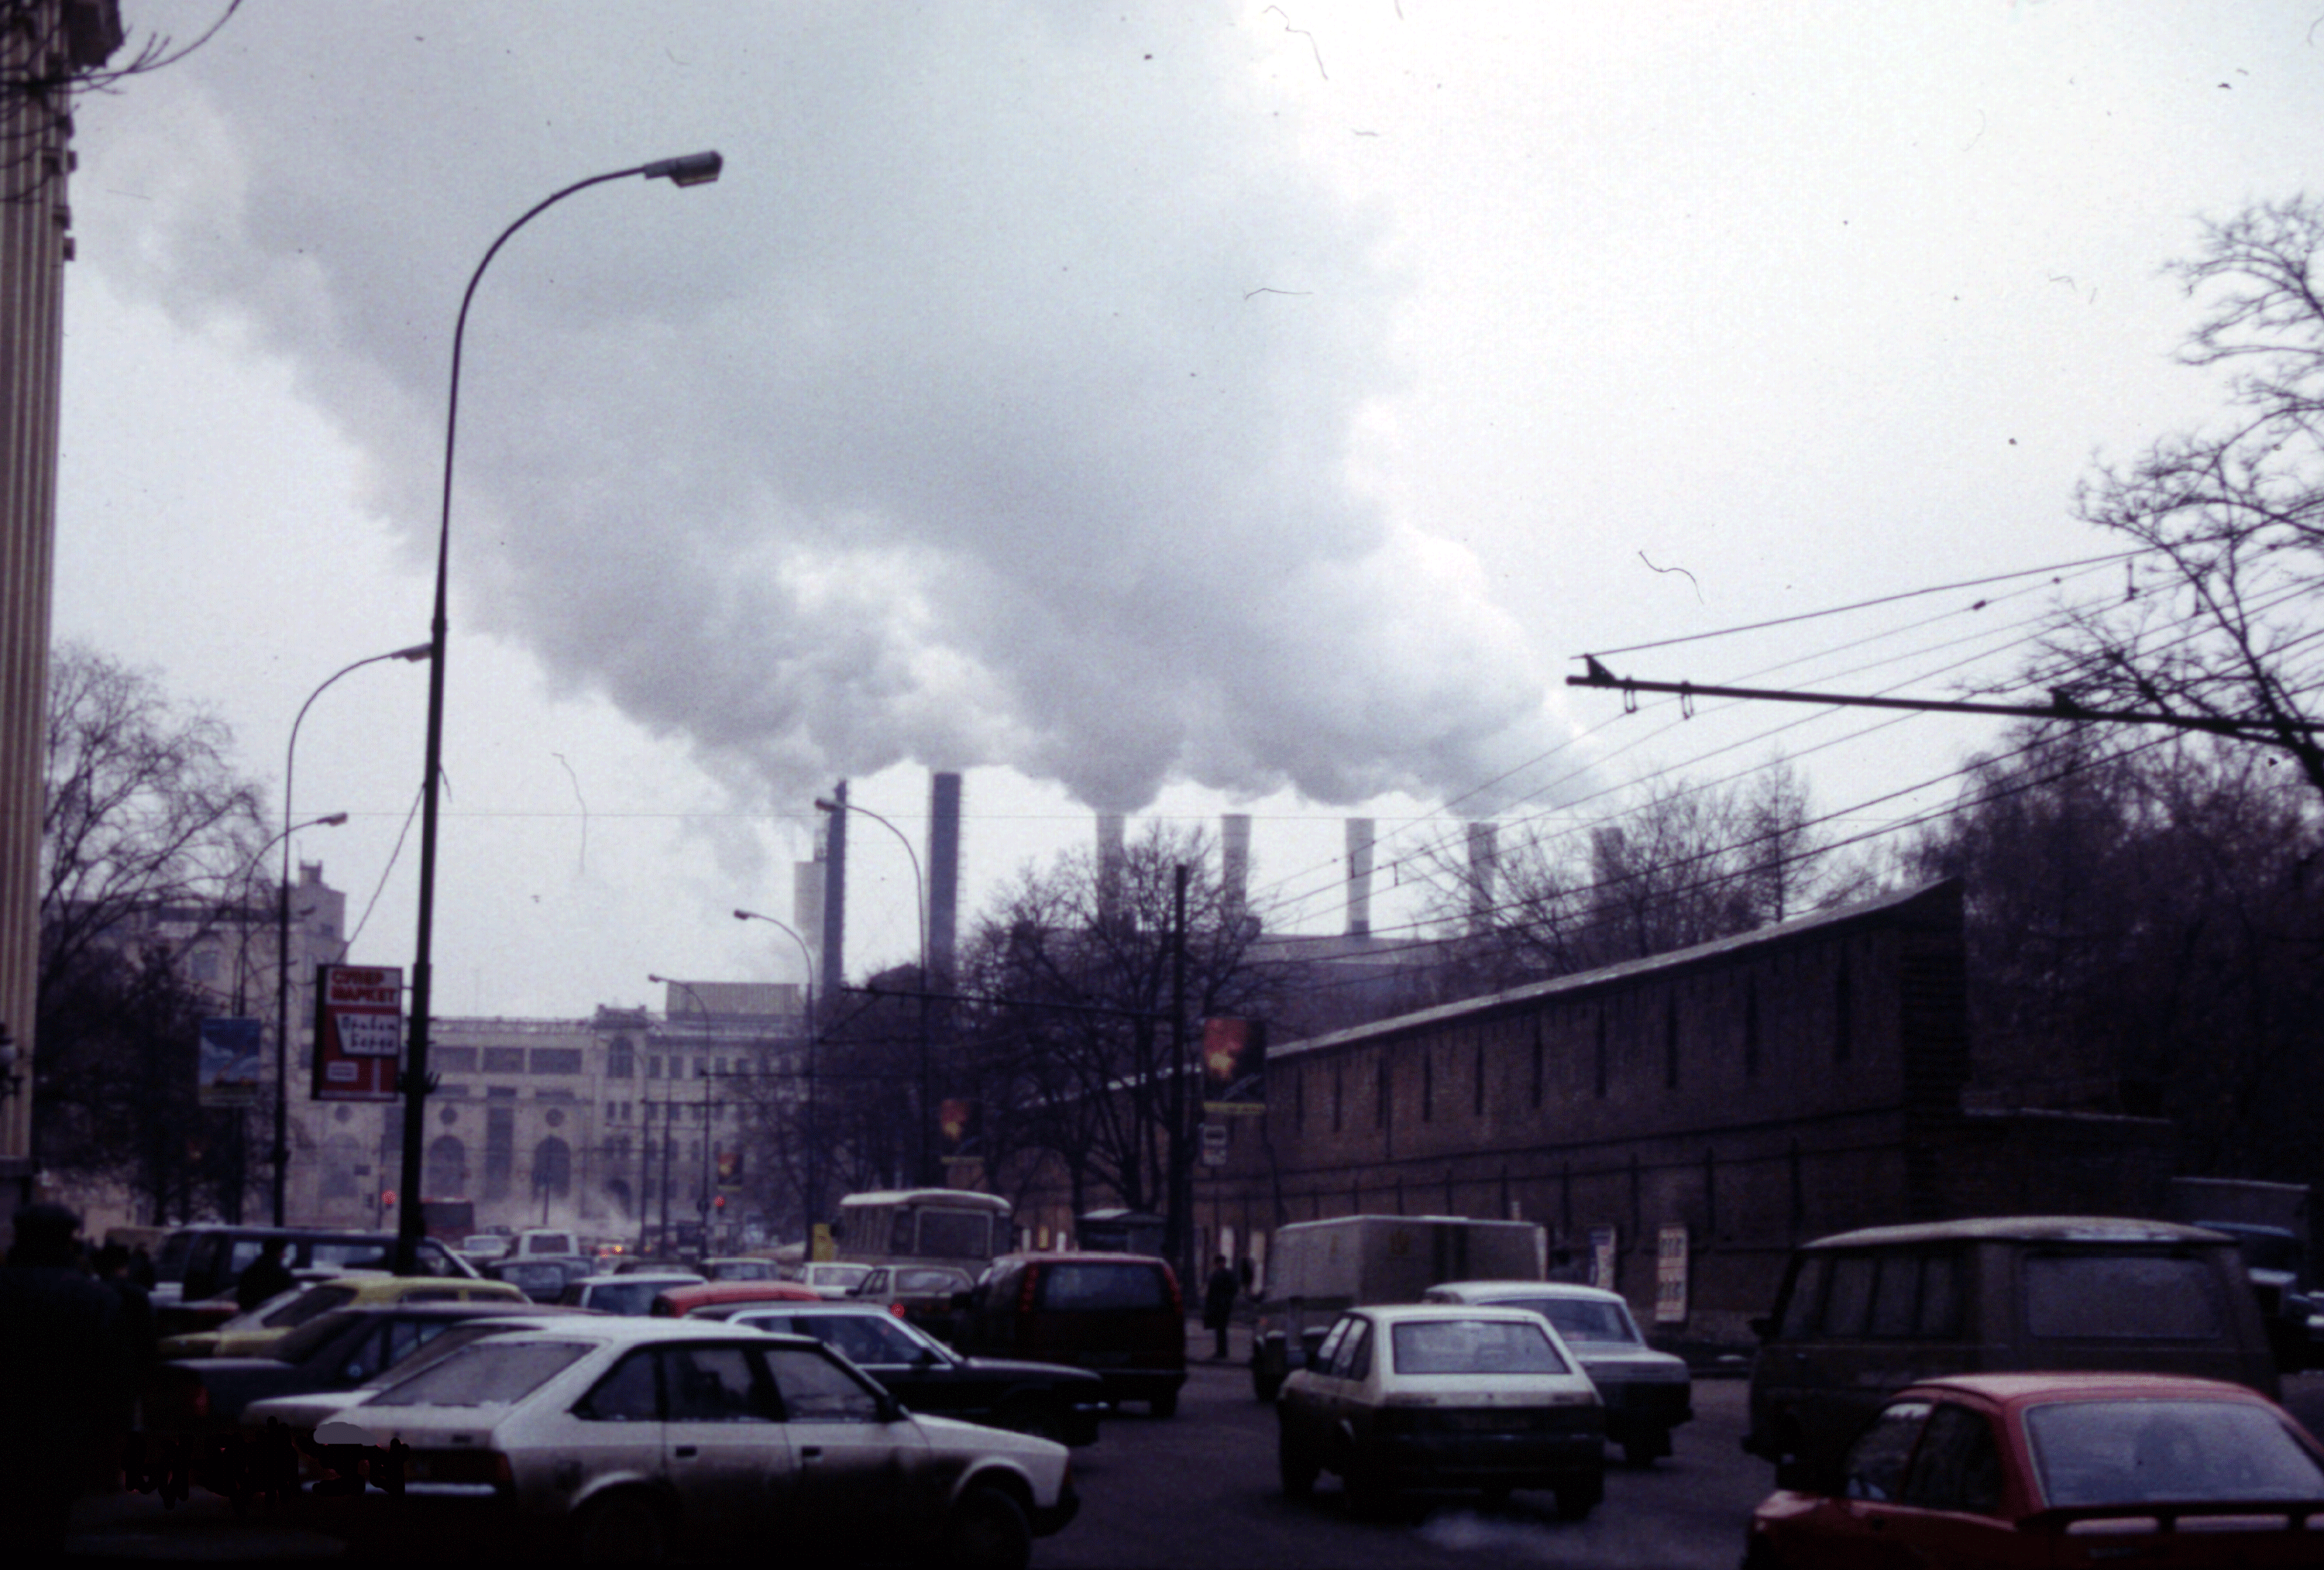
Power Plant Emissions in Moscow (1984)
Roger Taylor, available from National Renewable Energy Laboratory

Slide 33
Worldwide Pollution Trends/Control
China
Contains 7 out of 10 most polluted cities worldwide
Two-thirds of 338 cities monitored are polluted
Largest producer/consumer of coal
Dust from Gobi Desert a problem - reaches U.S. in April
Indoor burning of coal and biomass a major problem
Air pollution regulations in 1987, 1995, 2000
Japan
17th century to 1925, copper mining pollution Shikoku Island
Early 1900s expansion of industry --> coal pollution Osaka
1970s, Osaka, Kobe, Kyoto, Tokyo very polluted
Regulations became stronger starting in 1980s
South Africa
Significant coal production, biomass burning
Constitution guarantees right to healthy environment
Australia
Coal burning, but relatively clean due to low population

