Slide 1
Presentation Slides for
Atmospheric Pollution:
History, Science, and Regulation
Chapter 9: Indoor Air Pollution
By Mark Z. Jacobson
Cambridge University Press, 399 pp. (2002)
Last update: March 30, 2005
The photographs shown here appear in the textbook and are provided to facilitate their display during course instruction. Permissions for publication of photographs must be requested from individual copyright holders. The source of each photograph is given below the figure and in the back of the textbook.

Slide 2
Indoor Air Pollutant Gases
Gas Emission Sources
Carbon dioxide Metabolic activity, combustion, garage exhaust, tobacco smoke
Carbon monoxide Boilers, gas or kerosene heaters, gas stoves, wood stoves, fireplaces, tobacco smoke, garage exhaust, outdoor air
Nitrogen dioxide Outdoor air, garage exhaust, kerosene and gas space heaters, wood stoves, gas stoves, tobacco smoke
Ozone Outdoor air, photocopy machines, electrostatic air cleaners
Table 9.3

Slide 3
Indoor Air Pollutant Gases
Gas Emission Sources
Sulfur dioxide Outdoor air, kerosene space heaters, gas stoves, and coal appliances
Formaldehyde Particleboard, insulation, furnishings, paneling, plywood, carpets, ceiling tile, tobacco smoke
Volatile org. carbon Adhesives, solvents, building materials, combustion appliances, paints, varnishes, tobacco smoke, room deodorizers, cooking, carpets, furniture, draperies
Radon Soils
Table 9.3

Slide 4
Indoor Air Pollutant Particles
Particle Emission Sources
Allergens House dust, domestic animals, insects, pollen
dust mite feces from cats, dogs, rodents
~ 10-40 μm diameter
1 gram of dust --> 100,000 feces
Pollen ~ 20-150 μm diameter
Asbestos Fire retardant materials, insulation
Fungal spores Soil, plants, foodstuffs, internal surfaces
~ 3 μm diameter
Bacteria, viruses People, animals, plants, air conditioners
PAHs Fuel combustion, tobacco smoke
Other Resuspension, tobacco smoke, wood stoves, fireplaces, outdoor air
Table 9.3

Slide 5
Radon
Radioactive but chemically unreactive colorless, tasteless, odorless gas produced by radioactive decay of uranium.
Radon precursors are bound to minerals, but radon is a gas that escapes through soil, through unsealed floors into houses, where its concentration builds up in the absence of ventilation
Radon has a half-life of about 3.8 days. Its decay products, called radon progeny, are electrically charged and can be inhaled or attach to particles that are inhaled.
Radon itself is not harmful, but its progeny, particularly polonium and lead, are highly carcinogenic. The combination of radon exposure with cigarette smoking increases lung-cancer risks.

Slide 6
Radioactive Decay Emission
Alpha particle
Nucleus of helium atom (2 neutrons + 2 protons). The least-penetrating form of radiation. Can be stopped by a piece of paper. Not dangerous unless inhaled or ingested.
Beta particle
High-speed electron. Penetrates deeper than does alpha particle but less than does gamma ray.
Gamma ray
Highly-energized, deeply-penetrating photon emitted from the nucleus of an atom during nuclear fission (e.g., in the sun’s core) but sometimes during decay of an element.

Slide 7
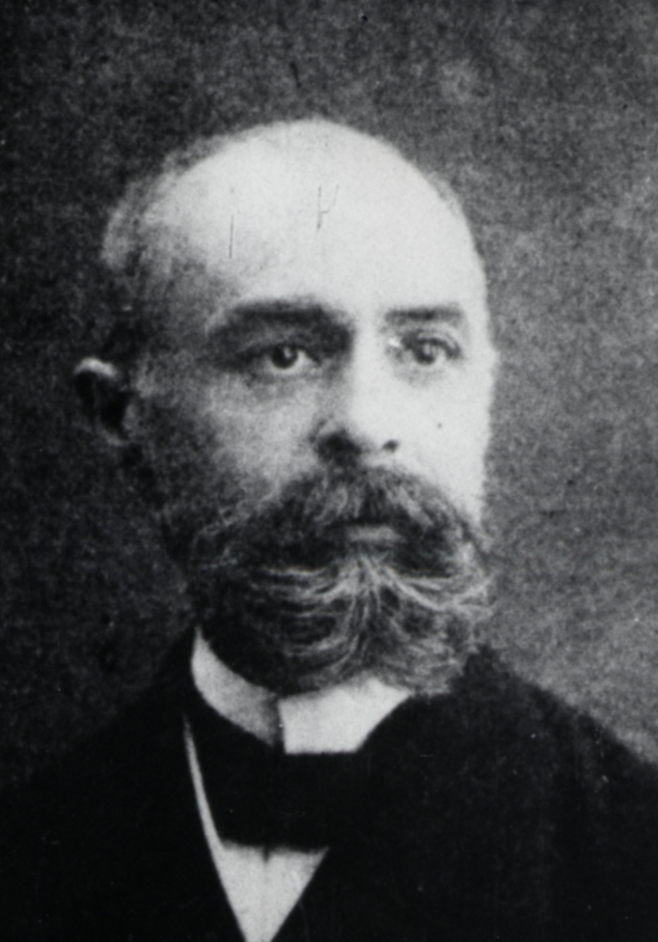
Antoine Henri Becquerel
(1871-1937)
March 1, 1896. Discovered radioactive decay.
Placed uranium-containing mineral on a photographic plate wrapped in thin, black paper, then put experiment in drawer.
After several days, developed plate. It was fogged by emissions due to radioactive decay of uranium.
Called it “metallic phosphorescence”
NBS Archives, courtesy of American Institute of Physics Emilio Segrè Visual Archives

Slide 8
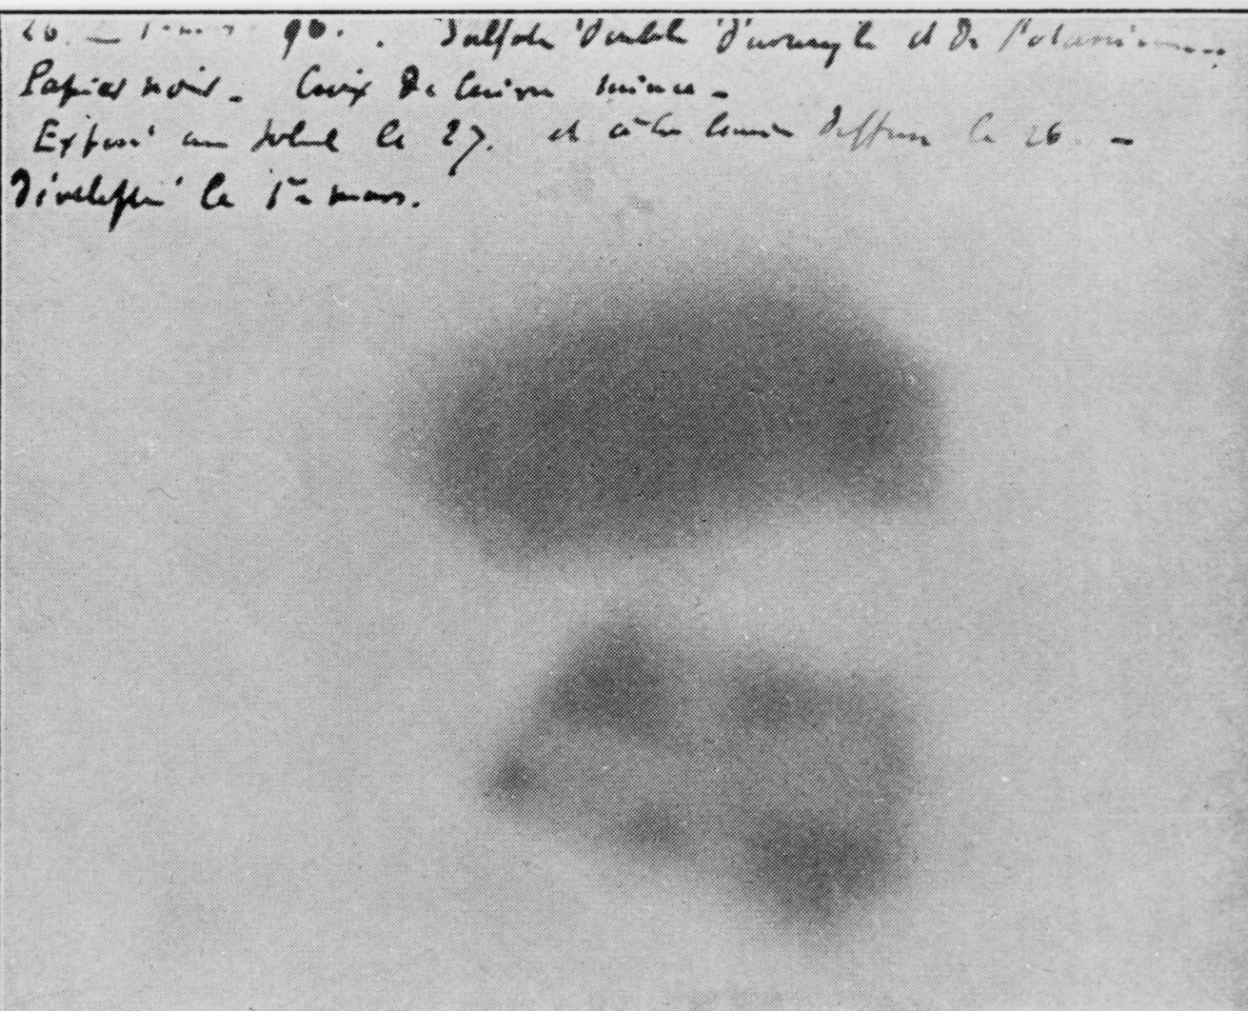
First Evidence of Radioactivity From Becquerel's Notes
American Institute of Physics Emilio Segrè Visual Archives, William G. Myers Collection

Slide 9
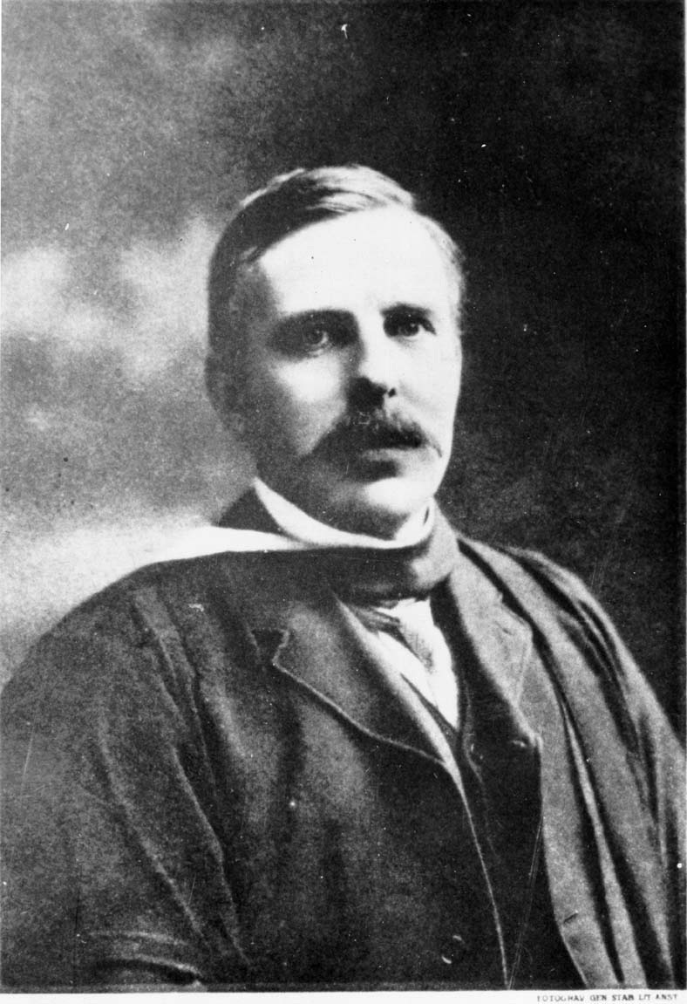
Ernest Rutherford (1871-1937)
1898. Found that Becquerel’s uranium emitted alpha and beta particles.
Rutherford also discovered gamma ray
Edgar Fahs Smith Collection, University of Pennsylvania Library

Slide 10
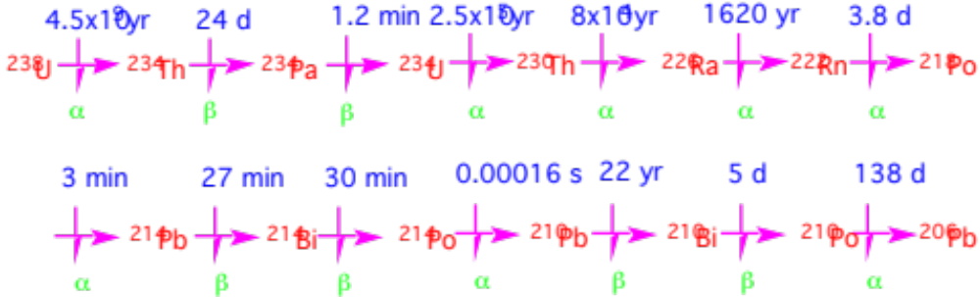
Decay of Uranium to Lead
Decay sequence produces radon, polonium, and lead
(9.1)

Slide 11
Asbestos
Class of natural impure hydrated silicate minerals that can be separated into flexible fibers.
Chemically inert. Does not conduct heat or electricity. Is fire resistant. Properties known by French Emperor Charlemagne (742-814).
Until the 1970s, used in construction industry as an electrical and thermal insulator in pipe and boiler insulation, cementboard, thermal tiles, pain, wallpaper.
Today new asbestos is banned, but asbestos still exists in many buildings.

Slide 12
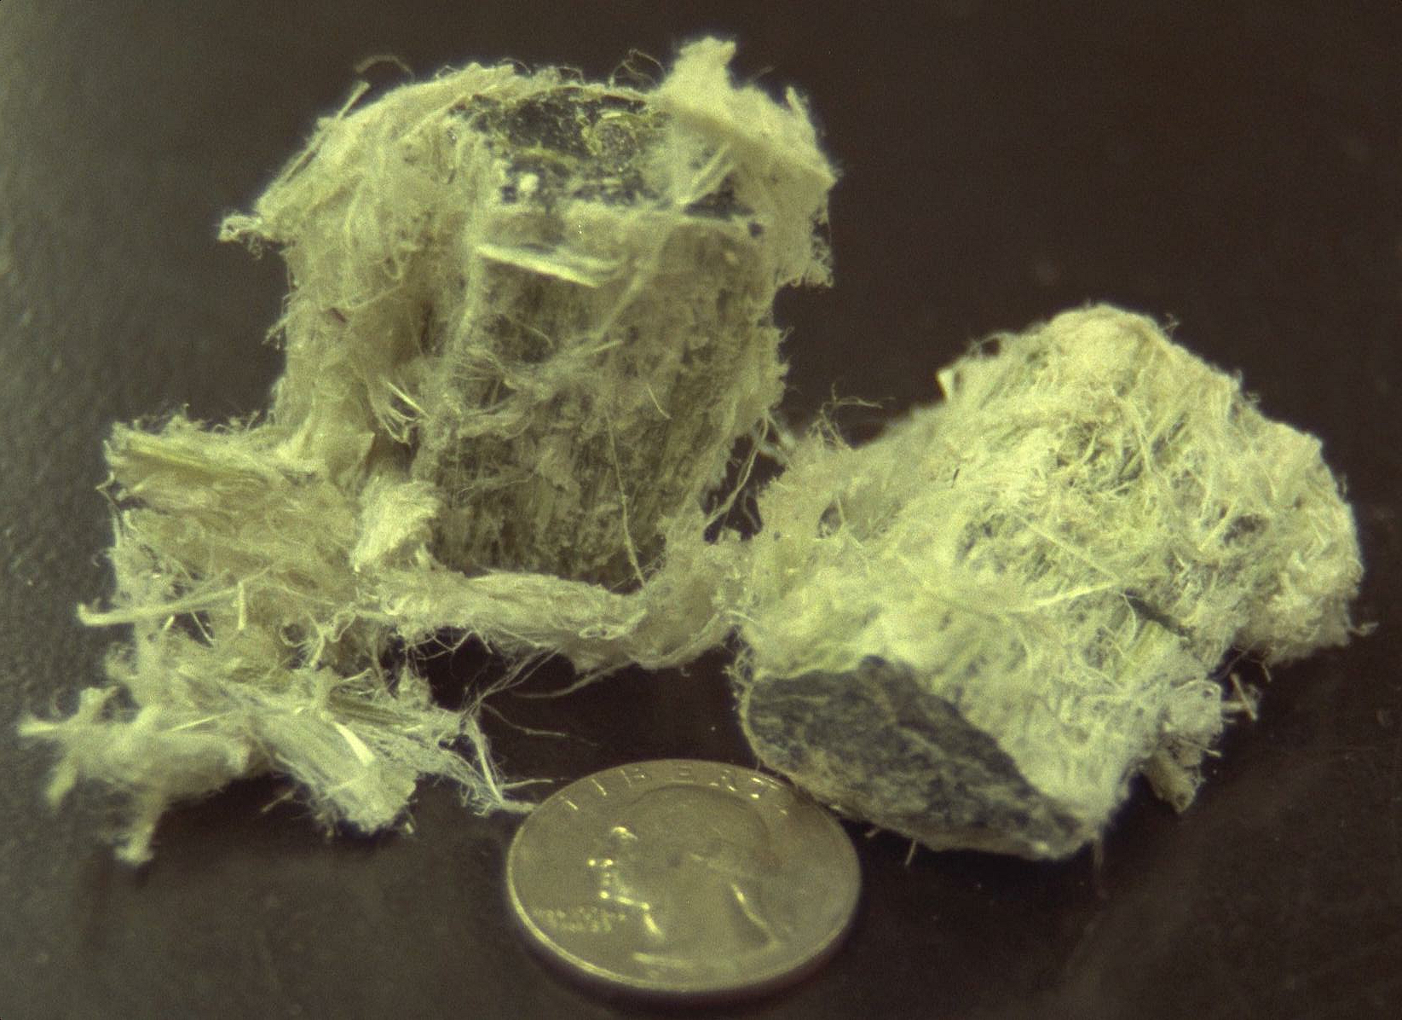
Chrysotile Asbestos
Robert Grieshaber

Slide 13
Health Effects of Asbestos
Lung cancer
Mesothelioma
Cancer of the mesothelial membrane lining the lungs
Asbestosis
Slow, debilitating disease of the lungs
1980s-2000. Libby Montana
192 deaths, 375 with lung problems due to mining vermiculite laden with asbestos

Slide 14
Environmental Tobacco Smoke
Mainstream smoke
Exhaled smoke
Sidestream smoke
Emitted from burning cigarette
Environmental tobacco smoke (ETS) = second-hand smoke
Combination of mainstream and sidestream smoke. Contains more than 4000 particle components and gases, over 50 of which are known carcinogens. ETS may cause 17% of lung cancers of nonsmokers.
Concentrations
One pack of cigarettes ≈ 20 μg m⁻³ of particles in room over 24 hours. Near smoker, concentrations 500-1000 μg m⁻³

Slide 15
Mainstream, Sidestream Smoke
Mainstream smoke Sidestream smoke
Pollutant (μg per cigarette) (μg per cigarette)
Carbon dioxide 10,000-80,000 81,000-640,000
Carbon monoxide 500-26,000 1200-65,000
Nitrogen oxides 16-600 80-3500
Ammonia 10-130 400-9500
Hydrogen cyanide 280-550 48-203
Formaldehyde 20-90 1000-4600
Acrolein 10-140 100-1700
Nicotine 60-2300 160-7600
Total particles 100-40,000 130-76,000
Phenol 20-150 52-390
Catechol 40-280 28-196
Naphthalene 2.8 45
Aniline 0.1-1.2 3-36
Table 9.2

Slide 16
Comparison of Cigarette with Automobile Emissions
CO NOx Particles
Avg. cigarette emission (g/cigarette) 0.0464 0.0021 0.058
Avg. automobile emission (g/mi) 3.4 0.4 0.08
Number of cigarettes resulting in same
emission as driving one mile 73.3 190.5 1.4
Est. U.S. cigarette emission (ton/day) 60 2.7 75
Est. mobile-source emission (ton/day) 189,000 32,000 9300
Table 9.3

Slide 17
Indoor Workplace Standards
NAAQS apply to outdoor pollution only in the U.S.
No regulations control air pollution in indoor residences.
Standards for indoor workplaces set by Occupational Safety and Health Administration (OSHA).
Recommendations for standards made by National Institute for Occupational Safety and Health (NIOSH) and American Conference of Governmental Industrial Hygienists, Inc. (ACGIH).
Permissible exposure limits (PELs) - set by NIOSH
Maximum allowable indoor workplace concentration over 8-h day
Time-weighted average threshold limit value (TWA-TLV)
Similar to PELs, but set by ACGIH

Slide 18
Comparison of Indoor with Outdoor Standards
Indoor 8-h Outdoor
PEL and Outdoor California
TWA-TLV NAAQS Standard
Gas (ppmv) (ppmv) (ppmv)
Carbon monoxide 35 9.5 (8-h) 9 (8-h)
Nitrogen dioxide 1 (15-m) 0.053 (annual) 0.25 (1-h)
Ozone 0.1 0.08 (8-h) 0.09 (1-h)
Outdoor standards tougher to protect entire population.
Outdoor standards for NO₂(g) tougher since ozone forms outdoors, but not indoors, from NO₂(g).
Table 9.4

