Slide 1
Presentation Slides for
Air Pollution and Global Warming:
History, Science, and Solutions
Chapter 12: The Greenhouse Effect and Global Warming
By Mark Z. Jacobson
Cambridge University Press (2012)
Last update: March 2, 2012
The photographs shown here either appear in the textbook or were obtained from the internet and are provided to facilitate their display during course instruction. Permissions for publication of photographs must be requested from individual copyright holders. The source of each photograph is given below the figure and/or in the back of the textbook.

Slide 2
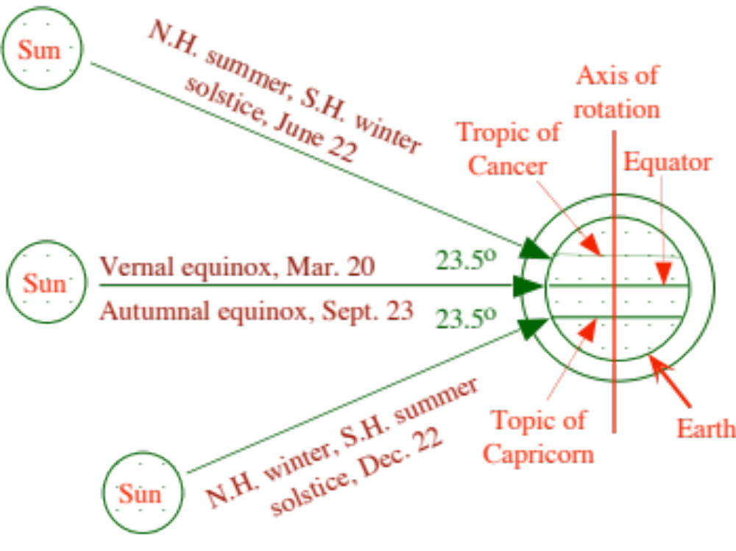
Angle of the Sun Relative to Earth
Figure 12.2

Slide 3


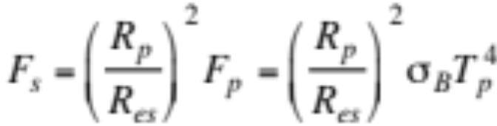
Solar Flux
R_{es}
R_{p}
F_{p}
F_{s}
Flux emitted by the Sun’s photosphere (W m⁻²) (12.1)
Conserve energy at any distance from Sun (12.2)
Solar flux received at top of Earth’s atmosphere (W m⁻²) (12.3)
≈ 1365 W m⁻²

Slide 4
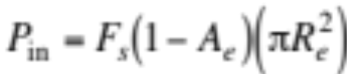
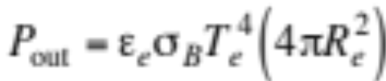
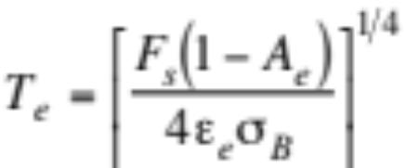
Equilibrium Temperature of Earth
Incoming radiation power (W) (12.4)
Outgoing radiation power (W) (12.5)
Equilibrium temperature of Earth (K) (Set P_{in}=P_{out}) (12.6)
≈ 255 K

Slide 5
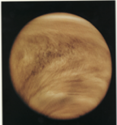
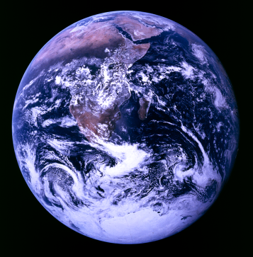
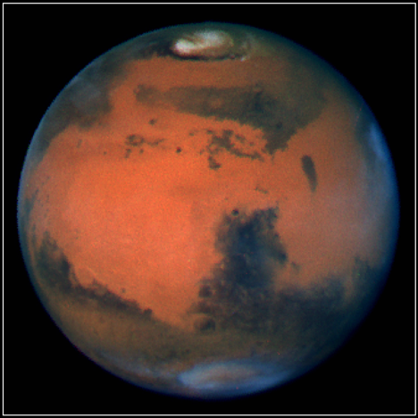
Venus, Earth, and Mars
National Space Science Data Center

Slide 6
Equilibrium/Actual Temperatures of Bodies in the Solar System
Surface Major Equilibrium Actual
Body Pres. (bars) Gases (frac.) Temp. (K) Temp. (K)
Venus 90 CO₂ (0.96) 252 730
N₂ (0.034)
Earth 1 N₂ (0.78) 255 288
O₂ (0.21)
Ar (0.0093)
CO₂ (0.00039)
Mars 0.007 CO₂ (0.95) 217 218
N₂ (0.027)
Table 12.2

Slide 7
Equilibrium/Actual Temperatures
Surface Major Equilibrium Actual
Object Pres. (bars) Gases Temp. (K) Temp. (K)
Moon 2x10⁻¹⁴ Ne (0.4) 270 274
Ar (0.4)
He (0.2)
Jupiter > 100 H₂ (0.86) 102 129
He (0.14)
Saturn > 100 H₂ (0.92) 77 97
He (0.74)
Uranus > 100 H₂ (0.89) 53 58
He (0.11)
Pluto 1x10⁻⁵ ? 41 50

Slide 8
Albedos and Emissivities
Surface Type Albedo Emissivity
Earth+atmosphere 0.3 0.9-0.98
Liquid water 0.05-0.2 0.92-0.96
Fresh snow 0.7-0.9 0.82-0.995
Old snow 0.35-0.65 0.82
Thick clouds 0.3-0.9 0.25-1.0
Thin clouds 0.2-0.7 0.1-0.9
Sea ice 0.25-0.4 0.96
Soil 0.05-0.2 0.9-0.98
Grass 0.16-0.26 0.9-0.95
Desert 0.2-0.4 0.84-0.91
Forest 0.1-0.25 0.95-0.97
Concrete 0.1-0.35 0.71-0.9
Table 12.1

Slide 9
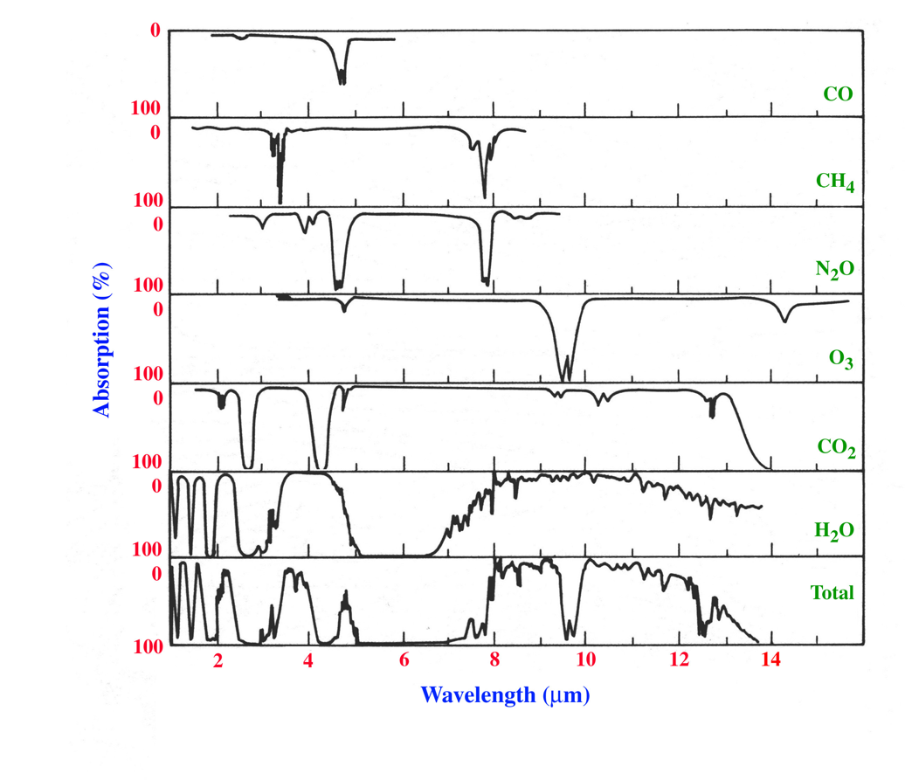
Percent Absorption of Infrared Radiation by Greenhouse Gases
Atmospheric
window
Figure 12.4

Slide 10
Estimated Global Warming Due to Different Gases and Particles
Percent Natural Percent Global
Greenhouse Effect Warming
Chemical Due to Chemical Due to Chemical
H₂O(g) 88.9 0.4
CO₂ (g) 7.5 46.5
Black carbon (S) 0.2 17
CH₄(g) 0.5 14
O₃(g) 1.1 11
N₂O(g) 1.5 4.2
CH₃Cl(g) 0.3 ~0
CFCL₃(g) 0 1.8
CF₂Cl₂(g) 0 4.2
CF₂ClH(g) 0 0.6
CCl₄(g) 0 0.3
Table 12.3

Slide 11
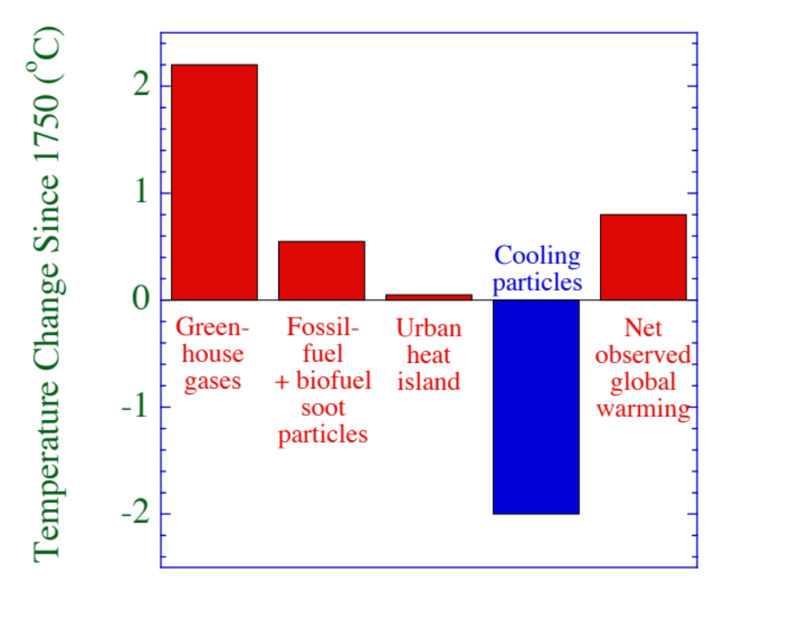
Primary Contributors to Net Observed Global Warming
Figure 12.7

Slide 12
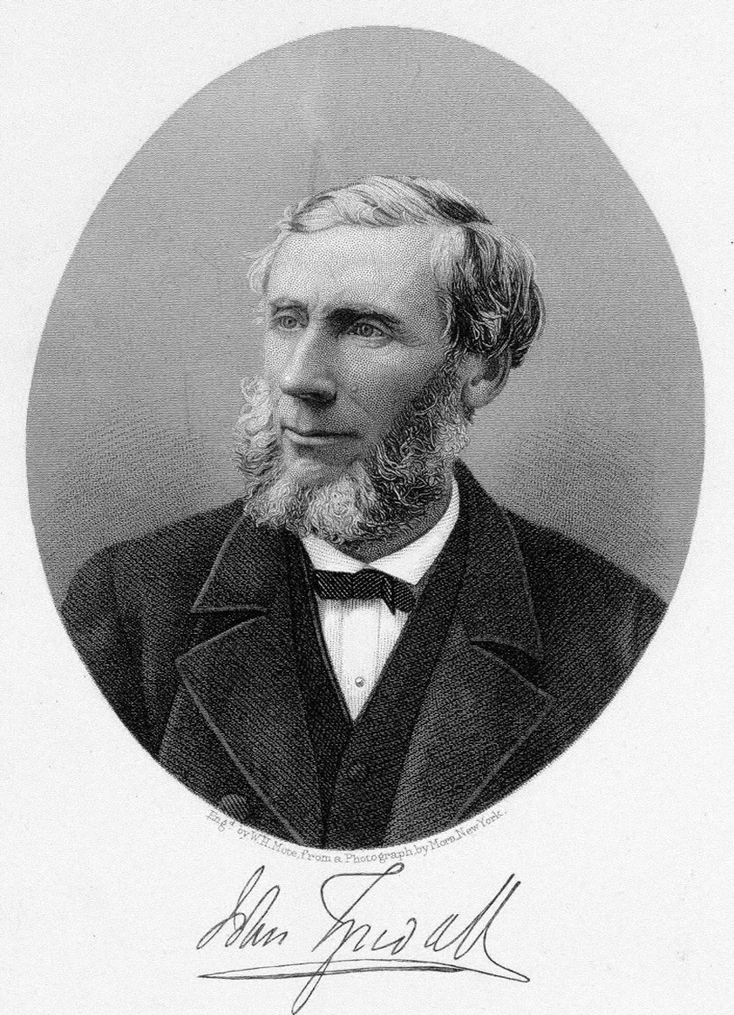
John Tyndall (1820-1893)
U. Pennsylvania Library

Slide 13
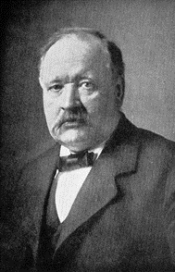
Svante August Arrhenius
(1859-1927)
U. Pennsylvania Library

Slide 14
Some Sources of Climate Data
Thickness of tree rings correlate with temperature and precipitation
¹⁸O:¹⁶O ratio
One out of one thousand oxygen molecules is heavy ¹⁸O
H₂¹⁸O has lower saturation vapor pressure than H₂¹⁶O
-->More ¹⁸O than ¹⁶O remains when water evaporates/sublim.
--> high ¹⁸O:¹⁶O in ice cores indicate warm snow/air
Glacial advance (cold) --> less seawater, more ¹⁸O in shells
--> 4.3ºC colder water --> 0.1% increase in shell ¹⁸O:¹⁶O
¹⁰Be from solar wind is high in ice sheets when solar activity is high
CO₂(g) and CH₄(g) in ice-core bubbles gives air composition
Thermometer and satellite data

Slide 15
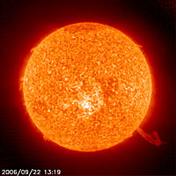
Hadean/Archean Eons (4.6-2.5 bya)
4.6-4 bya - meteorite bombardment
4.5-4 bya - magma oceans
4-2 bya - Faint Young Sun Paradox: 20-30% weaker sun but T~58C
www.astrosociety.org

Slide 16
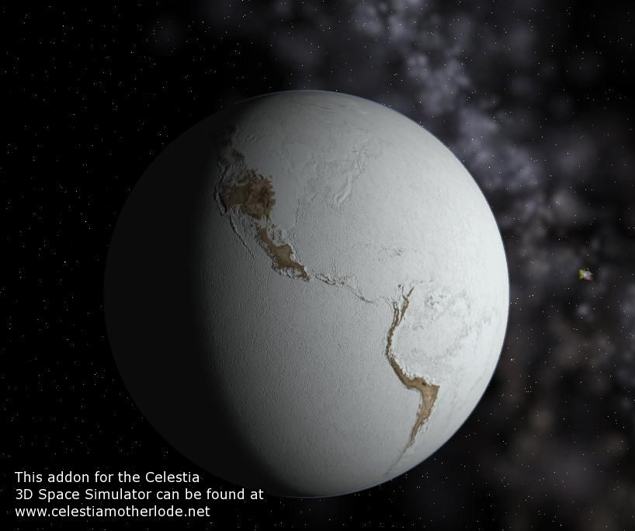
Proterozoic Eon (2.5-0.57 bya)
Glaciation 2.4-2.1 bya and 900-600 mya (snowball Earth)
Ice-free Earth between glaciations
2.3 bya oxygen began to build up slowly

Slide 17
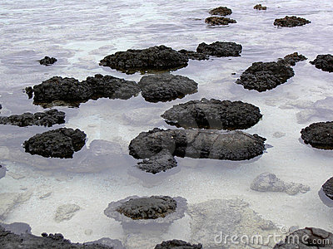
Stromatolites
From bacterial consumption of CO₂ and fossilization
M. Pilar/Dreamstime

Slide 18
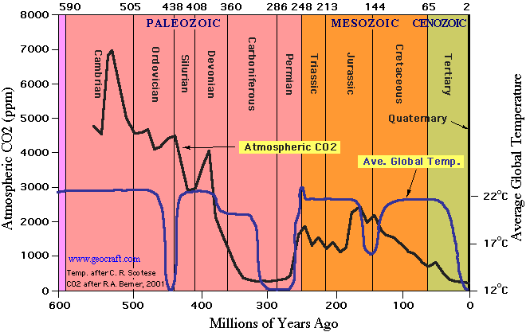
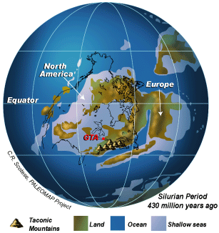
Historic Climate
570-460 mya
13-14 x current CO₂
Sea levels high
Earth all water above 30 ºN
440 mya
Glaciation with CO₂ up to 10 x current level
Geoscape.nrcan.gc.ca

Slide 19
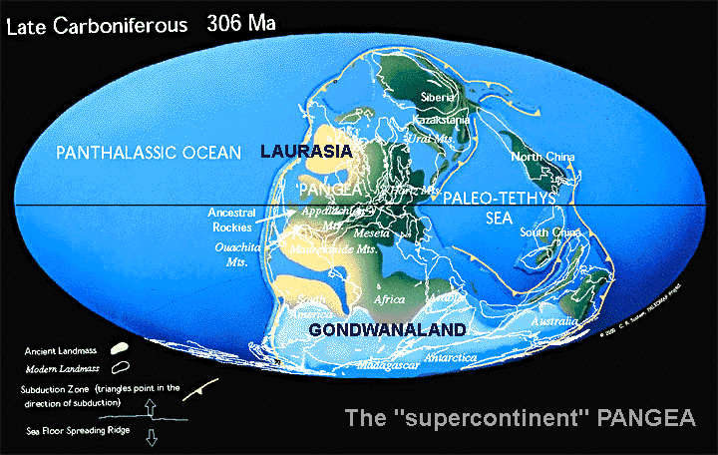
Historic Climate
395-345 mya
Land plants – high CO₂ and warm but CO₂ began to drop
345-280 mya (Carboniferous Period)
CO₂ dropped from 1500 to 350 ppmv
Carboniferous Ice Age
For last 600 my, low CO₂ only in Carboniferous, current periods.
www.geocraft.com
Glaciers spread from South
Pole, ocean circ. difficult

Slide 20
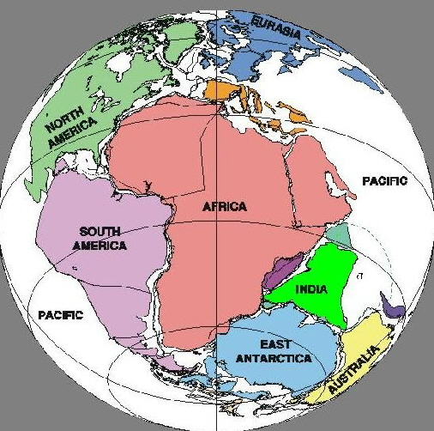
Historic Climate
280-50 mya
Relatively warm, CO₂ levels mostly high (5 x today)
220 mya- 180 mya
Pangea merged from Gondwana/Laurasia, then broke up
www.fossils.me.uk

Slide 21
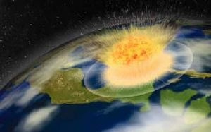
Historic Climate
120-90 mya
Last ice-free globe
Sea levels 100-200 m higher than today
20% of coast covered with water
65 mya
K-T (Cretaceous-Tertiary) extinction due to 10-km asteroid
News.softpedia.com

Slide 22
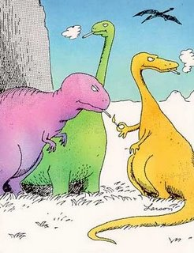
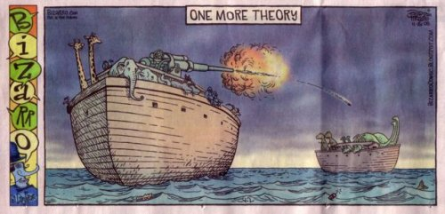
The Real Reasons For Dinosaur Extinction
Gary Larson

Slide 23
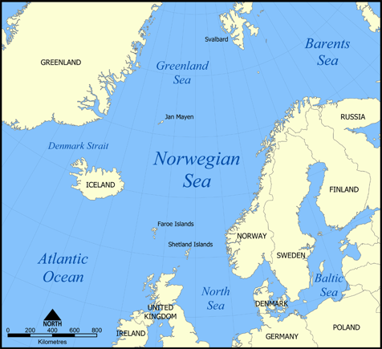
Historic Climate
55-53 mya
Tectonic activity temporarily increased volcanism and CO₂ and separated Norway/Greenland, opening Norwegian-Greenland Sea
50-3 mya
Cooling trend; continents drift to high latitudes
upload.wikimedia.org

Slide 24
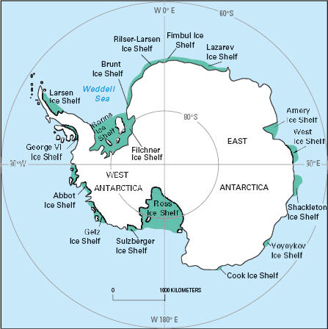
Historic Climate
40-38 mya
Sharp cooling and extinctions
Antarctic became glaciated with West (10%) and East Ice Sheets
37-26 mya
Cooling continued
Antarctic ice sheets expand
www.seacoastnrg.org

Slide 25
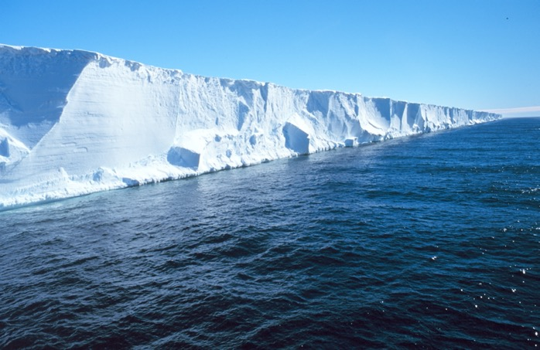
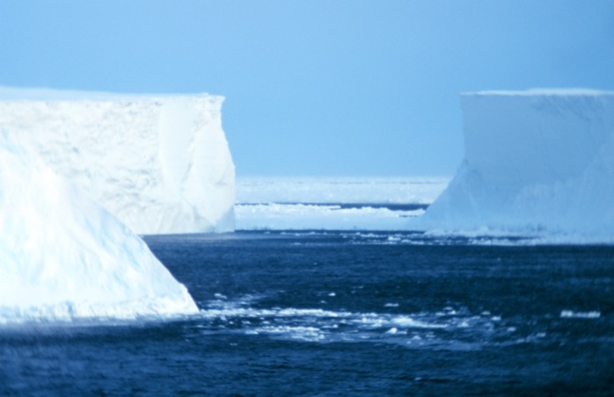
Ross-Sea Ice Shelf (1996) & Icebergs in the Ross Sea (1999)
Michael Van Woert, NOAA NESDIS, ORA. Available from NOAA Central Library

Slide 26
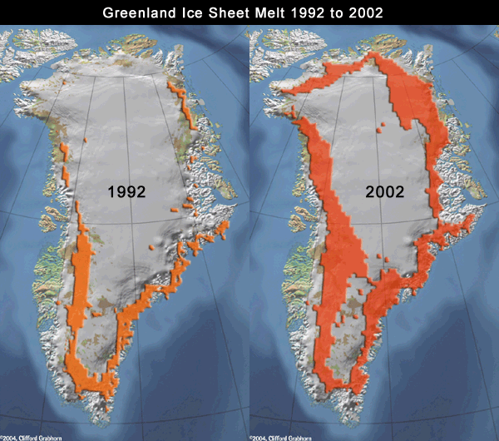
Historic Climate
26-5 mya
Temperatures stabilize
6-5 mya
Arctic sea ice and Alaskan glaciers develop
4-2.4 mya
Greenland ice sheet develops
www.ec.gc.ca

Slide 27
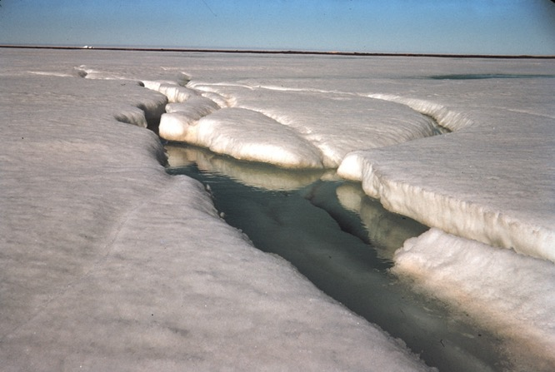
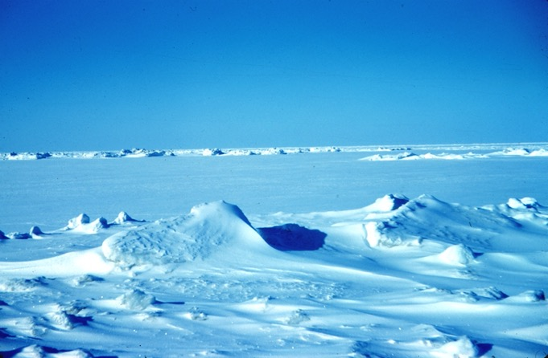
Sea Ice in Spring and Winter 1950, Near Alaska's North Slope
Rear Admiral Harley D. Nygren, NOAA Corps (ret.), available from NOAA Central Library

Slide 28
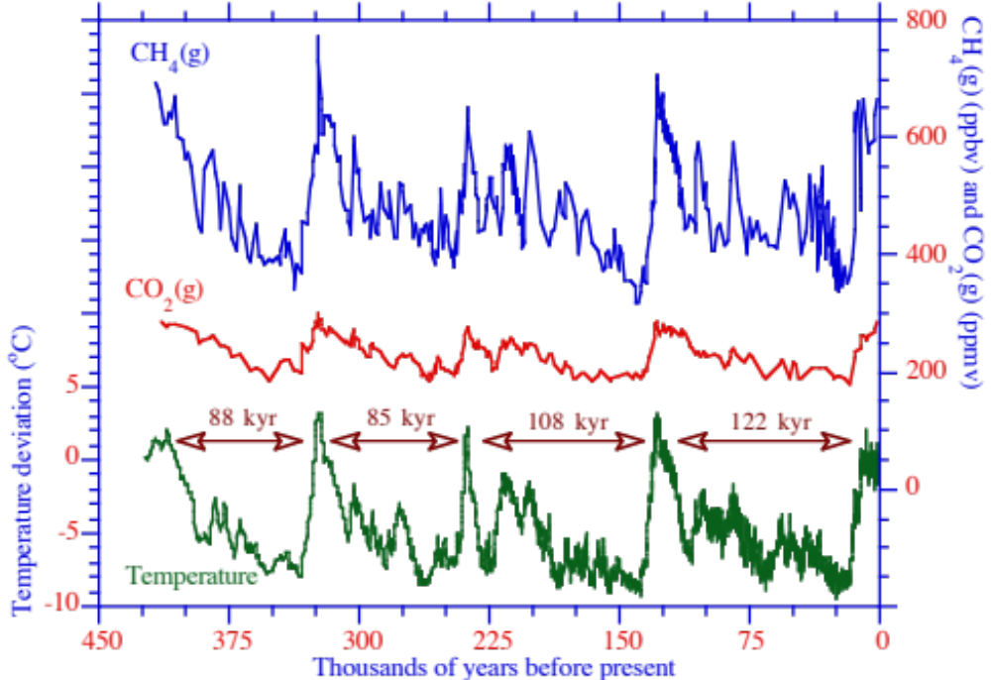
Ice-Core Record
Ice Ages Start 2.4 mya
CH₄(g) (ppbv) and CO₂(g) (ppmv)
Temperature deviation (ºC)
Jouzel et al. (1996); Petit et al. (1999)
Figure 12.20

Slide 29
Milankovitch Cycles
Milutin Milankovitch, Astronomer (1879-1958)
Natural temperature oscillations caused by gravitational attraction between Earth and other planets
Eccentricity of orbit around sun - period of about 100,000 years
Obliquity of Earth’s axis - period of about 41,000 years
Precession (wobble) of Earth’s axis - period of about 22,000 years

Slide 30
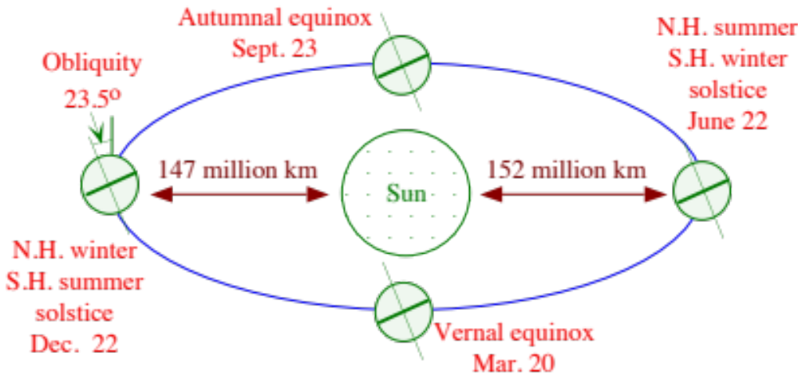
Orbit of the Earth Around the Sun
Figure 12.1

Slide 31
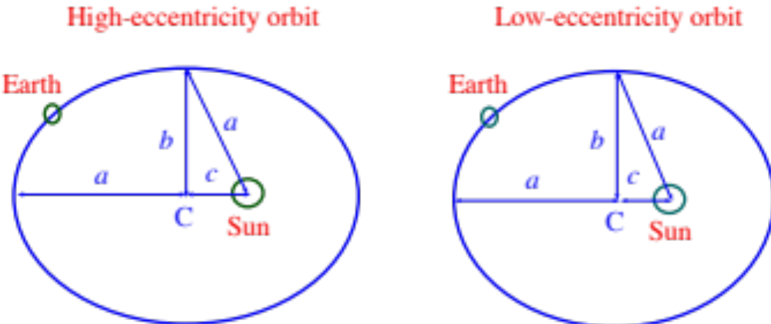
Earth's Orbit During High and Low Eccentricity
Eccentricity = c/a
Varies from 0.01 to 0.05 - currently 0.017 and decreasing
Figure 12.21

Slide 32
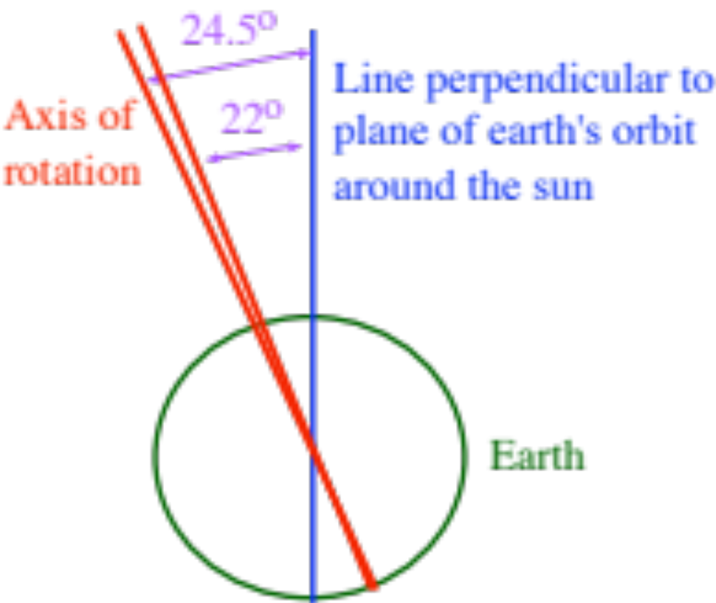
Obliquity
Currently 23.5º
and decreasing
Figure 12.22

Slide 33
Precession (Wobble)
Current N.
Hemisphere winter
N. Hemisphere
summer in
11,000 years
Current N.
Hemisphere summer
N. Hemisphere
winter in
11,000 years
Figure 12.22

Slide 34
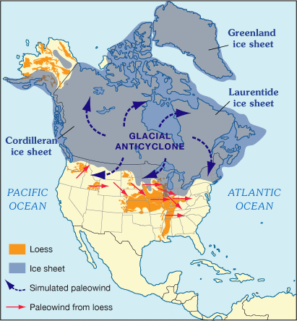
Laurentide Ice Sheet During Last Glacial Period
Esp.cr.usgs.gov

Slide 35
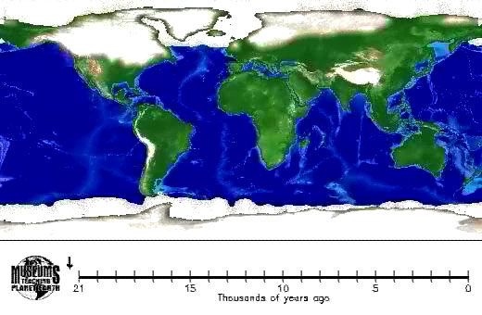
Ice Sheets 18,000 Y.A.
Earth.rice.edu

Slide 36
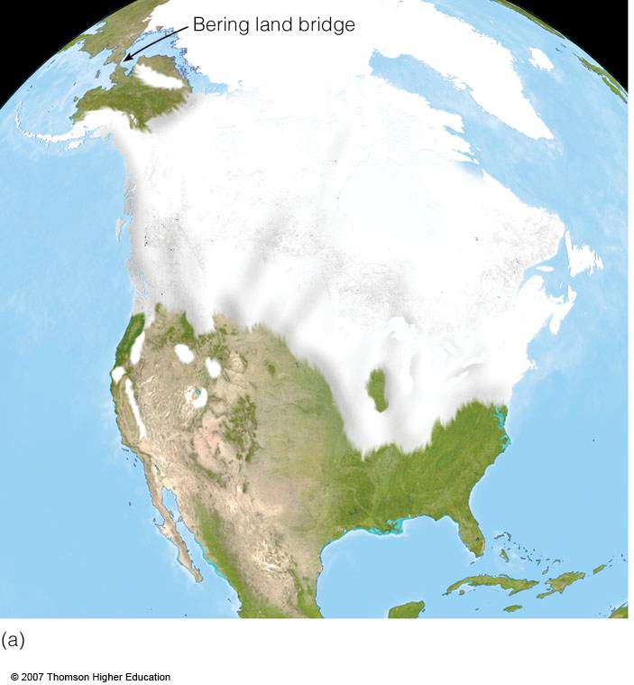
Bering Land Bridge
18,000-22,000 ya Maximum Glacial Extent

Slide 37
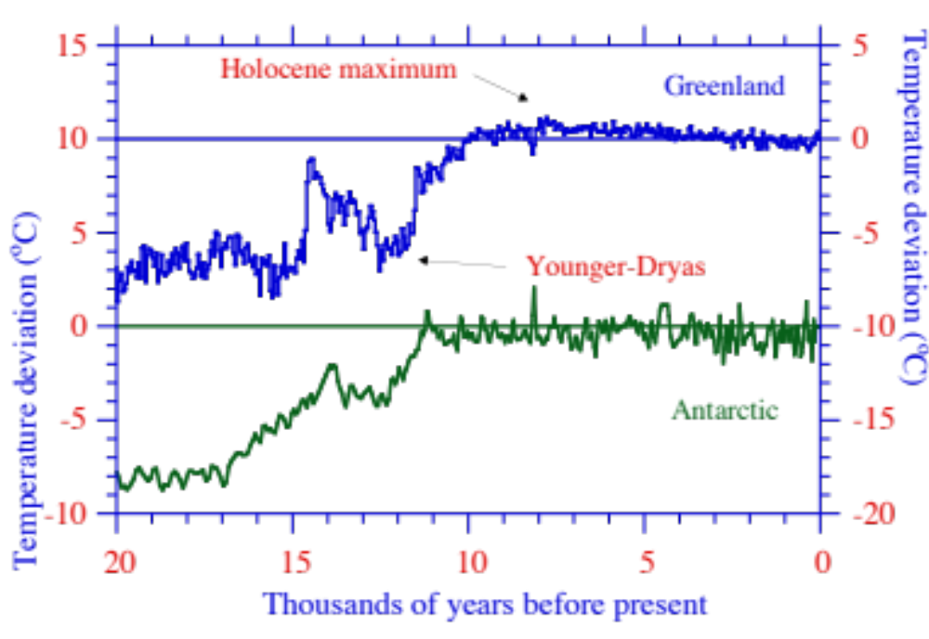
Temperature Anomaly Last 20,000 Years From Ice Core
Figure 12.23

Slide 38
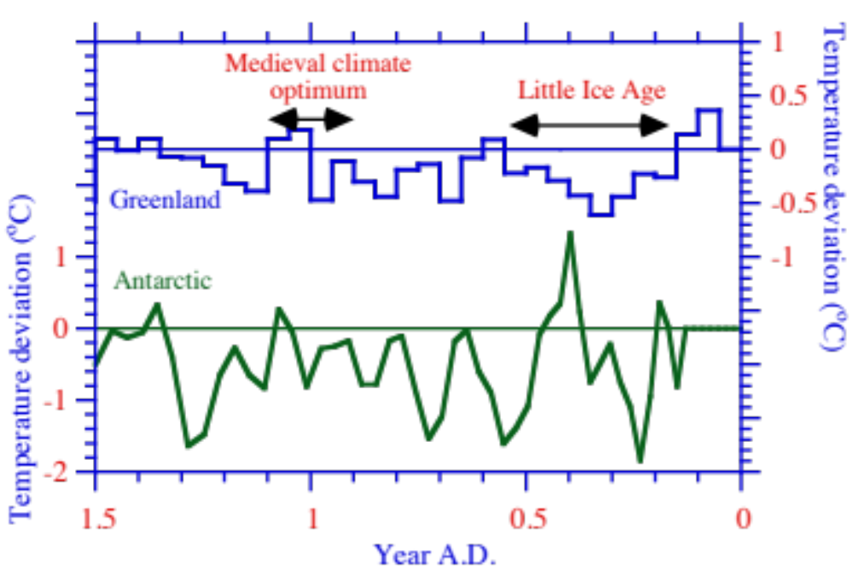
Temperature Anomaly During Last 1000 years From Ice Core
Figure 12.24

Slide 39
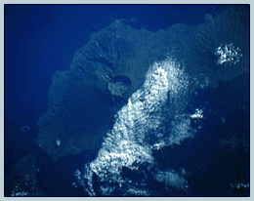
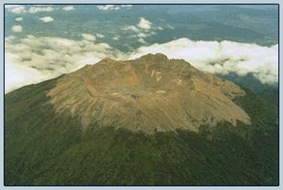
Tambora, Indonesia
From space shuttle
April 5, 1815 - Moderate eruption
April 10-11, 1815 - Most powerful eruption in recorded history
Took off 1400 m from the top of the mountain
1 billion tonnes of TNT (60,000 atomic bombs)
150 times more ash than Mt. St. Helens.
82,000 deaths, most local.
Reduced temperatures hemispherically by up to 2-3ºC for one year
In Europe and North America, 1816 was “Year without a summer”

Slide 40
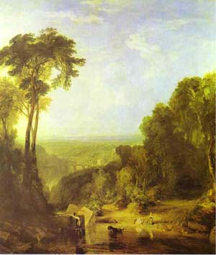
Year Without a Summer - 1816
Mary Shelley - “Frankenstein”
Lord Byron - “Darkness”
Crossing the Brook, 1815
William Turner (1775-1851)

Slide 41
Darkness
George Gordon, Lord Byron; Composed 1816
I had a dream, which was not all a dream.
The bright sun was extinguish’d, and the stars
Did wander darkling in the eternal space,
Rayless, and pathless, and the icy earth
Swung blind and blackening in the moonless air;
Morn came and went-and came, and brought no day,
And men forgot their passions in the dread
Of this their desolation; and all hearts
Were chill’d into a selfish prayer for light:
And they did live by watchfires-and the thrones,
The palaces of crowned kings-the huts,
The habitations of all things which dwell,
Were burnt for beacons; cities were consum’d…

Slide 42
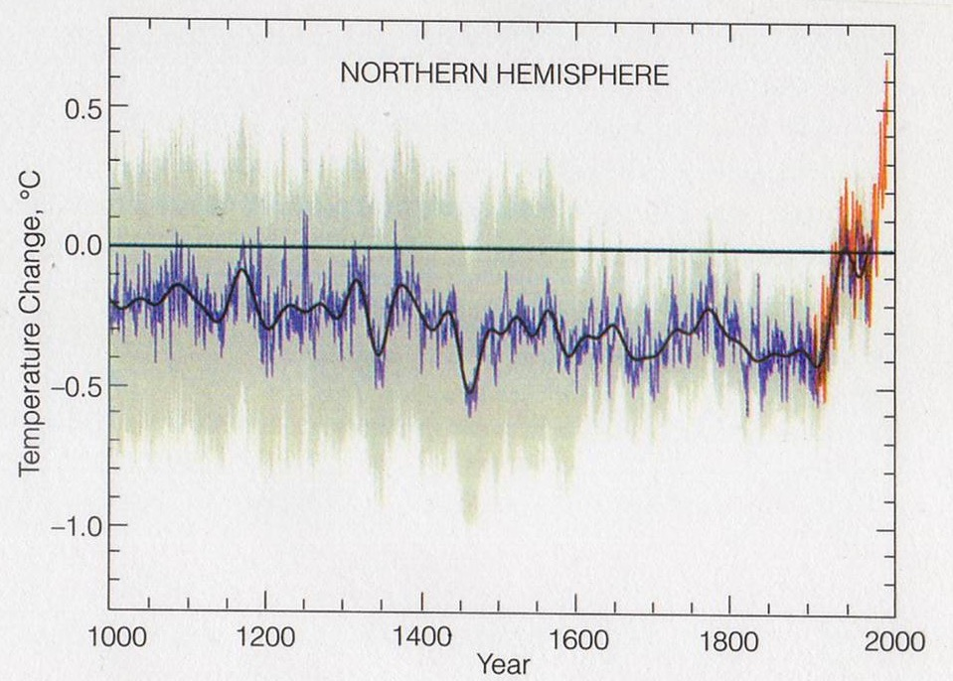
Temperature Anomaly During Last 1000 years
IPCC, 2001

Slide 43
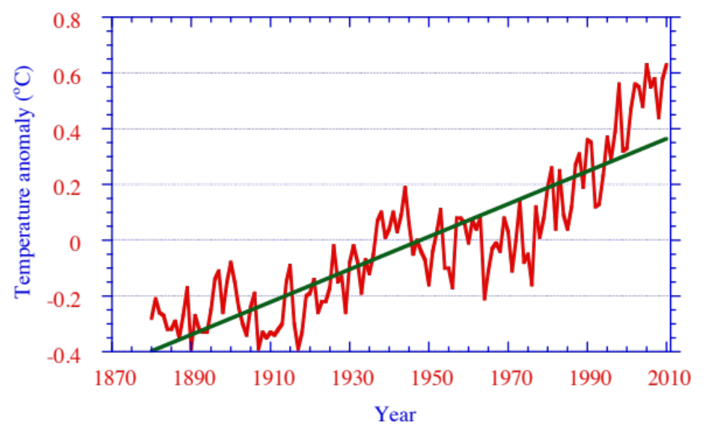
Mean Global Temperature Anomalies
Warmest years
2010/2005
-
2009
2007/1998
-
2002
2003/2006
-
2001/2004
-
NASA GISS, 2011; Figure 12.13

Slide 44
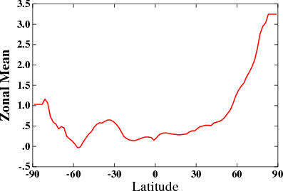
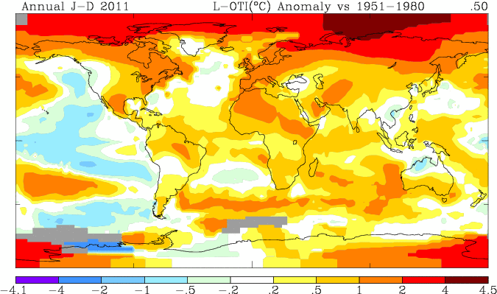
2011 Temperature Anomaly
Goddard Inst. Space Studies

Slide 45
Historical Temperature Change
Temperature
Change (K)
Period Years Ago Per 100 Years
1958-2007 52-4 +1.3
(radiosonde records)
1955-2010 56-1 +1.3
(land+ship measurements)
1880-2010) 121-1 +0.7
(land+ship)
Last 1000 years 1000-0 +0.052
(Vostok ice core)
Deglaciation after Younger 12,632-11,191 +0.3
Dryas (Vostok)
Last years of deglaciation 11,237-11,191 +2.2
after Younger Dryas (Vostok)
Deglaciation before last 138,000-128,000 +0.13
interglacial period (Vostok)
Table 12.4

Slide 46
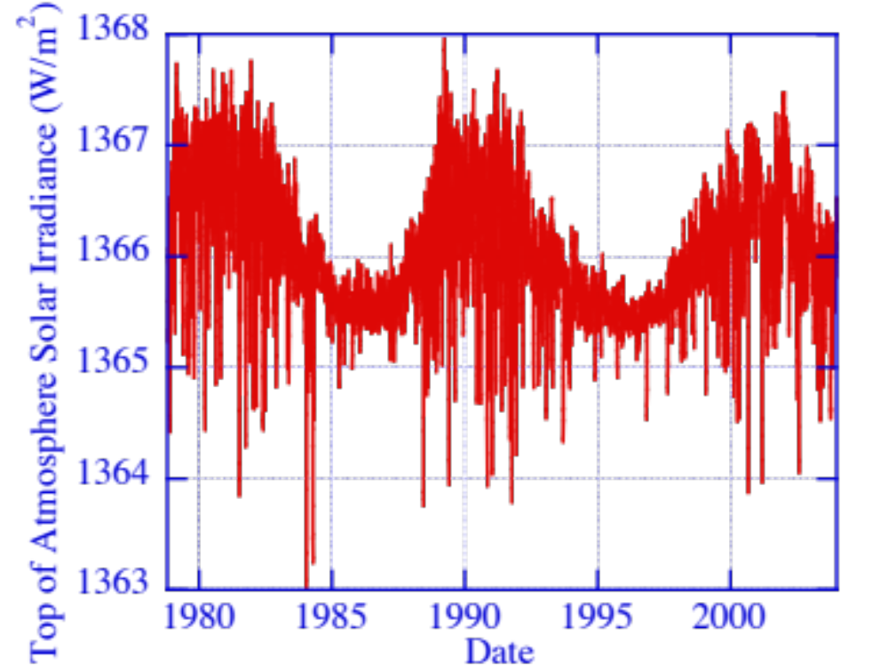
Solar Cycle 11/1/78-10/1/03
Figure 12.25

Slide 47
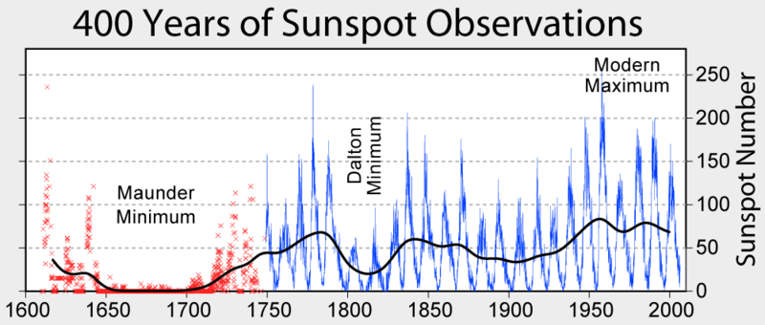
upload.widimedia.org

Slide 48
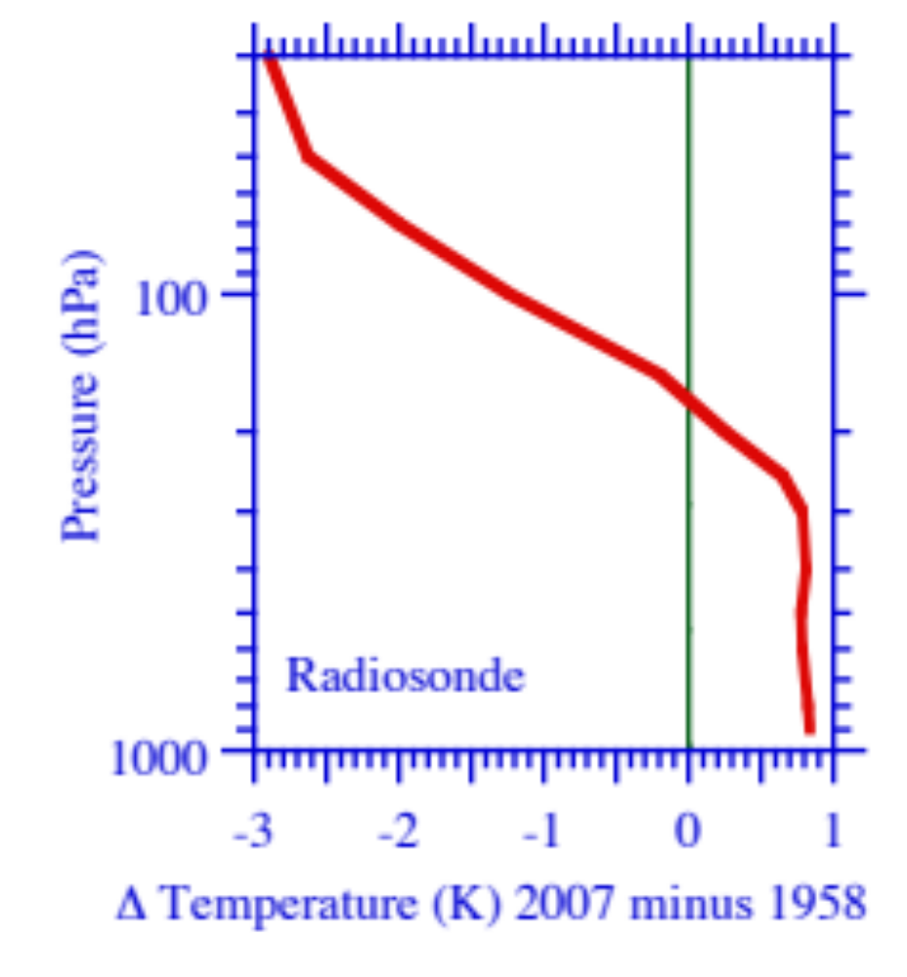
Observed Vertical Profile of Temperature Changes 1958-2007
Figure 12.14

Slide 49
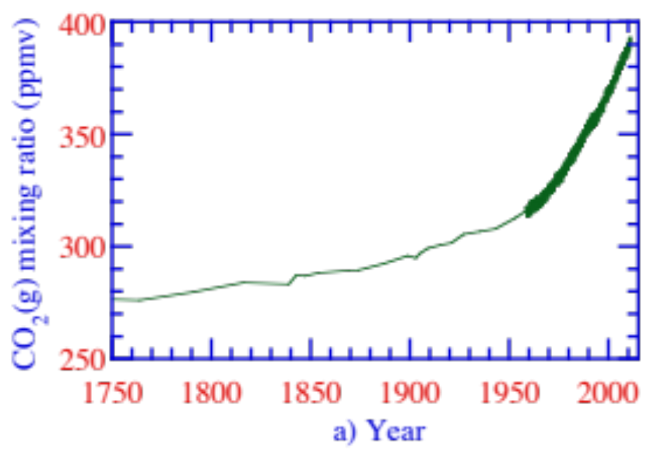
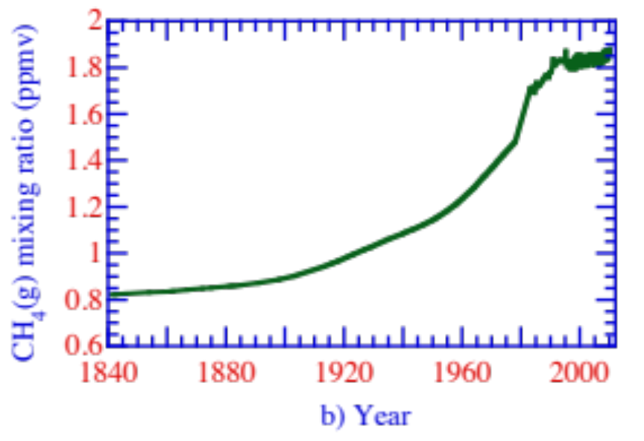

Trends in Ambient CO₂, CH₄, N₂O
Figure 12.8

Slide 50

Carbon Dioxide Emission 1750-2008
Figure 12.9

Slide 51

Fires in Africa (Oct. 1994-Mar. 1995)
Data collected by U.S. Air Force Weather Agency; image and data processing by
NOAA's National Geophysical Data Center

Slide 52

Methane Emission (1860-1994)
CH ₄(g) emissions (Tg of methane per yr)
Figure 12.11

Slide 53


Methane from Peatlands
Peatland complex, western Siberia
UCLA/News.mongabay.com
AP/Redskynews.com

Slide 54



Methane from Permafrost
Permafrost: soil/rock that remains below 0 ºC for 2 years
Melting Alaska Permafrost
www.alaska-in-pictures.com
www.sciencepoles.org
Ilulissat, Greenland
www.flickr.com

Slide 55

Black Carbon Emissions 1850-2005
Figure 12.12

Slide 56

Sulfur Dioxide Emissions 1850-2005
Figure 12.12

Slide 57
Feedbacks of Gases to Climate
Positive
Water-vapor-temperature-rise feedback
Snow-albedo feedback
Water-vapor-high-cloud feedback
Solubility-carbon dioxide feedback
Saturation-vapor-pressure-water-vapor feedback
Bacteria-carbon-dioxide feedback
Permafrost-methane feedback
Negative
Water-vapor-low-cloud feedback
Plant-carbon-dioxide feedback

Slide 58
Effects of Aerosol Particles on Climate
Daytime stability effect
Smudge-pot effect
Indirect effects on clouds
Semidirect Effect
Cloud absorption effect
Effect of airborne absorbing particles on surface albedo
Snow darkening effect
Self-feedback effect
Photochemistry effect
Particle effect through large-scale meteorology
Rainout effect

Slide 59


Heating Rate in and Between Cloud Drops Due to Cloud Absorption Effect
Figure 12.26

Slide 60

Correlation Between Aerosol and Cloud Optical Depths by Model & Satellite
Net of Indirect, Semidirect, Cloud Absorption Effects
Ten Hoeve et al. (2011); Figure 12.27

Slide 61

Smog Over China Decreasing Cloudiness
earthobservatory.nasa.gov, 2005

Slide 62

Smog Over India/Pakistan Decreasing Cloudiness

Slide 63
Impacts of Global Warming
Higher average globally-averaged surface temperatures
Loss of ice and snow/rise in sea-level
Greater regional extremes in temperature, precipitation
Increased severe-weather events
Shifts in agriculture/loss of fruit crops
Ocean acidification/loss of coral reefs
Increased heat-related illness and mortality
Increases in malaria, influenza
Increases in air pollution and air pollution mortality

Slide 64



Polar Sea Ice
Mar 7, 2008 Feb. 25, 2011
http://polar.ncep.noaa.gov/seaice

Slide 65


Global Sea Ice March 7, 2008
Feb 25, 2008
Feb 25, 2011
http://polar.ncep.noaa.gov/seaice

Slide 66


Arctic Sea Ice 1979-2011
1979-2000 mean 15.6 m sq km
Lowest years
2011
2005
2006
2007
2009
nsidc.org/arcticseaicenews

Slide 67

Antarctic Sea Ice 1979-2011
Nsidc.org/data/seaice_index/

Slide 68

The Last Polar Bear
Jan Martin Will/Dreamstime

Slide 69

Glacier in Mendenhall Nat. Park June 2010
A. Bobrov/Dreamstime.com

Slide 70

Grey Glacier, Andes, Chile
Adeliepenguin/Dreamstime

Slide 71

Iceberg With Window, Antarctica (2008)
A. Baque/Dreamstime

Slide 72

Global Mean Sea Level Change Since 1870
IPCC 2006

Slide 73

Island of Fualopa, Tuvulu
Peter Bennetts

Slide 74

Island in San Blas Archipelago
Erikgauger/Dreamstime

Slide 75

New Orleans, Louisiana
Olivierl/Dreamstime

Slide 76

U.S. Precipitation Trend 1901-2005
www.epa.gov/climatechange/science/recentpsc.html

Slide 77

Increases in Water Vapor and Temperature Both Increase Ground-Level Ozone in Polluted Air But Not in Background Air
→ Global warming increases ozone where it is already high – in polluted cities. California has the most polluted U.S. cities.
Figure 12.30

Slide 78

CO₂ Domes Over Cities
Local Carbon Dioxide (CO₂) emissions from fossil-fuel combustion increase local deaths by forming CO₂ “domes” over cities

Slide 79


Deaths from Los Angeles’ CO₂ Dome
3-D model results
Additional O₃ deaths/yr
Additional PM_{2.5} deaths/yr
Local CO₂ domes increase local temperatures and water vapor, which increase ozone and particulate matter (PM) where they are already high.
California has six of the 10 most polluted cities in the U.S. – thus California is greatly susceptible to the effects of CO₂ domes.

Slide 80

CO₂ Domes Over California
In California, local CO₂ domes may increase O₃ and PM deaths (due to respiratory illness, cardiovascular disease, severe asthma) by 50-100/yr.
Domes also enhance hospitalizations, emergency-room visits, lost work/school days, cough, airway pain, chronic bronchitis, asthma.

Slide 81



CO₂ Domes in the U.S.
Additional ozone deaths/yr
CO₂ Domes
Additional PM deaths/yr
CO₂ domes increase ozone and PM deaths in the U.S. by 300-1000/yr.

Slide 82

Percent World CO₂ Emissions by Country (2007)
Figure 12.31

Slide 83

Per Capita and National Emissions of Carbon (C) in CO₂ in 2007
Figure 12.32

Slide 84
Percent Change in 1990 Emissions Allowed Under Kyoto Protocol
Percent Change
Country in Emission
Switzerland, central Europe, European Union -8
United States -7
Canada, Hungary, Japan, Poland -6
Russia, New Zealand, Ukraine 0
Norway +1
Australia +8
Iceland +10
Table 12.5

Slide 85

Modeled Temperature Changes Due to Eliminating Anthropogenic CO₂, CH₄, and Fossil-Fuel Soot (BC+OM) Emissions
Figure 12.33

