Slide 1
Presentation Slides for
Air Pollution and Global Warming:
History, Science, and Solutions
Chapter 6: Effects of Meteorology on Air Pollution
By Mark Z. Jacobson
Cambridge University Press (2012)
Last update: February 3, 2012
The photographs shown here either appear in the textbook or were obtained from the internet and are provided to facilitate their display during course instruction. Permissions for publication of photographs must be requested from individual copyright holders. The source of each photograph is given below the figure and/or in the back of the textbook.

Slide 2
Horizontal Forces Acting on the Air
Pressure-gradient force
Apparent Coriolis force
Friction force
Apparent Centrifugal force

Slide 3
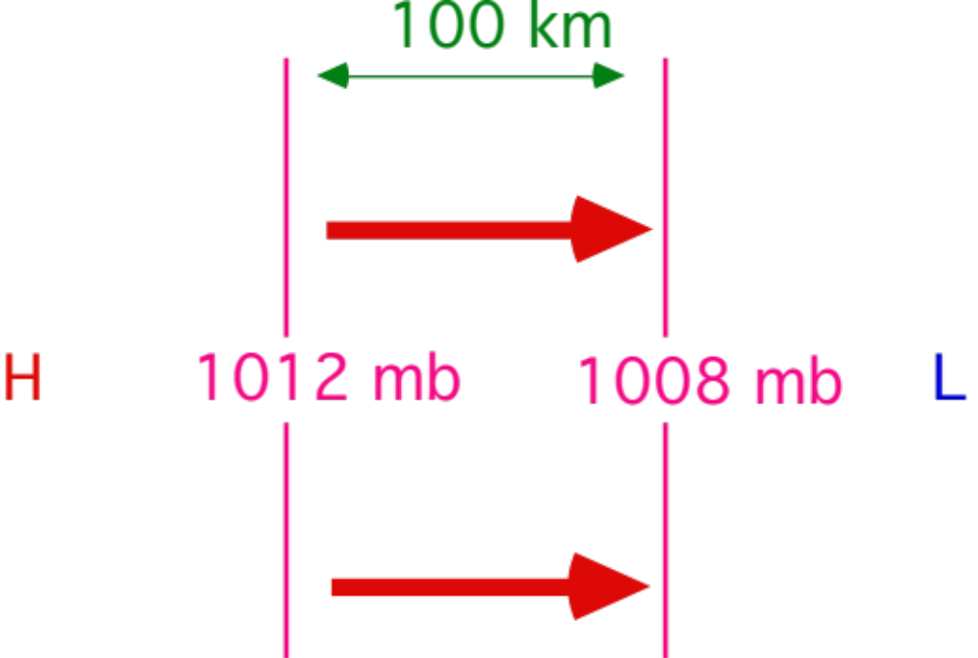
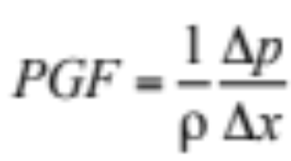
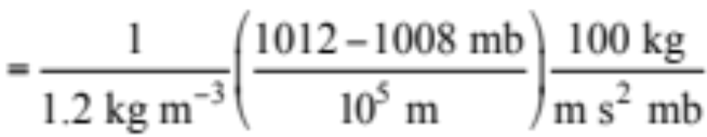

Pressure Gradient Force Per Unit Mass

Slide 4
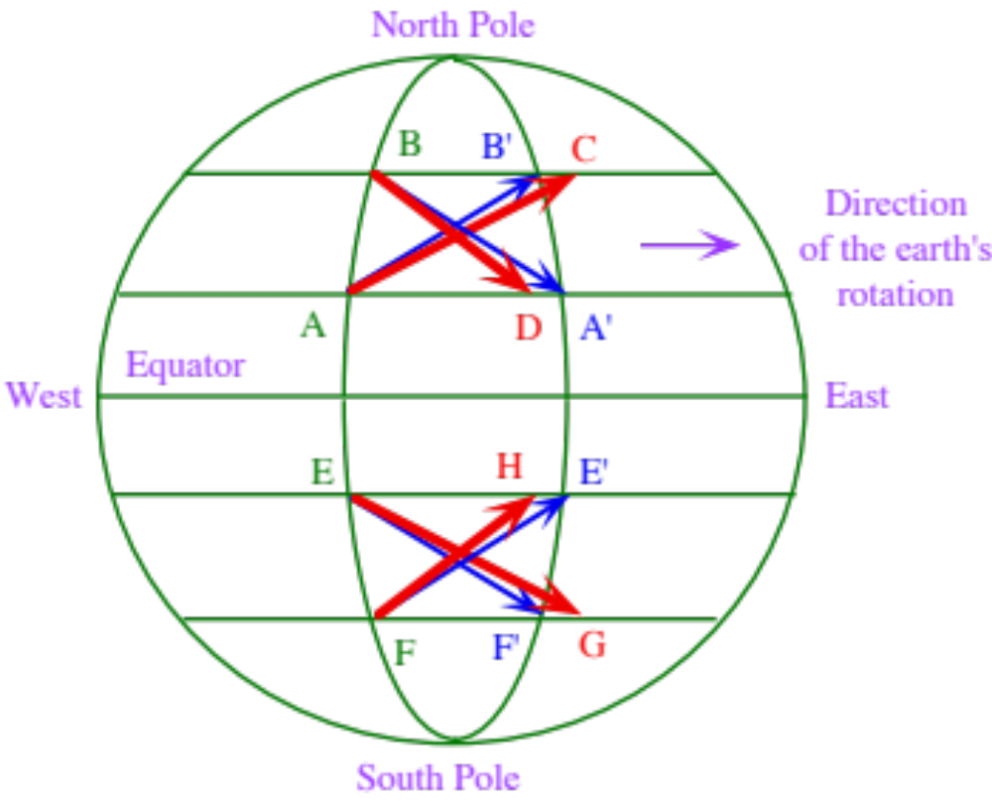
Apparent Coriolis Force
Figure 6.1

Slide 5
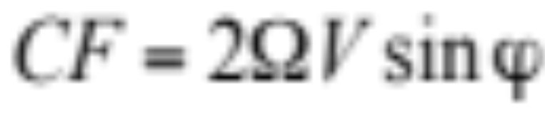
Coriolis Force Per Unit Mass
Ω = rotation rate of Earth (7.29 x 10⁻⁵ radians s⁻¹)
= 2π / 86,164
V = speed (m s ⁻¹)
ϕ = latitude
CF higher for faster rotation rate
CF equals zero when object at rest
CF equals zero at the equator
CF maximum at the poles

Slide 6

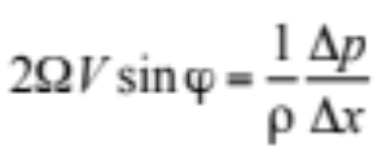
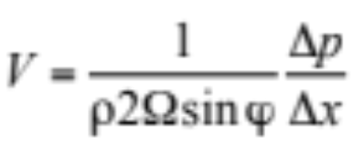
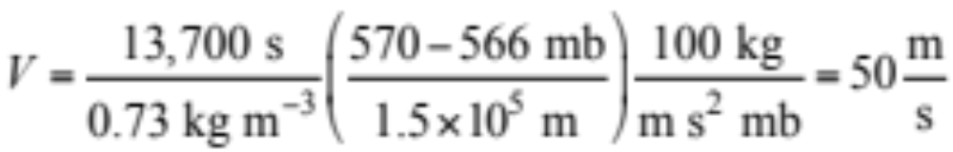
Geostrophic Wind
150 km
Apparent Coriolis force
Pressure gradient force
Geostrophic wind
H
L
Example: Find V when latitude=30 ºN
570 mb
566 mb

Slide 7
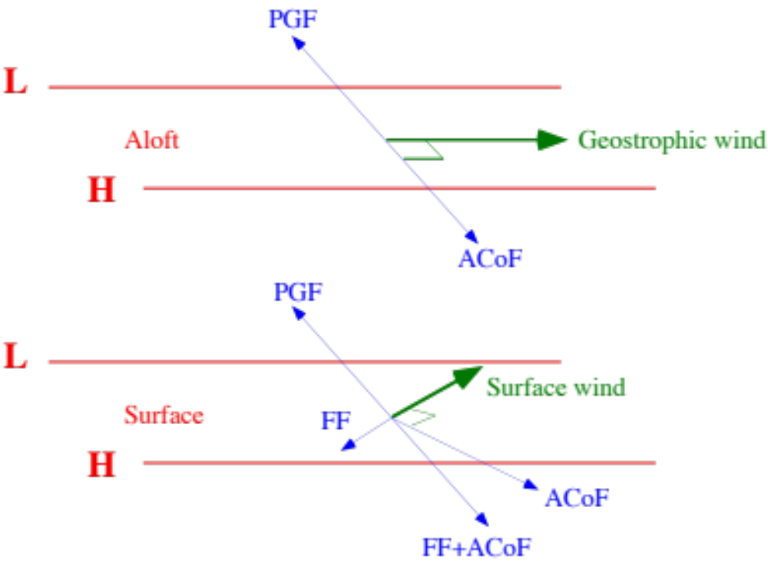
Geostrophic and Surface Winds Along Parallel Isobars
Figure 6.2

Slide 8
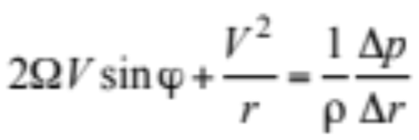
Cyclonic Flow (North. Hem.)
834 mb
Apparent Coriolis force
Pressure gradient force
830 mb
Gradient wind
L
Apparent centrifugal force
Force Balance
r = distance from center of curvature
V²/r = Apparent centrifugal force per unit mass
= -Centripetal force per unit mass
Figure 6.3

Slide 9
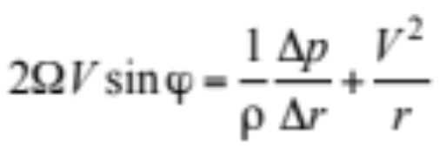
Anticyclonic Flow (North. Hem.)
830 mb
Apparent Coriolis force
Pressure gradient force
834 mb
Gradient wind
H
Apparent centrifugal force
Force Balance
Pressure gradients are weaker and winds are slower around a center of high than around a center of low.
Figure 6.3

Slide 10
Surf. Wind Around N. Hem. Low, High
996 mb
1112mb
992 mb
1116mb
L
H
Apparent Coriolis force
Pressure gradient force
Gradient wind
Apparent centrifugal force
Figure 6.4
Friction force

Slide 11
Summary of Winds
Geostrophic wind (2 forces; straight winds aloft)
  pressure gradient force
  apparent Coriolis force
Gradient wind (3 forces; curved winds aloft)
  pressure gradient force
  apparent Coriolis force
  apparent centrifugal force
Surface winds between straight isobars (3 forces; straight)
  pressure gradient force
  apparent Coriolis force
  friction force
Surface wind around pressure centers (4 forces; curved)
  pressure gradient force
  apparent Coriolis force
  apparent centrifugal force
  friction force

Slide 12
Hadley’s
Single-Cell
Model
L
H
Cold
Easterly Trade Wind
Warm
L
West
H
Warm
L
Easterly Trade Wind
Cold
H
L

Slide 13
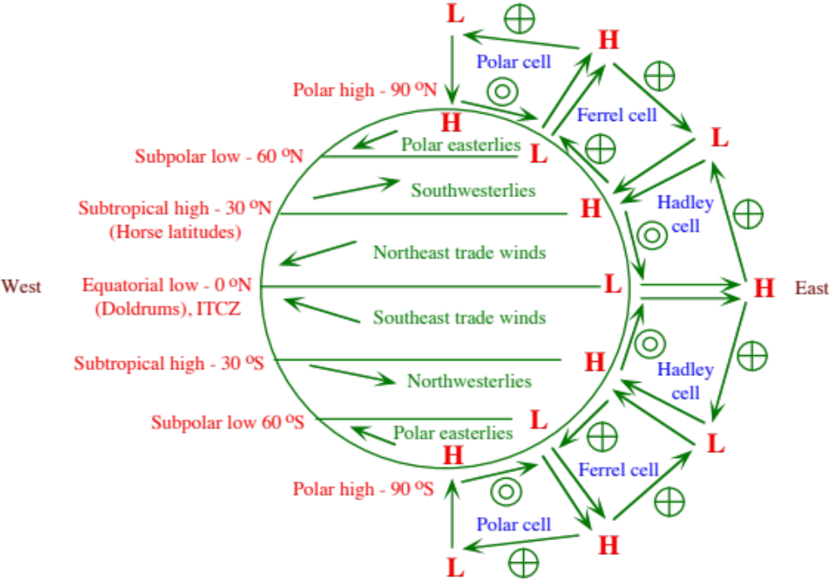
Three-Cell Model
Lowest
Lower
Lower
Lowest
Figure 6.5

Slide 14
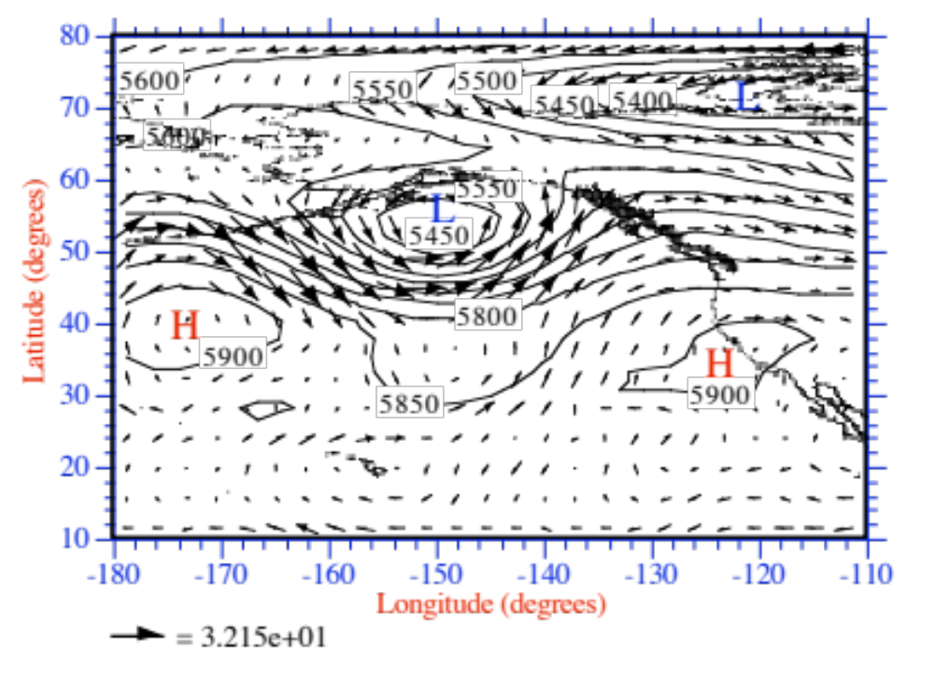
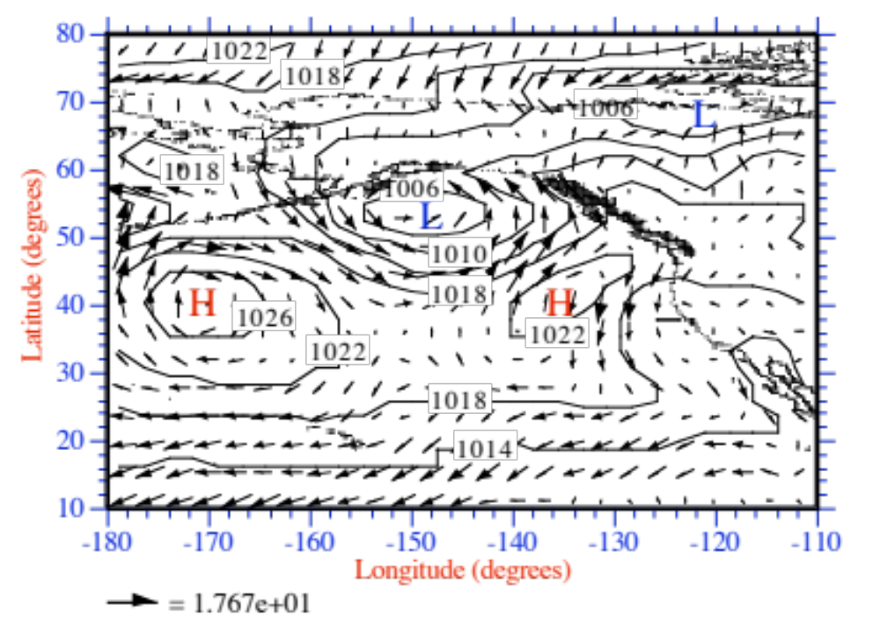
500-hPa and Sea-Level Maps
Figure 6.7

Slide 15
Specific Heat
Substance Specific Heat (J kg ⁻¹ K⁻¹)
Dry air at constant pressure 1004.67
Liquid water 4185.5
Clay 1360
Dry sand 827
Table 6.1

Slide 16
Characteristics of Low and High Pressure Systems
Surface Low-Pressure Surface High-Pressure
Characteristic Semiperm Thermal Semiperm Thermal
Latitude range 45-65 ºN 25-45 ºN 25-45 ºN 45-65 ºN
Surface pres. gradient Strong Variable Weak Variable
Surface wind speed Fast Variable Slow Variable
Surface wind direction Converging Converging Diverging Diverging
counter- counter clockwise clockwise
clockwise clockwise
Vertical air motions Upward Upward Downward Downward
Cloud cover Cloudy Cloud-free Cloud free, Cloud free
or cloudy sunny
Storm formation Yes Sometimes No No
Effect on air pollution Reduces Reduces Enhances Enhances
Table 6.2

Slide 17
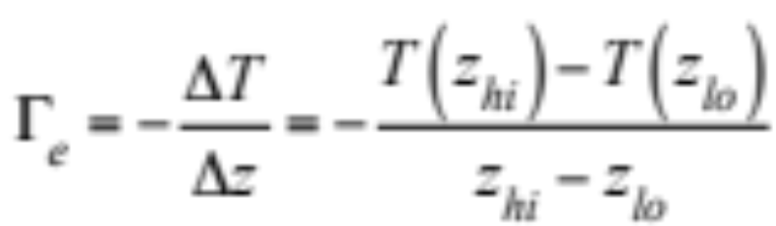
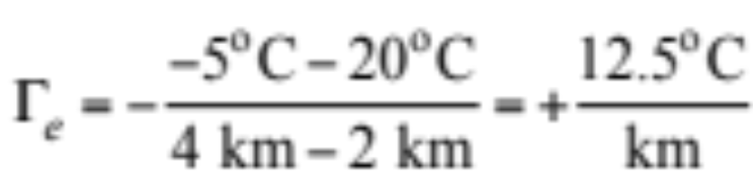
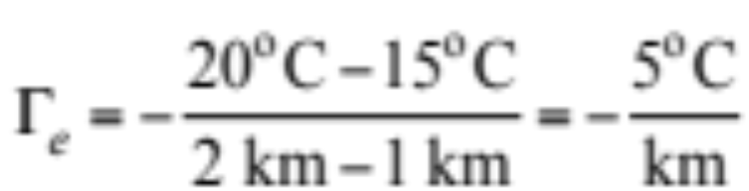
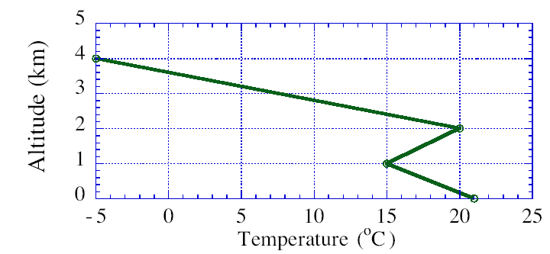
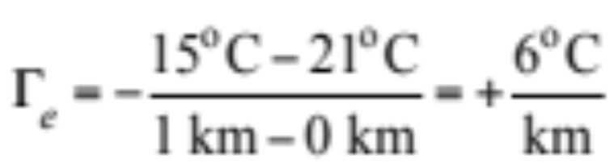
Environmental Lapse Rate
Negative of air temperature change with increasing altitude
Top layer:
Middle layer:
Bottom layer:

Slide 18
Adiabatic Process
Process by which no energy is exchanged between a system (parcel of air) and its surroundings (atmosphere).
Parcel
of air
Atmosphere

Slide 19
Adiabatic Expansion in Unsaturated Air
1. Rising air expands
2. Expanding air cools
Rising air cools
Unsaturated air cools +10 ºC per 1 km rise in altitude
→Dry adiabatic lapse rate
= +10 ºC/km
10 ºC
1 km
20 ºC

Slide 20
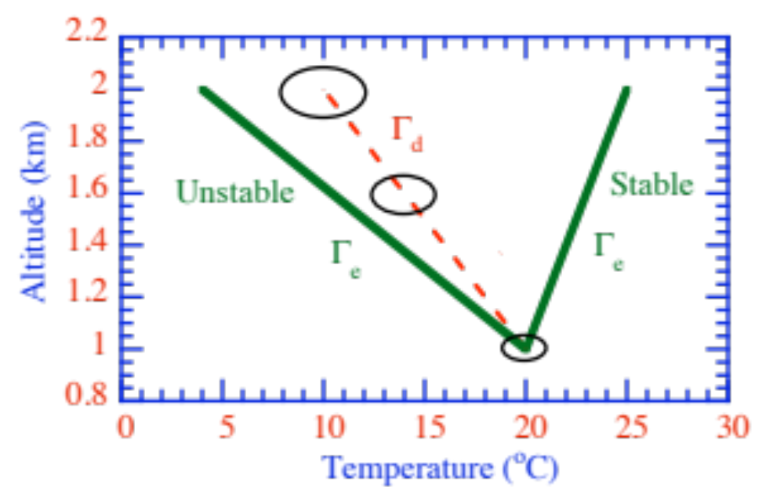
Stability and Instability
Compare parcel temperature with environmental temperature to determine stability
Figure 6.8

Slide 21
Adiabatic Expansion in Saturated Air
Saturated air cools +6 ºC per 1 km rise in altitude
+10 ºC/km cooling due to expansion
−4 ºC/km warming due to latent heat release
→Wet adiabatic lapse rate
= +6 ºC/km
14 ºC
1 km
20 ºC

Slide 22
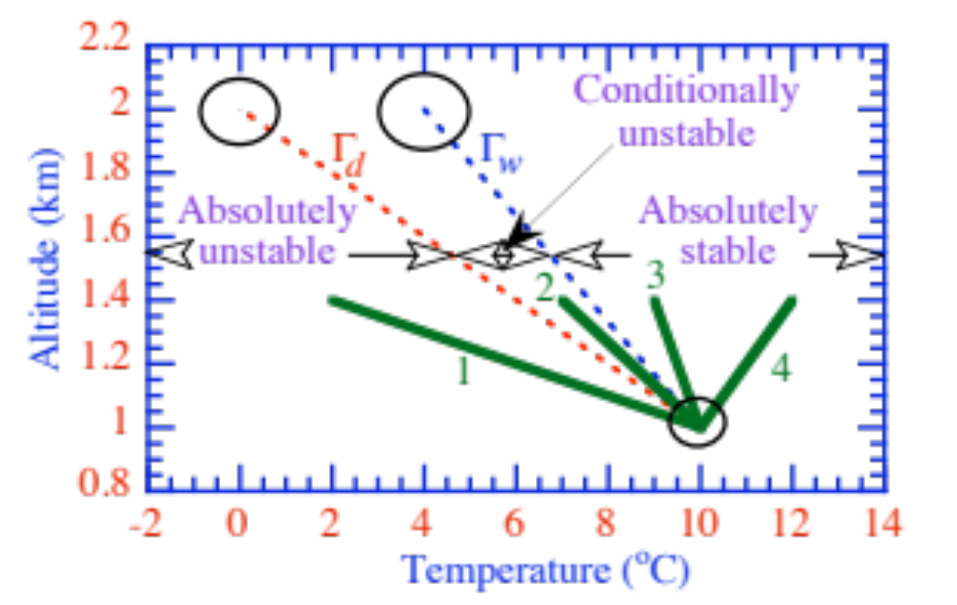
Stability in Saturated Air
Figure 6.9

Slide 23
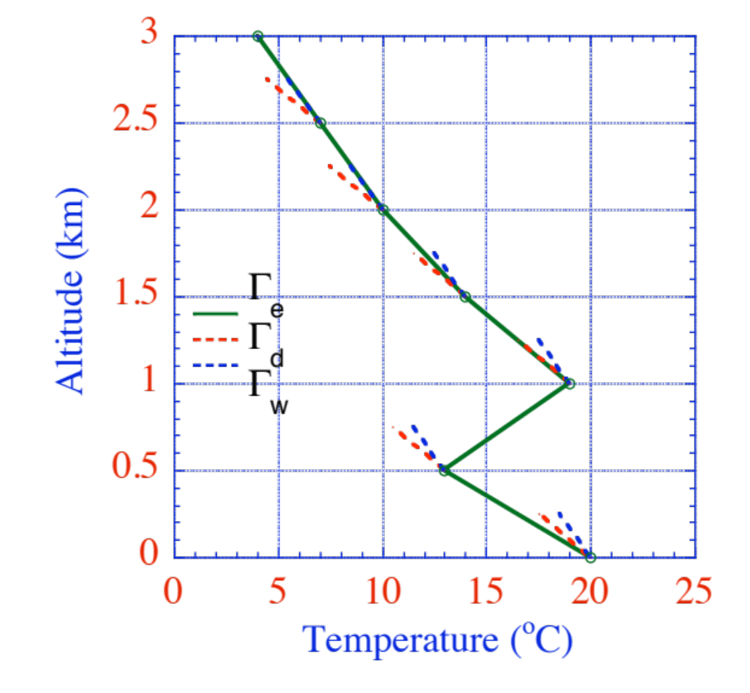
Stability in Multiple Layers
Saturated neutral
Saturated neutral
Conditionally unstable
Altitude (km)
Unsaturated neutral
Absolutely stable
Absolutely unstable

Slide 24
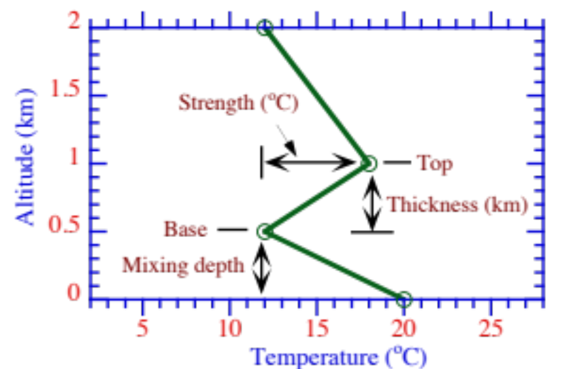
Temperature Inversion
Figure 6.10

Slide 25
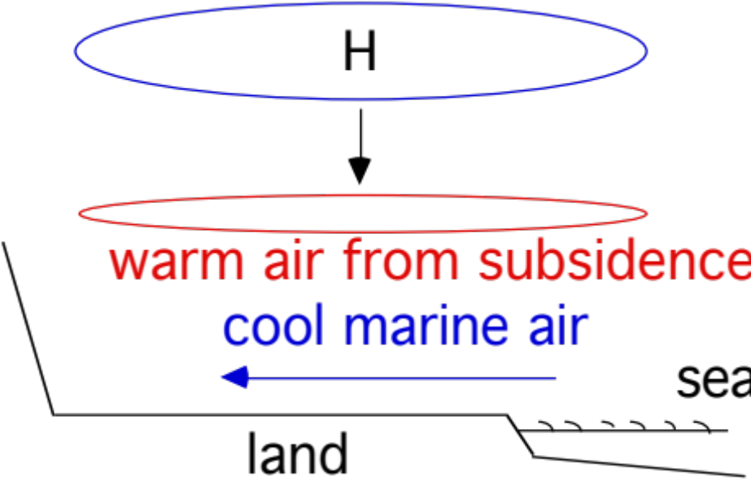
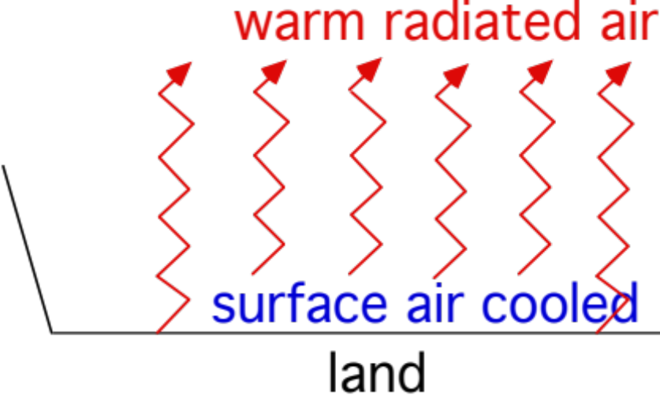
Inversion Types
Large-Scale Subsidence Inversion
Radiation Inversion

Slide 26
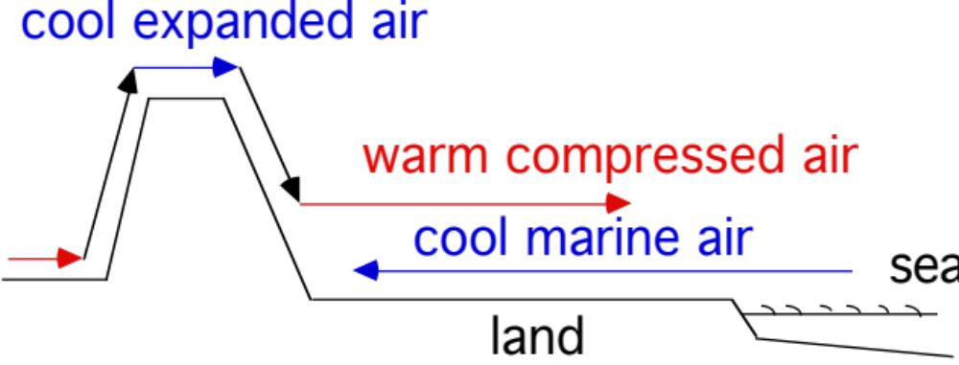
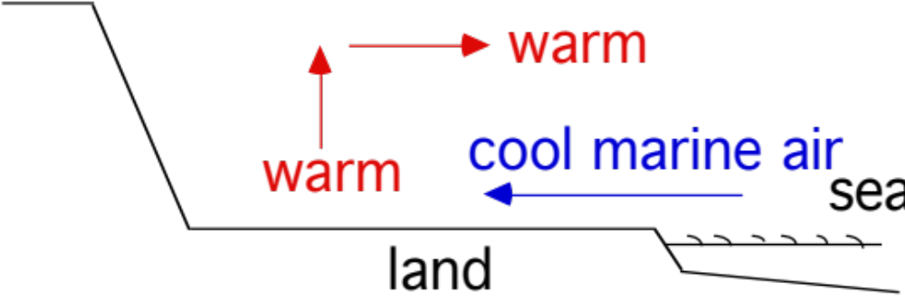
Inversion Types
Regional Subsidence Inversion
Marine Inversion

Slide 27
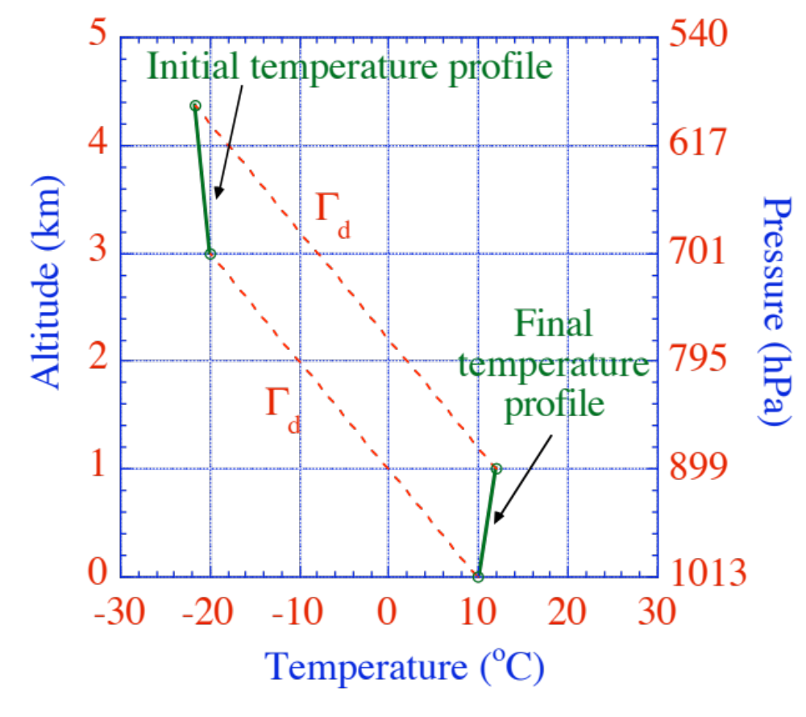
Formation of Subsidence Inversion
114 mb
Altitude (km)
Air pressure (mb)
114 mb
Figure 6.13

Slide 28
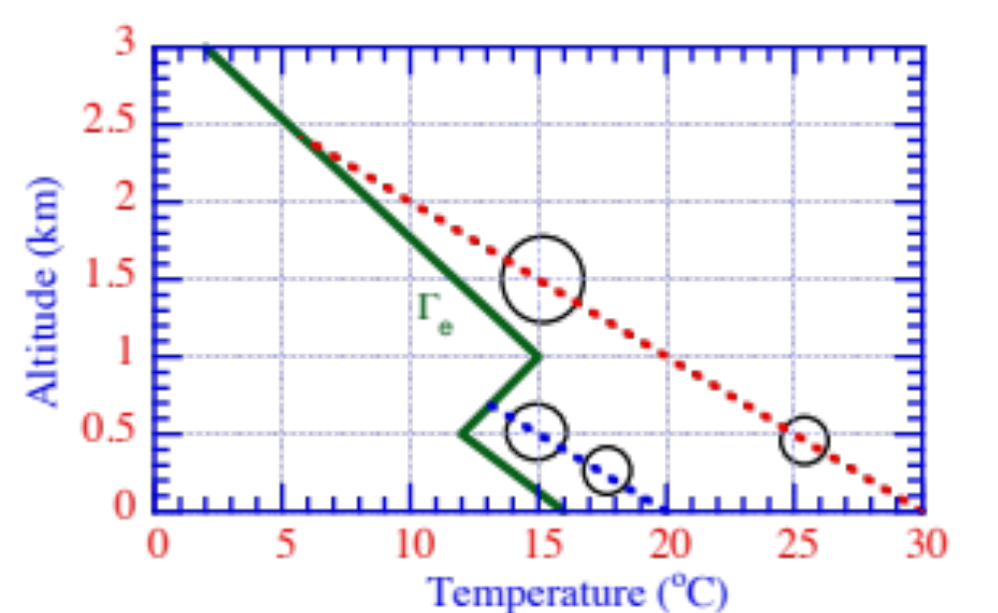
Trapping of Pollutants Under Inversion
Figure 6.11

Slide 29
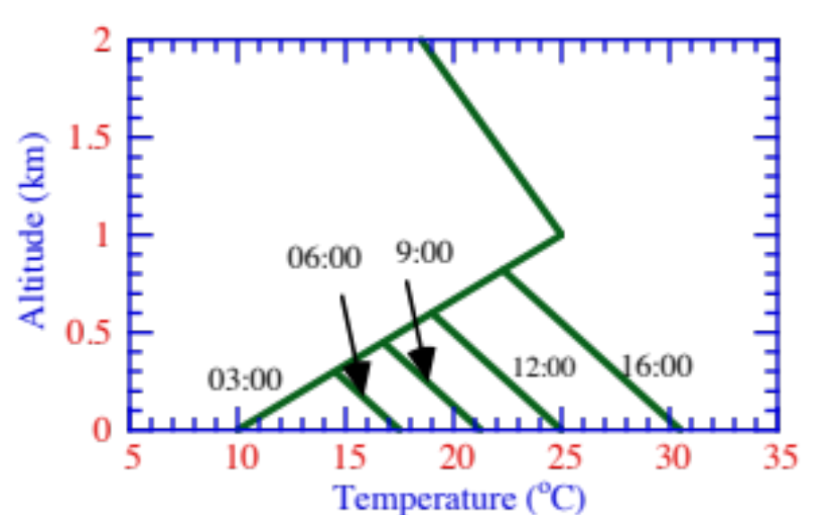
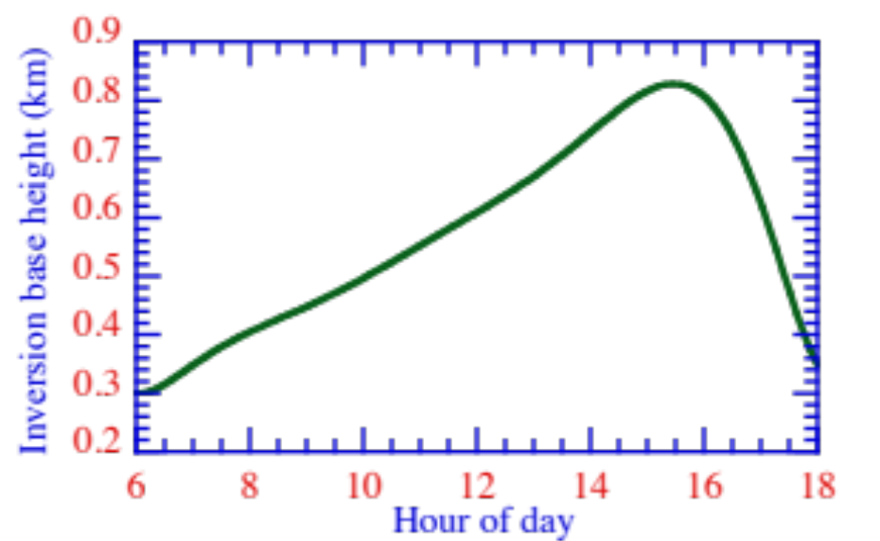
Inversion Base Height Change During the Day
Figure 6.14

Slide 30
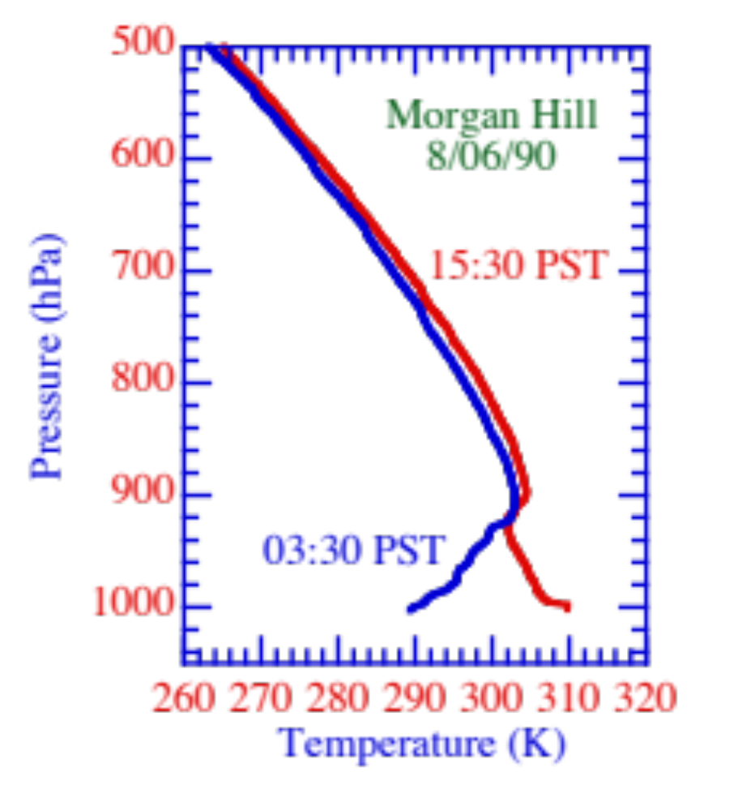
Morning and Afternoon Temperature Profiles
Figure 6.12

Slide 31
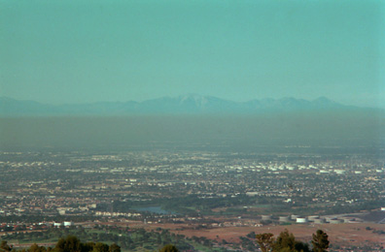
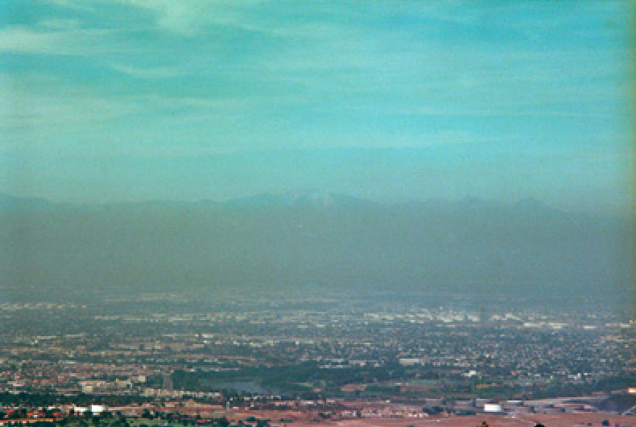
Change in Mixing Depth, Los Angeles, Dec. 19, 2000
Noon Late afternoon
Mark Z. Jacobson

Slide 32
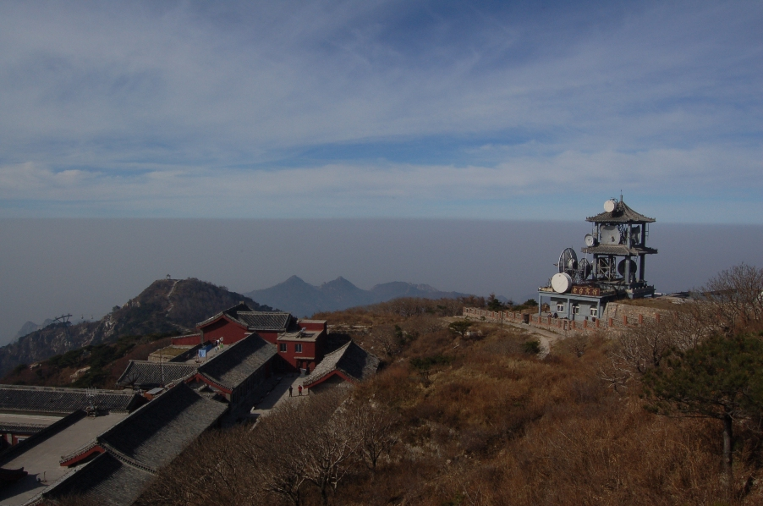
Pollution Under Inversion, Mount Taishan, China (Nov., 2007)
Andrew Chang

Slide 33

Pollution Under Inversion, Mount Taishan, China (Nov., 2007)
Andrew Chang
Andrew Chang

Slide 34
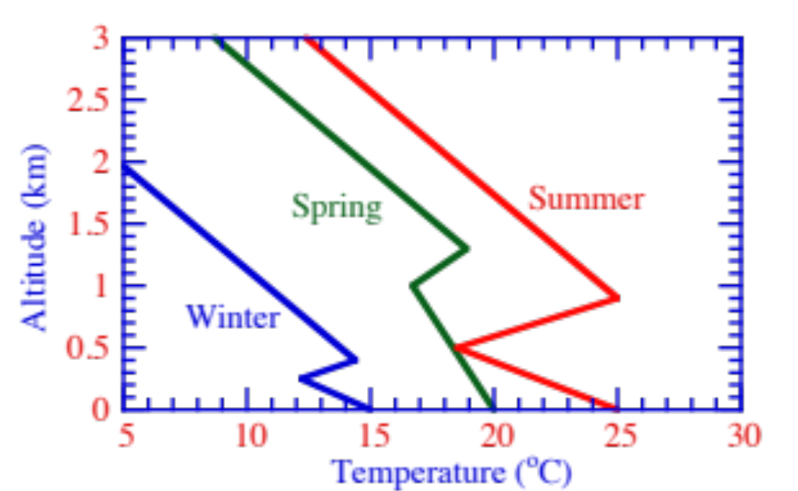
Seasonal Variation of Inversions
Figure 6.16

Slide 35
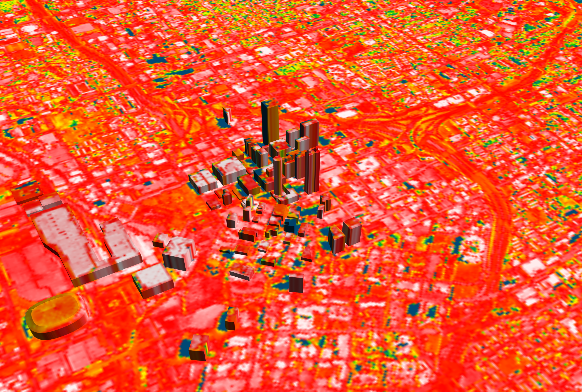
Heat-Island Effect
NASA-Goddard Space Flight Center Scientific Visualization Studio

Slide 36
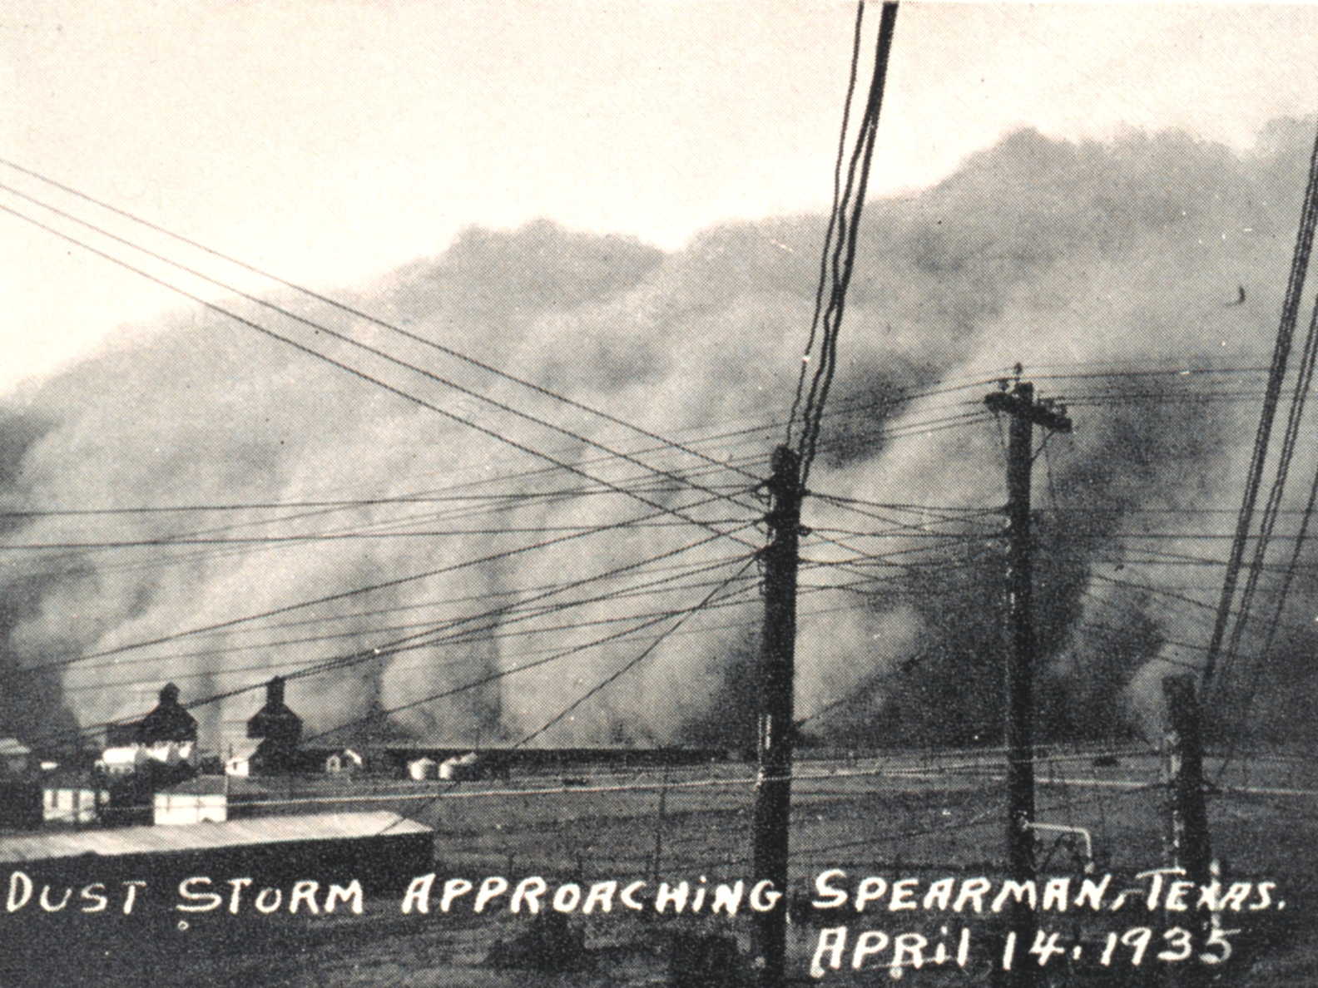
Dust Storm, Spearman, Texas (April 14, 1935)
National Oceanic and Atmospheric Administration Central Library

Slide 37
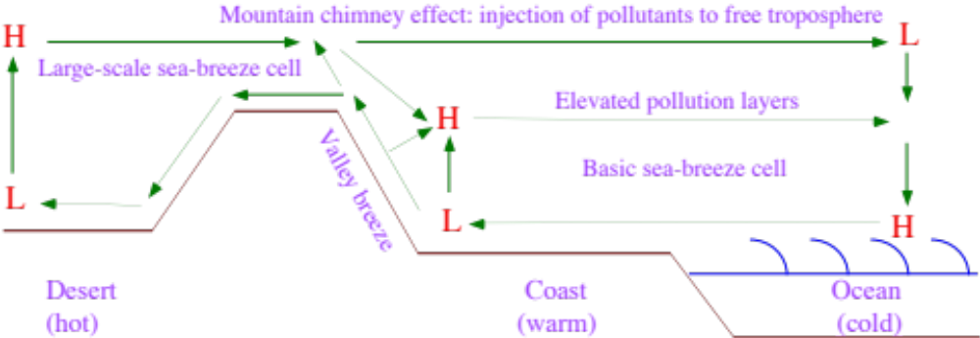
Sea Breeze Circulation
Figure 6.19

Slide 38
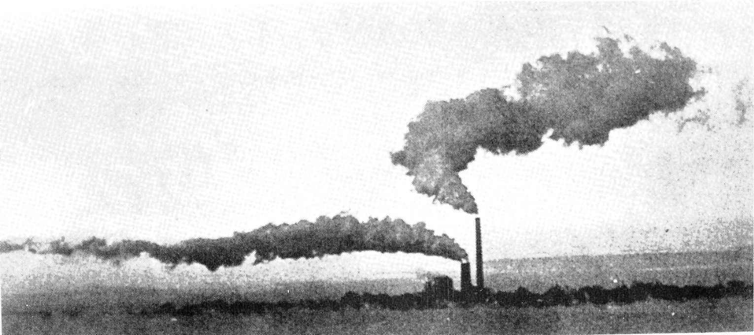
Upper and Lower Sea Breeze Winds
Ralph Turncote

Slide 39
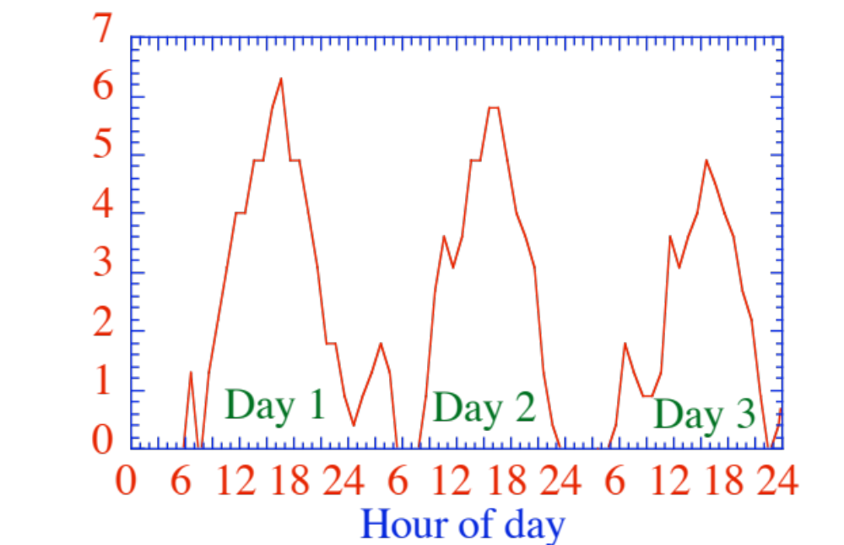
Sea Breeze Winds at Hawthorne, CA
Wind speed (m/s)
Figure 6.20

Slide 40
Methods of Producing Elevated Pollution Layers
Upper return flow of sea-breeze circulation
Mountain-chimney effect
Injection of fire plume into elevated inversion
Nighttime titration of surface ozone

Slide 41

Sunset Through Elevated Pollution Layer (Los Angeles)
Gene Daniels, U.S. EPA, May 1972, Still Pictures Branch, U.S. National Archives

Slide 42
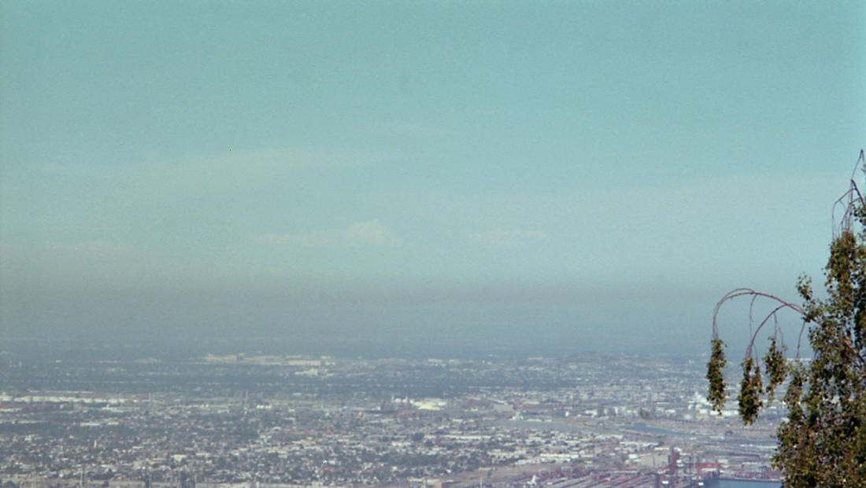
Elevated Pollution From Sea Breeze
(Los Angeles, July 22, 2000)
M. Z. Jacobson

Slide 43
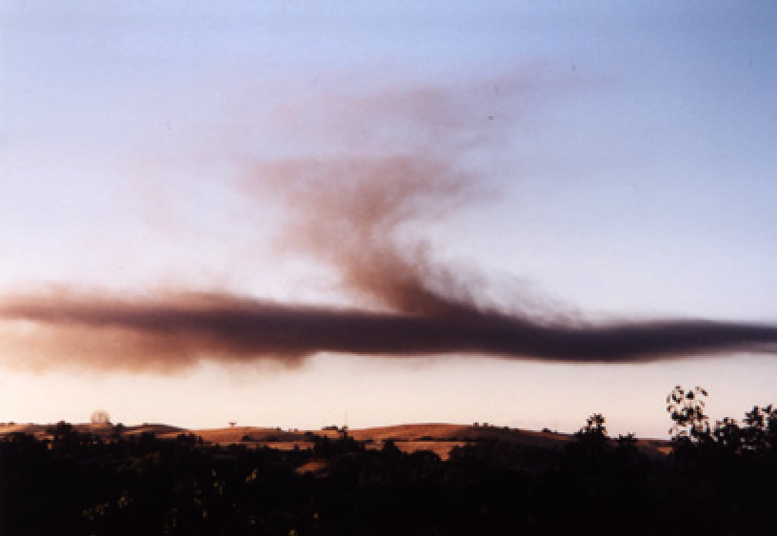
Smoke Trapped in Inversion After Fire
Menlo Park, California (June, 2001)
Mark Z. Jacobson

Slide 44
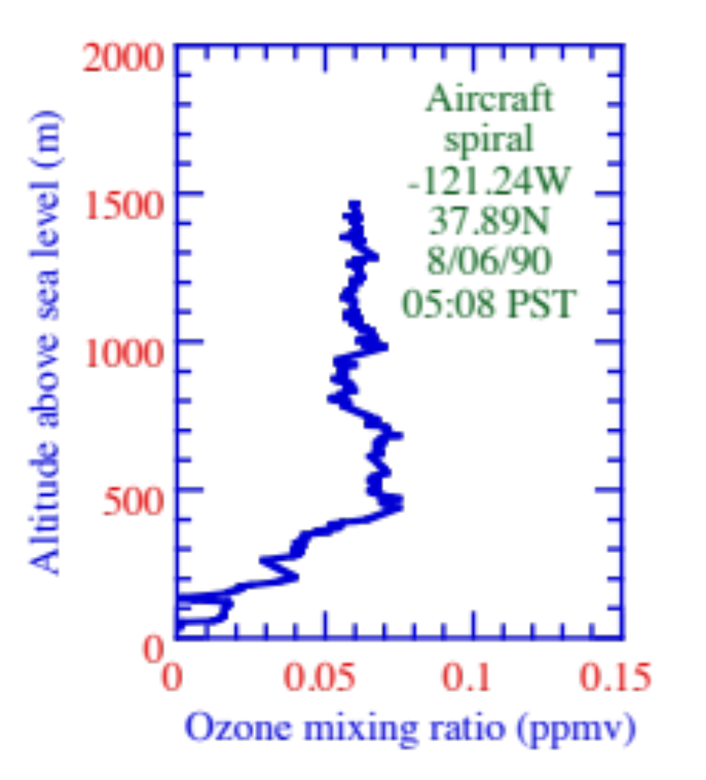
Nighttime Ozone Profile Over Stockton, California
Figure 6.24

Slide 45
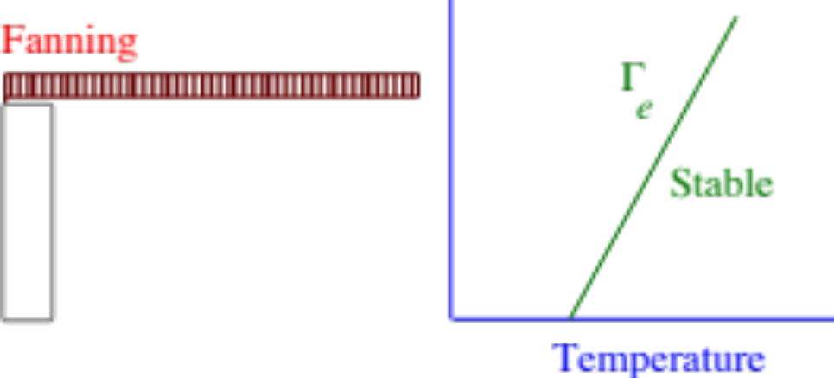
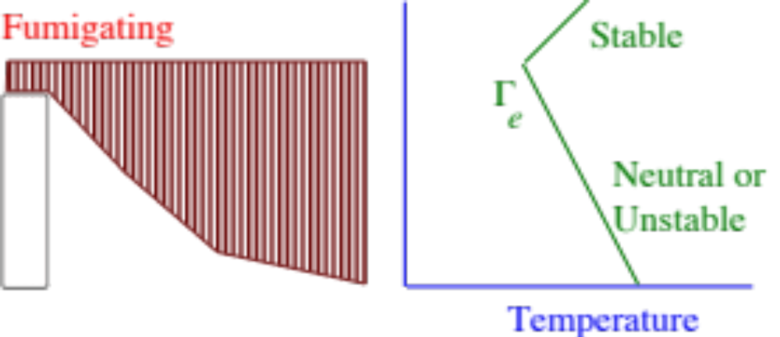
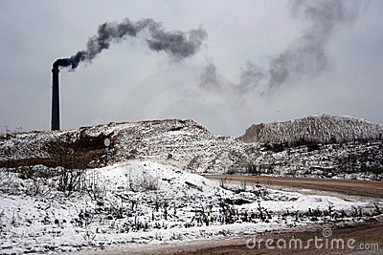
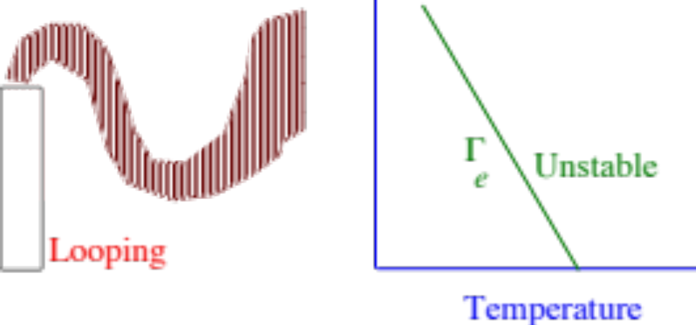
Plumes
L. Zakharchenko/Dreamstime

Slide 46
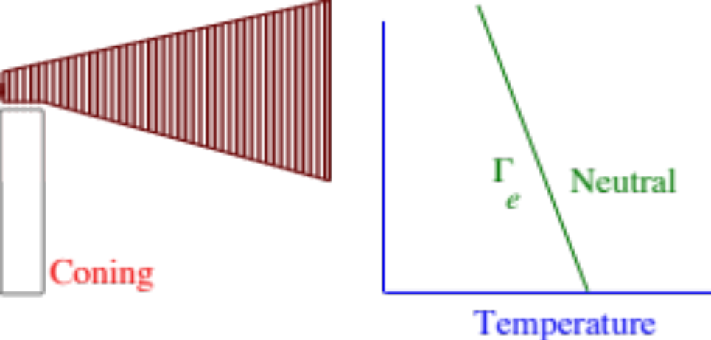
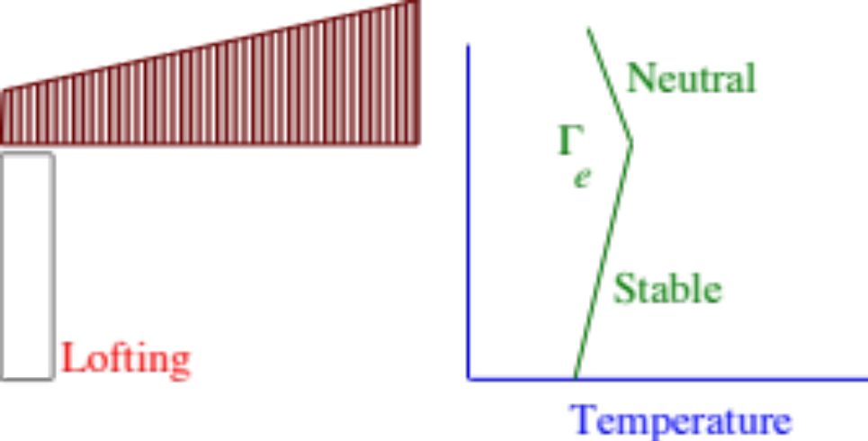

Plumes
Artem Sapegin/Dreamstime

Slide 47
How Aerosols Reduce Wind Speeds
Aerosols reduce solar radiation to ground (e.g., up to 6.5% in LA basin, Aug. 1987)
Reduction in surface solar cools the ground. Absorbing aerosols also heat the air, warming the upper boundary-layer. Both factors stabilize the air, reducing turbulence
Reduction in turbulence reduces vertical flux of horizontal momentum, slowing transfer of fast winds aloft to the surface.

Slide 48
Aerosol Effects on Wind Energy
Example mean annual wind speed
= 7 m/s without aerosols
= 6.93-6.65 m/s with aerosols (1-5% reduction)
1500 kW turbine, 77-m diameter rotor
Wind energy loss with aerosols 2-9%

Slide 49



Rainfall Reduction due to Aerosols
Smaller cloud drops, thicker clouds due to aerosols
Precipitation reduction due to aerosols
California precipitation
Data from Western Reg. Clim. Ctr. Prepared by G. Lopez, G. Franco

Slide 50
Aerosol Effects on Water Supply
Rainfall in California: 193 million acre-feet/year (1.54 mm/day)
Flow to reservoirs (agriculture/cities/industry):12.9% (24.9 maf/yr)
Precipitation reduction due to aerosols: 2-5%
--> Runoff loss to reservoirs: 0.5-1.25 maf/yr
Reducing aerosol pollution could have nearly a similar effect as proposed addition of upper San Joaquin River dam (1.3 maf)
Reducing aerosol pollution could also reduce 4-6 maf/yr needed to meet growth of California 2010 population to 40 million

Slide 51
California Aerosol Pollution Effects
Decrease net downward solar radiation
Increase net downward thermal-IR radiation
Decrease near-surface air temperature
Slightly increase mid-upper boundary-layer temperatures
Stabilize the air
Decrease wind speed by 1-5% avg., up to 8% locally
Decrease wind energy 2-9% avg., higher locally
Decrease precipitation by 2-5%
--> Aerosols decrease water supply, hydropower, and wind energy

