Slide 1
Presentation Slides for
Air Pollution and Global Warming:
History, Science, and Solutions
Chapter 7: Effects of Pollution on Visibility, UV Radiation, and Colors in the Sky
By Mark Z. Jacobson
Cambridge University Press (2012)
Last update: February 8, 2012
The photographs shown here either appear in the textbook or were obtained from the internet and are provided to facilitate their display during course instruction. Permissions for publication of photographs must be requested from individual copyright holders. The source of each photograph is given below the figure and/or in the back of the textbook.

Slide 2
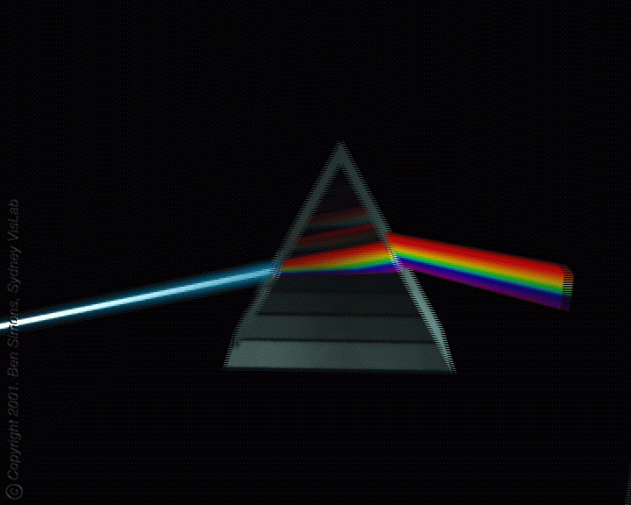
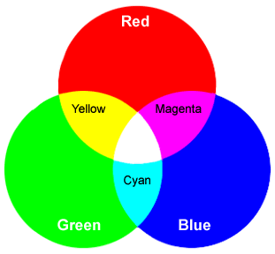
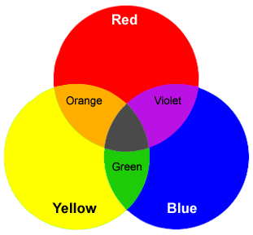
Additive Colors
0.6-0.75 micron
0.5-0.6 micron
0.38-0.5 micron
Newton’s primaries
Artist’s primaries
www.wiu.edu; theaudacityofcolor.com

Slide 3
Light Attenuation Processes
Gas absorption
Gas scattering
Aerosol and hydrometeor particle absorption
Aerosol and hydrometeor particle scattering
Reflection
Refraction
Dispersion
Diffraction

Slide 4
Light-Absorbing Gases
Gas Absorption wavelengths (υm)
Visible/Near-UV/Far-UV absorbers
Ozone < 0.35, 0.45-0.75
Nitrate radical < 0.67
Nitrogen dioxide < 0.71
Near-UV/Far-UV absorbers
Formaldehyde < 0.36
Nitric acid < 0.33
Far-UV absorbers
Molecular oxygen < 0.245
Carbon dioxide < 0.21
Water vapor < 0.21
Molecular nitrogen < 0.1

Slide 5

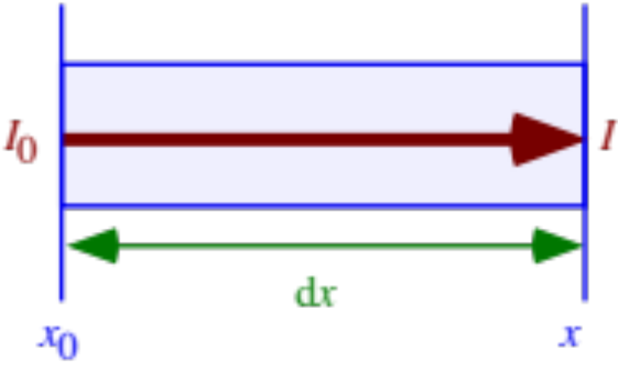

Gas Absorption
Conversion of radiative energy to internal energy by a gas molecule, increasing the temperature of the molecule
Attenuation of light intensity
(7.2)
Absorption extinction coefficient (1/cm)
(7.1)
b = gas absorption cross section (cm²/molec.)
N = gas concentration (molec./cm³)

Slide 6
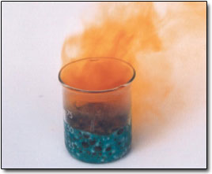
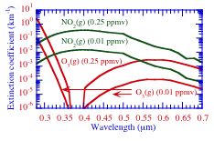
Absorption Extinction Coefficients of Nitrogen Dioxide and Ozone
NO₂
openlearn.open.ac.uk
Figure 7.3

Slide 7
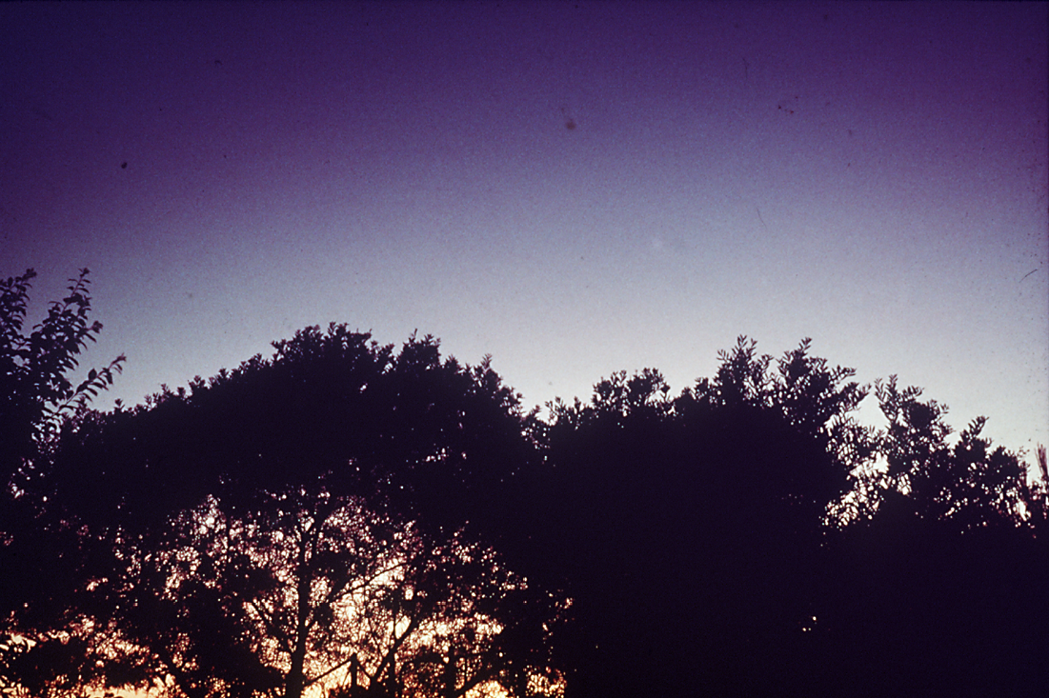
Purple Sky Due to Ozone Absorption of Green Light After El Chichon Volcano, 1982
J. Lew

Slide 8
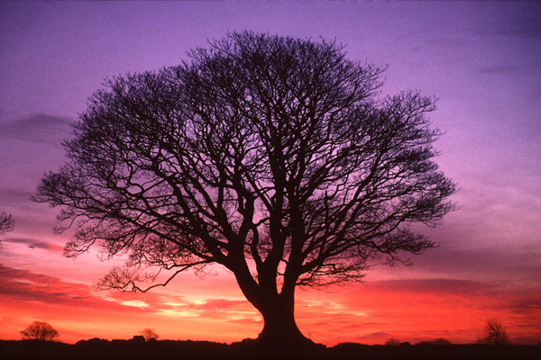
Red Sunrise / Purple Sky
Northumberland, UK
Ian Britton

Slide 9

Why is the Sky Blue?
liamdaly.com

Slide 10
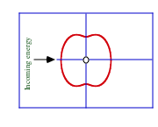
Gas (Rayleigh) Scattering
Redirection of radiation by a gas molecule without a net transfer of energy to the molecule
Probability distribution of where a gas molecule scatters incoming light
Figure 7.4

Slide 11
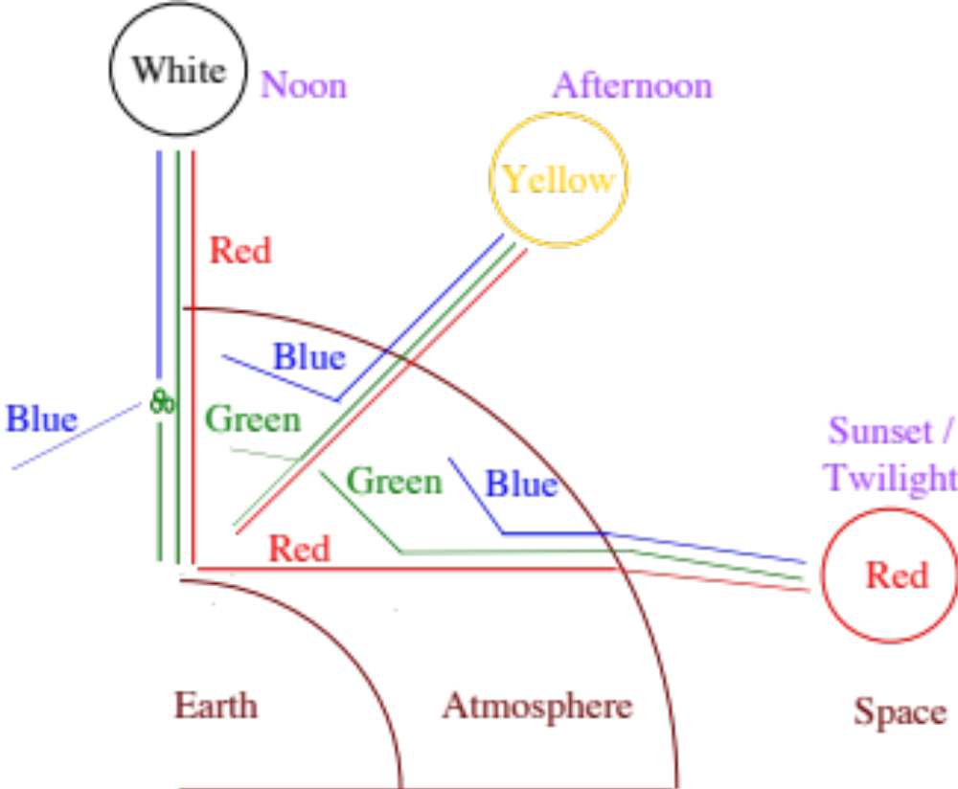
Color of the Sky and Sun
Figure 7.6

Slide 12
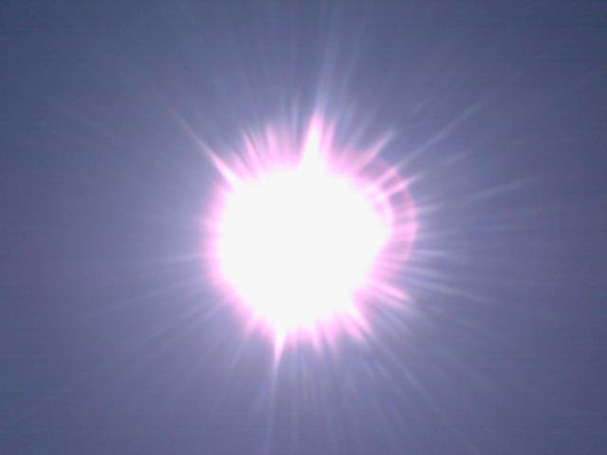
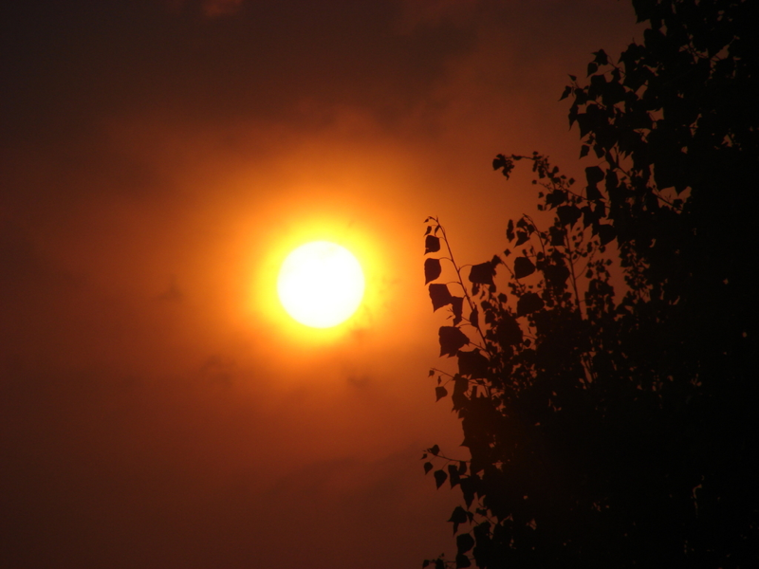
Sun at Noon and in the Afternoon
liamdaly.com
I146.photobucket.com

Slide 13

Yellowsunset
Yellow Sun at Sunset
Mark Z. Jacobson

Slide 14
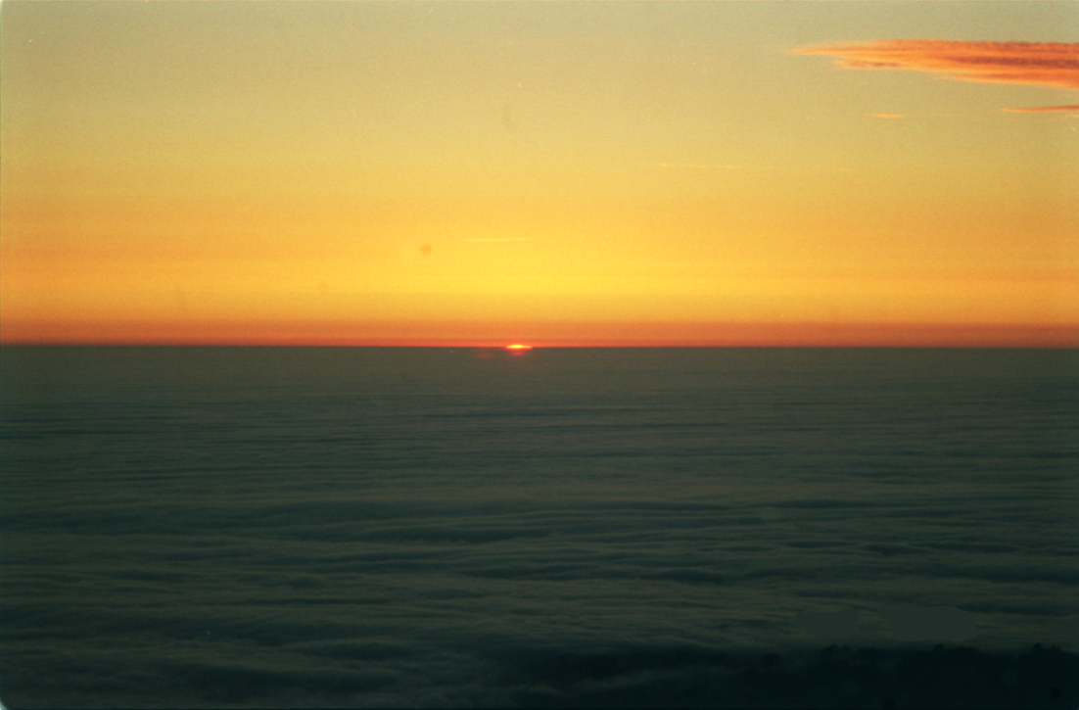
Red Horizon Over Clouds During Sunset
Mark Z. Jacobson

Slide 15
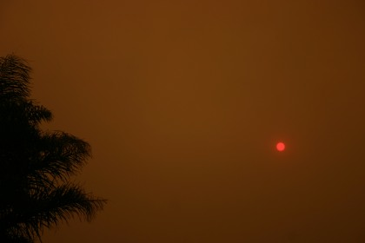
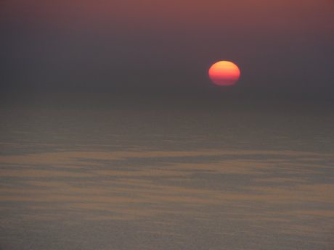
Red Sun Through Pollution
molvray.com
Intlxpatr.files.wordpress.com

Slide 16
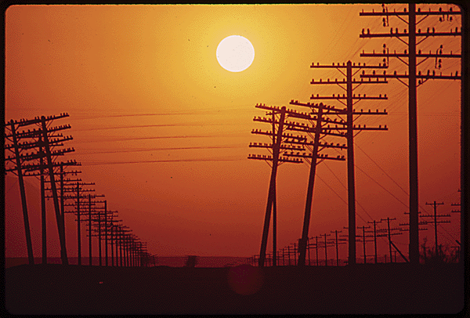
Red Sky Due to Smog
(Salton Sea, California)
Charles O'Rear, U.S. EPA, May, 1972, Still Pictures Branch, U.S. National Archives

Slide 17
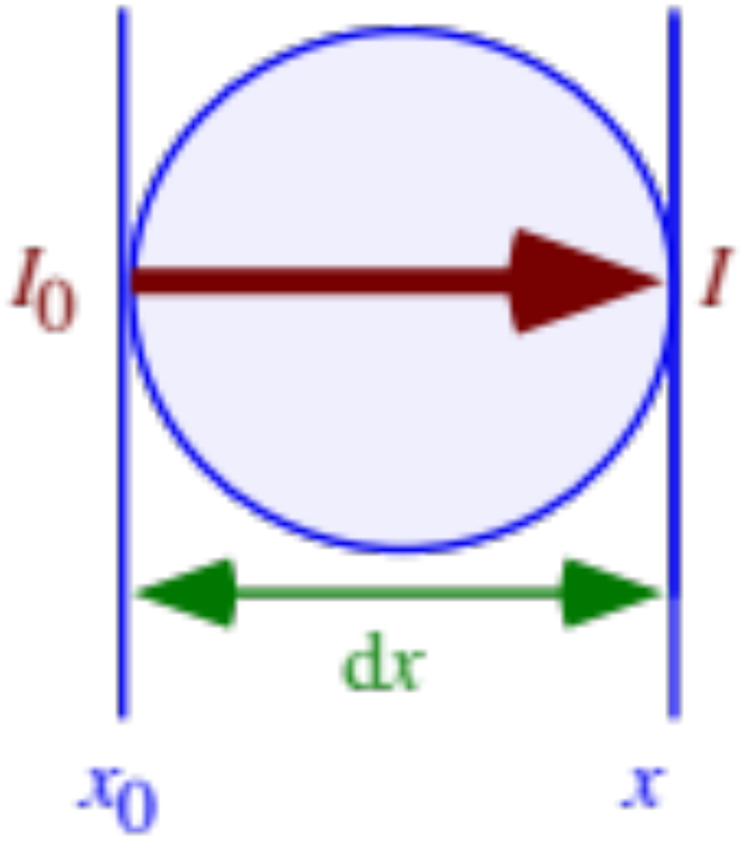

Particle Absorption
Conversion of radiative energy to internal energy by a particle, increasing the temperature of the particle
Attenuation of light through particle
(7.4)

Slide 18
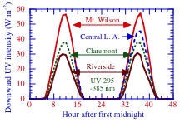
Effects of Pollution on UV Radiation Reaching Surface
Figure 7.12

Slide 19
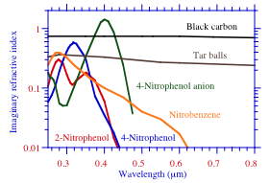
Imaginary Refractive Indices of Organic and Black Carbon
Figure 7.11

Slide 20
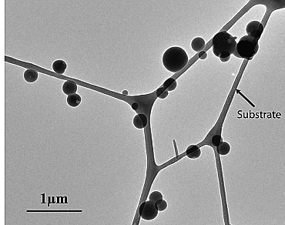
Tarballs
Adachi and Buseck (2011)

Slide 21
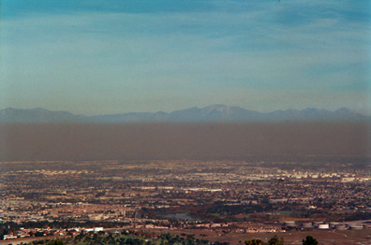
Brown Particles in Los Angeles Smog
(Dec. 2000)
Mark Z. Jacobson

Slide 22
Brown Color of Nitrogen Dioxide and Organic Particles
From preferential absorption of blue and some green by particles and transmission of red and remaining green (which makes brown)

Slide 23
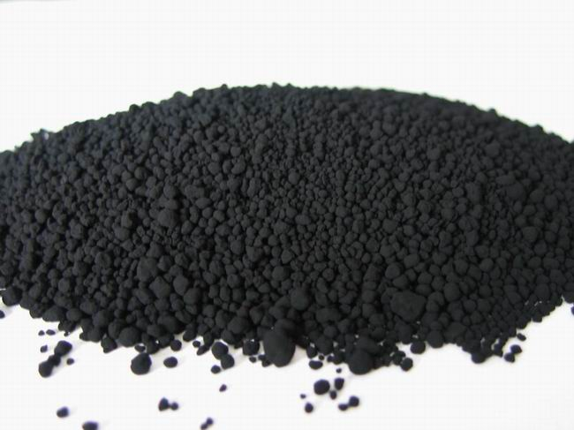
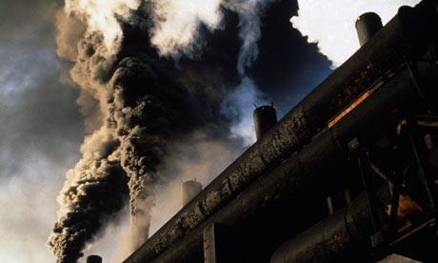
Black Carbon and Soot
www.ecofuss.com
img.alibaba.com

Slide 24
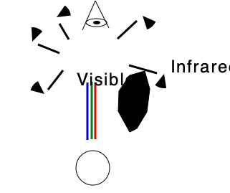
Black Color of Soot
Soot appears black because it absorbs all visible wavelengths (blue, green, red) and transmits no light.

Slide 25
Particle Scattering
Reflection
The bounceoff of light from an object at the angle of incidence
Refraction
  Bending of light as it travels between media of different density
Dispersion
  Separation of white light into colors
Diffraction
  Bending of light around objects
Scattering
  Combination of reflection, refraction, dispersion, diffraction.
  The deflection of light in random directions.

Slide 26
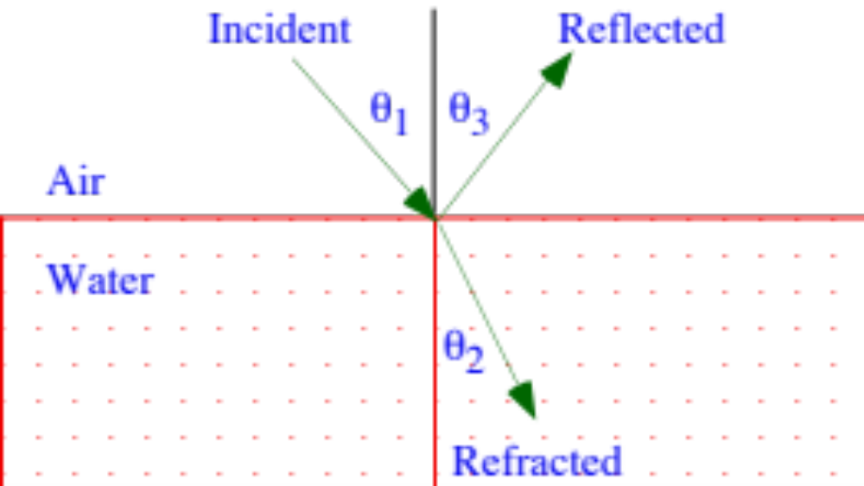
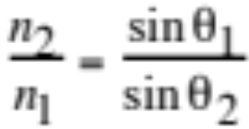
Reflection and Refraction
Snell’s Law
(7.5)
Real part of refractive index
n₁= c/c₁ (7.6)
c = speed of light in vacuum

Slide 27
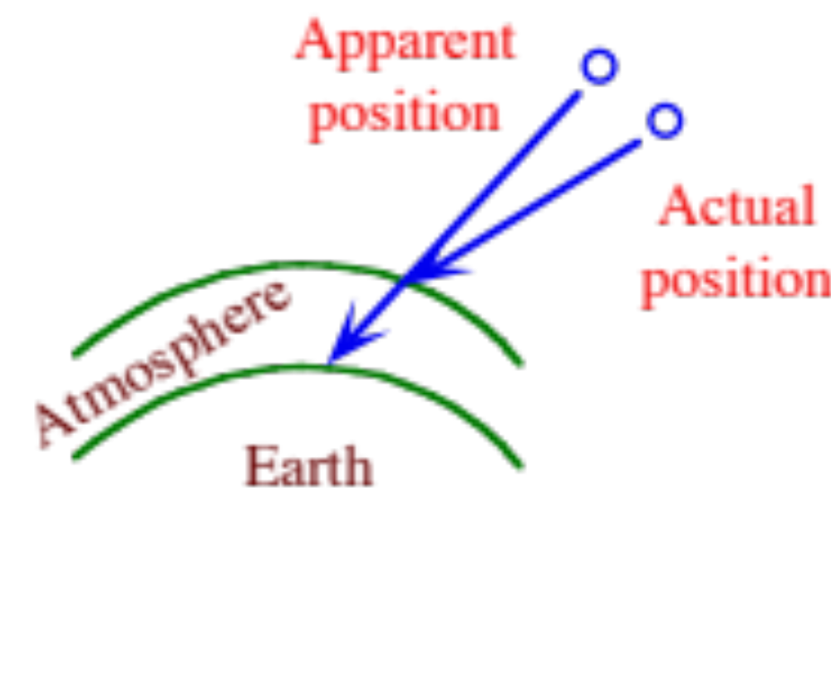
Refraction of Starlight
Figure 7.14

Slide 28
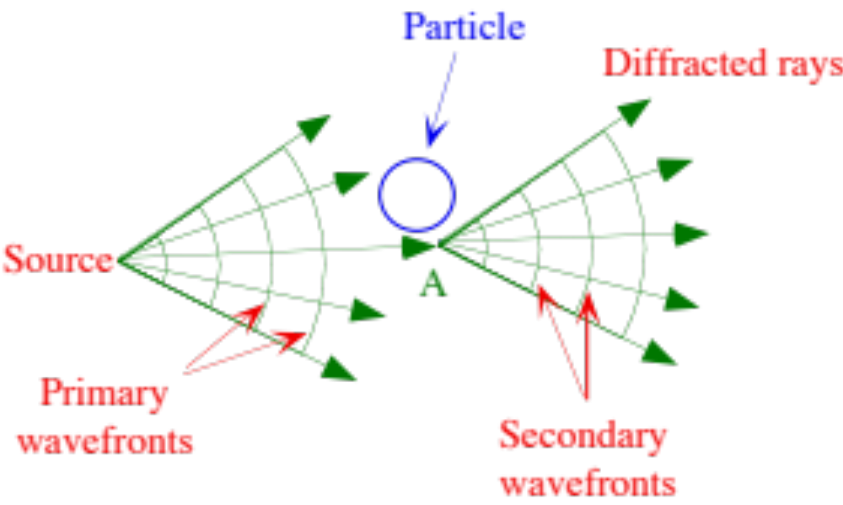
Diffraction Around A Particle
Huygens' principle
Each point of an advancing wavefront may be considered the source of a new series of secondary waves
Figure 7.15

Slide 29
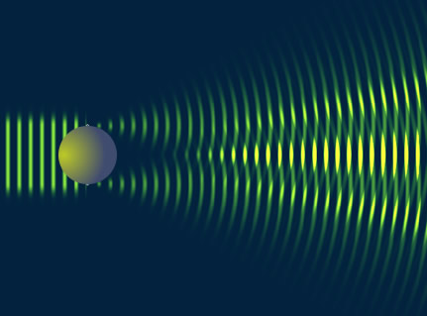
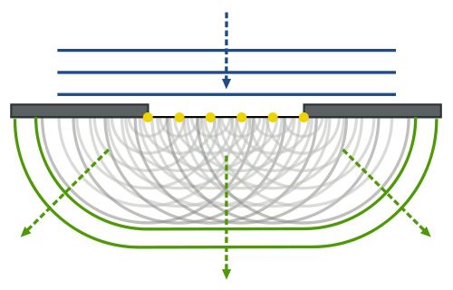
Huygen’s Principle
Every point on a wave front can be considered as a source of wavelets that spread out in the forward direction at the speed of the wave itself.
Upload.wikimedia.org
www.sgha.net

Slide 30
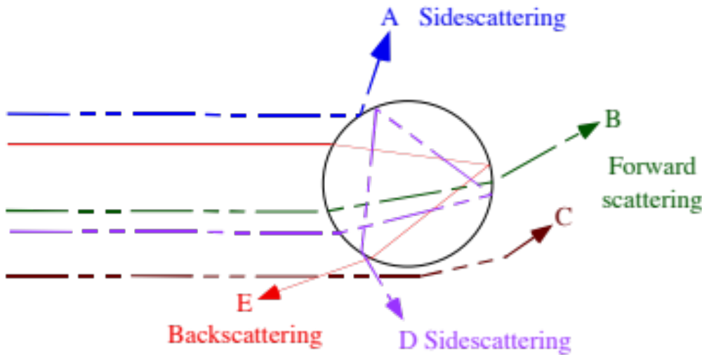
Radiation Scattering by a Sphere
Ray A is reflected
Ray B is refracted twice
Ray C is diffracted
Ray D is refracted, reflected twice, then refracted
Ray E is refracted, reflected once, and refracted
Figure 7.16

Slide 31
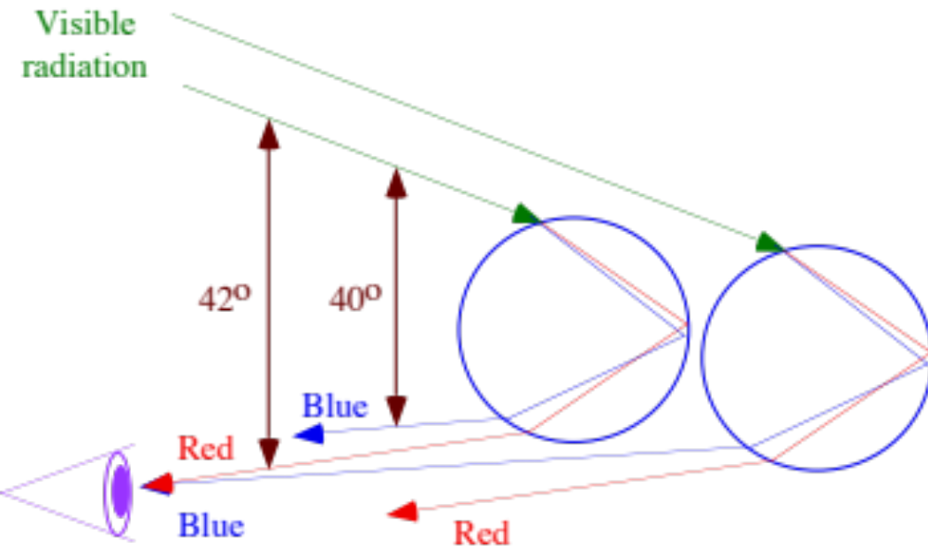
Geometry of a Primary Rainbow
Figure 7.19

Slide 32
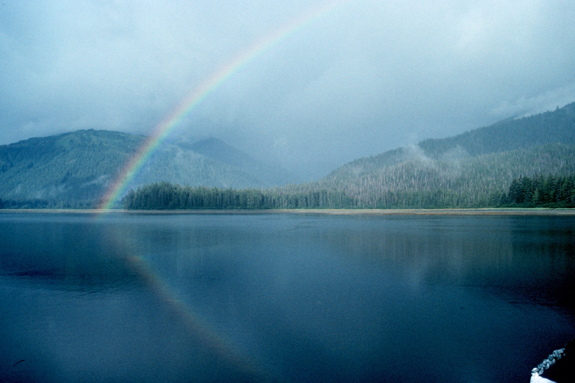
Primary Rainbow
Commander John Bortniak, NOAA Corps, available from the
National Oceanic and Atmospheric Administration Central Library

Slide 33
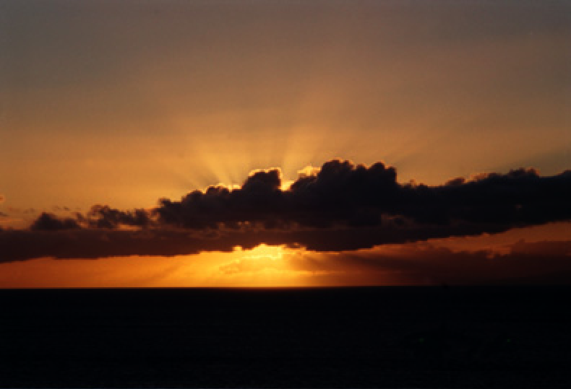
Forward Scattering of Sunlight
Mark Z. Jacobson

Slide 34
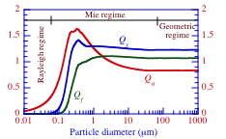
Soot Absorption/Scattering Efficiencies
Single soot particle absorption/scattering efficiencies and forward scattering efficiencies at a wavelength of 0.50 micron
Fig. 7.20

Slide 35
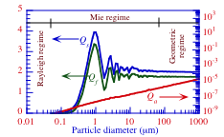
Water Absorption/Scattering Efficiencies
Single water particle absorption/scattering efficiencies and forward scattering efficiencies at a wavelength of 0.50 micron
Figure 7.21

Slide 36
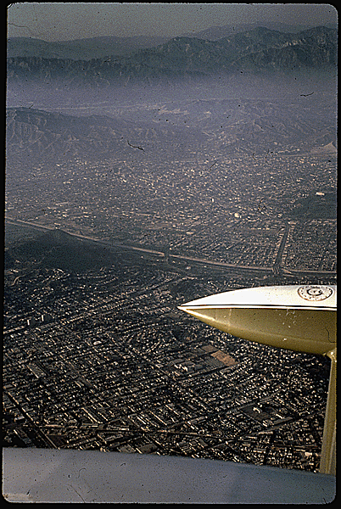
Los Angeles Haze
Gene Daniels, U.S. EPA, May, 1972, Still Pictures Branch, U.S. National Archives

Slide 37
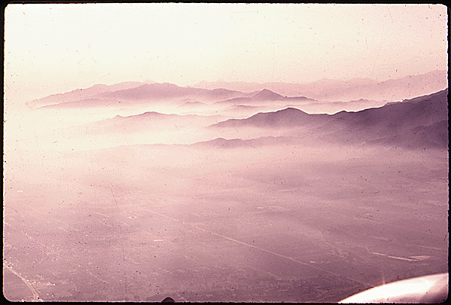
Haze and Fog Over Los Angeles
Gene Daniels, U.S. EPA, May, 1972, Still Pictures Branch, U.S. National Archives

Slide 38
Visibility Definitions
Meteorological range
Distance from an ideal dark object at which the object has a 0.02 liminal contrast ratio against a white background
Liminal contrast ratio
Lowest visually perceptible brightness contrast a person can see
Visual range
Actual distance at which a person can discern an ideal dark object against the horizon sky
Prevailing visibility
Greatest visual range a person can see along 50 percent or more of the horizon circle (360º), but not necessarily in continuous sectors around the circle.

Slide 39
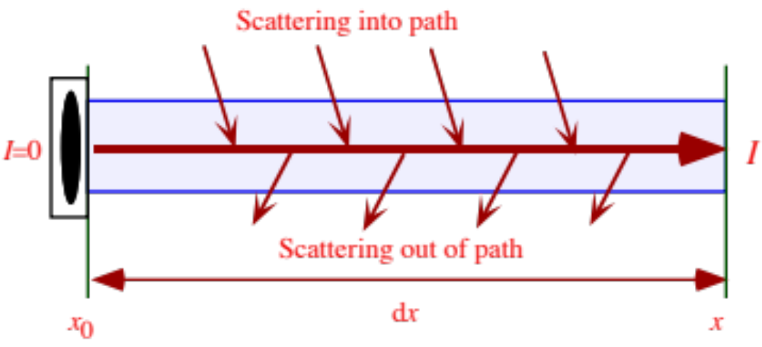
Visibility
The intensity of radiation increases from 0 at point x₀ to I at point x due to the scattering of background light into the viewer’s path
Figure 7.22

Slide 40
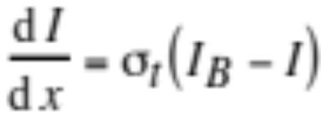

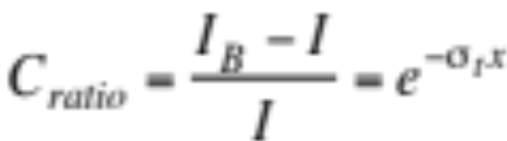
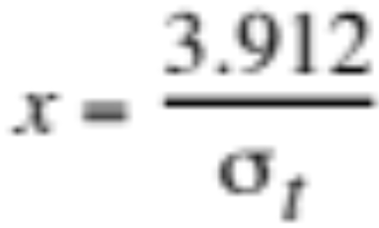
Meteorological Range
Change in object intensity along path of radiation (7.9)
Total extinction coefficient (7.10)
Integrate (7.9) (7.11)
Define liminal contrast ratio --> meteorological range (7.12)

Slide 41
Meteorological Range
 | Meteorological Range (km)
 | Gas scattering | Gas absorption | Particle scattering | Particle absorption | All
Polluted day | 366 | 130 | 9.59 | 49.7 | 7.42
Less-polluted day | 352 | 326 | 151 | 421 | 67.1
(Larson et al., 1984)
Table 7.4

Slide 42
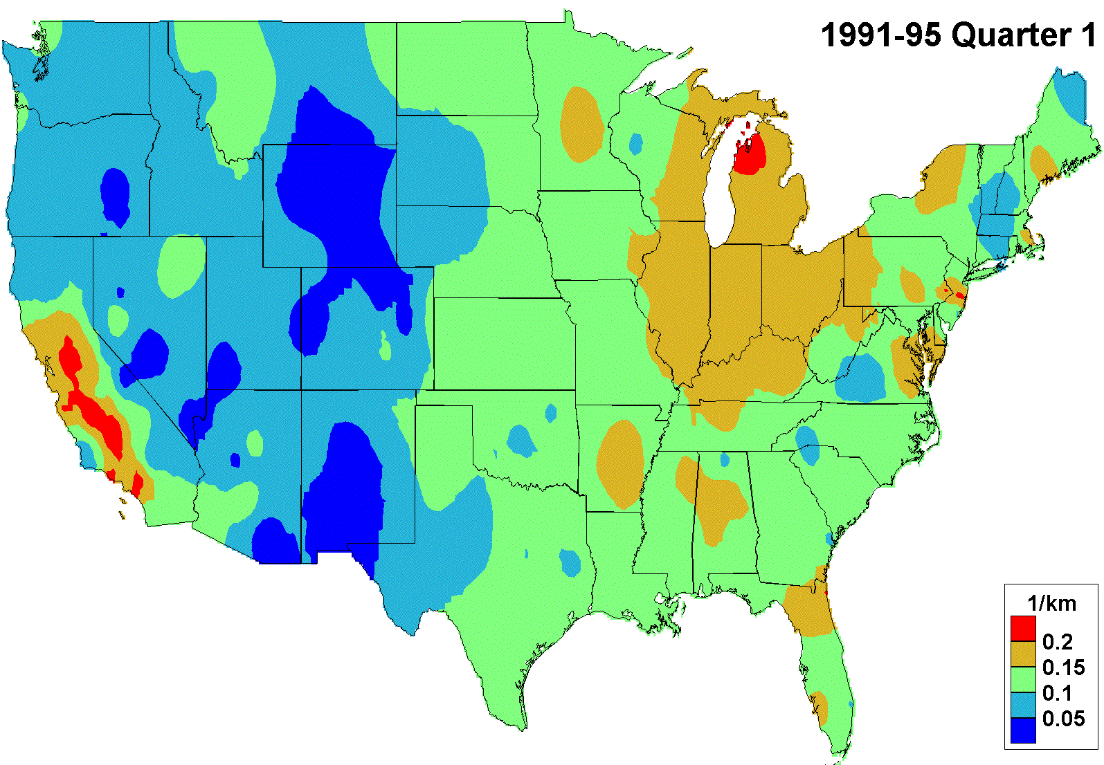
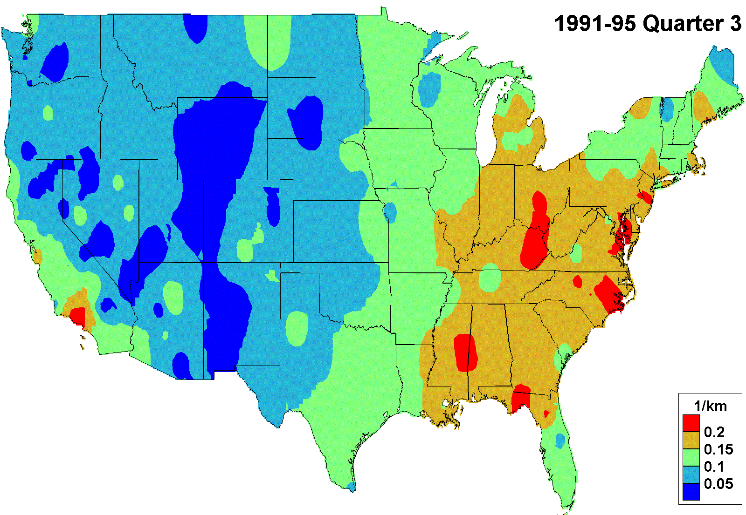
Winter and Summer Maps of Light Extinction
Schichtel et al. (2001)

