Slide 1
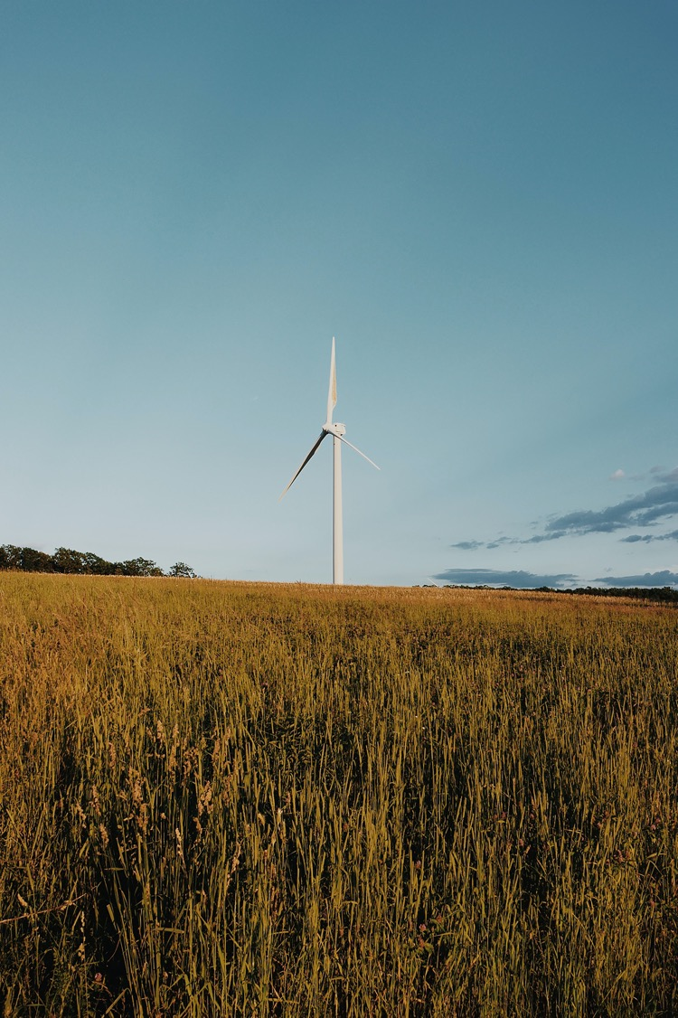
100% Clean, Renewable Energy and Storage for Everything
Mark Z. Jacobson
Stanford University

Slide 2
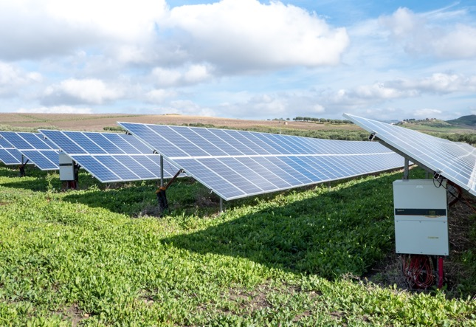
Chapter 1:
What Problems Are We Trying to Solve?

Slide 3
What’s are the Problems? Why act Quickly?
Fossil-fuel + biofuel air pollution cause ~7 million air pollution deaths/yr worldwide costing ~$30 trillion/year
Global warming will cost ~$30 trillion/year by 2050.
Fossil fuels will become scarce, increasing energy prices and economic, political, and social instability
Drastic problems require immediate solutions.

Slide 4
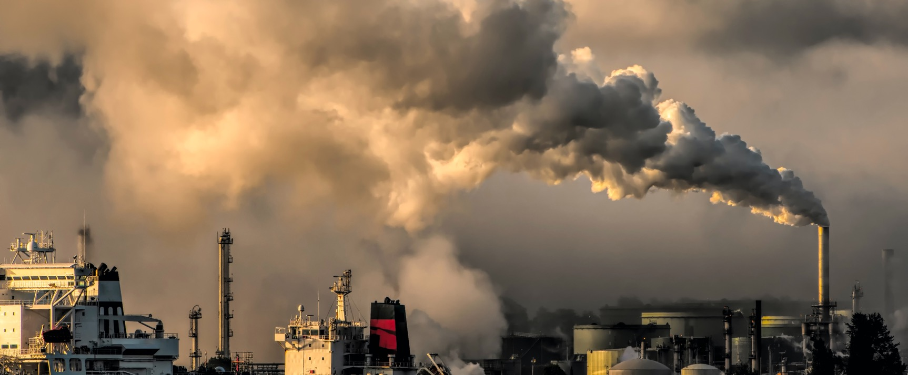
Air Pollution

Slide 5
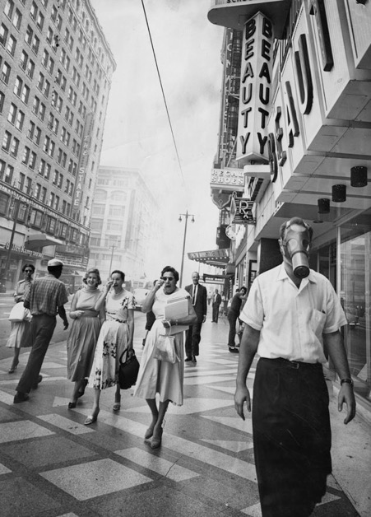
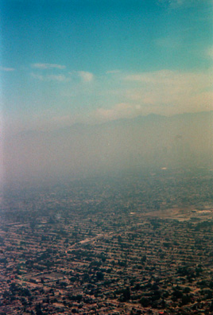
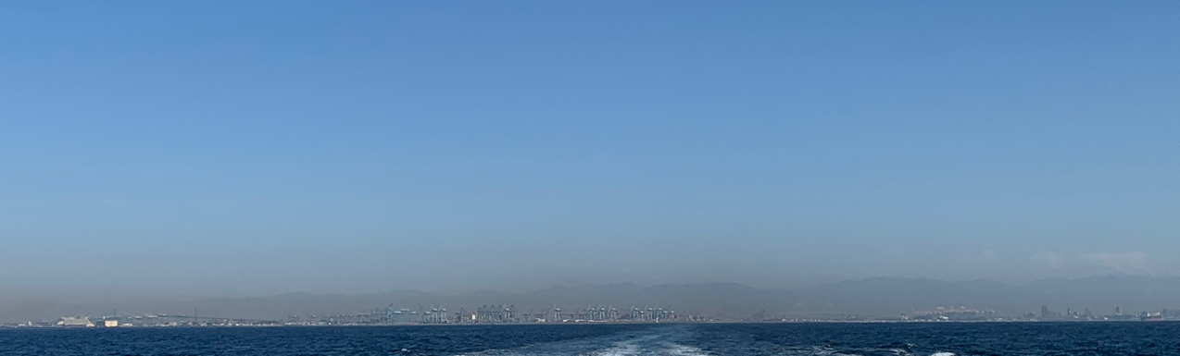
Los Angeles, Sept. 9, 1958
Los Angeles, July 23, 2000
San Pedro California, Sunday, Feb. 19, 2023, 9:30 AM
Notes:
August 22, 1964 photo by Art Worden. Courtesy Los Angeles Public Library, Los Angeles Herald Examiner Collection
July 23, 2000 photo by Mark Z. Jacobson
February 19, 2023, photo by Mark Z. Jacobson

Slide 6
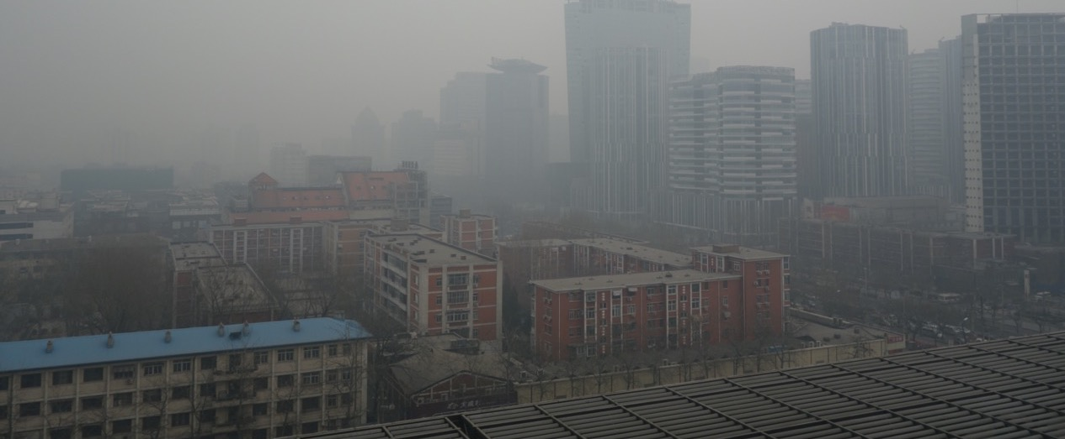
Beijing, China
Notes:
Beijing Air Pollution
Photo uploaded by Kentaro IEMOTO on Feb 22, 2014, under cc-by-sa-2.0 License.
https://commons.wikimedia.org/wiki/File:Beijing_Air_Pollution..._(12691254574).jpg

Slide 7
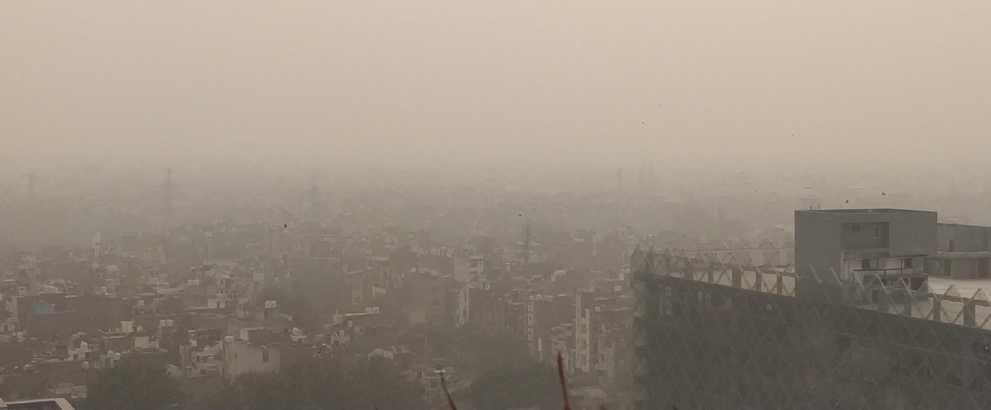
Delhi, India
Notes:
Delhi was suffering from the air pollution. According to reports air is hazardous for people
Photo uploaded by Prami.ap90 on Wikimedia Commons under cc-by-sa-2.0 License, on Nov 15, 2019
https://commons.wikimedia.org/wiki/File:Delhi_air_pollution_2019.jpg

Slide 8
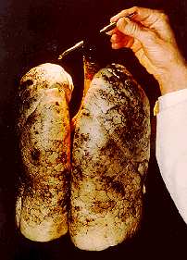
Lung of LA Teenage Nonsmoker in 1970s
Notes:
SCAQMD/CARB

Slide 9
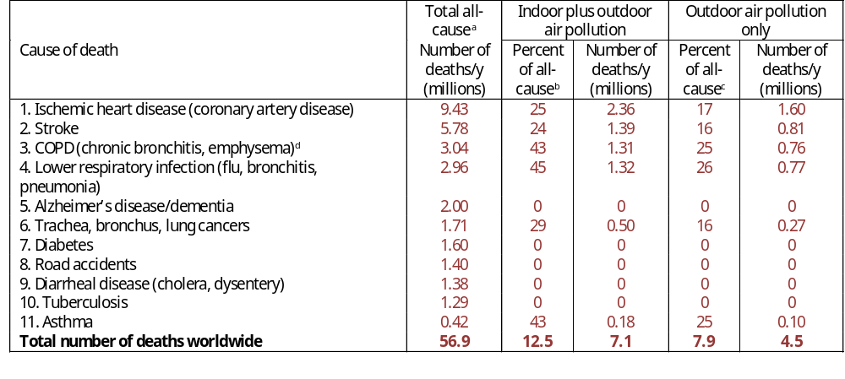
Air Pollution is World’s 2nd Leading Cause of Death
WHO (2017)
Notes:
Table 7.13. Leading causes of death worldwide in 2016. Also shown are the percentage and number of deaths in each category due to indoor plus outdoor air pollution and, separately, outdoor air pollution alone.
ªWHO (2017a).
^{b}WHO (2017b), except that the percentage of lower respiratory infection deaths that are due to indoor plus outdoor air pollution is estimated as the percent of respiratory deaths that are from outdoor air pollution from WHO (2017b) multiplied by the ratio of the percent of deaths from outdoor-plus-indoor to outdoor air pollution for COPD. The asthma percentage is assumed to be the same as the COPD percentage.
^{c}WHO (2017b), except that the percentage of stroke deaths that are due to outdoor air pollution is estimated as the percent of stroke deaths that are from indoor plus outdoor air pollution from WHO (2017b) multiplied by the ratio of the percent of outdoor to indoor-plus-outdoor air pollution for ischemic heart disease. The asthma percentage is assumed to be the same as the COPD percentage.
^{d}Chronic obstructive pulmonary disease (COPD) deaths are due to smoking and air pollution. They exclude asthma deaths, which are added separately.

Slide 10
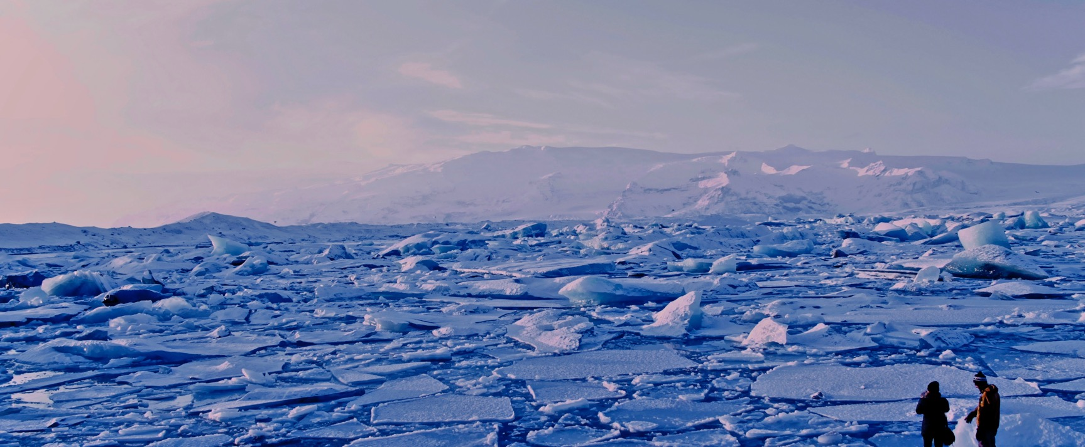
Global Warming

Slide 11
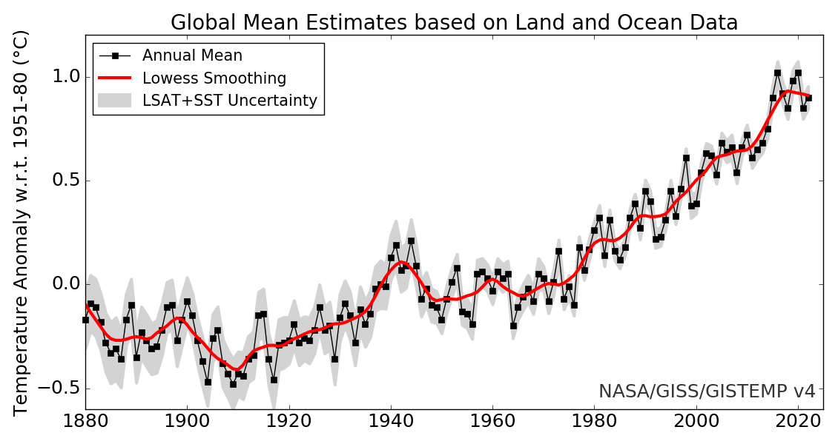
Mean Global Temperature Anomalies
https://data.giss.nasa.gov/gistemp/
GISTEMP Team, 2021: GISS Surface Temperature Analysis (GISTEMP), version 4. NASA Goddard Institute for Space Studies. Dataset accessed 20YY-MM-DD at https://data.giss.nasa.gov/gistemp/.
Lenssen, N., G. Schmidt, J. Hansen, M. Menne, A. Persin, R. Ruedy, and D. Zyss, 2019: Improvements in the GISTEMP uncertainty model. J. Geophys. Res. Atmos., 124, no. 12, 6307-6326, doi:10.1029/2018JD029522.
Notes:
NASA/GISS – relative to 1950-1981 mean.

Slide 12
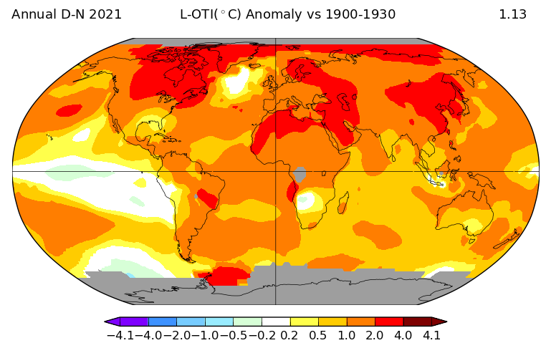
2021 ΔTemperature Versus 1900-1930
https://data.giss.nasa.gov/gistemp/
GISTEMP Team, 2021: GISS Surface Temperature Analysis (GISTEMP), version 4. NASA Goddard Institute for Space Studies. Dataset accessed 20YY-MM-DD at https://data.giss.nasa.gov/gistemp/.
Lenssen, N., G. Schmidt, J. Hansen, M. Menne, A. Persin, R. Ruedy, and D. Zyss, 2019: Improvements in the GISTEMP uncertainty model. J. Geophys. Res. Atmos., 124, no. 12, 6307-6326, doi:10.1029/2018JD029522.
Notes:
NASA/GISS

Slide 13
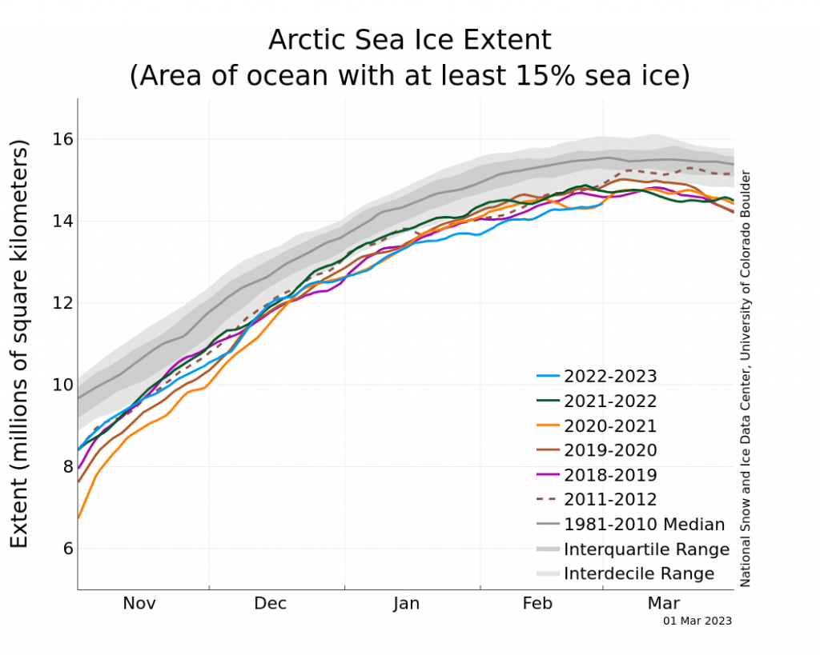
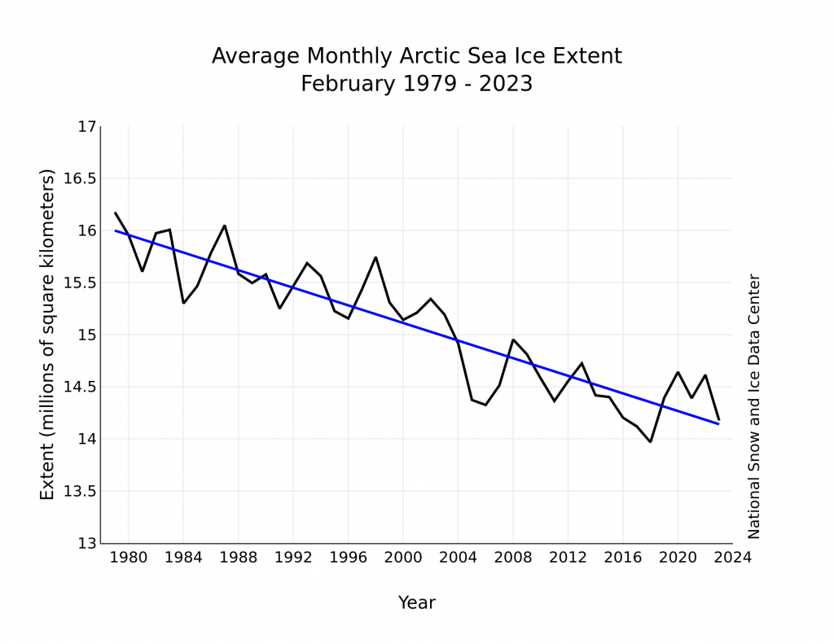
Arctic Sea Ice 2022 Versus 1981-2010 Mean
2.8% loss/decade
42,300 km² loss/year
http://nsidc.org/arcticseaicenews/
Notes:
http://nsidc.org/arcticseaicenews/
66 m of sea level in ice
58.3 m in Antarctic
7.36 m in Greenland
0.43 m in rest of world

Slide 14
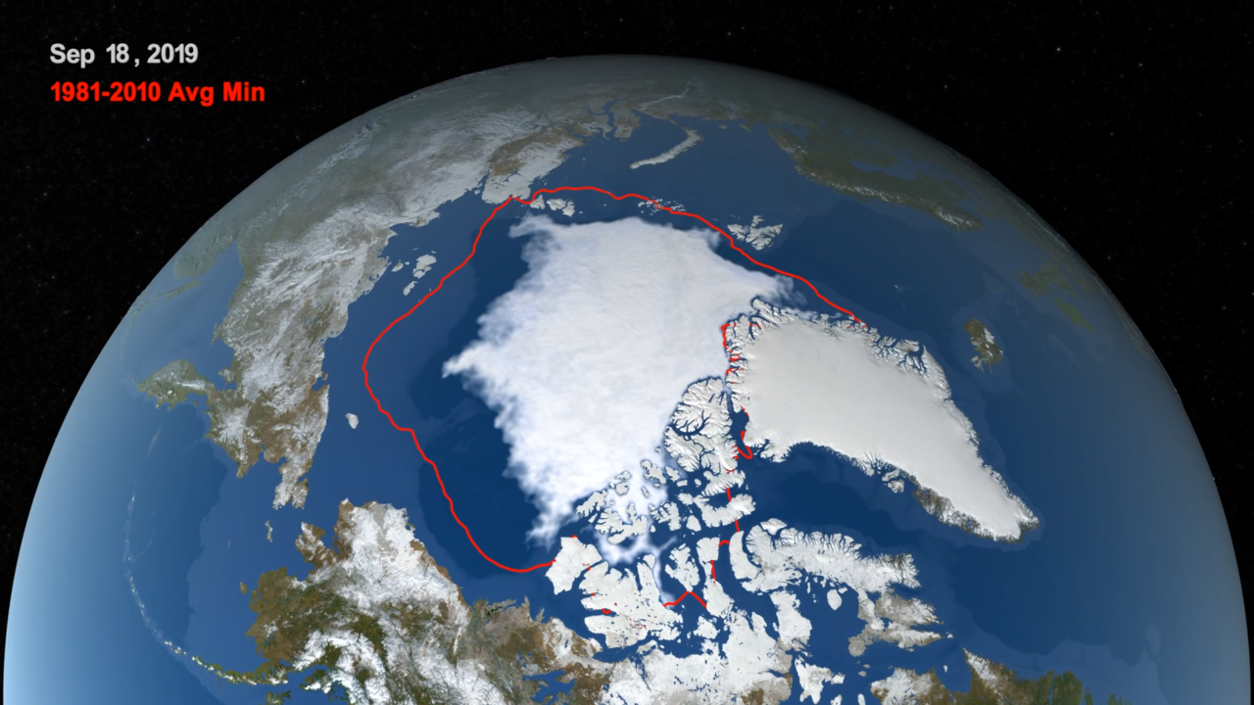
Arctic Sea Ice Decrease
https://climate.nasa.gov/news/2913/2019-arctic-sea-ice-minimum-tied-for-second-lowest-on-record/
Notes:
2019 Arctic Sea Ice Minimum Tied for Second Lowest on Record
https://climate.nasa.gov/news/2913/2019-arctic-sea-ice-minimum-tied-for-second-lowest-on-record/

Slide 15
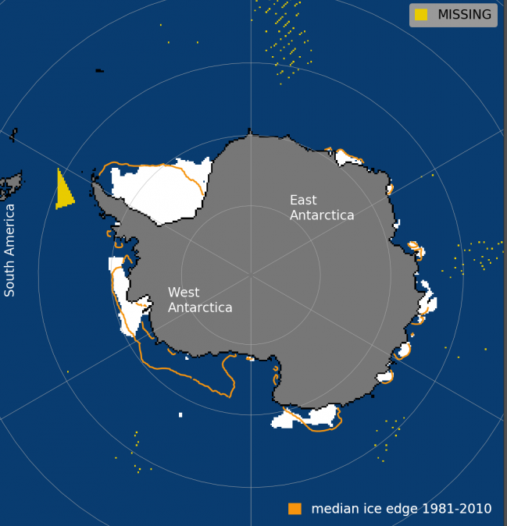
Antarctic Sea Ice Extent Feb. 25, 2022, vs 1981-2010
Orange line = 1981-2010 mean
http://nsidc.org/arcticseaicenews/
Notes:
66 m of sea level in ice
58.3 m in Antarctic
7.36 m in Greenland
0.43 m in rest of world

Slide 16
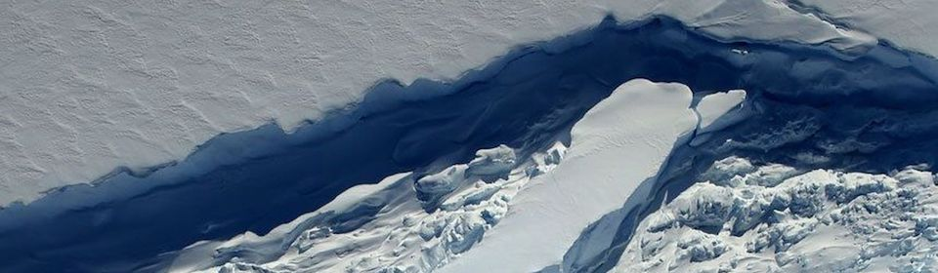
Larson C Ice Shelf Break in Antarctica
Notes:
A growing crack in the Larson C ice shelf by Jefferson A. Beck/NASA, photographed in Sep 2017.
https://www.asoc.org/explore/blog/1965-the-fragility-of-antarctica

Slide 17
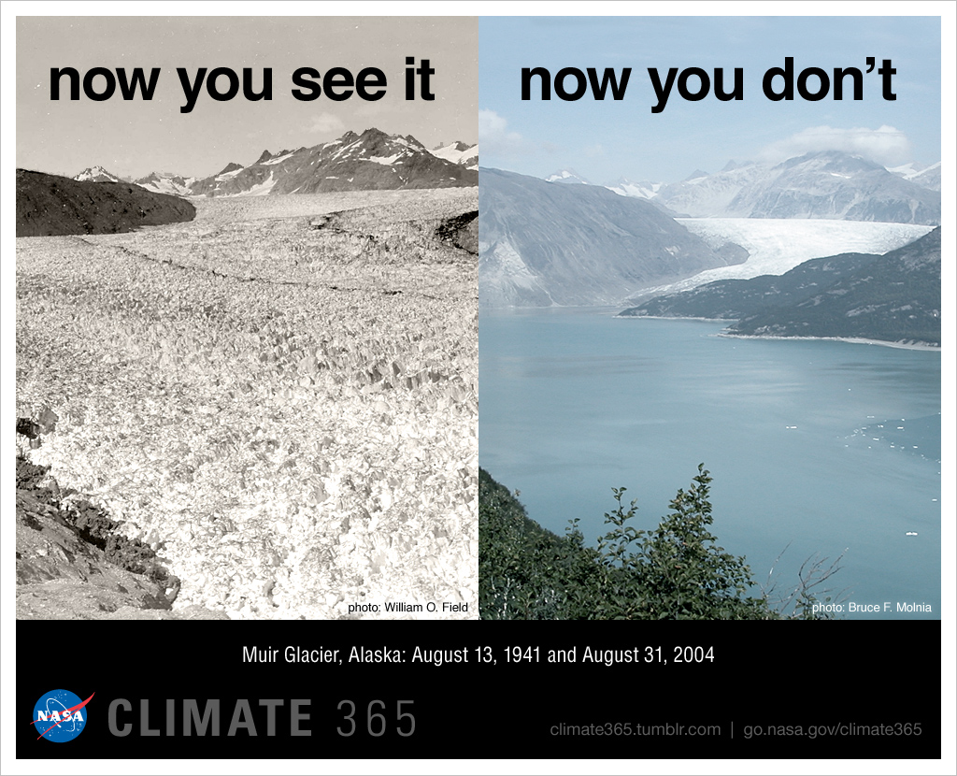
Muir Glacier, Alaska (1941/2004)
Notes:
A. Bobrov/Dreamstime.com

Slide 18
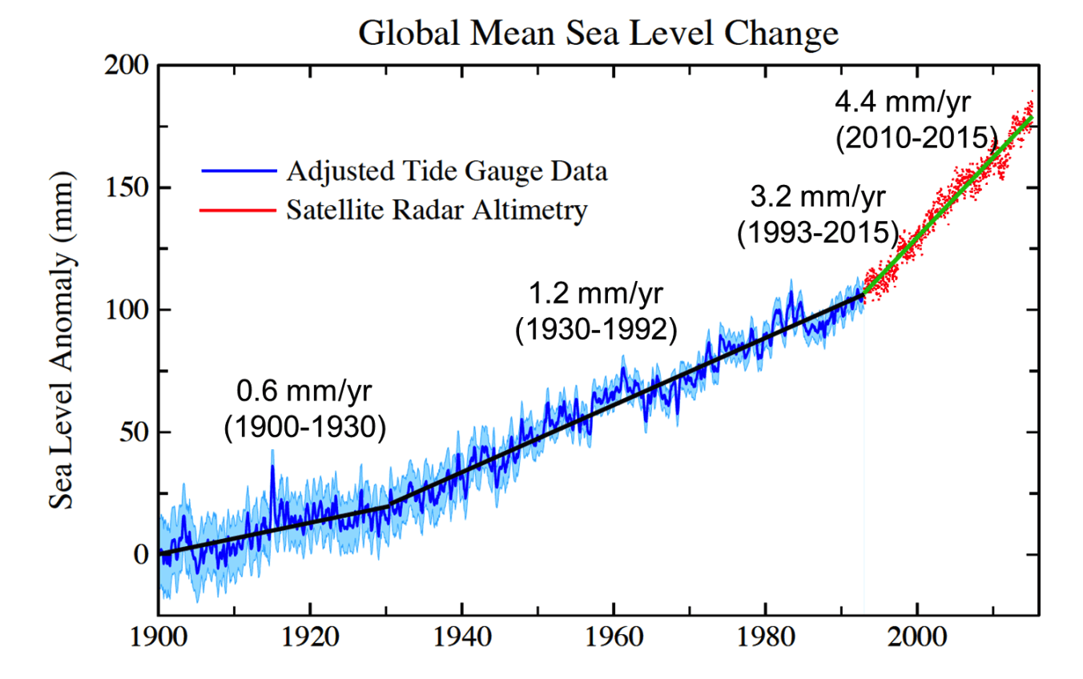
Hay et al. (Nature, 517, 2015)
Notes:
https://i1.wp.com/climateadaptation.hawaii.gov/wp-content/uploads/2015/11/Brief-1-Figure-4.png

Slide 19
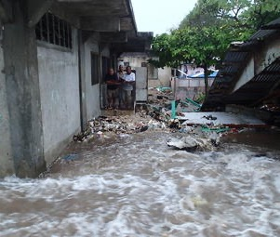
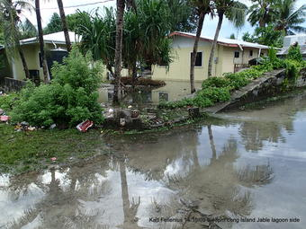
The Marshall Islands, Pacific Ocean
Notes:
Storm surge and king tide flooding
United States Geological Survey, https://www.usgs.gov/centers/pcmsc/science/low-lying-areas-tropical-pacific-islands?qt-science_center_objects=0#qt-science_center_objects

Slide 20
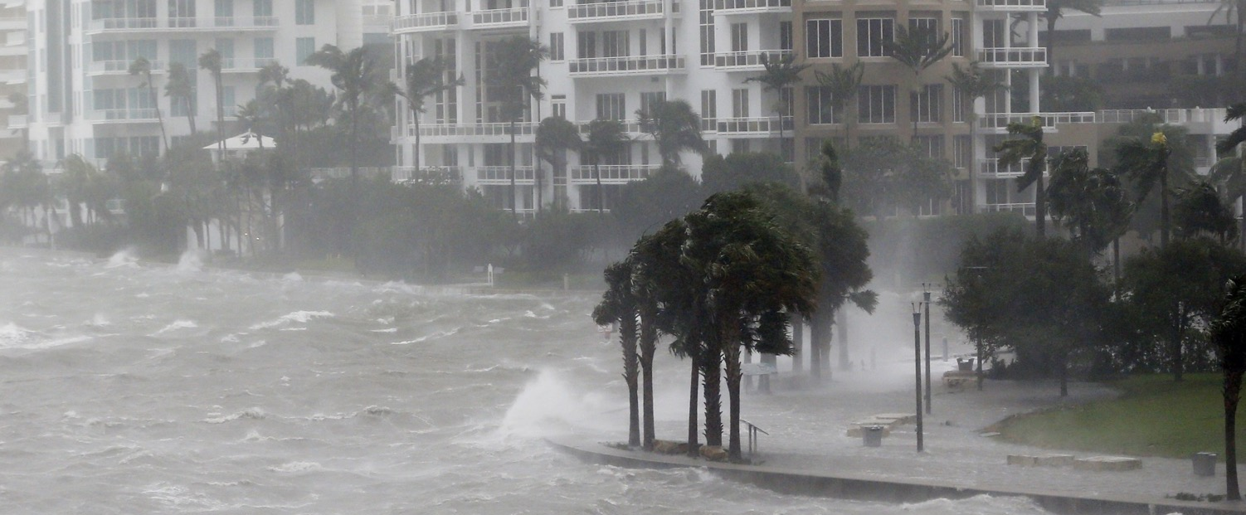
Miami, Florida
Notes:
Hurricane Irma
National Public Radio, https://www.npr.org/2020/06/13/875725714/a-4-6-billion-plan-to-storm-proof-Miami

Slide 21
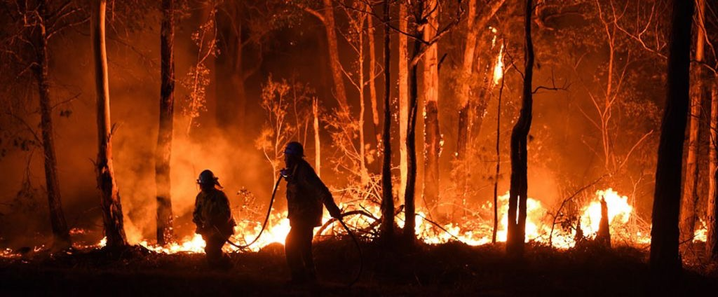
Australia Wildfires 2020
Notes:
https://www.pbs.org/wnet/nature/blog/australia-wildfire-wcs/

Slide 22
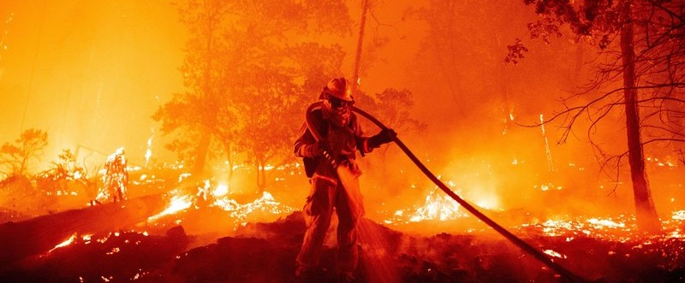
California Wildfires 2020
Notes:
https://www.npr.org/2020/09/04/909668879/whats-driving-california-s-biggest-ever-wildfire-season

Slide 23
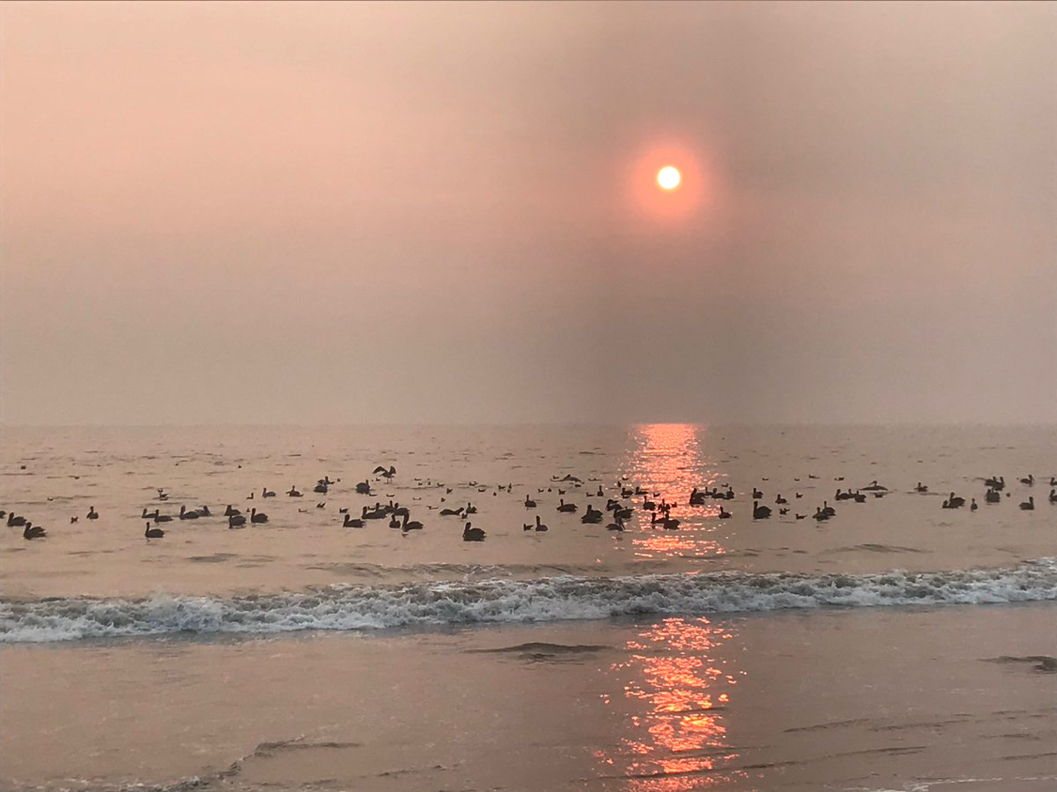
California
Wildfires 2018
Notes:
November 10, 2018, Rio Del Mar Beach, California – Late afternoon discoloration of the sun due to wildfire smoke
By Mark Z. Jacobson

Slide 24
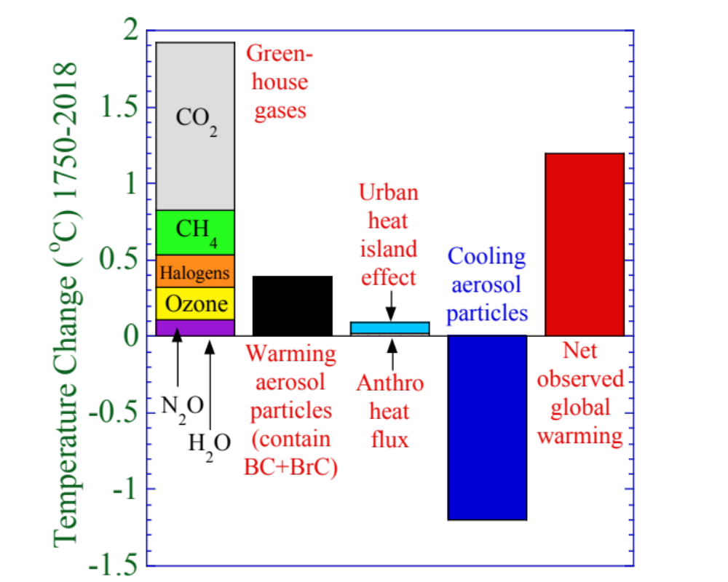
Contributors to Observed Global Warming
Notes:
Figure 1.2. Estimated primary contributors to net observed global warming from 1750 to 2018.
Results are based on global model calculations (Jacobson and Ten Hoeve, 2012; Jacobson, 2014; Russell et al., 2018) and radiative forcing data for greenhouse gases from Myhre et al. (2013). Greenhouse gases are discussed in Section 1.2.1. Warming aerosol particles include black carbon (BC) and brown carbon (BrC) from fossil fuel, biofuel, and open biomass burning sources (Section 1.2.2). Cooling aerosol particle components include primarily sulfate, nitrate, chloride, ammonium, sodium, potassium, calcium, magnesium, weakly absorbing organic carbon, and water. Section 1.2.4 describes the urban heat island effect. Its contribution to warming is from Jacobson and Ten Hoeve (2012). Section 1.2.3 discusses anthropogenic heat fluxes. Their contribution to warming is from Jacobson (2014). Net observed warming is from NASA (2018) using November 2016 to October 2017 average surface temperatures versus 1900 to 1930 average temperatures. Of all the warming in the figure 45.7 percent is due to CO₂, 16.3 percent is due to BC+BrC, 12 percent is due to CH₄, 9.0 percent is due to halogens, 8.8 percent is due to ozone, 4.3 percent is due to N₂O, 3.0 percent is due to the urban heat island effect, 0.7 percent is due to anthropogenic heat flux, and 0.23 percent is due to anthropogenic H₂O.

Slide 25

Energy Insecurity

Slide 26
Four Types of Energy Insecurity
Economic, social, and political instability due to the fact fossil fuels and uranium are limited resources.
Risk of severe power disruption due to the use of large, centralized plants rather than distributed energy (e.g., wind and solar).
Risk of energy supply disruption and price swings due to relying on fuel mined outside of a country.
Environmental degradation due to fossil fuel and uranium mining; meltdown, waste, and weapons risk due to nuclear energy.

