Slide 1

100% Clean, Renewable Energy and Storage for Everything
Mark Z. Jacobson
Stanford University

Slide 2

Chapter 7:
Steps in Developing 100 Percent WWS and Storage Roadmaps

Slide 3
Wind, Water, Solar (WWS) Solution
Electrify or Provide Direct Heat For All Sectors and Provide the Electricity and Heat with 100% WWS
ELECTRICITY TRANSPORTATION HEATING/COOLING INDUSTRY
Wind Battery-electric Electric heat pumps Electric arc furnaces
Solar PV/CSP Hydrogen fuel cell District heat/cold Induction furnaces
Geothermal Geothermal heat Resistance furnaces
Hydro Solar heat Dielectric heaters
Tidal/Wave Electron beam heaters
Heat pumps

Slide 4
Types of Storage for a 100% WWS System
ELECTRICITY HEATING/COOLING OTHER
CSP with storage Water tank Non-grid hydrogen
Pumped storage hydro Ice
Hydroelectric Underground
Batteries Borehole
Flywheels Water Pit
Compressed air Aquifer
Gravitational storage Building materials
Hydrogen storage & fuel cells

Slide 5

Can the World Transition to 100%, Clean, Renewable Energy for all Purposes?
How to Build Roadmaps for Countries or States

Slide 6
End-Use Versus Primary Energy
Primary Energy
Energy embodied in chemical bonds of raw fuels – coal, oil, natural gas, uranium, or in renewable (e.g., wind, solar, hydro, geothermal) electricity
End-use Energy (Final Consumption)
Energy used directly by a consumer after it is converted from primary energy and transmission/distribution losses are accounted for.
Energy embodied in electricity after T&D losses; natural gas after pipeline losses; and gasoline, diesel, and jet fuel after they are refined from oil.

Slide 7
End-Use Versus Primary Energy
Electricity sector
End-use energy is primary energy minus energy lost during generation, transmission, and distribution.
For coal, only 1/3 of chemical energy in coal is converted to electricity. Rest is waste heat. More electricity is lost during T&D.
For hydro, end-use energy is electricity generation minus T&D losses.
Transportation sector
Primary energy is energy in oil.
End-use energy is energy in oil minus the energy to refine oil to gasoline and transport gasoline to its end use.

Slide 8

Steps in Developing a Roadmap

Slide 9
Steps in Developing a Roadmap
1) Project end-use BAU energy demand to a future year (e.g., 2050) in each energy sector (electricity, transportation, building heating/cooling, industry)
2) Convert BAU energy to electricity, electrolytic hydrogen, or direct heat and apply energy efficiency measures
3) Calculate reduction in end-use demand due to a transition
4) Perform a WWS resource analysis
5) Estimate numbers of WWS devices to provide electricity and heat

Slide 10
Steps in a Developing a Roadmap
6) Estimate avoided energy, air pollution, and climate costs of a transition
7) Perform a grid analysis to ensure the grid can stay stable (Chapter 8)
8) Estimate job creation and lost due to a transition (Chapter 8)
9) Estimate footprint and spacing areas of WWS generators (Chapter 8)
10) Create a timeline for a transition (Chapter 9)
11) Propose policy mechanisms to affect a transition (Chapter 9)

Slide 11
Plug-to-Wheel Efficiency of Battery Electric Vehicle
Type of Efficiency | Low | High
Battery charging | 0.8 | 0.96
Battery discharging | 0.98 | 0.99
DC to AC inverter/wiring/power electronics | 0.97 | 0.98
Electric AC motor | 0.84 | 0.96
Overall | 0.64 | 0.89
Tank-to-wheel efficiency of ICE vehicle | 0.17 | 0.20
Ratio of ICE:BE efficiency | 0.19:1* | 0.31:1
*2050 estimate
Notes:
A BE vehicle, on the other hand converts 64 to 89 percent of electricity at the plug (before charging the car) into motion (plug-to-wheel efficiency), and the rest is waste heat. This efficiency is determined as follows and summarized in Table 7.2.
First, a permanent magnet electric motor has an efficiency of 89 to 96 percent. An induction electric motor has an efficiency of 84 to 94 percent (Bistak and Kim, 2017). Thus, the range of efficiencies of electric car motors is 84 to 96 percent. Whereas the Tesla Model S and Model X use an induction motor, the Tesla Model 3, for example, uses a permanent magnet motor.
In addition, efficiency losses occur due to converting electricity from the grid to chemical energy in a battery. These vehicle-charging losses can range from 4 to 20 percent of the electricity going into the battery, depending on the current and voltage used to charge the vehicle. Another 1 to 2 percent of energy is also lost during conversion of the battery’s chemical energy to DC electricity. In addition, 2 to 3 percent is lost converting DC to AC electricity in an inverter, adjusting the voltage for use in the motor, and using power electronic controls in the vehicle. Inverter losses are only 1 percent of energy (thus an efficiency of up to 99 percent) when the inverter uses silicon carbide as the semiconductor material (Rahman et al., 2016).
Accounting for all losses give the overall plug-to-wheel efficiency of a battery electric passenger vehicle as 64 to 89 percent, with an average of 77 percent (Table 7.2).
*=Assumed based on 2050 technology.

Slide 12
Plug-to-Wheel Efficiency of HFC Vehicle
Type of Efficiency | Low | High
Electrolyzer | 0.74 | 0.95
Compressor | 0.9 | 0.9
Hydrogen leakage | 0.99 | 0.997
Fuel cell effic. producing DC electricity | 0.5 | 0.7
Fuel cell latent heat loss | 0.846 | 0.846
DC to AC inverter/wiring/power electronics | 0.97 | 0.98
Electric AC motor | 0.84 | 0.96
Overall | 0.23 | 0.47
Tank-to-wheel efficiency of ICE vehicle | 0.17 | 0.20
Ratio of ICE:HFC efficiency | 0.36* | 0.87
*2050 estimate
Notes:
*=Assumed based on 2050 technology.

Slide 13
Factors to Multiply BAU End-Use Energy By to Obtain WWS Energy Needed
Fuel | Residential | Industrial | Transportation*
Oil | 0.2 | 0.82 | 0.19 or 0.36
Natural gas | 0.2 | 0.82 | 0.19 or 0.36
Coal | 0.2 | 0.82 | --
Electricity | 1 | 1 | 1
Heat for sale | 0.25 | 0.25 | --
WWS heat | 1 | 1 | --
Biofuels/waste | 0.2 | 0.82 | 0.19
* Conversion to BE or HFC vehicles

Slide 14
Heat Pump Versus Gas Boiler Efficiency
Coefficient of Performance | Low | High | Avg.*
Gas boiler | 0.8 | 0.8
Electric resistance heater | 0.97 | 0.97
Waste heat of combustion | 1.0 | 1.0
Ground source heat pump | 4.2 | 5.2
Air source heat pump | 3.2 | 4.5
Overall heat pump range | 3.2 | 5.2
Ratio gas boiler-to-electric resistance efficiency | 0.82 | 0.82 | 0.82
Ratio waste heat-to-heat pump efficiency | 0.31 | 0.19 | 0.25
Ratio gas boiler-to-heat pump efficiency | 0.25 | 0.15 | 0.20
*2050 estimate
Notes:
A BE vehicle, on the other hand converts 64 to 89 percent of electricity at the plug (before charging the car) into motion (plug-to-wheel efficiency), and the rest is waste heat. This efficiency is determined as follows and summarized in Table 7.2.
First, a permanent magnet electric motor has an efficiency of 89 to 96 percent. An induction electric motor has an efficiency of 84 to 94 percent (Bistak and Kim, 2017). Thus, the range of efficiencies of electric car motors is 84 to 96 percent. Whereas the Tesla Model S and Model X use an induction motor, the Tesla Model 3, for example, uses a permanent magnet motor.
In addition, efficiency losses occur due to converting electricity from the grid to chemical energy in a battery. These vehicle-charging losses can range from 4 to 20 percent of the electricity going into the battery, depending on the current and voltage used to charge the vehicle. Another 1 to 2 percent of energy is also lost during conversion of the battery’s chemical energy to DC electricity. In addition, 2 to 3 percent is lost converting DC to AC electricity in an inverter, adjusting the voltage for use in the motor, and using power electronic controls in the vehicle. Inverter losses are only 1 percent of energy (thus an efficiency of up to 99 percent) when the inverter uses silicon carbide as the semiconductor material (Rahman et al., 2016).
Accounting for all losses give the overall plug-to-wheel efficiency of a battery electric passenger vehicle as 64 to 89 percent, with an average of 77 percent (Table 7.2).

Slide 15
All-Purpose End-Use Power Demand
Year and Fuel Type | 143-Countries
2016 End-use demand | 12.6 TW
2050 Demand with current fuels (BAU) | 20.3 TW
2050 Demand with WWS | 8.7 TW
2050 Demand reduction w/ WWS 21.7% efficiency of BE, HFC v. ICE 3.4% efficiency of electric industry 13.2% efficiency of heat pumps 12.1% eliminating fuel mining 6.6% efficiency beyond BAU | 57.1%
Notes:
Source?

Slide 16
Timeline
for a Transition
Notes:
The percent WWS is after grid stability is accounted for (thus the final percent)
Figure 9.5. Timeline for 143 countries, representing 99.7 percent of world emissions, to transition from conventional fuels (BAU) to 100 percent wind-water-solar (WWS) in all energy sectors. Also shown are the annually averaged end-use power demand reductions that occur along the way. The energy sectors transitioned include the electricity, transportation, building heating/cooling, industrial, agriculture/forestry/fishing, and military sectors. The percentages next to each WWS energy source are the 2050 estimated percent supply of end-use power by the source. The 100 percent demarcation in 2050 indicates that 100 percent of end-use power in the annual average will be provided by WWS among all energy sectors by no later than 2050, but ideally sooner. An 80 percent transition is proposed to occur by no later than 2030. End-use power demand reductions occur for five reasons: (1) the efficiency of moving low-temperature building heat with heat pumps instead of creating heat with combustion; (2) the efficiency of electricity over combustion for high-temperature industrial heat; (3) the efficiency of electricity in battery-electric (BE) vehicles and in electrolytic hydrogen fuel cell (HFC) vehicles over combustion vehicles for transportation; (4) eliminating the energy to mine, transport, and process fossil fuels, biofuels, bioenergy, and uranium; and (5) improving end-use energy efficiency and reducing energy use beyond in the BAU case. The total demand reduction due to these factors is 57.1 percent (Table 7.1). From Jacobson et al. (2019).

Slide 17
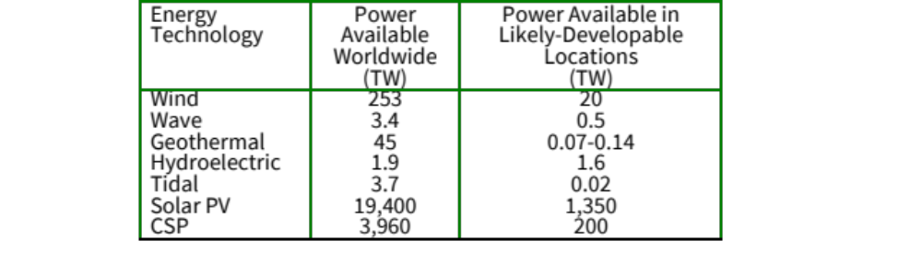
World WWS Resources
Notes:
Table 7.4. Power available in wind, water, and solar (WWS) energy resources if the energy were used in electricity generation devices worldwide and in likely developable locations. Also shown is the 2017 delivered electricity from WWS resources. All values are before transmission and distribution losses.

Slide 18
Rooftop Areas Available Among 145 Countries
Technology | Residential | Commercial/Govt.
Rooftop area suitable for PV* | 116,000 km² | 49,000 km²
Potential nameplate PV | 27.8 TW_{dc} | 11.7 TW_{dc}
Potential delivered PV | ~5.0 TW_{dc} | ~2.1 TW_{dc}
*Already excludes fire access and walking space areas
Notes:
Table 7.5. Residential and commercial/government rooftop areas suitable for solar PV panels and potential nameplate capacity of suitable rooftop areas, by country. From Jacobson et al. (2022).

Slide 19

Determining the Levelized Cost of Electricity

Slide 20
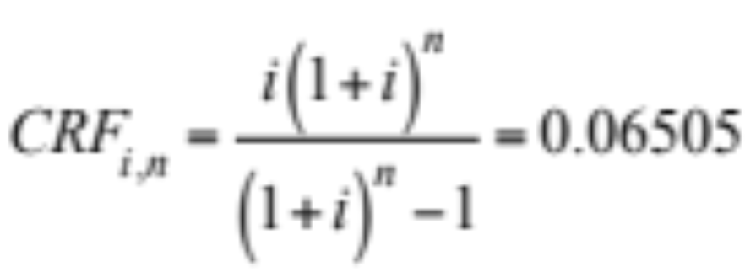
Capital Recovery Factor
Annual payment (A) = Present value (P) x Capital Recovery Factor (CRF)
What is the annual payment (A) on a P = $100,000 loan at i=5% interest over n = 30 years?
A = P x CRF = $100,000 x 0.06505 = $6,505 per year

Slide 21
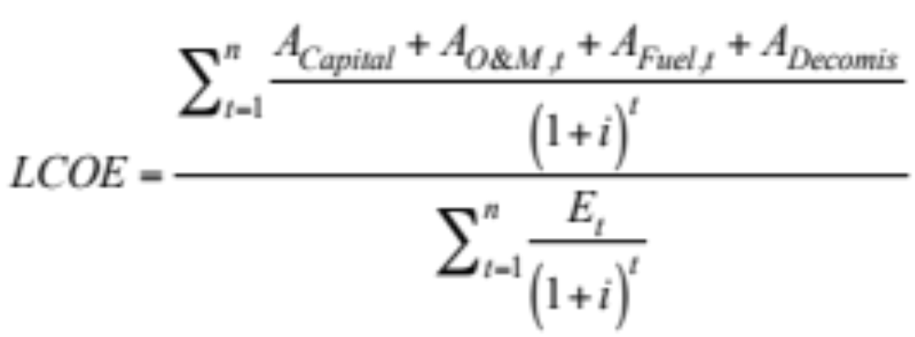
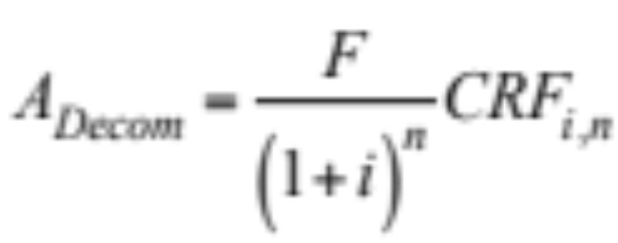
Annual Payments Example
A_{Capital} = annualized up-front capital cost
A_{O&M} = annual operation and maintenance cost
A_{Fuel,t} = annual fuel cost
A_{Decomis} = annualized future decommissioning cost
Annualized up-front cost = Present value (P) x cost recovery factor CRF
Annualized future cost

Slide 22
2022 U.S. Unsubsidized Private Levelized Cost of Energy (¢/kWh)
Wind onshore 2.4 to 7.5
Wind offshore 5.6 to 10.6
Geothermal 6.1 to 10.2
Hydroelectric 5.9 to 8.9
CSP with 18 hr storage 12.6 to 15.6
Utility-scale solar PV 2.4 to 9.6
Community rooftop PV 4.9 to 18.5
Residential rooftop PV 11.7 to 28.2
Gas combined cycle 3.9 to 10.1
Gas for peaking 11.5 to 22.1
Advanced pulverized coal 6.8 to 16.6
Nuclear 14.1 to 22.1
Lazard (2023)
Notes:
Table 7.9. Components of the unsubsidized levelized cost of electricity (LCOE) for several new WWS and BAU electricity generation technologies in the U.S. in 2020. The analysis is a private cost analysis (see footnote). All costs are in 2021 U.S. dollars.
https://www.lazard.com/research-insights/2023-levelized-cost-of-energyplus/

Slide 23
Social vs. Private Discount Rate
Private discount rate. Interest rates banks charge builders and consumers for taking out loans. It is also the opportunity cost of capital, or the rate of return of investing capital in a market.
Appropriate only for relatively short-term projects that dollar-for-dollar crowd out private investment. 5-8.4% in 2023
Social discount rate. Discount rate used in social cost analyses (accounting for energy, health, and climate costs). Used when the costs and benefits of a project occur at different times and over more than one generation (intergenerational projects). 181 experts suggest 1-3%.

Slide 24
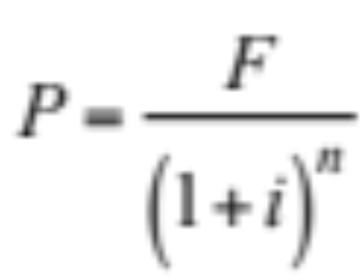
Social Versus Private Discount Rate
What is the present value (P) of F=$750 in damage that occurs in n=20 years from
1 tonne CO₂ emitted today using a private (6%) and social (2%) discount rate?
Private discount rate: P = $750 / (1 + 0.06)²⁰ = $234
Social discount rate: : P = $750 / (1 + 0.02)²⁰ = $505

Slide 25
Social vs. Private Discount Rate for Wind
Assume P_{r}=1,500 kW turbine, D=77 m blade, V_{m}=7.5 m/s, capital cost $1,300/kW, 10% energy losses, construction time 1 y, and lifetime 30 y. Compare cost w/social vs private discount rate of 2% vs. 6%.
CF = Capacity Factor (0.087 x V_{m} - P_{r}/D² ) = 0.4
Energy before losses = P_{r} x 8,760 h/y x CF = 5.25 million kWh/y
Energy after 10% loss & assuming 1 out of 31 y with no energy = 4.57 million kWh/y
CRFs for discount rates of 2 and 6% over 31 years = 0.0436 - 0.0718
Annual cost of capital = CRF x $1,300/kW x 1,500 kW = $85,000 - $140,000/y
Annual O&M @ $30/kW-y = $45,000 - $45,000/y
Decomissioning cost @$13/kW in final year = $460 - $230/y
Total Cost = $130,500 - $185,200/y
Cost/Unit Energy = 2.9 - 4.1 cents/kWh

Slide 26

Social Costs of Air Pollution Mortality and Carbon

Slide 27
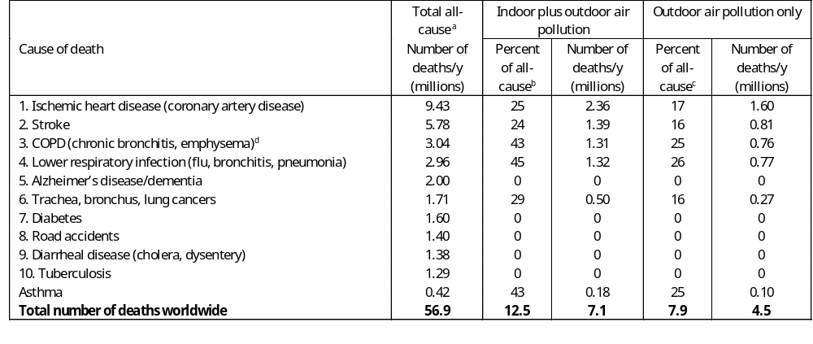
Air Pollution World’s 2nd Leading Cause of Death
July 15, 2012 by DS Jacobson
Notes:
Ischemia is a condition in which the blood flow (and thus oxygen) is restricted or reduced in a part of the body. Cardiac ischemia is the name for decreased blood flow and oxygen to the heart muscle.
long-term exposure to particulate matter and nitrogen oxides at levels close to the National Ambient Air Quality Standards (NAAQS) can prematurely age blood vessels and contribute to a more rapid buildup of calcium in the coronary artery.
A stroke is a sudden interruption in the blood supply of the brain. Most strokes are caused by an abrupt blockage of arteries leading to the brain (ischemic stroke). Other strokes are caused by bleeding into brain tissue when a blood vessel bursts (hemorrhagic stroke).
Chronic obstructive pulmonary disease (COPD) is a chronic inflammatory lung disease that causes obstructed airflow from the lungs. Symptoms include breathing difficulty, cough, mucus (sputum) production and wheezing. It's typically caused by long-term exposure to irritating gases or particulate matter, most often from cigarette smoke. People with COPD are at increased risk of developing heart disease, lung cancer and a variety of other conditions.
Emphysema and chronic bronchitis are the two most common conditions that contribute to COPD. These two conditions usually occur together and can vary in severity among individuals with COPD.
Chronic bronchitis is inflammation of the lining of the bronchial tubes, which carry air to and from the air sacs (alveoli) of the lungs. It's characterized by daily cough and mucus (sputum) production.
Emphysema is a condition in which the alveoli at the end of the smallest air passages (bronchioles) of the lungs are destroyed as a result of damaging exposure to cigarette smoke and other irritating gases and particulate matter.
Although COPD is a progressive disease that gets worse over time, COPD is treatable. With proper management, most people with COPD can achieve good symptom control and quality of life, as well as reduced risk of other associated conditions.
Bronchitis is an inflammation of the lining of your bronchial tubes, which carry air to and from your lungs. People who have bronchitis often cough up thickened mucus, which can be discolored. Bronchitis may be either acute or chronic.
Pneumonia is an infection in one or both lungs. Bacteria, viruses, and fungi cause it. The infection causes inflammation in the air sacs in your lungs, which are called alveoli. The alveoli fill with fluid or pus, making it difficult to breathe. Read on to learn more about pneumonia and how to treat it.
Asthma is a condition in which your airways narrow and swell and produce extra mucus. This can make breathing difficult and trigger coughing, wheezing and shortness of breath.
For some people, asthma is a minor nuisance. For others, it can be a major problem that interferes with daily activities and may lead to a life-threatening asthma attack.
Asthma can't be cured, but its symptoms can be controlled. Because asthma often changes over time, it's important that you work with your doctor to track your signs and symptoms and adjust treatment as needed.
Table 7.13. Leading causes of death worldwide in 2016. Also shown are the percentage and number of deaths in each category due to indoor plus outdoor air pollution and, separately, outdoor air pollution alone.
ªWHO (2017a).
^{b}WHO (2017b), except that the percentage of lower respiratory infection deaths that are due to indoor plus outdoor air pollution is estimated as the percent of respiratory deaths that are from outdoor air pollution from WHO (2017b) multiplied by the ratio of the percent of deaths from outdoor-plus-indoor to outdoor air pollution for COPD. The asthma percentage is assumed to be the same as the COPD percentage.
^{c}WHO (2017b), except that the percentage of stroke deaths that are due to outdoor air pollution is estimated as the percent of stroke deaths that are from indoor plus outdoor air pollution from WHO (2017b) multiplied by the ratio of the percent of outdoor to indoor-plus-outdoor air pollution for ischemic heart disease. The asthma percentage is assumed to be the same as the COPD percentage.
^{d}Chronic obstructive pulmonary disease (COPD) deaths are due to smoking and air pollution. They exclude asthma deaths, which are added separately.

Slide 28
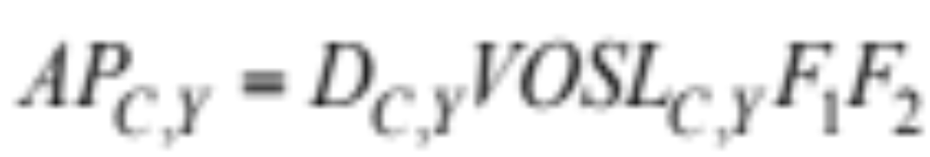
Cost of Air Pollution Mortality and Morbidity
AP = Air pollution cost ($/y) in country C in year Y
D = Air pollution deaths/y
VOSL = Value of statistical life ($/death)
F₁ = Ratio of VOSL+morbidity costs to VOSL alone ≈ 1.15
F₂ = Ratio of health+non-health costs to health costs ≈ 1.1
Notes:
The total annual damage cost ($/y USD) of air pollution due to conventional fuels (fossil fuel and biofuel combustion and evaporative emissions) in a country is estimated as
(Jacobson et al., 2017), where D_{C,Y} is the air pollution premature mortality rate (deaths/y) in country C in target year Y, VOSL_{C,Y} is the value of statistical life ($/death) in the country and for the target year, F₁ is the ratio of mortality plus morbidity (illness) costs to mortality costs alone, and F₂ is the ratio of health cost (mortality plus morbidity costs) plus non-health costs to health costs alone. Non-health costs include costs due to animal health impacts, lost visibility, reduced agricultural output, and corrosion to building materials and works of art. Table 7.15 gives low, medium, and high estimates of F₁ and F₂. These are held constant for all countries and years.
The value of statistical life is a widely used metric determined by economists to assign the cost of reducing mortality risk. It is the value of reducing 1 statistical mortality in a population. For example, if the average person in a city of 100,000 is willing to pay $75 to reduce her or his mortality risk by 1/100,000th, the statistical value of reducing one mortality is $7.5 million. The value of statistical life is also determined from how much more employers pay their workers who have a higher risk of dying on the job.

Slide 29

Social Cost of Carbon
July 15, 2012 by DS Jacobson
Table 7.16
Notes:
Table 7.17. Low, mid, and high estimates of the social cost of carbon (SCC).
Units of the SCC are USD per metric tonne-CO₂e. From Jacobson et al. (2017).
Climate change damage costs include costs arising from higher sea levels (coastal infrastructure losses), reduced crop yields for certain crops, more intense hurricanes, more droughts and floods, more wildfires and air pollution, more migration due to crop losses and famine, more heat stress and heat stroke, more disease of certain types, fishery and coral reef losses, and greater air cooling requirements, among other impacts. Only a portion of these costs is offset by lower heating requirements and higher yields of some crops.

Slide 30
2050 World (145 Countries) BAU vs WWS Cost
BAU fuel energy cost $17.8 trillion/yr
BAU fuel health cost $33.6 trillion/yr
BAU fuel climate cost $31.8 trillion/yr
BAU total social cost $83.2 trillion/yr
WWS total social cost $6.6 trillion/yr
WWS reduces energy cost 63% and economic (social) cost 92%
Jacobson et al. (2022)

Slide 31

Cost of Hydrogen Versus Gasoline

Slide 32
Cost of Using Hydrogen Versus Gasoline
Electrolyzer cost
Compresser cost
Hydrogen storage cost
Electricity cost for electrolyzer and compressor
Water cost
Overall cost of hydrogen fuel
Comparison with the cost of gasoline fuel
Notes:
Table 7.12. Calculation of the cost of producing, compressing, and using hydrogen for an HFC passenger vehicle and comparison with the fuel cost of driving a gasoline vehicle.

Slide 33
Hydrogen Electrolyzer Cost
a) Energy to make H₂ by electrolysis 53.4 kWh/kg-H₂
b) Electrolyzer capital cost $300-450/kW
c) Electrolyzer lifetime 19-10 years
d) Social/private discount rate 2-5%
e) Capital recovery factor 0.064-0.130
f) Installation factor to multiply capital cost 1.2-1.3
g) Operation and maintenance cost 1.5% of capital cost
h) Electrolyzer use factor 50-95%
i) Hours per year 8,760
j) Overall electrolyzer cost [ba(ef+g)/(hi)] $(0.34-0.53)/kg-H₂
Notes:
Table 7.12. Calculation of the cost of producing, compressing, and using hydrogen for an HFC passenger vehicle and comparison with the fuel cost of driving a gasoline vehicle.
M.Z. Jacobson, W.G. Colella,and D.M. Golden, Cleaning the air and improving health with hydrogen fuel cell vehicles, Science 308 (2005) 1901-1905
DOE (Department of Energy), DOE technical targets for hydrogen production from electrolysis, https://energy.gov/eere/fuelcells/doe-technical-targets-hydrogen-production-electrolysis
NREL (National Renewable Energy Laboratory), Hydrogen station compression, storage, and dispensing technical status and costs, https://www.nrel.gov/docs/fy14osti/58564.pdf
Compressor costs are calculated assuming a capital cost of $400,000-$515,000 for a compression rate of 33 kg-H₂/hour from 20 to 350 bars followed by dry running piston compressing up to 950 bars

Slide 34
Hydrogen Compressor Cost
a) Compressor capital cost $400,000-515,000
b) Compression rate (kg-H₂/hr) 33
c) Compressor lifetime 19-10 years
d) Social/private discount rate 2-5%
e) Capital recovery factor 0.064-0.13
f) Installation factor to multiply capital cost 1.2-1.3
g) Operation and maintenance cost 1.5% of capital cost
h) Compressor use factor 50-95%
i) Hours per year 8,760
j) Resulting compressor cost [a(ef+g)/(bhi)] $(0.25-0.34)/kg-H₂
Notes:
Table 7.12. Calculation of the cost of producing, compressing, and using hydrogen for an HFC passenger vehicle and comparison with the fuel cost of driving a gasoline vehicle.
M.Z. Jacobson, W.G. Colella,and D.M. Golden, Cleaning the air and improving health with hydrogen fuel cell vehicles, Science 308 (2005) 1901-1905
DOE (Department of Energy), DOE technical targets for hydrogen production from electrolysis, https://energy.gov/eere/fuelcells/doe-technical-targets-hydrogen-production-electrolysis
NREL (National Renewable Energy Laboratory), Hydrogen station compression, storage, and dispensing technical status and costs, https://www.nrel.gov/docs/fy14osti/58564.pdf
Compressor costs are calculated assuming a capital cost of $400,000-$515,000 for a compression rate of 33 kg-H₂/hour from 20 to 350 bars followed by dry running piston compressing up to 950 bars

Slide 35
Hydrogen Storage Tank Cost
a) Storage tank capital cost $450-550/kg-H₂-stored
b) Storage tank lifetime 50-30 years
c) Social/private discount rate 2-5%
d) Capital recovery factor 0.032-0.065
e) Installation factor to multiply capital cost 1.2-1.3
f) Max kg-H₂ stored per kg/yr-H₂ produced 1.37%
g) Operation and maintenance cost 1.5% of capital cost
h) Overall storage tank cost af(de+g) $0.33-0.75/kg-H₂
Notes:
Table 7.12. Calculation of the cost of producing, compressing, and using hydrogen for an HFC passenger vehicle and comparison with the fuel cost of driving a gasoline vehicle.
M.Z. Jacobson, W.G. Colella,and D.M. Golden, Cleaning the air and improving health with hydrogen fuel cell vehicles, Science 308 (2005) 1901-1905
DOE (Department of Energy), DOE technical targets for hydrogen production from electrolysis, https://energy.gov/eere/fuelcells/doe-technical-targets-hydrogen-production-electrolysis
NREL (National Renewable Energy Laboratory), Hydrogen station compression, storage, and dispensing technical status and costs, https://www.nrel.gov/docs/fy14osti/58564.pdf
Compressor costs are calculated assuming a capital cost of $400,000-$515,000 for a compression rate of 33 kg-H₂/hour from 20 to 350 bars followed by dry running piston compressing up to 950 bars

Slide 36
Cost of Electricity from Wind for H₂ Electrolysis and Compression
a) Energy to make H₂ by electrolysis 53.4 kWh/kg-H₂
b) Energy to compress H₂ 5.64 kWh/kg-H₂
c) Energy for electrolysis + compression 59.0 kWh/kg-H₂
d) Cost of electricity from a wind turbine $0.029-0.056/kWh
e) H₂ leakage rate 0.003-0.01
f) Overall electricity cost [dc/(1-e)] $1.72-3.34/kg-H₂
Notes:
M.Z. Jacobson, W.G. Colella,and D.M. Golden, Cleaning the air and improving health with hydrogen fuel cell vehicles, Science 308 (2005) 1901-1905
DOE (Department of Energy), DOE technical targets for hydrogen production from electrolysis, https://energy.gov/eere/fuelcells/doe-technical-targets-hydrogen-production-electrolysis
NREL (National Renewable Energy Laboratory), Hydrogen station compression, storage, and dispensing technical status and costs, https://www.nrel.gov/docs/fy14osti/58564.pdf
Compressor costs are calculated assuming a capital cost of $400,000-$515,000 for a compression rate of 33 kg-H₂/hour from 20 to 350 bars followed by dry running piston compressing up to 950 bars

Slide 37
Cost of Water for Electrolysis
Electrolysis reaction: H₂O + electricity →H₂ + 0.5 O₂
a) Molecular weight of H₂ 2.0158 g-H₂/mol
b) Molecular weight of H₂O 18.015 g-H₂O/mol
c) Water required for electrolyzer (b/a) 8.94 kg-H₂O/kg-H₂
d) Density of liquid water 1000 kg-H₂O/m³
e) Gallons per cubic meter 264.2 gal/m³
f) Water required for electrolyzer (ce/d) 2.36 gal-H₂O/kg-H₂
g) Cost of water per gallon $0.002-0.004/gal-H₂O
h) Cost of water kg-H₂ (fg) $0.0047-0.0094/kg-H₂
Notes:
M.Z. Jacobson, W.G. Colella,and D.M. Golden, Cleaning the air and improving health with hydrogen fuel cell vehicles, Science 308 (2005) 1901-1905
DOE (Department of Energy), DOE technical targets for hydrogen production from electrolysis, https://energy.gov/eere/fuelcells/doe-technical-targets-hydrogen-production-electrolysis
NREL (National Renewable Energy Laboratory), Hydrogen station compression, storage, and dispensing technical status and costs, https://www.nrel.gov/docs/fy14osti/58564.pdf
Compressor costs are calculated assuming a capital cost of $400,000-$515,000 for a compression rate of 33 kg-H₂/hour from 20 to 350 bars followed by dry running piston compressing up to 950 bars

Slide 38
Overall Hydrogen Fuel Cell Cost
Cost of hydrogen from wind-electrolysis
Electricity $1.72-3.34/kg-H₂
Electrolyzer $0.34-0.53/kg-H₂
Compressor $0.25-0.34/kg-H₂
Storage $0.33-0.75/kg-H₂
Water $0.005-0.009/kg-H₂
Total $2.6-5.0/kg-H₂
Notes:
M.Z. Jacobson, W.G. Colella,and D.M. Golden, Cleaning the air and improving health with hydrogen fuel cell vehicles, Science 308 (2005) 1901-1905
DOE (Department of Energy), DOE technical targets for hydrogen production from electrolysis, https://energy.gov/eere/fuelcells/doe-technical-targets-hydrogen-production-electrolysis
NREL (National Renewable Energy Laboratory), Hydrogen station compression, storage, and dispensing technical status and costs, https://www.nrel.gov/docs/fy14osti/58564.pdf
Compressor costs are calculated assuming a capital cost of $400,000-$515,000 for a compression rate of 33 kg-H₂/hour from 20 to 350 bars followed by dry running piston compressing up to 950 bars

Slide 39
Gasoline-Equivalent Cost of Hydrogen
a) Overall cost of hydrogen in fuel cell $2.6-5.0/kg-H₂
b) Lower heating value of gasoline 44 MJ/kg-gasoline
c) Tank-to-wheel efficiency of gasoline 0.17-0.20
d) Gasoline density 750 kg/m³
e) Gallons per cubic meter 264.2 gal/m³
f) Energy in gasoline (bd/e) 125 MJ/gal
g) Lower heating value of hydrogen 119.96 MJ/kg-H₂
h) Fuel cell + wiring + motor efficiency 0.41-0.67
i) Leakage rate of hydrogen 0.003-0.01
j) kg-H₂/gallon-gasoline [fc/(gh(1-i)] 0.27-0.51 kg-H₂/gal-gas
k) Gas equivalent cost of H₂ in fuel cell (aj) $0.70-2.54/gal-gas
Notes:
Table 7.12. Calculation of the cost of producing, compressing, and using hydrogen for an HFC passenger vehicle and comparison with the fuel cost of driving a gasoline vehicle.
M.Z. Jacobson, W.G. Colella,and D.M. Golden, Cleaning the air and improving health with hydrogen fuel cell vehicles, Science 308 (2005) 1901-1905
DOE (Department of Energy), DOE technical targets for hydrogen production from electrolysis, https://energy.gov/eere/fuelcells/doe-technical-targets-hydrogen-production-electrolysis
NREL (National Renewable Energy Laboratory), Hydrogen station compression, storage, and dispensing technical status and costs, https://www.nrel.gov/docs/fy14osti/58564.pdf
Compressor costs are calculated assuming a capital cost of $400,000-$515,000 for a compression rate of 33 kg-H₂/hour from 20 to 350 bars followed by dry running piston compressing up to 950 bars

