Slide 1

100% Clean, Renewable Energy and Storage for Everything
Mark Z. Jacobson
Stanford University

Slide 2

Chapter 9
History of the 100 Percent Movement and Policies Needed

Slide 3

Chronology of 100% WWS Roadmap Studies and Resulting Laws

Slide 4

2009
100% worldwide wind, water, solar (WWS) all-sector energy plan introduced
Conclusion
While technically and economically possible to transition by 2030, social and political barriers make complete transition more practical by 2050 with most (~80%) by 2030
Notes:
https://www.congress.gov/bill/114th-congress/house-resolution/540/cosponsors?q=%7B%22search%22%3A%5B%22%5C%22hres540%5C%22%22%5D%7D&resultIndex=1
https://www.demconvention.com/wp-content/uploads/2016/07/Democratic-Party-Platform-7.21.16-no-lines.pdf

Slide 5
Chronology of 100% WWS Roadmaps
2011 Energy Policy
World, U.S. 100% WWS Roadmaps
2013 Energy Policy
New York 100% WWS Energy Roadmap
2014 Energy
California 100% WWS Energy Roadmap
2016 Renewable Energy
Washington State 100% WWS Energy Roadmap
2015 Energy and Environmental Sciences
50-State 100% WWS Energy Roadmap
Notes:
https://www.congress.gov/bill/114th-congress/house-resolution/540/cosponsors?q=%7B%22search%22%3A%5B%22%5C%22hres540%5C%22%22%5D%7D&resultIndex=1
https://www.demconvention.com/wp-content/uploads/2016/07/Democratic-Party-Platform-7.21.16-no-lines.pdf

Slide 6
Chronology of 100% WWS Roadmaps
2015 Proceedings of the National Academy of Sciences
U.S. Study Matching Supply and Demand With 100% WWS
Cozzarelli Prize, National Academy of Sciences
2017 Joule
139 Country 100% WWS Roadmaps
2018 Renewable Energy
Matching Supply and Demand in 20 World Regions w/100% WWS
2018 Sustainable Cities and Society
100% Roadmaps for 53 Towns and Cities
2019 One Earth
143 Country 100% WWS Roadmaps & Grid Study
Notes:
https://www.congress.gov/bill/114th-congress/house-resolution/540/cosponsors?q=%7B%22search%22%3A%5B%22%5C%22hres540%5C%22%22%5D%7D&resultIndex=1
https://www.demconvention.com/wp-content/uploads/2016/07/Democratic-Party-Platform-7.21.16-no-lines.pdf

Slide 7
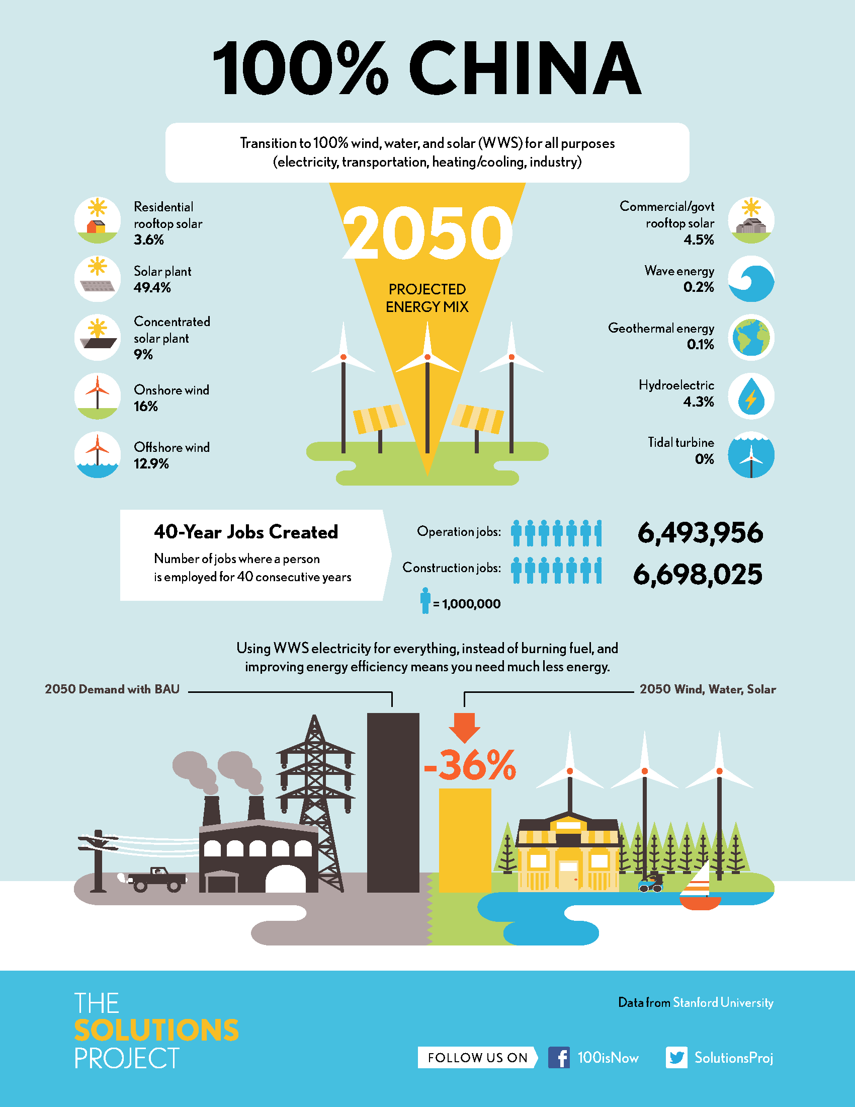
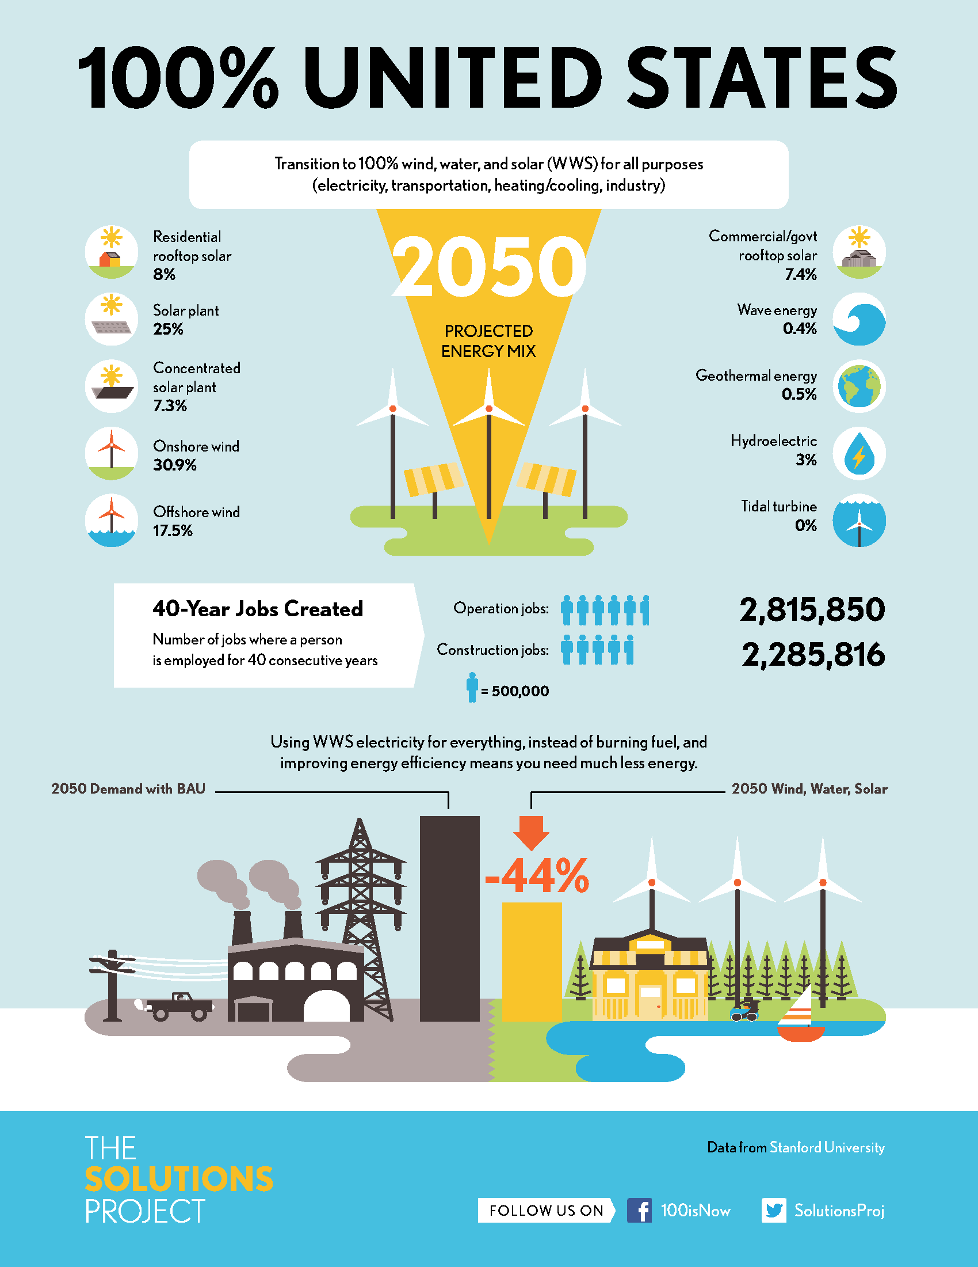

Slide 8
Some of the 100+ NGOs Committed to 100%
The Solutions Project Environment America
100.Org Toxics Action Center
Sierra Club Renewable Cities
350.Org National People’s Action
Greenpeace Institute for Self-Reliance
theRE100.org Hip Hop Caucus
go100percent.org Environmental Action
renewables100.org Renewable Energy Long Island
Climate Reality Emerald Cities Collaborative
iclei.org Community Power
The Center for Working Families Center for Community Change
Miami Climate Alliance Asian Pacific Environmental Network
Notes:
http://there100.org/companies
https://weather.com/science/environment/news/clean-energy-cities

Slide 9
Hillary Clinton (CSPAN-Oct. 30, 2015)
“We need to move as quickly as possible to 100% clean, renewable energy…We should do nothing that interferes with or undermines our efforts to reach that goal as soon as it is possible.”
Bernie Sanders (Website-November 2015)
“…by creating a 100% clean energy system. Transitioning toward a completely nuclear-free clean energy system for electricity, heating, and transportation is not only possible and affordable it will create millions of good jobs.”
Martin O’Malley (Press Release-July 2, 2015)
“I would take executive action to be powered by 100% renewable energy within 35 years.”
Notes:
https://www.c-span.org/video/?c4557641/hillary-readyfor100
https://berniesanders.com/issues/climate-change/
http://www.p2016.org/omalley/omalley070215climate.html

Slide 10
2016 U.S. Democratic Platform
We believe America must be running entirely on clean energy by mid-century.
Notes:
https://www.congress.gov/bill/114th-congress/house-resolution/540/cosponsors?q=%7B%22search%22%3A%5B%22%5C%22hres540%5C%22%22%5D%7D&resultIndex=1
https://www.demconvention.com/wp-content/uploads/2016/07/Democratic-Party-Platform-7.21.16-no-lines.pdf

Slide 11
House Resolution 540 (2015)
Expressing the sense of the House of Representatives that the policies of the United States should support a transition to near zero greenhouse gas emissions, 100 percent clean renewable energy, infrastructure modernization, green jobs,…

Slide 12
House Resolution H.Res.540, Senate Resolution S.Res.632
…U.S. should support a transition to…100% clean renewable energy,…
Senate Bill S.987, House Bills H.R.3314, 3671, 330
100% clean and renewable energy by 2050
100% clean and renewable energy by 2050
100% clean, renewable energy by 2035
100% renewable electricity by 2035
Green New Deal -- H.Res.109, S.Res.59
100% clean, renewable, and zero-carbon energy for all purposes by 2030
Notes:
https://www.congress.gov/bill/114th-congress/house-resolution/540/cosponsors?q=%7B%22search%22%3A%5B%22%5C%22hres540%5C%22%22%5D%7D&resultIndex=1
https://www.demconvention.com/wp-content/uploads/2016/07/Democratic-Party-Platform-7.21.16-no-lines.pdf

Slide 13
100% Renewable Electricity State Laws Resulting From WWS Roadmaps
100% by 2030
Rhode Island
By 2032
Washington D.C.
By 2040
Connecticut
By 2045
Hawaii, California, New Mexico, Washington State, New York
By 2050
Puerto Rico, Nevada, Maine, Wisconsin, Virginia, New Jersey
Notes:
https://www.congress.gov/bill/114th-congress/house-resolution/540/cosponsors?q=%7B%22search%22%3A%5B%22%5C%22hres540%5C%22%22%5D%7D&resultIndex=1
https://www.demconvention.com/wp-content/uploads/2016/07/Democratic-Party-Platform-7.21.16-no-lines.pdf
https://malegislature.gov/Bills/190/SD1932

Slide 14
61 Countries Committed to 100% Renewable Electricity
Afghanistan Denmark Kirbati Papua N.G. Tanzania
Aruba Djibouti Lebanon Philippines Timor-Les
Bangladesh Dominica Madagas Portugal Tokelau
Barbados Dom Rep. Malawi Rwanda Tunisia
Bhutan Ethiopia Maldives Samoa Tuvalu
Burkina Faso Fiji Marsh Is. Senegal Scotland
Cabo Verde Gambia Mongolia Solom Is. Vanuatu
Cambodia Ghana Morocco S. Sudan Vietnam
Colombia Grenada Nepal Spain Yemen
Comoros Guatemala Niger Sri Lanka
Congo, DR Haiti Niue St. Lucia
Cook Islands Honduras Palau Sudan
Costa Rica Kenya Palestine Sweden

Slide 15
Some of 140 Cities/Counties Committed to 100% Renewables
Atlanta (GA) Salt Lake City (UT) Sylva (NC)
Chicago (IL) San Diego (CA) Moab (UT)
Cincinatti (OH) San Francisco (CA) Boulder (CO)
Cleveland (OH) San Jose (CA) Burlington (VT)
Denver (CO) Spokane (WA) Rochester (MN)
Kansas City (MO) St. Louis (MO) Fayetteville (AR)
Los Angeles (CA) St. Paul (MN) Palo Alto (CA)
Madison (WI) St. Petersburg (FL) Middleton (WI)
Minneapolis (MN) Tallahassee (FL) Missoula (MT)
Orlando (FL) Abita Springs (LA) Questa (NM)
Philadelphia (PA) Sarasota (FL) Fayetteville (AR)
Portland (OR) Hanover (NH) Clarkston (GA)

Slide 16
Some of the 221 Companies Committed to 100% Renewables
IKEA Adobe JPMor/Chase Coca Cola
Google H&M HP Goldman-Sachs
Microsoft Nestle Nike Johnson & Johnson
Apple S&P Starbucks Walmart
Workday T-Mobile AB InBev Bank of America
Bloomberg BMW Group Burberry Citi
P&G Ebay Facebook Estee Lauder
GM Goldman-Sachs HSBC Infosys
Kellogg’s Lego Mars Morgan Stanley
Salesforce Organic Valley Amazon Wells Fargo
Notes:
http://there100.org/companies
https://weather.com/science/environment/news/clean-energy-cities

Slide 17

Public Opinion Surveys

Slide 18
Public Opinion Survey
26,000 people in 13 countries November 2017
Canada, China, Denmark, France, Germany Netherlands, Poland, South Korea, Sweden, Taiwan, UK, USA
82% want a world with 100% renewable energy
66% believe climate change is a global challenge
69% say renewables make countries more energy independent
73% say renewables will boost economic growth
Notes:
http://www.aweablog.org/new-poll-wind-power-overwhelmingly-popular-new-york/
https://www.theguardian.com/sustainable-business/2016/may/31/most-voters-support-transition-to-100-renewable-energy-says-australia-institute

Slide 19
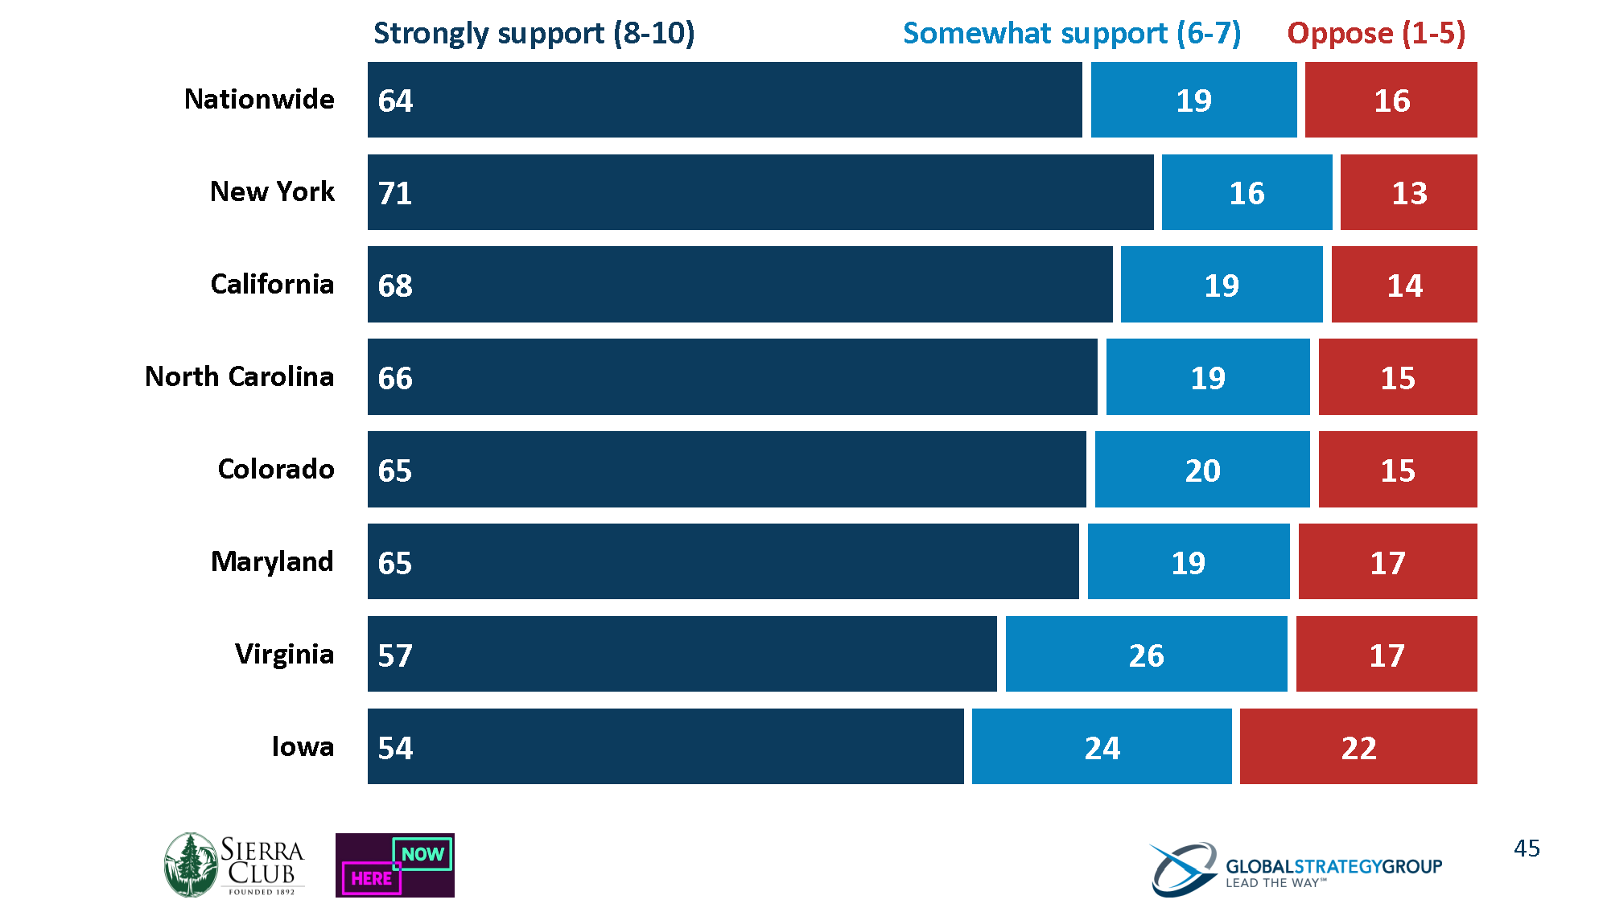
Do you support or oppose powering all energy in the U.S. entirely by clean and renewable sources like wind, solar, and hydroelectric by 2050? That means homes, businesses, cars, trucks.
Notes:
Exact question. Some people propose setting a goal for the United States to transition completely away from fossil fuels like coal, oil, ad natural gas by increasing energy efficiency and getting all of our remaining energy needs from clean and renewable sources like wind, solar, and hydroelectric by the year 2050. This would mean that American homes, businesses, cars, and trucks would be powered entirely by clean and renewable sources.

Slide 20

Timeline for a Transition

Slide 21
Timeline
for a
Transition
Notes:
Figure 9.5. Timeline for 143 countries, representing 99.7 percent of world emissions, to transition from conventional fuels (BAU) to 100 percent wind-water-solar (WWS) in all energy sectors. Also shown are the annually averaged end-use power demand reductions that occur along the way. The energy sectors transitioned include the electricity, transportation, building heating/cooling, industrial, agriculture/forestry/fishing, and military sectors. The percentages next to each WWS energy source are the 2050 estimated percent supply of end-use power by the source. The 100 percent demarcation in 2050 indicates that 100 percent of end-use power in the annual average will be provided by WWS among all energy sectors by no later than 2050, but ideally sooner. An 80 percent transition is proposed to occur by no later than 2030. End-use power demand reductions occur for five reasons: (1) the efficiency of moving low-temperature building heat with heat pumps instead of creating heat with combustion; (2) the efficiency of electricity over combustion for high-temperature industrial heat; (3) the efficiency of electricity in battery-electric (BE) vehicles and in electrolytic hydrogen fuel cell (HFC) vehicles over combustion vehicles for transportation; (4) eliminating the energy to mine, transport, and process fossil fuels, biofuels, bioenergy, and uranium; and (5) improving end-use energy efficiency and reducing energy use beyond in the BAU case. The total demand reduction due to these factors is 57.1 percent (Table 7.1). From Jacobson et al. (2019).

Slide 22
Can WWS Avoid 1.5 C Warming?
We can allow 350-575 GT-CO₂ emissions after 2015 to stay below 1.5 ºC warming and 1150-1450 GT-CO₂ to stay below 2 ºC
Converting 80% energy to WWS by 2030 & 100% by 2050 emits ~415 GT CO₂, limiting warming to 1.5 ºC
This requires reducing emissions ~9%/year from 2021-2030
3) →Possible for 100% WWS to avoid 1.5 ºC warming
Notes:
6-24 times more CO₂ & pollution per kWh than wind from mining & refining uranium and using fossil fuels for electricity during the 10-19 years to site permit (3.5-6 y), construction permit (2.5-4 y), and construct (4-9 y) nuclear plant compared with 2-5 years for a wind or solar farm

Slide 23
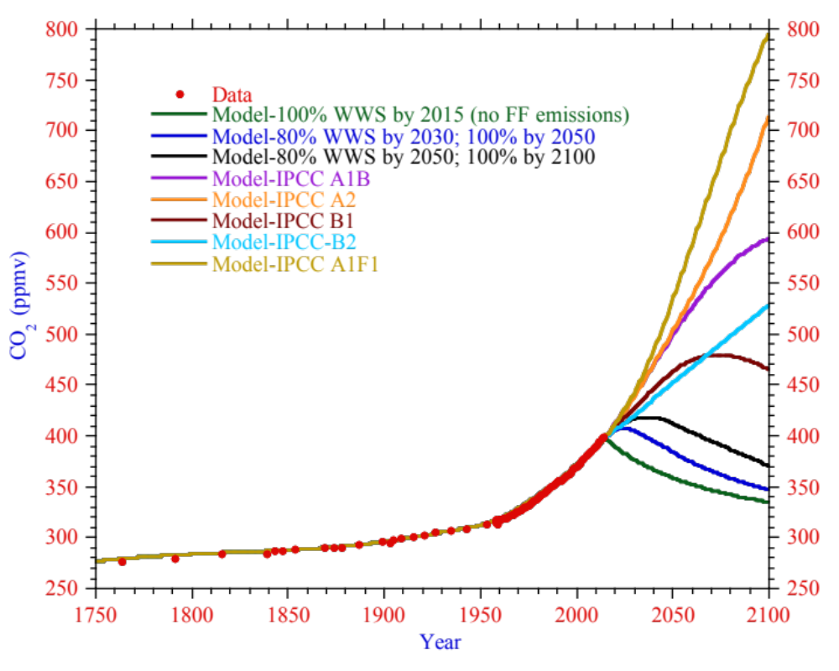
Change in CO₂ With WWS & IPCC Scenarios
Notes:
Figure 9.6. Comparison of historic (1751 to 2014) observed CO₂ mixing ratios (ppmv) from the Siple ice core (Neftel et al., 1994) and the Mauna Loa Observatory (Tans and Keeling, 2015) with GATOR-GCMOM model results (Jacobson, 2014) for the same period plus model projections from 2015 to 2100 for five Intergovernmental Panel on Climate Change (IPCC) scenarios (IPCC, 2000) and three WWS scenarios: an unobtainable case of 100 percent WWS by 2015; a case of 80 percent WWS by 2030 and 100 percent by 2050 (from Figure 9.5), and a less-aggressive case of 80 percent WWS by 2050 and 100 percent by 2100.

Slide 24

Obstacles to Overcome

Slide 25
Obstacles to Overcome
1) Vested interests in the current energy infrastructure
2) Zoning issues (NIMBYism)
3) Some countries are engaged in conflict
4) Some countries are in deep poverty
5) Transitioning long-distance aircraft and ships is challenging
6) Competition among solutions slows solution
Notes:
Conflicts > 10,000 deaths
Afghanistan (1978)
Syria (2011)
Yemen (2011)
Conflicts 1,000-10,000 deaths
Somalia (1991)
Nigeria (1998)
The Maghreb (Algeria, Morocco, Tunisia, Libya, Mali, Niger, Chad) (2002)
Iraq (2003)
Boko Haram insurgency (Nigeria, Cameroon, Niger, Chad) (2009)
South Sudan (2011)
Northern Mali (2012)

Slide 26
U.S. Coal, Oil, & Gas Subsidies (2002-2008)
Foreign tax credit for overseas production of oil $15.3 billion
Credit for production of nonconventional fuels $14.1
Oil and gas exploration and development expensing $ 7.1
Reduced government take on oil and gas leasing $ 7.0
Oil and gas excess percentage over cost depletion $ 5.4
Credit for enhanced oil recovery $ 1.6
Characterizing coal royalties as capital gains $ 1.0
Exclusion of benefits payments to disabled miners $ 0.44
Other tax code breaks $ 2.22
Direct grants and subsidies $18.
Total $72.5 billion
Notes:
https://www.eli.org/research-report/estimating-us-government-subsidies-energy-sources-2002-2008

Slide 27
U.S. Coal Subsidies (2002-2010)
Tax benefits $16.2 billion
  Production nonconventional fuels credit ($12.2 billion)
  Oil and gas exploration and development expensing
  Direct federal spending $9.2 billion
  DOE Office of fossil energy ($8.84 billion)
  39% of DOE Office budget for CCS initiatives
Total $25.4 billion
Notes:
https://www.eli.org/research-report/estimating-us-government-spending-coal-2002-2010

Slide 28

Policies Needed

Slide 29
Policy Mechanisms
1) Renewable Portfolio Standards
2) Incentives for increasing energy efficiency and reducing energy use
3) Requirements for using demand response
4) Feed-in tariffs
5) Output subsidies
6) Investment subsidies (loan guarantees, municipal financing)

Slide 30
Policy Mechanisms
7) Revenue-neutral carbon tax
8) Pollution tax or carbon tax
9) Mandatory emission limits
10) Cap and trade

Slide 31
Summary – Transitioning to 100% WWS
Electricity demand can be supplied by 100% WWS, storage, and demand response at low cost
Transitioning to 100% WWS in all energy sectors is technically and economically possible
The main barriers are social and political
The solution requires collective willpower and immediate deployment

Slide 32
Online 3-Module Course on 100% WWS
http://stanford.io/windwatersolar
Roadmaps
web.stanford.edu/group/efmh/jacobson/Articles/I/WWS-50-USState-plans.html
Infographic maps
www.thesolutionsproject.org
https://sites.google.com/stanford.edu/wws-roadmaps/home
Textbook on 100% WWS
https://web.stanford.edu/group/efmh/jacobson/WWSBook/WWSBook.html
Twitter: @mzjacobson

