Slide 1
Irrigating Corn to Adapt to Climate Change
PIAMDDI Project Meeting, December 13, 2013
Stanford University
(Monika Verma, Noah Diffenbaugh, Tom Hertel)

Slide 2
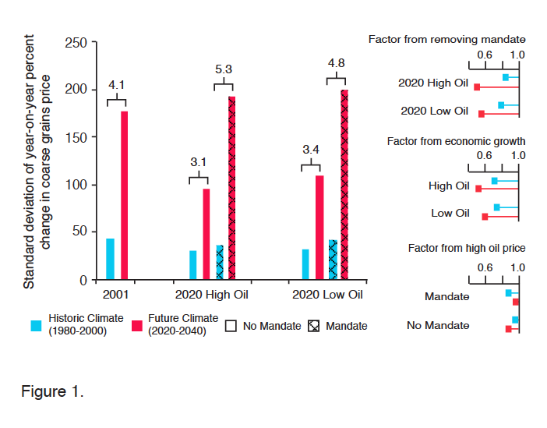
Climate-Energy-Policy Interaction
What we missed was Adaptation:
How can policy on bio-fuels affect it? Trade?

Slide 3
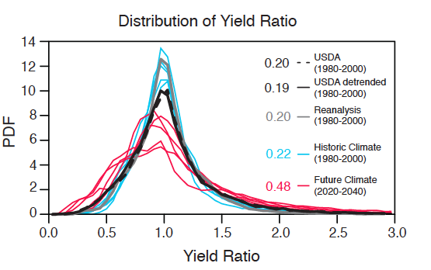
Recap
What about irrigation as adaptation?
Corn price Standard Deviation quadruples due to doubled SD of US corn yields, driven by Climate change
Notes:
What we did last year (a reminder from last year, main figure) and then where it led us? Adaptation options.
We concentrated on Policy response options; figure?
In this work we talk about irrigation, it could be new varieties or shift in crop production to north

Slide 4
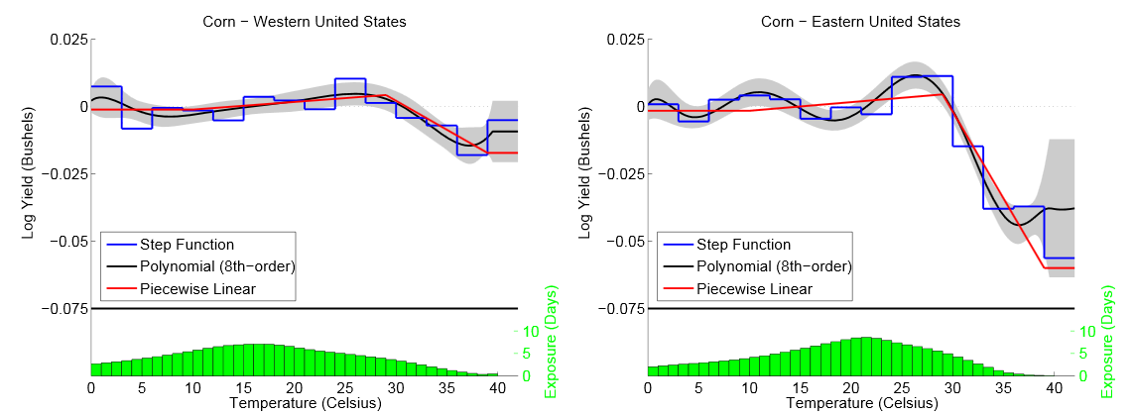
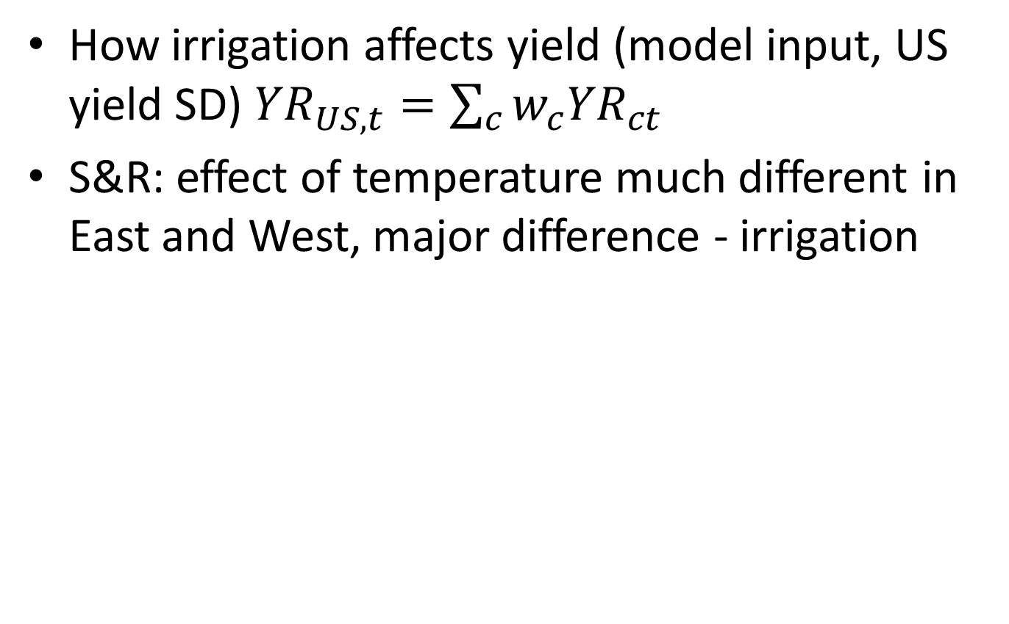
Irrigation’s Potential Impact
How irrigation affects yield (model input, US yield SD) ${YR}_{US,t}=\sum_{c}{w_{c}{YR}_{ct}}$
S&R: effect of temperature much different in East and West, major difference - irrigation
Source: Schlenker and Roberts, PNAS 2009, Fig A10
Notes:
NASS data for Nebraska and corn facts, 3rd largest corn producer, big ethanol producer
Explain the metric from previous work
Show differences in irrigated and non-irrigated yield variability metric, to give you a taste of real world differences
Check the sections of

Slide 5
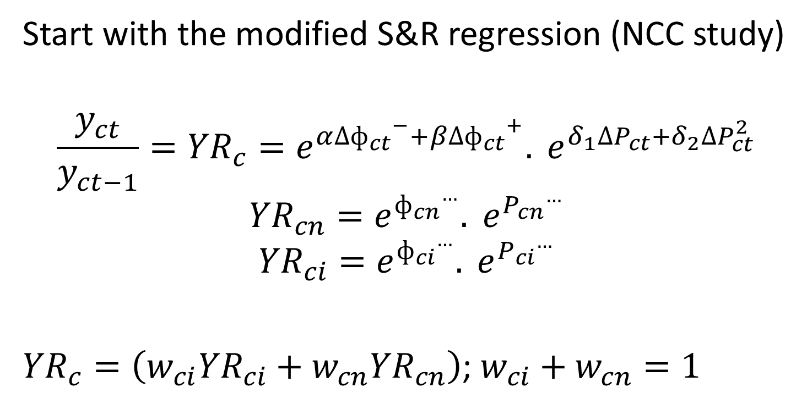
Yield Variability as input
Same functional form
Irrigated and non-irrigated corn production shares in county’s corn production
Notes:
Statistical model equations/derivations and refer to UNL work

Slide 6
USDA-NASS data for Nebraska– irrigated and non-irrigated corn yield/production county data (1990-2012)
Construct the same metric for Nebraska
  Yield SD for irrigated corn: 0.12
  Yield SD for non-irrigated corn: 0.34 (~ 3 times)
  Yield SD: 0.15

Slide 7
Question, what our previous graphs would look like with irrigation.
  Focus on simple case, leave out policy and oil price scenarios, concentrating on just climate change
+ + irrigation
  How do we bring in irrigation into our standard model framework, for comparison with earlier results?
Notes:
But before that show results from last work? Graph with SSA sims for yields and corn prices. One with mandate, one without and one in base case?

Slide 8
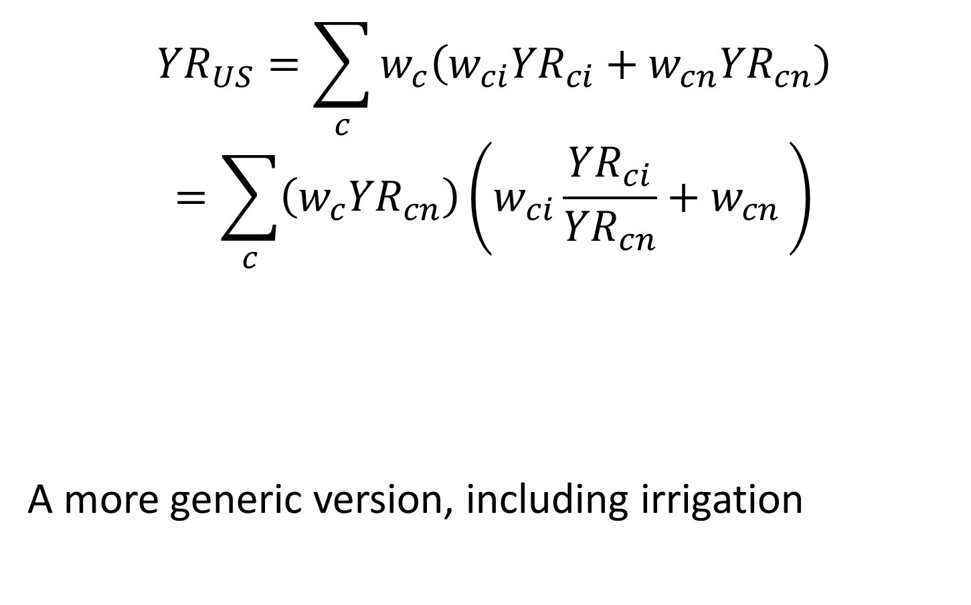
$${YR}_{US}=\sum_{c}{w_{c}\left(w_{ci}{YR}_{ci}+w_{cn}{YR}_{cn}\right)}$$
$$=\sum_{c}{\left(w_{c}{YR}_{cn}\right)\left(w_{ci}\frac{{YR}_{ci}}{{YR}_{cn}}+w_{cn }\right)}$$
A more generic version, including irrigation
what we had with our no-irrigation story
Know its present climate SD
Know that it doubles with climate change

Slide 9
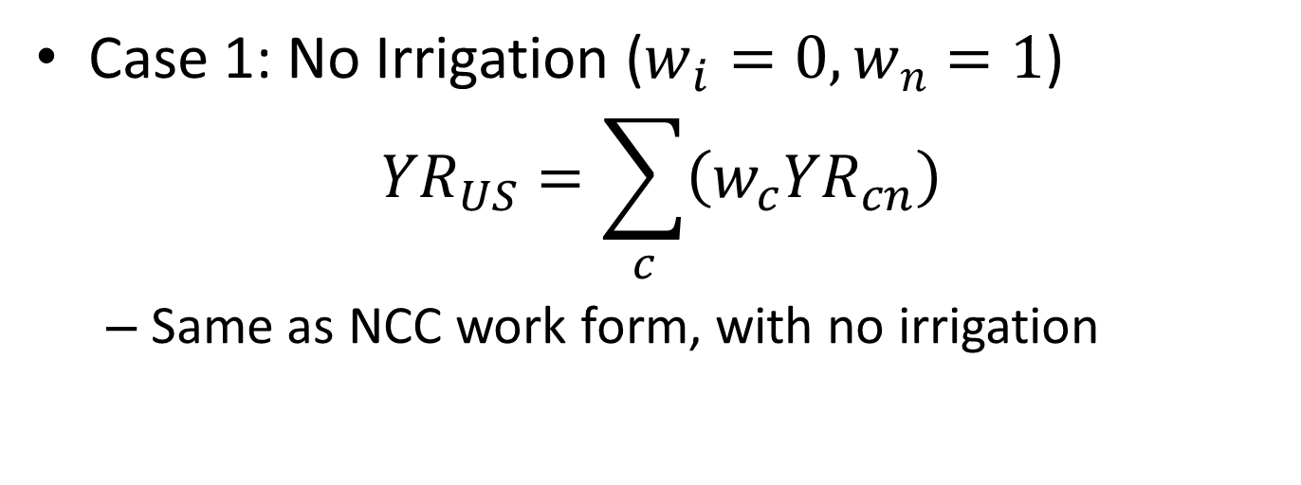
Implications
Case 1: No Irrigation ($w_{i}=0, w_{n}=1$)
$${YR}_{US}=\sum_{c}{\left(w_{c}{YR}_{cn}\right)}$$
  Same as NCC work form, with no irrigation
Notes:
Show some insights on results and derivations, I think there are about 3

Slide 10
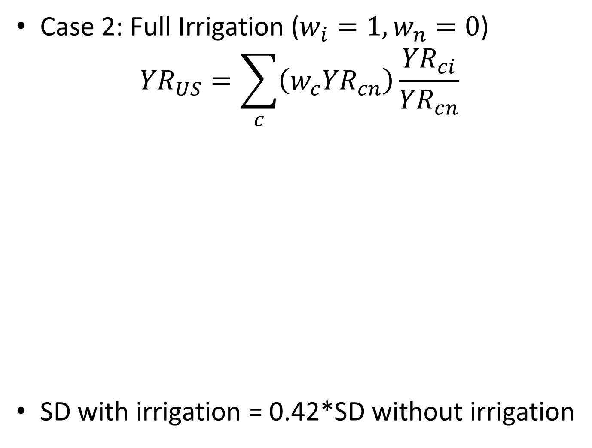
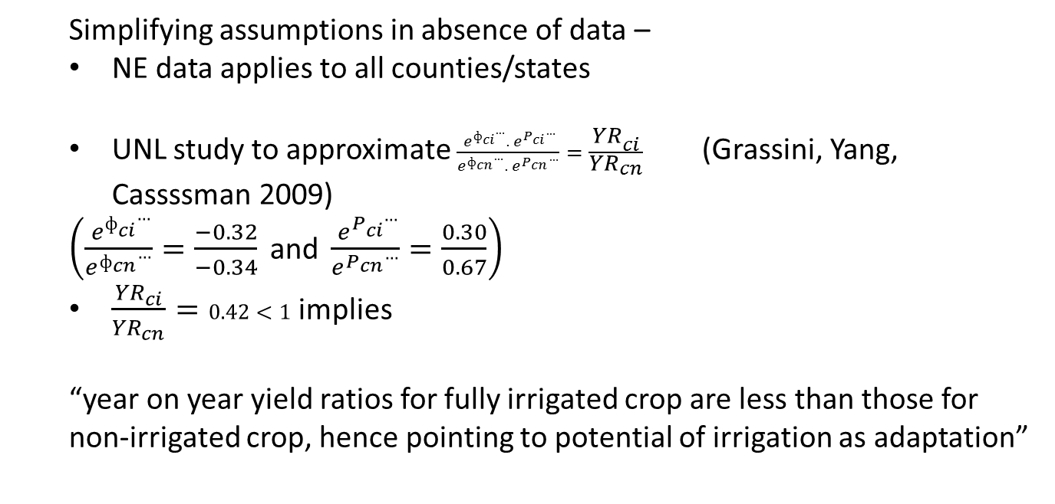
Case 2: Full Irrigation ($w_{i}=1, w_{n}=0$)
$${YR}_{US}=\sum_{c}{\left(w_{c}{YR}_{cn}\right)}\frac{{YR}_{ci}}{{YR}_{cn}}$$
SD with irrigation = 0.42*SD without irrigation
  Simplifying assumptions in absence of data –
  NE data applies to all counties/states
  UNL study to approximate $\frac{{ e}^{{ф_{ci}}^{…}}. e^{{P_{ci}}^{…}}}{e^{{ф_{cn}}^{…}}. e^{{P_{cn}}^{…}}}=\frac{{YR}_{ci}}{{YR}_{cn}}$ (Grassini, Yang, Cassssman 2009)
  $\left(\frac{{ e}^{{ф_{ci}}^{…}}}{e^{{ф_{cn}}^{…}}}=\frac{−0.32}{−0.34} \text{and} \frac{{ e}^{{P_{ci}}^{…}}}{e^{{P_{cn}}^{…}}}=\frac{0.30}{0.67}\right)$
  $\frac{{YR}_{ci}}{{YR}_{cn}}=0.42<1$ implies
  “year on year yield ratios for fully irrigated crop are less than those for non-irrigated crop, hence pointing to potential of irrigation as adaptation”

Slide 11
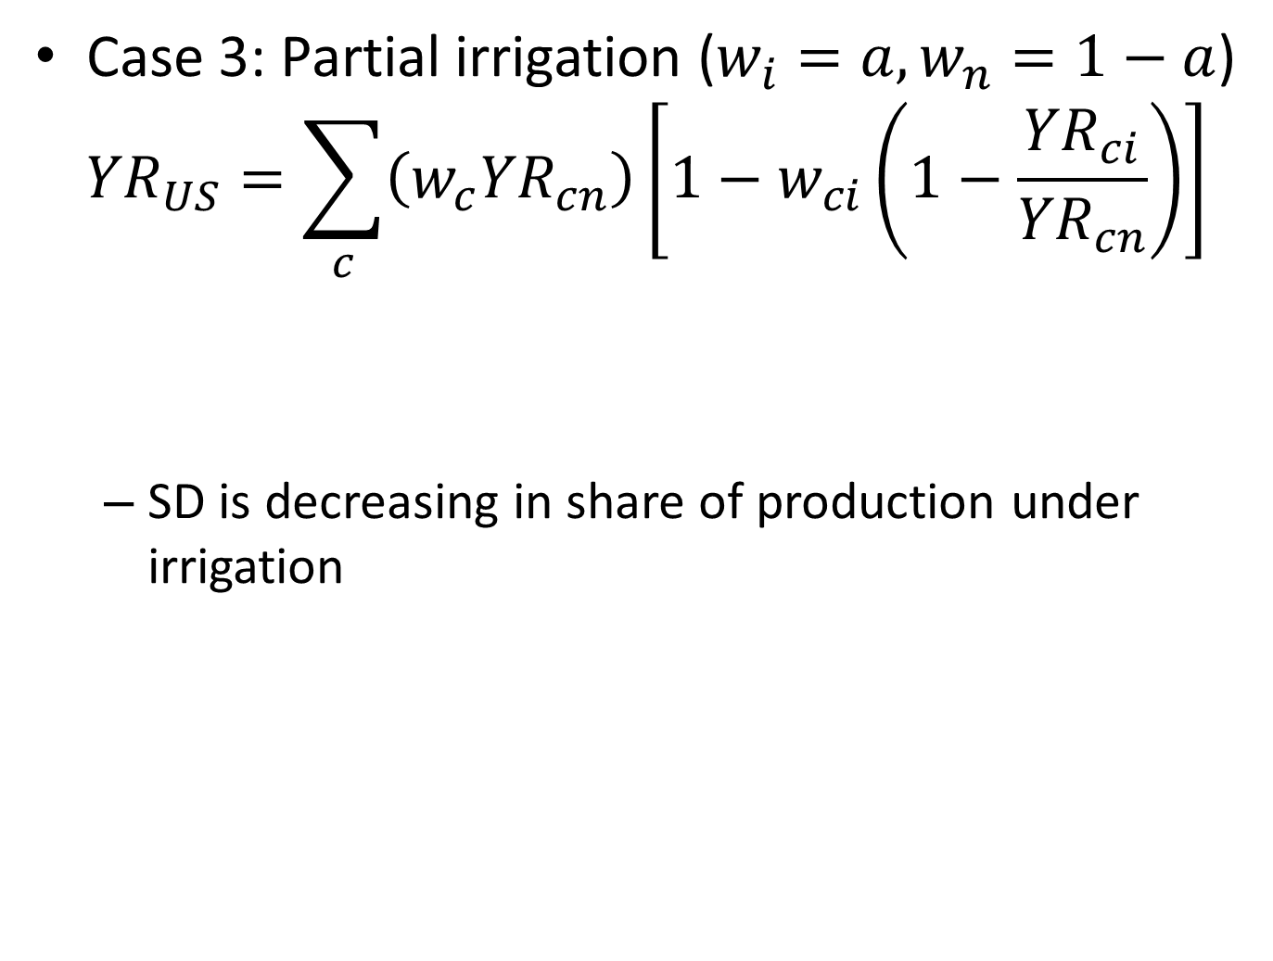
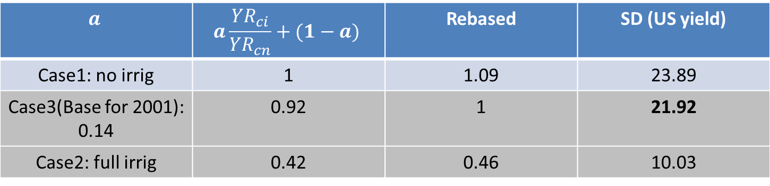
Case 3: Partial irrigation ($w_{i}=a, w_{n}=1−a$)
$${YR}_{US}=\sum_{c}{\left(w_{c}{YR}_{cn}\right)}\left[1−w_{ci}\left(1−\frac{{YR}_{ci}}{{YR}_{cn}}\right)\right]$$
  SD is decreasing in share of production under irrigation
0<(.)<1
0<(.)<1
$$a$$ | $$a\frac{{YR}_{ci}}{{YR}_{cn}}+(1−a)$$ | Rebased | SD (US yield)
Case1: no irrig | 1 | 1.09 | 23.89
Case3(Base for 2001): 0.14 | 0.92 | 1 | 21.92
Case2: full irrig | 0.42 | 0.46 | 10.03

Slide 12
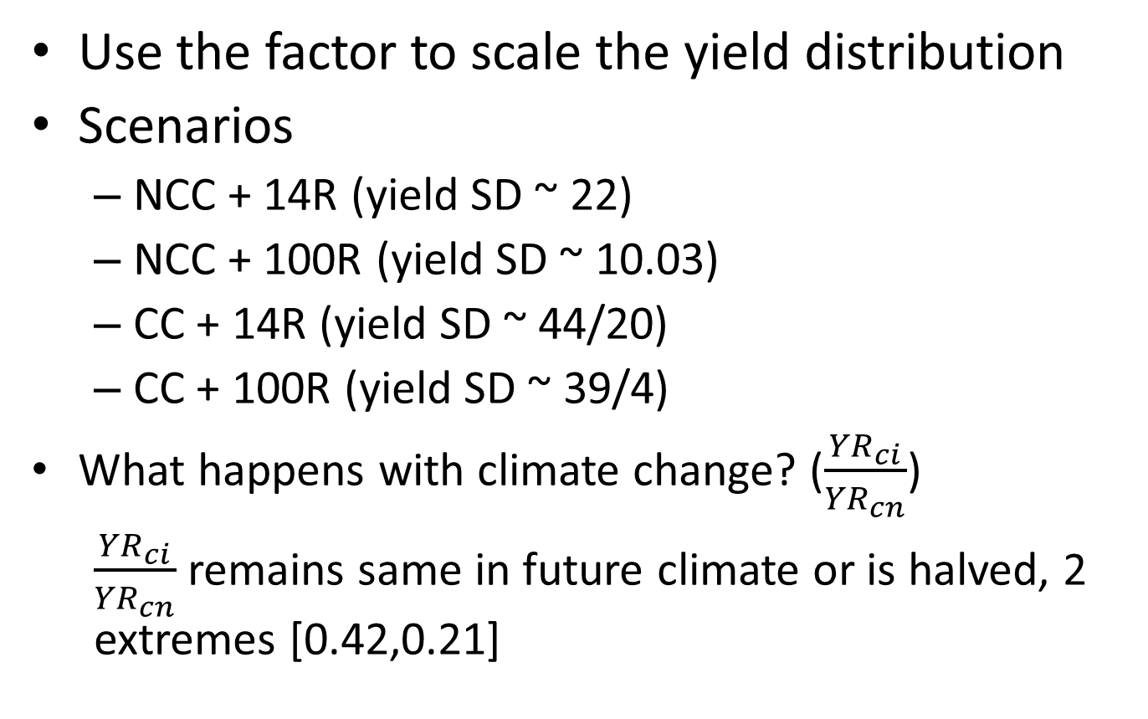
Implementation

Slide 13
X: corn yield SD
Y: corn price SD
Vertical distance: difference in price SD coming from irrigation
Y: corn price SD
Two points on same vertical line represent same climate realization

Slide 14
Notes:
See if can get some results for different mandate and oil price scenarios still
*One more graph with same axis comparison, think of a better color scheme to distinguish between present and future climate

Slide 15
Price and Yield SD under different climate and irrigation combinations
44
39
22
20
10
4
Climate Scenario
Height of Bar indicates Price SD and number next to bar is the yield SD

Slide 16
Strange result (with irrigation even after climate change we get less variability than under same irrigation % and no climate change)
  Other study: one from Swiss corn (Finger et al 2011, ClimChng)
Bring in more economics: even if irrigation is effective, under what conditions would it be feasible/viable to use
  One approach would be to take multiple corn price realizations for future and see if its profitable for farmers to use surface, ground water to irrigate
  Cost of irrigation, infrastructure.
Collaborate with actual working water model and see if these insights hold, magnitude of impact would likely change

Slide 17
