Slide 1
REGIONAL ECONOMIC IMPACTS OF Hurricane DISASTERS
Meri Davlasheridze
Texas A&M University at Galveston
Karen Fisher-Vanden
The Pennsylvania State University
Ian Sue-Wing
Boston University

Slide 2
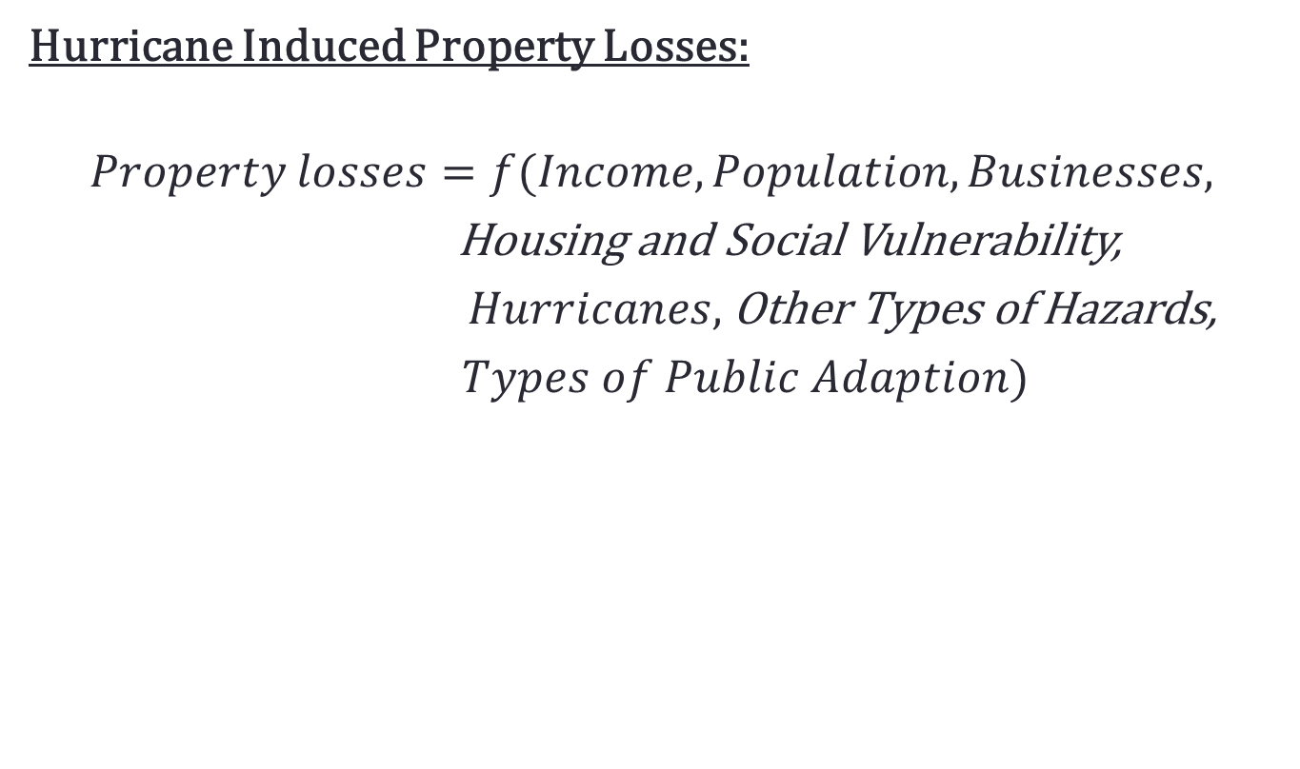
EMPIRICAL MODEL
Hurricane Induced Property Losses:
$$Property losses=f(Income, Population, Businesses,$$
Housing and Social Vulnerability,
$Hurricanes,$Other Types of Hazards,
$Types of Public Adaption)$

Slide 3
RESULTS
Variables | Beta | Standard error
Log of per capita income | 6769.8*** | (2.58)
1 year lag of population change | 0.0186*** | (0.00)
1 year lag of establishment change | 0.395*** | (0.03)
per capita vulnerable housing | 27833.0*** | (145.40)
Unemployment rate | 136.5*** | (3.43)
1 year lag of cum. Hurricane hits | 80.61*** | (1.70)
Number of hurricane hits | 2116.7*** | (73.43)
dummy for major hurricanes | 1089.0*** | (102.00)
1 year lag of other types of disasters | -302.3*** | (13.41)
Coastal county * Tropical storms | 252.1*** | (48.86)
CRS total credit points | -0.947*** | (0.02)
BCEGS | -581.2*** | (27.93)
Building Codes & Design studies | -24.24*** | (0.64)
Type I | -127.5*** | (4.26)
Type II | -10.92*** | (1.04)
Type III | -0.151*** | (0.03)
Constant | -102917.2*** | (26.08)
Number of observations | 13040

Slide 4
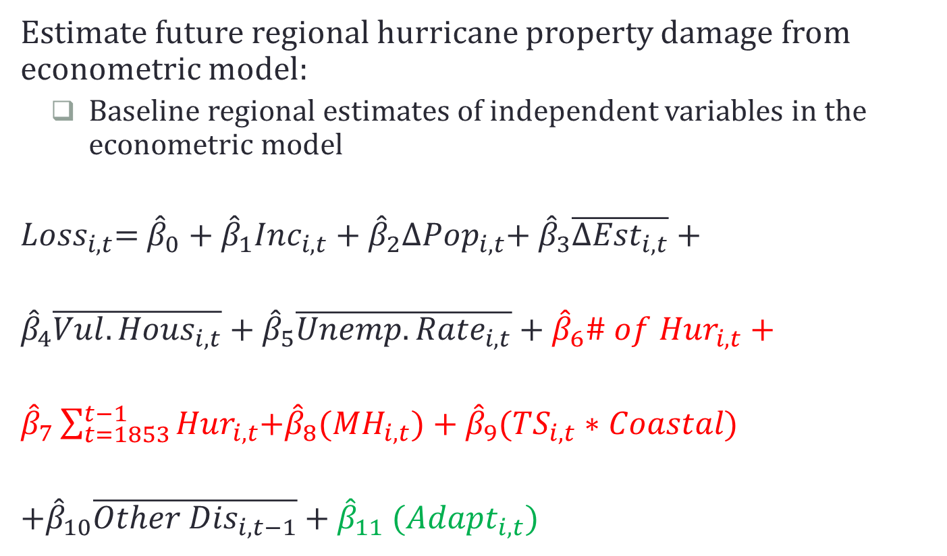
CONNECTION TO REGIONAL IAM
  Estimate future regional hurricane property damage from econometric model:
    Baseline regional estimates of independent variables in the econometric model
  ${Loss}_{i,t}$= ${\hat{β}}_{0}+{\hat{β}}_{1}{Inc}_{i,t}$ + ${\hat{β}}_{2}{∆Pop}_{i,t}$+ ${\hat{β}}_{3}\overline{{∆Est}_{i,t}}$ +
  ${\hat{β}}_{4}\overline{{Vul.Hous}_{i,t}}$ + ${\hat{β}}_{5}\overline{{Unemp. Rate}_{i,t}}$ + ${\hat{β}}_{6}{\# of Hur}_{i,t}$ +
  ${\hat{β}}_{7}\sum_{t=1853}^{t−1}{{Hur}_{i,t}}$+${\hat{β}}_{8}$(${MH}_{i,t})$ + ${\hat{β}}_{9}$(${TS}_{i,t}∗Coastal)$
  +${\hat{β}}_{10}\overline{{Other Dis}_{i,t−1}}$ + ${\hat{β}}_{11}$ (${Adapt}_{i,t})$

Slide 5
CONNECTION TO REGIONAL IAM
Hurricane projection data
Dynamic Downscaling Model of Knutson et al. (2012) combines
  Regional atmospheric model for seasonal Atlantic simulations (Zetac)
  Hurricane prediction model (GFDL hurricane model)
  Several global climate model (CMIP3 & CMIP5)
    Fewer Atlantic tropical storms in warmer climates
    Increase in the frequency of the most intense hurricanes
Emanuel, 2013
  Downscaling 6 different CMIP5 climate models
    Increased tropical cyclone activity over the 21st century under RCP8.5 emissions scenario

Slide 6


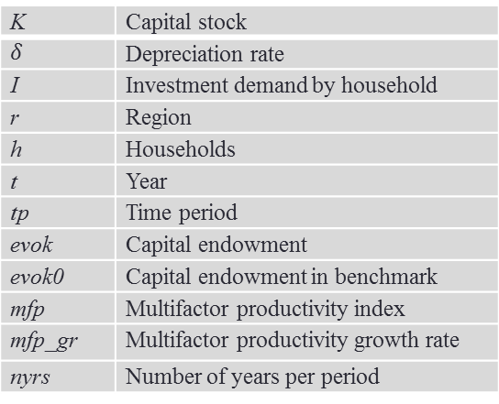
CONNECTION TO REGIONAL IAM
Input hurricane-induced property damages in the CGE model
Empirical Model
Property damages in the coastal regions (1989-2009)→the negative of capital stock growth rate compared to the base year (i.e. the data year used for calibration)
CGE
KLEM
σ_{KLEM} = 0.6
EM
KL
σ_{KL} = 1
σ_{EM} = 0.7
K | Capital stock
 | Depreciation rate
I | Investment demand by household
r | Region
h | Households
t | Year
tp | Time period
evok | Capital endowment
evok0 | Capital endowment in benchmark
mfp | Multifactor productivity index
mfp_gr | Multifactor productivity growth rate
nyrs | Number of years per period
M
E
K
L
σ_{M} = 0.6
σ_{E} = 0.8
M₁…
……….
M₂₇
C
PRP
NGD
OG
ELE
Capital stock
$$evok\left(r,h\right)=evok0\left(r,h\right)∗\frac{K\left(r,tp+1\right)}{K\left(r,"\text{tp}\text{=}\text{base} \text{year}\text{"}\right)}∗mfp$$
mfp = mfp*(1 + mfp_gr)**nyrs(tp)

Slide 7
CONNECTION TO REGIONAL IAM
  Scenario analysis:
    Hurricane damages without climate change
      Under different adaptation scenarios
    Hurricane damages with climate change
      Under different adaptation scenarios

Slide 8
THANK YOU!
QUESTIONS?

Slide 9
Last email from Tom Knutson
Meri,
The Zetac model tracks we sent you (which can extend beyond 5-days if the storm lasts that long) should give you landfalling information for the storms for both climate change and no-warming scenario you mention.
Unfortunately, the hurricane model downscale of the individual cases typically does not include the landfall time (as they are limited to 5-days maximum), so the intensity information you can derive for landfalling is quite limited, as it is coming basically only from the zetac model, which has intensities limited below 50 m/s in surface winds.
An extension of the cases to include US landfall is a relatively big project which we have talked about doing, but its not at the top of our queue at this time. An alternative might be a statistical downscale of the US landfall intensities from the zetac intensities using the method described in the paper. Joe could probably help with that. However, landfall intensities may have some extra issues that make it trickier to handle (i.e., we only have 6-hourly data and so can't have apples to apples comparison of landfall intensity between different cases, as the 6-hour data can't resolve the true landfall that well).
I hope this information gives you some feel for the issues at hand.
Joe might have some other thoughts to add.
-- Tom Knutson

