Slide 1
Adapting to Monsoon variability in India: the case for Irrigation
Esha Zaveri¹
Karen Fisher-Vanden¹
Danielle Grogan²
Rob Nicholas¹
Douglas Wrenn¹
¹Pennsylvania State University
² University of New Hampshire

Slide 2
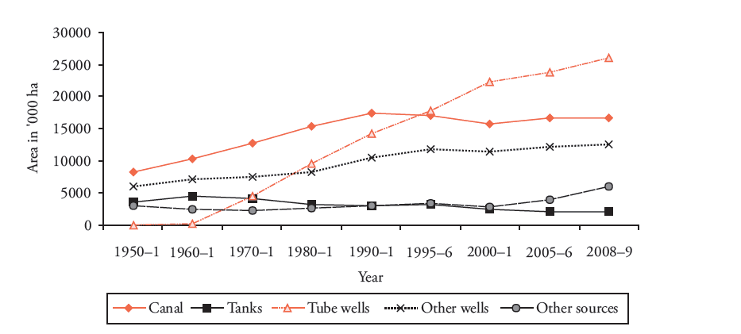
Background
Empirical Model Connection to WBM Connection to IAM
Notes:
The groundwater economic system contains interwoven natural and human components. At the surface, precipitation and irrigation pumped
from the aquifer supply water to crops, which evapotranspire back to the atmosphere during crop growth. Excess water inputs are lost through runoff or deep percolation past the root zone that eventually recharges the aquifer. The decision to use or not use the water stored in groundwater reservoirs for growing crops is largely based upon economic considerations. High-value crops require irrigation that is
limited by the availability of groundwater and the costs associated with pumping water to the parcel. A natural association exists between groundwater hydrology and agricultural economics through the wellparcel relationships. The methods by which the groundwater and economic processes are modeled and linked within an object-oriented framework are described next.
The cost of extracting groundwater depends on the depth of water table.

Slide 3
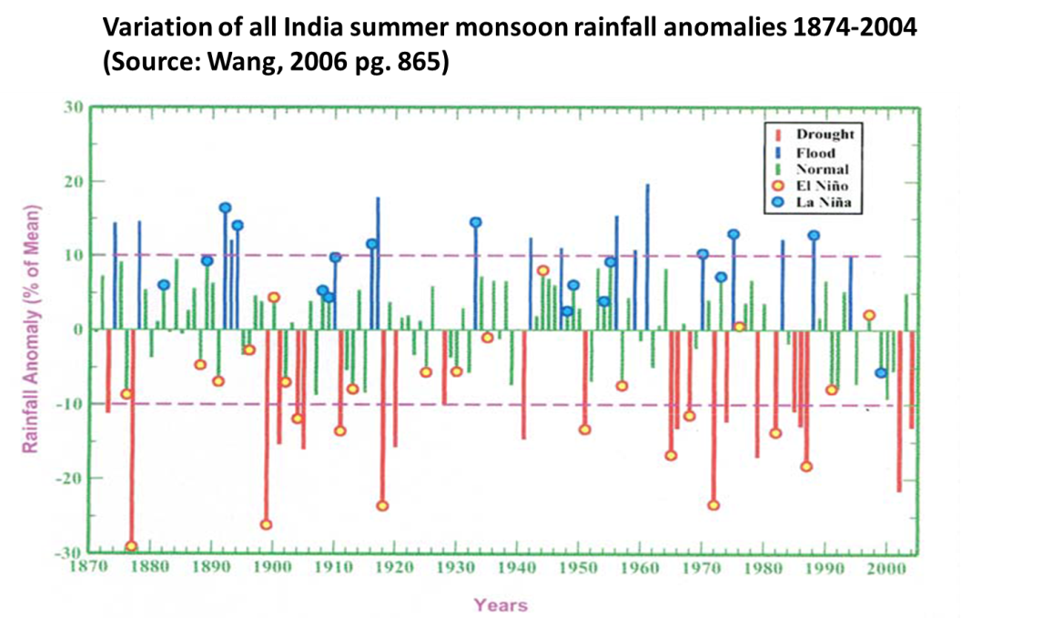
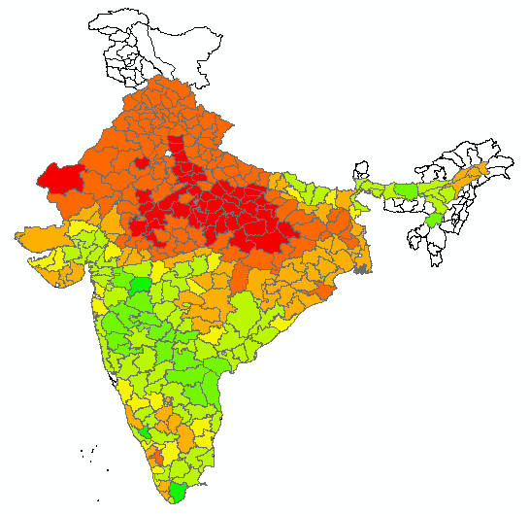
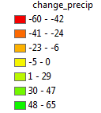
Empirical Model
Empirical Model Connection to WBM Connection to IAM
Step 1: How have crop irrigated areas changed in response to monsoon variability in India?
Percentage change in Monsoon rainfall from 1970 to 2004
 | Season | Crop water need (mm/total growing period) | Sensitivity to drought
Rice | Kharif, Rabi | 450-700 | high
Wheat | Rabi | 450-650 | low-medium
Sorghum | Kharif, Rabi | 450-650 | low
Source: Brouwer and Heibloem(FAO,1986)
Source: Brouwer and Heibloem(FAO,1986)
Notes:
The groundwater economic system contains interwoven natural and human components. At the surface, precipitation and irrigation pumped
from the aquifer supply water to crops, which evapotranspire back to the atmosphere during crop growth. Excess water inputs are lost through runoff or deep percolation past the root zone that eventually recharges the aquifer. The decision to use or not use the water stored in groundwater reservoirs for growing crops is largely based upon economic considerations. High-value crops require irrigation that is
limited by the availability of groundwater and the costs associated with pumping water to the parcel. A natural association exists between groundwater hydrology and agricultural economics through the wellparcel relationships. The methods by which the groundwater and economic processes are modeled and linked within an object-oriented framework are described next.
The cost of extracting groundwater depends on the depth of water table.

Slide 4
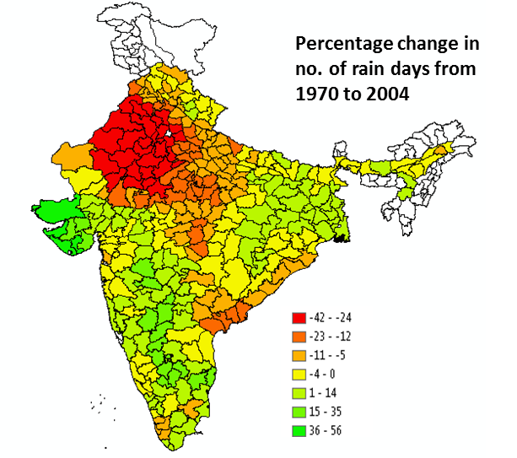
Empirical Model
Empirical Model Connection to WBM Connection to IAM
Step 1: How have crop irrigated areas changed in response to monsoon variability in India?
 | Season | Crop water need (mm/total growing period) | Sensitivity to drought
Rice | Kharif, Rabi | 450-700 | high
Wheat | Rabi | 450-650 | low-medium
Sorghum | Kharif, Rabi | 450-650 | low
Source: Brouwer and Heibloem(FAO,1986)
Source: Brouwer and Heibloem(FAO,1986)
Notes:
The groundwater economic system contains interwoven natural and human components. At the surface, precipitation and irrigation pumped
from the aquifer supply water to crops, which evapotranspire back to the atmosphere during crop growth. Excess water inputs are lost through runoff or deep percolation past the root zone that eventually recharges the aquifer. The decision to use or not use the water stored in groundwater reservoirs for growing crops is largely based upon economic considerations. High-value crops require irrigation that is
limited by the availability of groundwater and the costs associated with pumping water to the parcel. A natural association exists between groundwater hydrology and agricultural economics through the wellparcel relationships. The methods by which the groundwater and economic processes are modeled and linked within an object-oriented framework are described next.
The cost of extracting groundwater depends on the depth of water table.

Slide 5
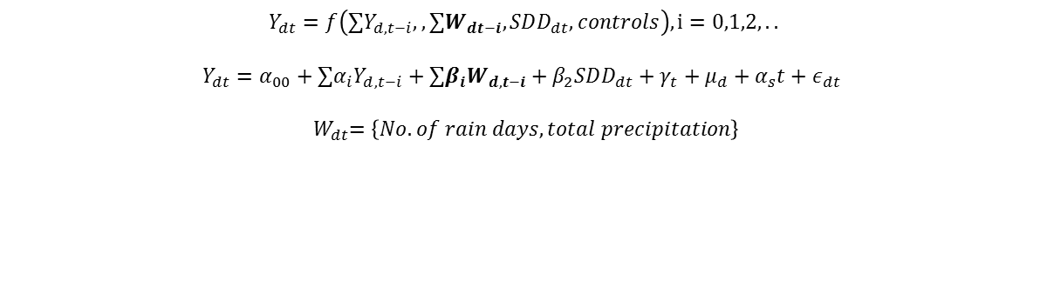
Empirical model
Empirical Model Connection to WBM Connection to IAM
$$Y_{dt}=f\left({∑Y}_{d,t−i},, {∑W}_{dt−i}, SDD_{dt}, controls\right), i=0,1,2,..$$
$$Y_{dt}=α_{00}+{∑α}_{i}Y_{d,t−i}+∑β_{i}W_{d,t−i}+β_{2}SDD_{dt}+γ_{t}+μ_{d}+α_{s}t+ε_{dt }$$
$${ W}_{dt}=\left\{No. of rain days, total precipitation\right\}$$
Dependent variable: Irrigation ratio | Wheat
 | (1) | (2) | (3) | (4)
Lag of irrigation ratio |  | 0.362** | 0.363** | 0.334*
 |  | (0.123) | (0.123) | (0.130)
2 year lag of irrigation ratio |  | 0.310*** | 0.310*** | 0.308***
 |  | (0.059) | (0.059) | (0.087)
3 year lag of irrigation ratio |  |  |  | 0.045
 |  |  |  | (0.080)
no. of rain days | -0.149 | -0.061 | -0.054 | -0.074
 | (0.092) | (0.066) | (0.064) | (0.071)
Lag of no. of rain days |  |  | -0.063 | -0.075
 |  |  | (0.047) | (0.057)
Monsoon rain | -0.044 | -0.053* | -0.054* | -0.061*
 | (0.034) | (0.024) | (0.024) | (0.027)
Lag of monsoon rain |  |  | 0.047** | 0.044*
 |  |  | (0.018) | (0.019)
Rabi degree days | -0.201*** | -0.130* | -0.126+ | -0.140*
 | (0.047) | (0.063) | (0.066) | (0.061)
Kharif degree days | -0.246 | -0.358* | -0.363* | -0.692
 | (0.272) | (0.174) | (0.175) | (0.588)
Constant | -22.367*** | -3.378 | -3.517 | 0.412
 | (1.775) | (2.762) | (2.837) | (5.405)
N | 7500 | 6932 | 6932 | 6659
R-sq (within) | 0.272 | 0.517 | 0.517 | 0.508
Historical period: 1970-2004
1 year:
Major Rabi crop: Wheat , mostly grown in the Rabi season across states.
16 states. 311 districts
1970 2004
May June Sep Oct Dec Feb June ‘70 ‘70 ‘70 ‘70 ‘71 ‘71
Kharif Rabi
planting planting
80% monsoon
* p<0.05 ** p <0.01 ***p < 0.001. All variables are in logarithmic form. Coefficients are elasticities. Standard errors clustered at district level.

Slide 6
Empirical model
Empirical Model Connection to WBM Connection to IAM
$$Y_{dt}=f\left({∑Y}_{d,t−i},, {∑W}_{dt−i}, SDD_{dt}, controls\right), i=0,1,2,..$$
$$Y_{dt}=α_{00}+{∑α}_{i}Y_{d,t−i}+∑β_{i}W_{d,t−i}+β_{2}SDD_{dt}+γ_{t}+μ_{d}+α_{s}t+ε_{dt }$$
$${ W}_{dt}=\left\{No. of rain days, total precipitation\right\}$$
Dependent variable: irrigation ratio | Kharif sorghum
 | (1) | (3) | (6) | (7)
Lag of irrigation ratio |  | 0.310*** | 0.312*** | 0.313***
 |  | (0.025) | (0.025) | (0.026)
2 year lag of irrigation ratio |  | 0.113*** | 0.112*** | 0.086***
 |  | (0.022) | (0.022) | (0.023)
3 year lag of irrigation ratio |  |  |  | 0.051*
 |  |  |  | (0.025)
no. of rain days | -0.931+ | -1.599** | -1.619** | -1.747***
 | (0.546) | (0.500) | (0.494) | (0.511)
Lag of no. of rain days |  |  | 0.436 | 0.276
 |  |  | (0.420) | (0.417)
Monsoon rain | -0.948*** | -0.808*** | -0.802*** | -0.863***
 | (0.169) | (0.155) | (0.155) | (0.157)
Lag of monsoon rain |  |  | -0.013 | -0.066
 |  |  | (0.144) | (0.144)
Kharif degree days | 1.525** | 0.157 | 0.158 | -0.622
 | (0.467) | (0.820) | (0.824) | (2.654)
Constant | -20.627* | -5.505 | -7.051 | 3.726
 | (9.097) | (7.775) | (7.993) | (21.106)
N | 5736 | 5353 | 5353 | 5162
R-sq (within) | 0.149 | 0.271 | 0.271 | 0.273
Historical period: 1970-2004
1 year:
Major Kharif crop: Kharif Sorghum grown only in the Kharif season
16 states. 311 districts
1970 2004
May June Sep Oct Dec Feb June ‘70 ‘70 ‘70 ‘70 ‘71 ‘71
Kharif Rabi
planting planting
80% monsoon
* p<0.05 ** p <0.01 ***p < 0.001. All variables are in logarithmic form. Coefficients are elasticities. Standard errors clustered at district level.

Slide 7
Connection to the Water Balance Model
Empirical Model Connection to WBM Connection to IAM
Step 1: Looking back: How have irrigated areas changed in response to monsoon variability in India?
Step 2: Looking forward: How will future changes in precipitation affect water supply?
-Use projections of precipitation changes to estimate irrigation responses into the future using estimates from Step 1

Slide 8
Connection to the IAM
Empirical Model Connection to WBM Connection to IAM
Step 1: Looking back: How have irrigated areas changed in response to monsoon variability in India?
Step 2: Looking forward: How will future changes in precipitation affect water supply?
-Use projections of precipitation changes to estimate irrigation responses into the future using estimates from Step 1
Step 3 : What are the future economic impacts?
-Use empirical estimates from Step 1 to inform demand for water in IAM agricultural sector in response to changes in precipitation
-Use WBM to inform supply side of water resources (fixed factor) in IAM
- Capture changes in crop production and crop trade balance via virtual water trade

Slide 9
Thank you!

Slide 10
Further extensions
Empirical Model Connection to WBM Connection to IAM Further extensions
1. Use NSS 59th Round (plot level data) to analyze irrigation decisions
Ag Year: July 2002-June 2003
2002 2003-time of survey
July Aug Dec Jan Feb June Aug Sep Dec
Kharif harvest Rabi harvest
1st Visit 2nd Visit
(Kharif season holdings ) (Rabi season holdings)

Slide 11
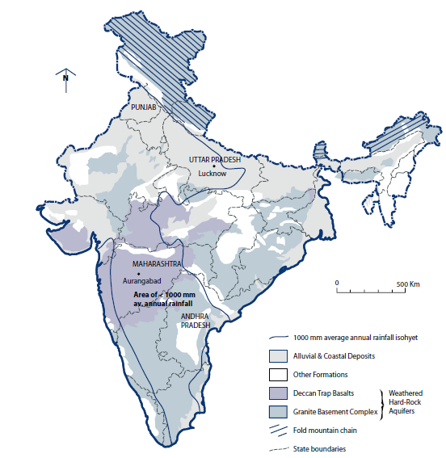
Further extensions
Empirical Model Connection to WBM Connection to IAM Further extensions
2. Use hydro-geological maps,
and type of irrigation to further
disaggregate irrigation change
Source: CGWB

