Slide 1

Adaptation, water resources, and IAMs:
An overview and a new project
Sheila Olmstead, University of Texas at Austin and RFF
Renata Rimsaite, Pennsylvania State University
Karen Fisher-Vanden, Pennsylvania State University
Ian Sue Wing, Boston University

Slide 2

Adaptation and water resources
Water resource impacts of climate change will affect health, agriculture, urban and industrial use, transport, energy supply and demand, non-market ecosystem services, fisheries, forestry, recreation…
Published estimates of regional and national economic impacts assume: (a) no adaptation; or (b) perfect adaptation.
Neither scenario is likely correct, given what we know about existing water resource management institutions.
Research need: model, quantify institutional constraints on adaptation to water impacts, for incorporation into IAMs.
Notes:
Both assumptions are naïve.
Perfect: dynamically optimal adaptation, with water priced at its marginal value, flowing to its highest-valued uses within and across sectors.
A “no adaptation” scenario is simply not going to happen – people have established irrigation systems to deal with arid climates since the beginning of civilization – just one of many types of institutions that we would expect to support adaptation as the climate changes.
But neither is perfect adaptation.

Slide 3
Important institutions to model
Water pricing institutions
  Administrative tariff schedules
  Water markets (our first project focuses here)
Direct allocation regimes
  Legal water rights structures
  Transboundary treaties
Water infrastructure investments
  Dams, reservoirs, flood control
Pollution control institutions
These institutions in current forms constrain efficient allocation, which should be considered in IAMs.
And institutions, themselves, may adapt (or “maladapt”) to change.

Slide 4
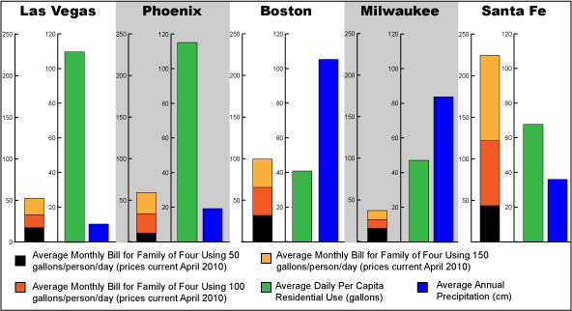
Evidence of institutional constraints
Source: Walton, Brett. 2010. The price of water: A comparison of water rates, usage in 30 U.S. cities. 26 April. www.circleofblue.org.
Notes:
Bell and Griffin (2008) summarize water prices in 319 U.S. cities in 40 states, 1995-2005 – prices are lowest, on average, in the arid western states.
Five US cities: read them.
Black/red/orange bar is average monthly water bill for family of four using 50, 100, and 150 gallons per person per day (April 2010). (100 is about average for US)
Green bar – average daily per capita residential use (gallons)
Blue bar is average annual precipitation in centimeters.
If we really wanted to understand the relationship between prices, demand and supply, we’d develop some much more sophisticated models to put data like these to work, but some of the oddities of water pricing are so obvious that, not only would they pop out from a careful economic model, they pop out in this simple graphic demonstration as well.
If prices were doing their job as that all-important signal, they would be relatively high where supply (blue) was low and demand (green) was high.
But look at the first two cities here– that is the case in both Las Vegas and Phoenix, but prices in those cities are extremely low. How are people to internalize the real value of water in those arid cities?
Santa Fe, on the other end, is doing much better in this regard – high prices help to mitigate that problem of high demand and low supply.
Obviously, need some rigorous work on this. But it doesn’t look good, with just this anecdotal evidence and the summary statistics from Bell and Griffin (2008).

Slide 5
Evidence of institutional constraints, cont.
Stark contrast between real-world water allocation and optimal allocation, in a static setting.
Relative prices in the U.S. West provide an example:
  San Diego: $225/acre-foot (af) vs. Central Valley farmers: $15-16/af.
  AZ farmers (Pima County): $27/af vs. City of Tucson: $479-$3,267/af. (Brewer et al. 2008)
  Rio Grande Valley (TX) value of water in agriculture: $300-$2,300/af, vs. urban uses: $6,500-$21,000/af. (Griffin and Boadu 1992)

Slide 6
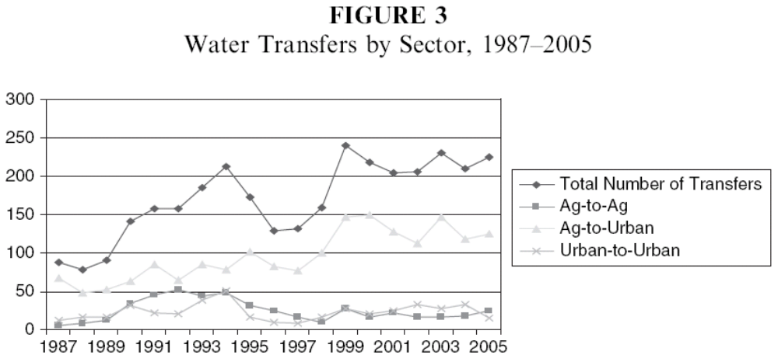
Markets are adaptive institutions
Brewer J., Glennon R., Ker A., Libecap G. 2008. Water markets in the West: Prices, trading, and contractual forms. Economic Inquiry. 46:91-112.
6
Notes:
Brewer et al. (2008) analyze data available on water trading in the western US from a publication called the Water Strategist, which reports a bunch of characteristics from all recorded water leases and sales in the west.
They look at data from 1987-2005.
They show that western states with the most urban growth appear to engage in the most water trading.
Colorado, California make up about 2/3 of the market in all transactions here over the 18 years of data. About 77% of the number of sales, but less than 50% of short-term and long-term leases (so leases relatively more common in other states).
Texas also pretty active water marketing, though more leases than sales.
As you can see, in terms of the total number of transfers, agriculture-to-urban trading is the most common, then agriculture-to-agriculture.
Ag to urban transfers also seem to be increasing over time.
This is pretty much true if you look at the AMOUNT of water transferred, as well, though less clear.
You get the picture – moving toward a world in which prices at least HELP to determine how water is used and where will bring about significant changes in its distribution.
These will be positive changes from an economic perspective.
Where will pricing and markets fail to provide efficient solutions to the problem of water allocation?
6

Slide 7
New project on water markets and adaptation
Estimate water demand curves by sector in the western U.S.
Estimate historic welfare gains from trading (1987-2010), where trading has been allowed.
Examine how U.S. water markets evolved between 1987-2010, and in the cross-section (do they vary with degree of aridity?).
Develop scenarios for different market structures to simulate
  Some less constrained
  Some more constrained?
  Which of these are more likely to occur, based on 1987-2010 and cross-sectional variation?
  What are the welfare implications?

Slide 8
Connection to IAMs
Above work emphasizes the need to build institutions into IAMs since water is not allocated efficiently
Important to capture these inefficiencies in order to more accurately measure implications of climate change on water use and adaptation responses.
Can include water resources in IAM (with help from WBM) but will need to distinguish between different end-users (e.g., ag and urban) who face very different demand functions for water.
Will use empirical work from above to parameterize this component of the model.

Slide 9
Prior research on water markets
Brookshire et al. (2004) estimate demands for water in AZ, CO, and NM (1990-2001)via 2SLS:
1) Price = f(State, Buyer, PDSI, Pop. Change, PerCap Income)
2) Quantity = f(Price, Value of Ag. Activity, Land price)
Their results suggest that:
  All markets are becoming more efficient
  Water is moving from lower-valued to higher-valued uses
  Government pays lower prices, but also has smaller share of the trades
First steps of our analysis are similar to their approach
  We seek to estimate water demands
  We can check their future predictions, because we have more data
  This information will be applied in welfare gains analysis
Notes:
CO market is most developed with increasing trades and rising prices that respond to market conditions

Slide 10
A first look at the data for our study
Available water rights data - Water Strategist
  12 states; 1987-2010; Price; Quantity; Seller; Buyer
Figure: Average Price by state by sector (1987-2010)
  In all states except ID ag-to-urb transactions are more expensive than ag-to-ag transactions
  In CO, MT, NM, NV, and TX ag-to-urb transactions are more expensive than urb-to-urb transactions

