Slide 1
Validating (or Evaluating)
Integrated Assessment Models of Global Land Use:
An Economic Perspective
Uris C. Baldos and Thomas W. Hertel
Purdue University
Presentation to the PIAMDDI meeting
Stanford, CA, December 14, 2013
The authors acknowledge support from the PIAMDDI project

Slide 2
Background and Motivation
Land-based activities are a large source of GHG emissions and could potentially offer 50% of efficient global abatement in the near term. IAMs have recently incorporated land use in their analyses. However, little work to date on testing these models against history. We aim to nudge this process ahead.
We pick up on several emerging themes from PIAMDDI and AMPERE:
  Focus on validation wrt a key stylized fact for one component of IAM (Schwanitz)
  Approach is one of hindcasting (Smith et al.)
  Emphasis on global land use change (JGCRI: Wise et al., Calvin et al.; MAgPIE)
  Key role for thoughtful experimental design (Karl Taylor: PCMDI)
  Consider presence of ‘error signatures’ in economic models of cropland
We also adhere to the KISS principle of “keep it simple”
Notes:
SIMPLE – designed to be a complement to large scale IAMs. Also a great tool in the classroom – last year at Stanford and this year at Purdue. Simple enough for interdisciplinary students to master and use – even as they learn!

Slide 3
The Key ‘Stylized Fact’ in Global Land Use
Over the past 50 years, global crop output has tripled, yet only a small fraction of this has come from area expansion. 85% of the Expansion has come from intensification: increased yields, cropping intensity.
If the world can reproduce this experience over the next 50 years, then we are ‘in luck’. If we must mostly expand area to feed 2 billion more people and significantly upgrade diets for more several billion additional individuals, currently at low income levels, then we are in trouble
So the key question is: Can this experience be repeated?
We don’t know the answer, but it is clear, if we are using models which cannot reproduce this historical outcome, then there will be little confidence in their projections of the future.
To answer this, developed SIMPLE = a Simplified International Model of agricultural Prices, Land use and the Environment
Notes:
SIMPLE – designed to be a complement to large scale IAMs. Also a great tool in the classroom – last year at Stanford and this year at Purdue. Simple enough for interdisciplinary students to master and use – even as they learn!

Slide 4
SIMPLE: A model of global agriculture
Global partial equilibrium model
  Food sectors include crop, livestock, processed foods
  7 Geographic regions (crop supply and cropland use)
  Both Land and Non-land inputs are less than perfectly elastic in supply
  5 Income regions (derived demands for crops, livestock and processed foods)
Global market clearing condition for crops
  Single world crop price
  Regional market clearing conditions for livestock and processed foods
Tracks changes in the following:
  Cropland use and GHG emissions from cropland change (two types of conversion: cropland to ‘other lands’ & ‘other lands’ to cropland)
  Agricultural investments in research & development facilitate adaptation to higher temperatures, changing precipitation
  Distribution of nutritional attainment by demand region
Notes:
SIMPLE – designed to be a complement to large scale IAMs. Also a great tool in the classroom – last year at Stanford and this year at Purdue. Simple enough for interdisciplinary students to master and use – even as they learn!

Slide 5

Exploring SIMPLE (1): Food demand is fueled by population & income while bioenergy use place additional demand for crops
Consumption by 5 Income regions
Food Security
Outcomes
Demand
Population
Income per capita
Demand
Response
Per Capita
Demand
Food Consumption
Global
Crop Market
Global
Biofuel Use
Notes:
From this slide you can see that SIMPLE is a relatively simple extension of the earlier conceptual framework. We have now highlighted some of the key parameters which hold the answer to our questions – e.g. price and income elasticities vary with income level of country, emissions factors depend on whether land is moving into crops or out of crops, etc.

Slide 6

Exploring SIMPLE (2): Crops are produced using land & non-land inputs with the possibility of input substitution
Consumption by 5 Income regions
Food Security
Outcomes
Demand
Population
Income per capita
Demand
Response
Per Capita
Demand
Food Consumption
Global
Crop Market
Global
Biofuel Use
Global
Crop Market
Non Land
Inputs
Input Substitution
Land
Inputs
Supply
Crop Production by 7 Geographic regions
Notes:
From this slide you can see that SIMPLE is a relatively simple extension of the earlier conceptual framework. We have now highlighted some of the key parameters which hold the answer to our questions – e.g. price and income elasticities vary with income level of country, emissions factors depend on whether land is moving into crops or out of crops, etc.

Slide 7



Exploring SIMPLE (3): Prices mediate food demand, input supply and equilibrate the global market for crops
Consumption by 5 Income regions
Food Security
Outcomes
Demand
Population
Income per capita
Demand
Response
Per Capita
Demand
Food Consumption
Global
Crop Market
Global
Biofuel Use
Food
Prices
Global
Crop Market
Global Crop
Price
Input
Prices
Non Land
Inputs
Input Substitution
Land
Inputs
Non Land Price
Response
Land Rent
Response
Supply
Crop Production by 7 Geographic regions
Notes:
From this slide you can see that SIMPLE is a relatively simple extension of the earlier conceptual framework. We have now highlighted some of the key parameters which hold the answer to our questions – e.g. price and income elasticities vary with income level of country, emissions factors depend on whether land is moving into crops or out of crops, etc.

Slide 8
Exploring SIMPLE (4): Economic responses to scarcity endogenously mediate cropland use
Consumption by 5 Income regions
Food Security
Outcomes
Demand
Population
Income per capita
Demand
Response
Per Capita
Demand
Food Consumption
Global
Crop Market
Global
Biofuel Use
Food
Prices
Global Crop
Price
Input
Prices
Non Land
Inputs
Input Substitution
Land
Inputs
Non Land Price
Response
Land Rent
Response
Supply
Crop Production by 7 Geographic regions
Notes:
From this slide you can see that SIMPLE is a relatively simple extension of the earlier conceptual framework. We have now highlighted some of the key parameters which hold the answer to our questions – e.g. price and income elasticities vary with income level of country, emissions factors depend on whether land is moving into crops or out of crops, etc.

Slide 9



Exploring SIMPLE (5): Crop productivity is affected by exogenous technological progress & climate change impacts
Consumption by 5 Income regions
Food Security
Outcomes
Demand
Population
Income per capita
Demand
Response
Per Capita
Demand
Food Consumption
Global
Crop Market
Global
Biofuel Use
Food
Prices
Global Crop
Price
Input
Prices
Land Use GHG Emissions/ Sequestration
Non Land
Inputs
Input Substitution
Land
Inputs
Non Land Price
Response
Emission Factors
Land Rent
Response
Climate: Temp, Precip & CO₂
Crop Productivity Growth
Investments in Ag. R&D
Supply
Investment -Yield Response
Crop Production by 7 Geographic regions
Notes:
From this slide you can see that SIMPLE is a relatively simple extension of the earlier conceptual framework. We have now highlighted some of the key parameters which hold the answer to our questions – e.g. price and income elasticities vary with income level of country, emissions factors depend on whether land is moving into crops or out of crops, etc.

Slide 10
Validation: Can we predict historical changes in output, price & the mix of extensive & intensive contributions?
Historical validation over a 45-year period (1961-2006)
Exogenous drivers are pop, income & estimated total factor productivity growth by region and sector
Results at the regional level are less satisfactory for many regions owing to integrated world market assumption
Notes:
Before applying SIMPLE to the question of climate adaptation, we need to subject it to some validation tests.
What to choose? In my view the most important development in global land use over the past half century has been the amazing increase in agricultural production which has been achieved with minimal area expansion: output rose by 200% while area rose by just 16% worldwide. It seems to me that when we look ahead to land use in 2050, this is exactly the piece of the puzzle that we need to get right. If we can replicate this experience, we are golden – if we can’t we have a big problem, given the potential GHG emissions from land conversion – particularly in the tropics where most of the population growth will occur.
So you want a model that can do this successfully, but you also want an experiment that can fail. It is not fair to give the model observed yield changes, for example, or to dictate per capita food consumption. These must be endogenous, as they are in SIMPLE where we take observed total factor productivity growth, leaving yields to adjust endogenously.
Based on this chart, you can see that SIMPLE does well in this experiment. Interesting, but that may just be dumb luck – can we do something more with this?

Slide 11
Using SIMPLE as a laboratory to explore economic limitations of existing IAMs
While SIMPLE is simple in its representation of biophysical processes and spatial resolution, it is richer in economic structure than many IAMs – it can be used to explore the implications of omitting key economic factors
Revisit historical validation with the restricted model:
  Fixed per capita demands (income and price are no longer drivers of food demand)
  Constant income & price responses over time (invariant to income level)
  Absence of endogenous intensive margin (yield is driven by exogenous productivity growth)
  Purely biophysical approach (omit economic responses)
Notes:
One thing that has interested me is the impact omitting some of these economic factors, as is the case in many of the IAMs being presented at these meetings. Should you worry about this? Or am I nitpicking? Let’s use this backcasting experiment as a laboratory to investigate these restrictions.

Slide 12
SIMPLE w/ Fixed per capita demands
Population
Food Security
Outcomes
Income per capita
Demand
Response
Per Capita
Demand
Food Consumption
Global
Crop Market
Global
Biofuel Use
Food
Prices
Global Crop
Price
Input
Prices
Land Use GHG Emissions/ Sequestration
Non Land
Inputs
Input Substitution
Land
Inputs
Non Land Price
Response
Emission Factors
Land Rent
Response
Crop Productivity Growth
Climate: Temp, Precip & CO₂
Investments in Ag. R&D
Investment -Yield Response

Slide 13
Implications of fixed per capita demands
With fixed per capita consumption, composition of diets is unchanging
Error signature: leads to underestimation of global production, yields and cropland growth rates

Slide 14
SIMPLE w/ constant income & price responses
Population
Food Security
Outcomes
Income per capita
Demand
Response
Per Capita
Demand
Food Consumption
Global
Crop Market
Global
Biofuel Use
Food
Prices
Global Crop
Price
Input
Prices
Land Use GHG Emissions/ Sequestration
Non Land
Inputs
Input Substitution
Land
Inputs
Non Land Price
Response
Emission Factors
Land Rent
Response
Crop Productivity Growth
Climate: Temp, Precip & CO₂
Investments in Ag. R&D
Investment -Yield Response

Slide 15
Implications when demand responses do not evolve with income
If demand response does not evolve with income, consumers will spend additional income on the same commodity/food
Error signature: leads to the overestimation of global production, yields and cropland

Slide 16
SIMPLE w/o the intensive margin of supply
Population
Food Security
Outcomes
Income per capita
Demand
Response
Per Capita
Demand
Food Consumption
Global
Crop Market
Global
Biofuel Use
Food
Prices
Global Crop
Price
Input
Prices
Land Use GHG Emissions/ Sequestration
Non Land
Inputs
Input Substitution
Land
Inputs
Non Land Price
Response
Emission Factors
Land Rent
Response
Crop Productivity Growth
Climate: Temp, Precip & CO₂
Investments in Ag. R&D
Investment -Yield Response

Slide 17
Implications of omitting the Intensive Margin
Without the intensive margin, crop yields will be dictated by our exogenous productivity growth
Error signature: This leads to the underestimation of crop yield change and overestimation of cropland use

Slide 18
A purely biophysical approach: omit income, price responses in demand, omit intensive margin
“Fixed per capita consumption + No Intensive Margin + Targeted Historical Crop Yield Growth”
Simply targeting yields is not adequate: Cropland use is too low

Slide 19
Having validated SIMPLE, we can use it to make projections up to 2051
Unlike the past, in the coming decades…
  Population growth RATE will be slowing across the globe
  Income is now growing fastest in low to middle income economies (China, Brazil, India, parts of Africa) – translates into rapid growth per capita food demand and promotes dietary transition
  Global total factor productivity (TFP) growth will still grow but at a slower pace
There will be new drivers of global agriculture
  Expansion of biofuel use
  Climate change impacts: Temperature & Precipitation and CO₂ fertilization
Notes:
Can this be folded into slide 21 on experiment/analysis

Slide 20
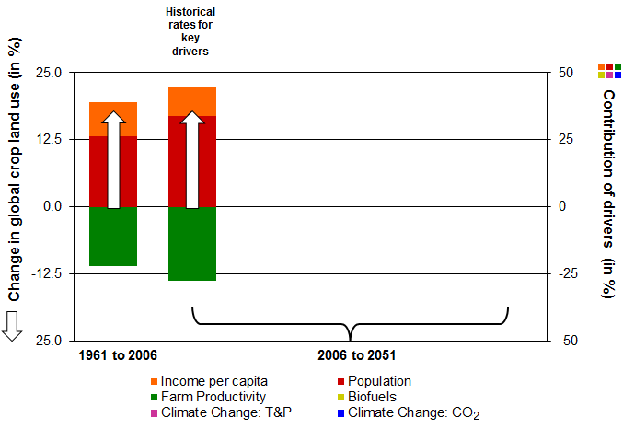
Naïve projections of the future based on past trends
If drivers follow historical trends then land use change is very similar
Population is the main driver of land use, followed by TFP
Baldos and Hertel (2013)

Slide 21
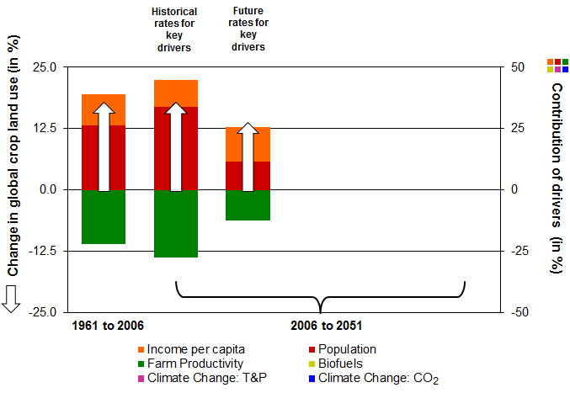
When we impose future population, incomes and TFP growth rates…
Projected global cropland use falls slightly relative to historical trend…
Unlike the past, the relative contribution of population decreases greatly! Income is now the main driver of land use
Baldos and Hertel (2013)

Slide 22
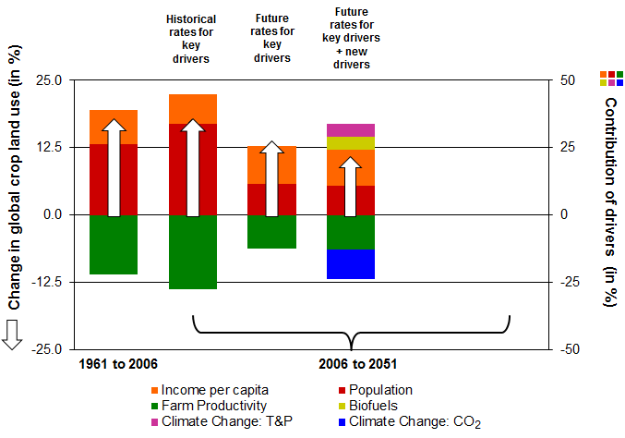
If we add biofuel and climate change impacts in the projections…
Increased biofuel use and adverse climate change impacts from temp. & precip. place more pressure to expand land use
But CO₂ fertilization might be large enough to completely offset these pressures
Baldos and Hertel (2013)

Slide 23
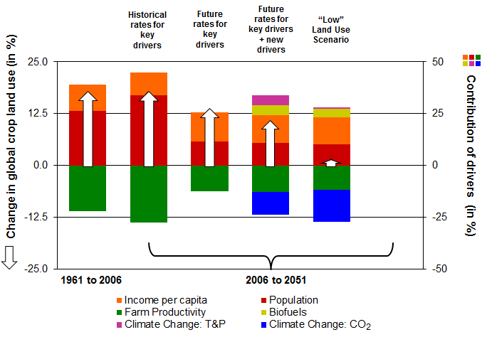
But projections on climate change impacts are quite uncertain…
Crop land expansion might be flat if T&P impacts are small and CO₂ fertilization effect is significantly large – draw from Lobell and Gourdji (2012) for uncertainties.
Baldos and Hertel (2013)

Slide 24
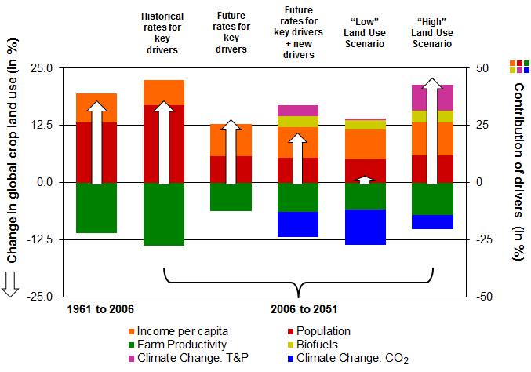
But projections on climate change impacts are quite uncertain…
Or, crop land expansion might exceed historical trends if T&P impacts are large and CO₂ fertilization effect is significantly small -- draw from Lobell and Gourdji (2012) for uncertainties
Baldos and Hertel (2013)

Slide 25
Implications for Model Validation/Evaluation
Differing treatment of economic behavior amongst IAMs have sharply different implications for historical land use – also sharply different error signatures
SIMPLE offers a useful vehicle for exploring these differences. Might this also be useful in other areas of IAMs? Is this already being done?
Next step is to incorporate these ideas into large scale IAMs
IAM Community would benefit from historical model comparison study focused on agr land use.
  MAgPIE has such an effort underway
  AgMIP is starting down this path; would benefit from PCMDI/PIAMDDI insights:
    Have not focused on narrowly designed experiments (analogue of exogenizing SST to focus on atmosphere in PCMDI might be to neutralize supply side of model, focus solely on demand response or vice versa)
    Have avoided historical validation/evaluation
In land use arena, model validation also hinges on critically on data; seek to improve consistency with GEOSHARE

