Slide 1
Lessons From Recent Model Comparison Studies
Massimo Tavoni (FEEM), Elmar Kriegler (PIK),
John Weyant (EMF)
December 13, 2013
PIAMDDI Fall PI Meeting
Bechtel Conference Center
Stanford University

Slide 2


Katniss/Karen Returns

Slide 3
Recent MIP contribution to literature
Forthcoming special issues
EMF27: 28 papers (Climatic Change)
AMPERE: 18 papers (Tech. Forc. & Social Change)
LIMITS: 12 papers (Climate Change Economics)
ROSE: 9 papers (Climatic Change)
EMF24-US: 11 papers (The Energy Journal)
EMF28_EU: 17 papers (Climate Change Economcs)

Slide 4

Exploring mitigation pathways for AR5
Large scale model inter-comparison efforts
AMPERE – Are short-term climate actions consistent with long-term goals?
Comparison study with 12 models (PIK & IIASA)
Special Issue in Technological Forecasting and Social Change
LIMITS – Implementing 2 degree climate policies: An assessment of Durban Platform architectures
Comparison study with 7 models (FEEM & PIK),
Special Issue in
Climate Change Economics
EMF27 – The Role of Technology for Climate Stabilization Comparison study with 19 models (Stanford & PIK),
Special Issue in Climatic Change
Climate policy
450ppm CO₂eq
550ppm CO₂eq
Technology variation
e.g. No CCS, limited bioenergy, Nuclear phase out
Weak policy action
No policy
RoSE – The impact of economic growth and fossil fuel availability on climate protection. Comparison study with 5 models (PIK);
Special Issue in Climatic Change
Variation of model baseline assumptions
e.g. population, economic growth, fossil fuel resources

Slide 5
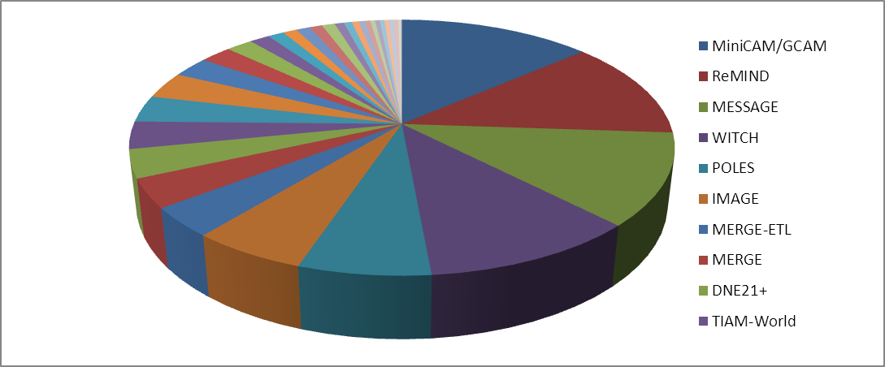
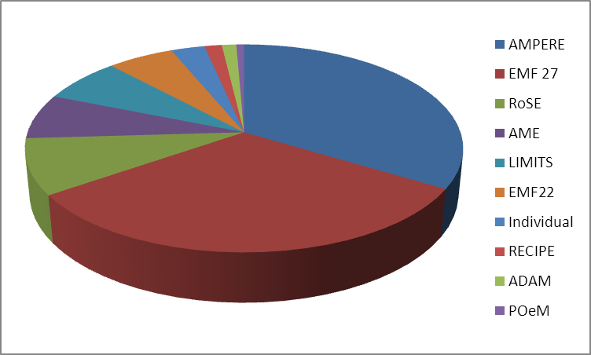
MIP contribution to AR5 scenario database
AR5 scenario database: Open community call to submit published (in press) mitigation pathways for quantitative analysis by AR5 authors (April 2012-May 2013)
1230 scenarios from 34 modeling teams, 9 comparative and 3 individual studies were submitted

Slide 6
Current EMF Studies
EMF 24, EMF 27, EMF 28 (two) on CC
EMF 29: Border Carbon Adjustments
EMF 26/31: Shale Gas
EMF 30: Non-Kyoto Forcing, Air Pollution,
      Bio-Energy & Land Use

Slide 7
EMF27 Study on
Global Technology and Climate Policy Strategies
Special issue in Climatic Change
Synthesis (Kriegler, Weyant et al.), Policy Overview (Blanford et al.), Technology Overview (Krey et al.)
X-cuts on Energy Efficiency (Sugiyama et al.), CCS (Koelbl et al.), Nuclear (Kim et al.), Non-Bio Renewables (Luderer et al.), Bioenergy (Rose et al.), Land use (Popp et al.), Resources (McCollum et al.), Non-Kyoto forcing (Rose et al.)
17 modeling team papers
18 participating models (17 x global, 1 x India)
AIM-Enduse, BET, DNE21+, EC-IAM, ENV-Linkages, FARM, GCAM, GCAM-IIM, GRAPE, IMACLIM, IMAGE, MERGE, MESSAGE, Phoenix, POLES, REMIND-MAgPIE, TIAM-ECN, WITCH
 | FullTech | LowEI | NoCCS | NucOff | LimSW | LimBio | Conv | EERE | LimTech
Baseline | 13/13 | 13/13 |  | 11/11 | 11/11 | 13/13 | 13/13 | 13/13 | 11/11
550 ppm | 13/13 | 13/13 | 12/12 | 11/11 | 11/11 | 13/13 | 13/13 | 12/12 | 6/9
450 ppm | 10/11 | 9/10 | 4/11 | 9/10 | 9/10 | 9/11 | 8/11 | 6/11 | 0/10

Slide 8
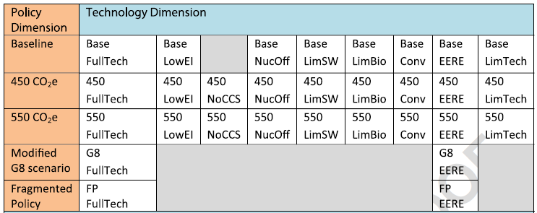
EMF 27 Global Technology and
GHG Mitigation Scenario Matrix

Slide 9
EMF 27: Participating Global Models
AIM/End Use (Japan)
BET (Japan)
DNE 2100 (Japan)
EC-IAM (Canada)
ENV-Linkages(OECD)
FARM (US)
GCAM (U.S.)
GCAM-IIM (India)
GRAPE (Japan)
IMACLIM (France)
IMAGE (Netherlands)
MERGE (U.S.)
MESSAGE (IIASA)
Phoenix (US)
POLES (France)
REMIND (Germany)
TIAM-World (Canada)
WITCH (Italy)

Slide 10
Structure of EMF 27 Special Issue
(Special Issue of Climatic Change)
Overview of Overviews (Kriegler, Weyant)
Policy Overview (Blanford et al.) |  | Technology Overview (Krey et al.)
Resources (McCollum et al.) | Renewables (Luderer et al.) | Bioenergy (Rose et al.) Land Use (Popp, et al.) Nuclear Energy (Kim et al.) | Energy Efficiency (Sugiyama et al.) Carbon Capture & Storage (Koebl, van Vuuren)
Non-CO2 Forcing (Rose et al.)
Individual Modeling Team Papers (17)
Subgroups

Slide 11
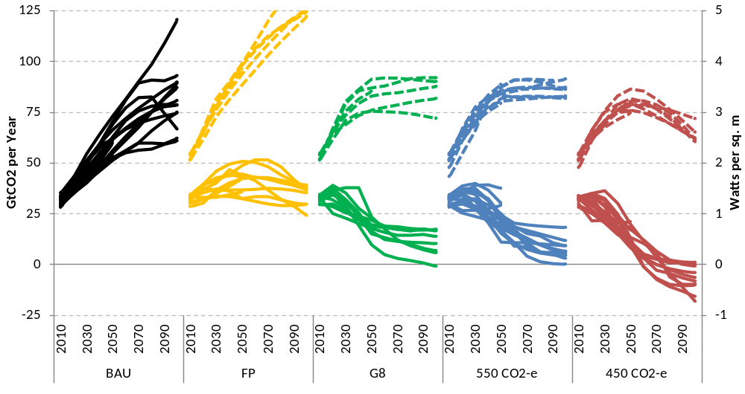
EMF27 emissions scenarios
Shown are FF&I CO2 emissions and radiative forcing
Blanford, Kriegler, Tavoni, Climatic Change, forthcoming
Kriegler, Weyant et al, Climatic Change, forthcoming

Slide 12
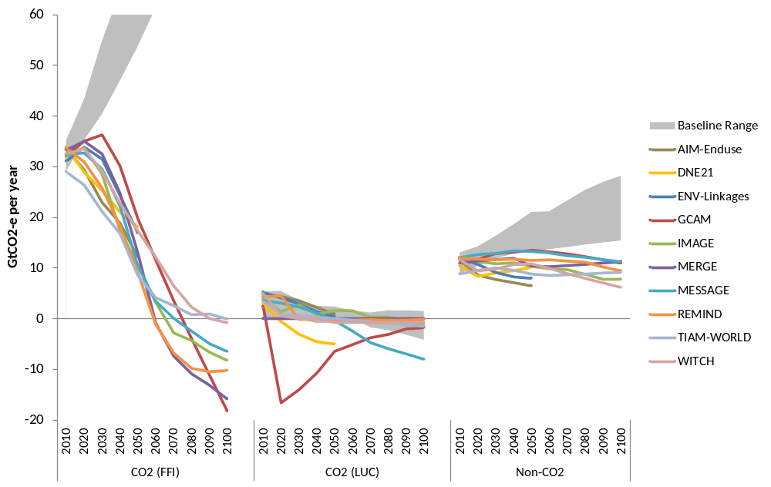
Sectoral emissions reductions
Blanford, Kriegler, Tavoni, Climatic Change, forthcoming

Slide 13
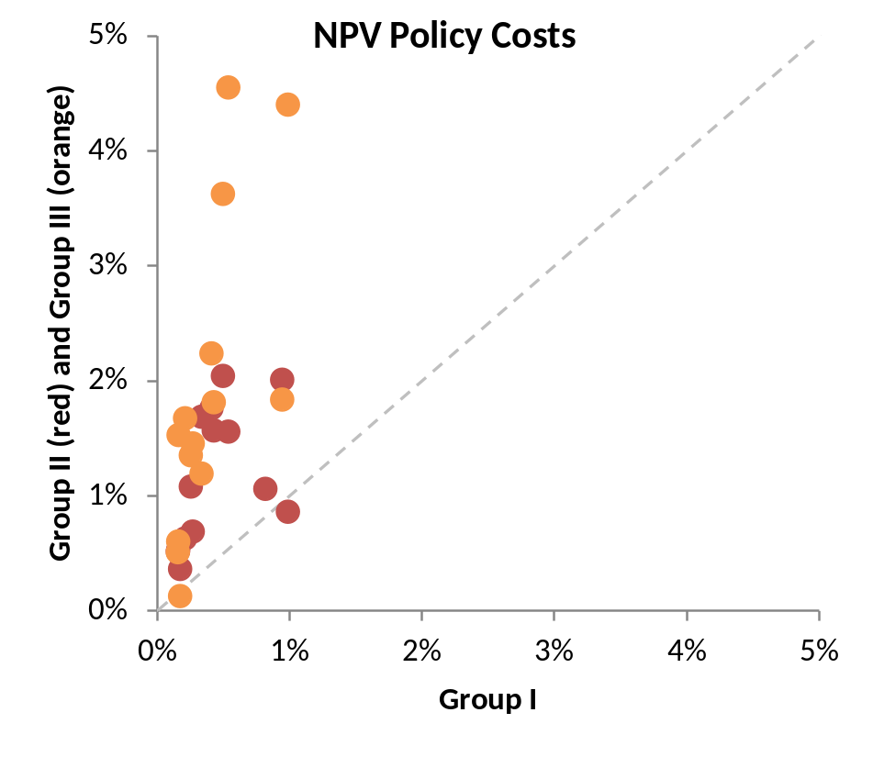
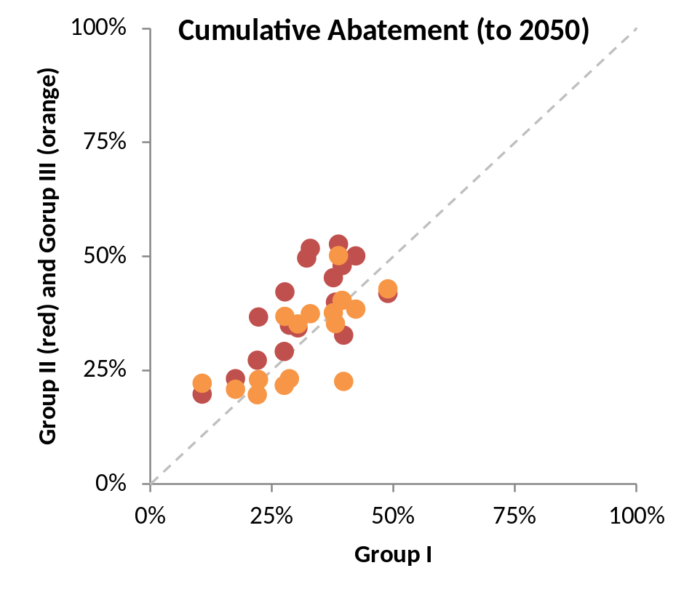
Regional emissions reductions and policy costs
550 ppm CO2e scenario
Blanford, Kriegler, Tavoni, Climatic Change, forthcoming

Slide 14
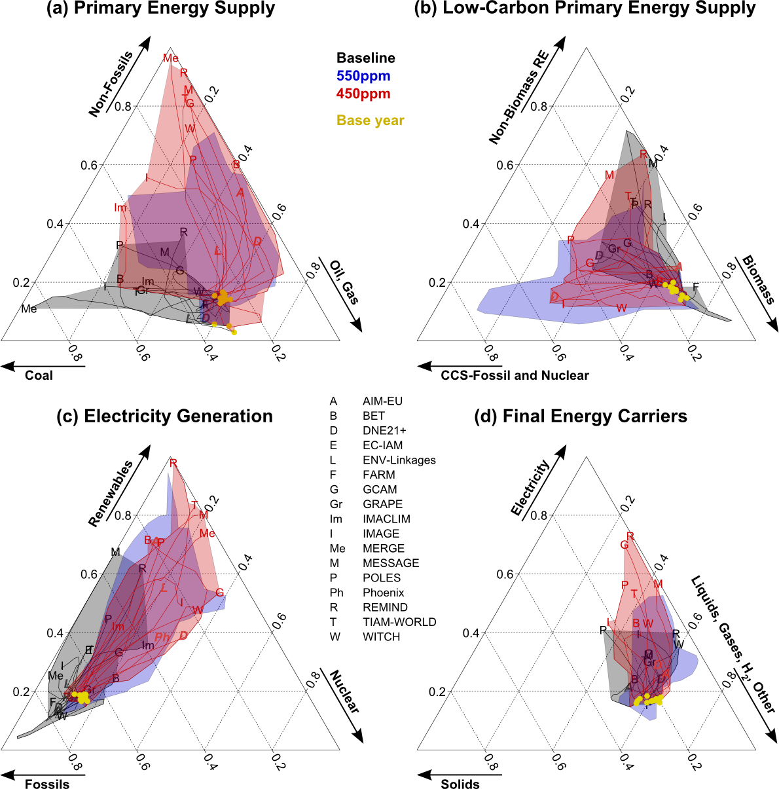
Energy system transformation
Kriegler, Weyant et al,
Climatic Change, forthcoming
Krey, Luderer et al,
Climatic Change, forthcoming

Slide 15
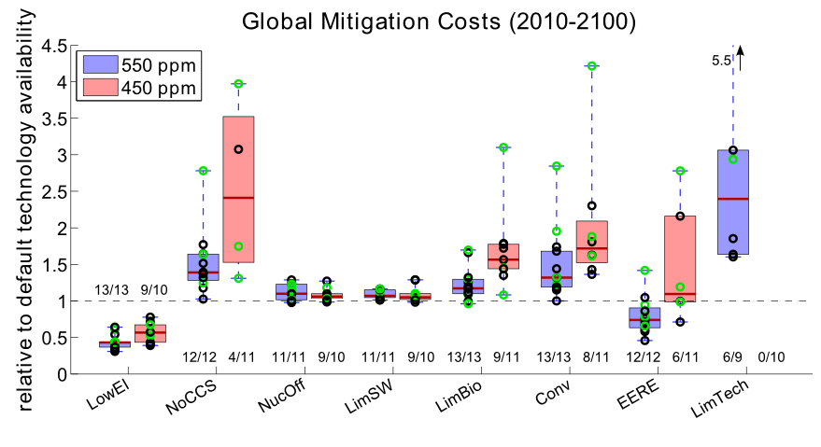
EMF27 – The role of technology for mitigation
BECCS is very valuable mitigation strategy, particular for 450 ppm
Krey, Luderer et al, Climatic Change, forthcoming
Kriegler, Weyant et al, Climatic Change, forthcoming

Slide 16
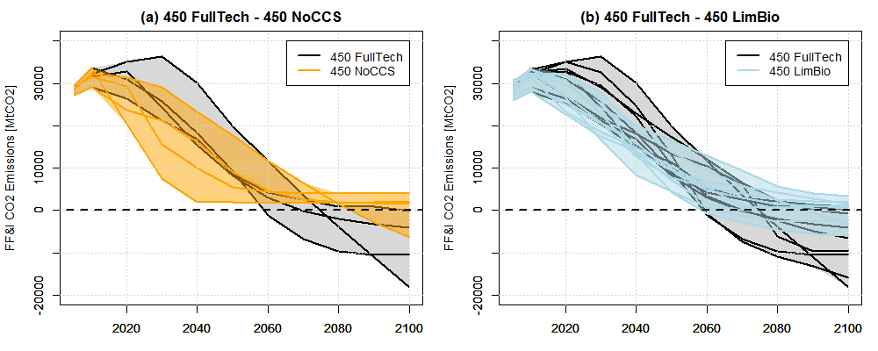
Impact of technology on emissions profile
Krey, Luderer et al, Climatic Change, forthcoming

Slide 17

ROSE study on the role of population, economic growth, fossil fuel availability and delayed action for achieving concentration targets
Special issue in Climate Change
Delayed action (Luderer et al.), Energy security (Cherp et al.), African development & emissions (Calvin et al.), Fossil fuel markets (Bauer et al.), Fossil fuel and biofuel interactions (Calvin et al.), Drivers of energy investment (DeCian et al.), China energy transformation (Chen et al.)
5 participating models (4 x global, 1 x China)
GCAM, IPAC, REMIND, WITCH, China-TIMES
For more information on the RoSE study: www.rose-project.org
Funded by

Slide 18
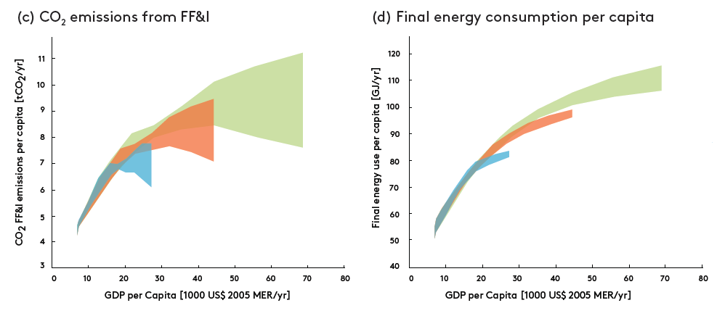

Climate stabilization requires strong climate policy
In the absence of climate policy and with current trends in energy intensity, energy demand and CO₂ emissions will increase with per capita income
~12 x current GWP
~8 x current GWP
~4 x current GWP

Slide 19
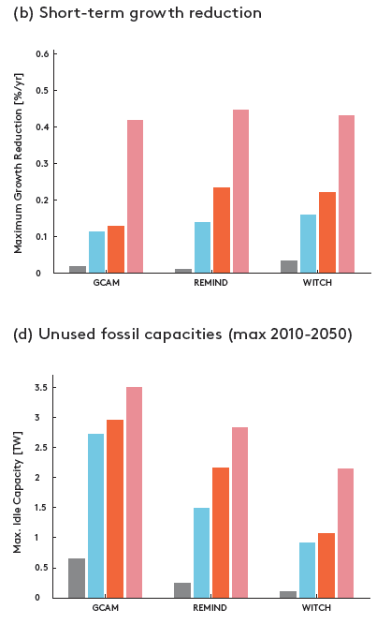

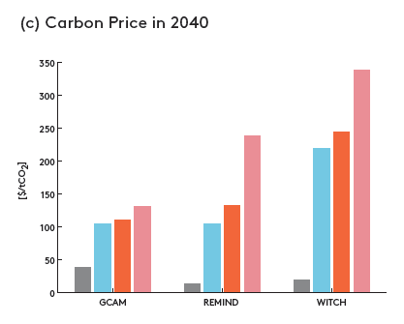
Economic impact of later action
Later action implies greater economic and institutional challenges for reaching 2ºC
Luderer et al., Climatic Change, online

Slide 20


AMPERE Project on ... a lot of things
Established a European Modeling Platform
Global models from the EU: GEM-E3, IMACLIM, IMAGE, MERGE-ETL, MESSAGE, POLES, REMIND, WITCH, WorldScan
EU models: Green-X, PRIMES, NEMESIS, TIMES-PanEU
International partner models: AIM-Enduse, DNE21+, GCAM
Special issue in Technological Forecasting and Social Change on delayed and fragmented action scenarios of climate policy
Implications of short term targets for the costs and feasibility of long term targets (Riahi et al., Bertram et al., Eom et al.)
Staged accession to global climate regime (Kriegler et al.)
X-cuts on climate outcomes (Schaeffer et al.), impact of delay and fragmentation on fossil fuel markets (Bauer et al.), EU roadmap (Schwanitz et al.)
Diagnostic indicators for integrated assessment models (Kriegler et al.)
Individual modeling team papers on carbon leakage (industry, land use, energy channel), technology diffusion, energy efficiency, energy system transformation
Funded by the EU 7th Framework Programme

Slide 21
AMPERE WP2 Study (Riahi et al.)
Focus on 2030
(extension of “pledge effort”)
World GHG emissions
80
Implications for costs, technology needs, and attainability of long-term stabilization goals?
AIM-Enduse
70
DNE21
GCAM
IMAGE
60
MERGE-ETL
MESSAGE
Rapid reductions
in the medium term
REMIND
50
WITCH
Baseline
High 2030
40
Low 2030
GHG emissions (GtCO2 equiv.)
Optimal
30
More stringent policies in the long term
20
Lack of short-term reductions (2030)
10
0
2000
2020
2040
2060
2080
2100

Slide 22
Key findings
High 2030 emissions (~60 GtCO2e) pose a triple-challenge:
  Fossil fuel lock-in (+50% compared to today by 2030)
  Stranded assets (100s of coal power plants globally)
  Requires doubling the “upscaling pace” of low-carbon energy
Implications for the transformation:
  Increased risks that low stabilization targets become unattainable
  Higher costs (particularly in the medium term)
  “Overshoot” reduces chances to stay below 2C
Energy Efficiency critical for keeping options open
Results are being published as a Special Issue of TFSC and open-access databases
(https://secure.iiasa.ac.at/web-apps/ene/AMPEREDB)

Slide 23
Thank You
The End

Slide 24
Simple Snowmass Rules & Regulations
(aka theWeyant rules)
No whining (aka the Janetos rule)
No BS (aka the Pavarini rule)
No grand standing (aka the Sutton rule)
Admit your discipline has more than a few limitations (aka the Schneider rule)
This is NOT all about you (aka the Pindyck rule)
Why Obey These Rules? Because …..(Next Slide)

Slide 25
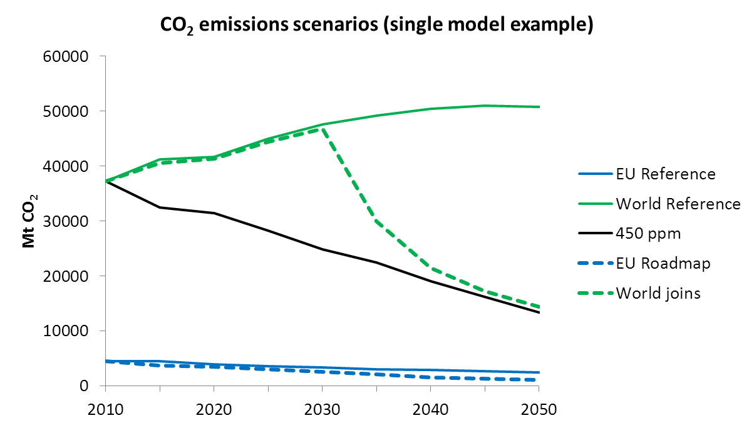
AMPERE WP3 study on fragmented action and staged accession
What implications for front runners (EU27; EU27 & China) and late adopters in an international climate policy regime?
What climate outcome can still be achieved if early movers are joined by the rest of the world after 2030?
How large are inefficiencies, e.g. from carbon leakage, in the initial period of fragmented action?
Study design:
Excess emissions until 2050 are not compensated in the 2nd half of the century

Slide 26
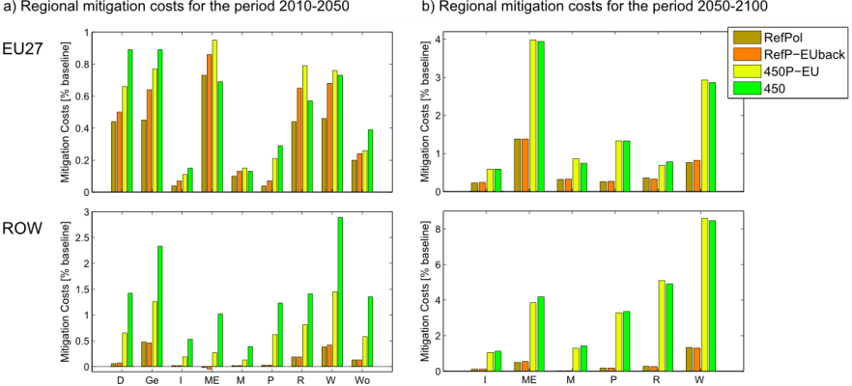
Mitigation costs for early movers & late adopters
NPV costs, 5 %/yr discounting
Reference policy (20-30-40% reduction in 2020-30-50) costs for EU significant portion of 450 ppm policy costs
Kriegler et al., Tech. Forecasting & Social Change, forthcoming

Slide 27
Backup slides

Slide 28
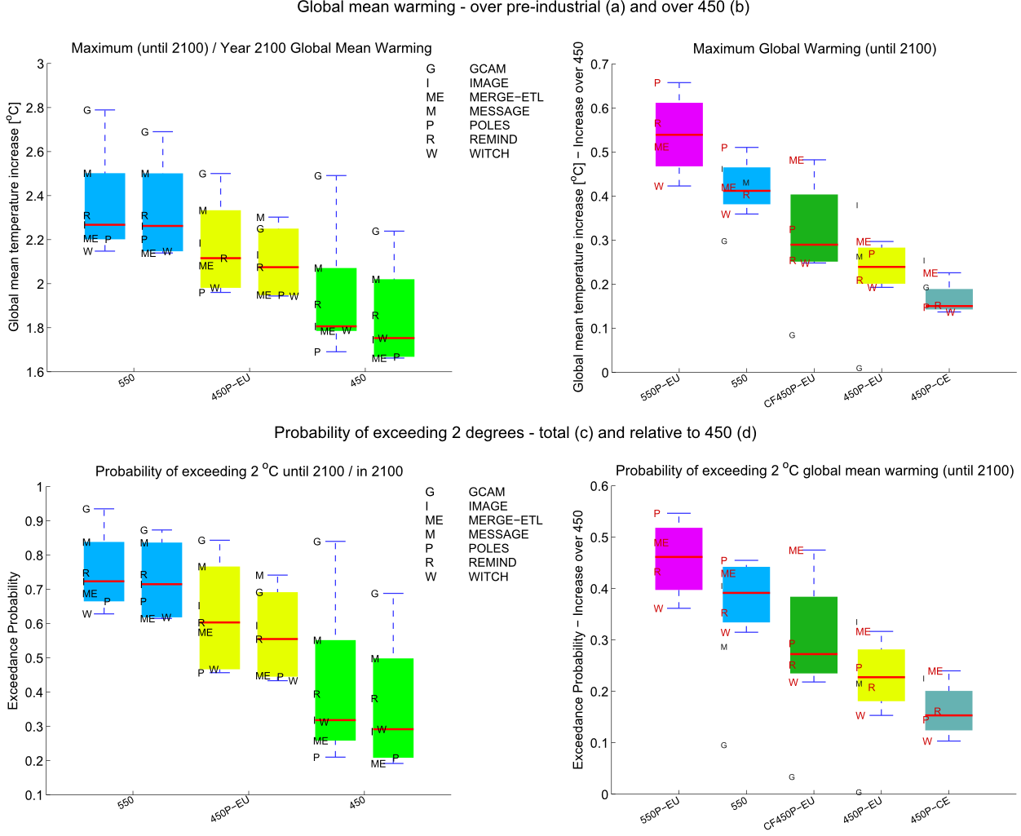
Climate outcome of accession scenario
Kriegler et al., Schaeffer et al.,
Tech. Forecasting & Social Change, forthcoming
Notes:
Da die vorigen Folien Einzelmodell-Ergebnisse zeigen, koennte man hier kurz darauf eingehen, dass die Ergebnisse verschiedener Modelle eine gewisse Bandbreite abdecken, und dass die klimatischen und wirtschaftlichen Folgen eines bestimmten Szenarios sich besser mittels eines Ensembles von Modellen untersuchen lassen.

Slide 29
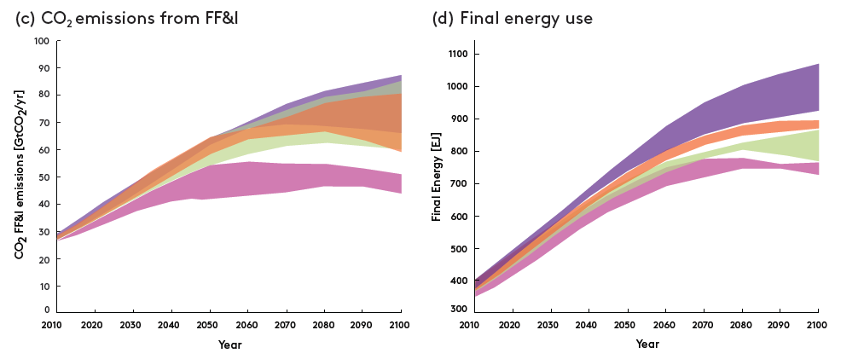
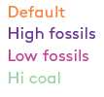
Climate stabilization requires strong climate policy
Fossil fuel scarcity alone is not sufficient to reduce CO₂ emissions
69-73 ZJ
72-84 ZJ
54-61 ZJ
67-83 ZJ
ca. 19 ZJ of fossil fuels burned until today
ca. 36 ZJ of proven reserves today

Slide 30
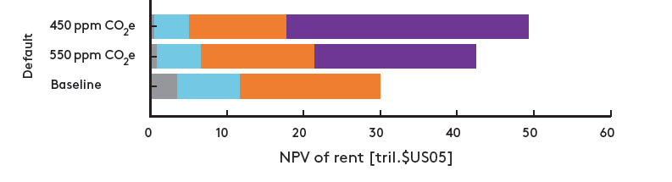
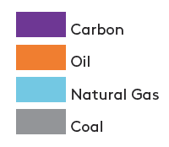
Mitigation strongly impacts fossil fuel markets
Mitigation improves energy security by diversifying energy supply Cherp et al., Climatic Change, forthcoming
Mitigation reduces fossil fuel rents.
This is overcompensated by the emerging carbon rent.
Fossil fuel rent = (Price - Production costs) * Fuel; Carbon rent = CO₂ price * Emissions
Bauer et al., Climatic Change, forthcoming
Results from the
ReMIND model
2010-2100, discounted at 5%

Slide 31
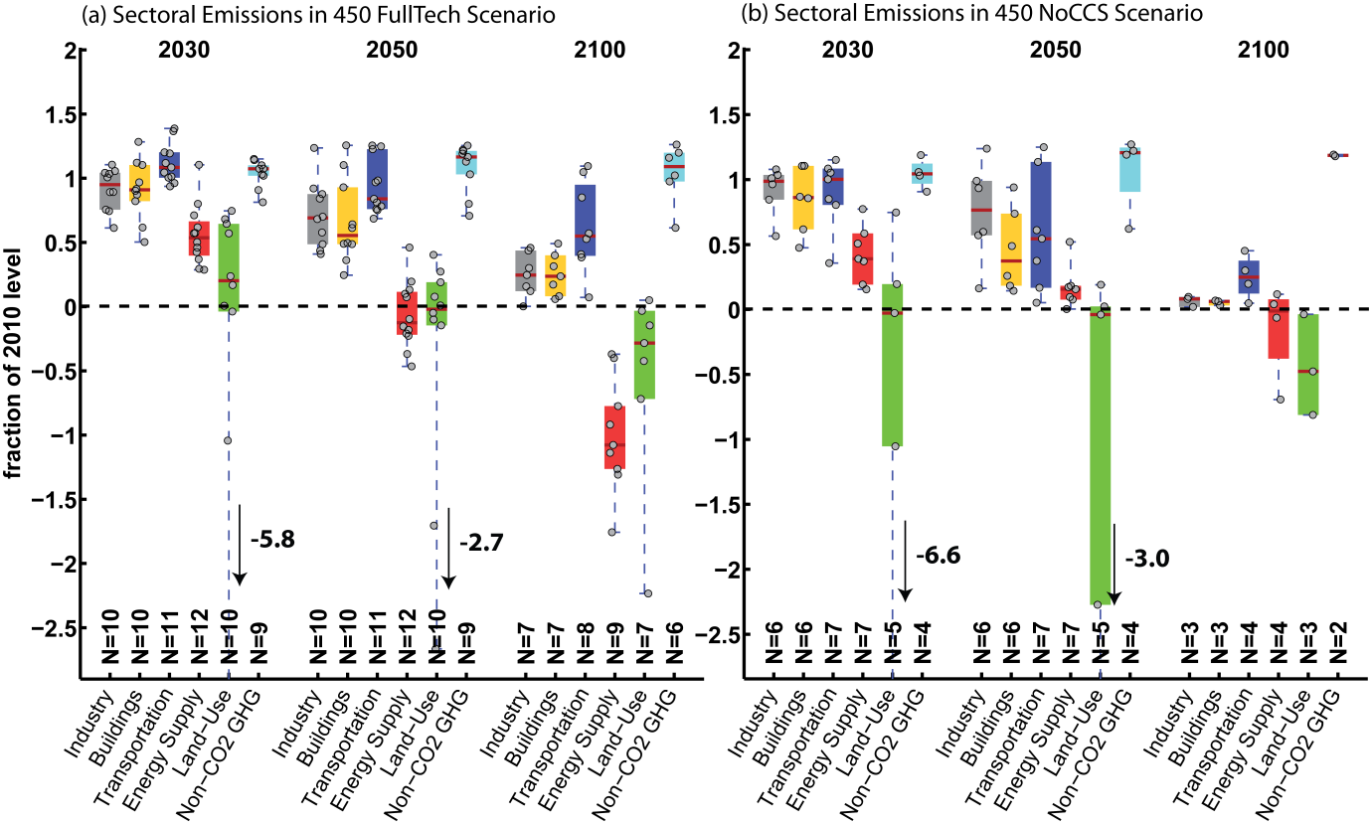
Sectoral emissions response
Krey, Luderer et al, Climatic Change, forthcoming

Slide 32
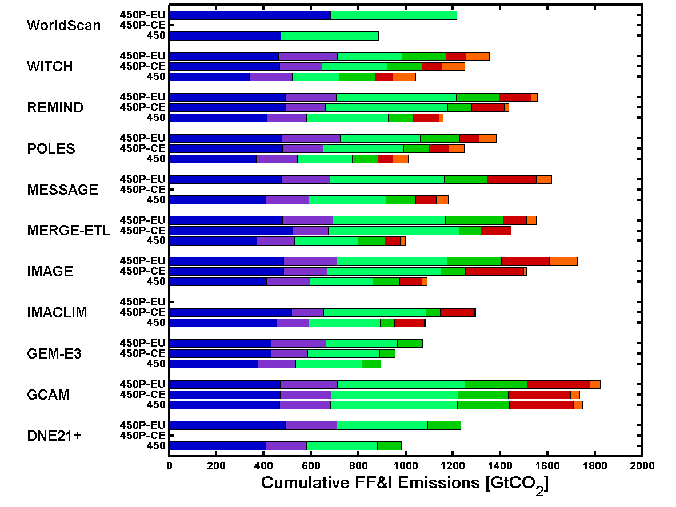
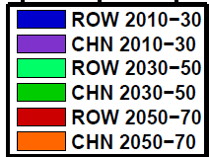
Carbon lock-in for late adopters
Kriegler et al., Tech. Forecasting & Social Change, forthcoming
Excess emissions after 2030 exceed those before 2030
Lower short term costs, but higher transitional costs due to carbon lock-ins

Slide 33
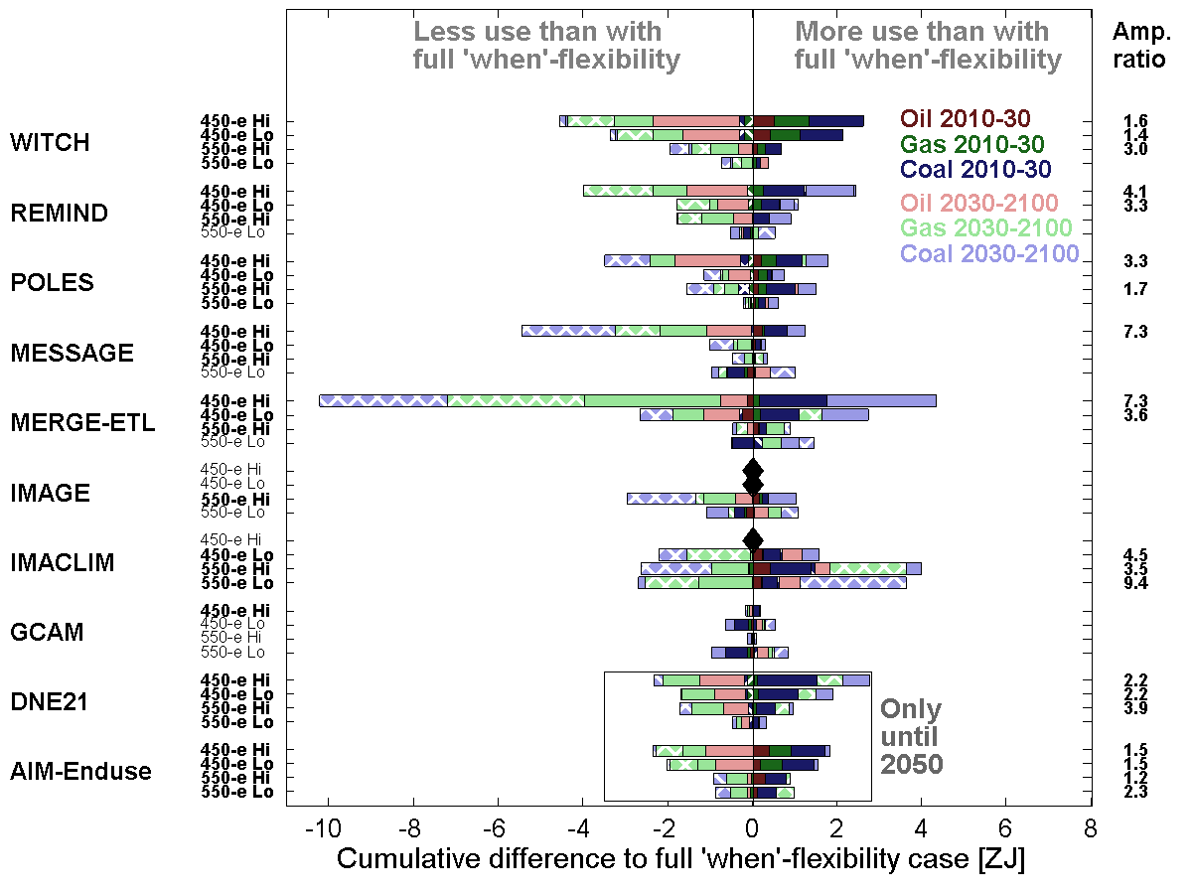

Fossil fuel market impact of delay & fragmentation
Fragmentation in staged accession scenarios (AMPERE WP3)
Carbon leakage effects limited (leakage rate < 20% in most cases)
Delayed action in reaching long term targets (AMPERE WP2)
➔ Less cumulative fossil fuel use (2010-2100) in the case of delay
Bauer et al., Tech. Forecasting & Social Change, forthcoming

Slide 34
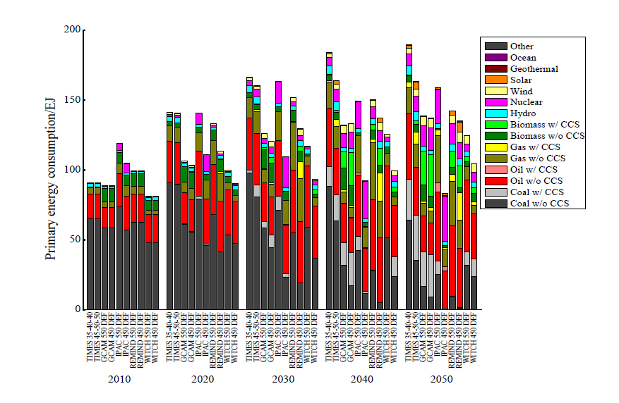
China energy transformation
Comparison of global models with China-TIMES
...
Chen et al., Climatic Change, published

Slide 35
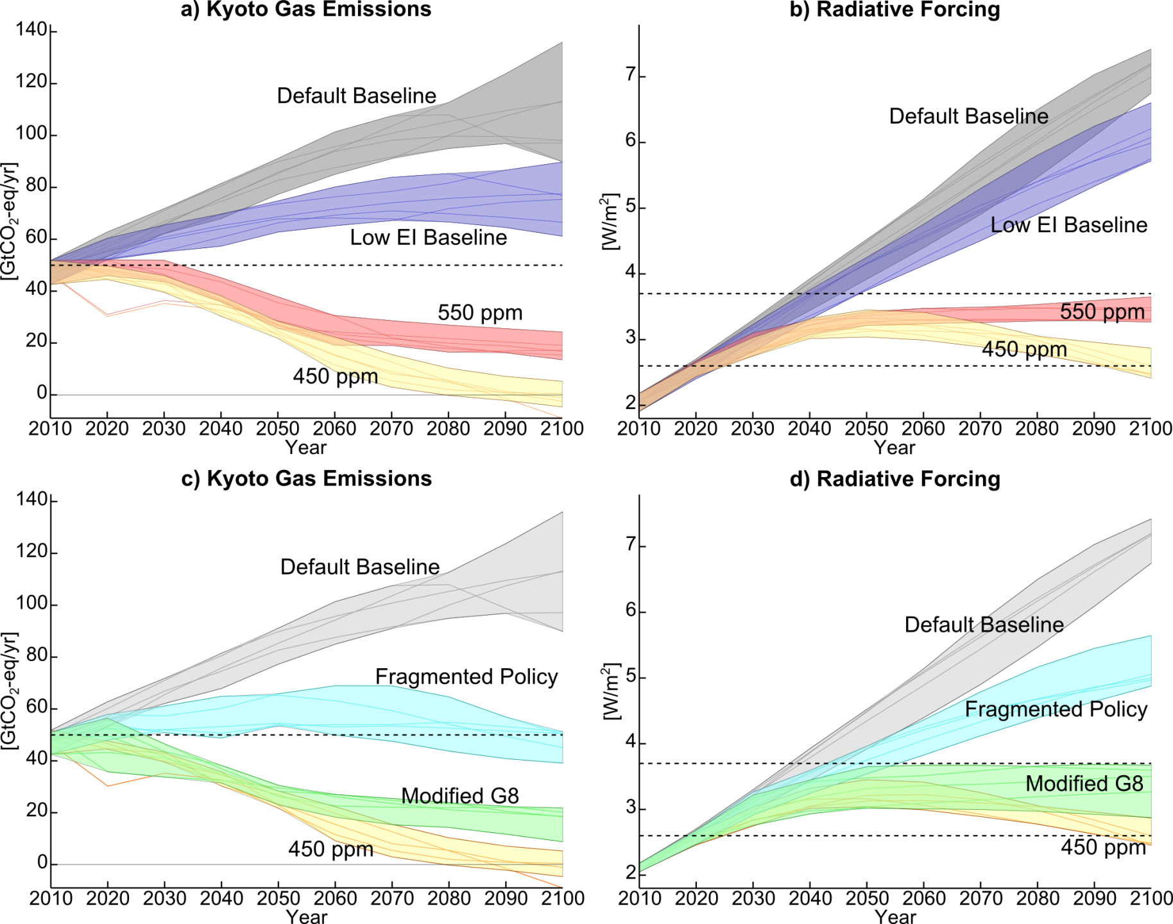
Kriegler, Weyant et al.,
Climatic Change, forthcoming

Slide 36
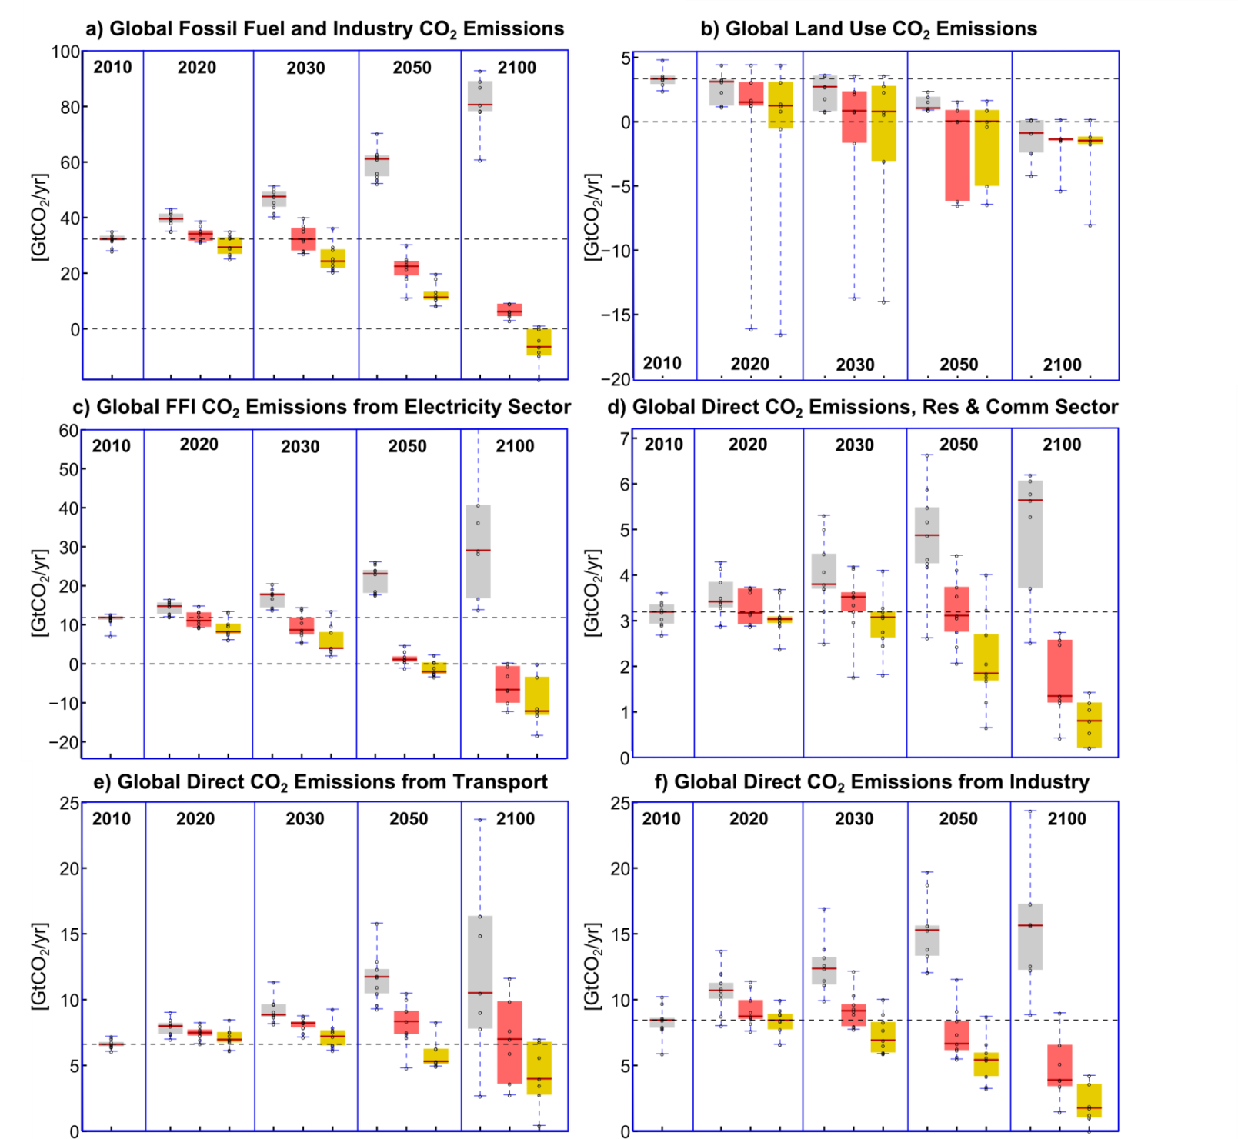
Kriegler, Weyant et al., Climatic Change, forthcoming

Slide 37
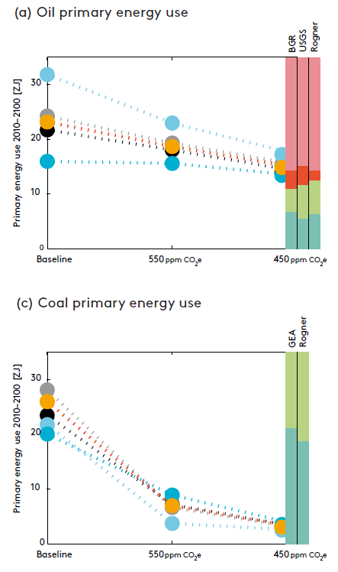

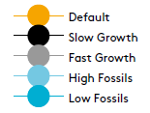
Mitigation strongly impacts fossil fuel markets
Strong reduction of coal use
Only moderate reduction of oil use (conventional reserves & resources are still being used)
Climate mitigation effectively limits uncertainty about future fossil fuel use
Bauer et al., Climatic Change, forthcoming

Slide 38
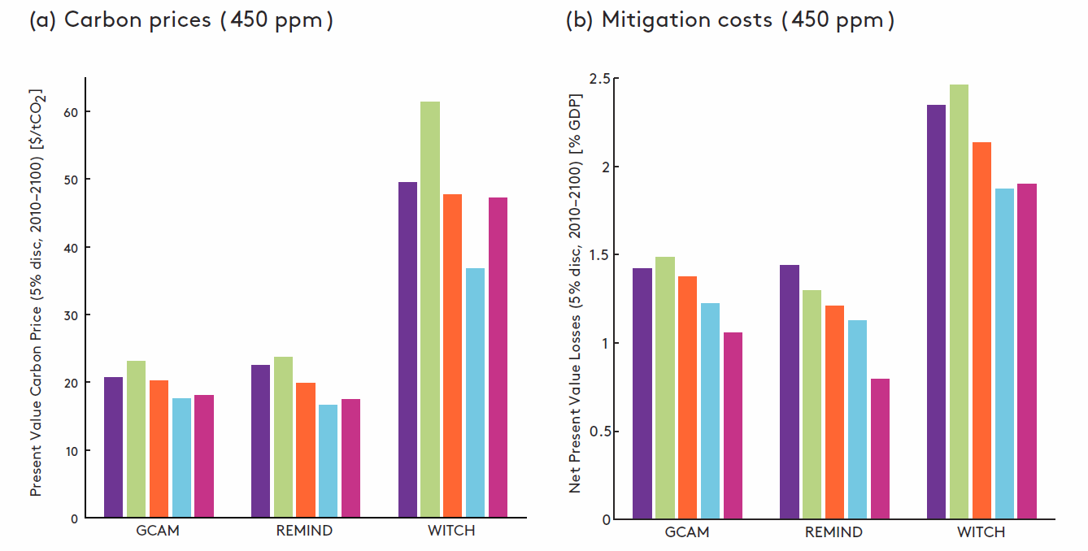
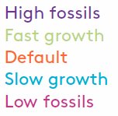
Carbon prices and mitigation costs 2010-2100
Estimates for „idealized immediate global action scenarios“!
Only direct costs of climate mitigation. No benefits, co-benefits or adverse side-effects included
Costs vary by 25-80% with economic growth and fossil fuel assumptions
Costs approximately double from 550 to 450 ppm CO₂e

Slide 39
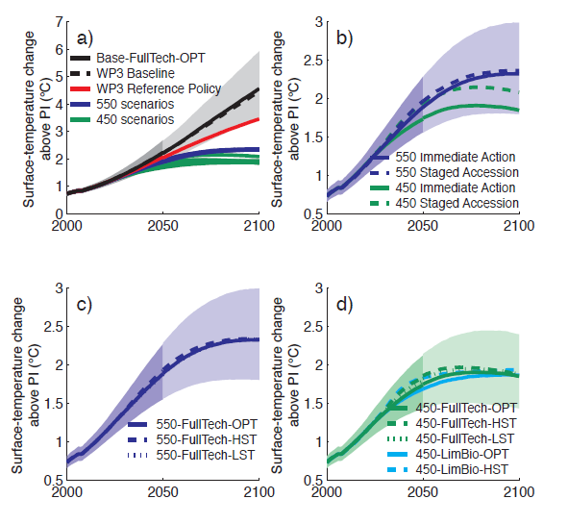
Temperature outcomes of AMPERE scenarios
Schaeffer et al., Technological Forecasting & Social Change, forthcoming

Slide 40
EMF 24: Motivating Questions
( Allen Fawcett/Leon Clarke)
What are the potential implications of sectoral approaches to GHG emissions reductions?
How do sectoral policies interact with an economy-wide policy?
How might technological improvements and technological availability influence the answers to the above questions?

Slide 41
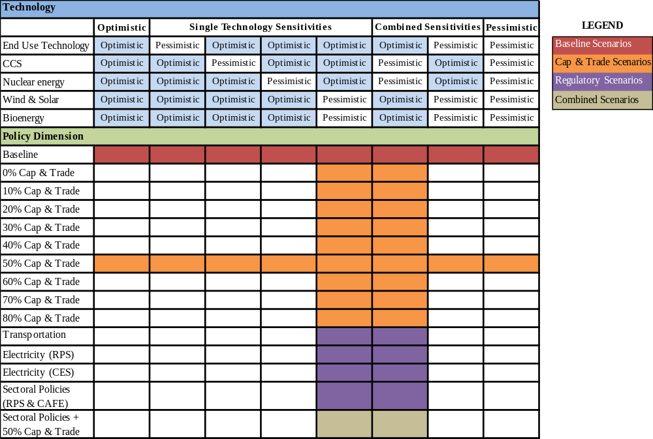
Overview of Scenarios

Slide 42
Policies
The policy scenarios of the EMF 24 exercise are based on combinations of three different types of national policy instruments:
  Economy-wide cap-and-trade policy,
  Transportation Sector policy represented by a Corporate Average Fuel Economy (CAFE) standard for light-duty vehicles,
  Electricity Sector policy represented by either a renewable portfolio standard (RPS) or clean energy standard (CES) combined with a CCS requirement for new coal.
These policy scenarios do not reflect any specific legislative or administration policy proposals, but instead are intended to represent more generic versions of economy wide and sector specific policies.

Slide 43
Total Cost & Emissions Reductions Across Scenarios

Slide 44
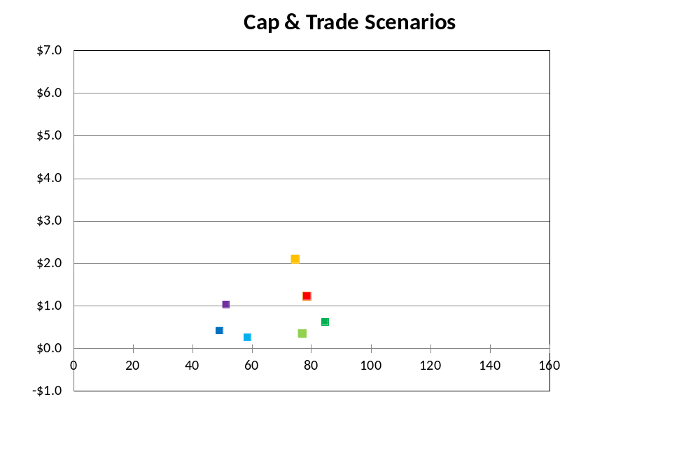

Net Present Value of Cumulative Cost
vs. Cumulative Abatement
Technology Assumption
- Optimistic CCS Nuke
Model
50% C&T
NPV of Total Cost – (Trillion $)
Cost Metric*
Consumption Loss
Cumulative Covered CO₂ Reductions (GtCO₂)
* GCAM’s Cost Metric is
Area Under MAC

Slide 45
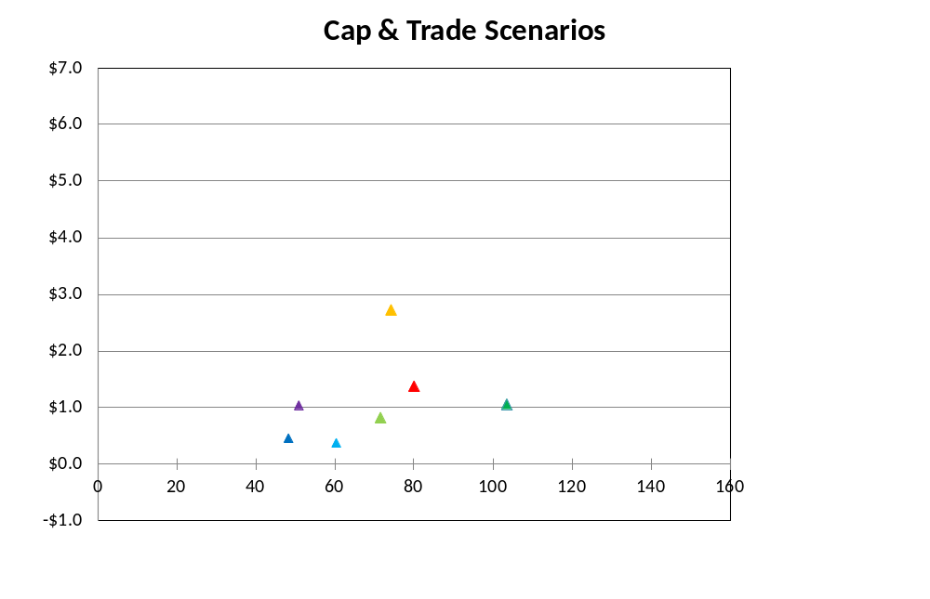
Net Present Value of Cumulative Cost
vs. Cumulative Abatement
Technology Assumption
- Optimistic RE
Model
50% C&T
NPV of Total Cost – (Trillion $)
Cost Metric*
Consumption Loss
Cumulative Covered CO₂ Reductions (GtCO₂)
* GCAM’s Cost Metric is
Area Under MAC

Slide 46
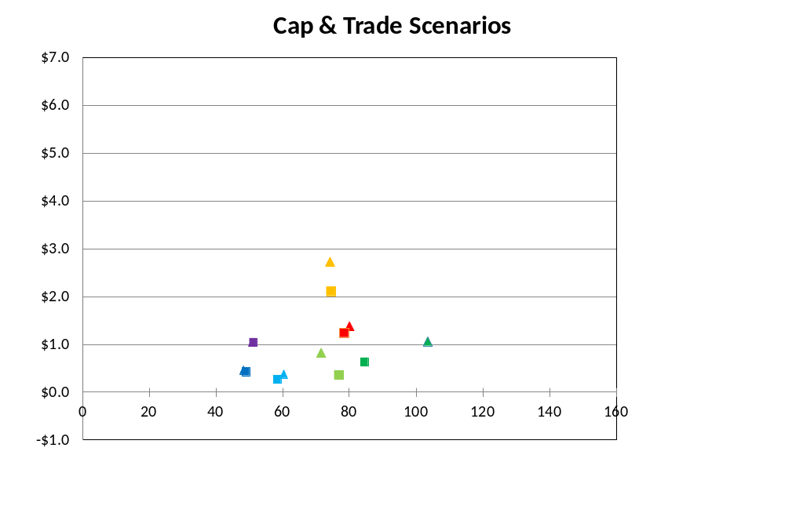
Net Present Value of Cumulative Cost
vs. Cumulative Abatement
Technology Assumption
- Optimistic RE
- Optimistic CCS Nuke
Model
50% C&T
NPV of Total Cost – (Trillion $)
Cost Metric*
Consumption Loss
Cumulative Covered CO₂ Reductions (GtCO₂)
* GCAM’s Cost Metric is
Area Under MAC

Slide 47
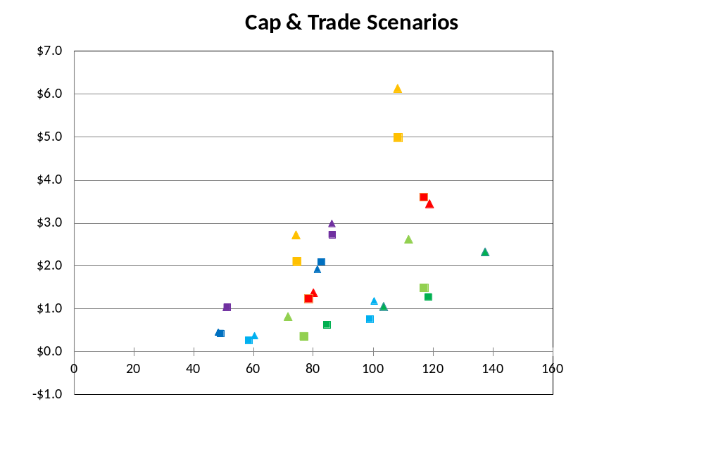
Net Present Value of Cumulative Cost
vs. Cumulative Abatement
Technology Assumption
- Optimistic RE
- Optimistic CCS Nuke
Model
80% C&T
NPV of Total Cost – (Trillion $)
Cost Metric*
Consumption Loss
Cumulative Covered CO₂ Reductions (GtCO₂)
* GCAM’s Cost Metric is
Area Under MAC

Slide 48
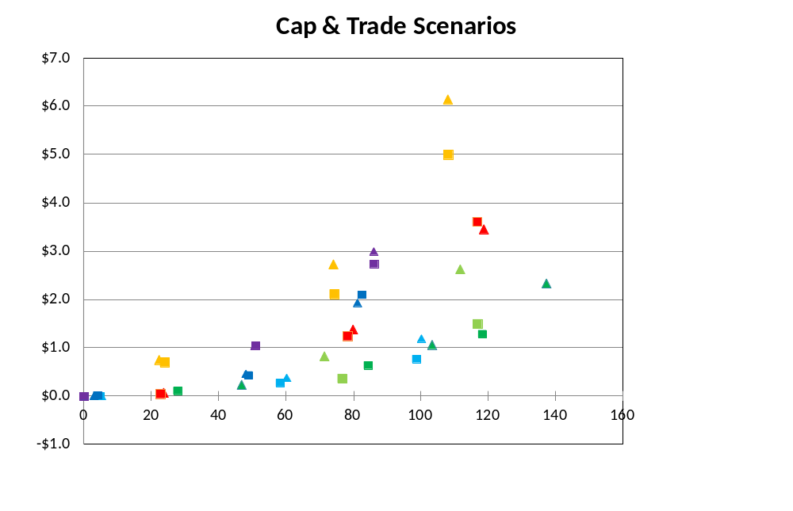
Net Present Value of Cumulative Cost
vs. Cumulative Abatement
Technology Assumption
- Optimistic RE
- Optimistic CCS Nuke
Model
NPV of Total Cost – (Trillion $)
Flat C&T
Cost Metric*
Consumption Loss
Cumulative Covered CO₂ Reductions (GtCO₂)
* GCAM’s Cost Metric is
Area Under MAC

Slide 49
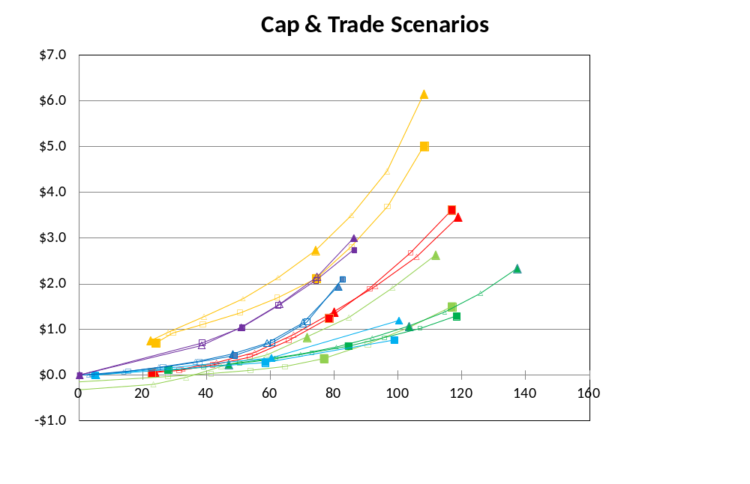
Net Present Value of Cumulative Cost
vs. Cumulative Abatement
Technology Assumption
- Optimistic RE
- Optimistic CCS Nuke
Model
NPV of Total Cost – (Trillion $)
Cost Metric*
Consumption Loss
Cumulative Covered CO₂ Reductions (GtCO₂)
* GCAM’s Cost Metric is
Area Under MAC

Slide 50
“Efficient Frontier”
Cost Metric Comparison

Slide 51
Revenue Recycling Caveats
The cap-and-trade scenarios assume a per-capita based lump-sum recycling of the revenue.
It is well-known from the literature that using the carbon revenue to lower pre-existing distortionary taxes may yield substantial efficiency gains.
Due to model differences in the representation of the fiscal system, this study is not able to explore this dimension further, but it is important to bear in mind that the estimated cost for the cap-and-trade policies presented here should be interpreted as an upper bound, i.e. cost may be smaller if the carbon revenue would be recycled by lowering marginal tax rates.

Slide 52
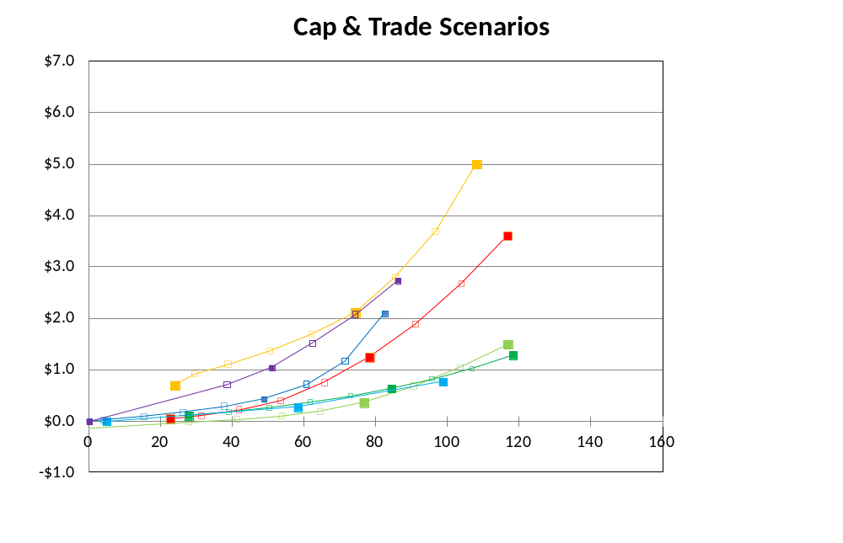
Net Present Value of Cumulative Cost vs. Cumulative Abatement
Technology Assumption
- Optimistic CCS Nuke
Model
NPV of Total Cost – (Trillion $)
Cost Metric*
Consumption Loss
Cumulative Covered CO₂ Reductions (GtCO₂)
* GCAM’s Cost Metric is
Area Under MAC

Slide 53
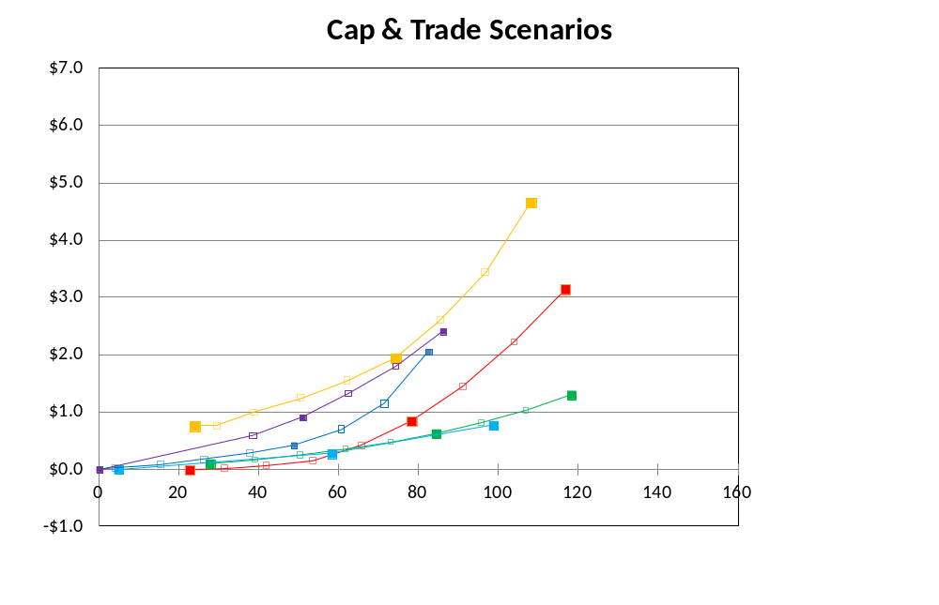
Net Present Value of Cumulative Cost vs. Cumulative Abatement
Technology Assumption
- Optimistic CCS Nuke
Model
NPV of Total Cost – (Trillion $)
Cost Metric*
Equivalent Variation
EV is the amount of income that must be given to people at base case prices to achieve policy case utility levels.
* GCAM’s Cost Metric is
Area Under MAC
Cumulative Covered CO₂ Reductions (GtCO₂)

Slide 54
Net Present Value of Cumulative Cost vs. Cumulative Abatement
Technology Assumption
- Optimistic CCS Nuke
Model
NPV of Total Cost – (Trillion $)
Cost Metric*
Consumption Loss
Cumulative Covered CO₂ Reductions (GtCO₂)
* GCAM’s Cost Metric is
Area Under MAC

Slide 55
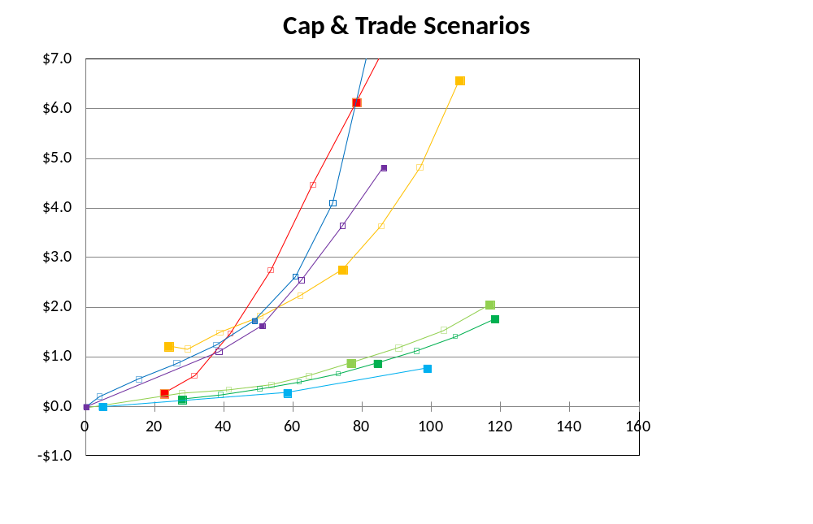
Net Present Value of Cumulative Cost vs. Cumulative Abatement
Technology Assumption
- Optimistic CCS Nuke
Model
NPV of Total Cost – (Trillion $)
Cost Metric*
GDP Loss
Cumulative Covered CO₂ Reductions (GtCO₂)
* GCAM’s Cost Metric is
Area Under MAC

Slide 56
Individual Models

Slide 57
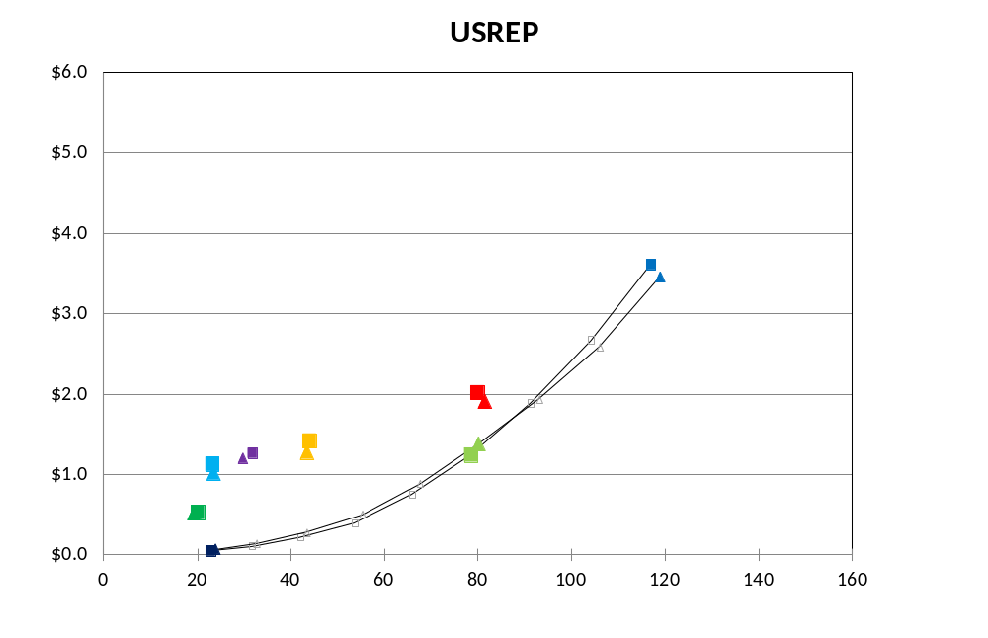
Net Present Value of Cumulative Cost vs. Cumulative Abatement
Emissions Metric
Technology Assumption
- Covered CO₂ Emissions (GtCO₂)
- Optimistic RE
- Optimistic CCS Nuke
80% Cap & Trade
NPV of Total Cost – C Loss – (Trillion $)
50% Cap & Sectoral Policies
CES +
New Coal CCS
RPS + New Coal CCS
RPS & Transport
50% Cap & Trade
Transport
Policy
Flat Cap & Trade
Cumulative Emissions Reductions

Slide 58
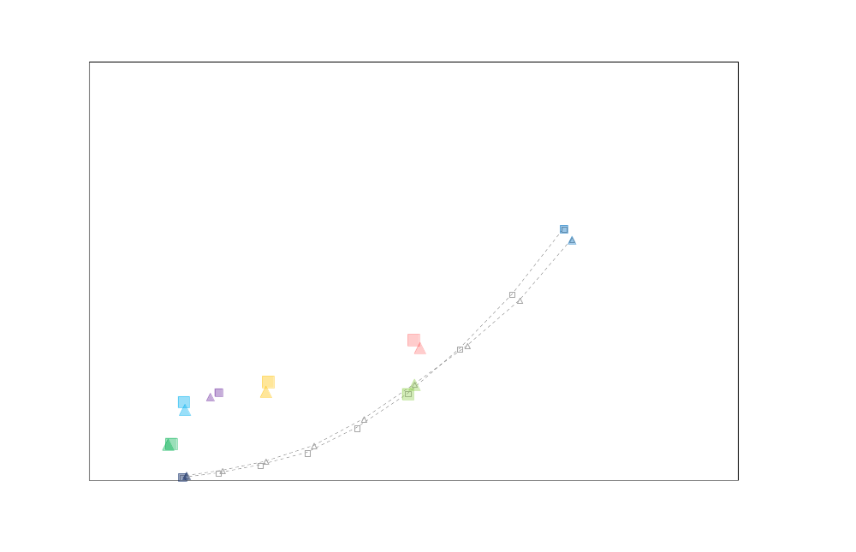
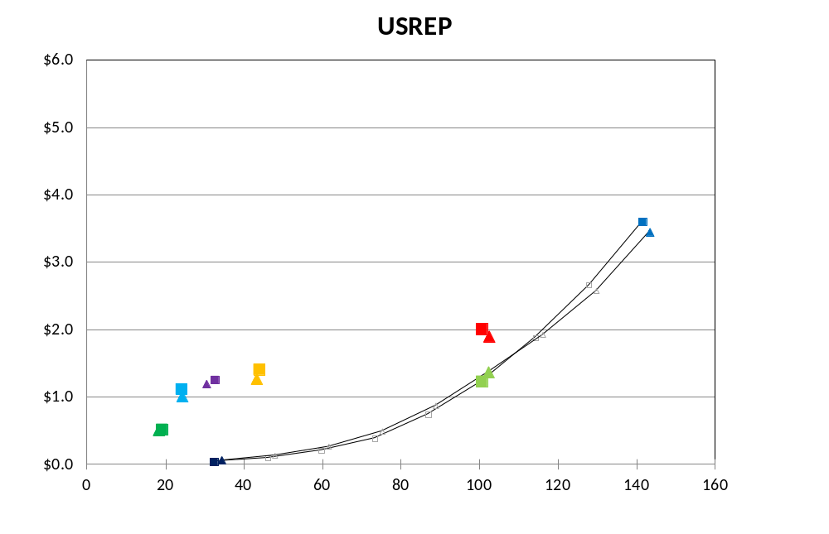
Net Present Value of Cumulative Cost vs. Cumulative Abatement
Emissions Metric
Technology Assumption
- Covered Emissions (GtCO₂e)
- Covered CO₂ Emissions (GtCO₂)
- Optimistic RE
- Optimistic CCS Nuke
80% Cap & Trade
NPV of Total Cost – C Loss – (Trillion $)
50% Cap & Sectoral Policies
CES +
New Coal CCS
RPS + New Coal CCS
RPS & Transport
50% Cap & Trade
Transport
Policy
Flat Cap & Trade
Cumulative Emissions Reductions

Slide 59
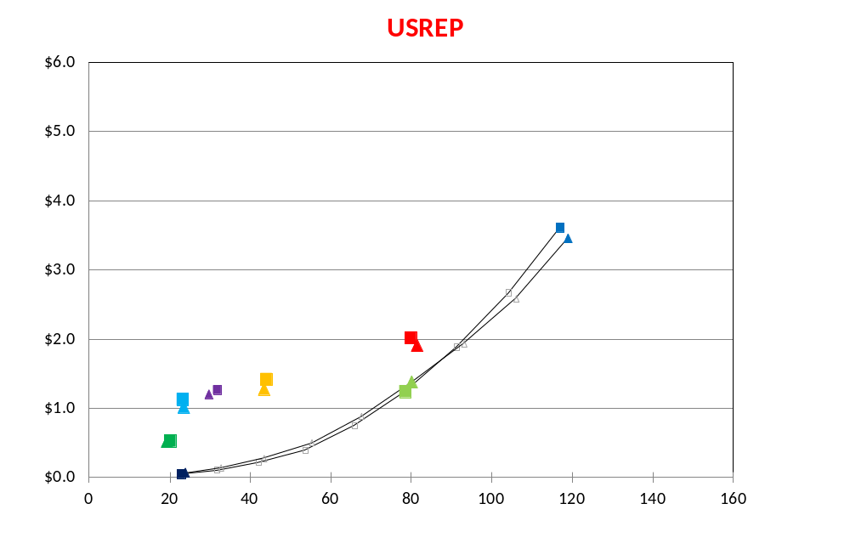
Net Present Value of Cumulative Cost vs. Cumulative Abatement
Cost Metric
Technology Assumption
Consumption Loss
- Optimistic RE
- Optimistic CCS Nuke
80% Cap & Trade
NPV of Total Cost – (Trillion $)
50% Cap & Sectoral Policies
CES +
New Coal CCS
RPS + New Coal CCS
RPS & Transport
50% Cap & Trade
Transport
Policy
Flat Cap & Trade
Cumulative Covered CO₂ Reductions (GtCO₂)

Slide 60
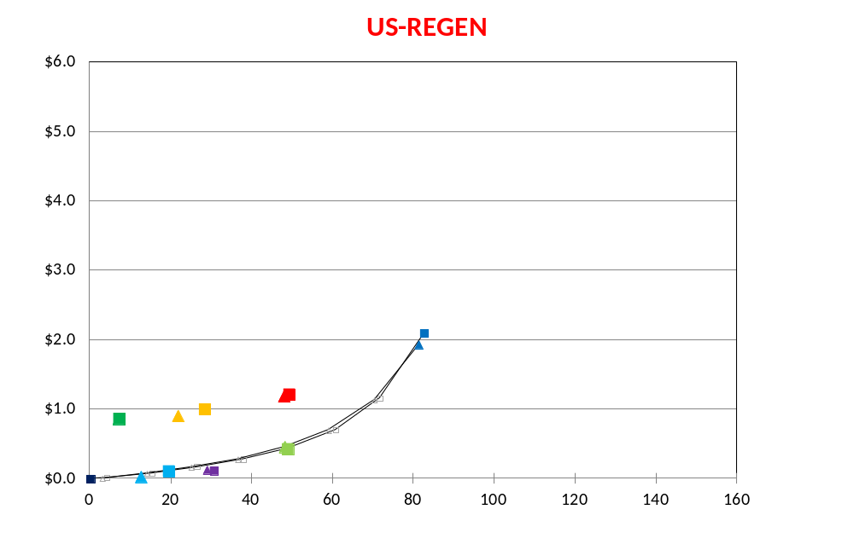
Net Present Value of Cumulative Cost vs. Cumulative Abatement
Cost Metric
Technology Assumption
Consumption Loss
- Optimistic RE
- Optimistic CCS Nuke
NPV of Total Cost – (Trillion $)
80% Cap & Trade
RPS & Transport
50% Cap & Sectoral Policies
Transport
Policy
50% Cap & Trade
Flat Cap & Trade
RPS + New Coal CCS
CES +
New Coal CCS
Cumulative Covered CO₂ Reductions (GtCO₂)

Slide 61
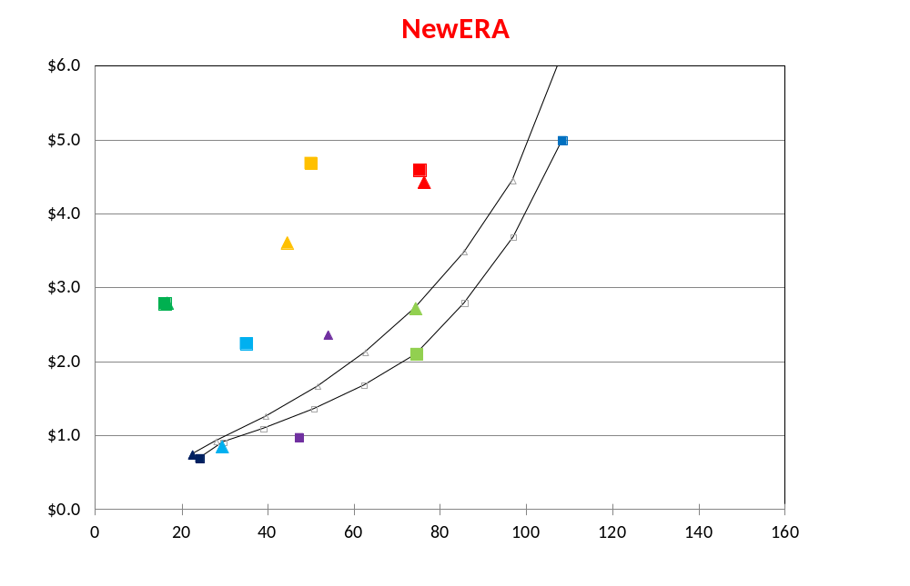
Net Present Value of Cumulative Cost vs. Cumulative Abatement
Cost Metric
Technology Assumption
Consumption Loss
- Optimistic RE
- Optimistic CCS Nuke
80% Cap & Trade
50% Cap & Sectoral Policies
RPS & Transport
NPV of Total Cost – (Trillion $)
Transport
Policy
50% Cap & Trade
RPS + New Coal CCS
CES +
New Coal CCS
Flat Cap & Trade
Cumulative Covered CO₂ Reductions (GtCO₂)

Slide 62
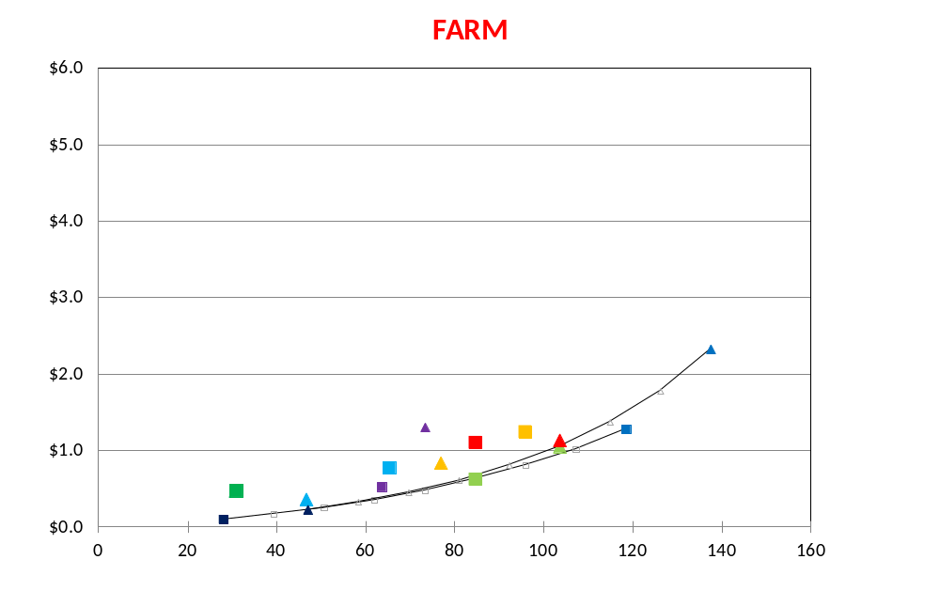
Net Present Value of Cumulative Cost vs. Cumulative Abatement
Cost Metric
Technology Assumption
Consumption Loss
- Optimistic RE
- Optimistic CCS Nuke
NPV of Total Cost – (Trillion $)
50% Cap & Sectoral Policies
RPS & Transport
80% Cap & Trade
CES +
New Coal CCS
Transport
Policy
RPS + New Coal CCS
Flat Cap & Trade
50% Cap & Trade
Cumulative Covered CO₂ Reductions (GtCO₂)

Slide 63
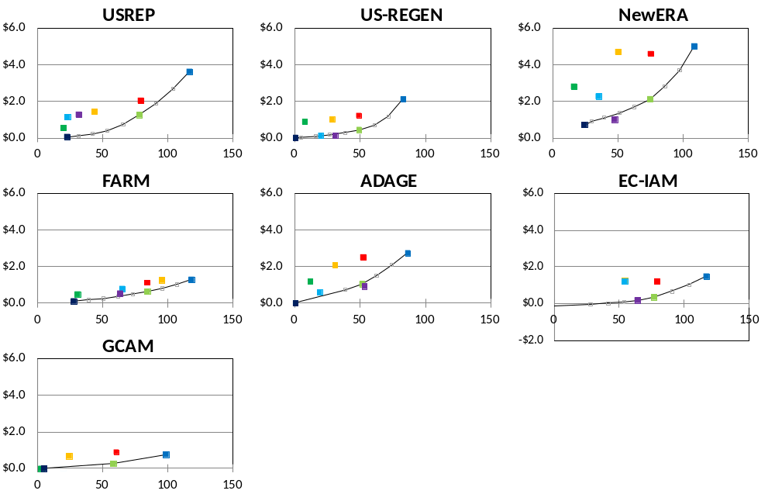
Net Present Value of Cumulative Cost vs. Cumulative Abatement
NPV of Cumulative Cost – (Trillion $)
*
Scenario (Color)
80% Cap & Trade
50% Cap & Trade
Flat Cap & Trade
CES + No New Coal
RPS + No New Coal
CAFE
CAFE & RPS + No New Coal
Cap & Regulations
Cost Metric (Shading)
- Consumption Loss
* - Area Under MAC
Technology Assumption
Cumulative Covered CO₂ Emissions Reductions (GtCO₂)
- Optimistic CCS Nuke

Slide 64
EMF 28: EU Study
(Brigitte Knopf)
Companion study to the global and US model comparison studies
Study coordinated by PIK together with EMF
Focus on the European policy context and in particular on the EU 2020 and 2050 climate targets:
  Transition of the EU energy system for meeting EU emissions reductions goals in 2020 and 2050, e.g. 80% reduction in 2050
  Influence of technological improvements and technological availability
  Implications and interactions of the mix of economic and regulatory instruments

Slide 65
EMF 28 Scenario Design
Technology dimension
 |  | Default w CCS | Default w/o CCS | Pessimistic | Optimistic | Green
CCS |  | on | off | off | on | off
Nuclear energy |  | ref | ref | low | ref | low
Energy efficiency |  | ref | ref | ref | high | high
Renewable energies |  | ref | ref | ref | high | high
Policy dimension for the EU | Policy dimension for the Rest of the World (ROW)
No policy baseline (no policy, also without the 2020 target) | no policy | EU11
Reference: including the 2020 targets and 40% GHG reduction by 2050 | a "moderate policy" scenario, e.g. with OECD going for -20%; no emission trading across macroregions (but trade within macroregions e.g. within EU) | EU1 | EU2 | EU3 | EU4 | EU5
Mitigation1: 80% GHG reduction by 2050 (with Cap&Trade within the EU) | a "moderate policy" scenario, e.g. with OECD going for -20%; no emission trading across macroregions (but trade within macroregions e.g. within EU) | EU6 | EU7 | EU8 | EU9 | EU10
Mitigation2: 80% GHG reduction by 2050 (with Cap&Trade within the EU) | 450ppme scenario from the global study; full emission trading for ROW, but no emission trading between ROW and EU | EU12 |  |  | EU14
Mitigation3: global 450ppm target with full Cap&Trade | 450ppme scenario from the global study; emission trading is allowed between all regions | EU13 |  |  | EU15
Scenario package for the models that go for the technology dimension (10 altogether)
Scenario package for the models that go for the policy dimension (7 altogether)
included in both scenario packages
Additional optional scenarios for models that go for the policy dimension

Slide 66
EMF 28 Models
PRIMES (ICCS)
POLES (IPTS)
POLES (EDDEN, Enerdata)
TIAM (UCL)
TIMES PanEU (U Stuttgart)
TIMES (VTT Finland)
WITCH (FEEM)
ELMOD (TU Berlin)
MultiMod (DIW)
LIMES-EU (PIK)
EMILIE (DIW)
EPPA (MIT)
PACE (ZEW)
GEM-E3 (IPTS)
FARM (Oeko-Institute / USDA)
GEMINI-E3
WorldScan / MERGE
Energy System Models
Hybrid Model
Electricity sector and/or
Infrastructure models
CGE Models

Slide 67


Slide 68


Slide 69
The Role of Border Carbon Adjustment in Unilateral Climate Policy: Overview of an Energy Modeling Forum Study (EMF 29)
Christoph Böhringer, Thomas F. Rutherford and Edward J. Balistreri^{c}

Slide 70
EMF 29 Modeling Teams
Model | Institution | People
BCR | Universities of Oldenburg, Calgary, and Wisconsin (Madison) | Böhringer, Carbone, Rutherford
CEPE | ETH Zürich | Caron
CVO | University of Oldenburg | Springmann
DART | Kiel Institute for the World Economy (IfW), Kiel | Weitzel, Hübler, Peterson
EC-MS-MR | Environment Canada, Ottawa | Ghosh, Luo, Siddiqui, Zhu
ENV-LINKAGES | OECD, Paris | Lanzi, Chateau, Dellink
FF | International Trade Commission (ITC), Resources for the Future (RFF), Washington | Fischer, Fox
MINES | Colorado School of Mines, Golden, University of Wisconsin, Madison | Balistreri, Rutherford
PACE | Centre for European Economic Research (ZEW), Mannheim | Alexeeva-Talebi, Böhringer, Löschel, Voigt
SNOW | Statistics Norway, Oslo | Böhringer, Bye, Faehn, Rosendahl
WEG_CENTER | University of Graz | Bednar-Friedl, Schinko, Steininger
WORLDSCAN | Netherlands Bureau for Economic Policy Analysis (CPB), Den Haag | Boeters, Bollen

Slide 71
Basic features of unilateral climate policy design
Size of the abatement coalition | A1xR – all Annex 1 regions (including the USA but without Russia)
Unilateral emission reduction pledge | 20 % from historical 2004 emission levels of the abatement coalition
Default unilateral climate policy (ref) | Each abating region adopts a uniform 20 % target that can be traded across abating regions.
Imposition of complementary BCA (bca) | Import tariffs plus export rebates Sector coverage: EITE industries Embodied carbon coverage: direct emissions plus indirect emission from electricity Import tariffs accrue to importing regions
Constant global emission constraint | bau emissions of non-coalition countries plus 80 % (= 100%-20%) of coalition countries’ historical emissions in 2004

Slide 72

EMF 29 Leakage Rate Projections

Slide 73
Thank You
The End

Slide 74
Cost Effectiveness of Electricity Sector Policies
For some models (US-REGEN, NewERA, ADAGE) the CES+New coal CCS requirements have smaller welfare impacts (in terms of EV) than an economy-wide cap with a comparable level of overall abatement.
In a first-best world without pre-existing distortionary taxes, sectoral policies always lead to larger costs of carbon abatement than a carbon tax or permits as the former fail to equalize the marginal cost of abatement across sources and users.
The welfare ranking of these policy instruments in a second-best setting, however, is ambiguous.
By driving up the price of carbon-intensive goods relative to leisure, a carbon pricing policy tends to compound the factor-market distortions created by pre-existing taxes, thereby creating a negative welfare impact termed the tax-interaction effect.
An electricity sector policy that yields a smaller increase in the consumer price of electricity as compared to a carbon-pricing policy may actually be a more efficient way to achieve a comparable level of abatement
In models with relatively steep abatement costs in the non-electric sectors and a relatively flat curve in the electric sector, the efficiency gain from the economy-wide coverage in terms of lowering total abatement cost is not very large, and as a result the CES is very close to efficient abatement allocation.

Slide 75
Emissions

Slide 76

Covered CO₂ Emissions
All Baseline Scenarios

Slide 77

Covered CO₂ Emissions
All 50% Emissions Target Scenarios

Slide 78
Net Present Value of Cumulative Cost
vs. Cumulative Abatement
Technology Assumption
- Optimistic CCS Nuke
Model
NPV of Total Cost – (Trillion $)
Cost Metric*
Consumption Loss
Cumulative Covered CO₂ Reductions (GtCO₂)
* GCAM’s Cost Metric is
Area Under MAC

Slide 79

Net Present Value of Cumulative Cost vs. Cumulative Abatement
Technology Assumption
- Optimistic CCS Nuke
Model
NPV of Total Cost – (Trillion $)
Cost Metric*
GDP Loss
Cumulative Covered CO₂ Reductions (GtCO₂)
* GCAM’s Cost Metric is
Area Under MAC

Slide 80

Net Present Value of Cumulative Cost vs. Cumulative Abatement
Cost Metric
Technology Assumption
Consumption Loss
- Optimistic RE
- Optimistic CCS Nuke
NPV of Total Cost – (Trillion $)
50% Cap & Sectoral Policies
80% Cap & Trade
RPS & Transport
Transport
Policy
CES +
New Coal CCS
50% Cap & Trade
RPS + New Coal CCS
Flat Cap & Trade
Cumulative Covered CO₂ Reductions (GtCO₂)

Slide 81

Net Present Value of Cumulative Cost vs. Cumulative Abatement
Cost Metric
Technology Assumption
- Optimistic RE
- Optimistic CCS Nuke
NPV of Total Cost – (Trillion $)
80% Cap & Trade
RPS & Transport
50% Cap & Sectoral Policies
RPS + New Coal CCS
CES +
New Coal CCS
50% Cap & Trade
Transport
Policy
Flat Cap & Trade
Cumulative Covered CO₂ Reductions (GtCO₂)

